Slide 1


The profile of Transgender who availed the Health services, at Garima Greh, New Delhi, India, 2024.
Mentor by - Dr. Sukesh Bhardwaj and Dr. Ekta Saroha
Presented by- Arpana Kumari
Roll no- PG/22/014
Date of Presentation- 18th June 2024

Slide 2


Content
Background
Literature review
Objectives
Methodology
Socio Demographics profile details
Healthcare Provider/Cost/Distance
Questionnaires
Recommendation
Conclusion

Slide 3
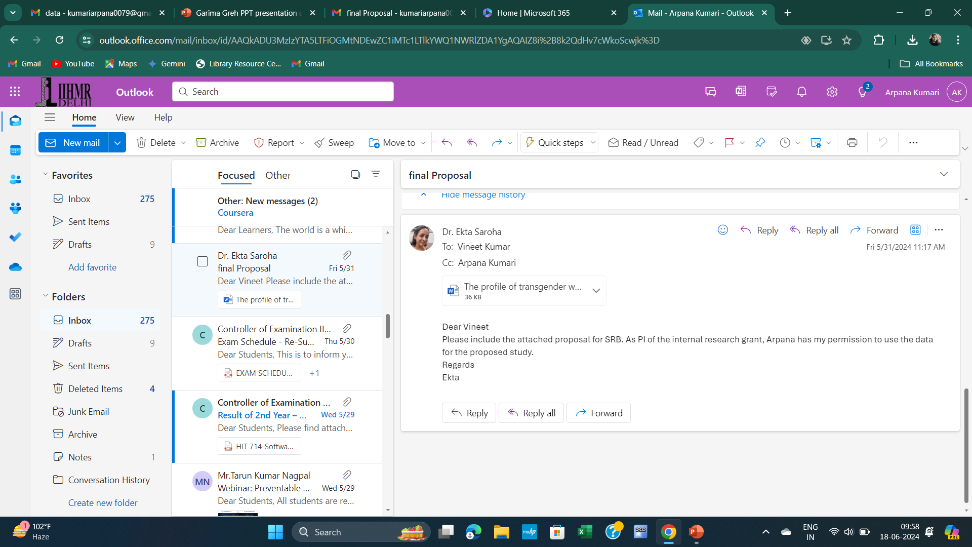
Screenshot of the Approval

Slide 4
Introduction
Overview of Garima Greh
Initiavtive by the Government of India
Provide safe and Supportive Housing
Objective of the study
Focus On Transgender Health Services
Comprehensvive Health Services
Inclusive approach for Transgender individuals
Emphasis for physical and mental Health
It focus on Marginalized communities including Transgender individuals.
Analyze health services utilization.
It impact on health and wellbeing.
Identify areas for the improvement.
Smile Scheme

Slide 5
Background
"Gender” refers to the characteristics of women, men, girls and boys that are socially constructed.
The transgender community in India has a rich historical background, dating back centuries, with diverse groups such as Hijras, Kothis, and Jogappas. Ancient scriptures like the Vedas and the Kamasutra hint at the recognition of three genders. This historical context sheds light on the complexity and depth of the transgender identity in India.
The term “transgender” encompasses individuals whose gender identity, expression, or behaviour diverges from the conventional expectations linked to the biological sex assigned to them at birth.
Transgender individuals are included within the broader of LGBTQ + community. According to the 2011 census, there were nearly around 490,000 transgender people living in India, and today the number is expected to be even higher. Before 2011, transgender people were not even counted in the Indian census. They remained an invisible and forgotten population.
Transgender people, also known as hijra, suffer from social marginalization, legal inequality, and total exclusion
The “Support for Marginalized Individuals for livelihood and Enterprises (SMILE) scheme” by the Ministry of Social Justice and Empowerment (MOJSE) is aimed at the rehabilitation of person (including transgender) engaged in begging.

Slide 6
It includes two sub schemes for the scheme should focus on rehabilitation, provision of medical facilities, counselling, education, skill development, economic linkages, etc, for beggars and transgender.
The scheme works with the support of States, Union territories, Local Urban bodies, voluntary organizations, CBO, for the rehabilitation of the person engaged in the Garima Greh.
It is an initiative by the Ministry of Social Justice and empowerment. The Ministry has decided to set up shelter homes for transgender persons who have been forced to leave their homes or have been abandoned by the family.
In India, transgender individuals can access specialized healthcare services at the Association for Transgender Health in India (ATHI) in New Delhi1, and VJ’s Transgender Clinic in Visakhapatnam, which offers comprehensive gender change surgeries.
Healthcare services encompass diagnosis, prevention, and treatment provided by healthcare professionals to address diseases and overall health needs.
In 2022, the Indian healthcare sector’s value surpassed $370 billion and is projected to exceed $610 billion by 2026 due to increasing demand for specialized and high-quality services
India operates a multi-payer universal healthcare model, funded by public and government-regulated private insurance, along with tax-funded public hospitals.

Slide 7
The "National Policy for Transgender Persons" (2014) ensures comprehensive healthcare, including mental health and gender reassignment surgeries.
The Transgender Persons (Protection of Rights) Act, 2019 prohibits discrimination and mandates access to essential medical facilities.
Guidelines from the Ministry of Health and Family Welfare focus on sensitizing healthcare providers and including gender-affirming treatments in insurance.
The National Council for Transgender Persons oversees the impact of policies and programs, ensuring healthcare rights are upheld.

Slide 8
Literature Review
Transgender individuals in India face significant obstacles in accessing healthcare, often being denied their right to adequate services. To address these challenges, it is essential to adopt a rights-based approach in both programming and research, focusing on removing the barriers that prevent transgender people from receiving proper healthcare.
The literature review reveals significant gaps in healthcare access for transgender individuals in India, focusing mainly on HIV, mental health, and gender-affirmative care, neglecting general healthcare services. Previous studies often center on specific ethno-cultural communities or transgender women, overlooking diverse gender identities within the transgender community. This study bridges the gap by examining the broader experiences of transgender persons in accessing routine healthcare. Utilizing a community-based participatory research approach and intersectionality framework, the study identifies systemic barriers, the impact on individuals, and strategies used by transgender persons to navigate healthcare challenges.
The literature review highlights the transformative impact of the Pehchan programme on transgender health in India. Studies show that its community involvement, rights-based collectivization, and gender-affirming approaches have significantly increased both the demand for and access to customized HIV, health, and social services. The programme has also enhanced self-efficacy and collective identity among transgender individuals. These successes underscore the need for continued enhancement of health, social, and community systems to sustain and build on these gains. This aligns with broader findings that underscore the importance of inclusive, community-centered healthcare initiatives.

Slide 9
The literature review for the abstract examines the unique challenges faced by transgender sex workers in India, a significantly understudied group within the commercial sex sector. Existing research often overlooks their specific experiences with sexual identity negotiation, risk perception, and condom compliance. Additionally, studies highlight barriers to healthcare access and community mobilization, emphasizing the urgent need for tailored health interventions. This study aims to address these gaps by focusing on transgender sex workers in Kolkata and rural West Bengal, providing insights for future programmatic efforts to reduce HIV/STI risks and improve health outcomes for this marginalized population.
The health disparities faced by LGBTQ individuals in India are multifaceted, stemming from societal stigma, discriminatory practices, and systemic neglect within the healthcare system. Addressing these disparities requires a comprehensive approach that includes legislative reforms, healthcare provider training, and policy changes aimed at fostering an inclusive healthcare environment. By systematically reviewing the vulnerabilities and healthcare gaps affecting LGBTQ individuals, this paper underscores the urgent need for concerted efforts to ensure equitable health outcomes for all populations in India.
This qualitative study explores the discrimination faced by LGBTQIA+ patients in Indian hospitals, highlighting systemic and organizational biases. Discrimination varies across hospital types, with public hospitals exhibiting explicit biases and trust/private hospitals demonstrating subtler forms. Departments like psychiatry and HIV services show greater sensitivity, but overall, healthcare providers lack awareness of LGBTQIA+ needs. The study underscores the urgent need for inclusive policies and systemic accountability in healthcare settings to ensure equitable treatment and well-being for LGBTQIA+ individual.
Health inequities faced by transgender populations are exacerbated by the omission of transgender-specific health needs in medical education curricula. Current approaches primarily rely on short-term attitude and awareness interventions, which, while effective initially, lack sustained impact due to methodological shortcomings. Literature consensus advocates for a shift towards pedagogical interventions that are longitudinally integrated and clinical skills-based. These interventions aim to better prepare healthcare providers to address the diverse health needs of transgender individuals effectively. Recommendations include curriculum reforms and institutional commitments to ensure comprehensive, ongoing education that supports equitable healthcare access and outcomes for transgender populations.

Slide 10
Objectives of the study
1
To describe the socio demographic profile of Transgender availing services at a shelter home in Delhi.
2
To describe the healthcare seeking profile (type of healthcare provider, cost of services, and distance travelled) of transgender availing services at a shelter home in Delhi.

Slide 11
Methodology
Study Design: Secondary data analysis.
Data source: Secondary data will be requested from the Principal Investigator of the IIHMR funded, ‘Determinants of non-communicable diseases among marginalized LGBTQIA+ in Delhi, India: a population survey’ study.
Study Area: The study was conducted at a shelter home in west district of Delhi.
Study duration: Secondary data analysed in June 2024.
Study Population: Transgender people 18 years old or above
Sample size: The study has data for 212 for transgender.
Data Analysis: The data will be summarized with the help of Microsoft Excel. quantities such as measures of central tendency (mean, median, mode) will be calculated to transgender populations of Delhi.

Slide 12
Inclusion Criteria
Transgender individuals aged 18 years or older.
Residing in the west district of Delhi.
Complete data available from the IIHMR funded study.
Provided informed consent for data use.
Exclusion Criteria
Under 18 years of age.
Not residing in the west district of Delhi.
Did not provide consent for secondary analysis.

Slide 13
Data for the following will be accessed and analysed (Annexure 1)
Annexure -Questionnaire
Socio- Demographics
Q. How old are you?
Q. Gender?
Q. What is the highest level of education you have completed?
0. Illiterate 1 Class 1-5 2. Class 6-9 3. Class10 4. Class 12 5. Graduate 6. Post- Graduate 7. Above postgraduate 8. Other (Specify)…
Q. Are you Currently employed?
0. NO 1. Yes, government Job 2. Yes, private job 3. Yes, NGO Job 4. YesSelf- employed 5. Other (Specify)…. 9. NR
Q. What is your monthly Income
  0.No income 1. &lt;RS.10,000 3. Rs.10,001-20,000 4. Rs.&gt;50,000 5. Other (Specify)…. 9.NR
Q. Do you live with
  0.Alone 1. Friends 2. Partner 3. Spouse 4. Parents 5. Family members 6. Other (specify)…. 9. NR
Q. What is your Religion
  0. Not Hindu 1. Hindu 3. Other (Specify)….
Q. What is your Caste?
  0.SC/ST/OBC 1. Not SC/ST/OBC 2. Other(specify)…. 9.NR

Slide 14
Healthcare provider, Cost, Distance
Q. Is it a private doctor or clinic?
  1. Yes 2. No 3. NR
Q. Is it a government doctor / facility?
  1. Yes 2. No 3. NR
Q. Is it an NGO facility?
  1. Yes 2. No 3. NR
Q. Is it Both private &amp; Government?
  1. Yes 2. No 3. NR
Q. Is it an informal provider?
  1. Yes 2. No 3. NR
Q. Is it Both private &amp; Government?
  1. Yes 2. No 3. NR
Q. Is it an informal provider?
  1. Yes 2. No 3. NR
Q. Is it Multiple providers?
  1. Yes 2. No 3. NR
Q. Is it another (Specify)?
Q. How much did you spend to get this (or the most recent) services?
  0. and ;Rs. 500 1. Rs 1000- 5000 2. &lt;Rs.1000 3. Free 4. Other(specify)…. 9. NR
Q. How far did you travel to get this (or the most recent) services?
  0. and ;Rs 10kms 1. 5-10kms 2. &lt;5kms 3. Free 4. Other(specify)…. 9. NR

Slide 15
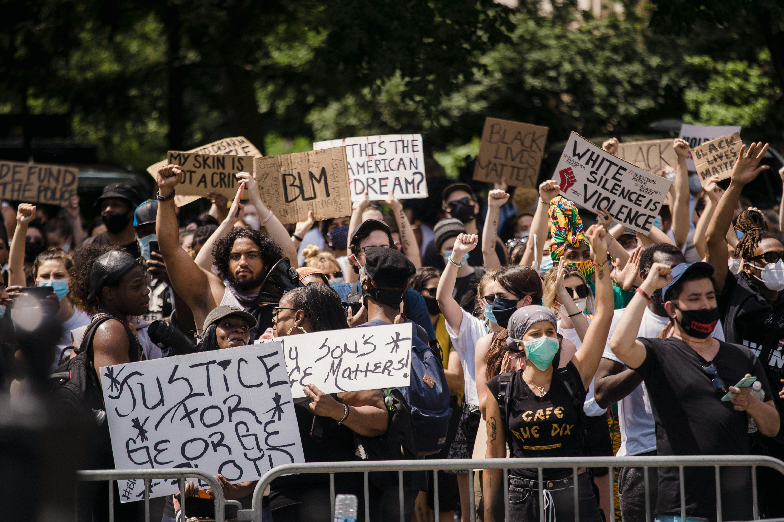
Challenges and issues transgender individuals face due to societal exclusion?
Social Stigma
Discrimination
Lack of acceptance
Their impacts on mental and well being

Slide 16
Problems They Are Facing Accessing health services
Addressed issues like lack of specialized counselors
Confidentiality concerns
Financial barriers
Lack of awareness about available services

Slide 17
Socio-Demographic
Age Group | Number of People | %Percentage
18-23 | 165 | 78.20
24-28 | 31 | 14.69
29-33 | 11 | 5.21
34-40 above | 4 | 1.90
Total | 211 | 100.00
Gender | Number of People | %Percentage
TransFemale | 38 | 36.19
TransMale | 38 | 36.19
TransGender | 26 | 24.76
Not Identify | 3 | 2.86
Total | 105 | 100

Slide 18
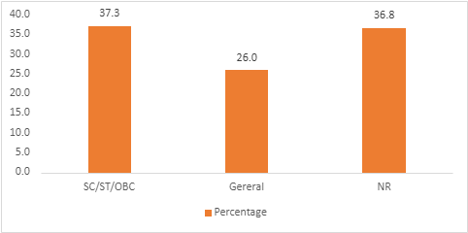
Religion | Number of People | %Percentage
Not Hindu | 18 | 10.17
Hindu | 146 | 82.49
Other | 13 | 7.34
NR | 0 | 0.00
Total | 177 | 100
Caste | No of People | Percentage
SC/ST/OBC | 72 | 37.3
Gereral | 50 | 26.0
NR | 71 | 36.8
Total | 193 | 100.0

Slide 19
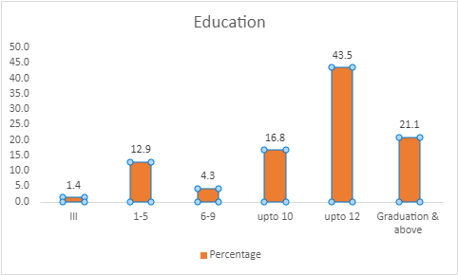
Education | No of people | Percentage
Ill | 3 | 1.4
1-5 | 27 | 12.9
6-9 | 9 | 4.3
upto 10 | 35 | 16.8
upto 12 | 91 | 43.5
Graduation & above | 44 | 21.1
Total | 209 | 100
Job | Number of People | %Percentage
No | 51 | 24.76
Gov | 14 | 6.8
Pvt | 73 | 35.44
NGO | 38 | 18.45
Self | 11 | 5.34
Other | 9 | 4.37
NR | 10 | 4.85
Total | 206 | 100

Slide 20
Income | Number of People | %Percentage
No | 43 | 21.61
<10,000 | 72 | 36.18
10-20,000 | 51 | 25.63
20-50,000 | 19 | 9.55
>50,000 | 2 | 1.01
Other | 5 | 2.51
NR | 7 | 3.52
Total | 199 | 100
Live | Number of People | %Percentage
Alone | 17 | 8.21
Friends | 39 | 18.84
Partner | 41 | 19.81
Spouse | 2 | 0.97
Parents | 42 | 20.29
Family | 47 | 22.71
Others | 9 | 4.35
NR | 10 | 4.83
Total | 207 | 100

Slide 21


Healthcare Provider/ Cost/ Distance

Slide 22
Healthcare Provider/ Cost/ Distance
Pvt Doc/Clinic | Number of People | %Percentage
Yes | 72 | 54.14
No | 55 | 41.35
NR | 6 | 4.51
Total | 133 | 100
Gov Doctor facility | Number of People | %Percentage
Yes | 55 | 52.38
No | 46 | 43.81
NR | 4 | 3.81
Total | 105 | 100

Slide 23
Healthcare Provider/ Cost/ Distance
NGO Facility | Number of People | %Percentage
Yes | 68 | 66.67
No | 30 | 29.41
NR | 4 | 3.92
Total | 102 | 100
Both pvt and Govt | Number of People | %Percentage
Yes | 80 | 65.57
No | 39 | 31.97
NR | 3 | 2.46
Total | 122 | 100
1
23

Slide 24
Informal Provider | Number of People | %Percentage
Yes | 60 | 63.83
No | 29 | 30.85
NR | 5 | 5.32
Total | 94 | 100
Multiple Providers | Number of People | %Percentage
Yes | 51 | 57.95
No | 30 | 34.09
NR(9) | 7 | 7.95
Total | 88 | 100

Slide 25
Other | Number of People | %Percentage
Yes | 2 | 50
No | 2 | 50
NR | 0 | 0
Total | 4 | 100
Cost( Spent ) | Number of People | %Percentage
>5000(0) | 34 | 24.82
1000-5000(1) | 14 | 10.22
<1000(2) | 52 | 37.96
Free(3) | 19 | 13.87
Other(4) | 10 | 7.3
NR(9) | 8 | 5.84
Total | 137 | 100

Slide 26
Distance | Number of People | %Percentage
>10km | 17 | 12.41
5-10km | 26 | 18.98
<5km | 50 | 36.5
Other | 20 | 14.6
NR(9) | 24 | 17.52
Total | 137 | 100
Cost( Spent ) | Number of People | %Percentage
>5000(0) | 34 | 24.82
1000-5000(1) | 14 | 10.22
<1000(2) | 52 | 37.96
Free(3) | 19 | 13.87
Other(4) | 10 | 7.3
NR(9) | 8 | 5.84
Total | 137 | 100
1
26

Slide 27
Recommendation
Based on the objective of describing the healthcare seeking profile of transgender individuals availing services at Garima Greh in New Delhi through secondary data analysis -
Enhance Data Collection and Monitoring: Implement robust systems for collecting and analyzing data on healthcare utilization by transgender individuals at Garima Greh. This should include regular monitoring of the types of healthcare services accessed, frequency of visits, and demographic characteristics to better understand their healthcare needs.
Improve Accessibility: Evaluate and address barriers to healthcare access such as distance traveled to reach healthcare providers. Consider establishing partnerships with local healthcare facilities to provide on-site services or telemedicine options to reduce travel burden.
Reduce Financial Barriers: Assess the affordability of healthcare services at Garima Greh and explore options for subsidizing or providing free services, particularly for essential healthcare needs specific to transgender health (e.g., hormone therapy, mental health support).

Slide 28

Enhance Healthcare Provider Training: Offer ongoing training to healthcare providers at Garima Greh on transgender health issues, including cultural sensitivity, gender-affirming care practices, and recognition of healthcare disparities faced by transgender individuals.
Expand Research Initiatives: Support further research initiatives focused on transgender health within the context of shelter homes like Garima Greh. This could include qualitative studies to explore lived experiences, health outcomes, and satisfaction with healthcare services provided.

Slide 29
Conclusion
In conclusion, the study highlights the socio-demographic and healthcare-seeking profiles of transgender individuals availing services at Garima Greh, a shelter home in New Delhi. The findings reveal a diverse range of backgrounds and experiences within this marginalized community, underscoring the pressing need for tailored healthcare services. The study underscores the critical role of supportive initiatives like Garima Greh in providing essential services, including medical care, counseling, and skill development, aimed at rehabilitating and empowering transgender individuals. It also emphasizes the importance of accessible, affordable, and inclusive healthcare services as outlined in the National Health Policy and the Transgender Persons Act of 2019. The study calls for continued efforts to address the unique health needs of transgender people, ensuring they receive comprehensive care and support for a dignified and healthier life.

Slide 30
References of the Study
Pandya, A. kumar, & Redcay, A. (2020). Access to health services: Barriers faced by the transgender population in India. Journal of Gay & Lesbian Mental Health, 25(2), 132–154. https://doi.org/10.1080/19359705.2020.1850592
Raghuram H, Parakh S, Tugnawat D, Singh S, Shaikh A, Bhan A (2024) Experiences of transgender persons in accessing routine healthcare services in India: Findings from a participatory qualitative study. PLOS Glob Public Health 4(2): e0002933. https://doi.org/10.1371/journal.pgph.0002933
Lacombe-Duncan, A., Logie, C. H., Persad, Y., Nayar, P., & Ryan, S. (2016). "It’s just who I am": Navigating healthcare contexts as a trans woman of color in Toronto, Canada. *Journal of the International AIDS Society*, 19(3), 20809. https://doi.org/10.7448/IAS.19.3.20809
Nyambo, B. T., & Kashaigili, J. J. (2021). Factors influencing women's participation in natural resource management in Kilombero District, Tanzania. Sexes, 3(4), 508-523. https://doi.org/10.3390/sexes3040036
Radojevic, M., & Swain, D. (2021). Understanding the role of serotonin transporter gene polymorphism in shaping neurodevelopment, environmental sensitivity, and mental health: A systematic review. Developmental Psychobiology, 63(7), 1381-1398. https://doi.org/10.1080/10538720.2021.2004285

Slide 31
Bhattacharya, S., & Sharma, A. (2022). Exploring healthcare access and disparities among LGBTQ individuals in urban India: A qualitative study. International Journal of LGBTQ Health, 7(1), 12-27. https://doi.org/10.1080/26410397.2022.2104678
Dubin SN, Nolan IT, Streed CG Jr, Greene RE, Radix AE, Morrison SD. Transgender health care: improving medical students' and residents' training and awareness. Adv Med Educ Pract. 2018 May 21;9:377-391. doi: 10.2147/AMEP.S147183. PMID: 29849472; PMCID: PMC5967378.

Slide 32
Thank you
Question?

