Slide 1

Patient satisfaction in ECHS polyclinics using SERVQUAL-An Individual Paticipant Data Meta-analysis
Mentor : Dr. Punit Yadav
Presented by: Dr. Chahat
IIHMR DELHI

Slide 2
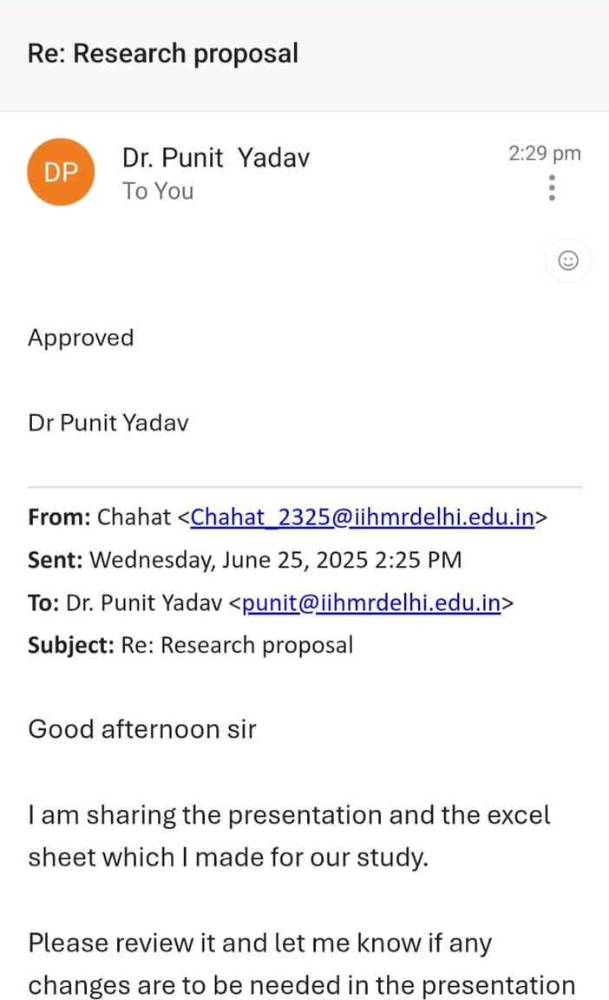
Mentor Approval

Slide 3
BACKGROUND
  Patient satisfaction is essential in modern, patient-centered healthcare.
  The SERVQUAL model assesses gaps between patient expectations and actual experiences through five dimensions.
  Patient satisfaction not only reflects treatment success but also influences adherence, loyalty, and perception of care.
  ECHS provides healthcare to ex-servicemen and their dependents, and assessing satisfaction helps improve care delivery for this unique population.

Slide 4
Rationale
  Limited evidence exists on patient satisfaction levels within ECHS polyclinics.
  Helps identify specific areas of improvement in service delivery to veterans.
  Provides data-driven insights for better management of government-funded healthcare services.

Slide 5
Research question
Are ECHS members satisfied with the services provided by ECHS in Polyclinics?

Slide 6
Objectives
To analyze patient satisfaction among attendees of the Ex-Servicemen Contributory Health Scheme (ECHS) Polyclinics in India using the SERVQUAL model.

Slide 7
Methodology
  Study Design: Individual Participant Data Meta-analysis (IPD-MA)
  Study Area: OPD settings in India
  Study Population: Patients attending these OPDs.
  Databases Searched: PubMed, Web of Science, and Grey Literature
  Inclusion Criteria:
English language publications
Studies from 2013 onward
Studies conducted in india

Slide 8

Study Selection Process
(Prisma flowchart)
Records identified through database searching (n = 41)
• PubMed: 33
• Web of Science: 8
Additional records identified through other sources (n = 5)
Records after duplicates removed (n = 46)
Abstract screening:
Records screened (n = 46)

Slide 9
(Prisma flowchart contd:)
Records excluded (n = 21)
• PubMed: 14
• Web of Science: 7
• Grey Literature: 0
Full-text articles assessed for eligibility (n = 25)
Articles excluded (n = 18)
• PubMed: 17
• Web of Science: 1
Studies finally included for analysis (n = 7)
• PubMed: 2
• Grey Literature (Dissertations): 5

Slide 10
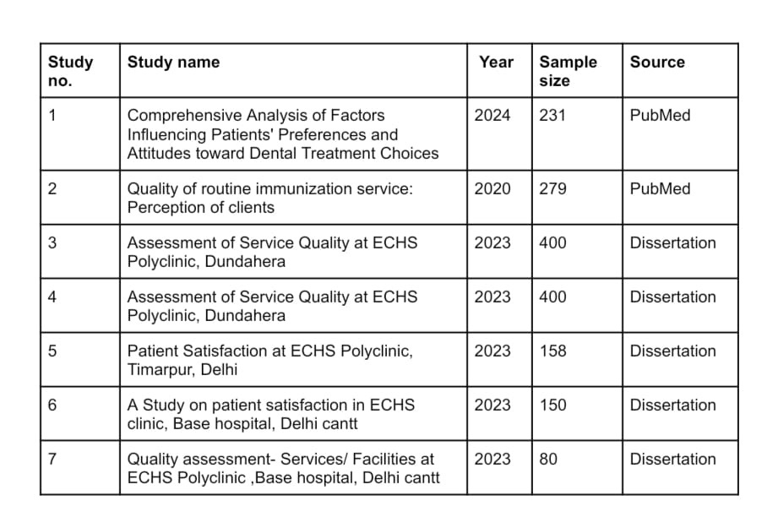
Summary of Included Studies

Slide 11
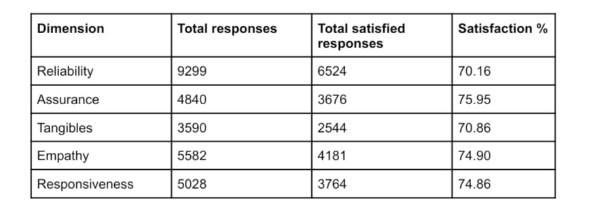
SERVQUAL Dimension wise satisfaction

Slide 12
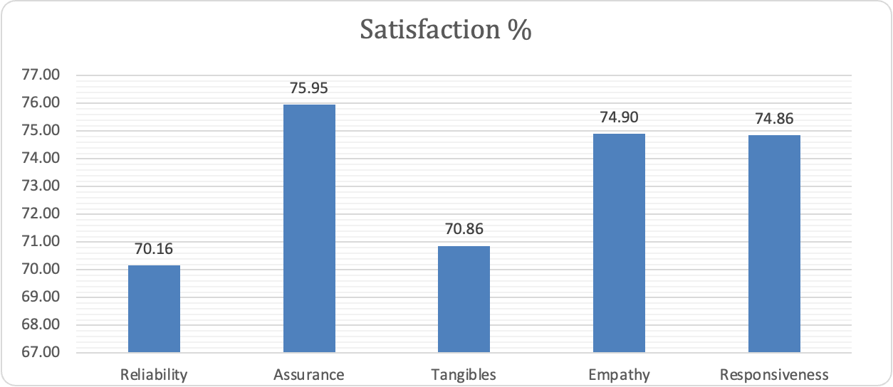
Results
Assurance and Responsiveness showed the highest satisfaction scores, while Reliability had the lowest

Slide 13
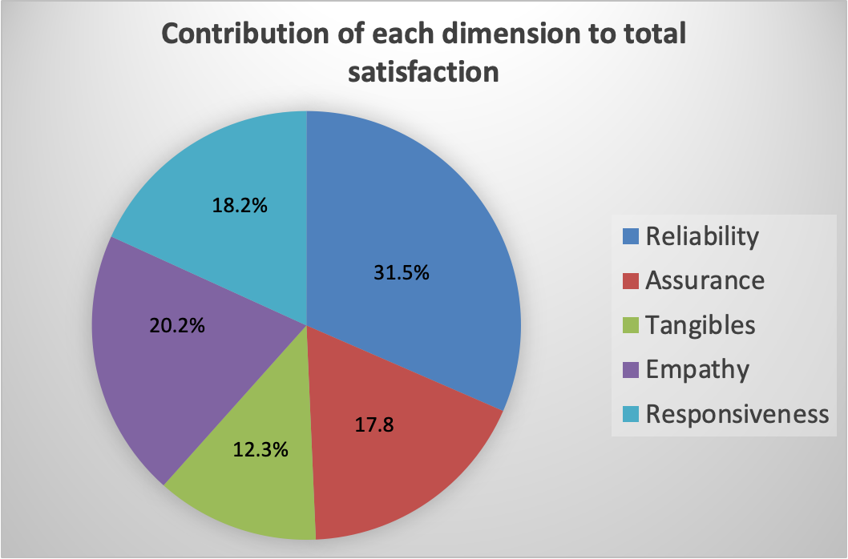
Results

Slide 14
Discussion
Top Performing Dimensions:
Responsiveness and Assurance recorded the highest satisfaction scores (74%). These reflect effective communication, confidence, and professional behavior among healthcare providers.
Lowest performing dimesion:
Reliability scored the lowest, showing that patients felt the services were not always regular or trustworthy
Dimension Contribution Insight:
Although Reliability scored the lowest, it contributed the highest number of satisfied responses, due to having the most no. of questions in questionnaires. This emphasizes its weight in overall care quality and targeted interventions in reliability-related areas can help enhance overall satisfaction.

Slide 15
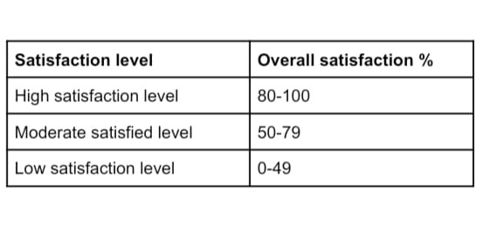
Conclusion
Overall Satisfaction:
The overall patient satisfaction across SERVQUAL dimensions was moderate, indicating reasonably good service delivery in ECHS polyclinics.

Slide 16

References
[1] Titoria R, Upadhyay M, Chaturvedi S. Quality of routine immunization service: Perception of clients. Indian J Public Health. 2020 Jan-Mar;64(1):44–49. doi:10.4103/ijph.IJPH_92_19.
[2] Krishnan GA, Nair AK, Bhaskar BV. Comprehensive analysis of factors influencing patients' preferences and attitudes toward dental treatment choices. Ann Afr Med. 2025 Apr 1;24(2):237–243. doi:10.4103/aam.aam_125_24.
[3] Yadav A. Patient satisfaction at ECHS Polyclinic, Dundahera (Gurugram) [dissertation]. New Delhi: International Institute of Health Management Research; 2023
[4] Singh M. Patient satisfaction at ECHS Polyclinic [dissertation]. New Delhi: International Institute of Health Management Research; 2023

Slide 17
[5] Mann J. Patient satisfaction at ECHS Polyclinic, Base Hospital, Delhi Cantt [dissertation]. New Delhi: International Institute of Health Management Research; 2023.
[6] Malik D. Quality assessment – Services/facilities at ECHS Polyclinic, Base Hospital, Delhi Cantt [dissertation]. New Delhi: International Institute of Health Management Research; 2023.
[7] Chopra A. Patient satisfaction at ECHS Polyclinic, Timarpur, Delhi [dissertation]. New Delhi: International Institute of Health Management Research; 2023.
[8] Parasuraman A, Zeithaml VA, Berry LL. A conceptual model of service quality and its implications for future research. J Mark. 1985;49(4):41–50. doi:10.1177/002224298504900403.

Slide 18
[9] Parasuraman A, Zeithaml VA, Berry LL. SERVQUAL: A multiple-item scale for measuring consumer perceptions of service quality. J Retailing. 1988;64(1):12–40.
[10] Ministry of Defence. Ex-Servicemen Contributory Health Scheme (ECHS) [Internet]. Department of Ex-Servicemen Welfare; 2023 [cited 2025 Jun 25]. Available from: https://www.desw.gov.in/ex-servicemen-contributory-health-scheme

Slide 19
Community outreach programme
  Conducted this activity on the occasion of the International Day for Disaster Risk Reduction (October 13) at Deepalaya NGO, Okhla, Delhi.
  Sensitized ~150 children from underserved communities about earthquake and fire safety preparedness.
Explained the Stop, Drop, and Roll technique
Explained how to use a fire extinguisher.
Guided children to "Drop, Cover, and Hold" under sturdy furniture.
Advised on staying away from windows and not using elevators.

Slide 20
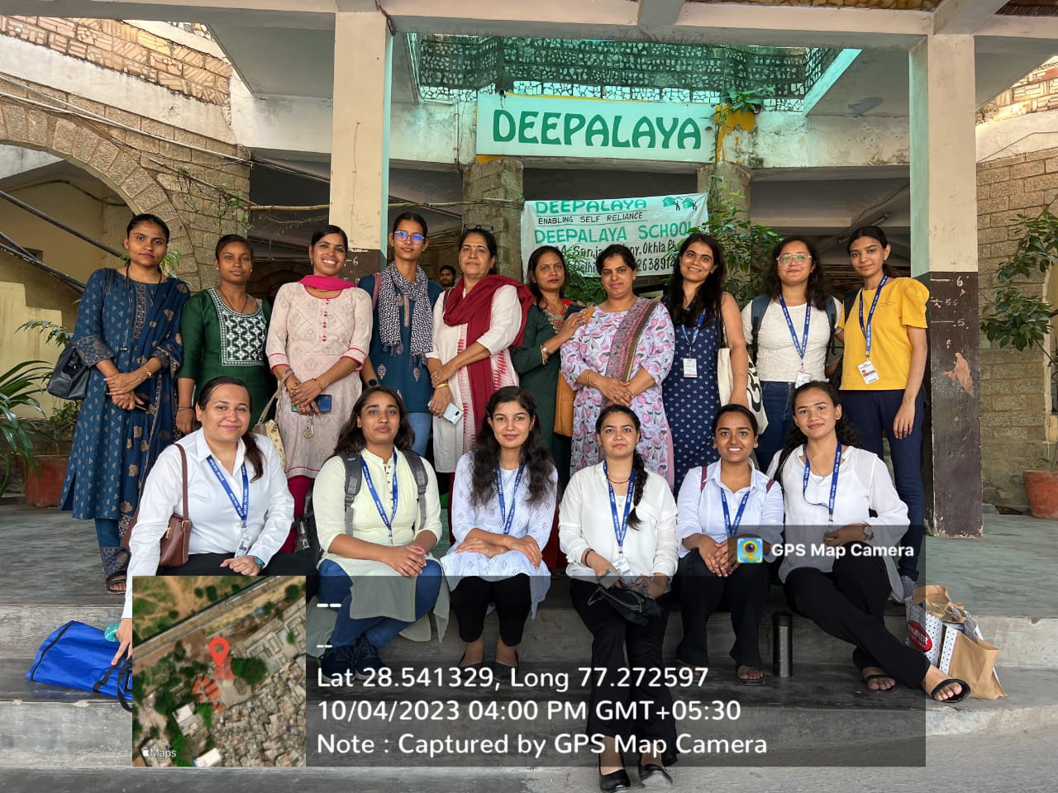

Slide 21
Thank you

