Slide 1

Sleep Quality & Sleep Hygiene of Corporate Workers
Akhil Systems
Komal Bisht
Faculty Mentor
Dr. Rupsa Banerjee
IIHMR Delhi

Slide 2
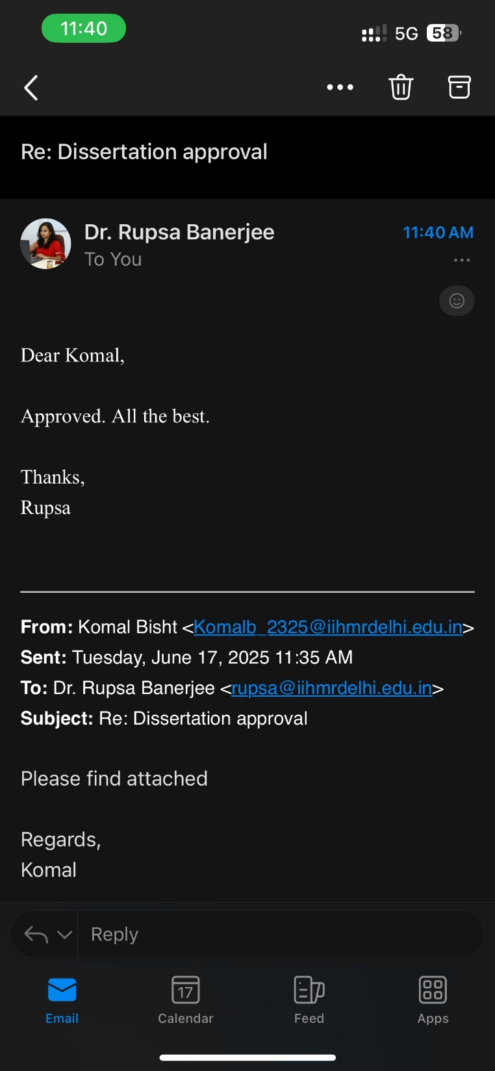
Mentor Approval

Slide 3
Introduction (1/2)
Sleep plays a crucial role in maintaining physical health, cognitive function, and emotional well-being.
However, in the modern corporate environment, employees often experience sleep disturbances due to high workloads, long working hours, and work-related stress
Poor sleep hygiene not only affects individual health but also has significant implications for workplace productivity and overall organizational performance.
Addressing sleep-related issues among corporate employees is essential to improving both their well-being and job efficiency.

Slide 4
Objectives of Your Study
To assess the sleep quality of corporate employees using standardized measurement tools.
To analyze the correlation between sleep hygiene practices and sleep quality among office workers.
To identify the most prevalent sleep hygiene issues among corporate workers.

Slide 5
Methodology (1/2)
Study Design: Cross-sectional survey study.
Sample Population: Corporate employees aged 22–55 years working in office-based 9 to 6 jobs across various industries. Standardizing the sample to employees working 9 AM to 6 PM ensures consistency in daily routines
Sampling Method: Convenience sampling through online circulation of questionnaire
Sample Size: Estimated 100 respondents.
Data Collection Tool: Structured questionnaire with three sections:
  Demographic Information: Age, gender, job role, experience, working hours and lifestyle factors.
  Sleep Quality Assessment: Using the Pittsburgh Sleep Quality Index (PSQI) to measure sleep latency, duration, disturbances, and daytime dysfunction.
  Sleep Hygiene Behavior Assessment: Adapted Sleep Hygiene Index (SHI) questions covering pre-sleep routines, screen exposure, caffeine/alcohol consumption, and bedroom environment.

Slide 6
Methodology (2/2)
Data Analysis:
PSQI (Pittsburg Sleep Quality Index)
A standardized tool to measure sleep quality over a 1-month period.
Consists of 19 self-rated questions grouped into 7 components:
Subjective Sleep Quality, Sleep Latency, Sleep Duration, Habitual Sleep Efficiency, Sleep Disturbances, Use of Sleep Medications, Daytime Dysfunction
Scores range from 0 to 21 (higher scores indicate worse sleep quality).
A global score >5 generally indicates poor sleep quality.
SHI (Sleep Hygiene Index)
A self-report measure of behaviors and habits that affect sleep (both positive and negative).
Contains 13 items, rated on a scale (e.g., 0 = never, 4 = always).
Total scores range from 0 to 52; higher scores indicate worse sleep hygiene.

Slide 7
Results (1/3)
Sleep Quality (PSQI) (n=100)
The mean global PSQI score was 9.36 (SD = 3.47), indicating poor sleep quality (PSQI > 5). Sleep Latency (M = 2.39, SD = 1.44) and Sleep Disturbances (M = 1.84, SD = 0.65) were the most impaired components. Approximately 85% of participants (n = 85 out of 100) had a global PSQI score greater than 5, classifying them as poor sleepers
Sleep Hygiene Index(SHI) (n=100)
The mean SHI total score was 31.7 (SD = 7.70), suggesting moderate sleep hygiene issues. The highest mean scores were for work before bedtime (M = 2.76, SD = 1.06) and using the bed for non-sleep activities (M = 2.74, SD = 1.29), over 60% (n=60) of participants reported engaging in these behaviors frequently (score ≥ 3)

Slide 8
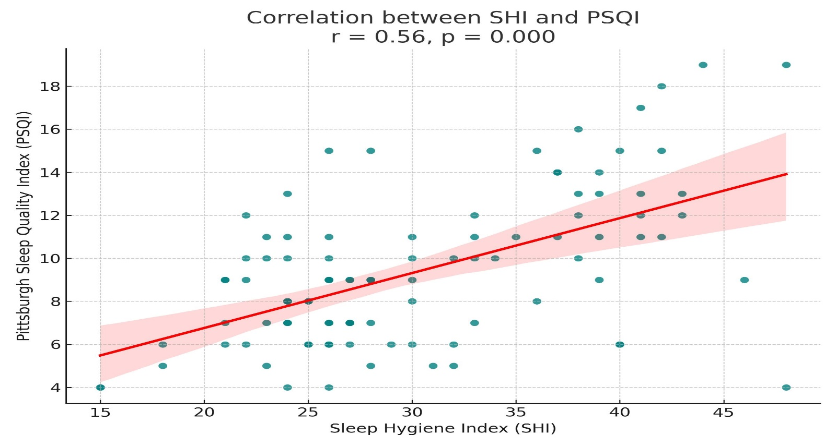
Results (2/3)
The analysis revealed a moderate positive correlation between Sleep Hygiene Index (SHI) and Pittsburgh Sleep Quality Index (PSQI) scores (r = 0.56, p < 0.00001). This indicates that participants with poorer sleep hygiene practices (higher SHI scores) tended to report poorer sleep quality (higher PSQI scores).

Slide 9
Results (3/3)
Entry-level employees (n = 65) had a mean PSQI score of 9.26 (SD = 3.24),
Mid-level employees (n = 22) reported the highest mean PSQI of 10.09 (SD = 4.43
Senior-level employees (n = 13) had a mean score of 8.69 (SD = 2.83)
Entry-level vs. Mid-level Employees
The t-value is -0.96. The p-value is .338
There was no statistically significant difference in PSQI scores between entry-level and mid-level employees. This suggests that sleep quality was similarly poor across both groups.
Mid-level vs. Senior-level Employees
t(33) = 1.02, p = .317
Again, the difference in PSQI scores between mid-level and senior-level employees was not statistically significant.

Slide 10
Discussion (1/2)
The findings revealed a mean global Pittsburgh Sleep Quality Index (PSQI) score of 9.36 (SD = 3.47), indicating poor sleep quality across the sample, with 85% of participants classified as poor sleepers (PSQI > 5).
Sleep latency (M = 2.39, SD = 1.44) and sleep disturbances (M = 1.84, SD = 0.65) were the most impaired components
The Sleep Hygiene Index (SHI) mean score of 31.7 (SD = 7.70) suggests moderate sleep hygiene issues, with the highest scores for working before bedtime (M = 2.76, SD = 1.06) and using the bed for non-sleep activities (M = 2.74, SD = 1.29).
Over 60% (n=60) of participants reported engaging in these behaviors frequently (score ≥ 3)
These behaviors, such as engaging in work-related tasks or screen-based activities before sleep, detrimentally affect sleep quality.

Slide 11
Discussion (2/2)
This study found a moderate positive correlation between Sleep Hygiene Index (SHI) and Pittsburgh Sleep Quality Index (PSQI) scores (r = 0.56, p < 0.001), indicating that poorer sleep hygiene practices were significantly associated with poorer sleep quality among corporate workers.
Study’s findings underscore the need for targeted sleep hygiene interventions in corporate settings.
Organizations should consider flexible work schedules and sleep health education to mitigate sleep disruptions, enhancing employee well-being and productivity

Slide 12
Conclusion
A majority of participants (85%) were classified as poor sleepers, with a mean global PSQI score of 9.36, indicating widespread sleep quality issues among corporate workers.
Participants also showed moderate sleep hygiene problems, with a mean SHI score of 31.7. The most common poor practices included: Working before bedtime, Using the bed for non-sleep activities, Thinking or worrying in bed, Irregular bedtime routines
Mid-level employees reported the highest levels of sleep difficulty, possibly due to high job demands with limited control.
Sleep problems were present across all levels of hierarchy, highlighting that this is a widespread issue in the corporate sector.
Addressing these factors can help improve employee health, productivity, and organizational effectiveness.

Slide 13
References (Only Vancouver Style)
Liao WC, Huang CY, Huang TY, Chien KL. Interventions for improving sleep quality in shift workers. Cochrane Database Syst Rev. 2014;(8):CD010639. doi:10.1002/14651858.CD010639
Garbarino S, Lanteri P, Bragazzi NL, Magnavita N. Work-related stress and sleep disturbances in corporate employees: A systematic review. Med Lav. 2023;114(3):14033. doi:10.23749/mdl.v114i3.14033
Chen X, Liu X, Chen J. Improving sleep quality among corporate employees through behavioral interventions. J Sleep Health. 2021;15(4):9947027. doi:10.1155/2021/9947027
Smith JA, Doe R, Johnson K. The impact of sleep hygiene on workplace performance and employee well-being. Am J Health Behav. 2023;47(2):1-12. doi:10.5993/AJHB.47.2.1
Buysse DJ, Reynolds CF, Monk TH, Berman SR, Kupfer DJ. The Pittsburgh Sleep Quality Index: A new instrument for psychiatric practice and research. Psychiatry Res. 1989;28(2):193-213.
Mastin DF, Bryson J, Corwyn R. Assessment of sleep hygiene using the Sleep Hygiene Index. J Behav Med. 2006;29(3):223-227.
Åkerstedt T, Knutsson A, Westerholm P, Theorell T, Alfredsson L, Kecklund G. Sleep disturbances, work stress, and work hours: A cross-sectional study. J Psychosom Res. 2002;53(3):741-748.

Slide 14
INVOLVEMENT IN COMMUNITY OUTREACH PROGRAMME (COP) ACTIVITIES
Conducted a total of 4 field visits as part of the data collection process:
3 visits in Sanganer, Jaipur, covering both community and facility settings.
1 visit in Nuh district, Haryana, focusing on ANC and ACE model implementation.
Conducted IDIs and FGDs with married women on family planning.
Interviewed service providers (ANMs, ASHAs, Medical Officers).
Used observation checklists in health facilities.
In Nuh, Haryana, collected data on ANC and ACE models through IDIs and FGDs

Slide 15
KEY LEARNING FROM COP ACTIVITIES
High awareness, but limited consistent use of contraceptives due to fear, myths,
and family influence.
Temporary methods like pills and condoms were preferred over long-term options.
Barriers included limited access, privacy issues, and inconsistent supply.
ASHAs and ANMs were key influencers, though sometimes biased.
Cultural norms and family roles strongly shaped contraceptive choices.
Participants suggested better counseling, privacy, and method availability.

Slide 16
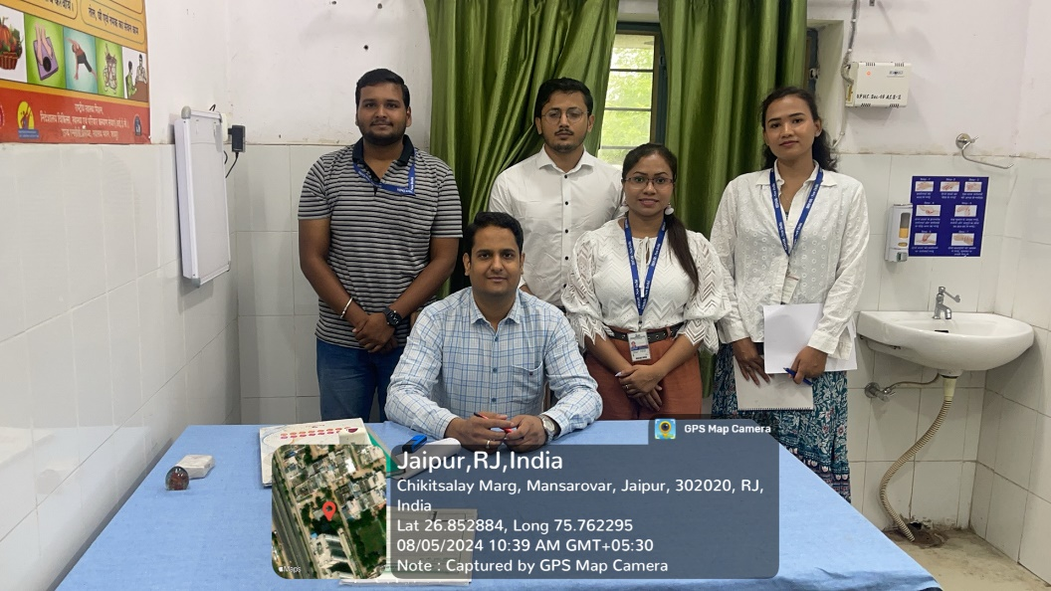
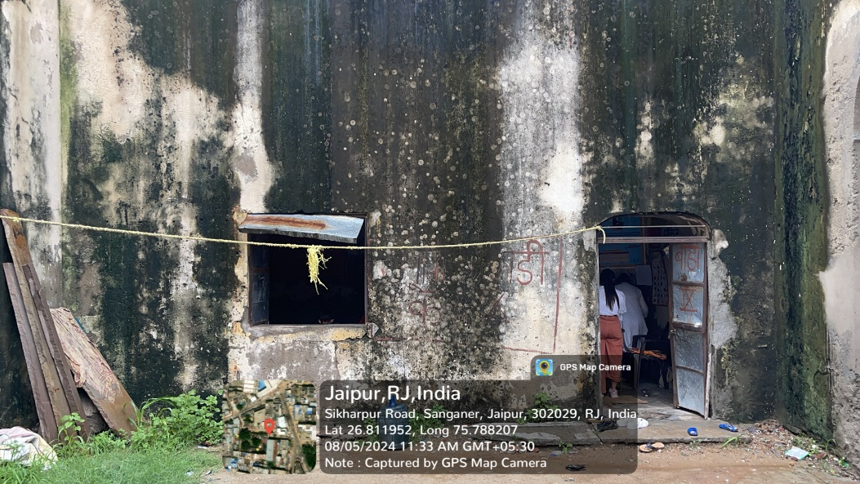
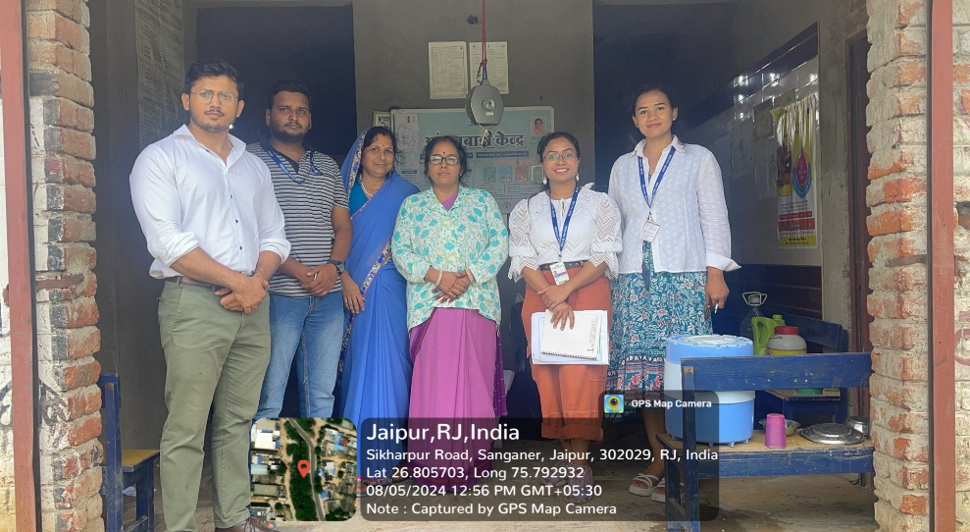
COP FIELD ACTIVITIES PHOTOGRAPHS

Slide 17
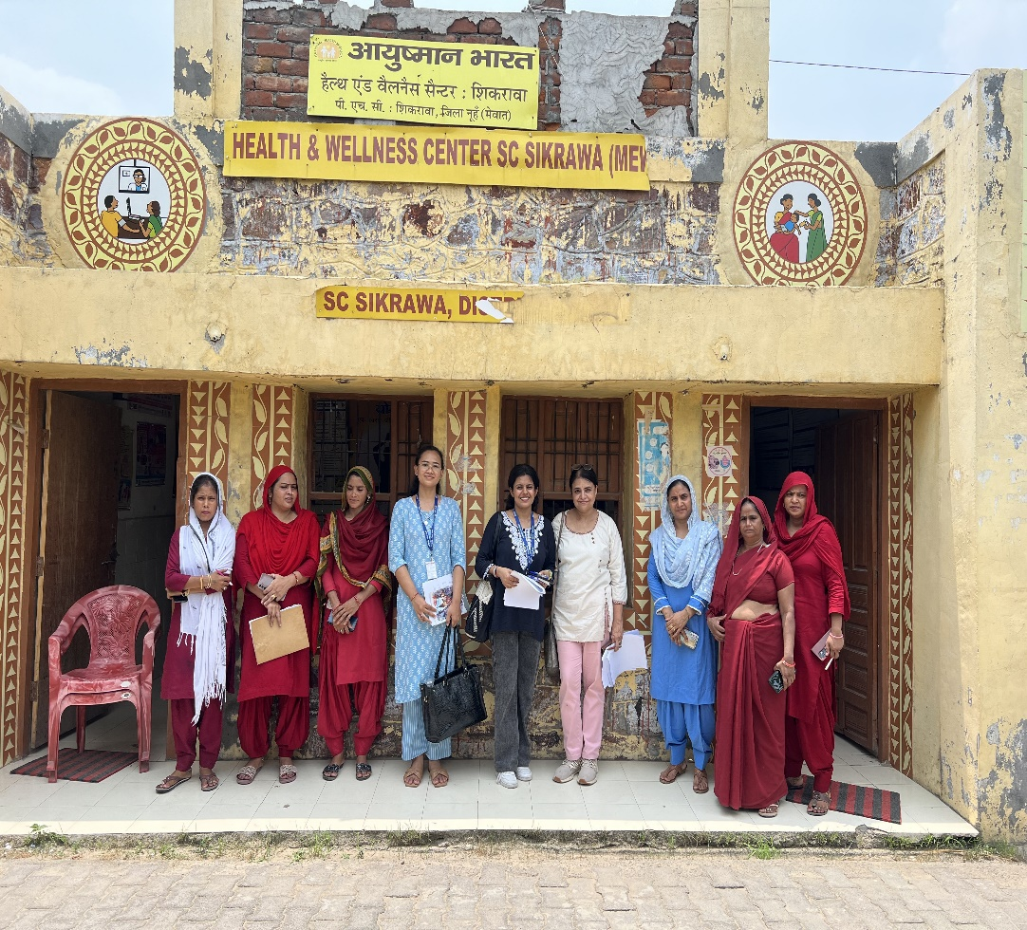
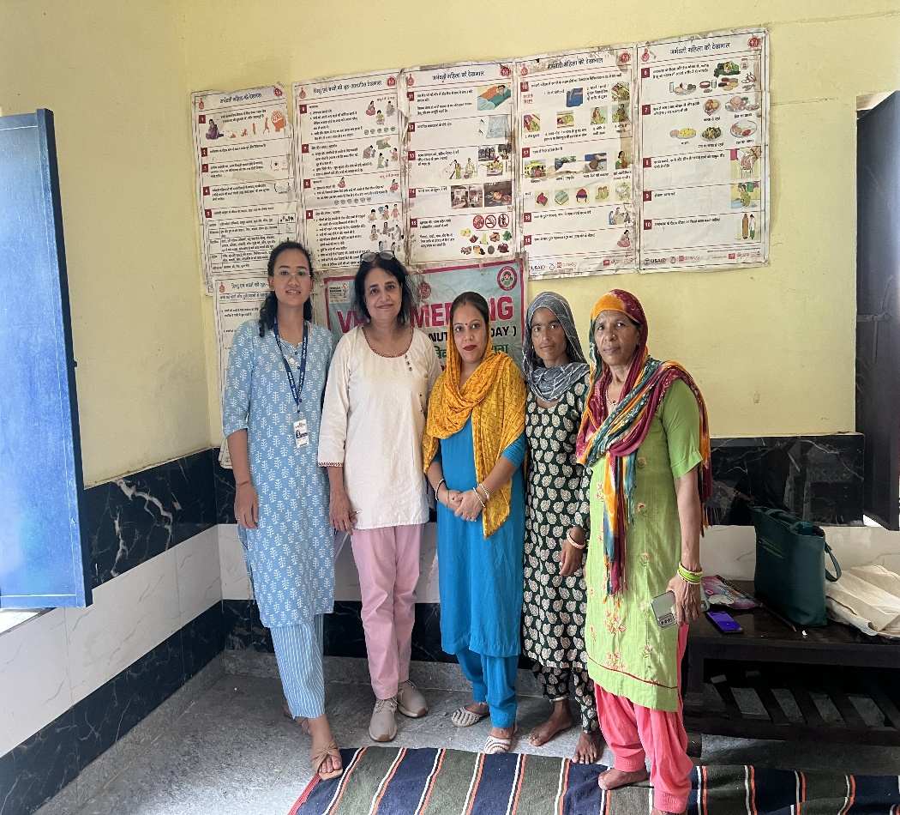
Pictorial Journey (1/2)

Slide 18
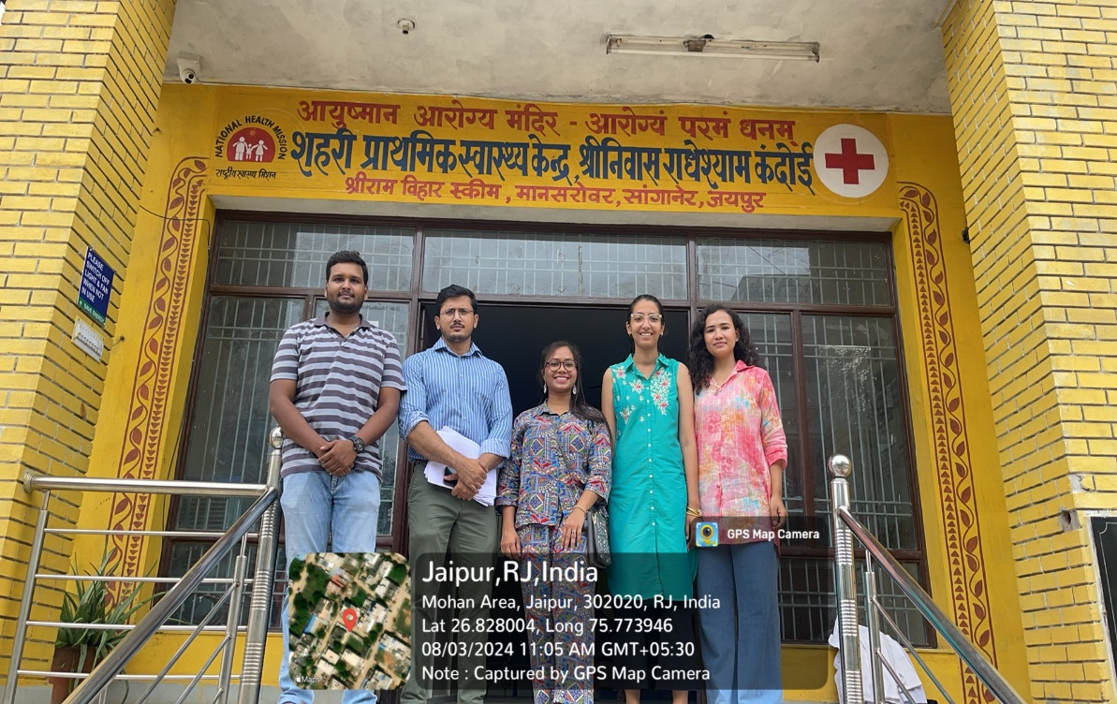
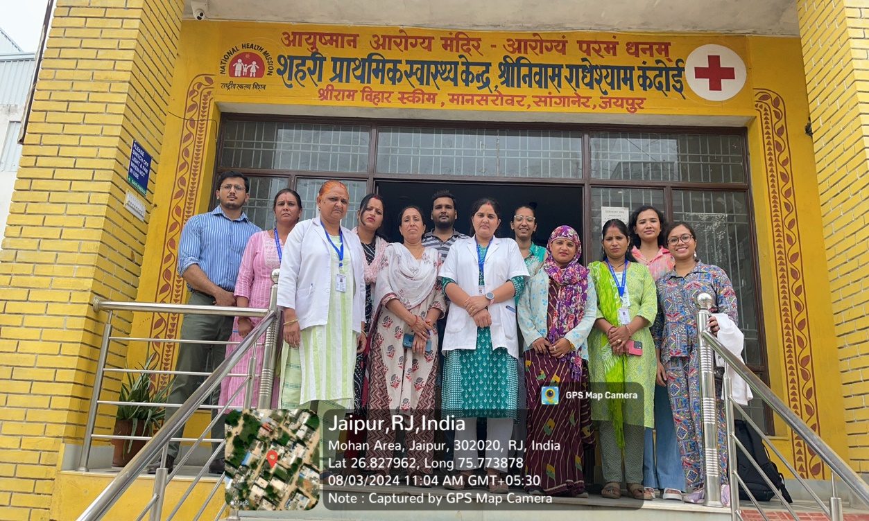
Pictorial Journey (2/2)

Slide 19
Thank You
Any Questions

