Slide 1
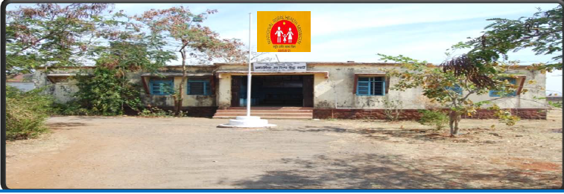
“AN ASSESSMENT OF THE FUNCTIONING & UTILIZATION OF JSY (JANANI SURAKSHA YOJNA) IN DISTRICT HOSPITAL OF SUPAUL,BIHAR”
Underguidence of Dr Dharmesh Lal
Associate Dean,IIHMR
Presented By:-
Dr Preeti Shokeen
PG/11/71

Slide 2
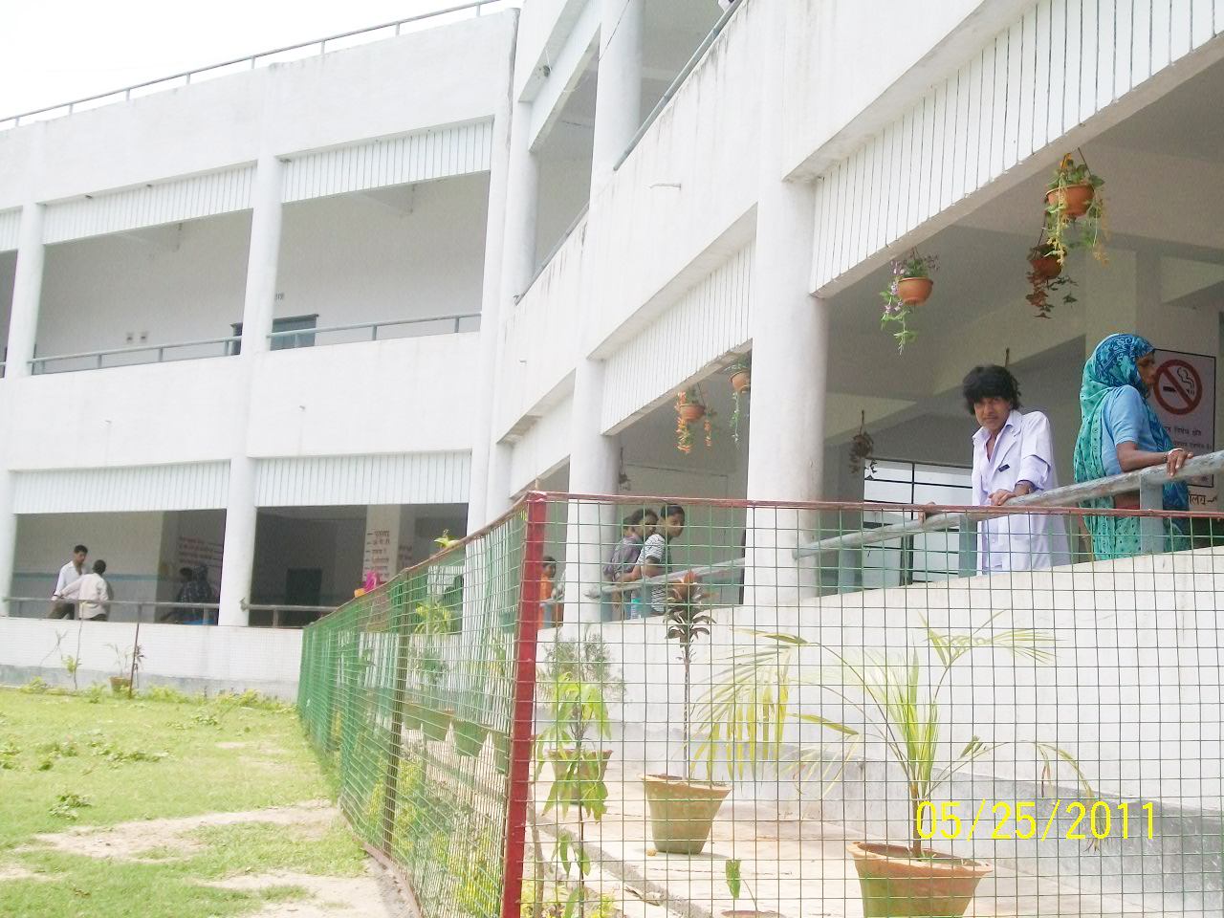
SADAR HOSPITAL SUPAUL
Established in British era in the year 1913 and formerly known as Wales Hospital.
Situated in the heart of the city and cater to the needs of the population of 22 lakhs of the district.
Provide L3 services for MCH and it was designated as District Hospital from SDH at the end of the year 2010.
Total sanctioned beds are 100.

Slide 3
Roles & Responsibilities As An HM:-
Plan,organize,direct,control & coordinate day to day activities of the hospital.
Planning & implementing strategic changes to improve service delivery at the hospital.
Managing,professional & administrative staff.

Slide 4
INTRODUCTION:- JANANI SURAKSHA YOJANA
The Janani Suraksha Yojana (JSY) is an incentive -based programme for the promotion of institutional deliveries.
The main objective of this programme is to ensure that each delivery is conducted in an institution and is attended to by a skilled birth attendant (SBA) to minimize/prevent maternal deaths and pregnancy -related complications in women and at the same time ensure the well -being of the mother and the new -born.
Eligibility Criteria:-
All pregnant women delivering in government health centres
BPL and SC/ST women delivering in accredited private institutions

Slide 6
RATIONALE OF STUDY:-
We see approaches of maternal & child health services changing over the years in order to reduce maternal maternity ratio and infant mortality rates which are the critical indicators in MCH services.
Janani Suraksha Yojana initiated in April 2005 has the impact of financial support and a new brand of personnel being part of strategy.
So,the purpose of this assessment was to review and assess its performance in terms of increase in institutional deliveries, quality of care and to understand the processes of implementation for further strengthening the scheme.

Slide 7
REVIEW OF LITERATURE:-
In a concurrent assessment of Janani suraksha yojana in Bihar, Madhya Pradesh, Orissa, Rajasthan and Uttar Pradesh,concludes that a high level of awareness about Janani Suraksha Yojana among recently delivered mothers in rural areas. ¹⁰
The pattern of utilization of maternal health services and their potential predictors, their distributions and their association with antenatal care utilization and pregnancy outcomes should be emphasized. Only 92 (33.6%) women had undergone the minimum recommended antenatal checkup during their current pregnancy, and 188 (68.6%) women had institutional deliveries. The antenatal services, in spite of being essential to the care of pregnant women, are being poorly delivered.¹²

Slide 8
REVIEW OF LITERATURE:-
The investigation of institutional care seeking for child birth in rural India, economic status emerges as a more crucial determinant than access. Economic status is also the strongest influence on the choice between a private-for-profit or public facility amongst institutional births. The Greater availability of obstetric services will not alone solve the problem of low institutional delivery rates. ¹⁴
Young educated recently delivered women with low parity, educated husband and belonging to higher socio-economic class had higher odds of utilization of accredited social health activist services. ¹⁵

Slide 9
OBJECTIVES OF STUDY:-
General Objective:-
To assess the Janani Suraksha Yojana in district hospital of Supaul.
Specific Objectives:-
To assess the functioning of JSY on quality of care and satisfaction among service providers .
To understand the awareness of JSY among beneficiaries.
To examine utilization of various components of the scheme, including ante natal care, transport support.
To identify the problems/barriers (if any) faced by the service provider and beneficiaries.

Slide 10
METHODOLOGY:-
STUDY PERIOD:- Two Months( March-April’13)
STUDY AREA:- District hospital of Supaul,Bihar
STUDY DESIGN:- A Descriptive Cross-sectional Study
SAMPLING DESIGN:- Convenient Sampling
STUDY SUBJECTS:-
Beneficiaries (the women who delivered in the district hospital)
Doctors & Grade-A Nurses & ANMs.
DPM,DPC and M & E Officer at district level.

Slide 11
SAMPLE SIZE:- 361 beneficiaries who had institutional deliveries & 25 service providers (both the doctors, Grade-A nurses & ANMs).
(Considering consecutive last 3 years data of beneficiaries who were registered, average mean study population was taken out as 6000 beneficiaries annually, from which sample size was calculated at 95% of CI which was 361.)
TOOLS USED FOR DATA COLLECTION:-
Data was collected using quantitative &qualitative semi -structured questionnaire, in-depth interviews (IDI) . Primary and secondary data sources were used for data collection. Primary data was collected from all the respondents.

Slide 12
FINDINGS & DISCUSSION:-
  Perspectives Of Service Providers On Quality Of Care & Satisfaction
Human Resources:-
Supaul District Hospital covering 3.6 lakhs population only have 7 medical doctors for obs-gynae &19 paramedical ANMs & nurses.
“Lack of adequate number of female attendants, sweepers, and ANMs is a major bottleneck in ensuring good quality delivery services in the institutions’’, noted by the district M & E officer.
STAFF | SANCTIONED POSTS | AVAILABLE | VACCANT
DOCTORS/ M.O | 32 | 19 | 13
NURSES | 54 | 20 | 34
source: District Health Report 2012,DHS Supaul.

Slide 13
B) Medical & Para-Medical Personnel Trained & Qualifications
7 doctors who were interviewed, it was noticed that all were MBBS, 3 lady and 4 male doctors providing services.
Only one doctor was having post graduate specialization.
Only 3 doctors received the Emoc & Bemoc training.

Slide 14
Other important point is that only 4 nurses are SBA trained out of 19.

Slide 15
Beneficiaries Perspectives On JSY
Characteristics Of Beneficiaries
Tab 1:- Characteristics Of JSY Beneficiaries
Beneficiaries Characteristics | No.(proportion) | Percentage(%)
1) Socio-demographic Profile
a) Age Distribution
19-21 yrs | 216 | 60%
22-24 yrs | 104 | 29%
25-27 yrs | 30 | 8%
28-30 yrs | 11 | 3%
b) Religion Distribution
Hindu | 166 | 46%
Muslim | 158 | 44%
Jain | 10 | 3%
Buddhism | 2 | 0%
Others | 25 | 7%
c) Caste Distribution
General | 112 | 31%
SC | 88 | 25%
ST | 95 | 26%
OBC | 66 | 18%
d) Education Distribution
Illiterate | 179 | 49%
Primary | 133 | 37%
Secondary | 25 | 7%
Higher Secondary | 18 | 5%
Graduate | 6 | 2%

Slide 16
2) Socio-economic Profile
a) SEC Status Distribution
APL | 194 | 54%
BPL | 167 | 46%
3) Delivery Details
a) Birth Order
1 | 104 | 29%
2 | 133 | 37%
3-6 | 124 | 34%
b) Place Of Delivery
Home | 0 | 0%
Way to hospital | 8 | 2%
Hospital | 353 | 98%
c) Delivery Conducted by
Doctor | 85 | 23%
Nurse | 216 | 60%
Dai | 39 | 11%
Relative | 4 | 1%
Other | 17 | 5%
d) Delivery outcome
Live birth | 338 | 94%
Still birth | 23 | 6%

Slide 17
Client Perspective:-
It was revealed that maximum 285 of the respondents got to know about JSY through ASHA, while 50 got through relatives & friends.
About 1% was through radio/T.V medium considered to be low & needs improvement.

Slide 18
  Functioning Components Of JSY
Tab 2:- JSY Clients Perspective
Beneficiaries/clients Perspective | No.(proportion) | Percentage(%)
1) ANC Registration
a) Registration Time
At 3 months | 310 | 86%
4-6 | 48 | 13%
7-9 | 3 | 1%
b) Card Received
Yes | 323 | 89%
No | 28 | 8%
Don’t Know | 10 | 3%
c) ANC Checkups
1 | 113 | 31%
2 | 174 | 48%
3 | 56 | 16%
4 | 0 | 0%
None | 18 | 5%
d) Not availed ANC
Did not have the time to go | 3 | 17%
Did not feel the need for ANC | 2 | 11%
No one to accompany for ANC | 7 | 39%
Family pressure | 2 | 11%
Others | 4 | 22%

Slide 19
2) Transportation
a) Mode of transport
cycle/bullock cart | 14 | 4%
tempo/bus | 187 | 52%
private vehicle | 75 | 21%
102-ambulance | 62 | 17%
others | 23 | 6%
b) Not availed 102 ambulance
Did not know about it | 28 | 46%
Called but could not connect | 7 | 12
Called but did not come | 5 | 8%
Previous bad experience | 10 | 16%
Did not call | 11 | 18%

Slide 20
Incentives To Beneficiaries:-
It was revealed that out of the 361 beneficiaries interviewed, 342 (95%) had received the money through cheques, no one received (0%) by cash and 19 (5%) had not received money as yet.

Slide 21
Out Of Pocket Expenditure
Tab 3:- Beneficiarie's Out Of Pocket (OOP) Expenditure
 | No.(proportion) | Percentage(%)
a) Transport Facility arrangement
Own cost | 290 | 80%
By ASHA/HW | 71 | 20%
b) Out Of Pocket Spent
Yes | 356 | 99%
No | 5 | 1%
c) Amount Spent
< 200 | 94 | 26%
200-500 | 156 | 44
500-800 | 74 | 21%
> 800 | 32 | 9%
d) Where Spent out(multiple response)
Travel cost | 290 | 22%
Food | 156 | 12%
Drugs | 226 | 17
Payment to doctor | 38 | 3%
Payment to nurse | 320 | 25%
Neonatal care | 190 | 15%
Others | 78 | 6%

Slide 22
It was revealed out that 99% respondents have done out of pocket expenditures.
80% travelled on their own cost through private vehicle.
44% respondents spent out Rs 200-500 while 21% spent out Rs500-800, even 9% were also there who spent above Rs800 till to Rs 1200.
They spent out on drugs (12%), transport, paid to doctors (3%) & maximum found on payment to nurses(25%) as demanded by nurses for carrying out delivery.

Slide 23
CONCLUSION:
The district hospital has made considerable improvement in the last two years, i.e. in 20010-11 and 2011-12. The number of institutional deliveries has gone up to 5603 (2010-11) from 6106 (2011-12) an increase of 33 per cent in one year.
Lack/shortage of medical and paramedical staff for the implementation of the programme, leading to increased work load.
Poor utilization of JSY services :- Only 16% had 3rd ANC checkup, while no one with 4th ANC, maximum 48% had 2nd ANC while 5% were also there who have not got any of ANC checkups.
Only 17% respondents came to hospital by 102 ambulances as many of them (46%) did not know about the free services of the ambulance. Maximum of them (52%) took private vehicles such as tempo, car, and auto for travelling.

Slide 24
Timely Receipt of money:- Incentives to beneficiaries were timely made out which is through cheques,only 5% got the time lag in receipt of money.
As most of the respondents are under BPL section then after too,99% have made out of pocket expenditure in different heads which can’t be reimbursed out.

Slide 25
RECOMMENDATIONS:-
The vacancies at all levels need to be filled up immediately. More number of ASHAs need to be engaged to share the increased burden.
The inadequacy of equipments, drugs, and the infrastructure should be assessed through facility surveys and the deficits are to be filled up urgently to meet increased demand for labour rooms.
There is a need for clear policy on monitoring and supervision. The monitoring and supervision diary at district and block level must be made mandatory.
Sensitization of district and block level programme managers needs to be stepped up. Feedbacks from top to bottom need to be streamlined.

Slide 26
Grievance cells should also be set up to look into the complaints related to non-payment & other problems faced by the clients.
Transport facilities must be enhanced & made available at the sub-centres and block levels also.
Innovation in the form of JSY help-line through NGOs can be experimented out by the state and each block of every district should be covered to enhance the implementation & further utilization of the scheme.

Slide 27
