Slide 1
Evaluation of hospital Information System in Deendayal UpadhayayHospital(DDU) ,Shimla

Slide 2
CONTENTS:
Organization Profile
About DDU
OpenMRS
Evaluation of HIS
Rationale of the study
Objective of the Project
Methodology
Outcomes of the study
Findings
Limitations
Recommendations
Refrences

Slide 3
ORGANIZATION PROFILE
HISP India is a not for profit NGO specializing since more than a decade in designing and implementing solutions in health informatics for the public health sector in India, and also recently in Bangladesh and Sri Lanka.
With a strong commitment to free and open source technologies, we work with a global perspective of the Health Information Systems Programmes (HISP) network, coordinated by the University Of Oslo, Norway, and are active in more than 20 countries in Africa and Asia.
In India, it has worked in at least 90% of the states, and currently has a presence in about 20 states.

Slide 4
MISSION
To enable networks of collaborative action with like-minded actors who aspire to the ideology of open source software, open standards and decentralized decision-making to create complementary strengths in providing integrated and public health friendly health information systems.

Slide 5
Vision
It works with a Vision “to enable and coordinate a network of excellence in public health informatics, specializing in integrated health information architectures, with a geographical focus on South-East Asia.”
HISP,India has a registered and head office in New Delhi, and project offices in Kerala, Himachal Pradesh, and Punjab.

Slide 6
DDU

Slide 7
About DDU
Deendayalupadhayay hospital is also known as rippon
DDU is an old heritage hospital and was opened in 1885.The 125 year old buildings are in a very bad condition, as there are strict rules and guidelines for repairing heritage buildings. It is built entirely of wood, and during the rainy season there are lots of leaks, causing bad conditions and posing a risk to computers and other electronic equipment. There are also a lot of monkeys in the area, vandalizing the buildings and power- and network cables. Nevertheless, due to its location and the lack of other public hospitals nearby, it is a much visited hospital. There is an average of about 1200 out- patient (OPD) visits per day.
It is the first district hospital of himachal pradesh where HIS is implemented by HISP,India.
It is the most established and functional government hospital.
It is a 150 bedded hospital with all functionalities.

Slide 8
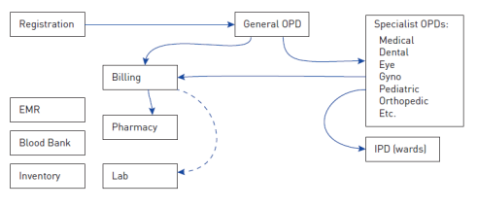

Slide 9
OpenMRS
The HIS developed by Society of Health Information Systems Programme (HISP India) and NHSRC is built on OpenMRS – Open Medical Records System.
It is community developed software which enables to design customized medical records without any programming knowledge, only medical and systems analysis knowledge is required. It uses minimal free text and maximum coded information making it easier to summarize and analyze
FEATURES :
  Central concept dictionary
  Security
  Privilege-based access
  Patient repository
  Unique identifiers per patient
  Data export
  Modular architecture
  Patient workflow
  Reporting tools

Slide 10
Evaluation Of HIS
Evaluation is the process of examining a subject and rating it, based on its important features
A systematic, rigorous, and meticulous application of scientific methods to assess the design, implementation, improvement or outcomes of a program. It is a resource-intensive process, frequently requiring resources, such as, evaluator expertise, labour, time and a sizeable budget
We determine how much or how little we value something, arriving at our judgment on the basis of criteria that we can define .

Slide 11
RATIONALE OF THE STUDY
Evaluate the system efficiency under various parameters.
System acceptance and satisfaction amongst end users and patients
Assessing effectiveness of HIS along with the current shortcomings in the deployed system.
As NRHM funded HISP project is in the process of implementing the HIS in 19 government hospitals of Himachal Pradesh, the results of this study will be useful for improving the existing system.

Slide 12
OBJECTIVES OF THE PROJECT
To assess the acceptance level of HIS among end users at DDU
User satisfaction of different user groups with HIS
To study patient satisfaction with patient care at the hospital

Slide 13
METHODOLOGY
Stakeholders | Number
Administrator | 1
Operators for Registration and Billing | 3
Main Store Manager | 2
Doctors | 23
Pharmacist/ JAS | 3
Radiology Department | 2
Laboratory Department | 6
Nursing Staff | 40
Patients | 200
Total Sample Size | 280

Slide 14
Type of study: Descriptive/cross sectional study
Study population (Stakeholders Identified):
1. Administrators
2. Users of the System:
Data Operators for Registration and Billing
Main Store Manager
Doctors(Medicine, Surgery, Gynecology, Dental, Pediatrics, ENT, Eye, Ortho Departments)
Pharmacist
Radiology Technician
Laboratory Technician
Nursing Staff (matron, staff nurse and wards)
3. Patients
Study site: Deen Dayal Upadhyay (DDU) Hospital, Shimla (HP)

Slide 15
Tools for the Study
Questionnaires for Administrators, Doctors, Nursing Staff, Laboratory Technicians, Radiology Technician.
FGDs for Nursing Staff, Laboratory and Radiology Technicians and Patients.
Interviews for Data Operators of Registration and Billing, JAS, Inventory and Patients.

Slide 16
OUTCOMES OF THE STUDY

Slide 17
Valid | Missing | Total | Availability of Real time information |  |  | TOTAL
N=15 (62.5%) | N=8 (34.8%) | N=23(100%) clinicians | Always | Most of Time | Sometimes
Access to patient data Across Various Departments |  | To be an effective | 0 | 2 | 0 | 2
 |  | Satisfactory | 1 | 8 | 2 | 11
 |  | Not at all | 0 | 0 | 2 | 2
Total |  |  | 1 | 10 | 4 | 15
Cross tabulation of Access to patient data across various departments against the Availability of Real Time Information

Slide 18
Total N= 16 (Paramedical Staff) |  | Satisfied with the Reports generated by HIS |  |  | Total
 |  | Yes | To some Extent | No
Satisfied in Time Taken for compilation of Reports | Yes | 5 | 0 | 3 | 8
 | No | 4 | 3 | 1 | 8
Total |  | 9 | 3 | 4 | 16
Cross tabulation of the level Satisfaction in Time Taken for Compilation of Reports against the level of Satisfaction with the Reports generated by HIS

Slide 19
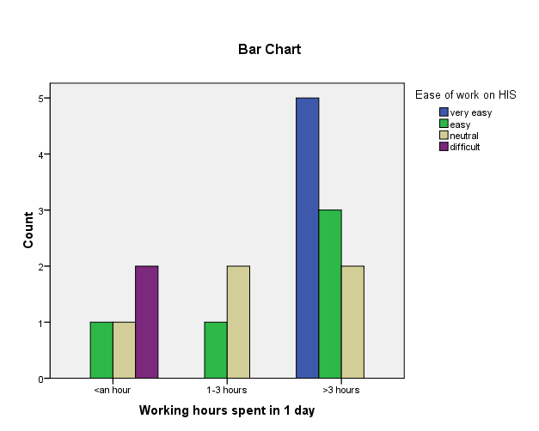
Cross tabulation of Working Hours against Ease of Working on HIS for Clinicians

Slide 20
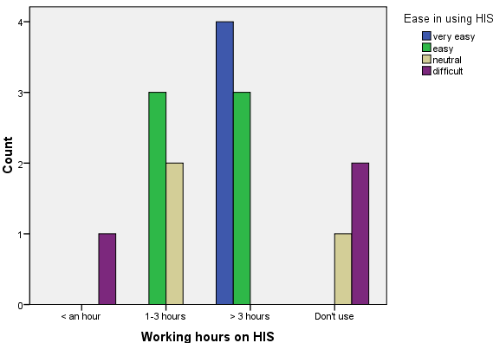
Cross tabulation of Working Hours against Ease of Working on HIS for Paramedical Staff

Slide 21
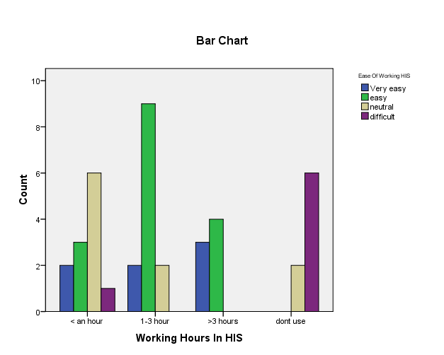
Cross tabulation of Working Hours against Ease of Working on HIS for Nursing Staff

Slide 22
17 (73.9%) out of 23 Clinicians, 40 (100%) of the Nursing staff, 16 (100%) of the Paramedical Staff responded that they work between 1 – 3 hours per day on the HIS application therefore had ease in using the application.
Also, it has been observed that due to heavy patient inflow and limited time for clinicians, they are bound to use the application as well as attend the patient at the same time. Hence, maintenance of electronic records suffers. Even some of clinicians were not interested in filling up the evaluation questionnaire because they themselves do not use the HIS application.
A positive feedback was received on interviewing JAS, registration and billing as they were satisfied with the time taken and efficiency of system even at rush hours.

Slide 23
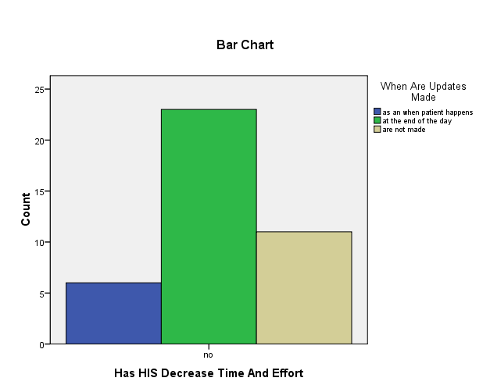
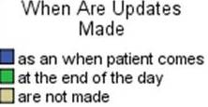
Cross tabulation of Decrease in Time and effort against the Time of Updating the HIS records for the Nursing Staff

Slide 24
It was observed that HIS application has not decreased time and effort as 23out of 40 nurses use to make updates at the end of the day and 11 nurses did not maintained any electronic patient records.
Furthermore, in the IPD departments, staff nurses pointed out that they have to come on weekends to update the records as a result lack of interest and commitment seen towards the application.
Also, the hospital staff has to maintain both the registers as well as electronic records as they are not confident about the electronic records generated by the HIS application.
As pointed out by some clinicians it is an extra burden for them as they are forced to use the system and make necessary updates at the end of the day.

Slide 25
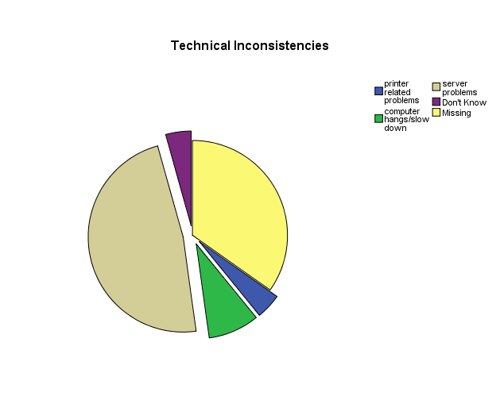
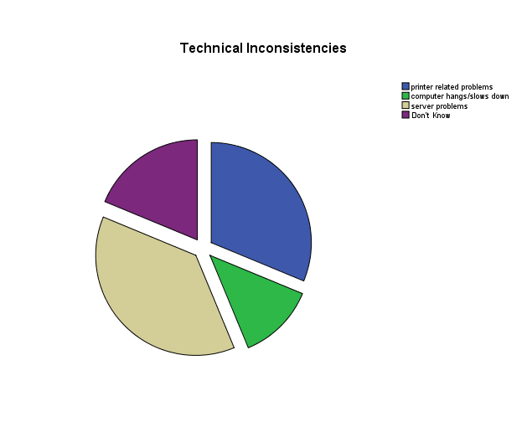
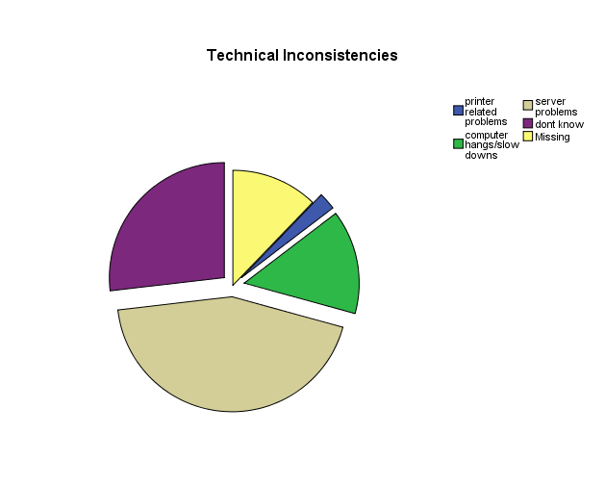
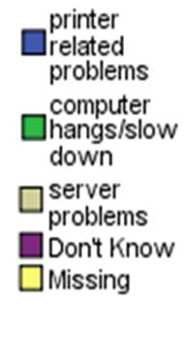
Paramedical Staff
Clinicians
Nursing Staff

Slide 26
50% of nurses and 47.8% of the Clinicians complained about server issues and internal errors, while only 37.5% of the paramedical staff had the same issue along with 31.2% of the printer related problems.

Slide 27
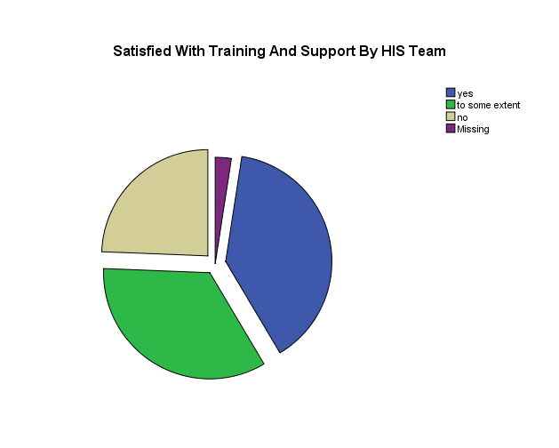
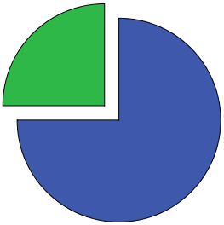
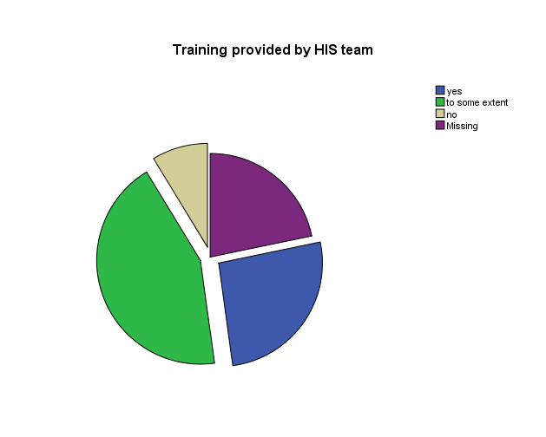
Satisfaction level with the HIS Team
Paramedical Staff
Clinicians
Nursing Staff

Slide 28
75% of the Paramedical Staff, 39% of the Nursing Staff and 26% of the Clinicians were satisfied with the training and support provided by the HIS Team.
Some of staff in IPD departments (male/female surgical and orthopedics ward) pointed out that they were busy attending the patients and also due to transfers they did not receive the HIS training.

Slide 29
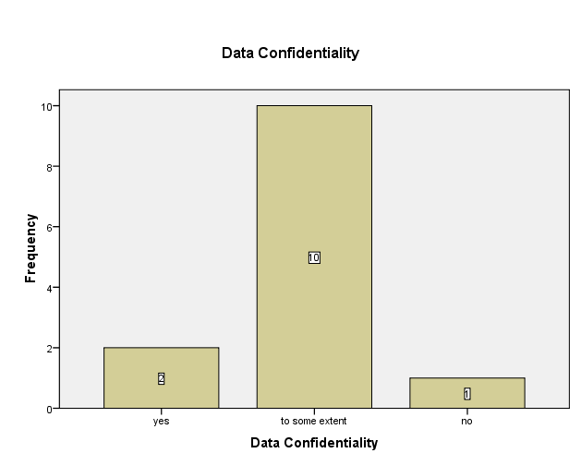
Data Confidentiality provided by the HIS application

Slide 30
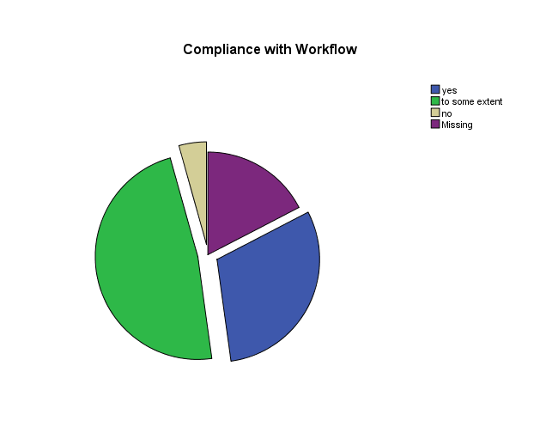
Clinicians response towards the compliance of the HIS application with the workflow of the OPD Departments
47.8% of the clinicians were satisfied to some extent with the compliance of the HIS application with the workflow of the OPD department but complaint that diagnosis and procedures were not adequate as per requirements and needed regular updating.

Slide 31
Earlier RSBY and BPL patients use to go directly to the laboratory after consultation. But after the implementation of HIS, patients again have to get themselves registered to billing before going to the laboratory. As a result, sometimes patient undergoes unnecessary botheration.
As per hospital administration, the records of BPL and RSBY patients are now easy to maintain with the help of HIS application

Slide 32
LIMITATIONS
The sample was taken from single hospital; therefore a generalized inference could not be obtained for the study.
The sample population for study was taken on conveniences basis.
The Patients were not aware of the HIS application, therefore had lesser interest in participating for the interviews and FGDs.
Also, the sample size for the Hospital stakeholders was limited.
The HIS application is not fully functional in most of the IPD/OPD departments of the hospital.

Slide 33
Recommendations
Biggest hindrance was data entry as clinicians had lack of time thus another person as data operator could be recruited to complete all the records.
Also training and follow-up training should be done regularly.
On-site support is also good step to ensure that end-users having different computer skill are using this application.
Proper logistics support should be provided to all the departments of the hospital.
Regular updating of diagnosis and lab procedures is recommended.

Slide 34
Refrences
Centre for development of advanced computing (2011). Health Informatics. Retrieved August 14, 2011 from http://www.cdac.in/index.aspx?id=health_info
Cordos, A., Orza, B., Vlaicu A., Meza, S., Avram, C., & Petrovan, B.(2010). Hospital Information System using HL7 and DICOM standards. WSEAS Transactions on Information Science and Applications, 7(10), 1295-1304. Retrieved http://www.wseas.us/elibrary/transactions/information/2010/88-422.pdf
Felt-Lisk, S. (2006). New Hospital Information Technology: Is It Helping to Improve Quality?. Retrieved July 7, 2011 from http://www.mathematica-mpr.com/publications/pdfs/newhospinfo.pdf
Fraser, H., Biondich, P., Moodley, D., Choi, S., Mamlin B., & Szolovits P. (2005), Implementing electronic medical record systems in developing countries. Informatics in primary care, 13, 83-95. Retrieved September 1, 2011 from http://groups.csail.mit.edu/medg/ftp/psz/EMR-design-paper.pdf
Committee on Quality Health Care in America –Institute of Medicine. Crossing the Quality Chasm:A New Health System for the 21st Century.Washington: National Academy Press; 2001.http://www.nap.edu/books/0309072808/html/.
Haux R, Winter A, Ammenwerth E, Brigl B.Strategic Information Management in Hospitals –An Introduction to Hospital Information Systems.New York, Berlin, Heidelberg: Springer-Verlag;2004.
Winter A, Ammenwerth E, Bott O, Brigl B,Buchauer A, Gräber S, et al. Strategic InformationManagement Plans: The Basis Systematic In -formation Management in Hospitals. Int J MedInform 2001; 64 (2–3): 99–109.
Kuhn K, Guise D. From Hospital Information Systemsto Health Information Systems – Problems,Challenges, Perspectives.Methods Inf Med 2000;40: 275–286.

Slide 35
THANK YOU
Submitted by:Neha Gupta

