Slide 1


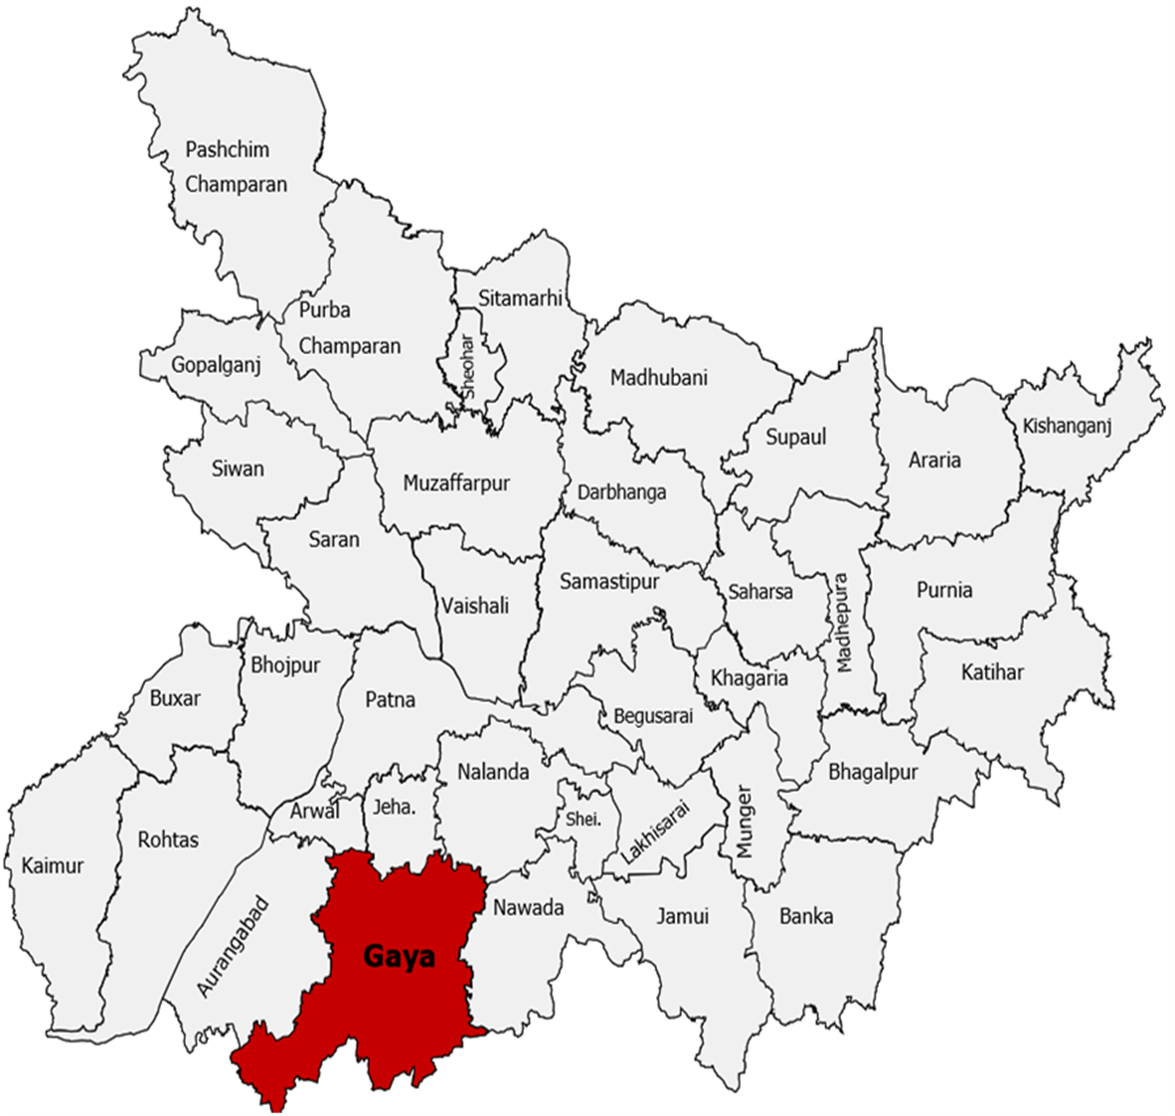
Monitoring the KPIs of Health Theme: Study of 2 Aspirational Blocks of district Gaya, Bihar from April 2020 to March 2024
UNICEF, Bihar
Presented By : Avantika Bakshi
Mentor : Dr. Sumesh Kumar
IIHMR Delhi

Slide 2
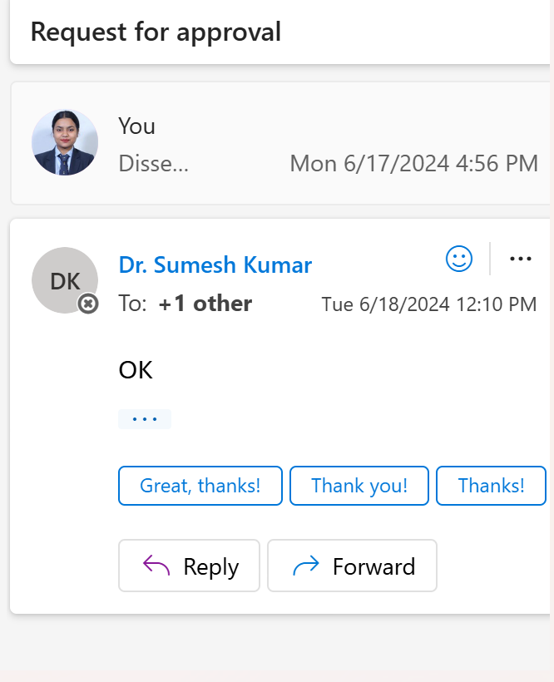
Mentor Approval

Slide 3
Introduction (1/2)
India's Aspirational District Program, established by NITI Aayog in January 2018, intends to accelerate and successfully improve the country's 112 least-developed districts. This program functions in three dimensions: convergence, collaboration, and competitiveness.
The program views states as accountable agents for capacity building, employing data-driven methodologies to record and analyse difficulties and identify bottlenecks.
Aspirational Block Program was later launched on January 2023 for a more targeted approach and intends to accelerate and successfully improve the country's 500 under developed blocks.
NITI Aayog tracks the development of each aspirational block using robust statistical models and ICTs, and grades them based on their accomplishments. The research looks at the progress made by the 2 blocks within the Health status topic.

Slide 4

Introduction (1/3)
The Aspirational Block Program has enabled governments to assume responsibility for the improvement of district administration using data-driven methods.
500 blocks were initially selected as Aspirational Blocks and out them, 100 blocks were selected for intensive interventions. Out of 100 blocks all over India, 4 blocks are selected from Gaya district. 7 KPIs of health from “Health and Nutrition” have been decided to be monitored to track the progress of the selected blocks and rank them on the basis of their performance to encourage a healthy competition among the blocks.

Slide 5

Introduction (2/3)
The study is performing a trend analysis of the data uploaded by the facility on the HMIS portal and understand the trend in the data before and after the launch of Aspirational block program within the three key performance indicators of the health theme.
These blocks are classified as "aspirational" because their development indicators are lower than the national average. The programe aims to enhance the standard of living for the people living in these blocks and reduce regional disparities by concentrating on their development needs and integrating federal, state, and local government initiatives and resources.

Slide 6
Introduction (3/3)
Intervention based on the facility capacity building and quality improvement amends the service provision of the facility in a difference of pre and post launch of the ABP.
The study focuses on the trend in Maternal and child Health status of 2 aspirational blocks namely: Konch & Wazirganj of district Gaya State Bihar after the launch of Aspirational Block Programme on 7th January 2023.
The Aspirational Block Programme identified the data from January to March 2023 as their baseline data, with the target to achieve a 100% ( 0% in case of LBW children)

Slide 7
Objectives of Your Study
To compare the data of the Key Performance Indicators(KPIs) before and after the launch of Aspirational block program in Konch and Wazirganj and to see the trend of data of Maternal and Child health.
Identify the bottlenecks and challenges to provide suggestions for the same.
To provide evidence based constructive suggestions as a step towards achieving the set target of improving the KPIs.
3 KPIs being compared are:
> Percentage of ANC registration within the first trimester against total ANC registrations.
> Percentage of institutional deliveries against total reported deliveries.
> Percentage of LBW babies less than 2500 grams.

Slide 8
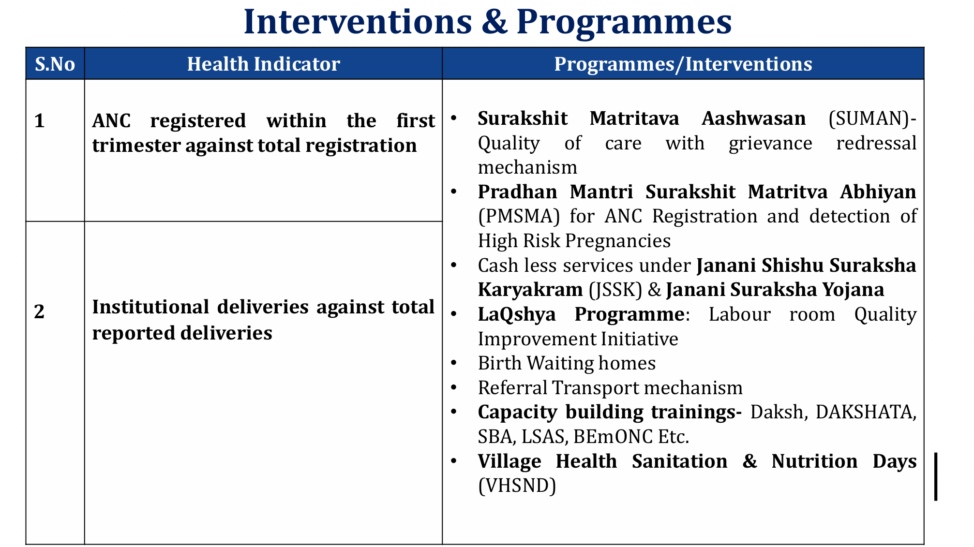
Interventions Undertaken by the Government

Slide 9
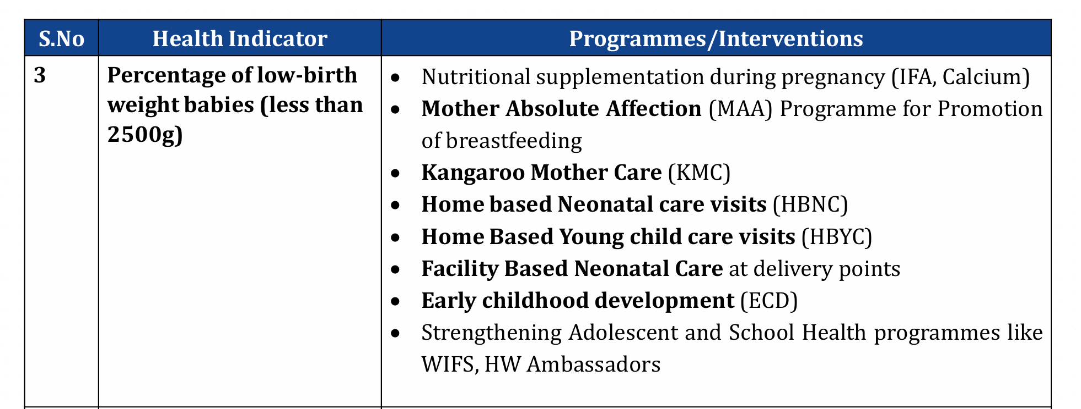

Slide 10
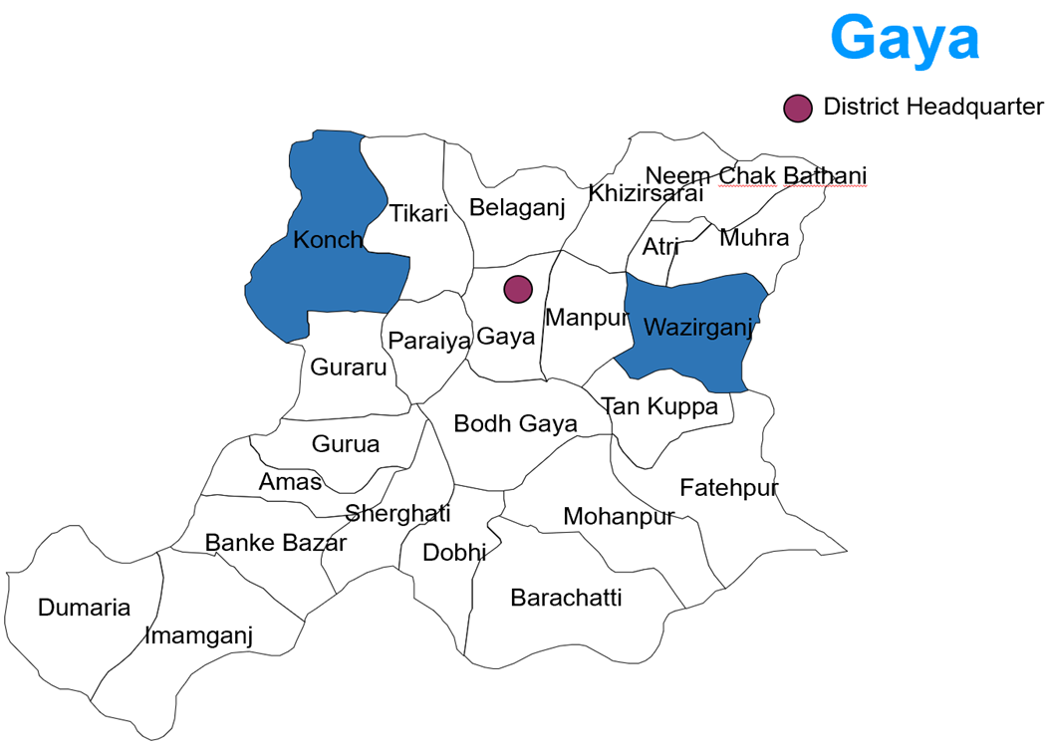
Methodology (1/2)
Study design: Observational Secondary study
Study population: Women and children of the blocks namely Konch and Wazirganj
Research instrument: Champions of Change website & HMIS.
Data Analysis Plan: Data analysis by using MS Excel
Distance To Frontier Analysis to show how far are the blocks from their set target.

Slide 11
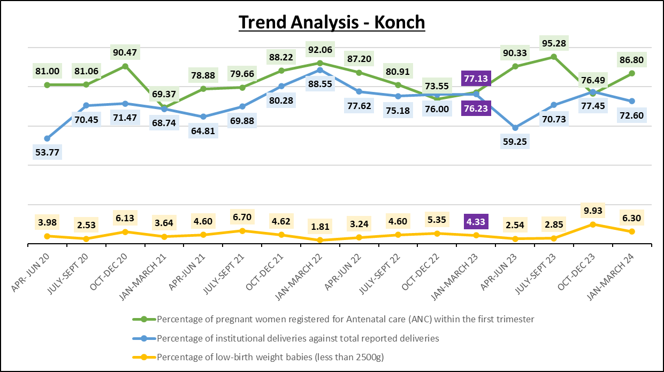
Results
Baseline

Slide 12
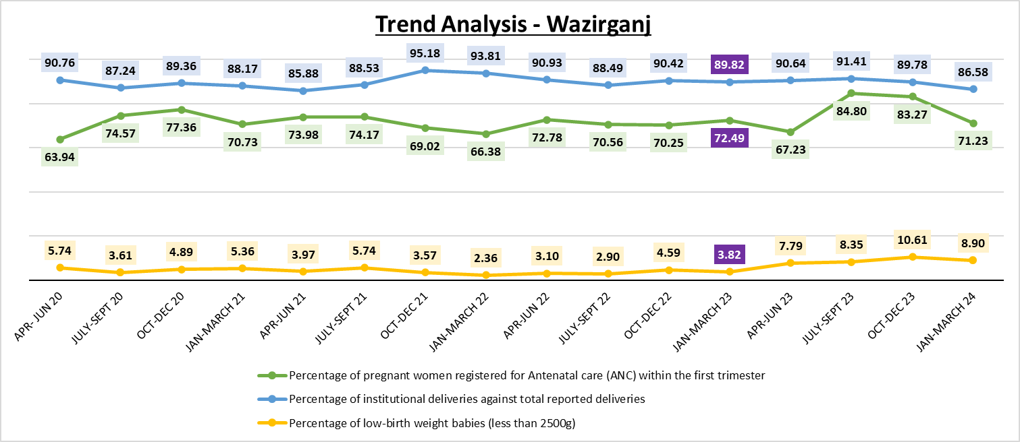
Baseline

Slide 13
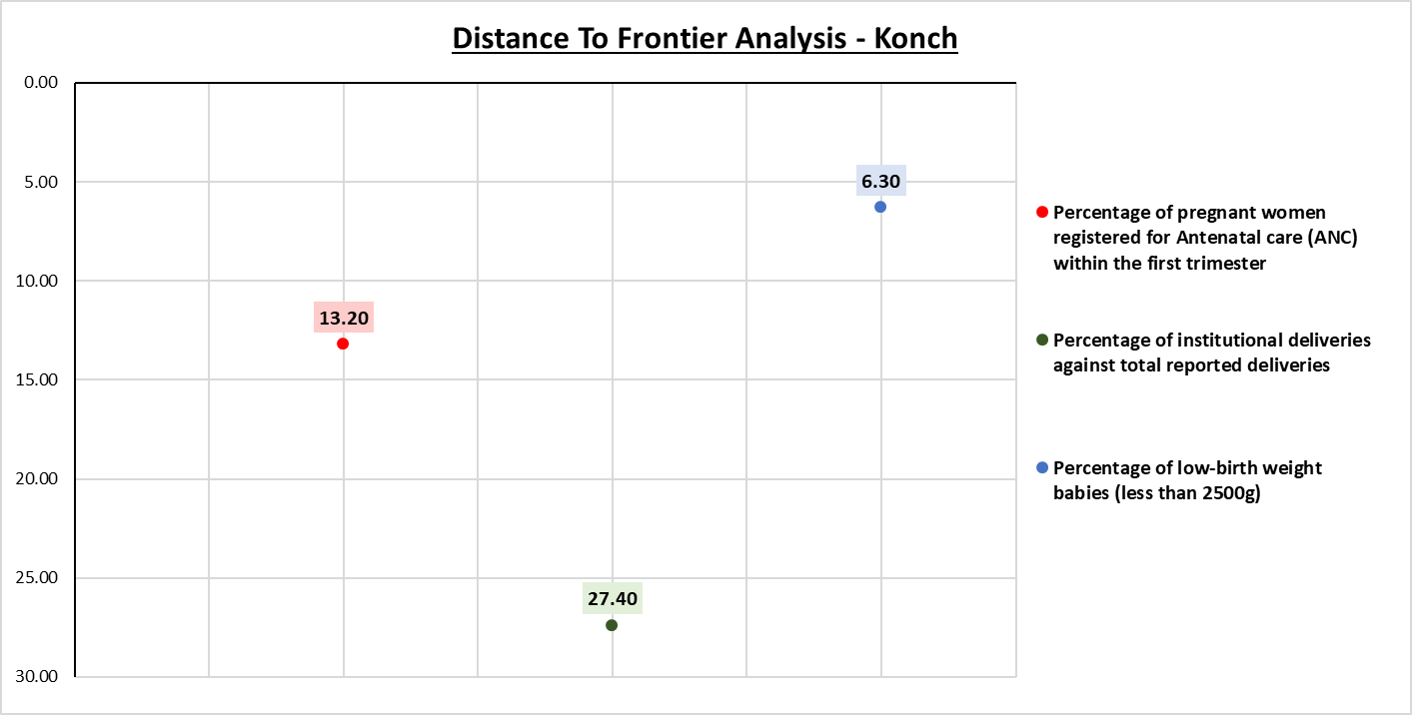
Distance to Frontier = Benchmark Target – Present Score(Jan-March 24)
Distance to Frontier: How far are you from your target? 0: Achieved ; Positive: Further away; Negative: Over achieved

Slide 14
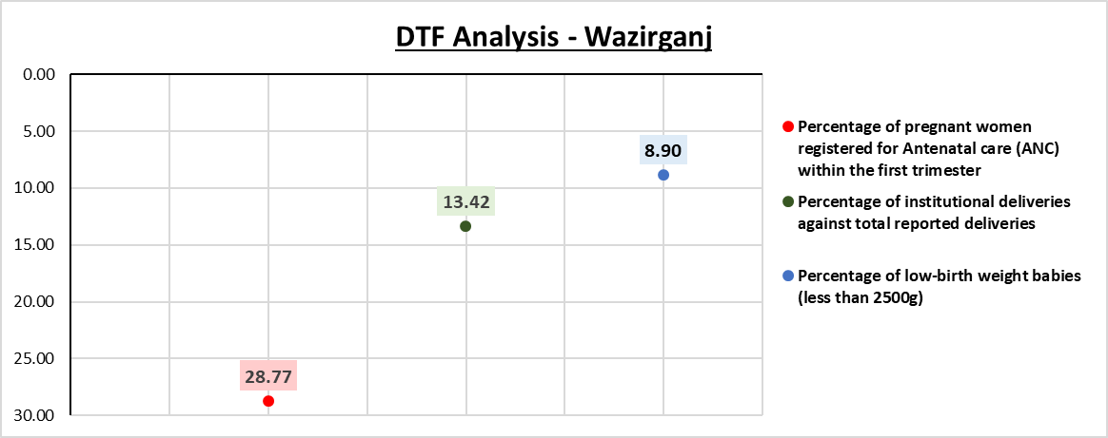
Distance to Frontier = Benchmark Target – Present Score(Jan-March 24)
Distance to Frontier: How far are you from your target? 0: Achieved ; Positive: Further away; Negative: Over achieved

Slide 15
Discussion
The data's trend demonstrates the challenges facilities have in achieving the Aspirational Block Programme's goals while putting new strategies and priorities into practice in order to reach or surpass the expected outcomes after setting a baseline for comparison.
The inconsistency or existence of a sizable disparity between the feasible target and the data at this point indicates the facility's unwillingness to adapt to new changes in public health systems and its incapacity to modify as per the operational interventions.
That merely indicates that the rate of development under the program has not outpaced natural trajectories, not that the indicators have not improved.
Not all indicators show change at a similar frequency, frequency of data collection should be adjusted.
The growth rates of each indicator differ from one another. It should be noted that the growth rates of long-term and medium- and short-term indicators are different.
The trajectory of the percentage of LBW babies has not changed significantly, suggesting that the methods' implementation and sustainability have not been up to pace.

Slide 16
Challenges
One of the issues associated with the implementation of ABP is the disparity between the data recorded and the data that was monitored. A competitive approach should be less of a priority, as discussions with many stakeholders have shown, as this could lead to blocks reporting data incorrectly. Additionally, indicators should be revised. Additional trainings and educational initiatives are also required in addition to this.
A common problem identified in all blocks, regardless of their performance, is the shortage of human resources and technical skills at the block level. Despite receiving assistance from NITI Aayog, there's still a necessity to develop skills at the grassroots level.
There has been discontinuation of prioritization of engagement activities owing to leadership change in districts.
Inability to create behavioral change within the district administration has been one of the biggest challenges.
Even after successful implementation of interventions, there has been a major challenge in sustaining the change.

Slide 17
Conclusion
The 2 blocks have shown that there is a significant distance to achieving the target and it shall take a significant amount of time along with support from the development partners for a strategic approach to intensify the interventions.
A 6 point engagement framework can be proposed to leverage maximum social and human development outcomes from partner engagements.
Monitor
Promote
Identify
Collaborate
Engage
Facilitate

Slide 18
References
Amit Kapoor MG, Mark Esposito, Chirag Yadav. India’s Aspirational Districts Programme Focuses Governance Efforts On Development. Harvard. 2018-19.
Subramanian SV, Ambade M, Kumar A, Chi H, Joe W, Rajpal S, et al. Progress on Sustainable Development Goal indicators in 707 districts of India: a quantitative mid-line assessment using the National Family Health Surveys, 2016 and 2021. The Lancet regional health Southeast Asia. 2023;13:100155.
Green M, Kapoor A, Porter M, School H, Stern S. AN ASSESSMENT OF ASPIRATIONAL DISTRICTS PROGRAMME

Slide 19
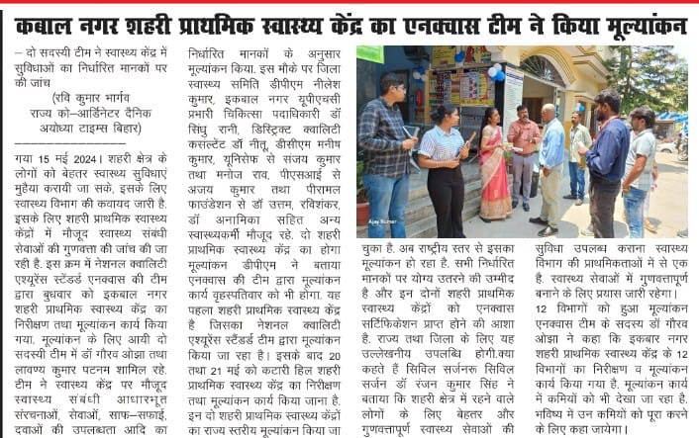

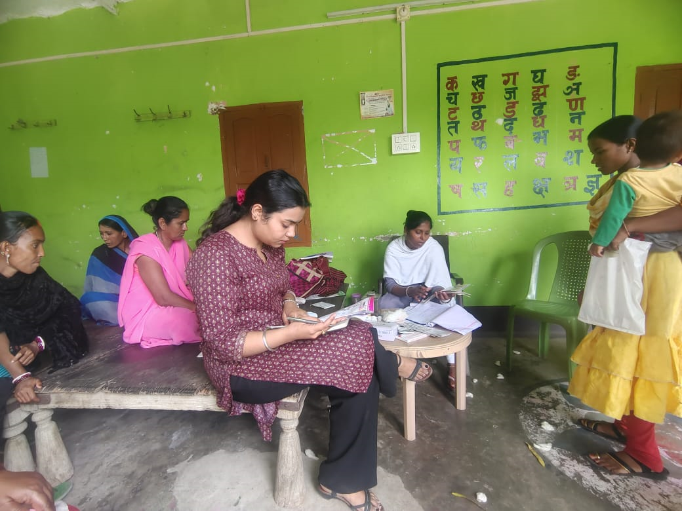
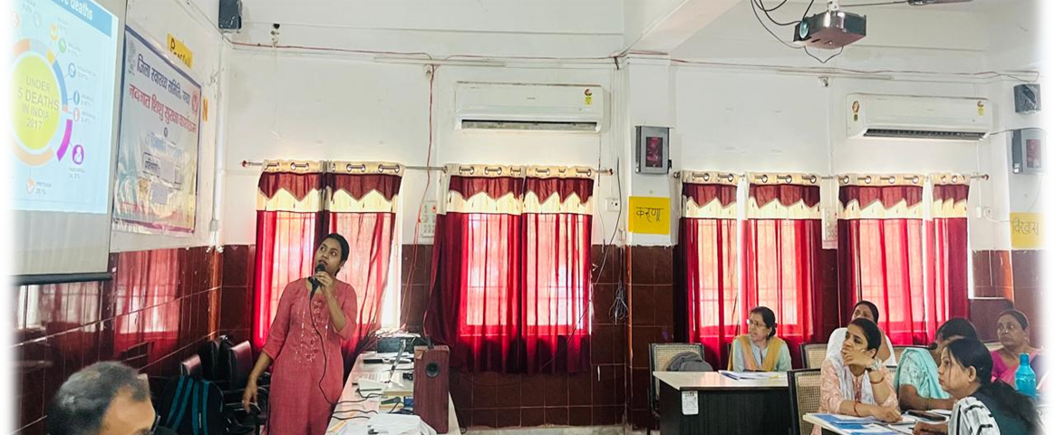
Pictorial Journey (1/2)

Slide 20
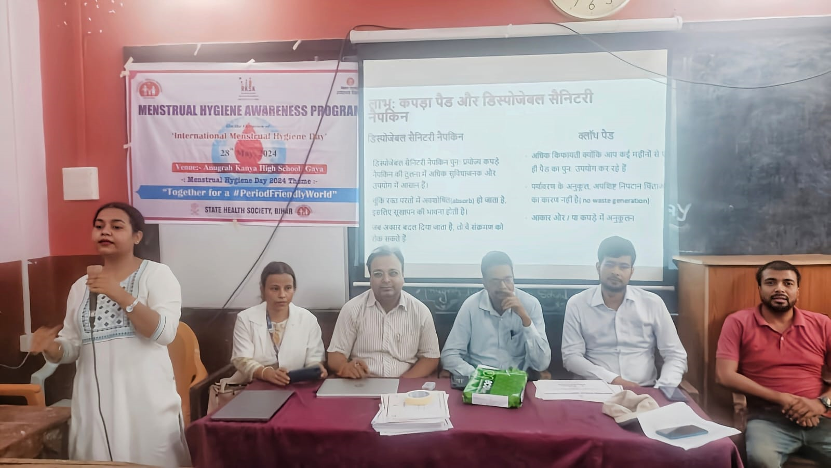
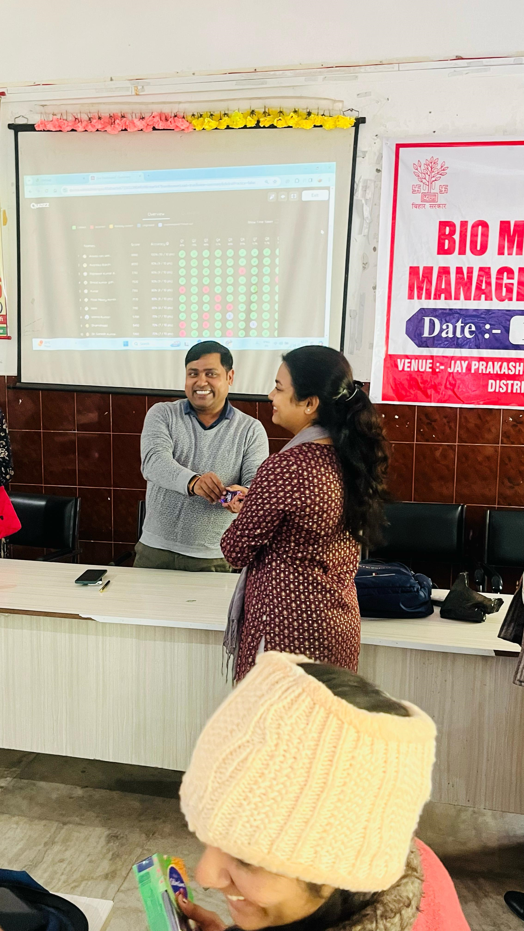
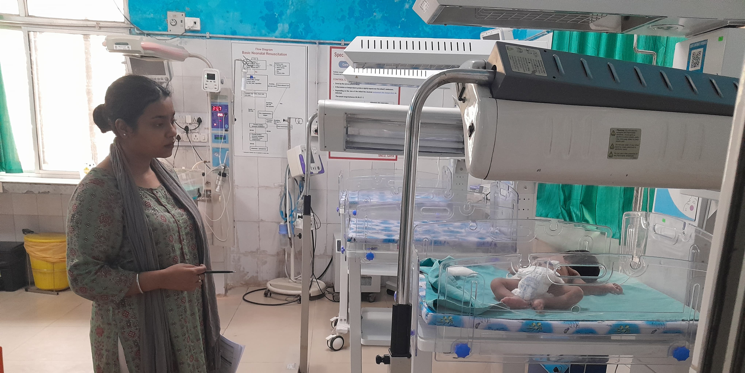
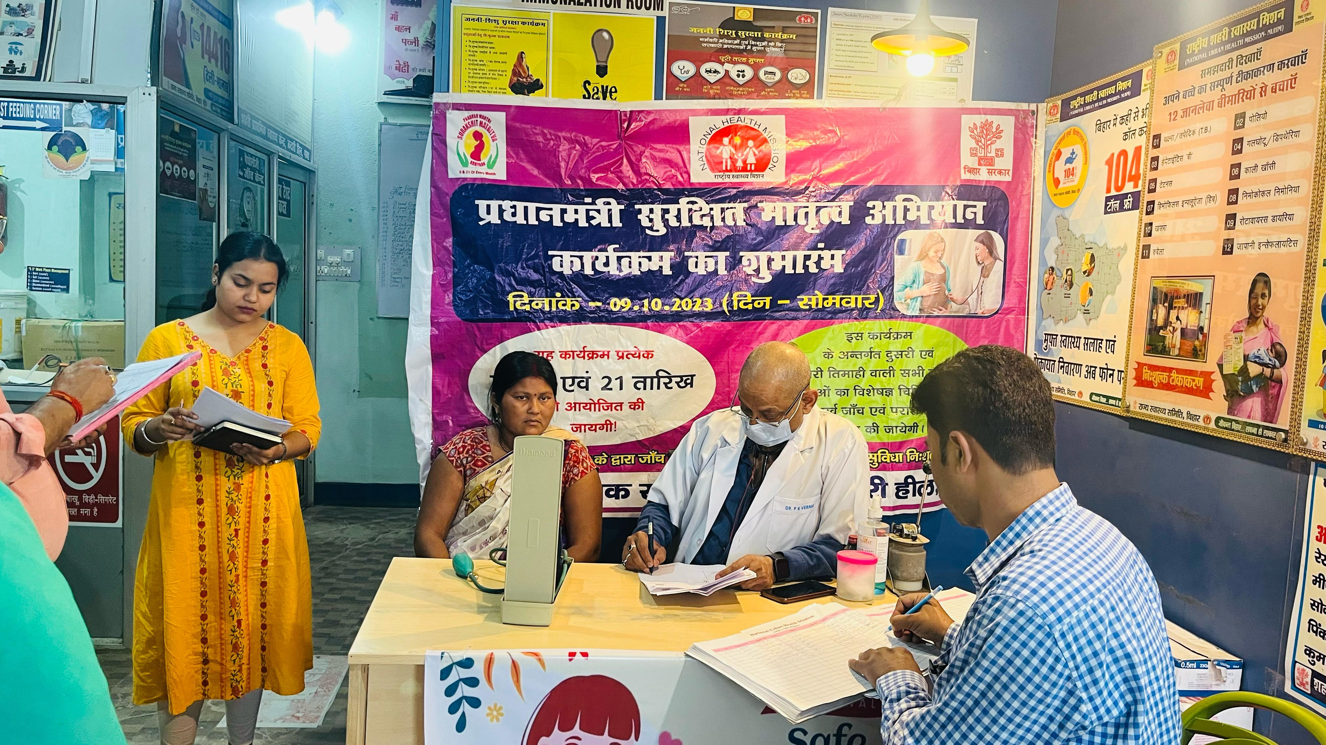
Pictorial Journey (2/2)

Slide 21
Thank You
Any Questions

