Slide 1
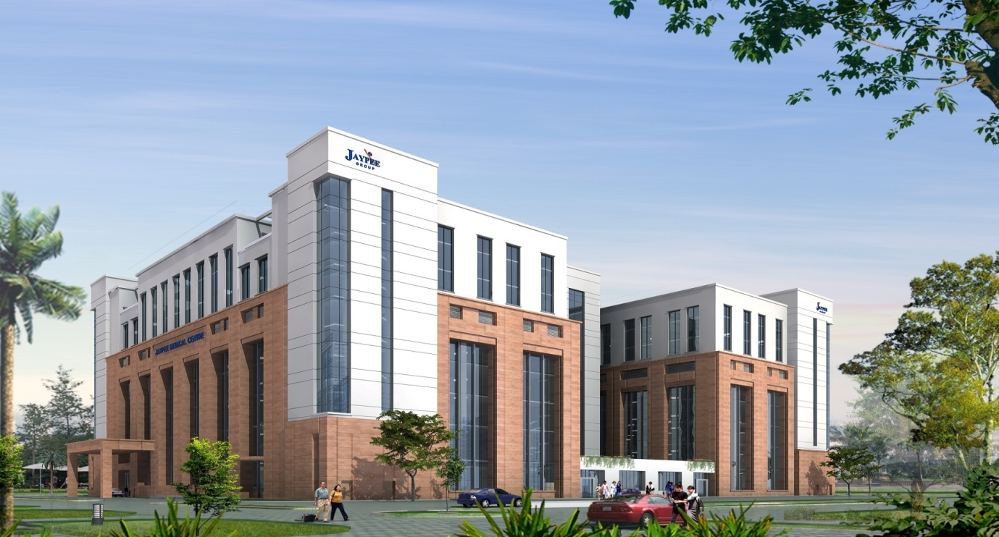
DISSERTATION REPORT
BY : -
Dr. Vidhi Gandhi
PG/11/113

Slide 2
Work Process designing and Functionality Evaluation for Implementation of LIMS (Laboratory Information Management System) in a tertiary care hospital

Slide 3
TABLE OF CONTENT
Introduction
Rational of study
Objective
Methodology
Work Process designing
Recommendations
Limitation of the study
References

Slide 4
Hospital Profile
Flagship Hospital of the Jaypee Group
Spread over 110000 Square Meters of campus
Total Beds: 1000 beds. ( 505 Beds in Phase 1)
Proposed Nursing School on campus
Would be a LEED Certified building
Would target for Joint Commission International accreditation in first year

Slide 5
Hospital Profile
Sl. No. | FLOOR | DEPARTMENTS
1 | Seventh | Wards
2 | Sixth | Wards
3 | Fifth | Wards
4 | Service | IT Server, AHU, PTS station and MEP
5 | Fourth | OT Complex, ICCU, Cath lab.
6 | Third | Economy Bed, IVF, MICU, SICU, NICU, Labour and Delivery
7 | Second | Chemotherapy, Cosmetology, Endoscopy, Physiotherapy, Paediatric, Office.
8 | First | Behavioral science, Orthopedics , Neurology, Gen. Surgery/MAS, Pulmonology, Ophthalmology, Dental, ENT, Diabetes Cardiac clinic.
9 | Ground | Executive Health Check up, Dialysis, Radiology, Day care, Emergency and Trauma, Pharmacy.
10 | Upper basement | Blood Bank, Pathology Laboratory, Nuclear medicine, Kitchen, Administration.
11 | Lower basement | Bio-medical Eng., Radiation Oncology, Laundry, Mortuary, CSSD.

Slide 6
TASK PERFORMED IN THE ORGANIZATION
Assisted in planning of electrical requirement in upcoming SARDAR hospital in Ankaleshwar .
Assisting in planning of an upcoming hospital of Jaypee in Chitta:
  review of Layout plans from medical as well as operational prospective made by architectural team
  Designing of electrical layout in the same.
  Designing of furniture layout related to medical equipment requirement.
  Assisted in planning out of dental unit, ophthalmology unit, Assisted in planning of swing doors and steel paneled doors for Jaypee medical center
Assisted in planning of corner guards and wall guards for Jaypee medical center

Slide 7
Assisted in making pricing policy:
  Making comparative list for different procedures and for different departments.
Assisted in planning Layout of BLOOD BANK for Vivekanand Medical Institute, Palampur
Working on developing INTERNATIONAL M<ARKETING PLAN 2013-2014 for Jaypee Medical Center.
Working on hospital policy manual according JCI & NABH for Jaypee medical center

Slide 8
LEARNINGS
How to look-up while reviewing the layouts from operational aspect, point to be taken into consideration so that department can work effectively and efficiently.
How to make policies for a hospital with help of a systematic format
How to make a marketing plan for a hospital and points of initiation for the same.

Slide 9
INTRODUCTION
In recent times LIMS functionality has spread even farther beyond its original purpose of sample management.
A Laboratory Information Management System (LIMS) is an excellent tool to support the laboratory enabling it to manage the processes described.
Without LIMS, data and information are scattered over the organization and as such not available to the intended users.

Slide 10
LIMS implementations vary from small laboratories with simple requirements to large multi-site laboratories with complex requirements.
Since LIMS systems help to manage laboratory processes in different types of laboratories, they must have different functionalities to suit the different domains. Another prerequisite for LIMS systems is that they must be very flexible and easy to configure.

Slide 11
RATIONAL OF STUDY
It is said that a successful LIMS implementation is closely linked to the selection process.
There are reasons for not taking a formal selection process for a LIMS. The most prevalent is that most of the systems today all have about 80% functionality in common. In considering the ‘Pareto Principle’, it can be shown that it is in fact, the remaining 20% functionality that is of paramount importance.
There are many steps involved in the selection process. One of the most important (and frequently missed) steps in LIMS selection work process designing(WPD).
WPD defines the role of LIMS within the organization. Requirements must be clearly specified, concise and well understood.
On the basis of WPD a comprehensive list of required functionality/features of LIMS can be derived. This list is useful for prioritizing the needs of the organization and aids in vendor selection. (RFP)

Slide 12
General Objective
  To map a detailed process flow for laboratory in a tertiary care hospital and derive the functional requirements for the implementation of LIMS in the hospital.
Specific objectives
  To develop a detailed work process flow at the laboratory in a tertiary care hospitals .
  To assess the informational need of the laboratory system based on the process flow.
  To develop a comprehensive list of functions/ features of LIMS that will fulfill the informational need of the laboratory system and there by facilitate appropriate vendor selection.

Slide 13
METHODOLOGY
TYPE OF STUDY : The study is descriptive in nature.
LOCATION OF STUDY : Jaypee Medical Centre, Noida
DURATION OF STUDY : February 2013 – April 2013
SOURCES OF DATA
PRIMARY DATA
Informal Discussion with professionals, IT team and Laboratory Head in Jaypee Medical Center.
Discussion done with the laboratory incharge and staff of laboratory of different corporate hospitals in NCR.
SECONDARY DATA
Information from the Staff head of Laboratory of different corporate hospitals in NCR
Books
Journals

Slide 14
METHODS OF DATA COLLECTION
Observation: The activities of Laboratory were observed and noted.
Interviews: Direct Interview was held with the department in-charge.

Slide 15
WORK PROCESS DESIGNING
Laboratory layout in hospital
  Laboratory is situated at the upper basement.
  Sample collections rooms are in Ground , First and Second floor for OPD and Walk-in patients.
  Pneumatic shot system along with the provision of GDA for sample transfer to central receiving area

Slide 16
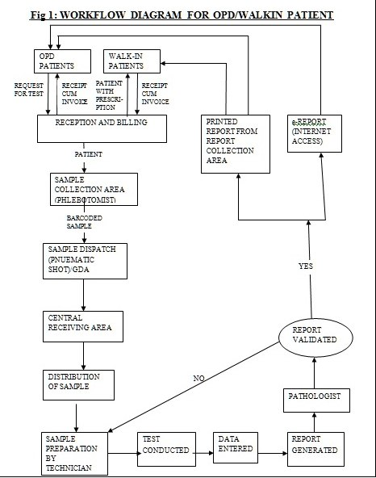

Slide 17
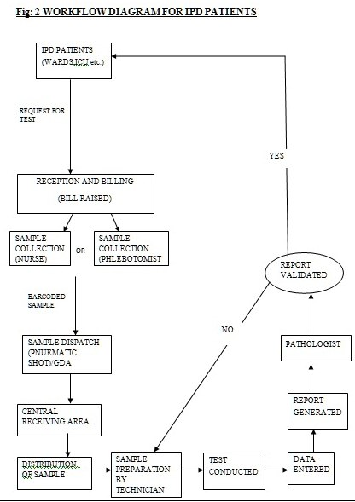

Slide 18
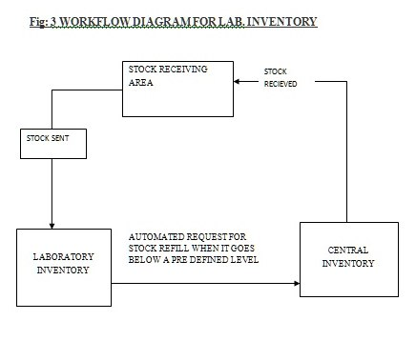

Slide 19
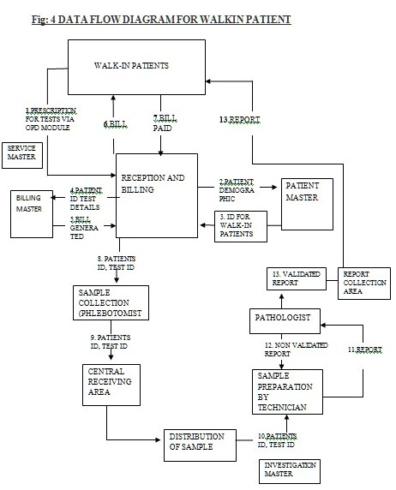

Slide 20
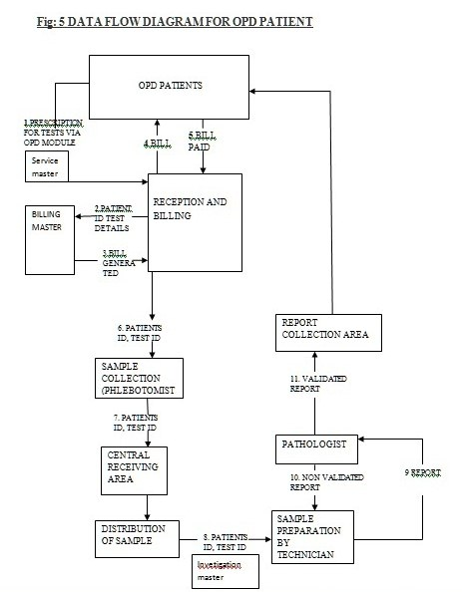

Slide 21
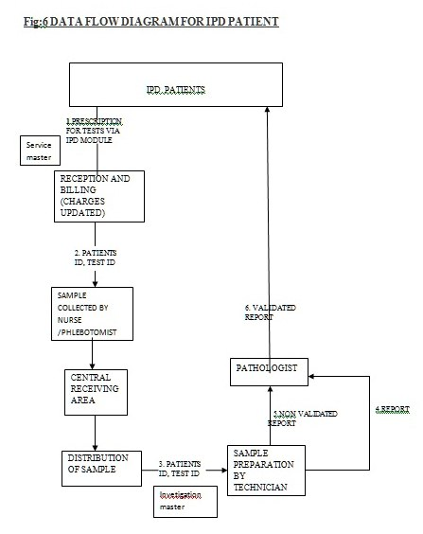

Slide 22
LABORATORY INFORMATION MANAGEMENT SYSTEM FLOW-

Slide 23
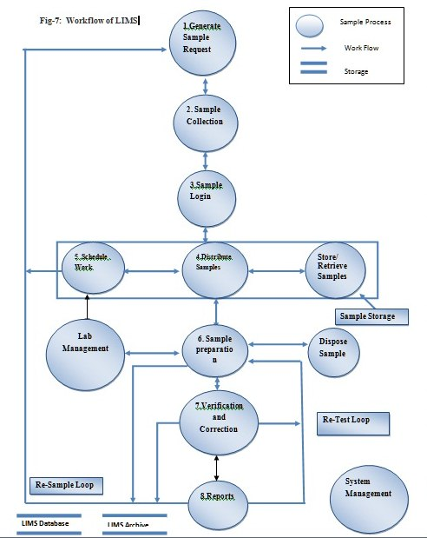

Slide 24
DETAILED LABORATORY MANGEMENT SYSTEM FLOW IN JAYPEE HOSPITAL-

Slide 25
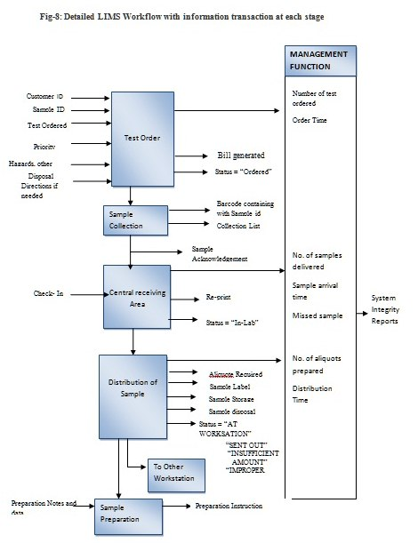
PRE-ANALYTICAL PHASE

Slide 26
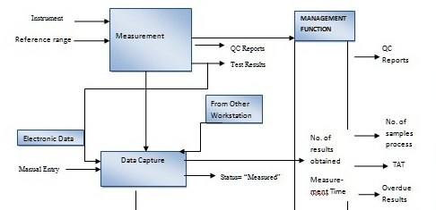
ANALYTICAL PHASE

Slide 27
POST-ANALYTICAL PHASE

Slide 28
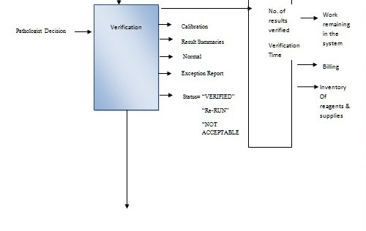
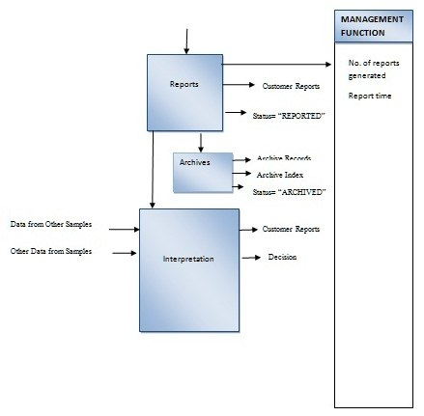

Slide 29
Data sheet
Recommendation

Slide 30
ADDITIONAL FEATURES
1. REQUEST GENERATION AND LABELS-
Should provide the provision so that collection label is printed on user definable format
Provide a test catalogue and specimen handling instructions with the option to print on labels
2. Provision for recording the sample dispatch report
3. SAMPLE DISTRIBUTION
Should provide the provision for Chain of custody function to have chronological record of a sample or evidence, including its collection, preservation, transportation, transfers, analysis and final disposal to ensure data integrity, security and compliancy.
Should have the ability to route specimens to specific racks and instruments.

Slide 31
Provision for keeping the record on sample storage and recovery tracking.
5 . SAMPLE ACKNOWLEDGEMENT
6. RESULT ENTRY- ENTERING DATA AND INFORMATION
Interface with bi-directional diagnostic equipment.
System should be able to support for POINT-OF-CARE TESTING (POCT) devices like bed side monitors, Computer On Wheel , palm tops or ipads etc.
7. REVIEWING AND APPROVING RESULT-
Provision for notification for SMS after generation of report.
SMS alert for reporting critical values to ordering physician and/or supervising medical officer based on standard operating procedure.
Provide bolding and font options and image.

Slide 32
8. MICROBIOLOGY
Track suspected nosocomial infections e.g. SSI,HAI and UTI
9. MANAGING LAB OPERATIONS
Inventory Management
System should be able to generate indents for laboratory consumables
Ability to track consumption of reagent and making auto self consumption entries based on volumes and load factor of each equipment run.
Ability to request equipment servicing (PM)and report failures to bio-medical department. Generate maintenance & repair issue ticket, tracking, escalation and resolution of the same (Issue management lifecycle)
User-defined delta check limits based on percentages and absolute limits by age and sex.
Essential reagents are highlighted when less in stock

Slide 33
10. INFORMATION ACCESS ONLINE
system should have the ability to access SOPs online.
Development of web portal system for patients so that they can view and print report of their own.

Slide 34
LIMITATION OF THE STUDY
Data collected on the basis of informal discussion with various professionals.
Information bias: Considering the competitive nature of the health sector respondents might have not provided the adequate and right information.
Time constraint – the time was short for conducting scientific market research on prevailing LIMS system in various hospitals.
In absence of HIS in the hospital the study assumed the case of ideal information system for a hospital.

Slide 35
REFRENCES
Christine Flaherty, MHA, MT(ASCP), CPHQ : Implementing A Quality Management System For The Laboratory available on http://www.n.cdc.gov/cliac/pdf/Addenda/cliac0208/Addendum%20T.pdf
Mcdowall, R.D. A Matrix for the Development of a Strategic Laboratory Information Management System. Analytical Chemistry Vol 69– (Oct 1993)
McLelland, Alan "What is a LIMS - a laboratory toy, or a critical IT component? (1998).
Christine Paszko, Ph.D “How Can a LIMS Needs Assessment Save the Laboratory Money” ( August 2009) available on http://www.atlab.com/docs/How%20Can%20a%20LIMS%20Needs%20Assessment%20Save%20the%20Laboratory%20Money.pdf

Slide 36

THANK YOU

