Slide 1

"Identifying and Addressing Operational Gaps in Gastroenterology Department Services within a Multispecialty Hospital"
Faculty Mentor-
Dr Sumesh Kumar
IIHMR Delhi
Submitted By-
Dr Alisha Shandilya
PG/23/012

Slide 2
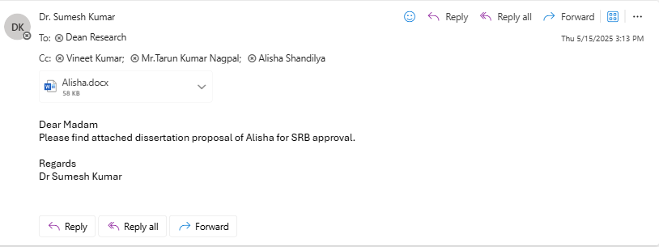
Mentor Approval

Slide 3
Introduction
Gastroenterology (GI) services in multispecialty hospitals often face coordination challenges due to the complex interplay between outpatient services, inpatient care, and procedural duties. In many cases, consultants are overburdened and their time poorly synchronized across departments. This results in long patient waiting times, delayed procedures, and staff burnout. The absence of a centralized, real-time scheduling system exacerbates these issues, especially when multiple specialists (e.g., anesthetists) are required simultaneously. By identifying these operational gaps and implementing an integrated scheduling model, hospitals can potentially improve efficiency, patient satisfaction, and care outcomes.

Slide 4
Objectives
To assess the current workflow in the Gastroenterology department, including OPD consultations, inpatient rounds, and procedural scheduling, through systematic data collection and analysis.
To identify key operational pain areas contributing to patient waiting times, scheduling conflicts, and delayed procedures.
To develop and implement an integrated scheduling model that aligns the availability of consultants, anesthetists, and support staff to streamline patient care across OPD, procedural, and inpatient services.
To evaluate the impact of the integrated scheduling model on:
Patient waiting times for consultations and procedures
Doctor consultation and procedural efficiency
To provide data-driven recommendations for sustainable workflow improvements that enhance patient satisfaction, reduce burnout among healthcare staff, and improve overall departmental efficiency.

Slide 5
Methodology (1/2)
● For pre implementation phase data is collected from 15 March to 15 April. For post implementation phase data is collected from 16 April to 15 May.
● Based on identified key pain areas and workflow inefficiencies, targeted strategies were developed.
Data was collected on:
● Patient waiting time (for OPD and procedures)
● Doctor consultation time

Slide 6
Data sources (manual entry in registers)included patient records of Appointment time ,patient-in time for consultation and procedures, Dr in-time for consultation and procedures, and consultation schedules

Slide 7

Methodology (2/2)
Study design : Prospective observational study.
Study area : Gastroenterology Department of a multispecialty hospital.
Sampling method : Simple random sampling.
Sample size : To determine the sample size (as per NABH) statistical power of 44%, level of significance set at 0.05 with screening population of 500 were used.
(where n=Number of samples, N=Total population and e=error tolerance)
By using this formula the sample size is calculated:
n=500/1+500(0.0025)
=500/2.25 ≈222.2

Slide 8
Data Collection Tools:
Custom-designed Excel sheets capturing variables such as:
● Doctor name and consultation timing
● Patient arrival and departure times
● Average consultation and waiting durations
Purpose- Evaluate doctor scheduling efficiency.
Identify discrepancies between appointment and actual consultation times.
Analyze waiting times to improve patient experience.

Slide 9
Variables covered-
Variables Description | Variables Description
Date | Date Of the patient visit.
Doctor Name | Doctor Name The consulting doctor for the patient.
Walk-in | Walk-in Time of arrival for patients without an appointment.
Appointment | Appointment Time of arrival for patients with an appointment.
IN Time | IN Time Actual time the patient entered the consultation room.
OUT Time | OUT Time Actual time the patient exited the consultation room.
Waiting time | Waiting time =(Walk-in time or appointment time)-(IN time)
Consulting time | Consulting time =(IN time) –(OUT time)

Slide 10
Method of Data Collection:
Secondary Data Collection: Appointment registers,patient assessment registers,consultation timings.
● Data was triangulated through staff interaction, departmental protocols, and clinical notes to validate findings.
Expected Outcomes:
● Significant decrease in average OPD and procedure-related waiting times due to better scheduling and coordination among consultants, anesthetists, and support staff.
● Enhanced allocation of doctor time across OPD, inpatient rounds, and procedural duties
● Faster TAT for consultations and procedures leading to better patient experience and potentially higher patient retention.

Slide 11
Key pain areas | Reason
Dr Consultation delay | Dr punch in timings Dr on floor rounds Procedures in between OPD
FIC | On the 4th floor. No proper detailing about the procedure and additional charges
PAC | Anesthetist is not available permanently in department.
Patient shift from IPD to recovery room | No GDA staff present there at the time of shifting
Procedure | Anesthetist is not available permanently in department. Dr consulting the OPD /Appointment patients
Discharge summary preparation to approval time | Doctor is consulting the patient or in between procedure, so discharge summary approval takes time.

Slide 12
OBSERVATIONS
  Appointments start at 10:00 AM, but doctors are generally available only from 10:30 AM.
  IPD rounds begin at 9:00 AM, overlapping with OPD hours and causing delays for appointment patients.
  Doctors frequently go for procedures during OPD hours and vice versa, leading to disruptions in patient flow.
  No planned procedure scheduling system which affect coordination and resource planning.

Slide 13
Suggestions | Implementation
Doctors timing should be scheduled. | Doctors started to consult 5 days a week. 8:30AM-10:00AM(IPD rounds) 10:00AM-11:00AM(Procedures) 11:00AM-02:00PM(OPD consultation) 02:00PM-04:00PM(Procedures) 04:00PM-05:30PM(OPD consultation)
Anaesthetist should be permanently available | LTP Anaesthetists started to cover the department.
A scheduler should be there in where comprehensive list of planned procedures must be made available to consultants, anesthetist, pediatrician, nurses, technicians, FIC persons and coordinators at least one day in advance. This ensures all involved personnel are well-prepared and aligned for the upcoming schedule. | A google drive Excel spread sheet is now maintained by the Nursing staff which is updated on daily basis one day before to all the concerned staff and it helps to make sure that everyone is present on time.
Patients scheduled for procedure should be contacted via telephone one day prior to confirm their booking and provide any necessary instructions or preparation details. | Nursing staff calls the patients one day before in advance to ensure their presence at the time of procedure.
Doctors should be advised to give discharge approval at regular interval of time like 30 min or 1 hr. gap. They have to review from the HIS and give approval. | JRs gets the discharge summary approved at the interval of 30 minutes in between the OPD consultations of Doctors to ensure the timely discharge of patient.

Slide 14
Results (Pre Implementation)
 | AVG CONSULTING TIME
 | March-April
 | appointment patients | walk in patients
Dr A | 00:08:50 | 00:07:45
Dr B | 00:15:43 | 00:18:44
Dr C | 00:14:00 | 00:16:27
Dr D | 00:12:16 | 00:12:38
 | Avg waiting time
 | March -April
 | appointment patients | walk in patients
Dr A | 01:00 | 01:27
Dr B | 00:42 | 01:11
Dr C | 00:52 | 01:40
Dr D | 00:44 | 00:52

Slide 15
Results (Post implementation)
 | Average consultation Time
 | April-May
 | Appointment patients | Walk in patients
DR A | 00:10 | 00:10
DR B | 00:18 | 00:18
DR C | 00:13 | 00:16
DR D | 00:10 | 00:10
 | Average waiting Time
 | April-May
 | Appoint patients | Walk in patients
DR A | 00:33 | 01:03
DR B | 00:40 | 01:20
DR C | 00:34 | 00:57
DR D | 00:30 | 00:49

Slide 16
Results (3/3)
COUNT OF PROCEDURES
 | JAN | FEB | MAR | APRIL | MAY
UGIE | 115 | 91 | 98 | 123 | 151
Colonoscopy | 39 | 31 | 37 | 41 | 67
ERCP | 17 | 10 | 16 | 41 | 43
Sigmoidoscopy | 20 | 19 | 15 | 18 | 36
Fibro scan | 40 | 48 | 42 | 70 | 59
TOTAL | 231 | 199 | 208 | 293 | 356

Slide 17
Discussion (1/2)
KEY PAIN AREAS | BEFORE | AFTER
FIC | ON 4TH FLOOR | ON 6TH FLOOR TILL 1:30 PM
PAC | Anesthetist is not available permanently in department. | LTP anesthetist are available
Patient shift from IPD to recovery room | No GDA staffs available. | GASTRO IPD shifted to 6th floor
Procedure | Procedure getting delayed due to lack of anesthetist | LTP anesthetist are covering the gastro department
Discharge summary preparation to approval time | Doctor is consulting the patient or in between procedure, so discharge summary preparation takes time. | JR’s preparing the discharge summary Consultant reviewing the summary and approving it
Scheduler | No Scheduler | Scheduler is prepared and everyone is pre informed regarding the procedures.

Slide 18
Discussion (2/2)
The study revealed critical inefficiencies in the scheduling and operational coordination within the Gastroenterology department.
Before intervention:
OPD appointments were scheduled from 10:00 AM, but doctors generally arrived by 10:30 AM.
IPD rounds started at 9:00 AM, overlapping with OPD hours, causing consistent delays.
Doctors were frequently required to switch between OPD and procedural duties without a defined system, disrupting patient flow and consultation efficiency.
There was no centralized or real-time scheduling system in place to coordinate among consultants, anesthetists, and support staff.

Slide 19
After Intervention-
A major change following the intervention was an increase in doctor consultation days—from 2–3 days per week to 5 days per week. This change had multiple downstream effects:
Higher patient throughput, as more consultation slots became available.
Reduced patient waiting times, due to better distribution of patient load across the week.
Improved patient satisfaction, linked directly to quicker access to care and smoother service flow.
The introduction of an integrated scheduling model further streamlined workflows and allowed for better alignment of resources.

Slide 20
Conclusion
The operational changes—particularly the expansion of doctor availability and the adoption of an integrated scheduling system—resulted in:
A significant reduction in patient waiting times for both OPD consultations and procedures.
Increased patient volume, as extended consultation days accommodated more patients.
Higher patient satisfaction scores, driven by timely service delivery.
Improved utilization of medical staff, minimizing downtime and overlapping duties.
Better coordination across services, ensuring that consultants, anesthetists, and support teams operated in a more synchronized manner.
These improvements demonstrate that strategic scheduling and workflow redesign can substantially enhance departmental efficiency, reduce staff burden, and elevate the overall patient experience.

Slide 21
References (Only Vancouver Style)
1. Lee TH, Regenstein F, Alford TB. Procedure Time Analytics: Leveraging Data to Improve Endoscopy Unit Efficiency. Clin Gastroenterol Hepatol. 2023;21(3):514–519.
2. EnvisionNext. Procedure timing analytics [Internet]. EnvisionNext. Available from: https://envisionnext.net/procedure-timing-analytics
3. National Accreditation Board for Hospitals & Healthcare Providers. NABH 5th edition guidebook [Internet]. Scribd. Available from: https://www.scribd.com/document/687148981/NABH-5th-Edition-Guidebook

Slide 22
INVOLVEMENT IN COMMUNITY OUTREACH PROGRAMME (COP) ACTIVITIES
Total no. of visits done by the Student: 10
Day-wise activities done by the student:
Mapping and listing of the area
Interaction with community Frontline Health Workers(ASHAs,ANMs) and community people.
Exposure of how to do Survey and Data collection in a community.
Asked them about the family members,Housing conditions(Kuttcha/Pakka House)were observed, measured their height, weight and BP asked about no. of family members and their source of income also if any member is having chronic disease they are suffering from and for how long or if they are taking any treatment or not.
Where they go for health check up.
Source of water(if suppiled by government or not)
Drainage system.

Slide 23
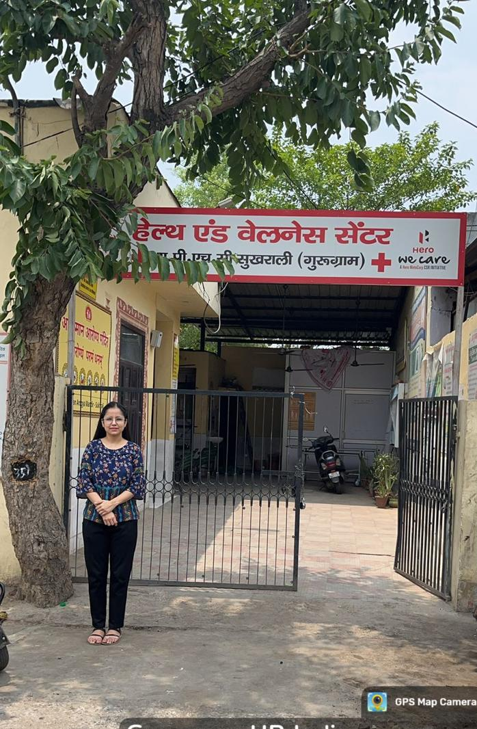
COP FIELD ACTIVITIES PHOTOGRAPHS

Slide 24
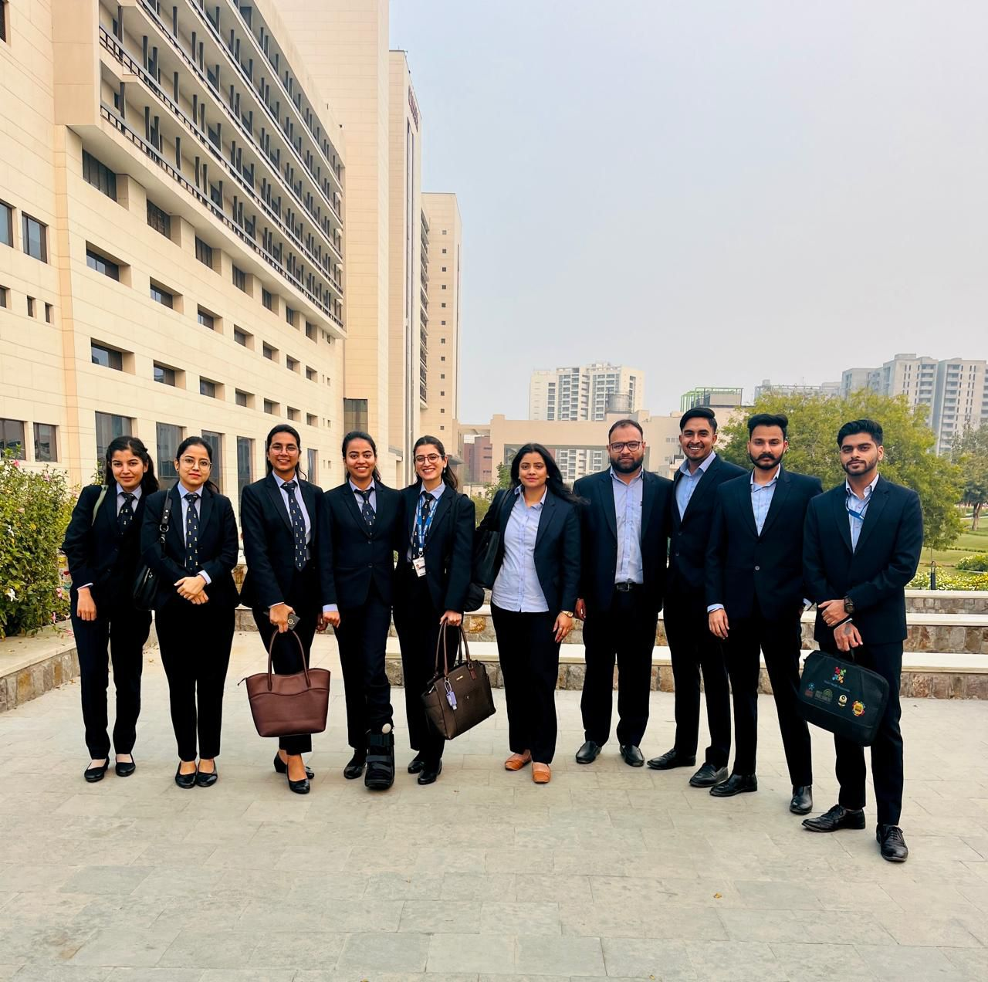
Pictorial Journey (1/2)
Amrita Hospital , Faridabad

Slide 25
Thank You

