Slide 1

Assessment of Heavy Metals in Drinking Water in Delhi, India
Presented by:- Rahul Prakash
PG/22/85
Mentor :- Dr. Ratika Samtani

Slide 2
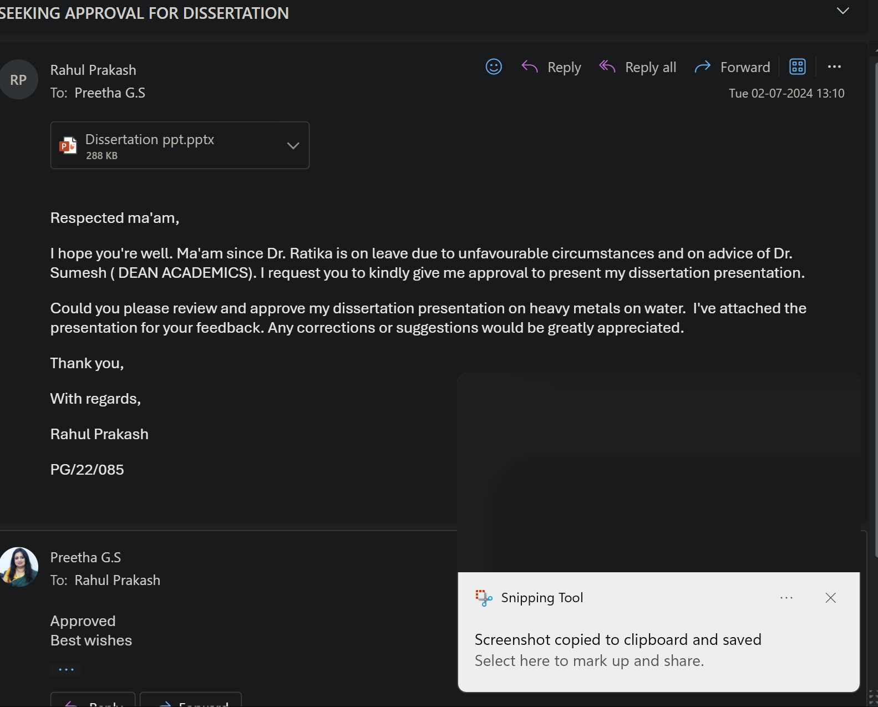
Mentor Approval

Slide 3
Introduction
Water pollution is a serious public health issue, contributing to 2 million yearly fatalities and depriving 1 billion people of access to safe drinking water (WHO, 2022). (Gleick, 2003). Because of their toxicity and endurance, heavy metals such as arsenic, chromium, copper, cadmium, nickel, zinc, and lead present serious concerns (Tchounwou, 2012). Human exposure to these metals has increased due to industrial processes and energy creation, frequently beyond permissible levels in drinking water (Rehman, 2017).
According to Tchounwou (2012), these metals are carcinogenic, harm several organs, and cause birth problems. They have no good effect on human health. Drinking tainted water is the primary source of exposure, and some metals can bioaccumulate in the body and raise the risk of cancer and other illnesses. While industrial exposure at work certainly has a role, drinking water is still the primary source.
Cardiovascular diseases, brain damage, kidney problems, and an increased risk of diabetes and cancer are among the health effects. For the sake of public health worldwide, heavy metal poisoning in drinking water must be addressed.

Slide 4
Objectives of Study
Primary Objective
To evaluate the concentrations of heavy metals in drinking water samples taken from different parts of Delhi NCR.
Secondary Objective
To compare the levels of heavy metals with national and international standard
To identify the potential health risks associated with detected levels.
To provide recommendations for mitigating heavy metal contamination.

Slide 5
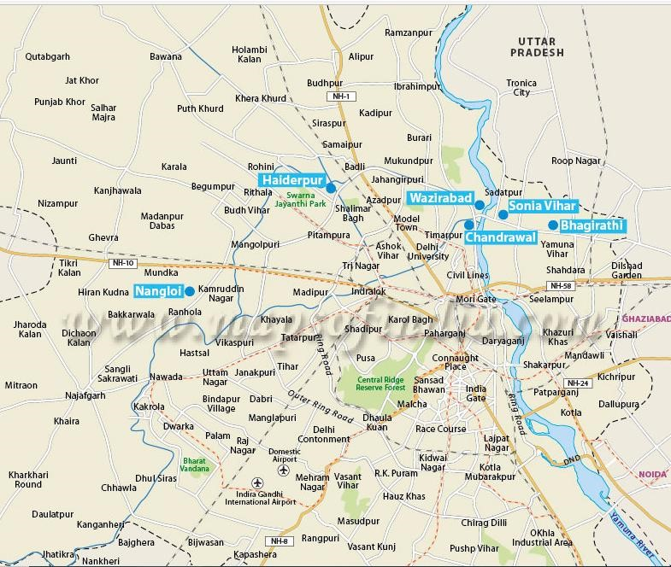
Methodology
Study Design: Cross-sectional study involving sample collection and analysis.
Study Area: Select locations across Delhi NCR representing diverse demographics and potential contamination sources. Dwarka, Sadatpur, Shahdra and Mundka.

Slide 6
Methodology
Study population
Residents drinking water from various sources (e.g., bore wells, municipal supplies, and bottled water).
Sample Size and Sampling
41 Sample size will calculated based on desired statistical power and population distribution. Convenient sampling will be used.
Study Variables
Independent variable: Heavy metal concentration in water samples (e.g., arsenic, lead, chromium)
Dependent variable: Potential health outcomes (self-reported through surveys)

Slide 7
Methodology
DATA COLLECTION TOOLS AND TECHNIQUES
Water Sample Collection Equipment: This will involved using sterile containers, the right preservation technique, and the right labeling to ensure identification.
Surveys: Residents were asked to complete standardized questionnaires with questions on their drinking water source, any possible health problems they may be having, and any other relevant behavioral or demographic data.
DATA ANALYSIS:
By MS Excel and SPSS

Slide 8
Results
Levels of heavy metals with national and international standards
 | Heavy metals | Desirable | permissible
 | CaCO3 (Mg/L)-600mg/L | 300 | 600
 | Chloride (Mg/L)-200-300 | 250 | 1000
 | Cu (Mg/L)-2 | 0.05 | 1.5
 | Total Iron as Fe | 0.3 | 1
 | Mn (Mg/L)-0.4 | 0.1 | 0.3
 | Sodium as Na |  | 200
 | S04 (mg/L)-250 | 200 | 400
 | Zinc as Zn (mg/l)-5 | 5 | 15
 | Ca (Mg/L)-100-300 | 75 | 200
 | Mg (Mg/L)-50 mg/l | 30 | 100
 | K(Mg/L)-12mg/l
 | Phosphorous(Mg/L)-1mg/L |  | 1
 | As (Mg/L)-0.01 | 0.05 | 0.01
 | Cd (Mg/L)-0.003 | 0.01
 | Chromium as Cr6+ (Mg/L)-0.05 |  | 0.05
 | F (Mg/L)-1.5 | 1 | 1.5
 | Lead (Mg/L) -0.01 | 0.05
 | Hg (Mg/L)-0.006 | 0.001

Slide 9
Sources of Drinking Water
SOURCE OF WATER | Frequency | Percent | Valid Percent | Cumulative Percent
 |  | 14.6 | 14.6 | 14.6
BISLARI | 2 | 4.2 | 4.2 | 18.8
 |  | 2.1 | 2.1 | 20.8
Ground water | 7 | 12.5 | 12.5 | 33.3
RO | 14 | 29.2 | 29.2 | 62.5
RO ( WASTE WATER ) | 5 | 10.4 | 10.4 | 72.9
SUPPLY | 9 | 18.8 | 18.8 | 91.7
TANKER | 4 | 8.3 | 8.3 | 100.0
 |  | 100.0 | 100.0

Slide 10
The concentrations of heavy metals in drinking water samples
 | CaCO3 (Mg/L)-600mg/L | Chloride (Mg/L)-200-300 | Cu (Mg/L)-2 | Total Iron as Fe | Mn (Mg/L)-0.4 | Sodium as Na | S04 (mg/L)-250 | Zinc as Zn (mg/l)-5 | Ca (Mg/L)-100-300 | Mg (Mg/L)-50 mg/l | K(Mg/L)-12mg/l | Phosphorous(Mg/L)-1mg/L | As (Mg/L)-0.01 | Cd (Mg/L)-0.003 | Chromium as Cr6+ (Mg/L)-0.05 | F (Mg/L)-1.5 | Lead (Mg/L) -0.01 | Hg (Mg/L)-0.006
Desirable | 300 | 250 | 0.05 | 0.3 | 0.1 |  | 200 | 5 | 75 | 30 |  |  | 0.05 | 0.01 | 0.05 | 1 | 0.05 | 0.001
permissible | 600 | 1000 | 1.5 | 1 | 0.3 |  | 400 | 15 | 200 | 100 |  |  |  |  |  | 1.5
Mean | 79.707 | 64.376 | .004232 | .0993 | .0286449 | 3.6132 | 25.9151 | .4332 | 9.429 | 15.944 | 1.451 | 1.0917 | .000093 | 0.0000 | .008783 | .2551 | .001785 | 0.000000
Median | 28.000 | 24.400 | .001300 | .0300 | .0015000 | .9000 | 10.2000 | .1400 | 2.800 | 5.400 | .500 | .2000 | 0.000000 | 0.0000 | 0.000000 | .0900 | 0.000000 | 0.000000
Std. Deviation | 119.3363 | 96.3738 | .0089785 | .12545 | .10311259 | 6.00195 | 37.67749 | .58377 | 14.7159 | 22.4376 | 2.3364 | 1.82363 | .0003357 | 0.00000 | .0437964 | .34911 | .0060520 | 0.0000000
Range | 510.0 | 410.8 | .0400 | .47 | .53900 | 24.16 | 161.68 | 2.17 | 68.5 | 96.9 | 8.8 | 6.80 | .0014 | 0.00 | .2800 | 1.54 | .0280 | 0.0000
Minimum | 6.0 | 3.4 | .0010 | .01 | .00100 | .04 | .12 | .10 | .9 | .2 | .1 | 0.00 | 0.0000 | 0.00 | 0.0000 | .02 | 0.0000 | 0.0000
Maximum | 516.0 | 414.2 | .0410 | .48 | .54000 | 24.20 | 161.80 | 2.27 | 69.4 | 97.1 | 8.9 | 6.80 | .0014 | 0.00 | .2800 | 1.56 | .0280 | 0.0000

Slide 11
The potential health risks associated with detected levels
Disease | Percentage
Typhoid | 49
Dysentry | 23
Diarrhea | 65
cholera | 32
Gastroenteritis | 13

Slide 12
Discussion
Calcium: All samples have low concentration and below desirable limits, low calcium levels in drinking water may not directly impact health but can contribute to insufficient dietary intake, potentially increasing the risk of osteoporosis and bone-related disorders over time. Adequate calcium intake is essential for maintaining bone health, particularly in populations with already low dietary calcium sources.
Phosphorous: 18 percent of our samples are above high phosphorus levels in water can promote harmful algal blooms, which produce toxins harmful to human health and ecosystems. Exposure to these toxins through contaminated water can cause skin irritation, gastrointestinal issues, and liver damage. It can also lead to oxygen depletion, threatening aquatic life and ecosystems.
Magnesium: 83 percent of samples have low magnesium levels in drinking water can lead to muscle cramps, fatigue, and irregular heart rhythms. Chronic deficiency may increase the risk of cardiovascular diseases like hypertension and heart disease. Magnesium is crucial for nerve function, muscle health, and overall cardiovascular well-being, highlighting the importance of adequate intake.

Slide 13
Discussion
Fluoride: 93% of samples have low fluoride levels in drinking water can increase the risk of dental cavities, as fluoride helps strengthen tooth enamel and prevent decay. Insufficient fluoride intake can lead to higher dental treatment costs and oral health issues, particularly in children and communities without access to other fluoride sources. 1 sample have High fluoride levels in drinking water can cause dental fluorosis, characterized by discoloration and pitting of tooth enamel. Prolonged exposure can lead to skeletal fluorosis, resulting in joint pain and bone deformities. Excessive fluoride intake is particularly harmful to children, affecting tooth and bone development.
Zinc: All samples have low zinc levels in drinking water can lead to weakened immune function, slower wound healing, and impaired taste and smell. Zinc deficiency can also affect growth and development in children, increase susceptibility to infections, and cause skin issues like dermatitis. Adequate zinc is essential for overall health and well-being.

Slide 14
Conclusion
This study highlights the urgent need to address heavy metal contamination in Delhi NCR's drinking water. The detected levels of calcium, magnesium, fluoride, and zinc are below safe limits, And the amount of phosphorus and fluoride has exceeded safe limits posing severe health risks to residents. The high prevalence of waterborne diseases further emphasizes the critical nature of this issue.
Immediate actions are required, including:
Regulatory Measures: Implement and enforce stringent regulations on industrial waste disposal.
Regular Monitoring: Conduct regular and comprehensive monitoring of water quality.
Public Awareness: Educate the public on safe drinking water practices.
Purification Technologies: Develop and deploy effective water purification technologies.
These steps are essential to ensure safe drinking water and protect public health in Delhi NCR.

Slide 15
References (Only Vancouver Style)
1.Ajmal M, Uddin R. Quality of drinking water in the Aligarh Muslim University Campus, Aligarh, U.P. (India) with respect to heavy metals. Environ Monit Assess. 1986 Mar;6(2):195-205. doi: 10.1007/BF00395630. PMID: 24254648.
2. Bajwa BS, et al. Uranium and other heavy toxic elements distribution in the drinking water samples of SW-Punjab, India. Journal of Radiation Research and Applied Sciences. 2017;10(1):13–9.
3. Bhardwaj R, Gupta A, Garg JK. Evaluation of heavy metal contamination using environ-metrics and indexing approach for River Yamuna, Delhi stretch, India. Water Sci. 2017; 31: 52–66. https://doi.org/10.1016/j.wsj.2017.02.002
4. Edition F. Guidelines for drinking-water quality. WHO chronicle. 2011; 38(4):104–8.
5. EPA. Edition of the Drinking Water Standards and Health Advisories. 2012: EPA 822-S-12-001. Washington, DC: Office of Water U.S. Environmental Protection Agency; 2012.
6. Gleick, P. H. Global freshwater resources: soft-path solutions for the 21st century. Science 2003, 302, 1524– 1528, DOI: 10.1126/science.1089967

Slide 16
Thank You

