Slide 1










Awareness of Biomedical Waste Management Among Hospital Staff
Presented by: Priyanka Barik
Under guidance of : Dr. Preetha G.S
IIHMR Delhi

Slide 2
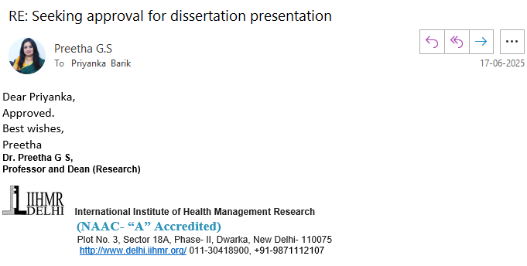



Mentor’s Approval

Slide 3

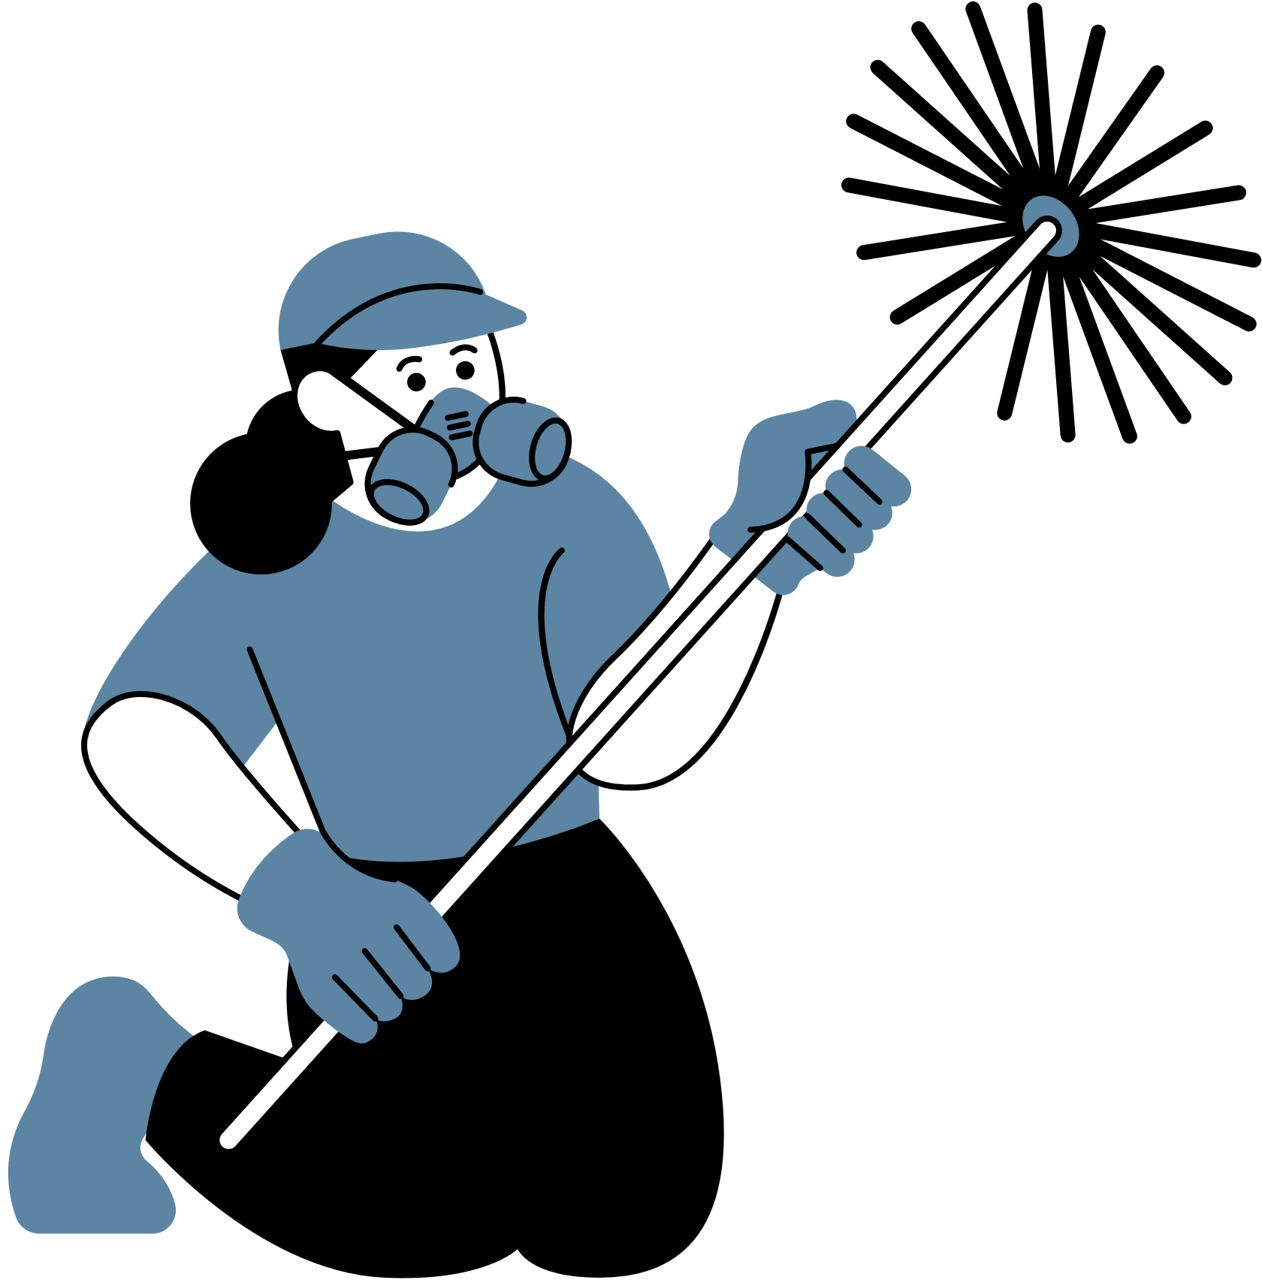
Introduction
Biomedical Waste (BMW) refers to any waste generated during the diagnosis, treatment, or immunization of humans, including sharps, infectious materials, and chemical waste.
Improper handling of BMW poses serious risks to healthcare workers, patients, waste handlers, and the environment, including infection transmission, injuries, and pollution
Hospital staff play a crucial role in biomedical waste segregation, storage, transport, and disposal — making their awareness and adherence to protocols essential for safety and compliance
This presentation evaluates the level of awareness among hospital staff, highlights gaps in knowledge and practices, and emphasizes the importance of regular training and strict implementation of BMW rules.

Slide 4


Objectives of the study
To assess the awareness and knowledge of hospital staff regarding Biomedical Waste Management (BMWM) rules, guidelines, and disposal practices
To evaluate the current waste segregation and disposal practices followed by different categories of hospital staff, including doctors, nurses, technicians, and housekeeping personnel
To recommend strategies for improving BMW management practices in the hospital, including training interventions, policy enhancements, and infrastructure improvements.
To identify gaps and challenges faced by hospital staff in implementing proper biomedical waste disposal.

Slide 5


Data & Methodology
Study Population
Study Design
The study includes healthcare professionals and support staff directly or indirectly involved in biomedical waste management, such as:
· Doctors
· Pharmacist
· Nurses
· Laboratory Technicians
· Housekeeping Staff
· Administration
· PCC Staff
This study is a cross-sectional, descriptive study conducted among the hospital staff of 450- bedded multi speciality Hospital in Faridabad to assess their awareness, knowledge, and practices regarding biomedical waste management (BMWM).

Slide 6

Data & Methodology
Sample Size & Sampling Method
Data Collection Method
A random sampling or stratified sampling approach has been used to ensure equal representation from different departments. The sample size has been determined based on hospital staff availability and statistical requirements for reliability.
Calculated sample size- 250
Achieved Sample size- 211
· Primary Data:
o A structured questionnaire has been used to collect data on awareness, knowledge, and practices related to BMWM.
o Face-to-face interviews with staff
o Observational study in hospital wards and waste disposal areas to verify compliance with BMWM guidelines.

Slide 7
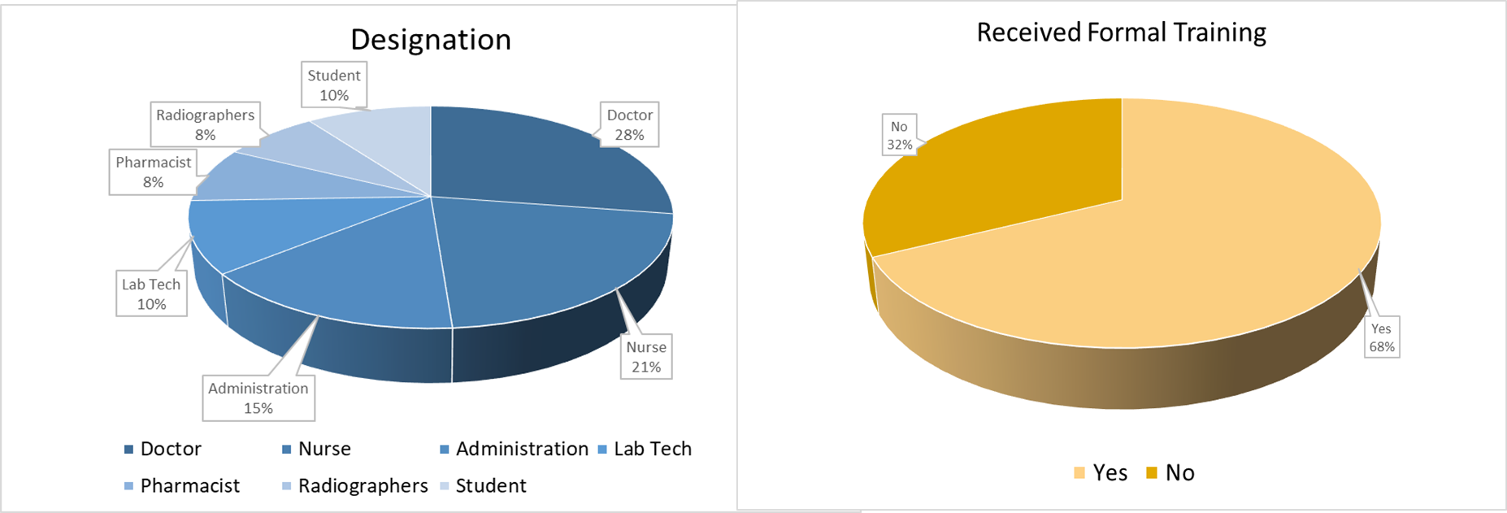
Result

Slide 8
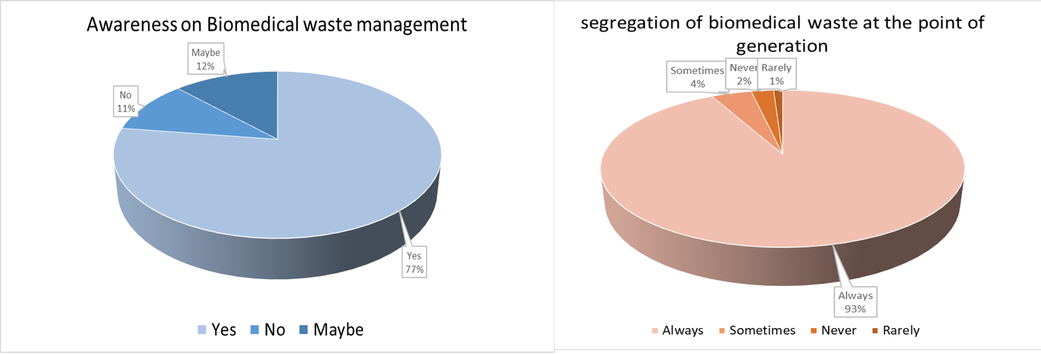
Result

Slide 9
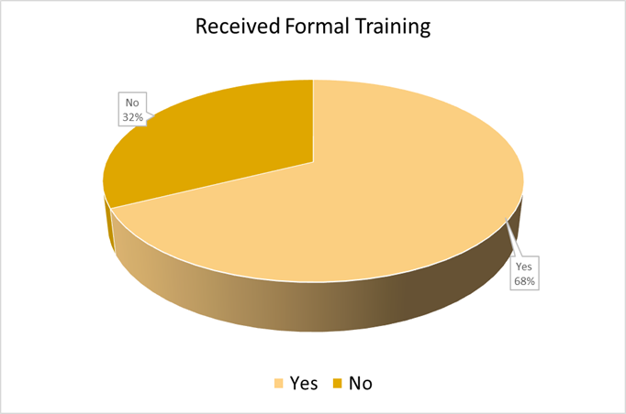
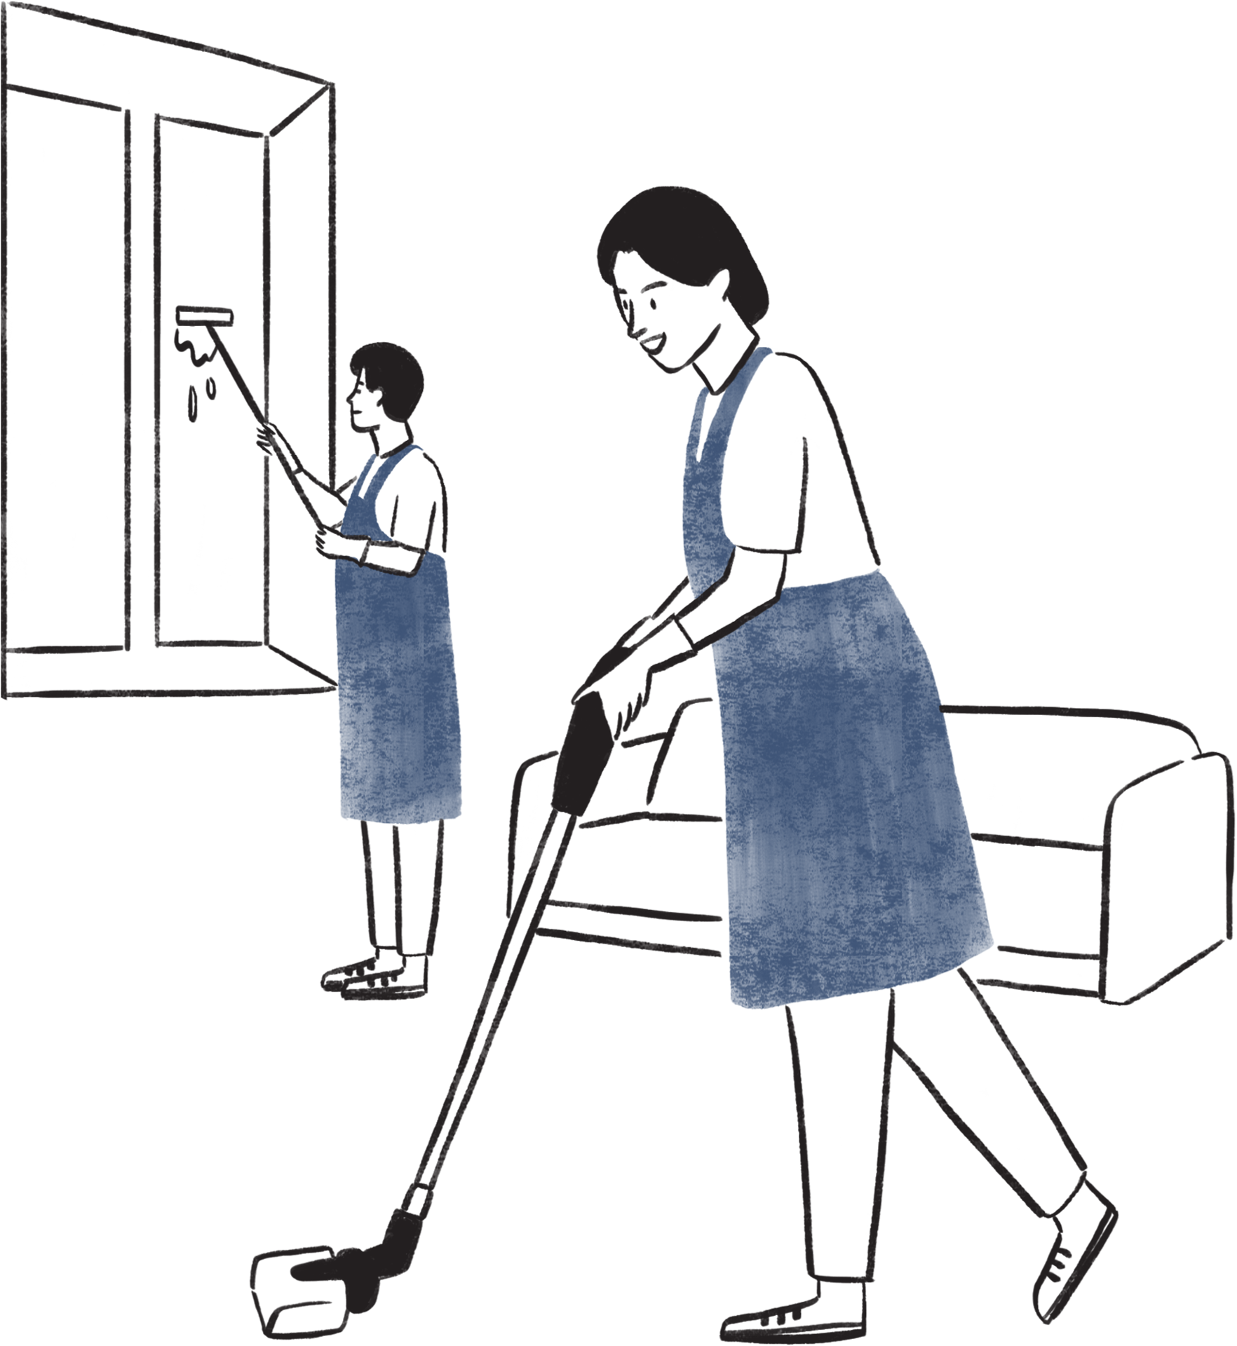
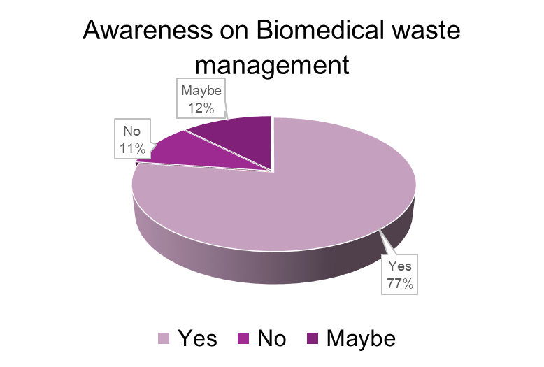
Result
Training & Awareness
•Received Formal BMWM Training:
•Yes: 143 (68%)
•No: 68 (32%)
Awareness of BMWM Rules (2016):
•Yes: 163 (77%)
•Maybe: 26 (12%)
•No: 22 (10%)
Need for Additional Training
•Yes: 125 (59%)
•No: 79 (37%)
•Unclear/Missing: 6

Slide 10
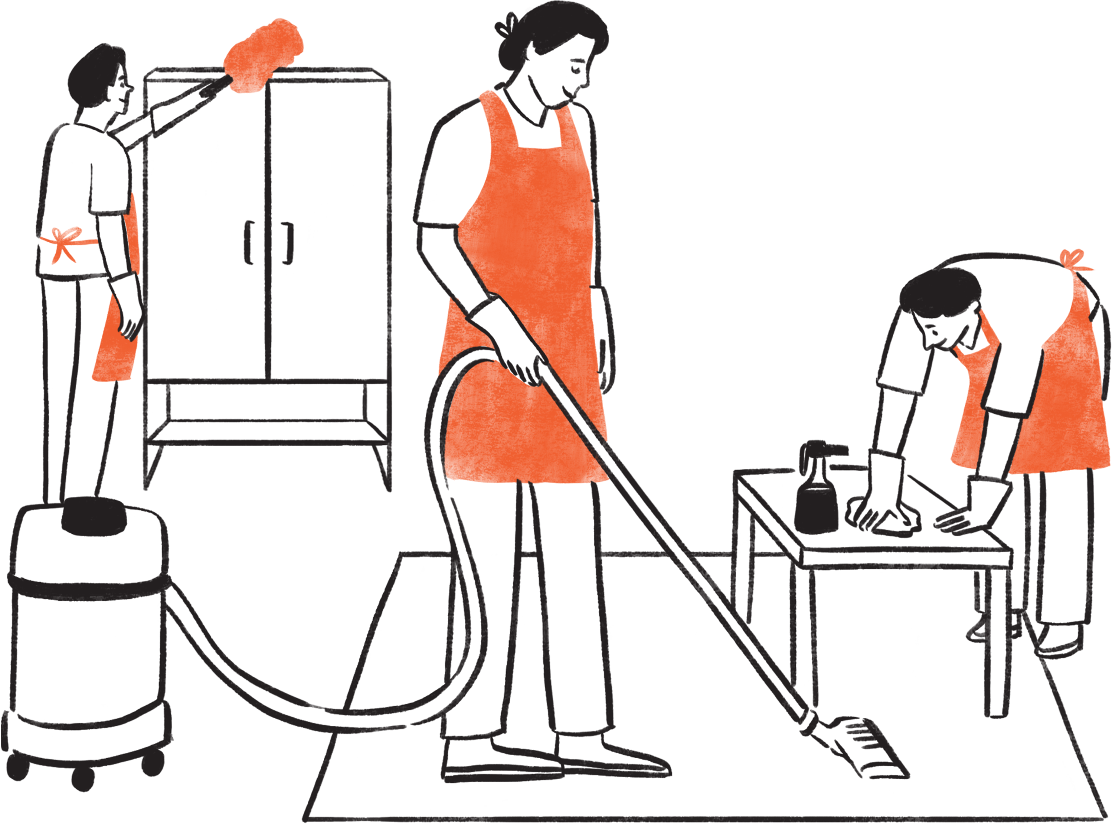
Result
Waste Disposal Practices
•Frequency of Waste Disposal:
•Every Shift: 69
•Once a Day: 63
•After Every Procedure: 46
•Not Sure: 27
Segregation at Point of Generation:
•Always: 143
•Sometimes: 37
•Rarely/Never: 25
Use of Personal Protective Equipment (PPE):
•Always: 152
•Sometimes: 28
•Rarely/Never: 25
Sharps Disposal:
•Puncture-proof Container: 179 (85%)
•Others (e.g., plastic bags or not sure): 26
•Missing/invalid: 6

Slide 11






Discussion
Gaps and challenges faced by hospital staff in implementing proper biomedical waste disposal
-Lack of Adequate Training and Awareness
Gap: Many staff members, especially housekeeping and support staff, are not formally trained in BMWM protocols.
Challenge: Inconsistent understanding of color coding, segregation procedures, and handling techniques.
-Improper Segregation at Source
Gap: Biomedical waste is often mixed with general waste, especially in wards or OPDs.
Challenge: Staff may dispose of items incorrectly due to time pressure or lack of supervision.
-Irregular or Infrequent Training Programs
Gap: Training is often one-time or infrequent; new staff may not be oriented properly.
Challenge: Continuous lapses in compliance, especially with changing guidelines.

Slide 12
Discussion
  The study shows 77% of hospital staff were aware of BMWM Rules (2016), and 68% had received formal training, which is comparable to findings from Pandit et al. (2007) where awareness was relatively high in tertiary hospitals but practices still lacked consistency.
  Similar to Gupta et al. (2008), this study found that while staff had basic knowledge of segregation, practical application was inconsistent
  Mensudar et al. (2011) also reported that housekeeping staff were the least trained, aligning with our observation that support staff often lacked proper understanding due to literacy or language barriers.
  In line with Shrivastav et al. (2012), this study noted irregular waste disposal practices (e.g., once a day vs. every shift), posing infection risks due to overflowing bins.
  Studies by Rao et al. (2014) and Sefouhi et al. (2013) emphasized the lack of PPE use and poor segregation at source, which is confirmed here, with 25 respondents rarely or never using PPE, and 25 admitting to improper waste segregation.
  The overall conclusion aligns with Thirumala (2013), who highlighted that awareness alone is not sufficient—structured training, supervision, and accountability mechanisms are essential for compliance.

Slide 13
Discussion
Limitations of the study
-Limited Cooperation from Staff-Hospital staff
-Different cadres (nurses, lab staff, cleaners) have varying levels of knowledge and training, making it hard to generalize findings..
-Hospital management was cautious about allowing research that might reveal compliance gaps.
-Bias in Self-Reported Awareness- Staff may claim they follow proper BMWM procedures even if observations suggest otherwise.

Slide 14


Conclusion
•The study reveals that while a significant portion of hospital staff are aware of Biomedical Waste Management (BMWM) guidelines, practical implementation still faces many challenges.
•Key gaps include inadequate training, improper waste segregation, insufficient resources, and lack of consistent supervision.
•Support staff, such as housekeeping, are particularly vulnerable due to limited awareness and language barriers.
•To ensure safe and compliant biomedical waste practices, there is an urgent need for:
•Regular training programs for all staff categories.
•Policy reinforcement and regular audits.
•Adequate infrastructure and PPE availability.
•A well-informed and motivated hospital workforce is essential to protect
public health, staff safety, and the environment.

Slide 15
Key Findings
  Varying Levels of Awareness and Training
  Confusion and Misapplication of Rules
  Administrative and Monitoring Deficiencies
  Observation Limitations

Slide 16


Thank you for your attention

