Slide 1
Optimizing HIS Utilization: Evaluating Physician-Driven Improvements for Improved Workflow Efficiency
Trio Tree Technologies
SRB Dissertation Presentation
By Shivang Bhama (PG/23/111)
Mentor: Dr. Sumesh Kumar
IIHMR Delhi
Duration: March 1 – May 30, 2025

Slide 2
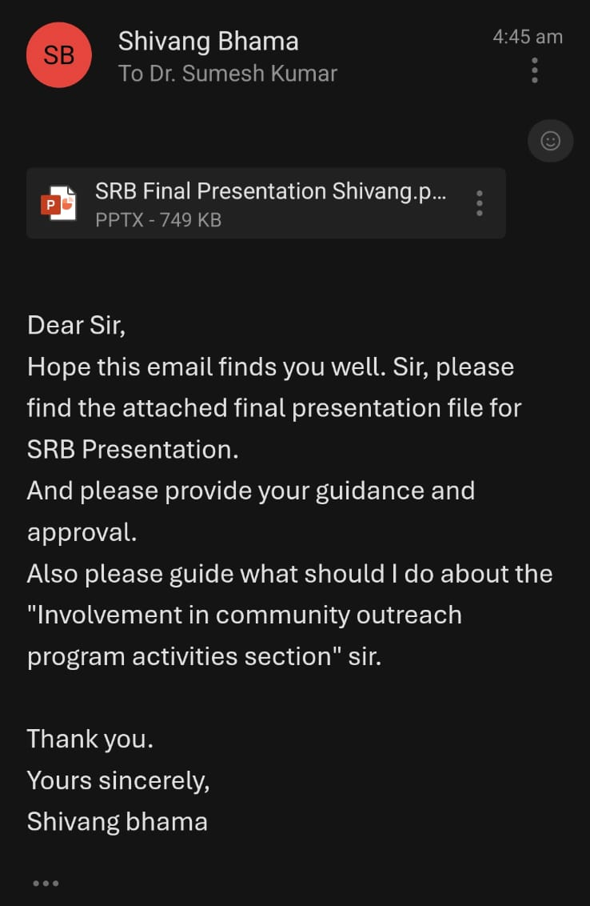
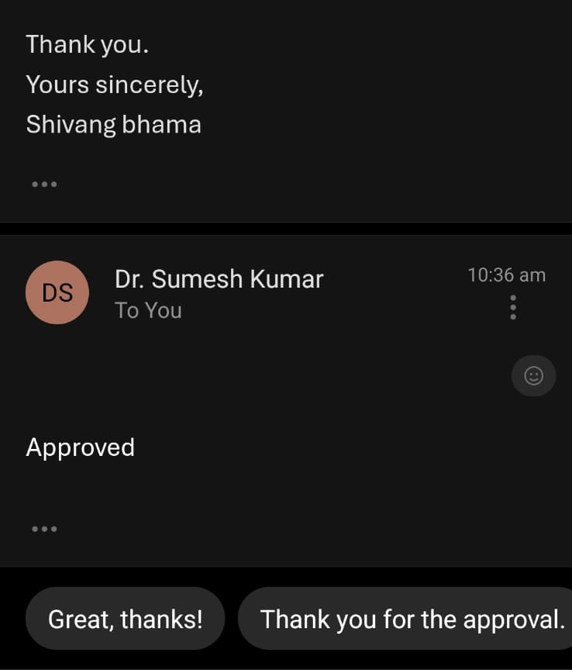
APPROVAL FROM MENTOR

Slide 3
Introduction
Healthcare Information Systems (HIS) have become essential in modern hospital operations by digitizing patient records, improving clinical workflows, and enhancing the overall quality of care.
HIS tools like Electronic Medical Records (EMR) support faster documentation, better access to patient data, and improved clinical decision-making.
However, the effectiveness of HIS largely depends on how smoothly physicians can interact with its modules.
At a Multi-Specialty Hospital in Hyderabad, EMR is being implemented by Trio Tree Technologies, with a focus on Implementing key clinical modules: Physician, Nursing (OP & IP), Discharge Summary, Templates.
This study evaluates physician interaction with these modules, identifies usability challenges, and measures the impact of physician-driven HIS improvements.

Slide 4
Research Objectives
To evaluate the usability of clinical modules in the Hospital Information System (HIS).
To find out the gaps in the HIS related to clinical modules.
To do intervention to fulfil the gaps in HIS and improve physician satisfaction.

Slide 5
Study Design & Methodology
Type: Descriptive, survey-based research.
Duration: March 1 – May 30, 2025.
Setting: Multispecialty Hospital, Hyderabad.
Sample Size: 92 physicians (Cochran’s formula).
Sampling Method: Purposive sampling across departments.
Tools: Structured questionnaire + semi-structured interviews.

Slide 6
Data Collection Tools
Pre/Post Rating-Based Questionnaire using 1–5 Likert scale.
Interview Guide aligned with 3 objectives:
  Usability of HIS modules
  Documentation time & system gaps
  Workflow efficiency & physician satisfaction

Slide 7
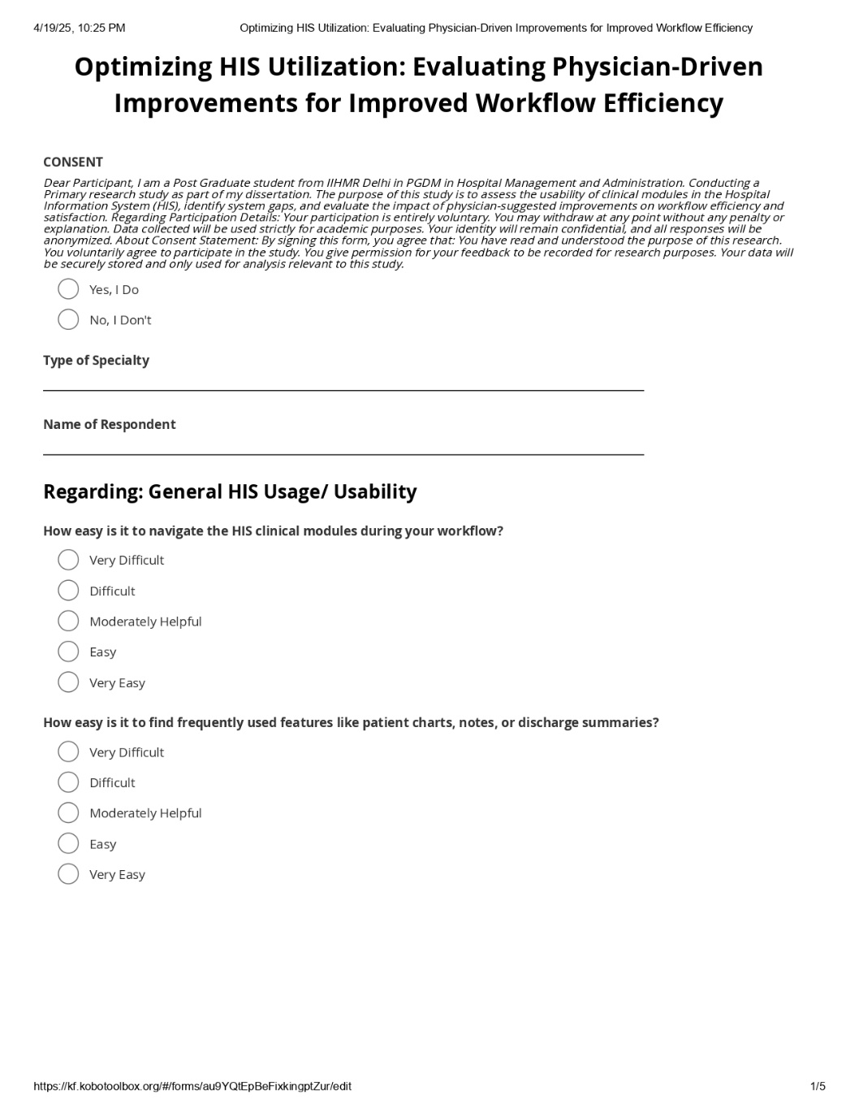
Consent Form & Sample Interview Questions

Slide 8
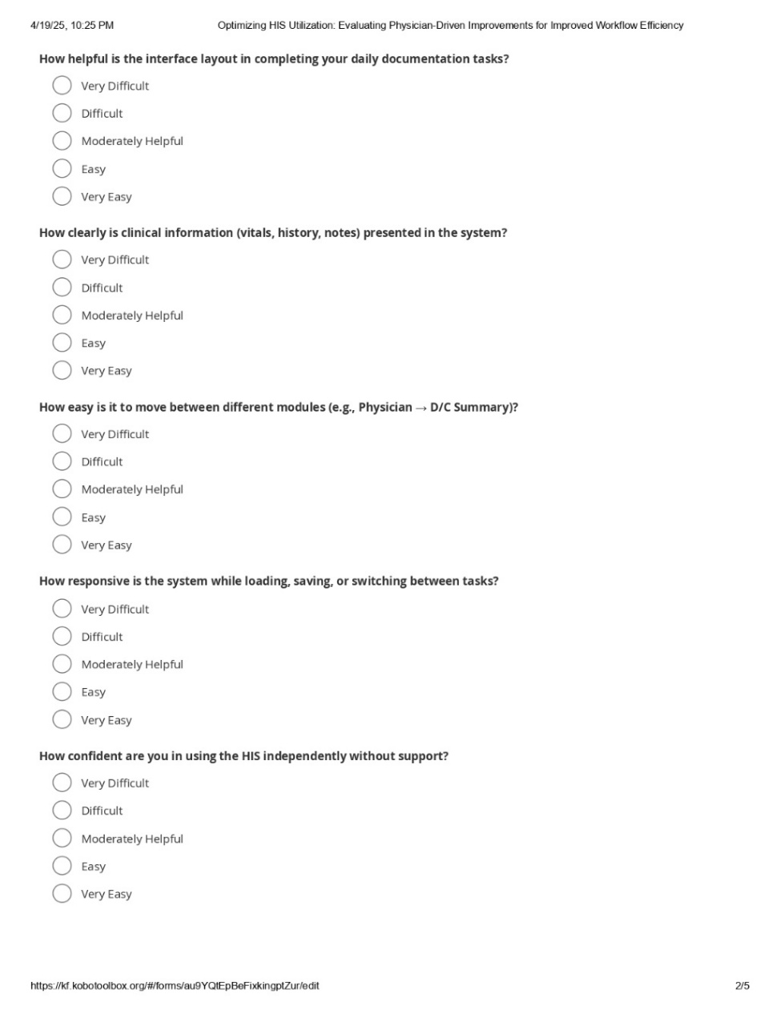
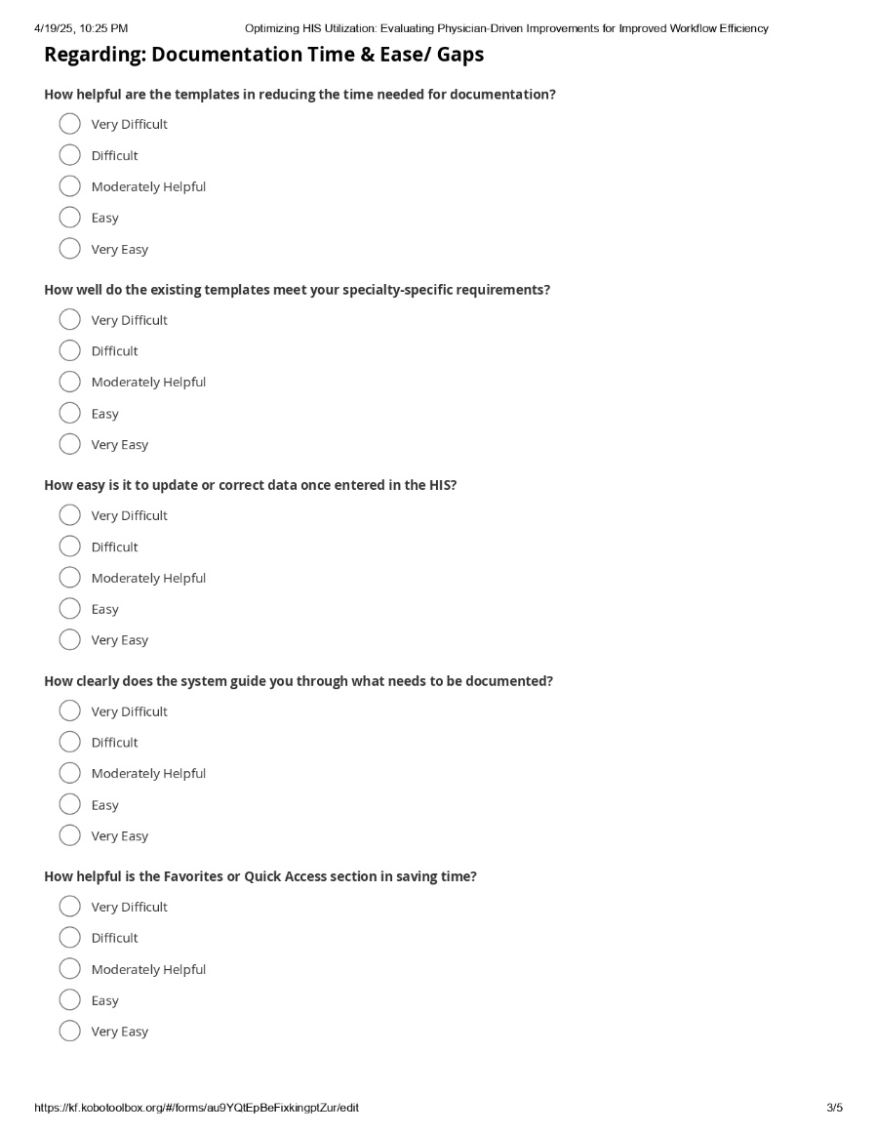
Consent Form & Sample Interview Questions

Slide 9
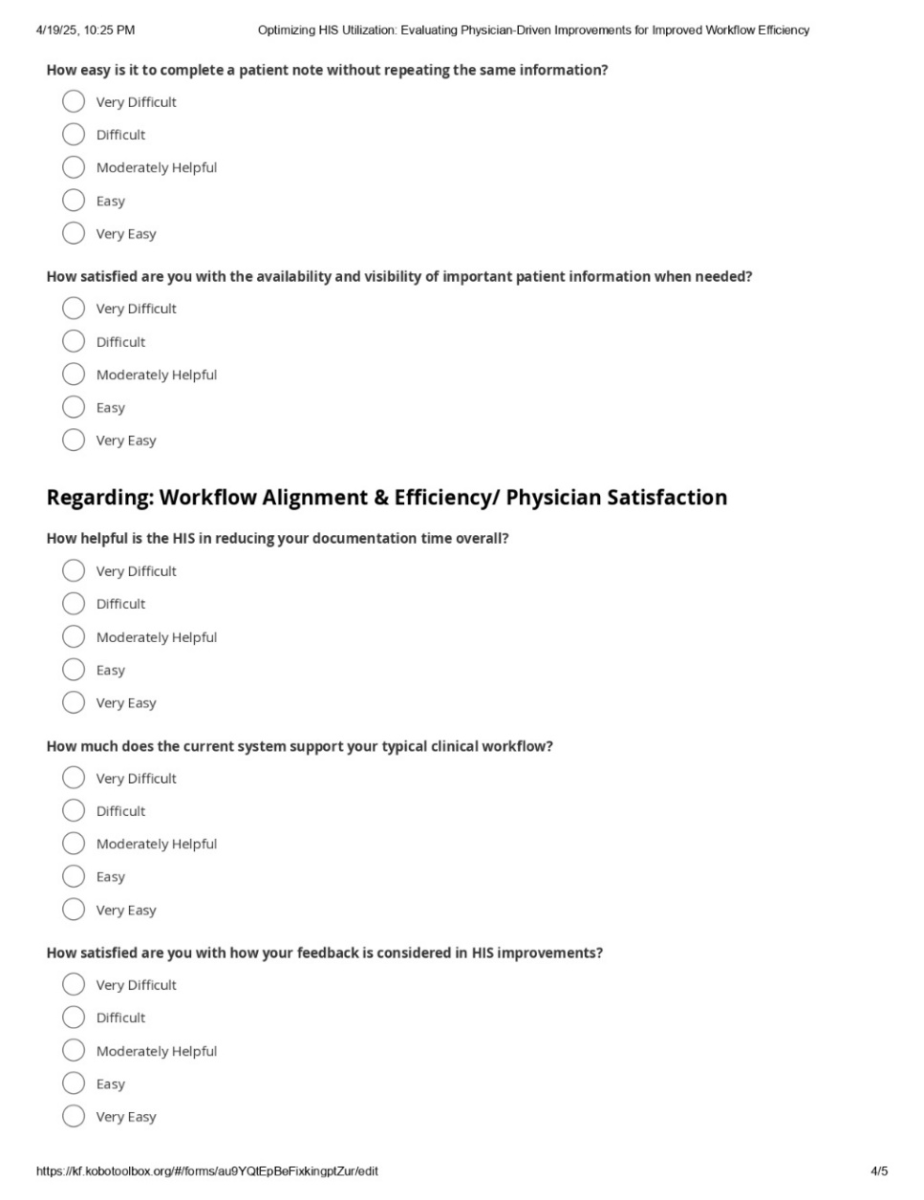
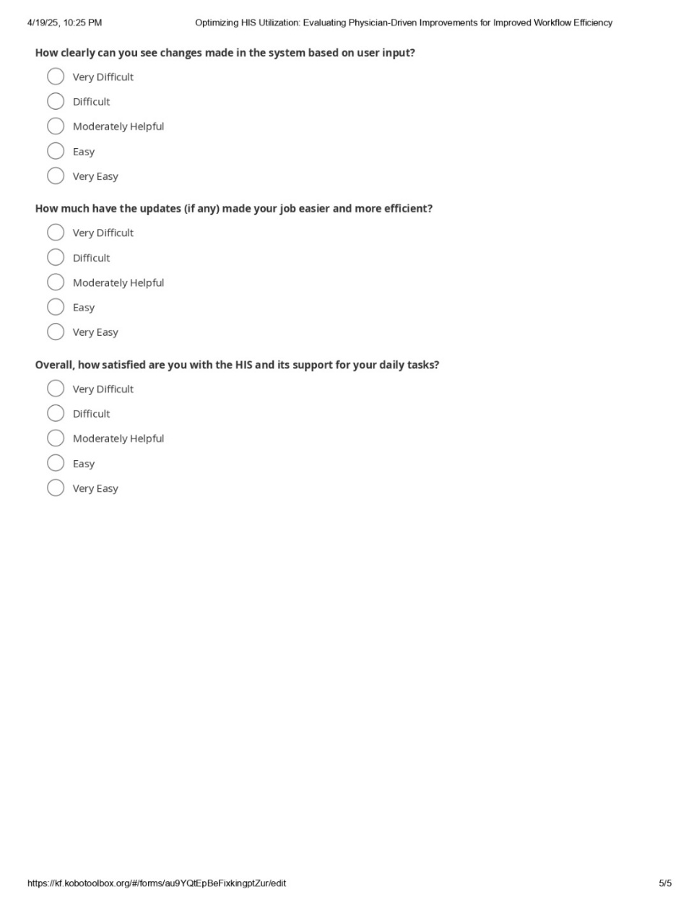
Consent Form & Sample Interview Questions

Slide 10
Gaps Identified
User interference is not Smooth
Too many clicks needed to complete a process
Difficulty in adopting to change in technology
Delayed or Missed Information

Slide 11
Challenges Encountered
Fulfilling multiple users multiple requirements.
User forget the optimal process.
Deny to adapt to change in HIS.
Not using all features of HIS.

Slide 12
Interventions/ Modifications Done
Changes the Out-Patient SOAP Screen to SNAPSHOT Screen.
Help them to use favorites section in the system.
Modifying system as per user specialty or wants.
Frequent training of users about new functionalities.

Slide 13
Results (Pre vs Post Intervention Analysis)
Sample Overview:
Total Responses Collected: 95 Physicians
Minimum Required (Cochran’s Formula): 92 (at 95% Confidence level)
This Ensures Statistical Reliability in evaluating the impact of physician-driven HIS changes.

Slide 14
Results (Pre vs Post Intervention Analysis)
A). Usability of HIS Modules (Q1-Q7)
General HIS Usability (Feedback) | Pre-Mod Mean | Post-Mod Mean
Difficult | 24.20601 | 0
Easy | 1.82225 | 30.97744
Moderately Helpful | 16.78646 | 34.13553
Very Difficult | 55.64887
Very Easy | 1.5218 | 34.88721
Interpretation: Before intervention, 79.7% rated HIS as either “Difficult” or “Very Difficult.” Post-modification, these dropped to 0%, while “Easy” and “Very Easy” rose to a combined 65.87%, showing major improvements in a navigation, clarity, and user confidence.

Slide 15
Results (Pre vs Post Intervention Analysis)
B). Documentation Time & Ease (Q8-Q14)
Documentation Time & Ease/ Gaps (Feedback) | Pre-Mod Mean | Post-Mod Mean
Difficult | 24.9624 | 0
Easy | 3.00751 | 37.29323
Moderately Helpful | 19.84962 | 30.22556
Very Difficult | 50.82706 | 0
Very Easy | 1.35338 | 32.4812
Interpretation: Before intervention, 75.97% of physician found documentation difficult. After implementing structured templates, checkboxes, and training. “Very Easy” and “Easy” scores rose to a combined 69.77%, reflecting drastic improvements in speed and ease of documentation.

Slide 16
Results (Pre vs Post Intervention Analysis)
C). Workflow Alignment & Physician Satisfaction (Q15-Q20)
Workflow Alignment & Efficiency/ Physician Satisfaction (Feedback) | Pre-Mod Mean | Post-Mod Mean
Difficult | 25.43859 | 0
Easy | 2.80701 | 36.49122
Moderately Helpful | 19.64912 | 35.08771
Very Difficult | 51.4035 | 0
Very Easy | 0.70175 | 28.42105
Interpretation: Before intervention, The system was not aligned with physician workflows, as 76.84% reported it as difficult or very difficult. After updates, 71.91% rated it as “Easy” or “Very Easy,” showing improved satisfaction and smoother clinical process integration.

Slide 17
Discussion
Before Modification, Majority of physicians rated HIS usability, documentation, and workflow alignment as either “Difficult” or “Very Difficult”.
Usability: 79.7% Negative feedback
Documentation: 75.8% Negative feedback
Workflow Alignment: 76.8% Negative feedback

Slide 18
Discussion
After Physician-Driven Interventions, these ratings dropped to 0% with:
Usability: “Easy” + “Very Easy” = 65.9%
Documentation: “Easy” + “Very Easy” = 69.8%
Workflow Alignment: “Easy” + “Very Easy” = 71.9%

Slide 19
Conclusion
This study confirms that involving physicians in HIS design enhances Usability, Documentation efficient, and workflow Satisfaction.
The Shift from “Very Difficult” to “Very Easy” was data-proven across all 20 parameters.
The findings support a scalable model for HIS organizations to make their HIS more adaptable, user-friendly, and clinically effective.

Slide 20
Ethical Considerations
Participation is voluntary and withdrawal is allowed anytime.
Written informed consent will be obtained.
Anonymity and data confidentiality ensured.
No sensitive data collected; minimal risk involved.
Ethical approval obtained from the Scientific Review Board (SRB).

Slide 21
Significance of the Study
Supports user-centric HIS design.
Enables data-driven improvements in physician workflows.
Offers replicable framework for HIS feedback-based optimization.
Directly contributes to digital health adoption in Indian hospitals.

Slide 22
References
Arreola M, Neiman HL, Sugarman A, Laurenti L, Forys R. Implementation of a radiology electronic imaging network: the community teaching hospital experience. Journal of digital imaging [Internet]. 1997 Aug;10(3 Suppl 1):146–9. Available from: https://pubmed.ncbi.nlm.nih.gov/9268864/
Ball M. Hospital information systems: perspectives on problems and prospects, 1979 and 2002. International Journal of Medical Informatics. 2003 Mar;69(2-3):83–9.
Berg M. Implementing information systems in health care organizations: myths and challenges. International Journal of Medical Informatics [Internet]. 2001 Dec;64(2-3):143–56. Available from: https://repub.eur.nl/pub/61646/
Cowan DF. Laboratory Informatics and the Laboratory Information System. Informatics for the Clinical Laboratory. 2005;1–20.
Huckvale C, Car J, Akiyama M, Jaafar S, Khoja T, Bin Khalid A, et al. Information technology for patient safety. Quality and Safety in Health Care [Internet]. 2010 Aug 1;19(Suppl 2):i25–33. Available from: https://qualitysafety.bmj.com/content/19/Suppl_2/i25
Arora L, Ikbal F. Experiences of implementing hospital management information system (HMIS) at a tertiary care hospital, India. Vilakshan - XIMB Journal of Management. 2021 Nov 19;ahead-of-print(ahead-of-print).
Kasambara A, Kumwenda S, Kalulu K, Lungu K, Beattie T, Masangwi S, et al. Assessment of implementation of the health management information system at the district level in southern Malawi. Malawi Medical Journal [Internet]. 2017 [cited 2020 Sep 21];29(3):240–6. Available from: https://www.ajol.info/index.php/mmj/article/view/163199
Chaulagai CN, Moyo CM, Koot J, Moyo HB, Sambakunsi TC, Khunga FM, et al. Design and implementation of a health management information system in Malawi: issues, innovations and results. Health Policy and Planning. 2005 Sep 2;20(6):375–84.
FlowForma. Process Automation Case Study - Hospital. https://www.flowforma.com/hospital-case-study. Accessed 16 Mar. 2025.

Slide 23
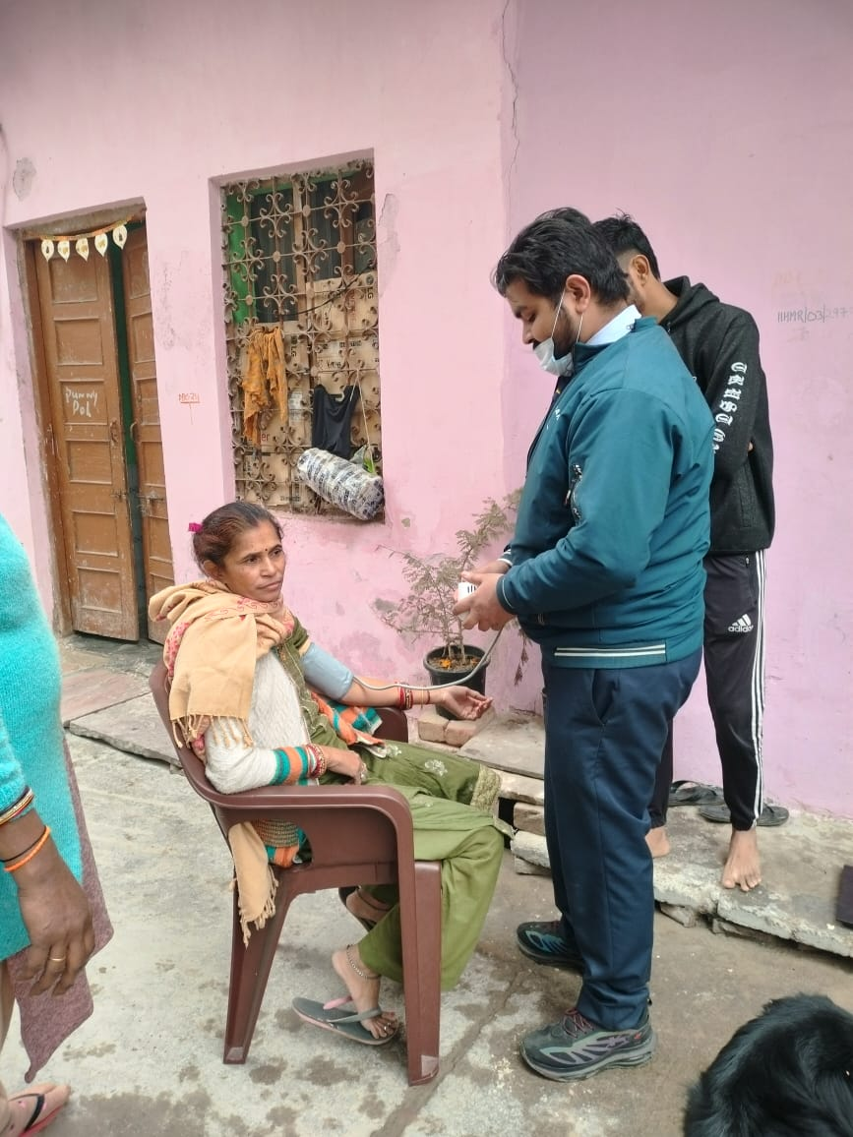
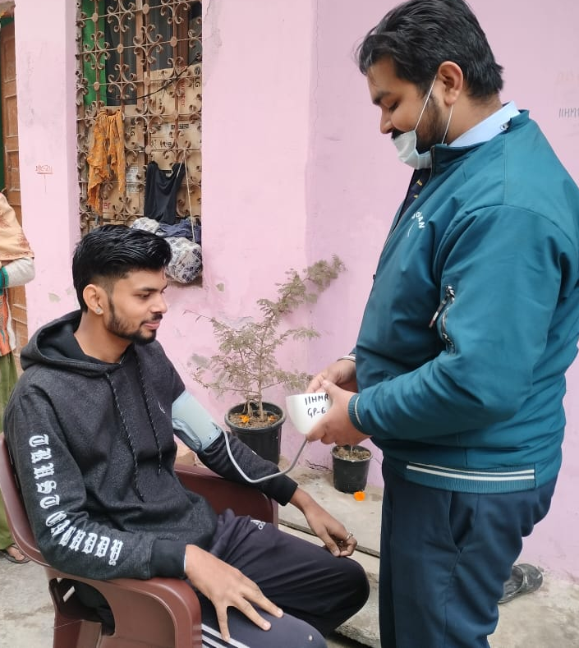
Involvement in Community Outreach Program (COP) Activities
Total no of visits:-Visited Goyala Dairy around 6-7 times.
No of activities done:-
Surveyed the members asking them about their ABHA card and are they aware about its benefits, how they get Daily needs in their household, measured their height, weight and BP, & Ask for any chronic disease they are suffering from and also their family social history including them.
Where they go in first place whenever anyone from their family suffer from any Health related issue (mostly free treatment).
How they Receive water in their household? Suppiled by government vehicles, and the location they live in has no proper drainage system.

Slide 24
THANK YOU ☺

