Slide 1
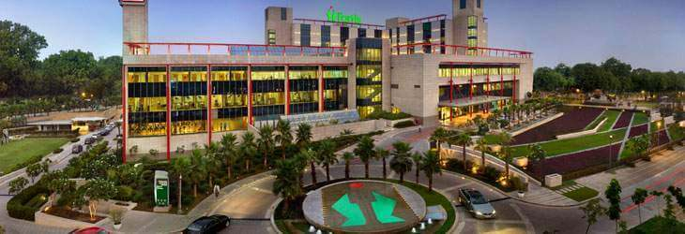
A Study on Employee Satisfaction at Fortis Memorial Research Institute

Slide 2
INTRODUCTION
Employee satisfaction is one of the most studied dimension of Human Resource Management. It is of prominent importance for any organization.
For an organization employees are of great value as they play major part in achieving the organizations goals and objectives and hence it tries to keep their employees happy, engaged and satisfied. To continuously raise and maintain the levels of engagement and satisfaction HR professionals have to face challenges.
The realm of employee satisfaction is a core part in management of human resource that is exhaustively researched in current times and hospitals are trying to hire and retain their best personnel’s by keeping them satisfied and engaged in order to increase productivity and decrease turnover.

Slide 3
OBJECTIVES
To assess the level of employee satisfaction in FMRI.
To identify the key factors that contribute to employee satisfaction.

Slide 4
METHODOLOGY
Study Design: Cross-sectional
Study setting: Fortis Memorial Research Institute, Gurgaon
Stud Duration: 3 months
Sample size: 312 (25%) of total population.
Sampling Technique: Random sampling
Selection Criteria
Inclusion -
Active employees in record
Employees having above 6 months experience in FMRI
Both male and female employees
Employees of all age group
Exclusion
Inactive employees in record
Employees on probation period of 6 months

Slide 5
DATA COLLECTION
A questionnaire was drafted using 12 drivers of employee satisfaction.
Promotions through invitation through mail was done.
Flyers were made to make the employees aware of the survey.
The questionnaire was circulated among 322 employees who were randomly allocated into the study.
Their responses were collected and the data was analyzed.
Total Population (1288)
Excluded from study n= 10
Incomplete questionnaire
Analyzed( n=312)
Excluded from analysis(n=10)
Randomized Sample (n=322)

Slide 6
RESULT & DATA ANALYSIS
CATEGORY | HIGHEST | LOWEST
Doctors | Career Growth & Opportunities | Work life balance
Nurses | Employee well being | Work life balance
Paramedics | Employee well being | Work life balance
Staff & Executives | Employee well being | Remuneration, reward & recognition
Service | Employee well being | Remuneration, reward & recognition

Slide 7
CATEGORY | HIGHEST | LOWEST
Doctors | Training & Development | Resources & Information Provided
Nurses | Training & Development | Alignment of Personal Goals with Organization Goals
Paramedics | Culture | Alignment of Personal Goals with Organization Goals
Staff & Executives | Culture | Resources & Information Provided
Service | Culture | Alignment of Personal Goals with Organization Goals

Slide 8
CATEGORY | HIGHEST | LOWEST
Doctors | Job Security | Relationship with Supervisor
Nurses | Job Security | Relationship with Supervisor
Paramedics | Relationship with Supervisor | Fairness at work
Staff & Executives | Feedback | Job Security
Service | Feedback | Job Security

Slide 9
Overall Satisfaction

Slide 10
Discussion
Paramedic Staff of FMRI have a highest sense of employee well being while
the nurses staff have the lowest score. This can be a result of varying working hours.
For Remuneration, Rewards and recognition Doctors were the highest satisfied category while Service staff being the lowest.
Doctors feel that they have ample amount of opportunities for their carrier growth while the lowest can be seen for nurses category.
Service staff have highest balance of Work and Personal life while Nurses are highly dissatisfied.
Nurses feel that they lack in Resources and information provided for carrying out their task while Doctors are satisfied enough with the Infrastructure.
Doctors are provided the adequate amount of training and development required for performing their tasks while service staff lack in that.

Slide 11
The Culture of FMRI has been found most suitable by paramedics and doctors while nurses slightly disagree.
Paramedics staff have a good relationship with supervisors while other categories it was satisfactory.
Doctors in FMRI believe that there is high level of Fairness at work while nurses are dissatisfied with fairness levels.
All categories except service staff believe that there job is secure.

Slide 12
Conclusion
The overall satisfaction achieved by FMRI was above the set benchmark. This indicates a good health of the hospital.
Benefits, perks and culture provided by the organization can be a prominent reason for higher satisfaction levels in certain drivers such as employee well being, training and development and job security.
Higher job satisfaction level of hospital staff results in higher competitiveness and performance of the hospital.

