Slide 1

Healthcare advancement for Rural and Tribal women
using ICT
Disha Soni, PGDHM 1st year
Mentor: Dr. Nishikant Bele
International Institute of Health Management Research
Introduction
Objective
Results
Recommendations
As per the study, it has been observed that various amendments in the plan and policies have been done by government concerning the women from remote areas in India. Over the time, government along with various NGOs has rolled out various schemes to make them more digitally inclusive and make the Digital India Mission fully successful by reaching to the society where it is hard to reach.
Information and communication technology intensify the reach of remote women to health information and act as an arsenal to combat their health problems.
There is copious amount of services with different purposes that are available for women which works on the ICT platform, such as to induce the behavioral changes, to improve the RMNCH services and so on.
Diverse projects have been implemented on the ICT platforms which are currently being used for the women or by the women itself as they are shown in the following table 3.
TABLE 3: DIFFERENT PROJECTS LAUNCHED BY VARIOUS PUBLIC AND PRIVATE BODIES
There is a larger scope for the primary study to be conducted regarding this subject, to understand the real-time perspective of tribal women and to give a clearer viewpoint to the government to improve their services and to the society as well to make them more inclusive. The government should approach more towards the public-private partnership (PPP), as it helps to achieve more sound result towards development
Worldwide, a revolution has been observed in the technological advancements in the last decade and India is also vying to get the top spot. Information and communication technology (ICT) have impacted almost every settlement be it urban, rural or tribal. To keep abreast with new trends of technology the Indian government has also launched various e-projects, e-programmes and e-missions to make socially excluded groups from the rural and tribal areas adept in using the technology and to make all the groups counterbalanced.
Scheduled Tribes (STs), residing in tribal areas are also known as Adivasis or tribal groups, they are excluded in India majorly on the social grounds and they face discrimination on the basis of their race. People living in remote areas are still relegated to various aspects and don’t have equal access and opportunities. For a patriarchal society like India, Women in spite of having almost equal strength to the men even in the remote areas, they are dominated by the male members of the family and are not given equal opportunities by their parents itself and it is even more prominently visible in rural and tribal areas. The impact of unequal treatment to women is visible in their literacy rate although there has been a change in the pattern of female literacy in the last four decades among STs in shown below in Table 1
TABLE 1: Literacy rate among STs among last 4 decades
Remote population have lower levels of antenatal care, fewer institutional deliveries, lower levels of immunization, and higher prevalence of reproductive tract and sexually transmitted infections. Women are more likely to seek care only when the illness is out of control. Pregnancy like conditions are not even considered by them as worthy to require medical attention.
The gender discrimination also persists to create a digital divide among them. As shown in the IAMAI report (2015), 71 percent of internet users are male and female stands for only 29 percent. However, it is slightly lower in urban India. The women are the most vulnerable group considering the digital exclusion and it becomes more worse for the women who belong to the socially excluded groups
The significance of this study is to explore the various services that are available for the empowerment of tribal and rural women in India and to understand how information and communication technology (ICT) is helping them to improve their health through education, health awareness and health facilities.
Limitations
The generalizability of the result is limited by the finite amount of scientific research conducted on the use of ICT for tribal women, so annual reports of various public-private organization, blogs and articles are referred for this study.
Methodology
Literature-based review has been conducted to form a descriptive study with an aim to obtain the deeper understanding about the health of women particularly among the tribal and rural groups.
Databases searched were Scopus, Web of Science, ProQuest, Google Scholar and PubMed, Research gate to obtain related articles. Due to paucity of scientific articles, we have also used publicly available data from the Annual report of International and national public-private agencies.
The keywords Health status of women, Tribal women, Rural women, ICT, e-governance were used in combination with digital health solution, m-health for Tribal women, government initiatives, Census of India using Boolean operators (and/or) to retrieve the most related papers. The time frame was between 2005 and 2019.
All the data sources used in the analyses is given in the following table 2.
TABLE 2: ANNUAL REPORTS REFERRED
Various initiative taken to improve the health of a women through the incorporation of ICT are considered in this study. Other than research articles, these data sources are referred to extract the various factors like no. of institutional deliveries, MMR, various projects that are implemented for them on the ICT platform.
Conclusion
This research is aimed at analyzing the effective ICT solutions available for the remote women and how it can improve their skillset to empower them. Based on the literature review and descriptive analyses, it can be concluded that there are numerous solutions available on the ICT platform for them which assist to educate them about health, nutrition, knowledge, pregnancy and many more conditions.⁶ As per the government data, women are socially ignored and its impact can be seen on their health and well-being as they are least bothered to seek any medical care until symptom aggravates, follow unsafe birth practices, have poor nutrition which leads to increased IMR, MMR, malnutrition and much more complications. The rate of IMR, MMR, child vaccine, nutritional status has been improved with the enhanced use of ICT platform for the women’s welfare as it provides various apps and portals to them to improve their awareness and knowledge (Executive Summary – Tribal Health Report, India, n.d.).¹
Project | Launched by | Target users | Delivery channel | Function | Expected impact
E-Mamta³ | Govt. of Gujrat | Mother and Child | App | Recording and tracking system | To maintain the data of pregnant women so that IMR and MMR can be tracked easily
ImTeCHO⁴ | SEWA Rural with HFW (Govt. of Gujrat) | ASHAs | Mobile- and web-based application | Supportive supervision, change management | To enhance the performance of ASHAs through improved management to reduce the IMR and MMR.
Medic Mobile² | Medic Mobile (NGO) | Female CHWs | SMS/Text | TSE*, RMS**, diagnosis, and monitoring Information delivery service | To strengthen community health systems and improve record-keeping for patients.
Kilkari⁵ | Mobile Alliance for Maternal Action (USAID) | Pregnant women and new mothers | App | Information and knowledge management | To improve the knowledge of low-literate rural population
MIRA channel² | ZMQ Development | Rural women | App | Information delivery service | To empower them by providing the necessary health knowledge and make them aware about the health services they require.
*RMS = Remote Management System **TSE = Target and skill enhancement
Year | Male | Female
1981 | 24.52 | 8.04
1991 | 40.65 | 18.19
2001 | 59.17 | 34.76
2011 | 68.50 | 49.40
Source: Office of Registrar General, India
SOURCE | PUBLISHING YEAR
Report of expert committee on tribal health (Executive Summary – Tribal Health Report, India, n.d.)¹ | 2017-18
Ministry of tribal affairs (Annual Report) | 2017-18
Digital Inclusion of low-skilled and low-literate people (Digital Inclusion for Low-Skilled and Low-Literate People: A Landscape Review - UNESCO Digital Library, n.d.)² | 2018
Exclusion from Digital Infrastructure and Access | 2016
Bibliography
Executive Summary – Tribal Health Report, India. (n.d.). Retrieved May 28, 2020, from http://tribalhealthreport.in/executive-summary/
Digital inclusion for low-skilled and low-literate people: A landscape review—UNESCO Digital Library. (n.d.). Retrieved May 28, 2020, from https://unesdoc.unesco.org/ark:/48223/pf0000261791
Barot, D., Mall, A., Makadia, K., & Kedia, G. (2015). Family Health Survey Data Validation in Sabarkantha District. International Journal of Multidisciplinary Research and Development, 2(8), 368–371.
Modi, D., Dholakia, N., Gopalan, R., Venkatraman, S., Dave, K., Shah, S., Desai, G., Qazi, S. A., Sinha, A., Pandey, R. M., Anand, A., Desai, S., & Shah, P. (2019). mHealth intervention “ImTeCHO” to improve delivery of maternal, neonatal, and child care services—A cluster-randomized trial in tribal areas of Gujarat, India. PLoS Medicine, 16(10). https://doi.org/10.1371/journal.pmed.1002939
LeFevre, A., Agarwal, S., Chamberlain, S., Scott, K., Godfrey, A., Chandra, R., Singh, A., Shah, N., Dhar, D., Labrique, A., Bhatnagar, A., & Mohan, D. (2019). Are stage-based health information messages effective and good value for money in improving maternal newborn and child health outcomes in India? Protocol for an individually randomized controlled trial. Trials, 20. https://doi.org/10.1186/s13063-019-3369-5

Slide 2
Introduction
Worldwide, a revolution has been observed in the technological advancements in the last decade and India is also vying to get the top spot. Information and communication technology (ICT) have impacted almost every settlement be it urban, rural or tribal. To keep abreast with new trends of technology the Indian government has also launched various e-projects, e-programmes and e-missions to make socially excluded groups from the rural and tribal areas adept in using the technology and to make all the groups counterbalanced.
Scheduled Tribes (STs), residing in tribal areas are also known as Adivasis or tribal groups, they are excluded in India majorly on the social grounds and they face discrimination on the basis of their race. People living in remote areas are still relegated to various aspects and don’t have equal access and opportunities. For a patriarchal society like India, Women in spite of having almost equal strength to the men even in the remote areas, they are dominated by the male members of the family and are not given equal opportunities by their parents itself and it is even more prominently visible in rural and tribal areas. The impact of unequal treatment to women is visible in their literacy rate although there has been a change in the pattern of female literacy in the last four decades among STs in shown below in Table 1

Slide 3
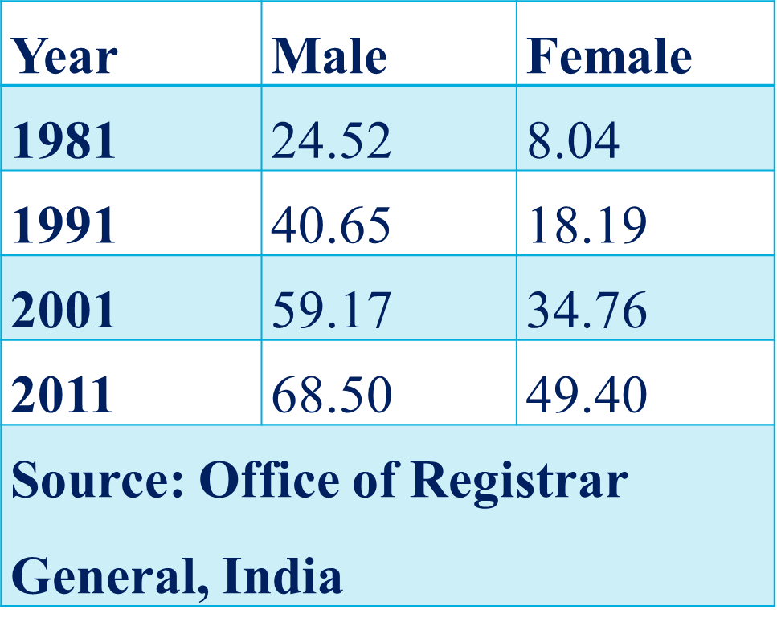
Introduction
TABLE 1: Literacy rate among STs among last 4 decades
Remote population have lower levels of antenatal care, fewer institutional deliveries, lower levels of immunization, and higher prevalence of reproductive tract and sexually transmitted infections. Women are more likely to seek care only when the illness is out of control. Pregnancy like conditions are not even considered by them as worthy to require medical attention.
The gender discrimination also persists to create a digital divide among them. As shown in the IAMAI report (2015), 71 percent of internet users are male and female stands for only 29 percent. However, it is slightly lower in urban India. The women are the most vulnerable group considering the digital exclusion and it becomes more worse for the women who belong to the socially excluded groups

Slide 4
Objective
The significance of this study is to explore the various services that are available for the empowerment of tribal and rural women in India and to understand how information and communication technology (ICT) is helping them to improve their livelihood through education, health awareness and health facilities.

Slide 5
Methodology
Literature-based review has been conducted to form a descriptive study with an aim to obtain the deeper understanding about the health of women particularly among the tribal and rural groups.
Databases searched were Scopus, Web of Science, ProQuest, Google Scholar and PubMed, Research gate to obtain related articles. Due to paucity of scientific articles, we have also used publicly available data from the Annual report of International and national public-private agencies.
The keywords Health status of women, Tribal women, Rural women, ICT, e-governance were used in combination with digital health solution, m-health for Tribal women, government initiatives, Census of India using Boolean operators (and/or) to retrieve the most related papers. The time frame was between 2005 and 2019.
Various initiative taken to improve the life of a women through their empowerment and skill development are considered in this study. Other than research articles, these data sources are referred to extract the various factors like no. of institutional deliveries, MMR, various projects that are implemented for them on the ICT platform.

Slide 6
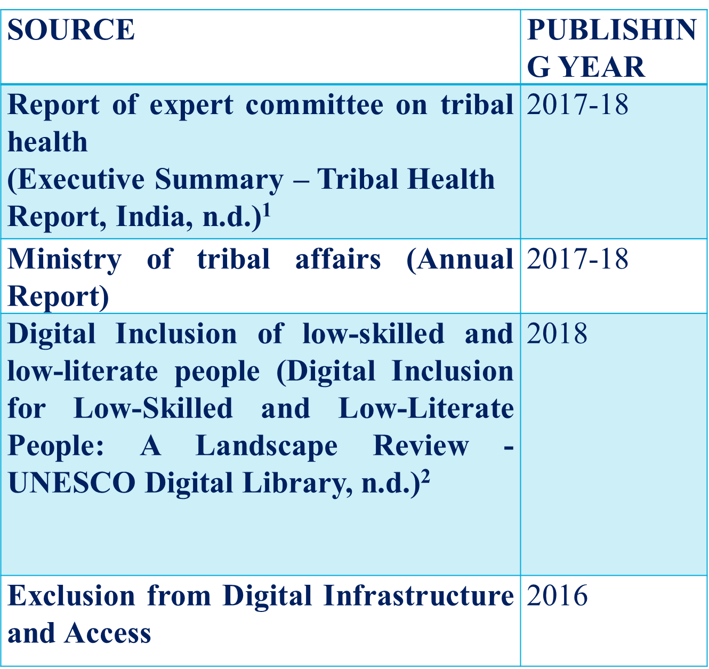
Methodology
All the data sources used in the analyses is given in the following table 2.
TABLE 2: ANNUAL REPORTS REFERRED
Various initiative taken to improve the life of a women through their empowerment and skill development are considered in this study.

Slide 7
Results
As per the study, it has been observed that various amendments in the plan and policies have been done by government concerning the tribal women in India. Over the time, government along with various NGOs has rolled out various schemes for the STs women to make them more digitally inclusive and make the Digital India Mission fully successful by reaching to the society where it is hard to reach.
Information and communication technology intensify the reach of tribal women to health information and act as an arsenal to combat their health problems.
There is copious amount of services with different purposes that are available for tribal women which works on the ICT platform, such as to induce the behavioral changes, to improve the RMNCH services and so on.
Diverse projects have been implemented on the ICT platforms which are currently being used for the women or by the women itself as they are shown in the following table 3.

Slide 8
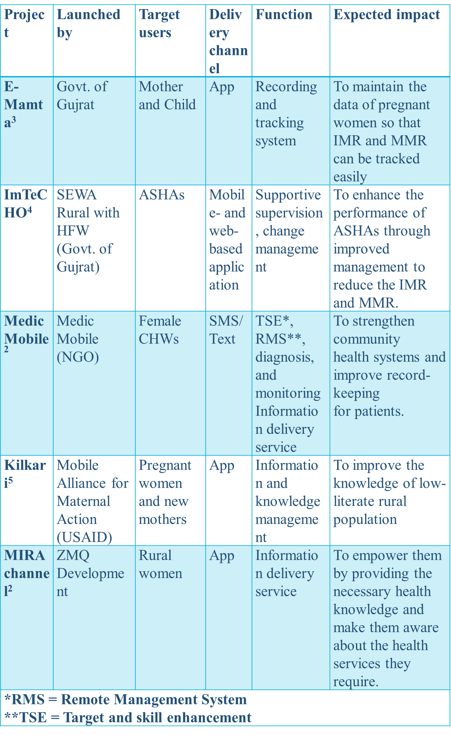
Results
TABLE 3: DIFFERENT PROJECTS LAUNCHED BY VARIOUS PUBLIC AND PRIVATE BODIES

Slide 9
Recommendations
There is a larger scope for the primary study to be conducted regarding this subject, to understand the real-time perspective of tribal women and to give a clearer viewpoint to the government to improve their services and to the society as well to make them more inclusive. The government should approach more towards the public-private partnership (PPP), as it helps to achieve more sound result towards development

Slide 10
Limitations
The generalizability of the result is limited by the finite amount of scientific research conducted on the use of ICT for tribal women, so annual reports of various public-private organization, blogs and articles are referred for this study

Slide 11
Conclusion
This research is aimed at analyzing the effective ICT solutions available for the tribal women and how it can improve their skillset to empower them. Based on the literature review and descriptive analyses, it can be concluded that there are numerous solutions available on the ICT platform for the tribal women which assist to educate them about health, nutrition, knowledge, pregnancy and many more conditions.⁶ As per the government data, women are socially ignored and its impact can be seen on their health and well-being as there are least bothered to seek any medical care until symptom aggravates, follow unsafe birth practices, have poor nutrition which leads to increased IMR, MMR, malnutrition and much more complications. The rate of IMR, MMR, child vaccine, nutritional status has been improved with the enhanced of ICT platform for the women’s welfare as it provides various apps and portals to them to improve their awareness and knowledge (Executive Summary – Tribal Health Report, India, n.d.).¹

Slide 12
Bibliography
Executive Summary – Tribal Health Report, India. (n.d.). Retrieved May 28, 2020, from http://tribalhealthreport.in/executive-summary/
Digital inclusion for low-skilled and low-literate people: A landscape review—UNESCO Digital Library. (n.d.). Retrieved May 28, 2020, from https://unesdoc.unesco.org/ark:/48223/pf0000261791
Barot, D., Mall, A., Makadia, K., & Kedia, G. (2015). Family Health Survey Data Validation in Sabarkantha District. International Journal of Multidisciplinary Research and Development, 2(8), 368–371.
Modi, D., Dholakia, N., Gopalan, R., Venkatraman, S., Dave, K., Shah, S., Desai, G., Qazi, S. A., Sinha, A., Pandey, R. M., Anand, A., Desai, S., & Shah, P. (2019). mHealth intervention “ImTeCHO” to improve delivery of maternal, neonatal, and child care services—A cluster-randomized trial in tribal areas of Gujarat, India. PLoS Medicine, 16(10). https://doi.org/10.1371/journal.pmed.1002939
LeFevre, A., Agarwal, S., Chamberlain, S., Scott, K., Godfrey, A., Chandra, R., Singh, A., Shah, N., Dhar, D., Labrique, A., Bhatnagar, A., & Mohan, D. (2019). Are stage-based health information messages effective and good value for money in improving maternal newborn and child health outcomes in India? Protocol for an individually randomized controlled trial. Trials, 20. https://doi.org/10.1186/s13063-019-3369-5

Slide 13
Thank you.

