Slide 1


TO STUDY THE IMPACT OF PROCESS AUTOMATION ON EFFICIENCY AND USER ACCEPTANCE: DIGITALIZATION OF EYEQ HOSPITAL SUPPLY CHAIN
TOPIC

Slide 2
IIHMR MENTOR
DR NIDHI YADAV
MENTORS
EYE Q MENTOR
AJAY SINGH
SUPPLY CHAIN MANAGER

Slide 3
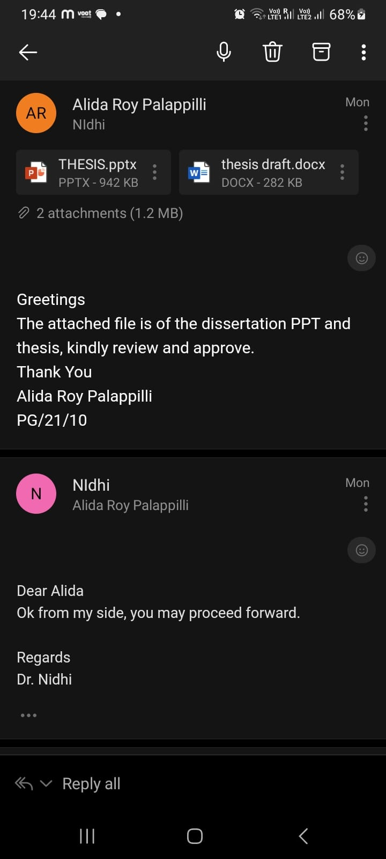

Slide 4
PROPOSAL PRESENTATION
CONTENT
INTRODUCTION
OBJECTIVE
METHODOLOGY
RESULT
CONCLUSION
RECOMMENDATION
LIMITATION
REFERENCE
ALIDA ROY PALAPPILI

Slide 5
BACKGROUND OF EYEQ
The Eye-Q hospital chain is committed to providing the best quality eye care at an affordable cost across India.
Established in 2007, Eye-Q is a chain of 30 domestic Super- Speciality Eye Hospitals in Delhi-NCR, Haryana, Uttar Pradesh, Uttarakhand, and Gujarat. Also, 3 hospitals in Nigeria, Africa
SCOPE OF SERVICES
Comprehensive Eye Care
Cataract Services
Refractive Services
Retina Services
Glaucoma Services
Pediatric Services
Visual Aid Services
Occuplasty Services
Optical Servic
Supply Chain Management is a process that involves the planning, organizing, directing, and controlling of the procurement and flow of materials and products from suppliers to customers

Slide 6
Impact of Digitalization:
Digitalization involves the use of digital technologies to streamline and automate processes. In the context of a hospital's supply chain, digitalization can play a crucial role in the following ways:
Inventory Management
Supply Chain Visibility
Cost Savings
User Acceptance:
The success of any digitalization initiative depends on user acceptance. In the context of a hospital's supply chain, the following factors can influence user acceptance:
Training
Ease of Use
Communication
INTRODUCTION

Slide 7
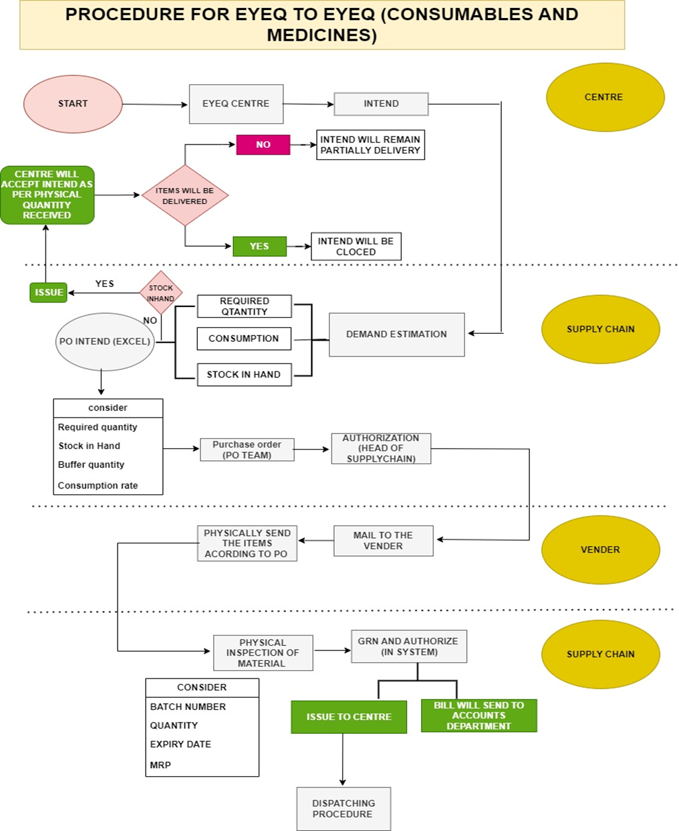

Slide 8
PRIMARY OBJECTIVE :
To identify and analyze the impact of process automation for supply chain efficiency in an EyeQ hospital.
SECONDARY OBJECTIVE:
To examine the supply chain department user acceptance of digitalization.
OBJECTIVE

Slide 9
STUDY DESIGN : Mixed method research
Quantitative Data Collection
Qualitative Data Collection :
STUDY DURATION: 3 months
AREA OF STUDY : EYEQ VISION PVT. LTD
INCLUSION : The participants will be the employ of supply chain department
EXCLUSION : Employs other than supply chain
Those who won't provide informed consent
DATA COLLECTION: EYETECH (SOFTWARE), GOOGLE FORM AND EXCEL
DATA ANALYSIS: The data collected could be analyzed by microsoft excel
METHODOLOGY

Slide 10

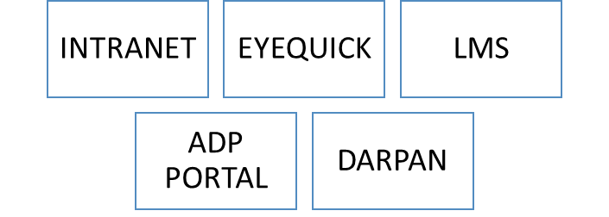
RESULT
TYPES OF SOFTWARE USED IN SUPPLY CHAIN

Slide 11
USER EXPERIENCE | COUNT | PERCENTAGE
LESS THAN 2 YEARS | 3 | 25%
2 -5 YEARS | 6 | 50%
6-10 YEARS | 2 | 17%
MORE THAN 10 YEARS | 1 | 8%

Slide 12
User Acceptance & Satisfaction Statements | ANSWER
Overall, I am satisfied with HIS | NEUTRAL
HIS performance speed is acceptable | DISAGREE
HIS is user friendly and easy to use | DISAGREE
HIS provides sufficient information | AGREE
HIS provides accurate information | AGREE
HIS screens layouts are appropriate | DISAGREE
HIS provides updated information | NEUTRAL
My practice needs are optimized by HIS | NEUTRAL
HIS provides clear information | AGREE
HIS fonts and characters are easy to read | AGREE
HIS General Assessment Overall Score | DISAGREE
Laptop computers | AGREE
Computers are always available when I need them for HIS use | AGREE
Desktop computers | NEUTRAL
Availability of Computers in the Hospital Overall Score | AGREE
I am prepared for HIS downtime | DISAGREE
HIS downtime procedure is clear and comprehensive | DISAGREE
Current HIS training materials are helpful | NEUTRAL
I am satisfied with the support provided to HIS users | NEUTRAL
Overall, I am satisfied with HIS | NEUTRAL
I received enough training on HIS | NEUTRAL
Users' Satisfaction Overall Score | NEUTRAL

Slide 13
DISCUSSION
Implementation of INTRANET Software:
Significantly improves efficiency and accuracy of day-to-day activities within the organization.
Real-time reporting feature enables timely access to critical information, aiding decision-making and resource allocation.
Sales details reporting provides insights on revenue streams, customer preferences, and sales trends for optimizing marketing strategies and sales processes.
Purchase details reporting streamlines procurement, tracks supplier information, and facilitates efficient inventory management.
Stock in hand reporting enables comprehensive inventory visibility, minimizing stockouts and holding costs.
DARPAN Implementation:
Improves analytical capabilities of technical administration with a centralized platform for data collection and visualization.
Objectively presents project data, aiding in data-driven decision-making and identifying areas for improvement.
Practical implications include enhanced project management, strategic planning, transparency, and accountability.

Slide 14
ADP Portal:
Simplifies attendance management with a user-friendly interface and accessible dashboard.
Employees can conveniently record attendance, view attendance history, check leave balances, and monitor attendance patterns.
EyeQuick Software:
Streamlines communication and collaboration between distributors and departments.
Ticket raising portal captures distributor requests, reports issues, and facilitates effective communication.
Improves coordination, reduces miscommunication, and ensures timely issue resolution.
Hospital Information System (HIS) User Acceptance:
User-friendliness and ease of use are important factors for successful adoption and implementation.
Downtime procedures need to be well-defined and comprehensive.
HIS performance, including system speed and user interface, impacts user acceptance.
Demographics, such as job type, years of experience, and age, influence user satisfaction levels.

Slide 15

Real-time reporting on sales details, purchase details, and stock in hand enhances decision-making and inventory management.
Limitation regarding the generation of aging reports requires alternative methods for tracking and analyzing aging goods.
DARPAN software improves analytical capabilities, project monitoring, and data-driven decision-making.
System Performance:
Improving the performance and user-friendliness of the HIS is crucial for acceptance and user satisfaction.
Enhancements should focus on software speed, screen designs, and logic of functions.
Organizational Support:
Comprehensive training, dedicated time for learning, and improved user manuals are essential for user support.
Better technical support from the vendor should be ensured.
CONCLUSION

Slide 16
RECOMMENDATION
INTRANET software:
Explore options to incorporate aging reports
Continuously monitor and evaluate the software's performance to identify areas for improvement and optimize its functionality.
DARPAN software:
Address data integration challenges by ensuring compatibility with diverse data sources.
Provide comprehensive training and support to users to promote higher adoption rates and proficiency in using the software.
ADP portal:
Conduct user feedback surveys to gather insights and identify areas for improvement in terms of usability and functionality.
EyeQuick software:
Continuously evaluate and refine the ticket raising portal to optimize its efficiency and effectiveness.

Slide 17
LIMITATION
LIMITATION
Generalizing the results and conclusions to other departments and healthcare levels may have limitations.
External validity should be considered when applying the findings beyond the supply chain department.

Slide 18
REFERENCE
. Ketikidis, P., Dimitrovski, T., Lazuras, L., & Bath, P. A. (2012). Acceptance of health information technology in health professionals: an application of the revised technology acceptance model. Health informatics journal, 18(2), 124-134
. Khalifa, M. (2013). Barriers to health information systems and electronic medical records implementation. A field study of Saudi Arabian hospitals. Procedia Computer Science, 21, 335-342.
. Khalifa, M. (2014). Technical and Human Challenges of Implementing Hospital Information Systems in Saudi Arabia. Journal of Health Informatics in Developing Countries, 8(1).
Menon, Sreekumar, 2015/05/10 Best Practices and Implementation Challenges in Effective Project ManagementDOI : 10.13140/RG.2.1.1439.8886.
Pai, F. Y., & Huang, K. I. (2011). Applying the Technology Acceptance Model to the introduction of healthcare information systems. Technological Forecasting and Social Change, 78(4), 650-660

Slide 19
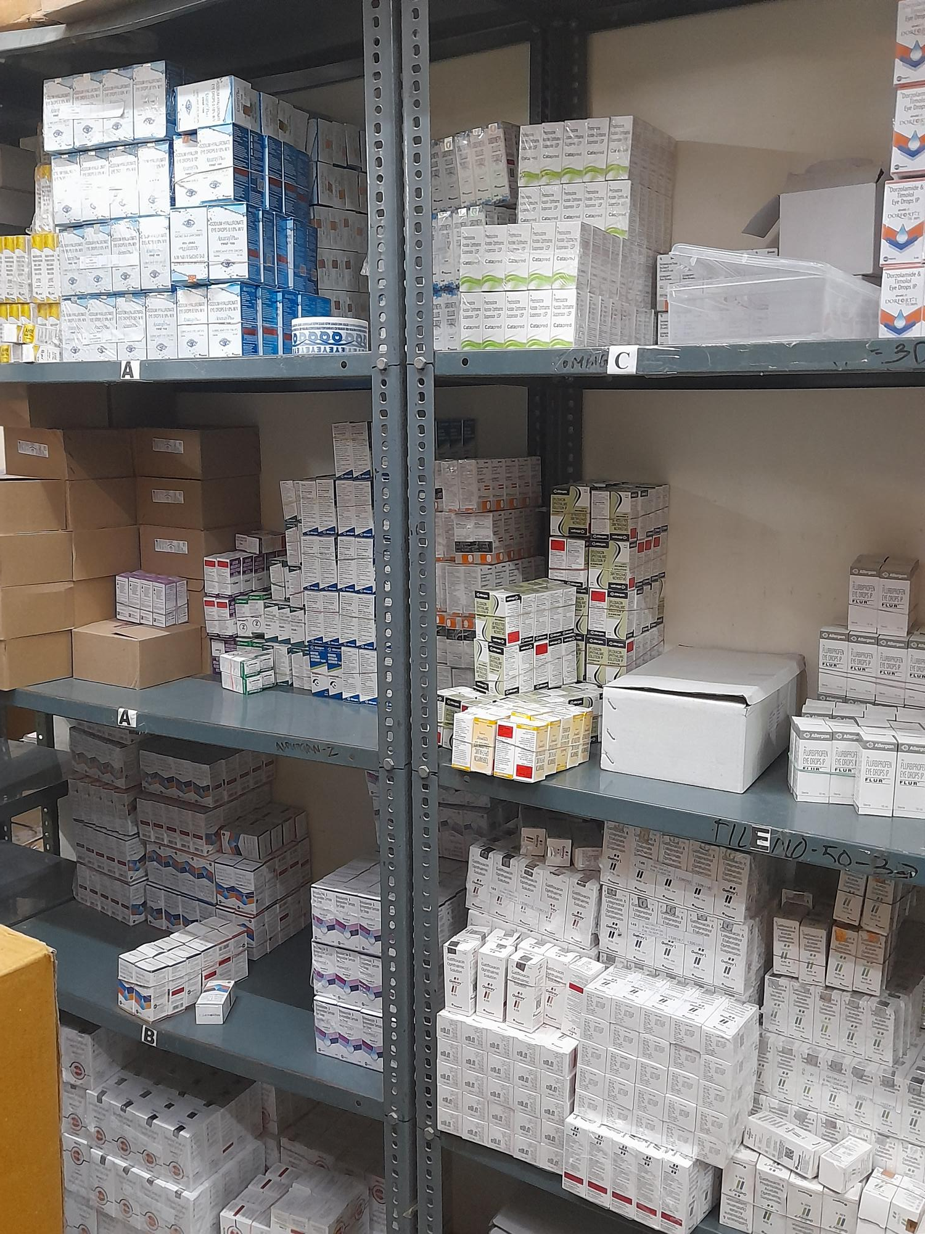



Slide 20
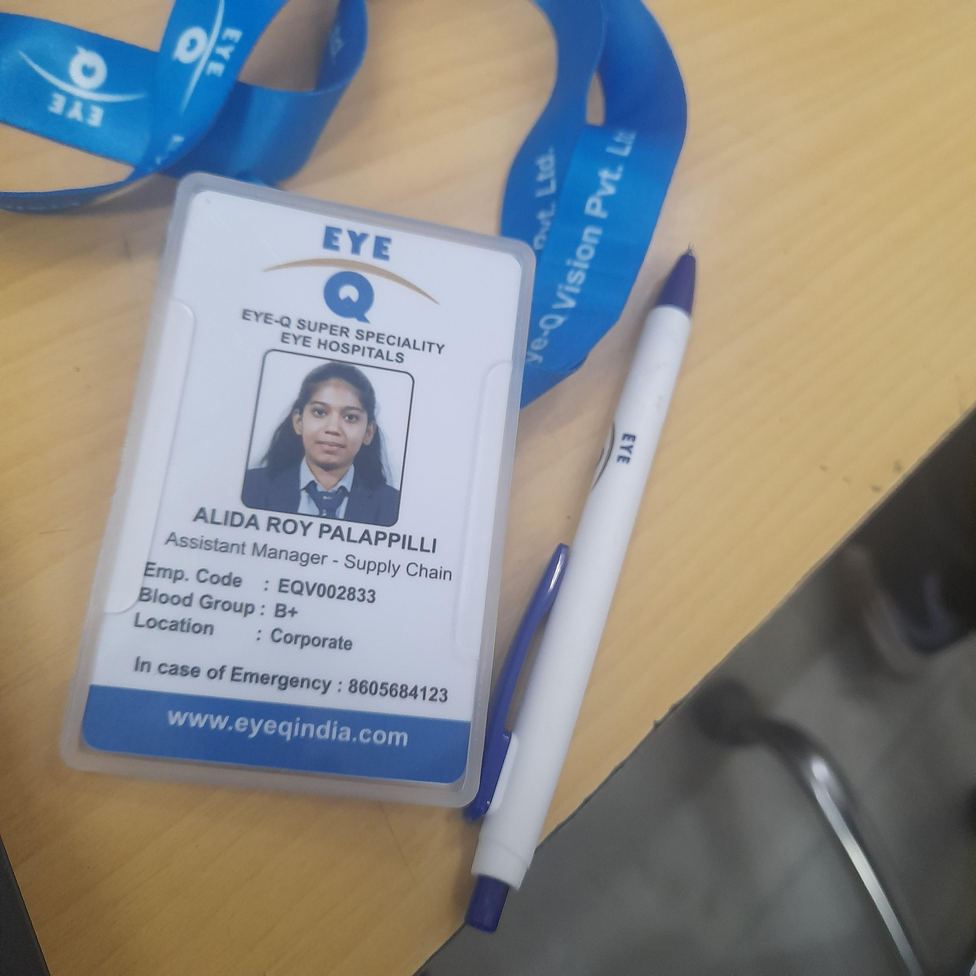

Slide 21
THANK YOU

