Slide 1
Impact of AI-Based Microlearning and Digital Tools on Study Habits and Performance of MBBS Students
“Real-Time Insights from PhysicsWallah MedEd (PW MedEd)"
Team: Dr. Shivangi Mishra( PG/23/112)
Faculty Mentor: Dr. Anandhi Ramachandaran
IIHMR Delhi

Slide 2
Introduction:
The evolving demands of medical education, especially post-COVID, have accelerated the adoption of digital tools.
PW MedEd is a next-generation learning platform that blends AI, microlearning, and clinical content to support MBBS students throughout their academic journey.
This study explores how real-time engagement data from the PW MedEd app reflects shifts in student behavior, learning preferences, and content effectiveness — particularly between January and June 2025.

Slide 3
Introduction to PW MedEd 2.0:
• PW MedEd 2.0 is a comprehensive digital platform for MBBS students.
• Designed to support preparation for Professional Exams, NEET PG, FMGE.
• Combines AI-powered microlearning with interactive, structured content.
• Offers over 900+ hours of faculty-led conceptual video lectures.
• Provides immersive 3D learning via the MedVerse module.
• Features a large QBank with 15,000+ clinical MCQs, including PYQs.
• Live + recorded class access supports self-paced and guided learning.
• Acts as a one-stop learning ecosystem from Day 1 to NEET PG.

Slide 4
PW MedEd Features Overview:
PW MedEd is a comprehensive platform that integrates multiple digital tools to enhance MBBS learning:
• FARRE – Frequently Asked Repeated Revision Exam Questions for university professional exam prep.
• MedVerse – 3D models & pathology slides for immersive visual learning.
• Vitals – High-yield flashcards per subject for fast recall.
• Clinical Corner – Case-based guides for OSCEs, ward rounds, and exams.
• QOD – 15,000+ MCQs with adaptive learning and test analytics.
• Video Lectures – Live + recorded conceptual lectures by top faculty.
• Concise Notes – Diagram-based summaries for quick revision.

Slide 5
Objectives of Your Study:
• Analyze real-time engagement data from the PW MedEd app.
• Compare study behavior between January and June 2025.
• Identify user segments based on watch time and tool usage.
• Evaluate the impact of key features (FARRE, QOD, MedVerse, Clinical Corner).
• Recommend strategies to optimize digital learning outcomes.

Slide 6
Methodology:
• Study Design: A quantitative, observational study focused on digital engagement behavior among MBBS students using PW MedEd.
• Study Duration: Six months – from January to June 2025, capturing two academic quarters including exam-preparation season.
• Data Source: Extracted from backend analytics of the PW MedEd app, including user interaction logs, watch time data, feature access frequencies.
• Sample Size: 2,969 actively enrolled MBBS students from various academic years across India, using the platform regularly for at least one month during the study window.

Slide 7
Methodology:
• Data Collection Parameters: Watch time of users, Feature usage and engagment(FARRE, MedVerse, Clinical Corner, QOD), Overall app engagement review, DAU Trends (January-June).
• Analytical Tools:
Microsoft Excel and Google Sheets for data cleaning, aggregation, and pivot analysis.
Graphical insights generated using bar charts, line graphs, and user segmentation histograms.
Descriptive statistics were used to calculate average watch time, standard deviation, feature-wise usage trends, and behavioral segmentation.

Slide 8
Methodology:
Key Metrics:
Total & Average Watch Time,Max/Min Watch Time(Video lectures engagement).
Feature-wise Monthly Usage (FARRE, MedVerse, Clinical Corner,QOD).
User Segmentation
DAU Trends

Slide 9
Key Results:
Total Watch Time: ↑ from 165,000 mins (Jan) to 240,000 mins (June) → +45.5% increase.
Average Watch Time/User: ↑ by 43.3% overall — showing deeper engagement.
Video Lectures: ↓ per-user watch time (14.3 hrs to 11.3 hrs) — shift toward microlearning.
User Segmentation: ↑ in moderate/low-duration users; ↓ in long-session learners.
Most Engaged Features: FARRE, QOD, and Clinical Corner.
MedVerse showed novelty drop — users explored early but didn’t retain.

Slide 10
Engagement Overview – Key Insights (Jan–Jun 2025):
• MAU peaked in June (30,765) after a dip in February — aligns with academic preparation cycles.
• Avg Daily Users stayed steady (~6,400–6,900), highest in March during mid-sem activity.
• Avg Total Watch Time dropped from 18,900 mins (Jan) to 14,700 mins (June), showing reduced deep viewing.
• Avg Time/User fell from 2.76 mins (Jan) to 2.20 mins (June), indicating shift toward faster, goal-focused usage.
Engagement is high, but students prefer shorter, revision-oriented interactions as exams near.

Slide 11
Video Lecture Engagement (Jan vs June 2025):
• In January 2025, students spent an average of 14.31 hours per user on video lectures.
• By June, this dropped to 11.31 hours per user — a 21% decrease in average engagement time.
• Total watch time also declined from 42,493 hours in January to 33,802 hours in June.
• Interestingly, the user count remained stable (~2,969 in both months), indicating that user base was retained, but individual usage intensity declined.

Slide 12
Interpretation:
The drop in watch time suggests a shift in study behavior:
- In January, students likely relied heavily on conceptual lectures to start new subjects or semesters.
- By June, their focus may have shifted to faster tools like FARRE, QBank, or test series for revision and exam practice.
• This pattern reflects a transition from deep learning (via lectures) to rapid, outcome-driven prep closer to exams.
• It also highlights the need for more condensed or targeted video content in later months to match student pacing and attention span.
Enhancing micro-video content or integrating short revision playlists in June could improve engagement retention.

Slide 13
Feature-wise Engagement Insights (Jan–Jun 2025):
• FARRE:
- There was a significant increase in engagement in January with 21,300 users, followed by a decrease in February to 16,304.
- From March to June, the user count stabilized between 16,800 and 17,900.
- This indicates robust usage for revision, particularly during exam seasons.
• MedVerse:
- There is a downward trend from 14,080 users in January to 9,841 in June.
- This implies that students initially explore it but do not consistently return.
- It may benefit from being more deeply integrated into anatomy and pathology coursework.

Slide 14
Feature-wise Engagement Insights (Jan–Jun 2025):
Clinical Corner:
Steady use with a May peak (12,002), aligned with clinical postings and viva prep—effective for ward readiness.
QOD:
Grew from 13,677 (Jan) to 19,227 (Jun), showing strong interest in daily MCQs and high scalability.
DAU:
February dip (64,033), peak in June (70,997)—mirrors academic cycles and exam preparation phases.

Slide 15
User Segmentation – Watch Time Trends (Jan vs June 2025):
• Low Engagement (<5 hrs):
↑ from 1,188 (Jan) to 1,363 (June) – more students shifted to short sessions.
• Moderate (5–15 hrs):
↑ from 779 (Jan) to 848 (June) – steady rise in focused, revision-oriented learners.
• High (15–30 hrs) & Very High (30+ hrs):
↓ from 1,002 (Jan) to 778 (June) – fewer users watched long-form content.
Insight:
Students moved from deep-dive lectures in Jan to faster, exam-driven preparation by June.

Slide 16
Discussion:
• Students shifted from long lectures in January to quick revision tools like FARRE and QOD by June.
• Engagement became polarized: Fewer high-duration users and More short-session users seeking efficiency
• Tools like Clinical Corner sustained engagement; MedVerse saw early interest but limited long-term use.
• Drop in avg. video watch time (↓21%) reflects exam-time shift to faster learning formats.
PW MedEd effectively supports both deep learning and rapid revision, but must optimize microlearning to sustain engagement across phases.

Slide 17
Recommendations:
• Use behavioral segmentation to deliver personalized nudges and study paths.
• Promote FARRE, QOD, and Test Series more actively before exams.
• Re-engage low-duration users through gamified challenges or leaderboards.
• Introduce shorter, recap-based video formats for final prep months.
• Deploy AI-driven dashboards to guide users from passive to active learning.

Slide 18
Conclusion:
• AI-based microlearning significantly improved student engagement patterns.
• Users increasingly preferred fast, high-yield content over long lectures as exams neared.
• Tools like FARRE, QOD, and Clinical Corner showed sustained, exam-focused usage.
• Disparity in engagement reveals the need for adaptive content strategies.
• PW MedEd effectively supports both early learning and final revision phases.

Slide 19

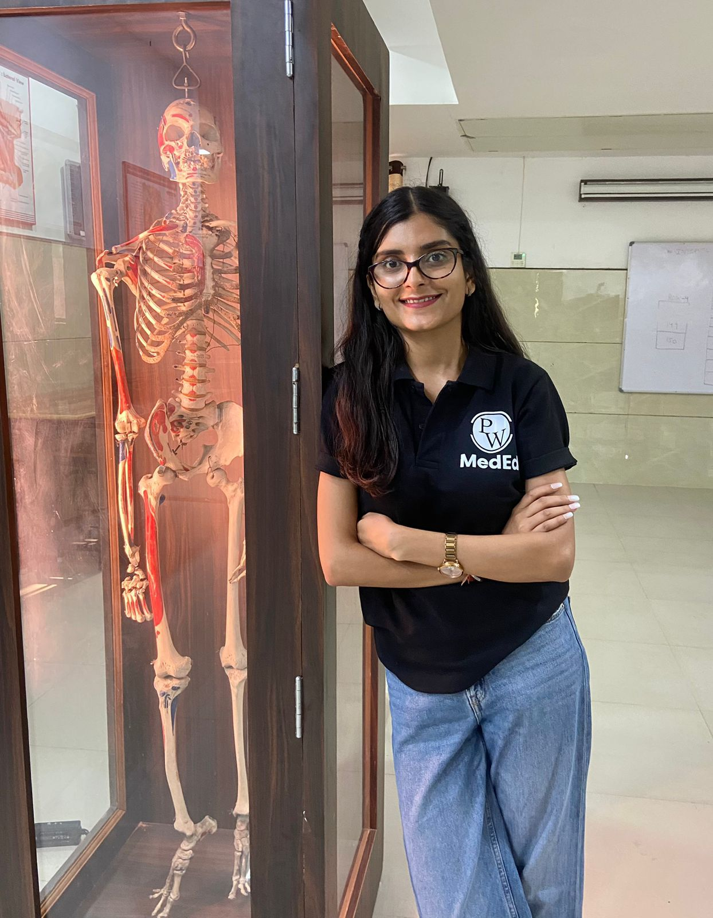
Pictorial Journey

Slide 20
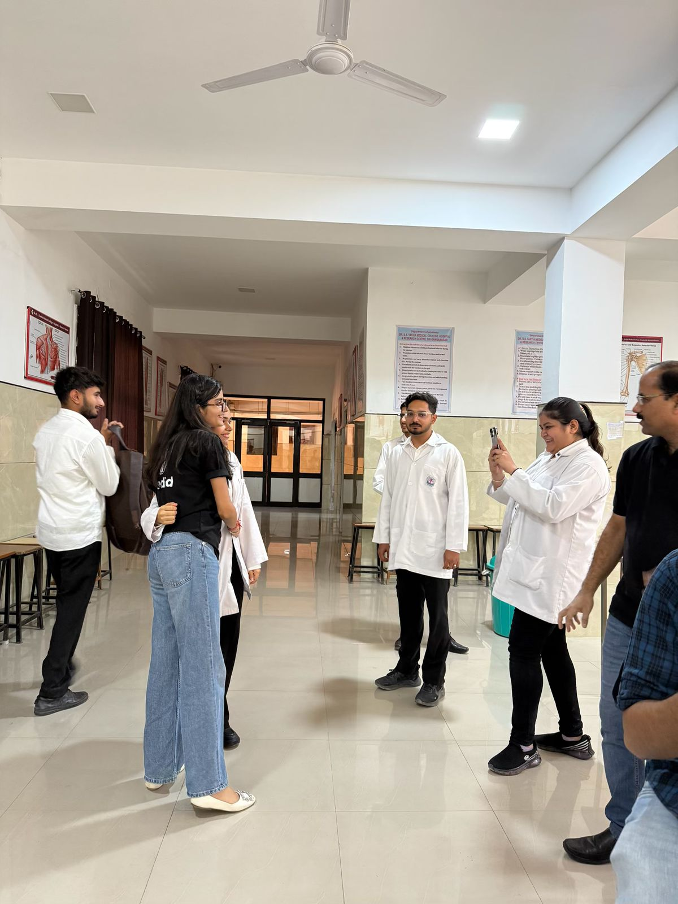
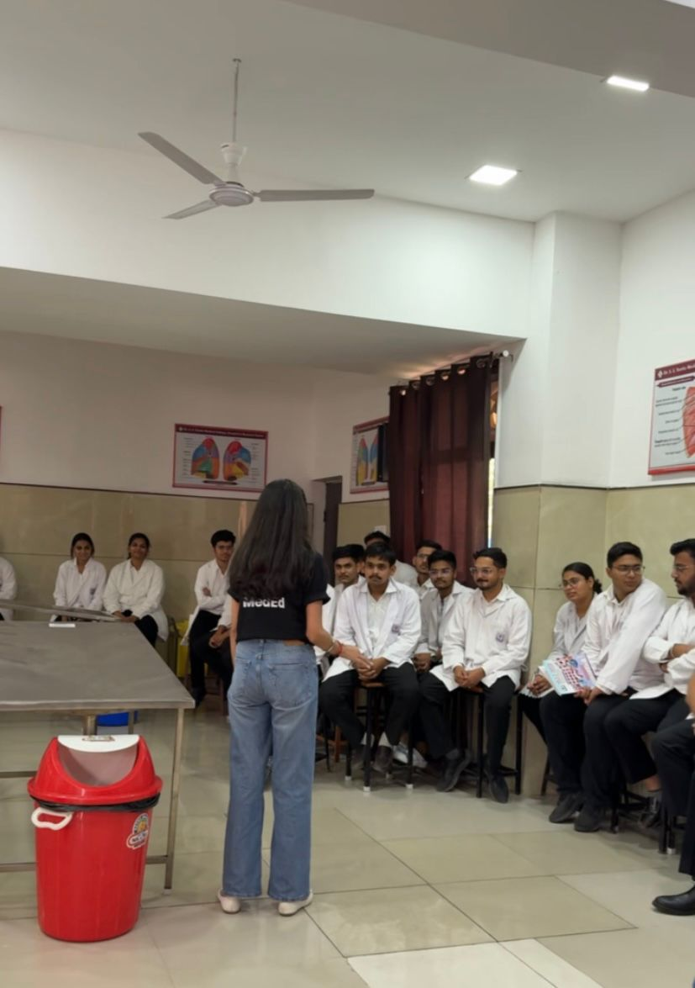

Slide 21
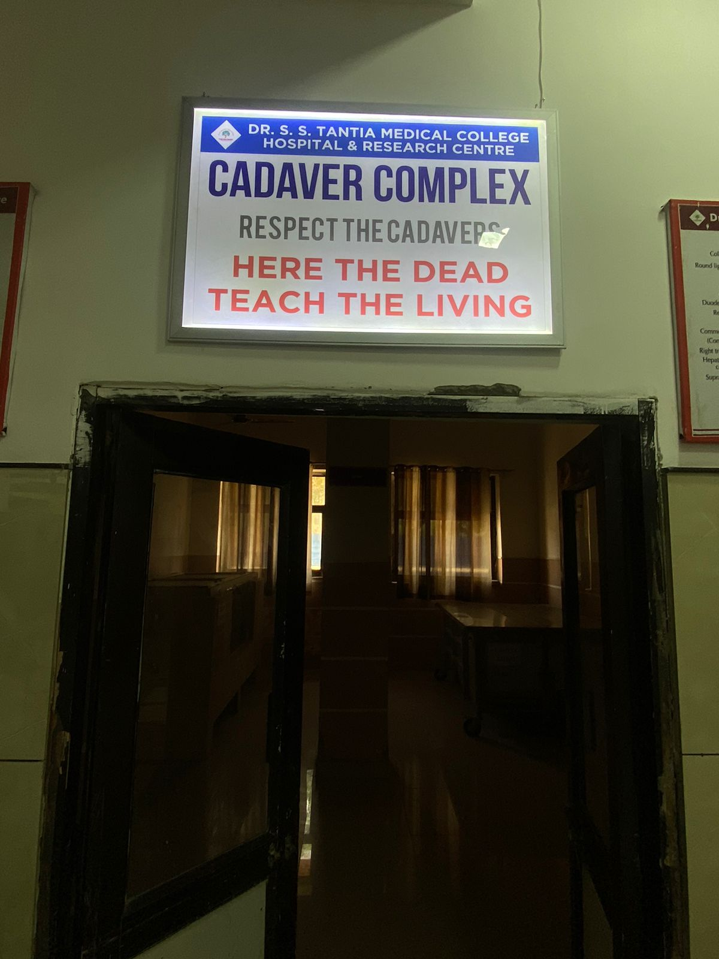
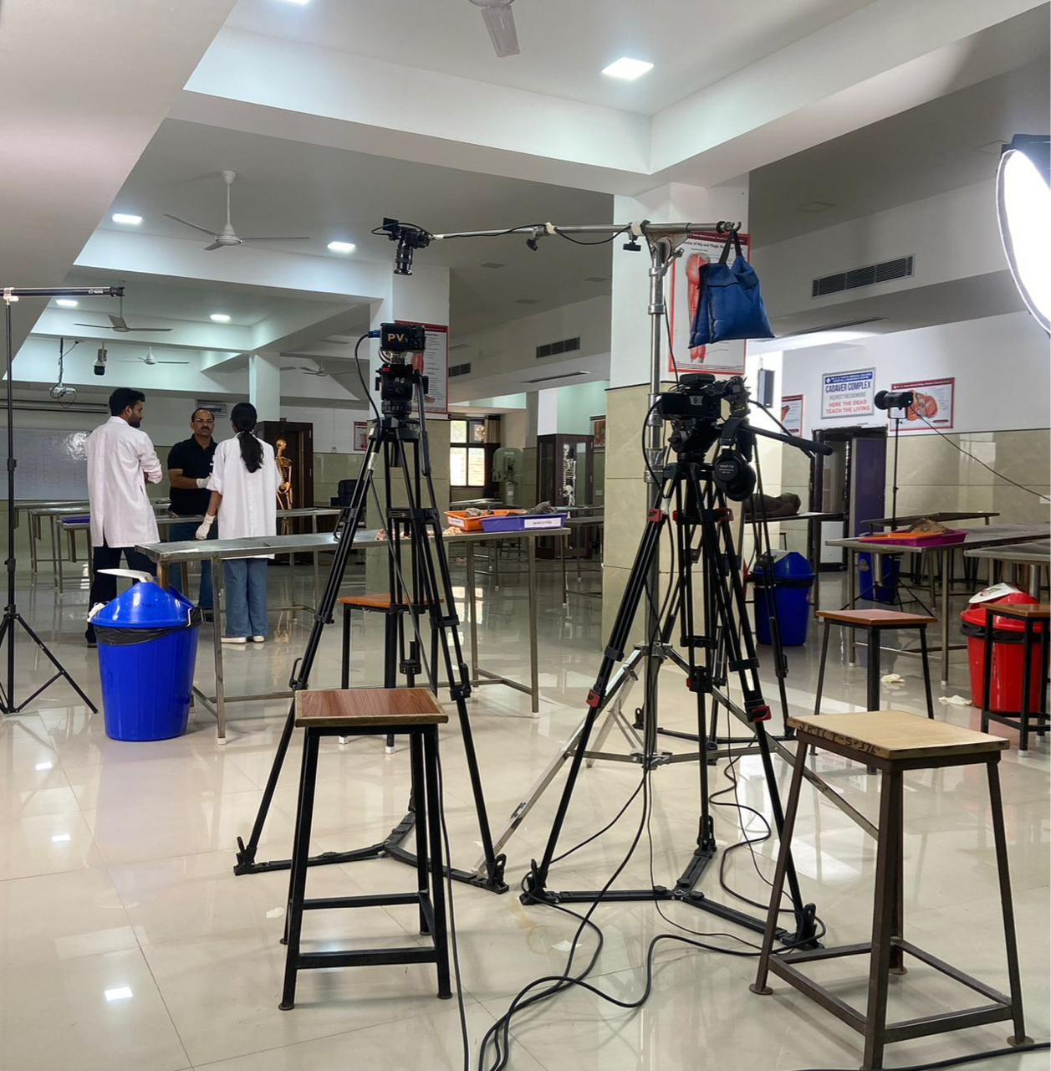

Slide 22
Thank You

