Slide 1

Assessment of Awareness and Utilization of Antenatal Care Services among Urban Slum Population in Delhi
By: Manish Prajapat
Faculty Mentor: Dr. Vinay Tripathi
IIHMR Delhi

Slide 2
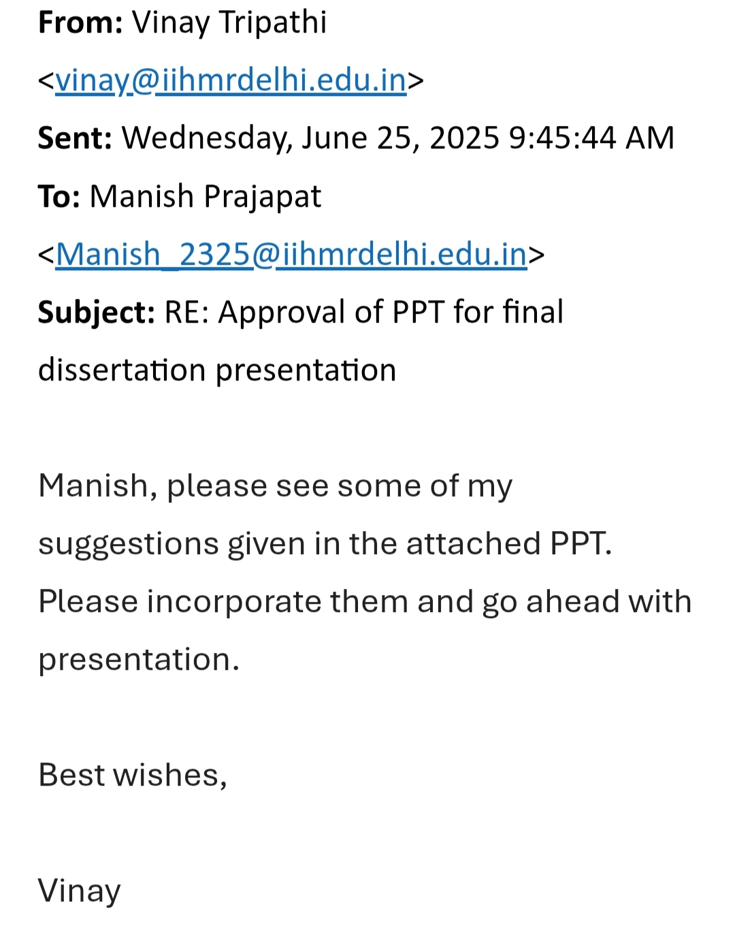
Mentor Approval

Slide 3
Introduction (1/2)
ANC stands for Antenatal Care.
It refers to the regular medical and health check-ups that a pregnant woman receives during her pregnancy to ensure the health and well-being of both the mother and the fetus.
Key components:
1. Early registration of pregnancy (preferably in the first trimester)
Minimum 4 ANC Visits (as per WHO and Indian guidelines)
Essential Services Provided:
  Blood pressure and weight monitoring
  Blood and urine tests
  Iron-Folic Acid (IFA) supplementation
  Tetanus toxoid injections
  Ultrasound scans
  Counseling on diet, hygiene, birth preparedness, and danger signs

Slide 4
Introduction (2/2)
• Antenatal care (ANC) is essential for maternal and fetal health.
• Urban slums in India face systemic barriers to ANC.
• Study focuses on slum population in Delhi.
• Only 58% of urban slum women complete 4 ANC visits (NFHS-5).
• Govt schemes: JSY, PMSMA, RMNCH+A.
• Issues: fragmented health services, low literacy, economic constraints.

Slide 5
Objectives of Your Study
1. To assess awareness about ANC services among women.
2. To assess utilization of ANC services.
3. To identify influencing factors.

Slide 6
Methodology (1/2)
• Study Design: Cross-sectional
• Sample Size: 384 women
• Population: Women aged 15–49 (pregnant or delivered in last 12 months)
• Tools: Semi-structured questionnaire, based on NFHS-5 and WHO ANC guidelines
• Sampling technique: Purposive Selection of Urban Slum Areas
• Variables: Age, marital status, education, income, occupation
• Family type and number of children also recorded

Slide 7
Methodology (2/2)
Data Analysis
Data were entered in Microsoft Excel and analyzed using SPSS (Statistical Package for the Social Sciences).
Descriptive statistics (frequency, percentage, mean, standard deviation) were used to summarize variables.
Chi-square tests were used to assess the association between socio-demographic variables and ANC utilization.
P-values < 0.05 were considered statistically significant

Slide 8
Results (1/4)
Awareness of ANC Services
Total Respondents: 382
Heard of ANC: 371 (97.1%)
Not Heard of ANC: 11 (2.9%)

Slide 9
Results (2/4)
Utilization of ANC Services
Total Respondents: 357
Received ANC: 341 (95.5%)
Did Not Receive ANC: 16 (4.5%)

Slide 10
Results (3/4)
Awareness vs Education Level
Utilization vs Income Level
Education Level | Heard of ANC | Not Heard
Graduation and above | 19 | 0
High school (11–12) | 45 | 5
Intermediate (6–10) | 187 | 2
Primary (1–5) | 94 | 2
No education | 26 | 2
Income Category | Received ANC | Did Not Receive
Low | 59 | 3
Lower-Mid | 273 | 11
Upper-Mid | 7 | 2
High | 2 | 0

Slide 11
Results (4/4)
Statistical Test Results
Test | Chi² | p-value | Interpretation
Awareness vs Education | 13.91 | 0.0076 | Significant association: Education impacts awareness.
Utilization vs Income | 6.97 | 0.0727 | Not statistically significant at 0.05 level.
T-test (Age vs ANC Utilization) | 0.189 | 0.852 | No significant age difference between users and non-users.

Slide 12
Discussion (1/2)
This study aimed to assess the level of awareness and utilization of antenatal care (ANC) services among women residing in urban slums of Delhi. The findings revealed encouraging levels of both awareness and utilization, suggesting that public health interventions and grassroots outreach efforts may be having a positive effect in these underserved areas.
High Awareness and Utilization Rates
The results show that 97.1% of the women surveyed were aware of ANC services, and 95.5% reported utilizing these services during their most recent pregnancy. These figures are significantly higher than previous national estimates, such as the NFHS-5 report, which indicated that only about 58% of women in urban slums completed the recommended ANC visits

Slide 13
Discussion (2/2)
Impact of Education
A statistically significant relationship was found between education and awareness of ANC services (Chi-square = 13.91, p = 0.0076). Women with higher levels of education were more likely to be aware of the purpose
Utilization Not Significantly Affected by Income
Contrary to common assumptions, the association between income levels and ANC utilization was not statistically significant (p = 0.0727), although descriptively, utilization was slightly lower among women in higher income categories.
No Significant Age Difference
The t-test results showed no significant difference between the ages of women who utilized ANC services and those who did not (p = 0.852). This finding implies that age is not a major determinant in ANC utilization within this population, further reinforcing the universality of outreach efforts.

Slide 14
Conclusion
This study highlights a notably high level of awareness and utilization of antenatal care (ANC) services among women residing in urban slums of Delhi. The majority of participants demonstrated knowledge about ANC and actively sought these services during pregnancy, reflecting the positive impact of ongoing public health programs and the outreach efforts of community health workers.
The significant association between education and ANC awareness underscores the importance of improving female literacy as a long-term strategy to enhance maternal health.
Despite these encouraging findings, the study also identified a small yet important fraction of women who remain unaware of or unable to access ANC services. These gaps indicate that barriers such as lack of social support, limited health literacy, or structural challenges persist even in urban settings where healthcare facilities are relatively more accessible.

Slide 15
References
Ministry of Health and Family Welfare (MoHFW), Government of India.
National Health Mission – RMNCH+A Strategy.
https://nhm.gov.in
International Institute for Population Sciences (IIPS) and ICF. (2021).
National Family Health Survey (NFHS-5), India: Delhi.
Mumbai: IIPS.
World Health Organization (WHO). (2016).
WHO Recommendations on Antenatal Care for a Positive Pregnancy Experience.
Geneva: World Health Organization.
https://www.who.int/publications/i/item/9789241549912
Awasthi, A., Pandey, C. M., & Chauhan, R. K. (2020).
Utilization of antenatal care services and its determinants among slum dwellers in urban India: Evidence from NFHS-4.
BMC Pregnancy and Childbirth, 20, 241.
https://doi.org/10.1186/s12884-020-02933-z
Gupta, S., Yadav, S., & Saini, S. K. (2019).
Antenatal care utilization among women in urban slums of North India.
International Journal of Community Medicine and Public Health, 6(3), 1103–1107.
https://doi.org/10.18203/2394-6040.ijcmph20190586

Slide 16
INVOLVEMENT IN COMMUNITY OUTREACH PROGRAMME (COP) ACTIVITIES
Total no. of visits done by the Student: 15
Activities done by the student:
Mapping & listing
Health intervention delivery
Health Education & Awareness Campaigns
Door to door surveys
Conducting in-depth interviews and focused group discussion

Slide 17
KEY LEARNING FROM COP ACTIVITIES
Identification of vulnerable communities
understanding community needs
Public awareness approaches
Building trust and relationships
Promoting civic engagement
Fostering a sense of collective responsibility

Slide 18
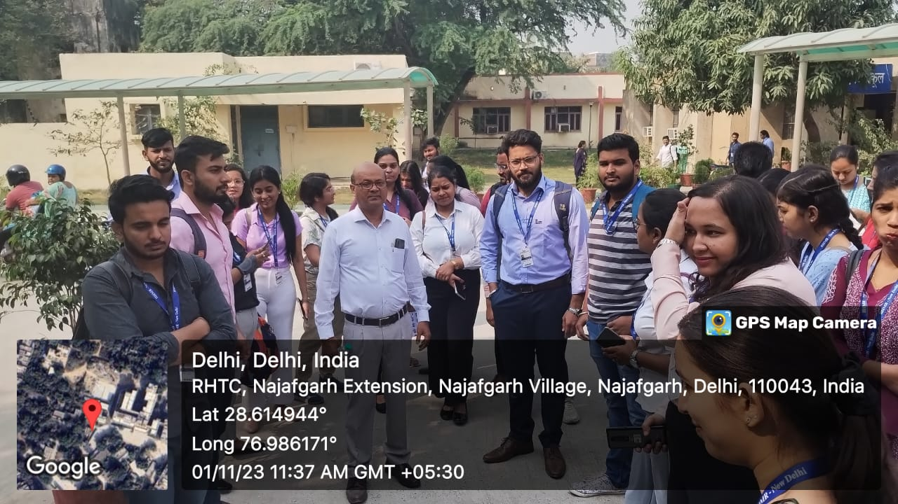
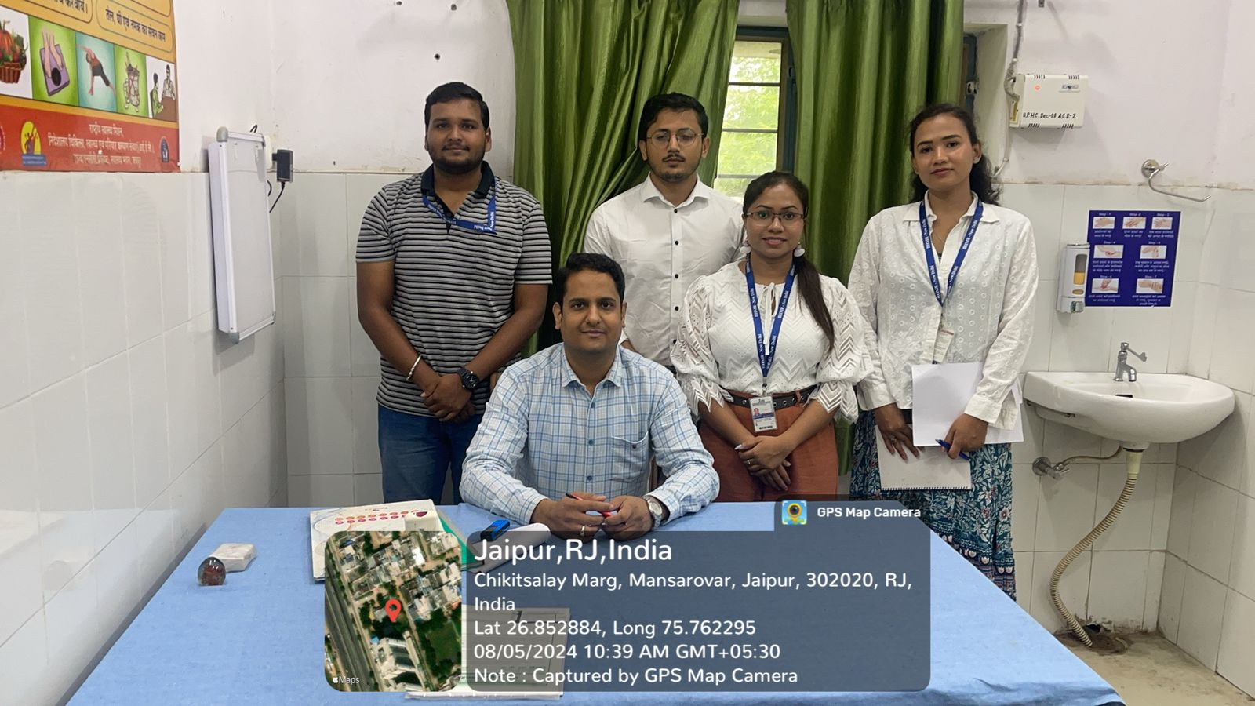
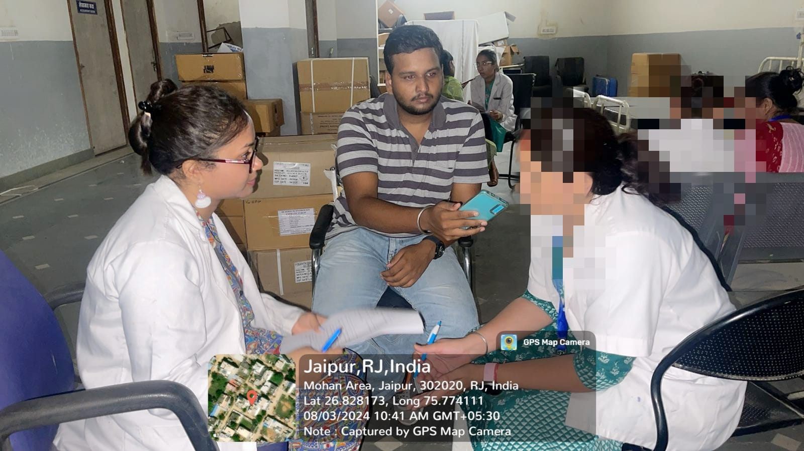
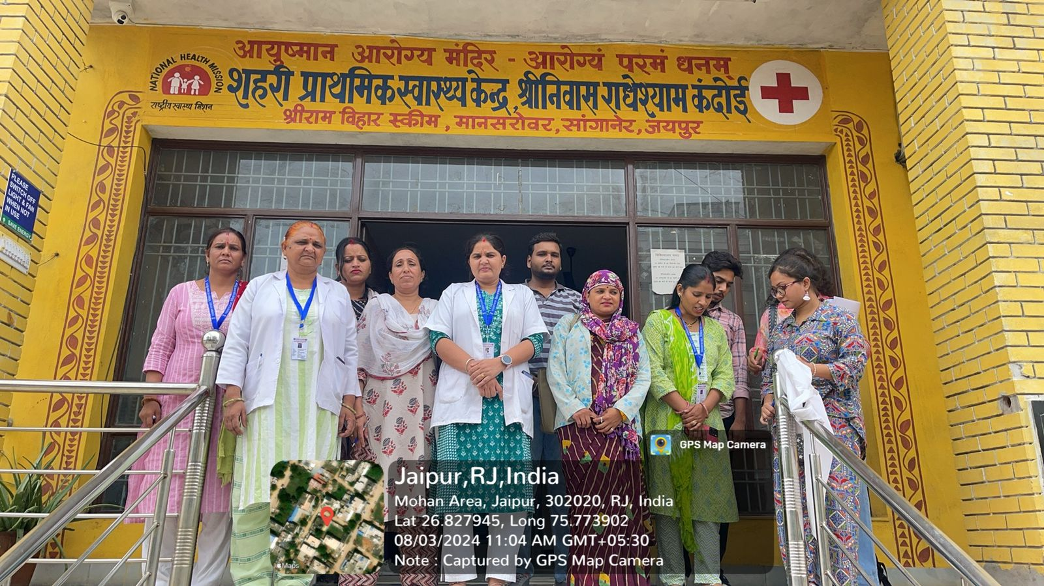
COP FIELD ACTIVITIES PHOTOGRAPHS

Slide 19
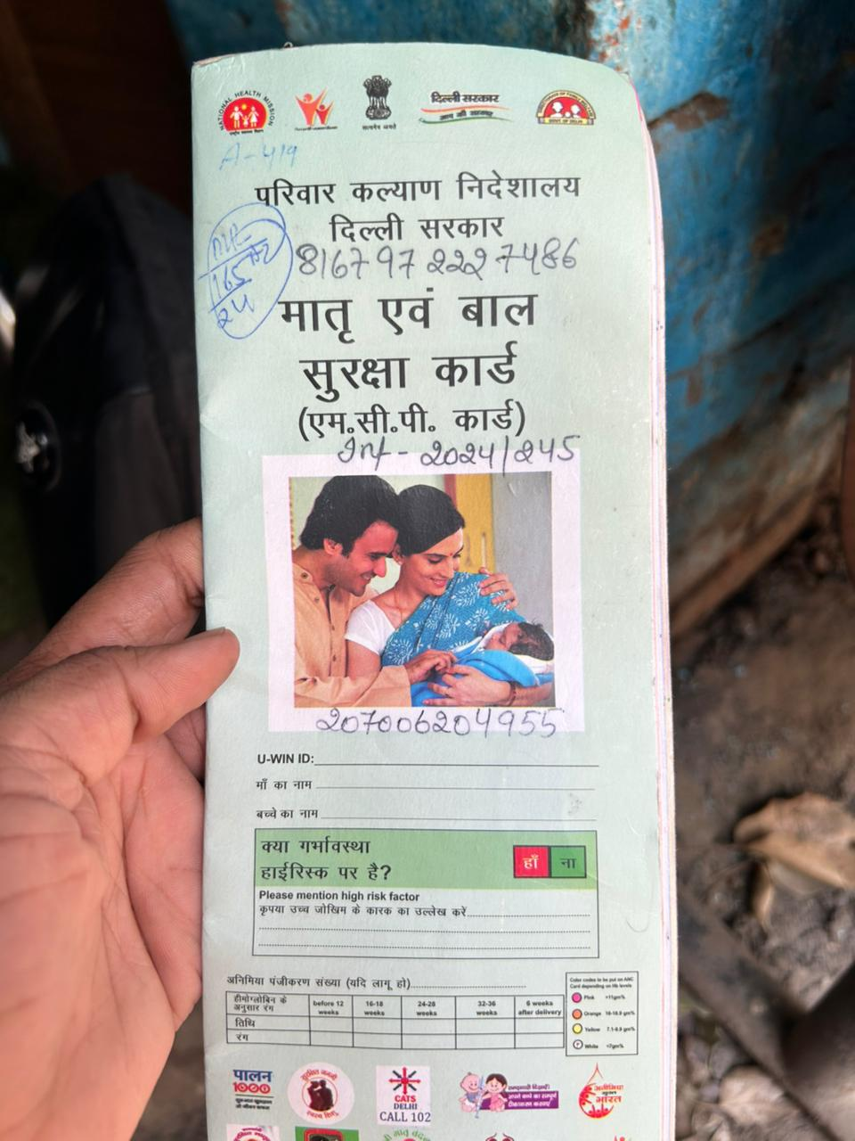
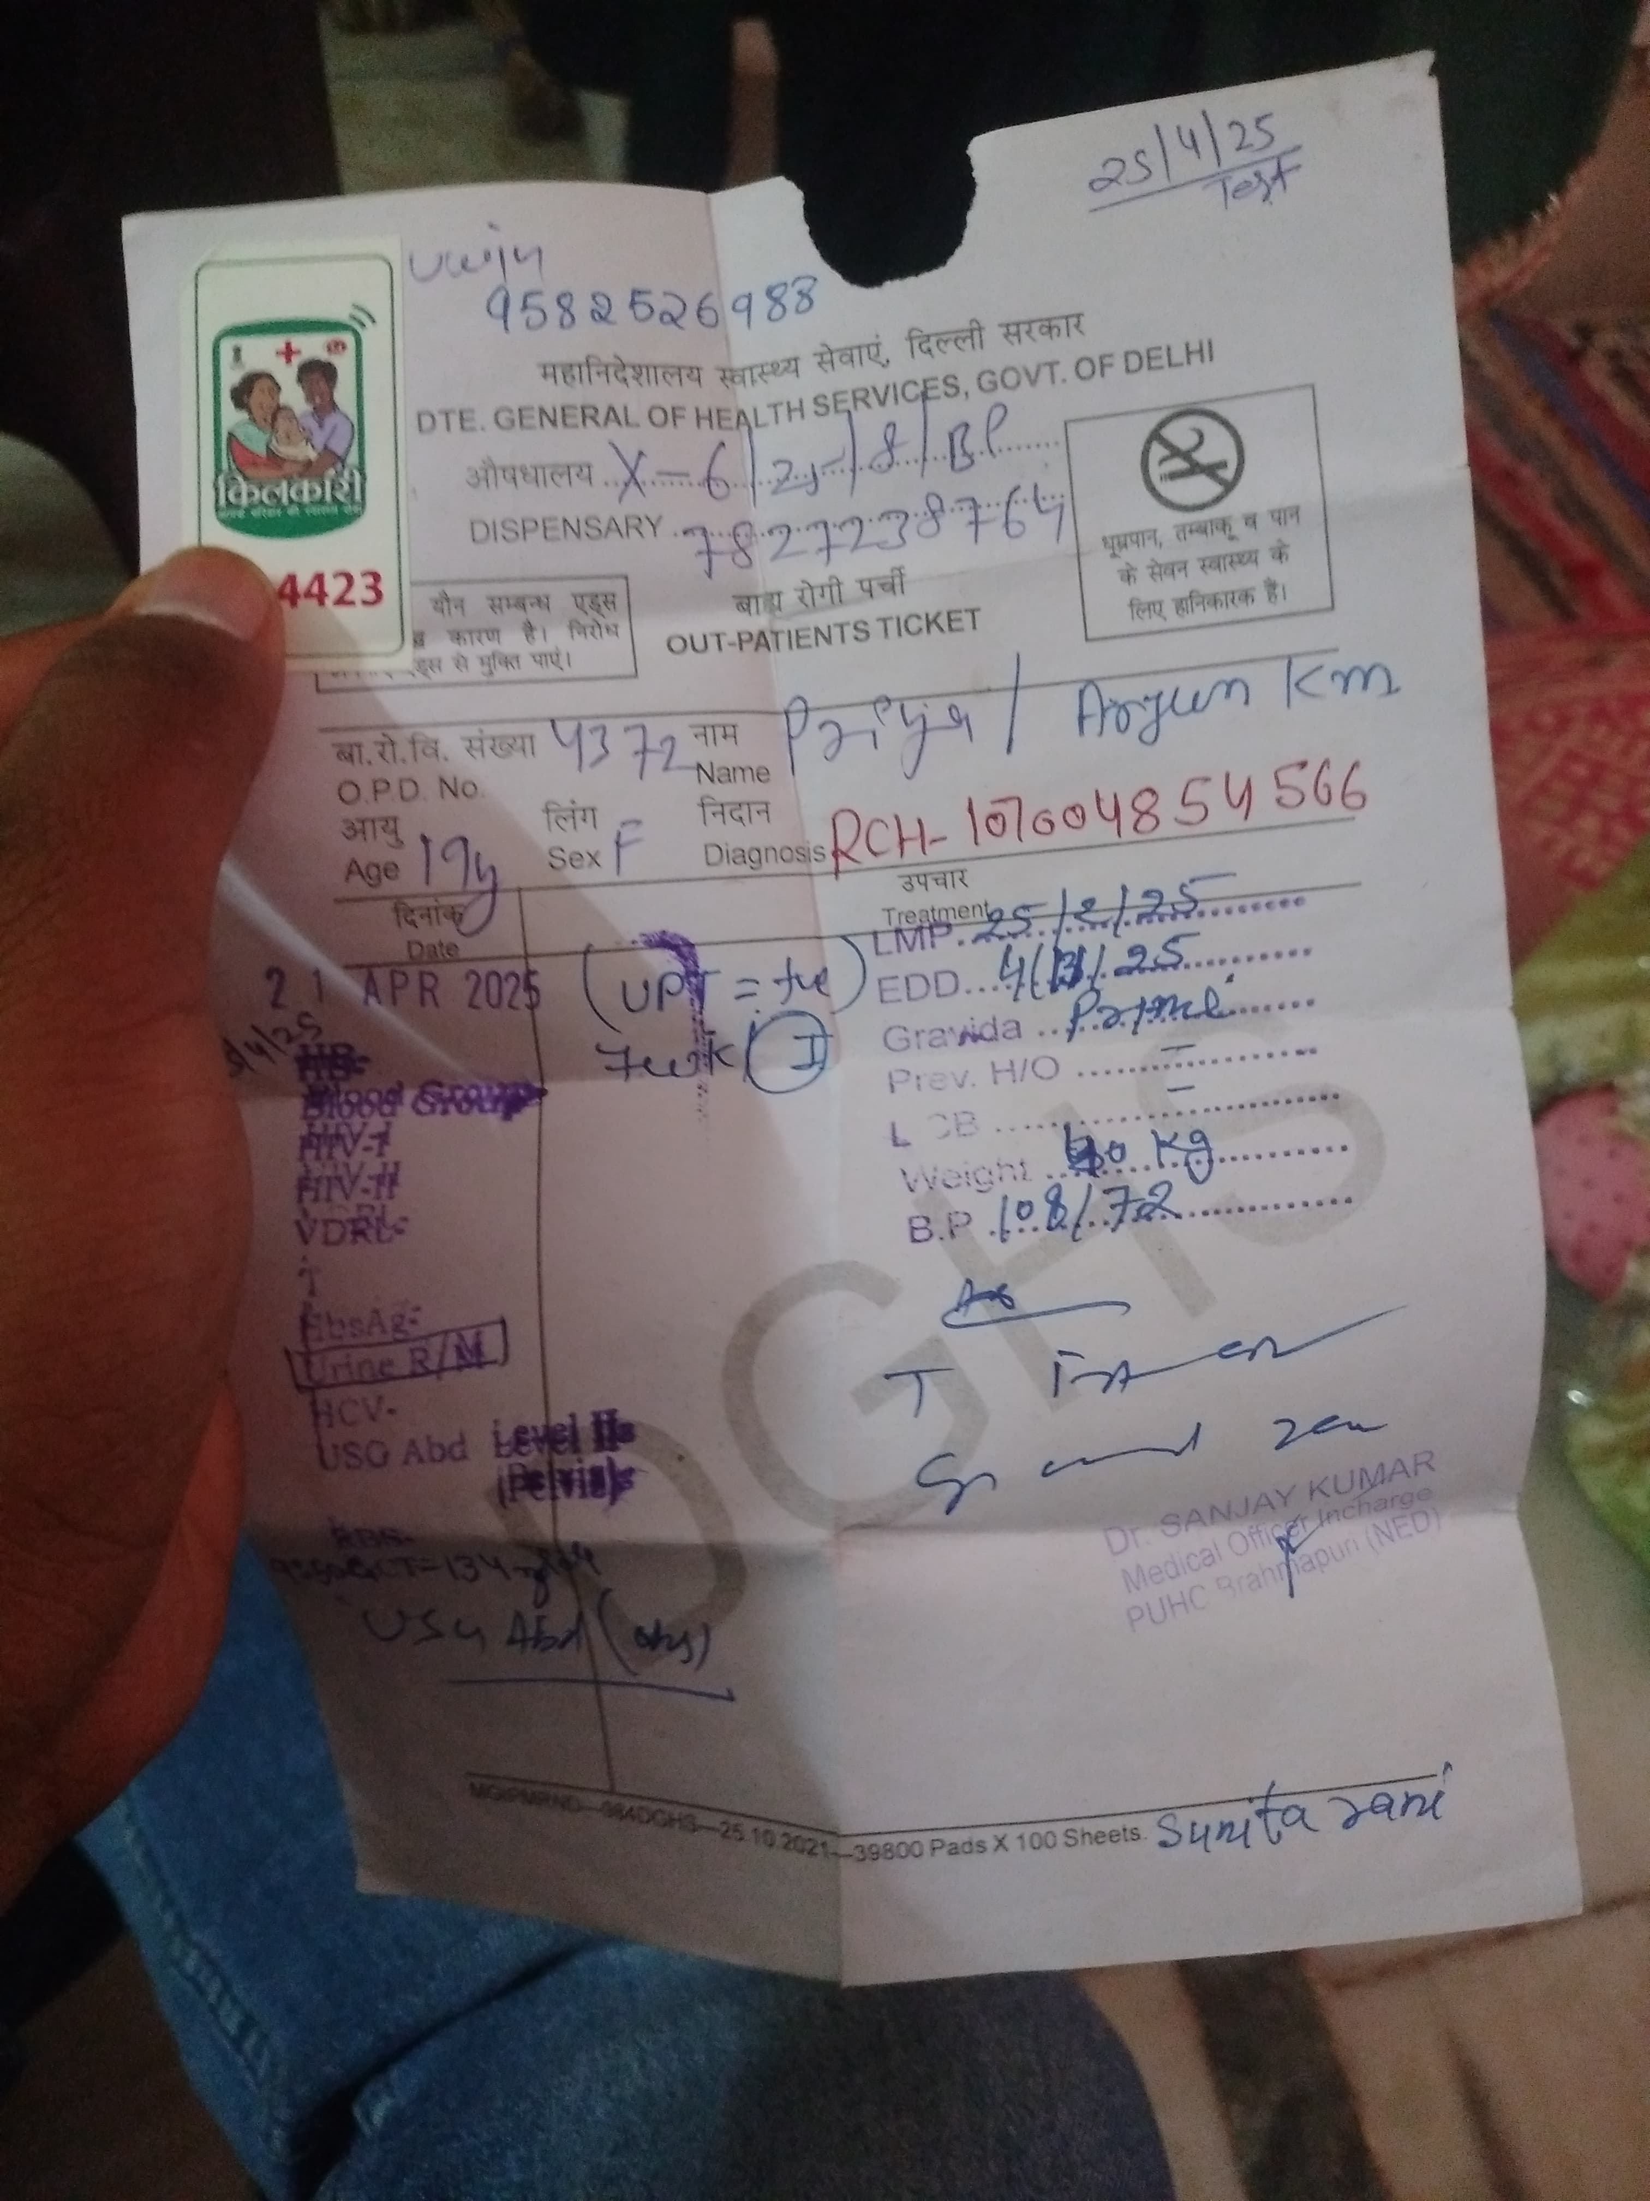

Pictorial Journey (1/2)

Slide 20
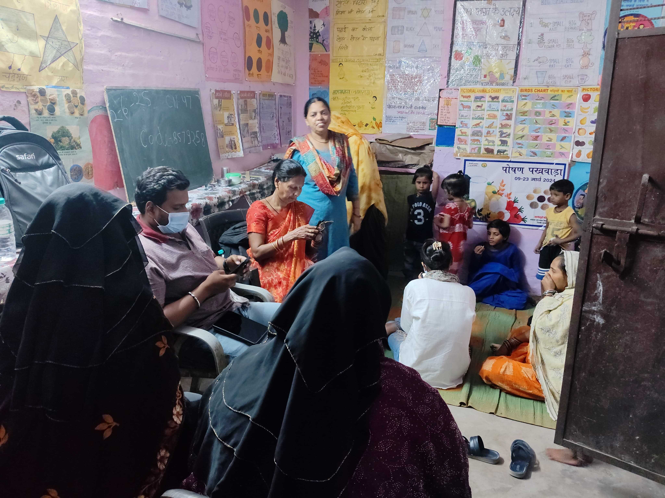
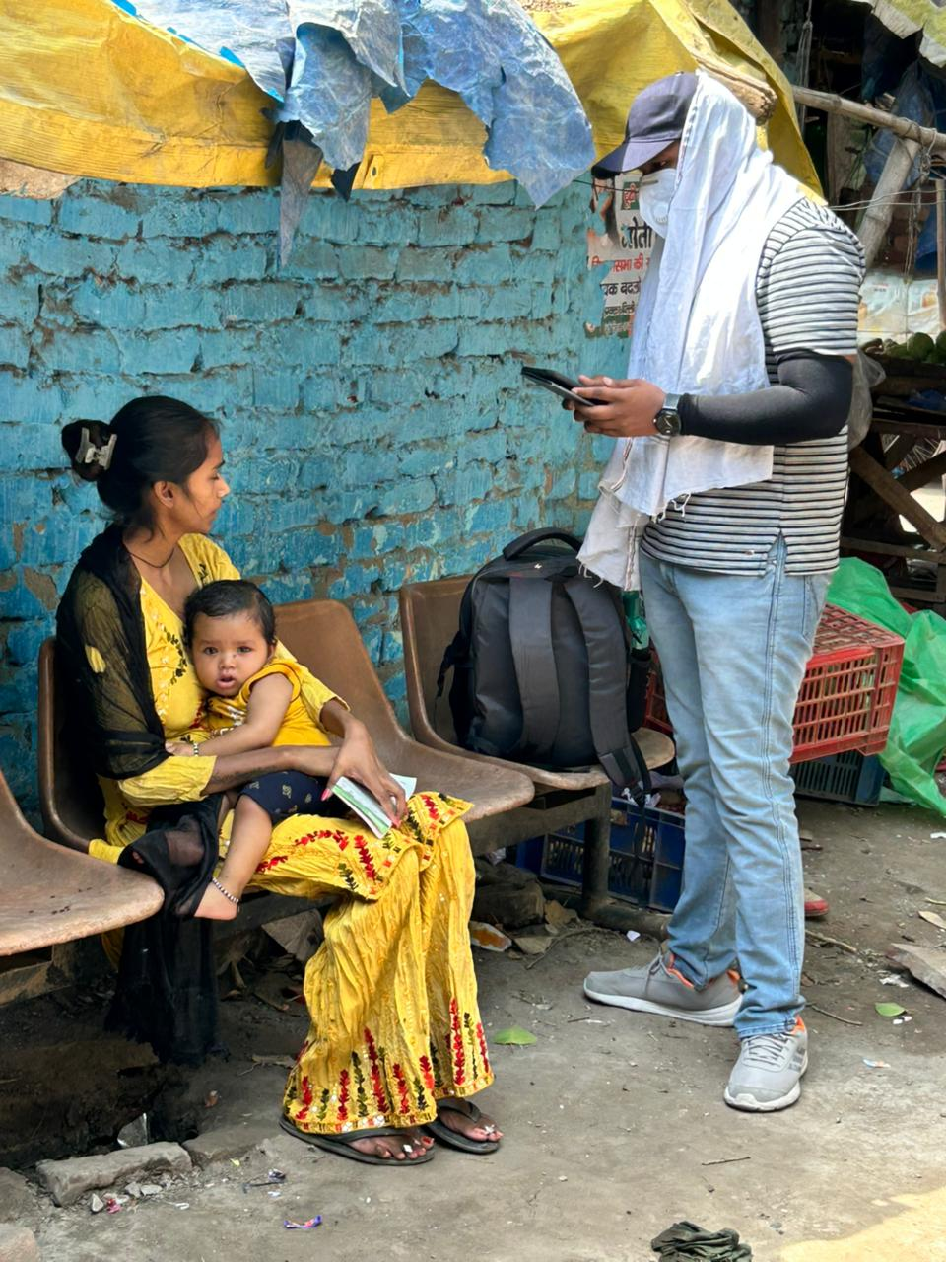
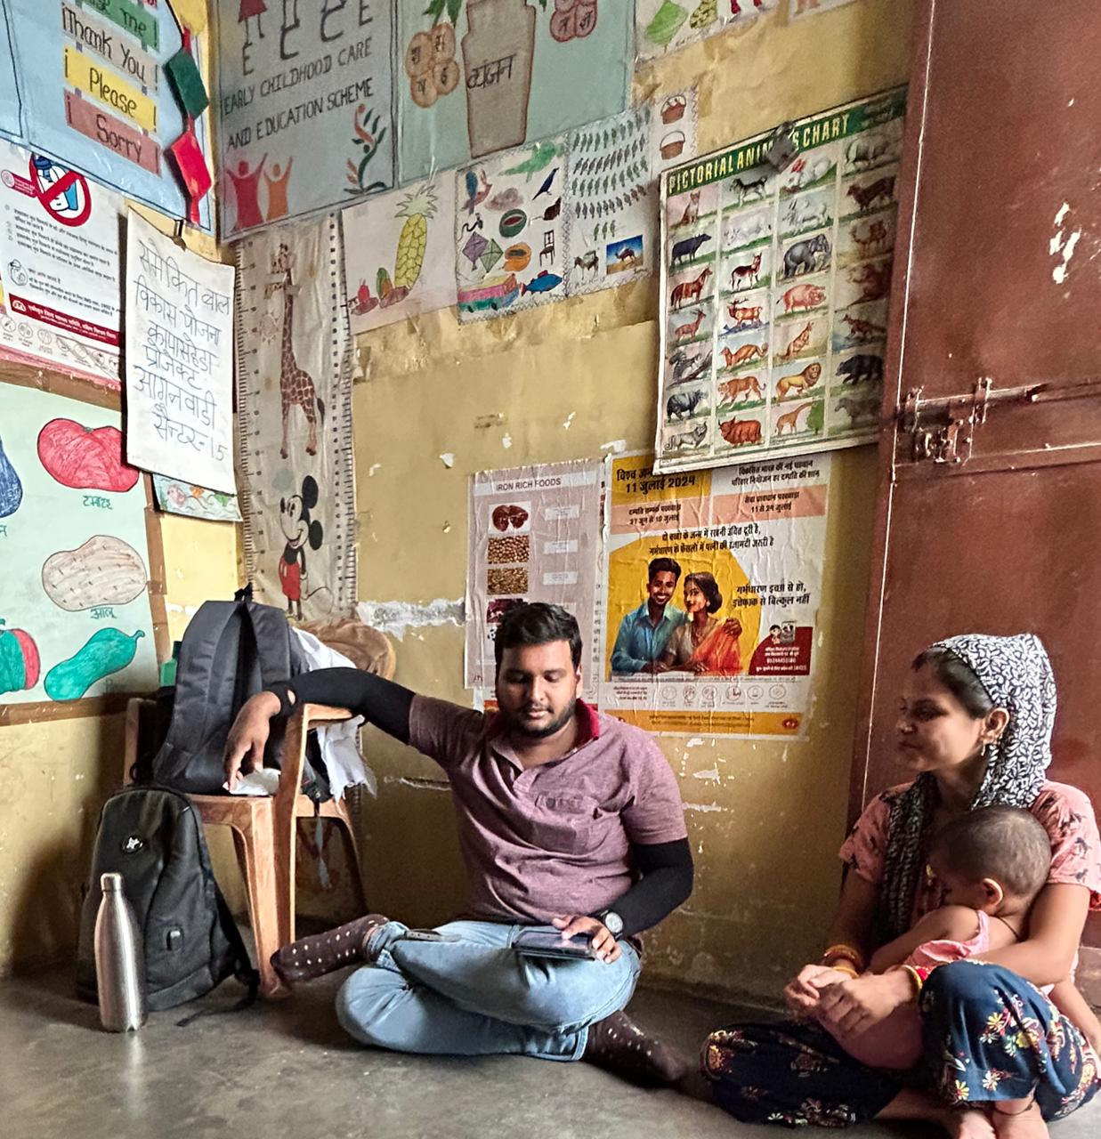
Pictorial Journey (2/2)

Slide 21
Thank You
Any Questions

