Slide 1

To Assess the Impact of Community Outreach, Patient Support and Caregiver Sensitization Programs on Cancer Awareness Among Residents of Barpeta and Dibrugarh Districts
Integra Ventures Services Pvt. Ltd.
Public Health Vertical
Dr. Ratika Samtani
IIHMR Delhi

Slide 2
Mentor Approval

Slide 3

Introduction
Cancer remains a leading cause of morbidity and mortality worldwide(1)
Projections indicate that by 2050, new cancer cases could rise to 35 million, primarily due to population growth and aging. Cancer is the second leading cause of death in the United States following heart disease.(2)
According to Global Cancer Observatory (GLOBOCAN) data published in 2020, breast and cervical cancers ranked 1 and 2, respectively, in the cancer types that cause the highest number of overall deaths in India.(3)
The most prevalent ones in India are oral, breast, and cervical cancers . In India, lung cancer accounted for most cancers in males (10.6%), followed by oral (8.4%) and prostate (6.1%). Among females, breast cancer was the commonest (28.8%), followed by cervical cancer (10.6%.(4)
Oral cancers, along with oropharyngeal cancers, are the sixth most common malignancy worldwide.(5)
Assam, located in Northeast India, bears a disproportionately high cancer burden compared to the national average.(6)
ACCF conducted 137 awareness camps, sensitizing 4,903 individuals. ASHA workers screened 308,922 people door-to-door, referring 68,037 for further evaluation at Health and Wellness Centers. Additionally, ACCF trained over 3,345 caregivers on treatment modalities, government healthcare schemes, and home care techniques, while providing diagnostic and treatment support to reduce out-of-pocket expenses and prevent treatment discontinuation.
Cancer Screening in Assam | Percentage
Cervical cancer | 0.7%
Breast Cancer | 0.2%
Oral cancer | 0.5%

Slide 4
Objectives of the study
1. To evaluate the effectiveness of community outreach programs in increasing cancer awareness among residents of Barpeta and Dibrugarh districts.
2. To assess the role of patient support in enhancing cancer awareness and understanding of treatment options in the target districts.
3. To assess the impact of caregiver sensitization programs on cancer awareness and caregiving practices.

Slide 5
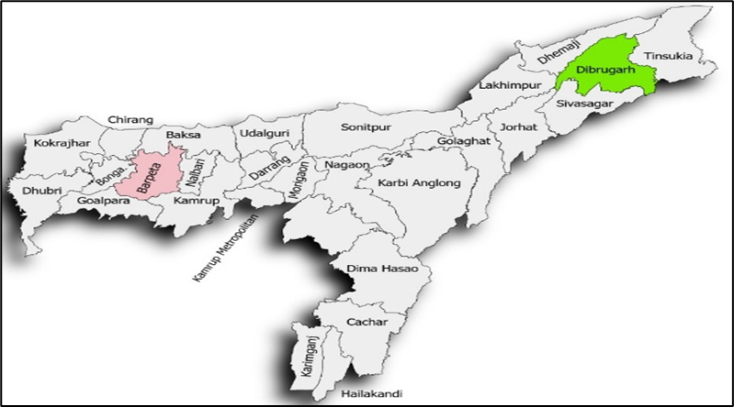
Methodology
Study Geography | Barpeta and Dibrugarh (Assam)
Study Participants | Caregiver , Cancer Patients , Community Member
Study Tool /Instruments | Semi-structured questionnaire ,Key informant Interview , FGD
Data Collection Method / Timeline | Kobo Tool box Software, 20 days
Ethical Consideration | Informed Consent from the Respondents, Ethical approval from ACCF
Data Analysis Study Design | SPSS, Excel (Quantitative) Mix-Method

Slide 6
Methodology
Sampling Methodology: Convenience sampling was adopted to comprehensively assess the effectiveness of community outreach, patients support and caregiver sensitization.
Sample Size Calculation: A 95% confidence interval and a 5% margin of error were chosen for the calculation, alongside a 90% population proportion.
Due to the highly remote and rural setting, 122 sample covered out of 150 intended sample (81%) were successfully conducted in Dibrugarh and 139 sample covered out of 198 intended sample (71%) , with crucial support from the ACCF team, who facilitated the process and provided necessary resources.
The project's sampling methodology was carefully crafted to ensure data accuracy, representativeness, and reliability. It employed a stratified approach, accounting for different beneficiary groups, with sample sizes determined using statistical principles. A total of 261 individuals were selected from Barpeta and Dibrugarh for this study.
Cancer Care Programme Activities | Sample universe Dibrugarh | Samples covered | Sample universe Barpeta | Sample covered | Total Sample Covered
Care Giver Sensitization programme | 62 | 34 | 138 | 79 | 113
Community level Cancer awareness activity | 29 | 29 | 28 | 28 | 57
Patient support for diagnostics, treatment, and other related needs | 59 | 59 | 32 | 32 | 91
Total | 150 | 122 | 198 | 139 | 261

Slide 7
Results
Socio-demographic Characteristics of the Respondents
Finding from the Cancer Patients

Slide 8
Results
Finding from the Cancer Patients Caregiving
Findings from the Caregiving sensitization

Slide 9
Results
Findings from Community Outreach Programs

Slide 10
Discussion
The present study assessed the impact of ACCF’s community outreach, patient support, and caregiver sensitization programs on cancer awareness and caregiving practices in Barpeta and Dibrugarh, Assam. Findings indicate significant improvements in awareness and early detection, especially in Barpeta, where 50% of patients were diagnosed at a pre-cancerous stage and 31% at Stage I.
In contrast, 29% of patients in Dibrugarh were diagnosed at advanced stages. Chemotherapy and surgery were common treatments, with radiation more prevalent in Dibrugarh (35%) than Barpeta (23%). Most patients had health insurance (92% in Dibrugarh, 76% in Barpeta), yet 18% in Barpeta lacked coverage. Cost and transport remain key barriers, underscoring the need for enhanced support mechanisms. Youth engagement was low, and women were the primary participants, reflecting their role in caregiving and health promotion. Overall, the interventions show promise but gaps in early detection, insurance coverage, and accessibility need addressing.

Slide 11
Discussion
The caregiving landscape in Barpeta and Dibrugarh shows a heavy reliance on immediate family members (86% and 100% respectively), with minimal community support (11% in Barpeta). Formal caregiving training remains low—29% in Barpeta and only 3% in Dibrugarh impacting caregiver confidence, which was higher in Barpeta (68%) than Dibrugarh (55%).
Key challenges included financial strain (79% Dibrugarh, 71% Barpeta), emotional stress (52% Barpeta, 39% Dibrugarh), and difficulty understanding medical instructions (61% Barpeta, 17% Dibrugarh).Participation in awareness programs was higher in Barpeta (87%) than Dibrugarh (71%), yet awareness of cancer risk factors was greater in Dibrugarh (74% vs. 63%).
Stigma around cancer remains high in both districts (41%), indicating deep-rooted socio-cultural barriers. Screening uptake varied, with oral screening more common in Dibrugarh (62%) and breast (61%) and cervical (37%) screening higher in Barpeta. However, about one-third in both districts reported no screening, highlighting the need for sustained awareness, caregiver training, stigma reduction, and improved screening access.

Slide 12
Conclusion
ACCF’s outreach in Barpeta and Dibrugarh has significantly improved early detection, treatment uptake, and caregiver involvement, demonstrating the value of targeted community interventions. High insurance coverage and strong female participation are encouraging outcomes. However, challenges such as lack of caregiver training, financial strain, transport barriers, and persistent stigma remain. Screening is still uneven, and youth engagement is limited.
Moving forward, efforts must focus on expanding caregiver support, improving logistics and financial access, addressing stigma, and actively engaging youth and men to ensure inclusive and equitable cancer care.

Slide 13
References
Suwankhong, D., Liamputtong, P., Boonrod, T., Simla, W., Khunpol, S., & Thanapop, S. (2023). Breast Cancer and Screening Prevention Programmes: Perceptions of Women in a Multicultural Community in Southern Thailand. International journal of environmental research and public health, 20(6), 4990. https://doi.org/10.3390/ijerph20064990
Islami F, Goding Sauer A, Miller KD, Siegel RL, Fedewa SA, Jacobs EJ, McCullough ML, Patel AV, Ma J, Soerjomataram I, Flanders WD, Brawley OW, Gapstur SM, Jemal A. Proportion and number of cancer cases and deaths attributable to potentially modifiable risk factors in the United States. CA Cancer J Clin. 2018 Jan;68(1):31-54. doi: 10.3322/caac.21440. Epub 2017 Nov 21. PMID: 29160902.
Arzanova E, Mayrovitz HN. The Epidemiology of Breast Cancer. In: Mayrovitz HN, editor. Breast Cancer [Internet]. Brisbane (AU): Exon Publications; 2022 Aug 6. Chapter 1https://www.ncbi.nlm.nih.gov/books/NBK583819/ doi:10.36255/exon-publications-breast-cancer-epidemiology
Shekhar S, Sharma C, Thakur S, Raina N. Cervical cancer screening: knowledge, attitude and practices among nursing staff in a tertiary level teaching institution of rural India. Asian Pac J Cancer Prev. 2013;14(6):3641-5. doi: 10.7314/apjcp.2013.14.6.3641. PMID: 23886159.
Dikshit R, Gupta PC, Ramasundarahettige C, Gajalakshmi V, Aleksandrowicz L, Badwe R, Kumar R, Roy S, Suraweera W, Bray F, Mallath M, Singh PK, Sinha DN, Shet AS, Gelband H, Jha P; Million Death Study Collaborators. Cancer mortality in India: a nationally representative survey. Lancet. 2012 May 12;379(9828):1807-16. doi: 10.1016/S0140-6736(12)60358-4. Epub 2012 Mar 28. Erratum in: Lancet. 2012 May 12;379(9828):1790. PMID: 22460346.
Lowy DR, Schiller JT. Reducing HPV-associated cancer globally. Cancer Prev Res (Phila). 2012 Jan;5(1):18-23. doi: 10.1158/1940-6207.CAPR-11-0542. PMID: 22219162; PMCID: PMC3285475.
Harsha Kumar H, Tanya S. A Study on Knowledge and Screening for Cervical Cancer among Women in Mangalore City. Ann Med Health Sci Res. 2014 Sep;4(5):751-6. doi: 10.4103/2141-9248.141547. PMID: 25328788; PMCID: PMC4199169.

Slide 14
INVOLVEMENT IN COMMUNITY OUTREACH PROGRAMME ACTIVITIES
Total no. of visits done by the Student: 1
Day-wise activities done by the student:
Menstrual awareness camp done in Delhi urban slum
Understanding Menstruation: Educate on the menstrual cycle, its biological basis, and dispel myths and misconceptions.
Hygiene Practices: Promote the use of clean, safe menstrual products and proper disposal methods to prevent infections.
Access and Affordability: Raise awareness about available menstrual products, low-cost options, and government schemes.
Breaking the Stigma: Address taboos and encourage open discussions at home, schools, and within the community.

Slide 15
KEY LEARNING FROM COP ACTIVITIES
Increased Awareness: Outreach efforts significantly improved knowledge about the menstrual cycle, hygiene practices, and product usage among adolescent girls and women.
Breaking Silence and Taboos: Safe community spaces encouraged open dialogue, helping to reduce stigma, myths, and shame associated with menstruation.
Behavioral Change: Many participants shifted from unhygienic practices (e.g., using old cloth) to safer options like sanitary pads or reusable products.
Role of Male Engagement: Involving boys and men helped normalize conversations around menstruation and fostered community support.
Need for Continued Engagement: One-time sessions were effective but insufficient—sustained efforts, follow-ups, and peer-led models proved more impactful.
Empowerment Through Knowledge: Girls reported feeling more confident and better equipped to manage menstruation after participating.

Slide 16
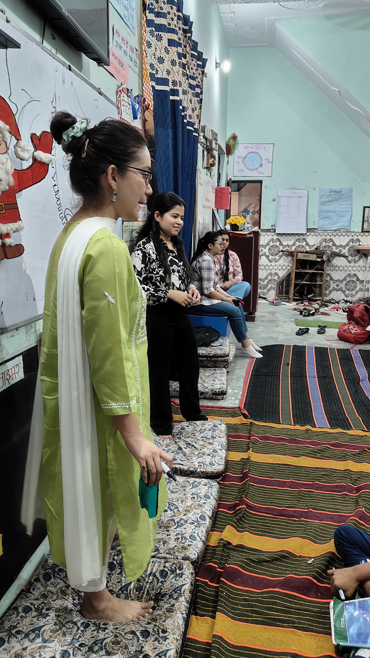
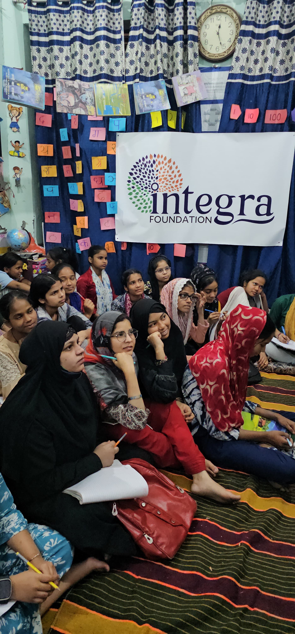
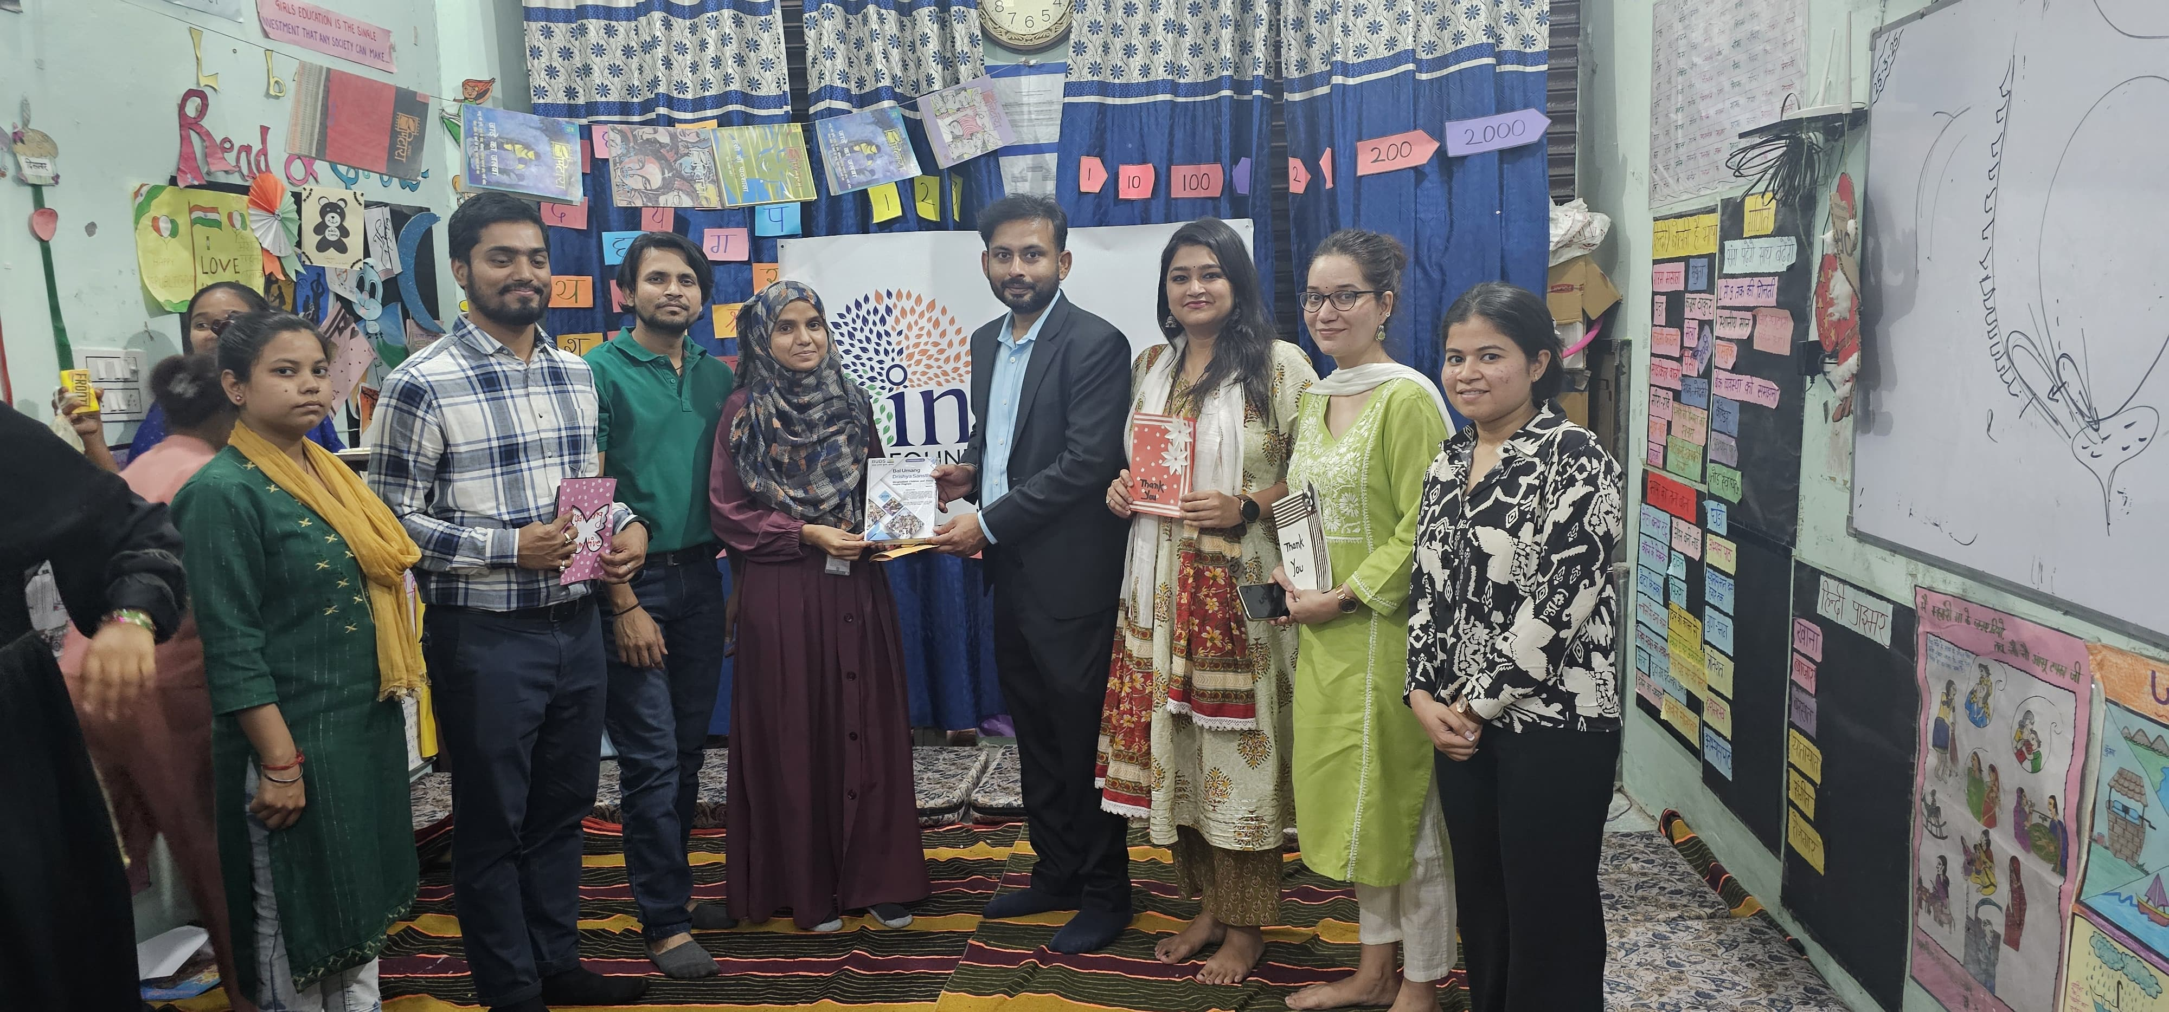
COP FIELD ACTIVITIES PHOTOGRAPHS

Slide 17
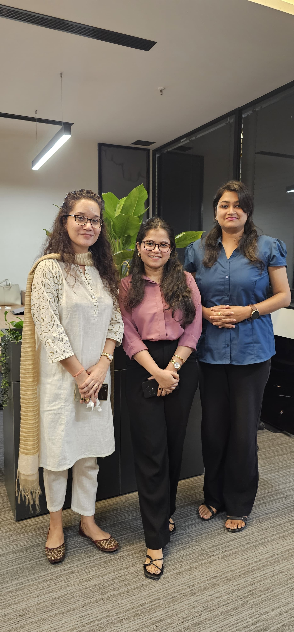
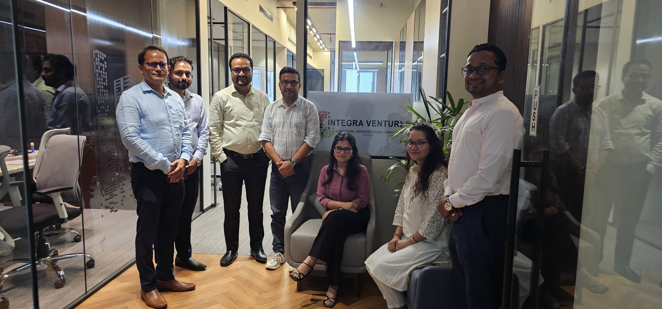
Pictorial Journey

Slide 18

Any Questions

