Slide 1

Dissertation
In
Dell Services, Noida
(September 5- December 5, 2011)
Project Report on:
A study on the process of resolving the incident affecting the Clients’ business and their management after implementing EHR (Vista) in Superspeciality Hospitals
Presented by:
Dr.Neelima Thakur

Slide 2
Contents
Introduction
Need Of The Study
General Objective
Limitations
OPAS
Severities of Incidents
Observations
Conclusion
Result
Recommendations
References

Slide 3
Introduction (About Dell Services)
Dell Systems is an information technology services provider based
in Plano, Texas, USA.(1)
Peter Altabef has served as president and chief executive officer since 2004.
H. Ross Perot and eight associates founded Perot Systems in June 1988 after having sold electronic data system (EDS) to General Motors.
On September 21, 2009, Perot Systems agreed to be acquired by Dell for $3.9 billion.

Slide 4
Introduction (About Dell Services)
As a top-five finisher for the third consecutive year, Perot Systems was named to the Fortune magazine “Most Admired Companies in America” list for IT Services in 2008.
The expanded Dell is expected to get better positioned for immediate an long-term growth and efficiency.
The acquisition---Dell has acquired perot systems, creating comprehensive, customer-focused IT-solutions company. The acquisition will result in a compelling combination of two iconic information technology brands.

Slide 5
General Objective
To study the post Go- live incident analysis and their management by restoring service as quickly as possible with the least impact to business operations

Slide 6
Specific Objectives
The specific objectives are as following:
Incident detection and recording
Classification and initial support
Investigation and diagnosis
Resolution and recovery
Incident closure
Incident ownership, monitoring, tracking and communication
Establish incident framework management
Evaluation incident framework management

Slide 7
Need Of The Study
The need of this project is to:
To study the severities of incidents
To study how to quickly resolve the incidents affecting the Clients’ business.
To study the process of Root cause analysis and Request for Change
To process and maintain the data in both the systems
.

Slide 8
Benefits
Updated Incident record (including resolution and/or Work-around)
Resolved and closed Incidents
Communication to Customers
Management information (reports).
Problem Management (Root cause analysis)
Request for Changes to resolve Incidents.
This study will give the idea that what all challenges can be faced ,when a US based software gets implemented in Indian Hospital. So that one can avoid those mistakes.
Same information can be processed and maintained in both the systems.

Slide 9
Data collection tools
Primary data collection- Qualitative in nature
Interaction with Application Support and Maintenance team.
Interaction with Integration team and Configuration team.
Observation and review of the features of HIS and VistA modules.
Direct Observation of the work processes using existing HIS

Slide 10
Secondary data collection
Secondary data – Quantitative in nature
Review of OPAS
Review of HIS Manual.
VistA CPRS user Manual
Integration Requirements and Message profile documents of the organization.
HL7 training document from the organization
Requirement Document of VistA-EHR CPRS Module v1.0 (organization)
Other books, papers, websites and articles.

Slide 11
Limitations
Due to confidentiality issues only part of the methodology could be adopted.
The secondary data collected were allowed to be used in a limited amount.
Certain readings of the client hospital were not allowed to be documented because of confidentiality issues.

Slide 12
Background
The existing HIS in the Hospital currently contains all the modules of Admission, Billing, Lab, Radiology, Pharmacy, Materials Management etc.
The Hospital had implemented VistA that was integrated with the existing Hospital HIS to provide advanced clinical functionality which is limited in the current HIS.

Slide 13
The following types of support are in scope of this procedure:
1st line support : Project executes Service Desk function.
2nd line support: Project receives Tickets (Incident or Requests) from the (Service Desk and works on the Tickets.
3rd line support : Team gets involved only if specialist application knowledge is required for e.g. when code changes are needed.

Slide 14
Descriptions and Definitions
Incident- Any event which is not part of the standard operation of a service and which causes, or may cause, an interruption to, or a reduction in, the quality of that service.
Incident Tracking System- This is an automated or a manual system used to support the Service Management processes, e.g. to record and track. OPAS tool will be used for the same.

Slide 15
Ticket- This can be an Incident, Request for Information or Service request.
Problem- A condition identified as a result of multiple incidents that exhibit common symptoms or as a result of a high impact
Incident Management- The Process responsible to return the IT Service to Users as quickly as possible.

Slide 16
Incident Tracking System
OPAS (Operational Process Applications Suite)
Developed specifically to support service management processes for large and/or complex IT organizations.
It provides -Incident, problem, change, request, and configuration management across the spectrum of IT operational areas such as server support, operations, security and administration, network support, and disaster recovery.

Slide 17
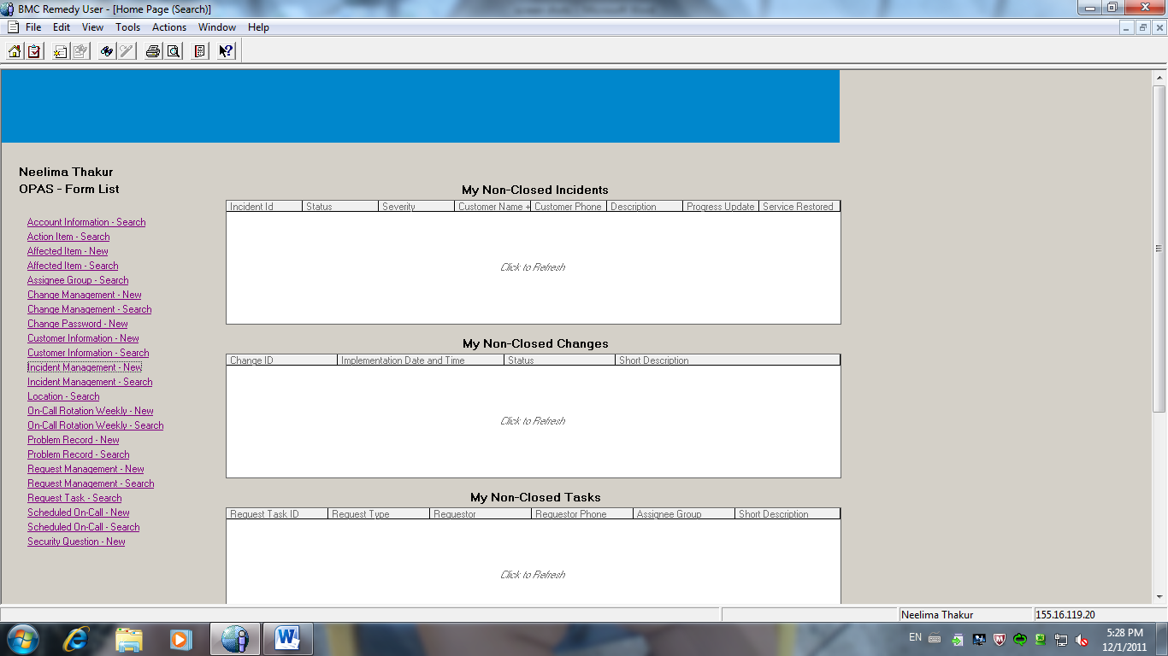

Slide 18
Incident tickets reported in OPAS explorer are assigned
in four groups.
They are:
  MAX-HIS Application Support
  Max-Application Parameters
  Max-Mumps HL7 App Support
  MAX-VistA Application Support

Slide 19
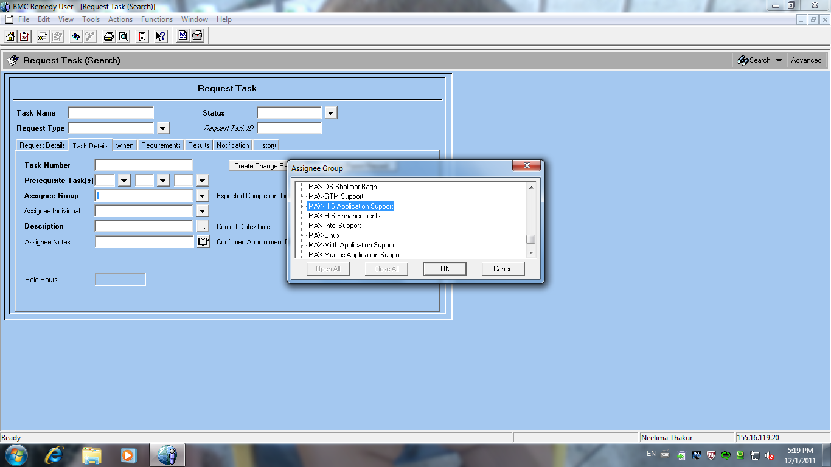

Slide 20
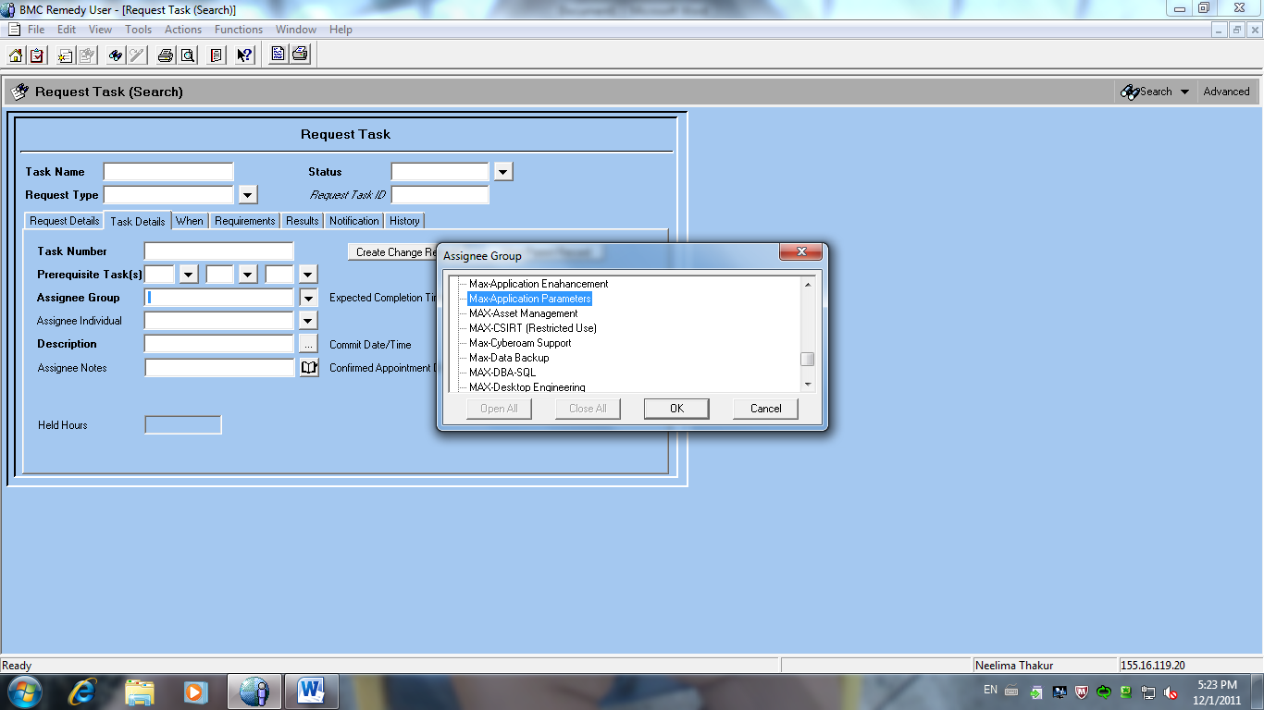

Slide 21
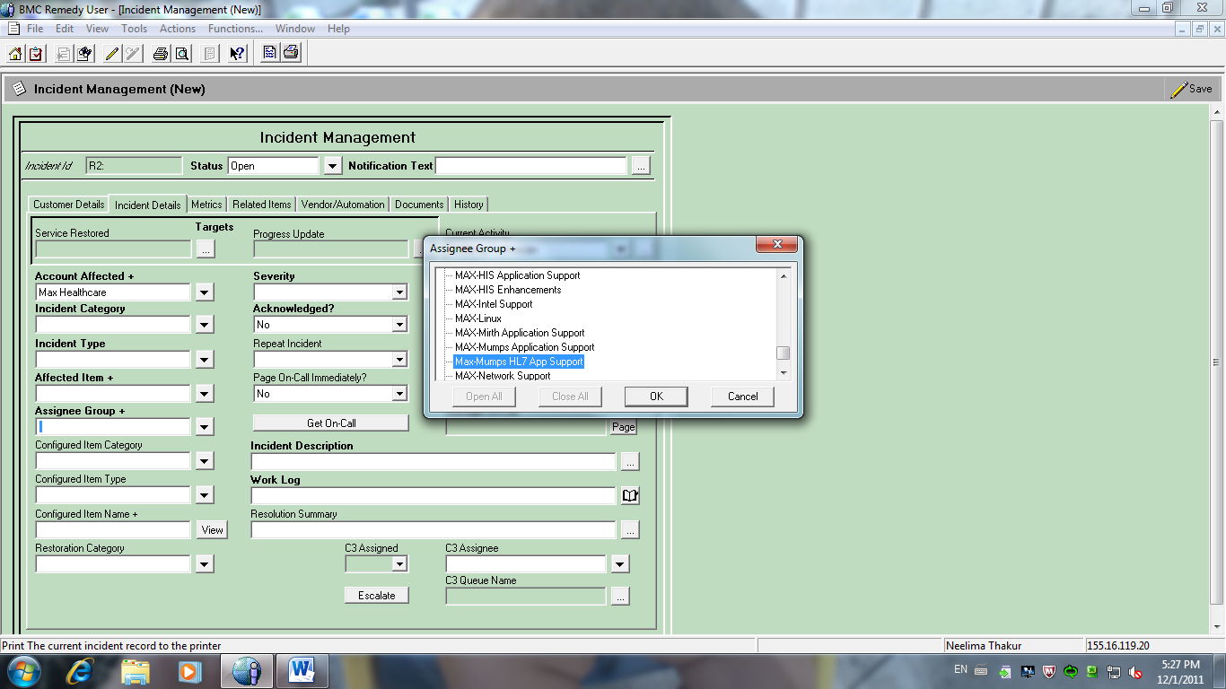

Slide 22
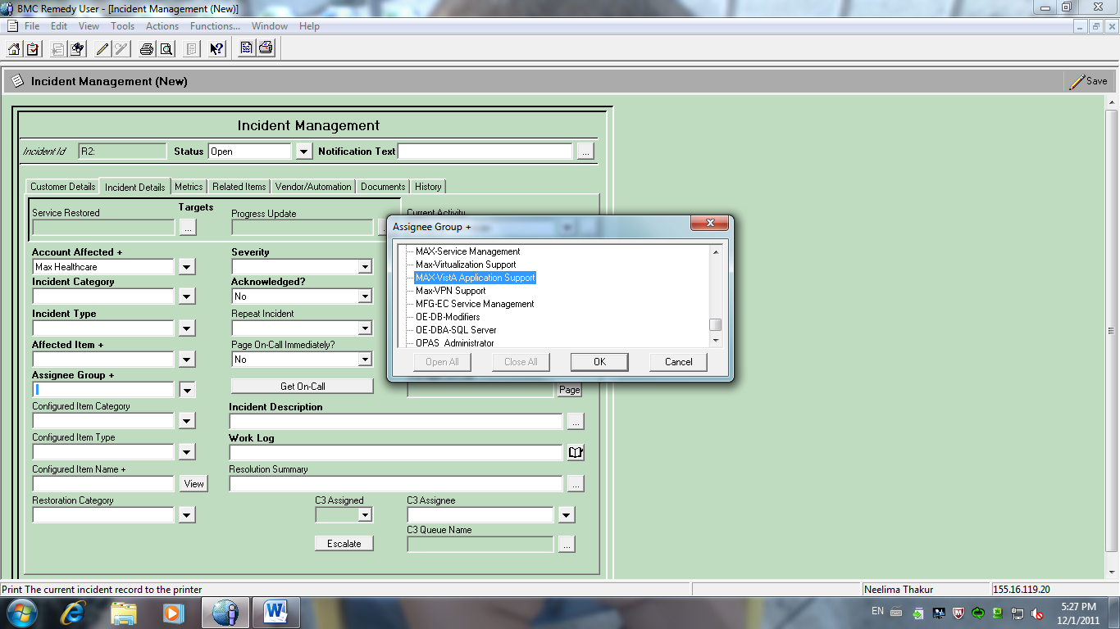

Slide 23
Severities of Incidents
Severity One –
An Incident which severely impacts Customers
business operations or renders it non-operational.
  Example:
  Key applications impacted (e.g. HIS, Vista, putty, Mirth e-mail)
  Key function impacted (e.g. Operation Theater, Front Desk, Admissions, Billing, Discharge)
  A majority of users in one location impacted
  HIS/Mirth/VistA not working for 1 or more facilities
  One or more site operations impacted

Slide 24
Customer Contact SLA:
This Severity Level is responded to on a 24x7 basis and shall have an acknowledgement target of 30 minutes
Resolution SLA:
A Severity One Incident record is considered to be resolved on time if the Service is restored within four hours

Slide 25
2. Severity Two
An Incident which materially impacts Customers business operations or degrades the capacity handing
Examples :-
Part of one site operations impacted
Key application performance degraded
HIS/VistA/Mirth working slow for 1 or more facilities
Primary VistA or Mirth server fails, secondary server working
Internet not working for 1 or more facilities

Slide 26
Customer Contact SLA
This Severity Level is responded to on a 24x7 basis and shall have an acknowledgement target of 1 hour.
Resolution SLA
A Severity Two Incident record is considered to be resolved on time if Service is restored within 24 hours.

Slide 27
3.Severity Three –
An Incident which has minor impact on Customers business operations.
Examples
Up to 20 users impacted in one location
Non-key services impacted (e.g. Wireless service)
HIS/VistA not working for 1 or more departments (not listed as critical) less than 20 users
Problem with multiple printers in same department or on same floor
Defect Reported in HIS/VistA

Slide 28
Customer Contact SLA:
This Severity Level is responded to during the Customer’s local business hours and shall have an acknowledgement target of 1 business day.
Resolution SLA:
A Severity Three Incident record is considered to be resolved on time if Service is restored within three business days.

Slide 29
4.Severity Four –
An incident which impacts only one user and does not disrupt business operations.
Examples
    Problem with 1 printer
    1 User not able to access HIS/VistA
    Defect Reported in HIS

Slide 30
Customer Contact SLA:
This Severity Level is responded to during the Customer’s local business hours and shall have an acknowledgement target of 2 business days.
Resolution SLA:
A Severity Four Incident record is considered to be resolved on time if Service is restored with in five business days

Slide 31
Incident Management Process
Entry Criteria
An incident that is reported by customer.
Inputs
Tickets communicated to Service Desk by various modes such as
Phone Call, Fax or E-Mail.
Through Incident Tracking System
Known Error
Auto generated incidents from HIS/Mirth/VistA error log
Monitoring team can raise an incident if an abnormal system behavior is observed

Slide 32
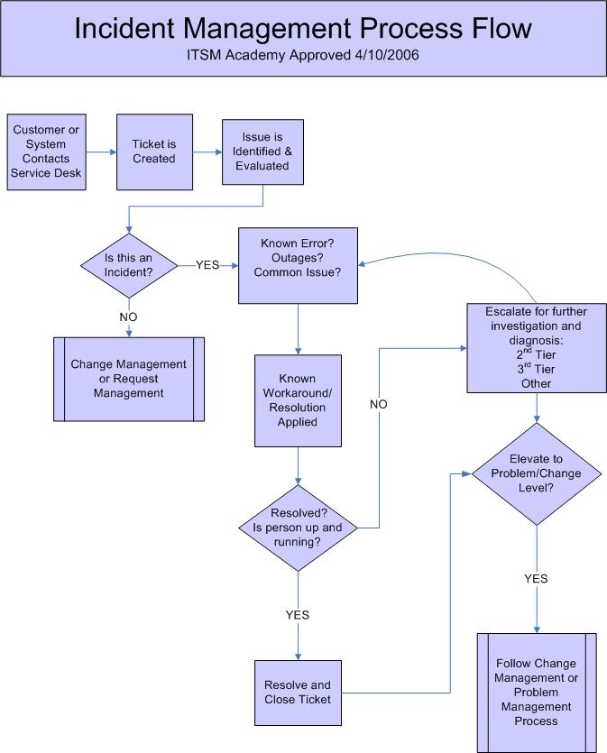

Slide 33
Exit Criteria
Support team associates contact end users for verification, on every resolved incident prior to placing the ticket in “Service Restored” or “Closed” status.
The preferred method of contact is in person (face-to-face) or telephone. E-mail and voice mail are also acceptable

Slide 34
Incident Life Cycle

Slide 35
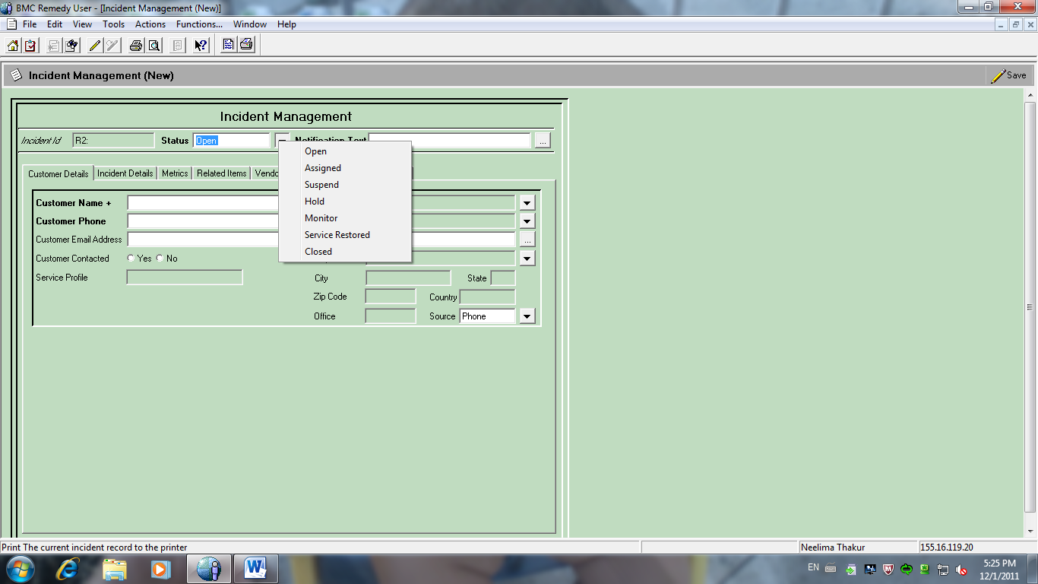

Slide 36
Observations
Incident Record was taken for the period of 12 Sept to 25 Sept and for 25 Oct to 1 Nov. Following issues were reported during observation:
Configuration Issue: Data entry errors. E.g. user name is not showing in doctors list in CPRS.
Data Mapping: It is the process of creating data element mappings between two distinct data models. These issues were raised because of wrong data mapping. E.g. Investigation ordered in CPRS is not reflecting in HIS.

Slide 37
HIS Defect: This issue developed because of integration problem as message flow from HIS to CPRS did not happen properly. E.g. Patient transfer is not visible in CPRS.
Training Issues: This issue is develops as End user does know to properly use the CPRS and HIS.
Vista Issues: This is vista software bugs.

Slide 38
Temporary Issue: This issue develops when there is problem with Infrastructure Support or with network.
Privilege Issue: This issue develops when Application Maintenance and Support team had not given proper rights to user. E.g. User did not get the required the rights in HIS, unable to create purchase order in HIS.

Slide 41
From the data collected and analysis done it was observed that
Maximum numbers of incidents are because of HIS Defect .
Minimum number of incidents are of Data Mapping.

Slide 42
Incident Record of 12 to 25 September

Slide 44
From the data collected it was observed that
Maximum numbers of incident tickets were raised in MAX-Mumps HL7 Application Support
Minimum in Max-Application Parameters Group.

Slide 45
Conclusion
The HL7 incompatibility of HIS makes it difficult to integrate it with VistA.
Health Level Seven (HL7) is a standard for electronic data exchange in all healthcare environments.
VistA is a product which is completely compatible with HL7. But as HIS is not compatible with HL7 this leads to development of incidents.
HL7 message format requires some mandatory fields to be included which may be mandatory or optional in the case of HIS. So, to match the fields and convey the HIS message, the fields have to be matched properly and similarly in both the systems.

Slide 46
Reasons for Training Issues:
As new staff keep joining the hospital frequently, so the system is new to them and they commit quite a few mistakes and thus during this period issues are developed.
More over Doctors/Nurses are not so computer savvy and also reluctant to use the system and also commit a lot of mistakes.

Slide 47
Reasons for Privilege Issues:
When all the rights required by the users is not given by the Support Team.
Also there is frequent shifting of nurses and other staff in different wards and floors that gives need for quick update of the data which is not followed at present.

Slide 48
Reasons for Temporary Issues:
This issues develop because of technical problem or when the server is down.

Slide 49
Reasons for Data Mapping Issues:
VistA has been developed according to the US veteran servicemen and hence its functionalities, data-elements and attributes are different from that of Indian healthcare, so it is a challenge to implement it in the Indian healthcare scenario. Examples
Example 1. Pin code :
VistA: Pin code is a 4 digit field.
Indian scenario: Pin code is of 6 digits
Example2.Date:
VistA: Date format is mm/yy/dd.
Indian scenario: The date format is dd/mm/yy

Slide 50
Result
  The maximum number of incidents develops because of integration problem as both HIS and VistA are two diverse software’s and the HL7 incompatibility of HIS makes it difficult to integrate it with VistA.

Slide 51
  There are two options to solve an Incident:
  Without a code change: The associate can solve the incident, through analysis depending on the Business/Functional Knowledge and the Process Flow of various applications involved in carrying out the processes. E.g. parameter changes.
  With a code change: This has to be done via the Change Management Procedures

Slide 52
Recommendations
Software should be upgraded and made HL7 Compatible, so it will easy to enable the interoperability.
Complete requirements should be taken from the client side and they should be documented and fixed before working on them.
Every configuration should be cross checked and reviewed.

Slide 53
Time to time training should be given to new staff, refreshers and end users.
Hardware and network maintenance: Computers, peripherals, printers, routers and cables are bound to stop working from time to time have to be attended to right away and in house staff should be available to attend these issues.
Bug reporting and fixing: The hospital should have a bug reporting form that is available at each workplace within the establishment. This form should be completed every time any user encounters any bug in the software.
An attempt should be made to educate users to distinguish between hardware, networking and software faults.

Slide 54
Method of Evaluating Incidents
Incident Management Capability Metrics (IMCM)
The Incident Management Capability Metrics provide organizations with a baseline against which they can benchmark their current incident management processes or services.

Slide 55
These metrics can be used to
Evaluate an existing capability
Identify areas for process improvement in an existing capability
Help determine the services and functions needed to create an incident management capability

Slide 56
References
Electronic Health Records, Second Edition by Jerome Carter (Paperback - Mar. 15, 2008)
Best Practices in EMR Implementation: A Systematic Review Karim Keshavjee1, John Bosomworth2,4, John Copen
Implementing an Electronic Health Record System (Health Informatics) by James M. Walker, Eric J. Bieber, Frank Richards, and Sandra Buckley (Paperback - June 28, 2006)
Cusack CM:Electronic health records and electronic prescribing: promise and pitfalls. Obstet Gynecol Clin North Am. 2008 Mar;35(1):63-79, ix. Review.PMID: 18319129 [PubMed - indexed for MEDLINE.
EHR Implementation: A Step-by-Step Guide for the Medical Practice (American Medical Association) by Carolyn P. Hartley, Edward D. Jones III, and Newt Gingrich (Paperback - Feb. 28, 2005)
A document on MAX Healthcare Application Support and Maintenance
A document defining high level design as captured by Dell Services

Slide 57

Now You Can Clap
THANK YOU FOR YOUR PATIENT LISTENING

