Slide 1
Patient Medical Documentation as Means to Enhance Patient Safety in a Multi Specialty Hospital
By
Col Ravi Sharma
(on study leave)
(PGDHM/2013/052)

Slide 2
Problem Statement
Patient Safety should be supreme in a healthcare organisations
Accreditation as means to establish standardised processes
Documentation part of the processes and supports standardisation
Internal Audit at MRD focuses on completing the ‘record’ as per accreditation standard and legal requirement
Medical judgement is subjective hence not questioned

Slide 3
Contd.....
Varied type of non-standardised medical education
Gaps in understanding Patient Safety
Not part of evolution process of patient safety
Deficiencies in prelim education
Measures required to plug-in the holes which prevents achievement of high standards of Patient Safety

Slide 4
Aim
To Audit the Patient Medical Documentation in In-patient wards and ICUs for contributing towards Patient Safety in a multi-specialty hospital.

Slide 5
Objectives of Study
The objectives of this study are to analyze the following from the perspective of an administrator:
  To establish the role of documentation in the patient safety.
  To identify the likely non-medical errors by doctors and nurses in Patient Medical Documentation having direct bearing on safety of patient.
  To utilize internal audit of the Patient Medical Documentation as a possible means to Patient Safety in a new accredited hospital.
  To recommend a broad mechanism of internal audit so as to bring behavioral changes in the approach to documentation as means to improve patient safety in a hospital.

Slide 6
Methodology
Study Area. The study was carried-out in a Multi Specialty Tertiary Care Hospital
Study Design. Cross-Sectional Descriptive Study design
Study Period. 2nd Feb to 30th Apr 2015
Study Population. Patient Medical Documentation in In-patient wards and ICUs
Sample Size. A sample of 308 (Three Hundred and Eight) Patient Medical Documentation folders in the In-patient wards and ICUs was audited for the study
Study Tool. Existing Patient Medical Documentation Audit form was utilized.
Sampling technique. Non-Probability Convenience Sampling Technique

Slide 7
S No | Name of Ward | Number of Folders Audited
1. | IPD-1st floor | 56
2. | IPD-2nd floor | 43
3. | IPD-3rd floor | 47
4. | IPD-4th floor | 51
5. | ICU-1/CCU | 15
6. | ICU-1/CTVS | 16
7. | ICU-2 | 23
8. | ICU-3 | 21
9. | ICU-4 | 19
10 | ICU-5 | 17
 | TOTAL | 308

Slide 8
Procedure
Initial understanding- checklist prepared as per NABH Guidelines
Adapted with existing form for audit- Management Study
ICUs and IPDs
Initial 168 folders- No feed-back to wards
Bal samples- Daily Feed-back to doc’s and nurses
Focus of audit: HOW and WHEN

Slide 9
Patient Medical Documents Scrutinized
(a) Doctor’s Initial Assessment.
(b) Nursing Initial Assessment.
(c) Doctors’ Care Plan.
(d) Nursing Care Plan.
(e) Nutritional Assessment Done within 24 hrs.

Slide 10
Analysis

Slide 12
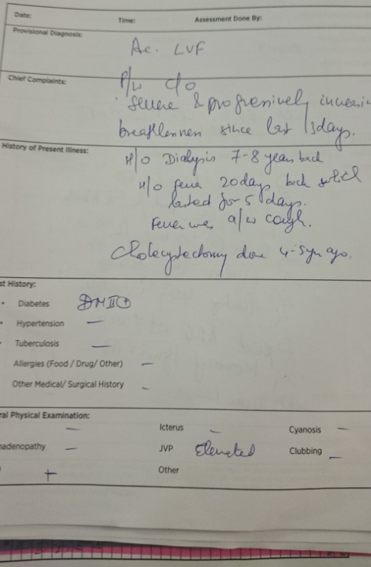
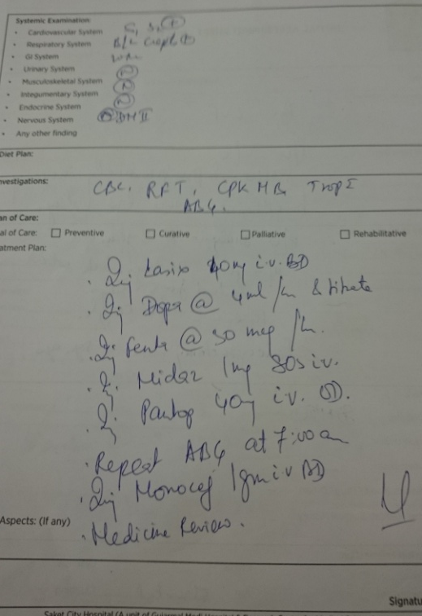

Slide 18
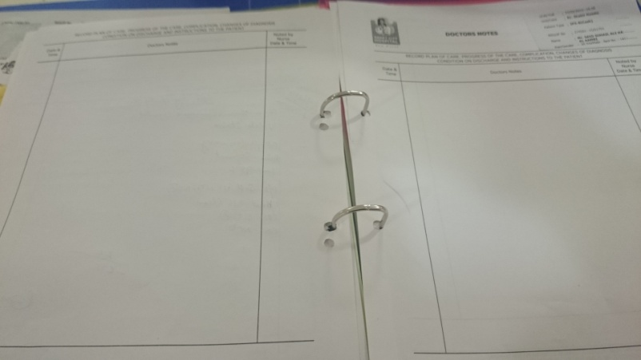

Slide 21
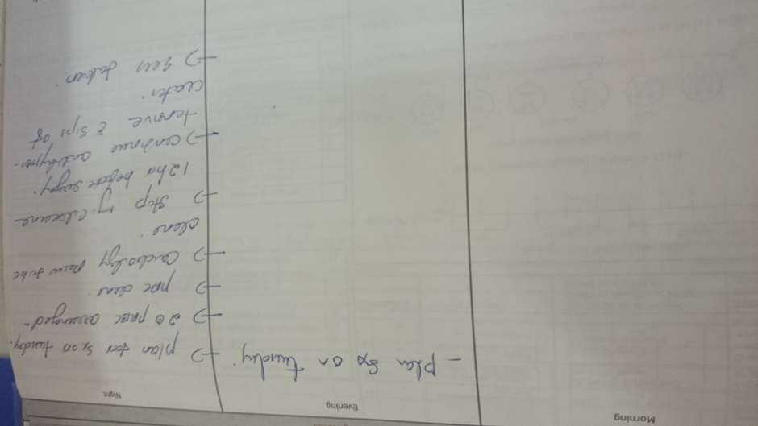

Slide 23
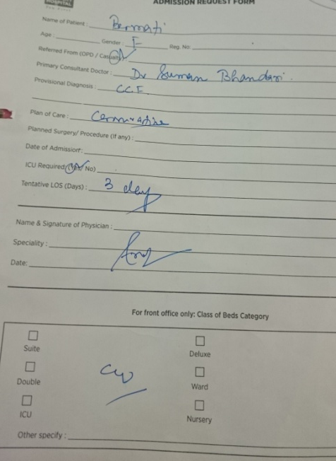
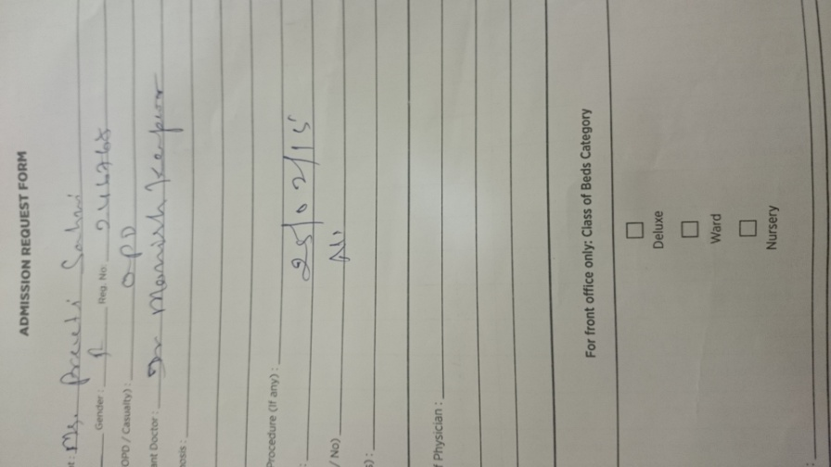

Slide 28
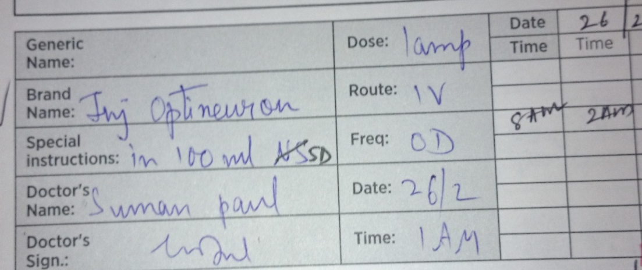
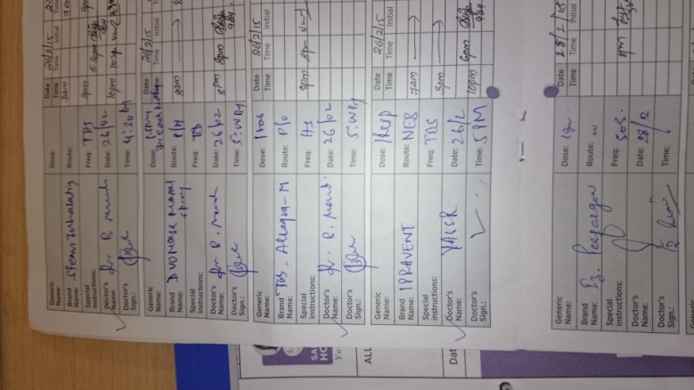
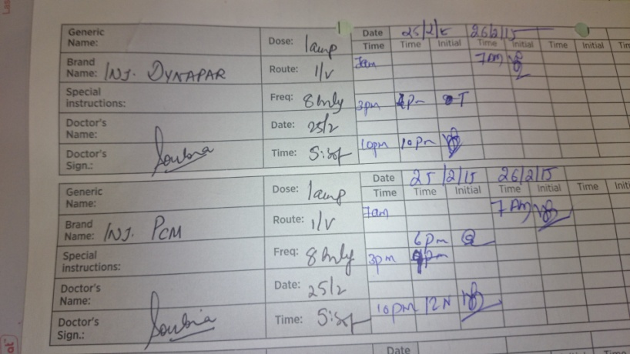

Slide 31
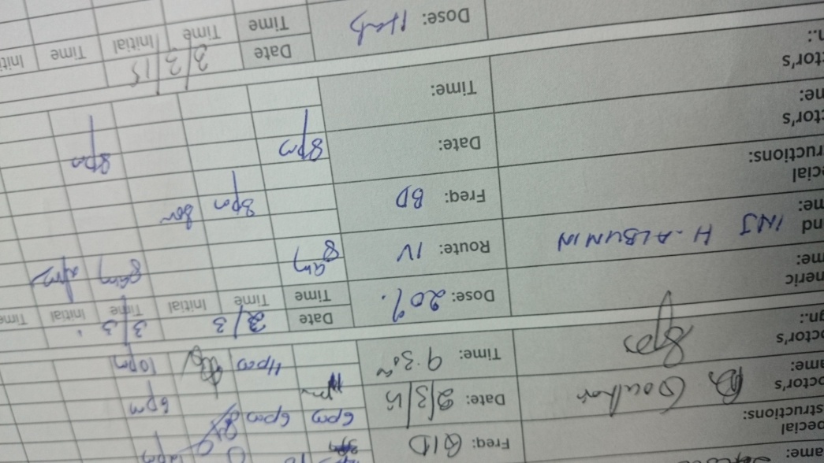

Slide 35
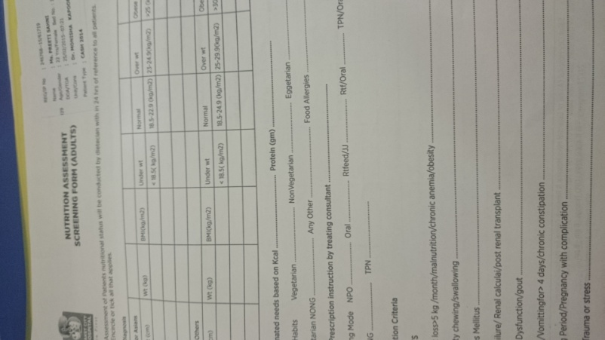

Slide 36
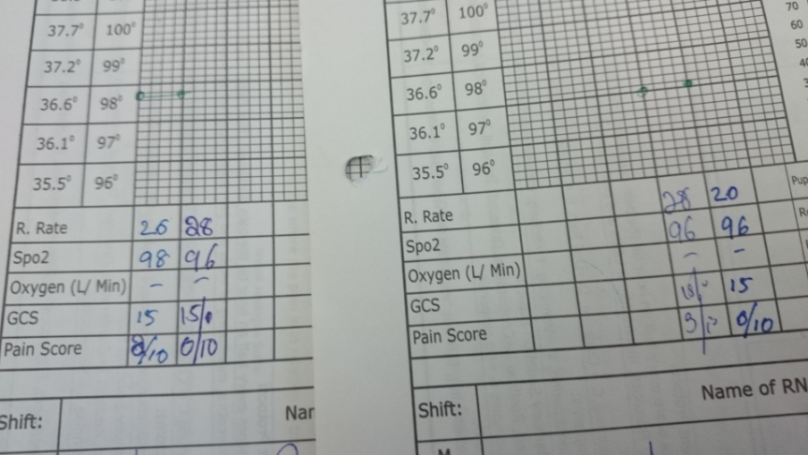
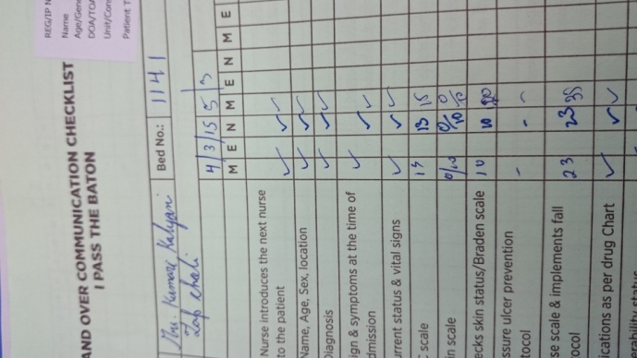

Slide 37
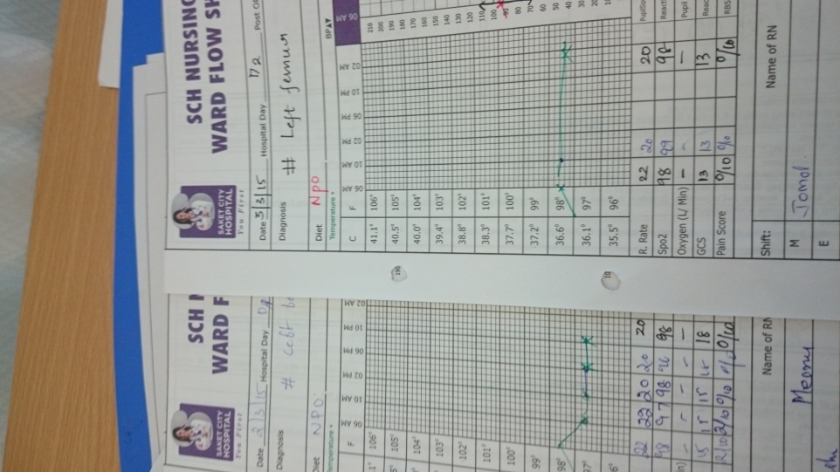
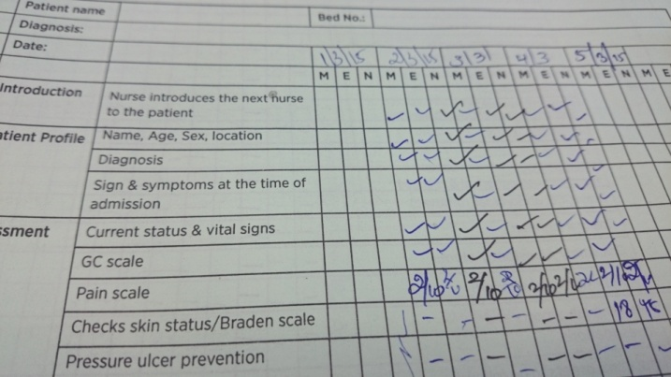

Slide 40
Progress of Doctor’s IA
Sample 1-60: 96%
Sample 61-120: 100% - Hawthorne effect (also referred to as the observer effect)
Sample 121-180: 97%
Sample 181-240: 98%
Sample 241-308: 99%

Slide 42
Progress of Nutritional Assessment
Sample 1-60: 35%
Sample 61-120: 20%
Sample 121-180: 46.7%
Sample 181-240: 53.3%
Sample 241-308: 75%

Slide 43
FINDINGS AND RECOMMENDATIONS
Traditional Approach: Assumed that well-trained, conscientious practitioners do not make errors -non-use of rubber stamp by 94% of the doctors
Errors could be reduced by redesigning systems and processes -using human factors principles. The audit of Patient Medical Documentation in the present study is an effort to do the same in an accredited hospital.
Adaption of concepts from other established and successful fields: Internal Audits are established norms in the Armed Forces
Non-standardisation of education- reduction of mistakes through document standardization is a viable alternative to achieve patient safety: Continuous Training guided by the deficiencies detected during the audit can provide a workable solution to fill the gaps in the initial medical education
Limiting the blame and avoid finger pointing- transparency, team spirit

Slide 44
Contd…….
Culture and Professionalism. Collective evolution of culture and professionalism involving Clinicians, governing boards, executive leaders, and middle managers of health care delivery organizations.
Overlap of all in the patient safety mechanism- monthly Board of Officers (BOO) detailed by Quality Department
  BOO -act as a mirror to “sharp-end” for self correction.
    Presiding Officer- Any Consultant.
    Members:
      One Resident Doctor
      One Nursing Staff
      One member from any of the non-medical staff
Conscious effort to improve patient safety- focus to improve malice of illegible signatures, illegible prescription and non-use of the personal stamp
NABH in our context came up taking inspiration from the advanced countries- fill in this void the internal audit mechanism

Slide 45
THANK YOU

