Slide 1
BARRIERS AND FACILITATORS INFLUENCING HEALTHCARE WORKER’S ADHERENCE TO PRASAV WATCH MONITORING PROTOCOLS IN BUNDI, RAJASTHAN
Faculty Mentor PRESENTED BY
Dr. Nishikant Bele AMISHA AWASTHI
Associate professor PG/23/014
IIHMR Delhi

Slide 2

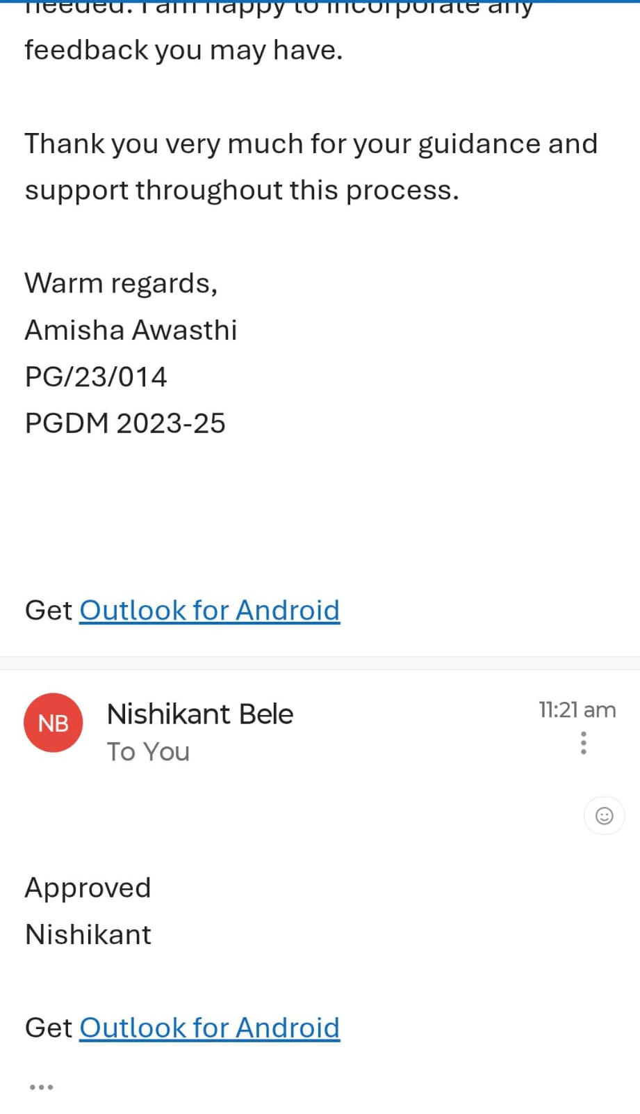
Mentor Approval

Slide 3
Introduction
Prasav Watch is a digital tool developed to improve maternal and child health, particularly during childbirth. It's a tablet-based application used in labor rooms to monitor women during labor and postpartum, aiming to help healthcare providers identify high-risk situations and provide timely care. The app captures various data points, from admission to discharge, including demographic details, labor progress, delivery notes, and postpartum monitoring. It also provides real-time alerts and suggestive messages to staff, guiding them on potential complications and appropriate actions.

Slide 4
Introduction
Maternal and newborn health remains a major concern in rural India due to limited access to quality care. Prasav Watch, a labor monitoring device, was introduced to support timely interventions during childbirth. Its effectiveness, however, depends on consistent adherence to monitoring protocols by healthcare workers. In regions like Bundi, Rajasthan, understanding the barriers and facilitators influencing this adherence is crucial. Identifying these factors will help improve protocol compliance, optimize device usage, and ultimately enhance maternal and neonatal outcomes.

Slide 5
Objectives of Your Study
To evaluate compliance with Prasav Watch protocols.
To Identify barriers to adherence.
To explore facilitators for adherence.
Recommend strategies to improve compliance.

Slide 6
Methodology
STUDY DESIGN:
Descriptive cross-sectional study conducted in Bundi District, Rajasthan
Sample size:
50 healthcare workers (ANMs, Nurses, ASHAs, AWWs)From Government hospital, CHCs, Sub-Centers.
Data Collection tool:
Structured Questionnaire Included both close-ended and open-ended questions.

Slide 7
Methodology
LIMITATIONS:
The study is limited to healthcare workers in Bundi, Rajasthan, which may restrict the generalizability of findings to other regions.
Time constraints may affect the comprehensiveness of data collection and analysis.
Being a cross-sectional study, it captures data at one point in time.

Slide 8
Results
A total of 50 healthcare providers participated in the study assessing the adherence to Prasav Watch monitoring protocols. The majority were Nurses (52%) followed by ANMs (48%).
Professional Background and Experience:
84% of respondents had more than 6 years of experience in maternal and newborn care. Facilities represented included Government hospitals (48%), CHCs (15%), Sub-centers (22%).
Training and Familiarity with Prasav Watch: 100% of participants reported receiving formal training (mostly workshops). 88% were “very familiar” with the monitoring protocols.90% believed Prasav Watch improves maternal and newborn outcomes.

Slide 9
Results
Availability of Guidelines and Protocol Adherence:
98% had access to reference guidelines or materials.
32% stated they always follow Prasav Watch protocols during deliveries, while 68% reported often.
Barriers and Enablers: Documentation challenges were noted by 88% of respondents.
Common barriers included:
Lack of staff (41%)Time constraints (46%)Technical issues (40%).
64% reported experiencing technical issues frequently, and 36% occasionally.
94% felt there was sufficient administrative support.

Slide 10
Results
Major enablers included:
proper training
resource availability,
peer support.
Suggestions for Improvement Respondents recommended:
Faster technical support (78%)
Improved internet access (60%)
Regular refresher trainings (55%)
Increased staff deployment (68%)

Slide 11
Discussion
Key Findings:
High Awareness, Yet Inconsistent Application: While all healthcare workers (HCWs) are well-trained and highly familiar (88%) with Prasav Watch protocols, and most (90%) believe in its efficacy for improving maternal-newborn outcomes, only 32% "always" adhere to them (68% "often"). This highlights a critical gap between knowledge and consistent implementation.
Core Operational Challenges
Adherence is significantly hampered by practical and systemic barriers:
Resource Constraints: Staff shortages (41%) and time constraints (46%) directly impact HCWs' capacity for comprehensive protocol execution.
Technical & Logistical Hurdles: Frequent technical malfunctions (40%) and significant documentation burdens (88%) disrupt workflows and deter consistent use.

Slide 12
Discussion
Leveraging Strengths & Support
Strong Administrative Support (94%): Substantial endorsement from leadership provides a solid foundation for implementing improvements.
Existing Enablers: Effective training, resource availability, and peer support are vital facilitating factors that can be leveraged.
Recommended Interventions
Based on HCW feedback, key strategies for improved adherence include:
Timely Technical Support (78%): Essential for minimizing disruptions from device issues.
Improved Connectivity (60%): Crucial for reliable data submission and digital functionality.
Continuous Training (55%): Regular refresher sessions to reinforce protocols and address evolving challenges.
Enhanced Staffing (68%): Alleviates workload, enabling full protocol compliance.

Slide 13
Recommended strategies to improve compliance
To enhance consistent adherence to Prasav Watch protocols and improve maternal-neonatal outcomes, key strategies include:
Workforce & Workflow: Increase the number of staff available and make sure work processes are efficient, allowing Prasav Watch to fit smoothly into daily tasks.
Technology & Support: This involves setting up quick and effective technical assistance, ensuring reliable internet access, and regularly maintaining devices to keep them working well.
Documentation: Simplify paperwork and provide extra help during busy times to ease the burden of record-keeping.
Development & Collaboration: Regular training sessions will keep skills sharp, and encouraging healthcare teams to share knowledge will foster a supportive learning environment.
These focused actions will empower healthcare professionals, leading to more effective use of Prasav Watch and, ultimately, better health results for mothers and newborns.

Slide 14
Conclusion
Study reveals that healthcare workers possess both the essential knowledge and a strong desire to utilize Prasav Watch effectively. However, consistent adherence depends significantly on overcoming practical obstacles within the system. By thoughtfully investing in better support, improved infrastructure, and adequate staffing, we can empower these professionals. This, in turn, will lead to more effective use of Prasav Watch and ultimately result in better health outcomes for mothers and newborns.

Slide 15
References
Bhattacharya, S., Singh, A., & Rathore, M. (2014). Adherence to evidence-based care practices for childbirth before and after a quality improvement intervention in health facilities of Rajasthan, India. BMC Pregnancy and Childbirth, 14(1), 1–10. https://www.researchgate.net/publication/264798871
Agrawal, P., Swain, D., & Ghosh, S. (2024). Barriers to and facilitators of maternal health service utilization in India: A systematic review. PLOS ONE, 19(1). https://pmc.ncbi.nlm.nih.gov/articles/PMC10759396/
Kruk, M. E., Gage, A. D., Arsenault, C., Jordan, K., Leslie, H. H., Roder-DeWan, S., ... & Pate, M. (2020). Systematic review of barriers to and facilitators of the provision of high-quality midwifery services in India. BMC Health Services Research, 20(1), 1–13. https://www.researchgate.net/publication/343220132
Sarna, A., Saraswathy, S., Sebastian, T., & Kumar, R. (2022). Exploring barriers and facilitators to adherence to postnatal care guidelines in urban India through mobile interventions. International Journal of Environmental Research and Public Health, 19(15), 9380. https://pmc.ncbi.nlm.nih.gov/articles/PMC9329952/

Slide 16
INVOLVEMENT IN COMMUNITY OUTREACH PROGRAMME (COP) ACTIVITIES
Total no. of visits done by the Student: 5-6
Activities done by the student:
Mapping and listing of the area.
Interaction with the community and frontline healthcare workers.
Field-Based Data Collection Skills

Slide 17
KEY LEARNING FROM COP ACTIVITIES
1. Mapping and Listing of the Area
Understanding Community Layout: Developed a detailed understanding of the geographical distribution of households, health facilities, and key resources.
2. Interaction with Community & FLHWs
Observed field-level challenges (resource gaps, cultural barriers).
Gained clarity on roles of ASHA, ANM, and AWW.
Learned community engagement and trust-building skills.
3.IDI with ASHA on High-Risk Pregnancies
Understood criteria for identifying high-risk pregnancies.
Noted ASHA's challenges and coping mechanisms.

Slide 18
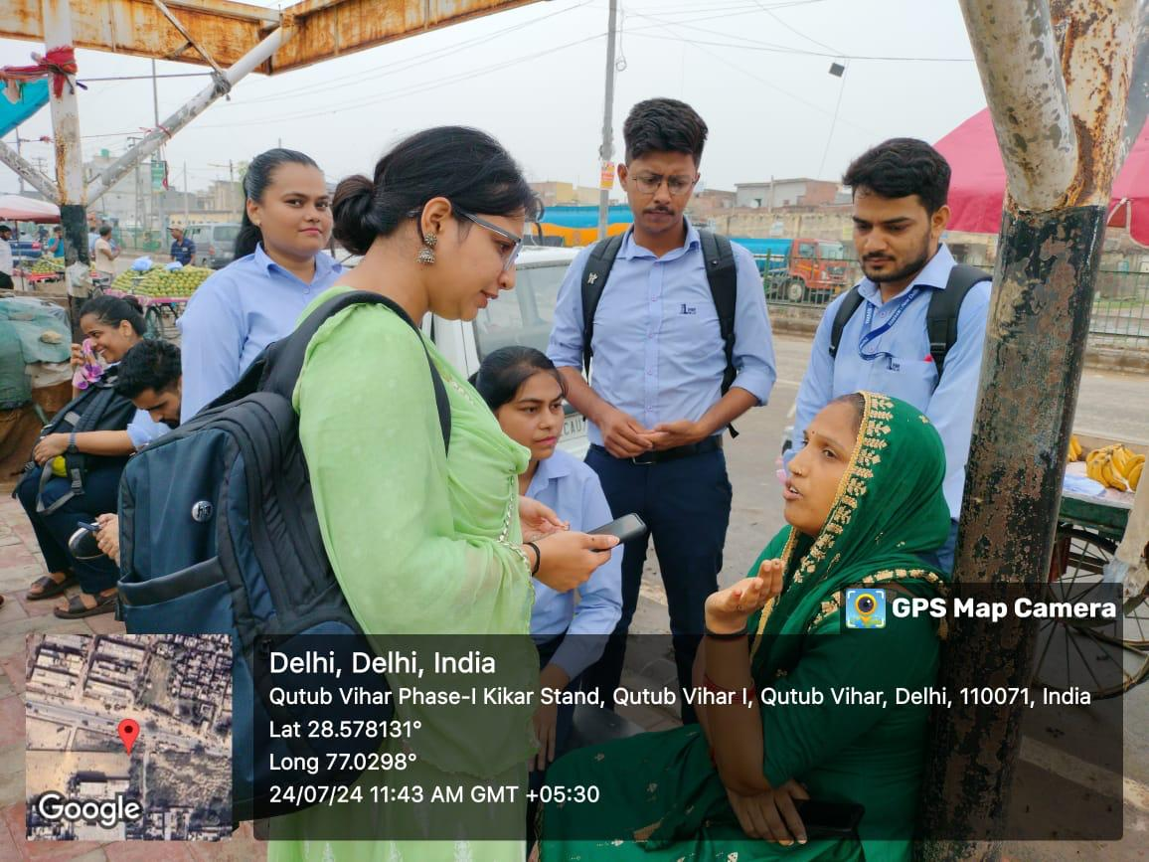
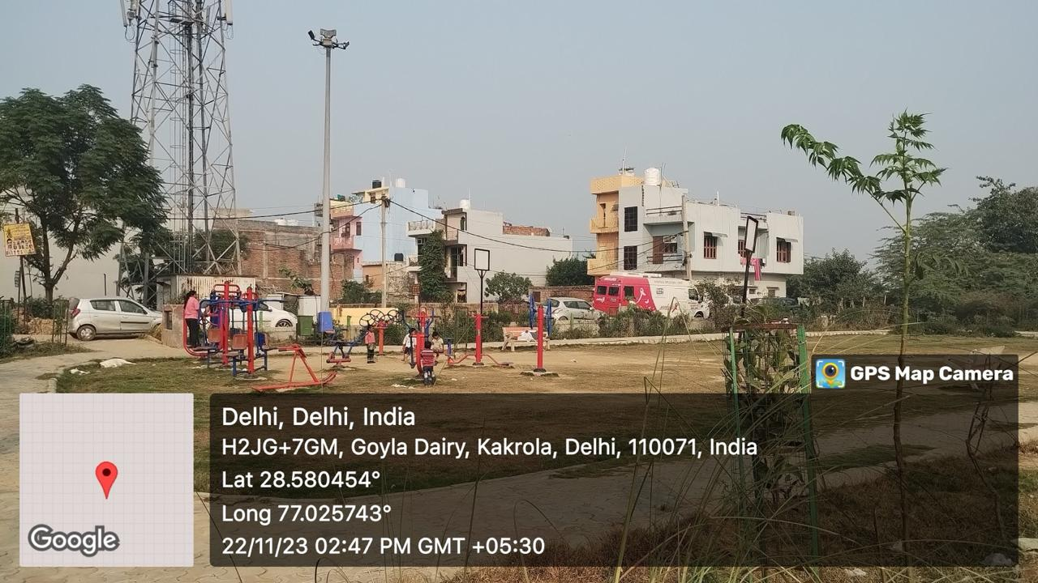
COP FIELD ACTIVITIES PHOTOGRAPHS

Slide 19
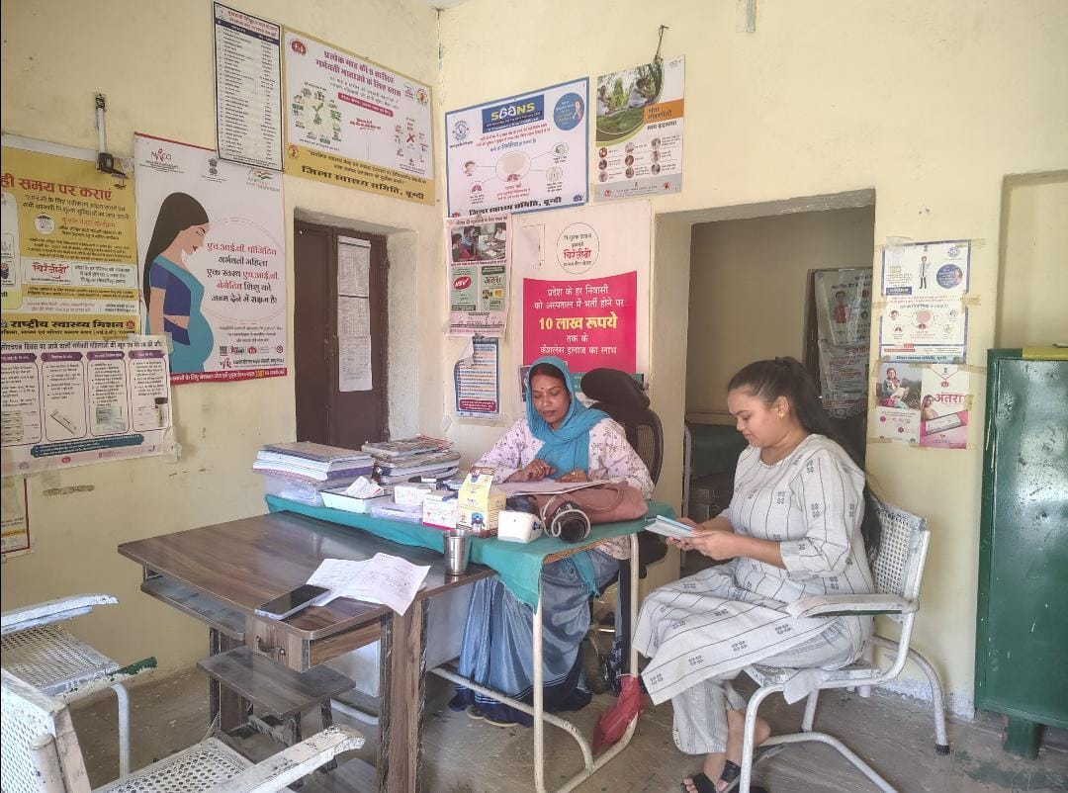
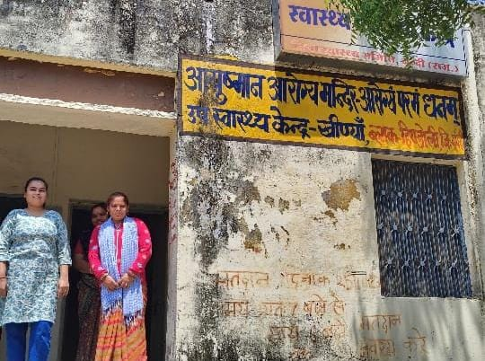
PICTORIAL JOURNEY

Slide 20
Thank You

