Slide 1

Awareness, Perception, and Participation in Preventive Health Checkups:
A Case Study at CK Birla Hospital, Gurugram
Md Zaid Sultan(PG/23/060)
Under Mentorship of
Dr. Divya Agarwal

Slide 2
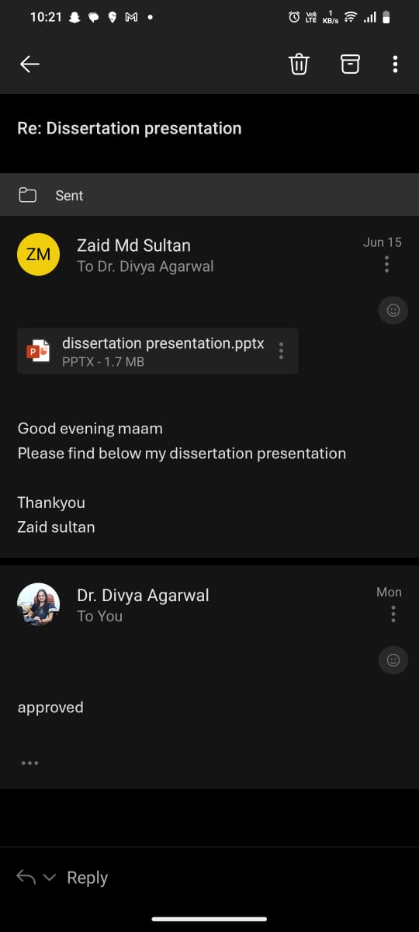
Mentor Approval

Slide 3
Introduction
Gurugram—a symbol of India’s urban boom—faces a hidden crisis. While gleaming offices and shopping malls dominate its skyline, sedentary lifestyles, processed diets, and chronic stress have fueled an explosion of non-communicable diseases (NCDs). Consider these realities:
Every 4 minutes, an Indian dies of diabetes (ICMR, 2023).
Hypertension affects 33% of Gurugram’s adults—higher than the national average.
60% of NCD-related deaths occur prematurely (under age 70).
The Hospital’s Initiative:
CK Birla Hospital launched preventive health packages in 2020, targeting early detection of diabetes, heart disease, and cancers. Despite discounted rates and social media campaigns, uptake remains low. This study investigates why.

Slide 4
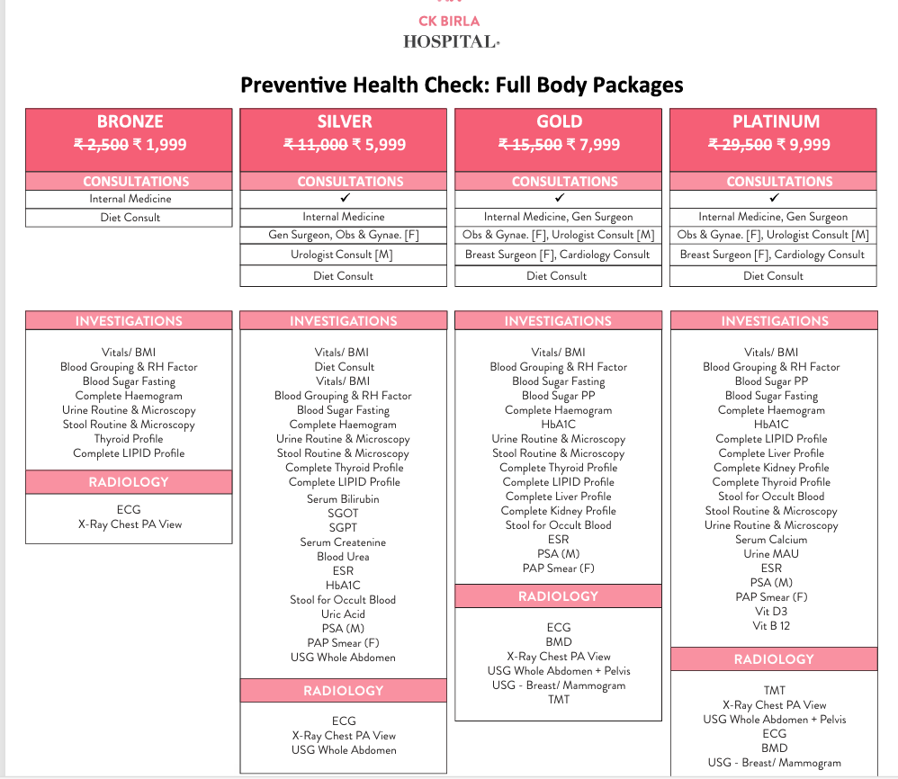
ABOUT CK BIRLA HEALTH PACKAGE

Slide 5
In response to India’s escalating burden of non-communicable diseases (NCDs), CK Birla Hospital, Gurugram, has pioneered a suite of comprehensive Preventive Health Check (PHC) packages. Designed to shift healthcare from reactive treatment to proactive wellness, these packages offer structured, affordable health assessments tailored to diverse needs and budgets.
Key Features of CK Birla’s PHC Packages:
Four Tiered Options:
  Bronze (₹1,999): Essential screening for basic metabolic health (diabetes, thyroid, lipids).
  Silver (₹5,999): Expanded diagnostics including liver/kidney function and cancer markers (PSA for men, Pap smear for women).
  Gold (₹7,999): Advanced prevention with cardiac stress testing (TMT), bone density (BMD), and mammography.
  Platinum (₹9,999): Holistic evaluation covering vitamin deficiencies (B12, D3), tumor markers, and cardiac health.
Gender-Specific Customization:
  Women: Breast ultrasound/mammography, gynecologist consultations.
  Men: Urologist consultations, Prostate-Specific Antigen (PSA) testing.
Early Detection: Identifies silent conditions like diabetes, hypertension, and cancers before symptoms manifest.

Slide 6
Cost Efficiency: Up to 66% savings compared to à la carte pricing.
Accessibility: Tiered pricing ensures broader socioeconomic reach.
3. Critical Diagnostics Included:
  Cardiac: ECG, Treadmill Test (TMT)
  Oncology: Stool occult blood, tumor markers
  Metabolic: HbA1c, lipid profiles, thyroid panels
  Organ Function: Liver, kidney, and ultrasound scans
4. Value Proposition:
  Packages discounted by 20-66% (e.g., Platinum slashed from ₹29,500 to ₹9,999).
  Multi-specialist consultations bundled with diagnostics (Internal Medicine, Cardiology, Gynecology/Urology).

Slide 7
Objectives of Study
To assess the level of awareness among patients regarding the availability and importance of preventive health checkup packages offered by CK Birla Hospital.
To evaluate patients’ perceptions and beliefs related to early disease detection and the role of preventive checkups in maintaining long-term health.
To identify key barriers (such as cost, time, fear, and lack of knowledge) that prevent patients from participating in regular preventive health screenings.
To analyze the relationship between socio-demographic factors (age, gender, education, and income) and the awareness, perception, and participation in preventive health checkups.

Slide 8
Methodology
Study Design
Approach: Quantitative cross-sectional study
Duration: March 1 – May 31, 2025 (12 weeks)
Location: General Outpatient Department (OPD), CK Birla Hospital, Gurugram
Rationale: Snapshots patient perspectives during routine visits, avoiding emergency care bias.
Participants
Included: 140 adults (≥18 years) from general OPD.
Excluded: Emergency/specialized care patients (oncology, cardiology).
Data Collection:
Structured questionnaire (demographics, awareness, barriers, participation).
Sampling: Convenience sampling (march-june 2024).
Ethics: Informed consent, anonymized data.

Slide 9

Methodology
Cochran’s Formula for Sample Size calculation.
Cochran’s formula is used to calculate an ideal sample size when the population is large or unknown. The formula is:
Where:
n0 = Required sample size
Z = Z-score (1.96 for 95% confidence level)
p= Estimated proportion of the population with the attribute (0.5 is used when unknown, as it gives the maximum sample size)
e = Desired level of precision (margin of error), usually 0.05 (5%)

Slide 10



Assume:
Confidence Level = 95% → Z = 1.96
Proportion = 0.5 (maximum variability, conservative estimate)
Margin of Error = 5% → e=0.05
So, the ideal sample size for an infinite population is approximately 384 respondents
Adjustment for a Finite Population (Optional)
If my total population size (N) is known and is relatively small, so I can adjust Cochran's formula as:
If, for example, the expected patient pool is N = 1000, then:

Slide 11
Although Cochran's ideal sample size is 384, for my project, but I have collected 140 responses. Therefore:
My current sample (n = 140) is smaller than the ideal (n ≈ 384), but still acceptable for an exploratory or indicative study, especially if access or time was limited.
Sampling Technique
Method: Systematic random sampling
Procedure:
  Daily OPD list numbered sequentially
  Sampling interval k k = Total daily patients / 15
  Every k k-th patient invited
  Replacement: Next eligible patient if refused
Stratification: Implicit by age/gender via hospital’s natural patient flow

Slide 12
Section | Variables Measured | Response Format
A: Demographics | Age, gender, education, occupation, income | Multiple-choice + open-ended
B: Awareness | General checkup knowledge, CK Birla package awareness, information sources | Dichotomous (Yes/No) + multiple-select
C: Perception | Belief in early detection, barriers (cost, time, fear, awareness) | 3-point Likert + checkbox
D: Participation | Checkup history, recency, future intent | Dichotomous + categorical
Data Collection Tool
Instrument: Structured questionnaire (4 sections, 13 items)
Language: English

Slide 13
Data Collection Procedure
Step-by-Step Workflow:
Screening: Research assistant reviewed OPD register daily at 9 AM
Invitation: Every k k-th patient approached in waiting area
Consent: Bilingual information sheet + written consent (Annexure II)
Administration:
  Self-filled questionnaire (literate patients)
  Researcher filled itself by asking the information from them(illiterate patients)
Duration: 5 to 6minutes per response
Anonymity: No names/identifiers collected

Slide 14
Results

Slide 15
Results

Slide 16
Discussion
Only 37% of respondents are aware of CK Birla Hospital's health checkup packages, while a significant 63% remain unaware. This reflects a major communication gap between the hospital and its patient base, despite the availability of preventive services.
The bar and line chart on the right reveals that among those who are aware:
Hospital Staff is the most influential source of information (40.38%),
Followed by Friends/Family (28.85%),
Social Media (19.23%),
And Others (11.54%).

Slide 17
Discussion
The top barriers to participating in preventive health checkups (PHC) are:
Lack of awareness (highest, ~57 responses),
Followed by cost (~54),
And other personal factors (~48),
with fear of diagnosis and lack of time also contributing.
It shows that both informational and economic challenges are key obstacles, especially in a setting where preventive care is often overlooked until symptoms appear.
The other chart shows mixed perceptions toward early detection:
Only 35% (49 respondents) believe in its benefits,
28.57% do not believe in it,
And a significant 36.43% remain unsure.

Slide 18

Actionable solution
1. Enhance Awareness & Education
Only 37% are aware of CK Birla packages
57 people cited lack of awareness as a top barrier
36% are “Not Sure” about early detection benefits
Solutions:
Health Education Counters at OPD areas to explain preventive care
Multilingual posters and video content in waiting rooms
2. Engage Staff in Information Dissemination
40% of awareness comes from hospital staff
Staff influence is the most trusted source
Solutions:
Train reception and nursing staff to briefly mention packages during patient registration.

Slide 19
3. Digital and Social Media Outreach
Only 19% heard from social media
36% unsure about early detection = knowledge gap
Solutions:
By Using Instagram reels, YouTube shorts, and WhatsApp forwards with simple health facts
Promote “Myth vs Fact” videos: e.g., “Preventive checkups don’t mean you're sick”
4. Address Cost as a Key Barrier
Cost cited by 54 respondents as a barrier
Higher awareness & participation in >₹60,000 income group
Solutions:
The hospital have to Introduce tiered pricing or discounted group/family checkups
Partner with employers to offer subsidized corporate packages
Run monthly or quarterly health camp days offering basic screenings for free or low cost

Slide 20
5. Rebuild Trust and Reduce Fear
44 respondents fear diagnosis
36.43% are unsure about the value of early detection
Solutions:
Use doctor videos to explain that early detection = better outcomes
Run counseling sessions post-diagnosis to help patients cope

Slide 21
Conclusion
This study explored the awareness, perception, and participation in preventive health checkups among patients visiting CK Birla Hospital, Gurugram. The findings clearly reveal significant gaps between the availability of preventive services and their utilization by the target population.
Despite CK Birla Hospital offering structured health checkup packages, only 37% of respondents were aware of these services. The primary source of awareness was hospital staff, highlighting the critical role of direct, interpersonal communication in health education. However, platforms like social media and digital outreach remain underutilized, despite their potential for wider and quicker dissemination.
A substantial portion of participants (63%) either lacked awareness or were misinformed about the benefits of early disease detection. Only 35% believed in early detection, while 36.43% were unsure, showing that many individuals remain unconvinced about the value of preventive care.
The major barriers identified were lack of awareness, cost, fear of diagnosis, and lack of time, all of which contribute to low participation rates. These barriers were particularly prevalent among individuals from lower income and education groups.

Slide 22
The study also showed that perception strongly influences participation. Those who believed in early detection were more likely to have undergone preventive checkups, whereas disbelief or uncertainty led to disengagement from preventive practices.
These insights highlight an urgent need for a multi-dimensional strategy that includes targeted awareness programs, financial flexibility, digital engagement, and community-based outreach. Empowering patients with knowledge, reducing financial and emotional barriers, and improving access through technology and partnerships can collectively drive higher participation in preventive health initiatives.
By addressing these gaps, CK Birla Hospital—and similar institutions—can play a transformative role in shifting the healthcare paradigm from reactive treatment to proactive prevention, ultimately leading to healthier communities and more sustainable healthcare systems.

Slide 23
References
World Health Organization. Noncommunicable diseases country profiles 2020. Geneva: WHO; 2020.
Mohan V, Deepa M, Pradeepa R. Prevention of non-communicable diseases in India: Need for integrated, multi-sectoral approaches. Indian J Med Res. 2019;149(2):189–93.
Kumar R, Singh M, Bansal R, Yadav R, Yadav V. A study to assess the awareness regarding preventive health check-up among adult population in urban area of Haryana. Int J Community Med Public Health. 2020;7(6):2367–71.
Sharma R, Jindal A, Mahajan A. Preventive health check-up: A study on awareness and practices among patients attending tertiary care hospital in North India. J Fam Med Prim Care. 2022;11(1):123–8.
Prashanth H, Chandrashekar M, Bhaskar D, Ramya S, Sowmya K. Awareness and utilization of preventive health services among patients attending outpatient department of a tertiary care hospital: A cross-sectional study. Int J Prev Curat Community Med. 2019;5(3):5–10.
National Health Portal of India. Preventive Health Check-up [Internet]. Ministry of Health and Family Welfare; 2022 [cited 2025 Jun 15]. Available from: https://www.nhp.gov.in/
Pandve HT, Chawla PS. Role of preventive health check-ups in India: A neglected aspect. J Community Health Manag. 2017;4(1):33–5.
Joshi S, Rajasekharan Nair V. Barriers and facilitators for preventive health check-up: A qualitative study among employees of a tertiary care hospital in South India. Indian J Health Sci Biomed Res. 2021;14(3):247–52.

Slide 24
INVOLVEMENT IN COMMUNITY OUTREACH PROGRAMME (COP) ACTIVITIES
Total no. of visits done by the Student: 5
Day-wise activities done by the student:
Mapping and listing of the area.
Interaction with the community and frontline healthcare workers.
Take feedback from the population of goyala dairy

Slide 25
KEY LEARNING FROM COP ACTIVITIES
1. Mapping and Listing of the Area
Understanding Community Layout: Developed a detailed understanding of the geographical distribution of households, health facilities, and key resources.
2. Interaction with Community & FLHWs
Observed field-level challenges (resource gaps, cultural barriers).
Gained clarity on roles of ASHA, ANM, and AWW.
Learned community engagement and trust-building skills

Slide 26
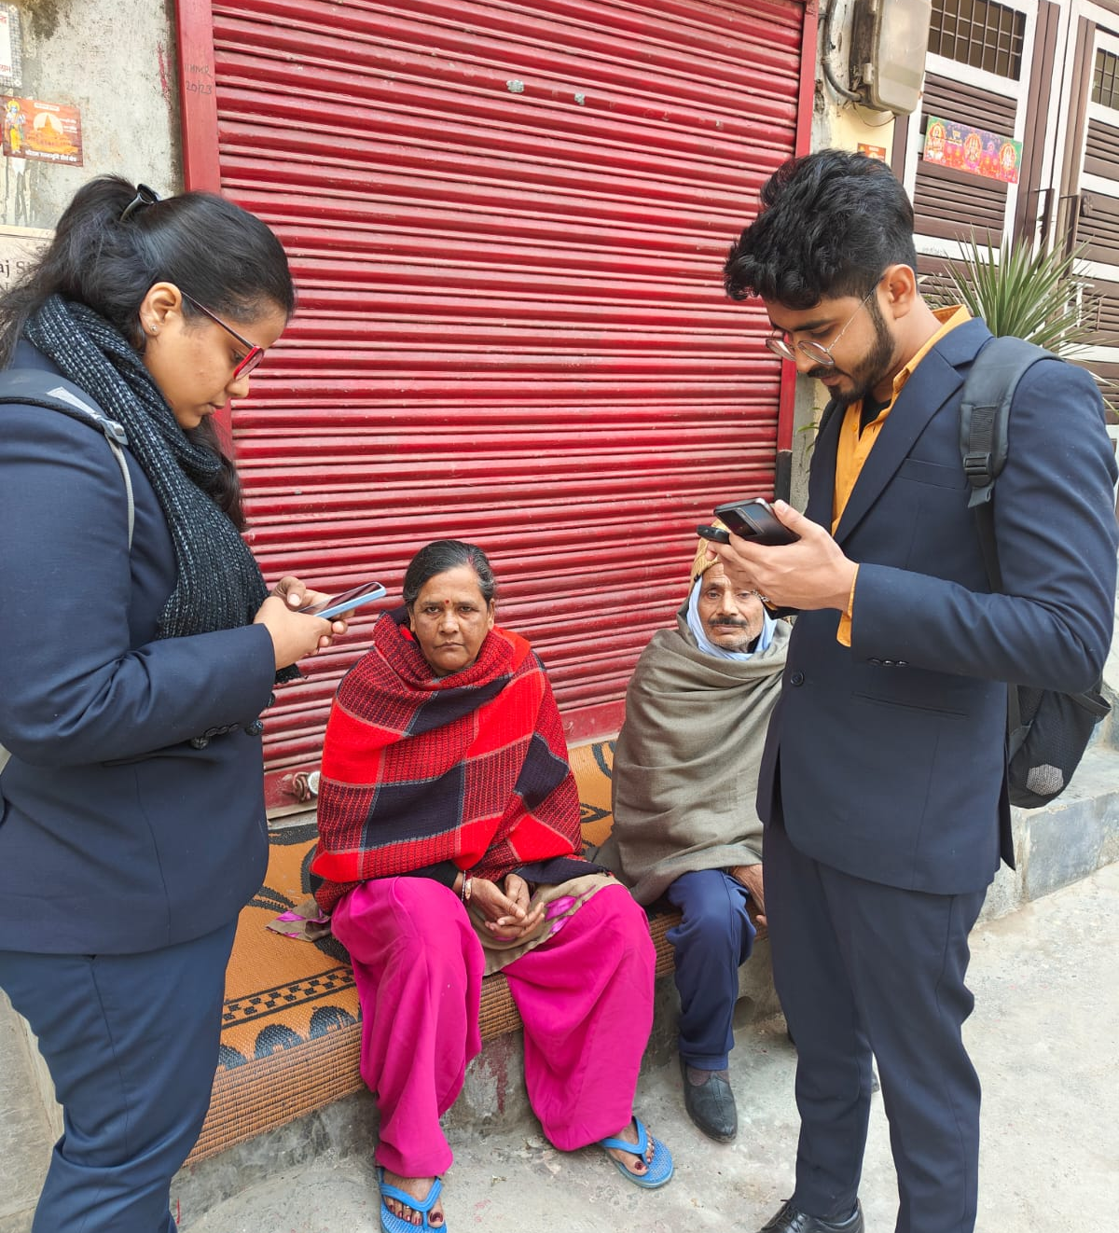
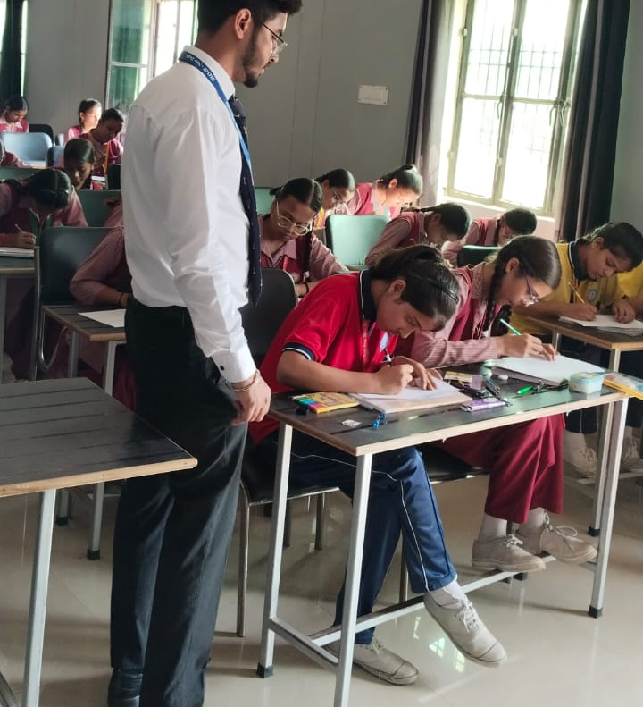
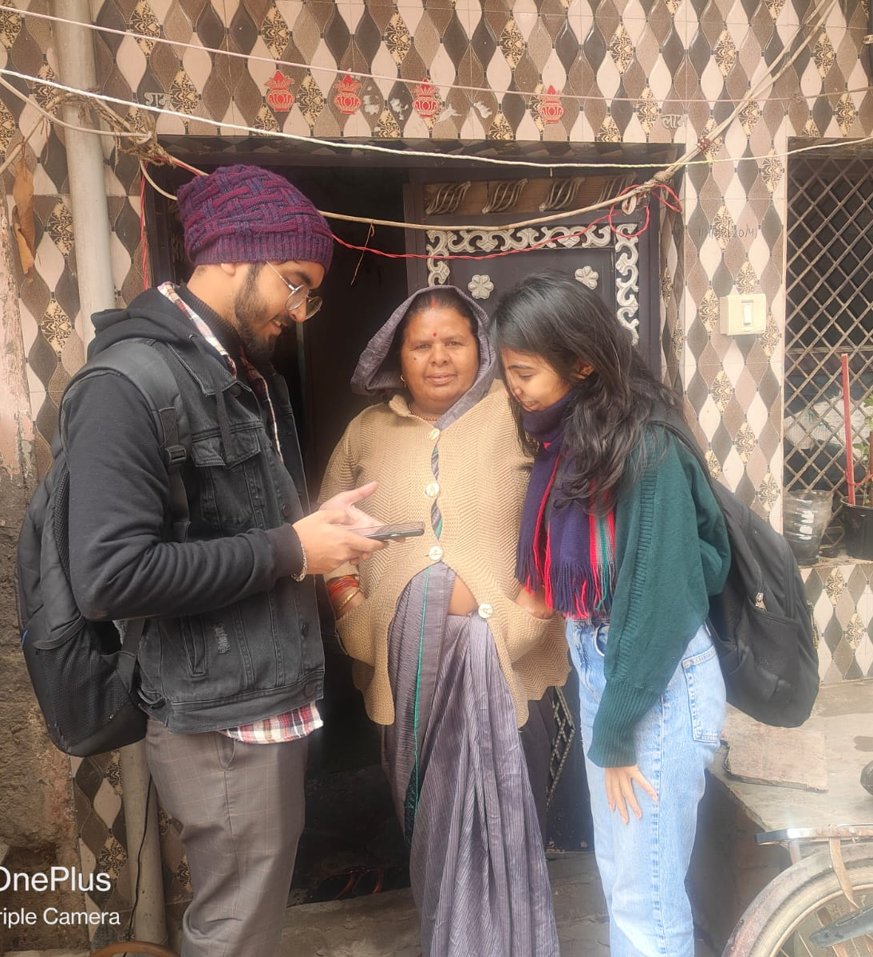
COP FIELD ACTIVITIES PHOTOGRAPHS

Slide 27
Thank You
Any Questions

Slide 28
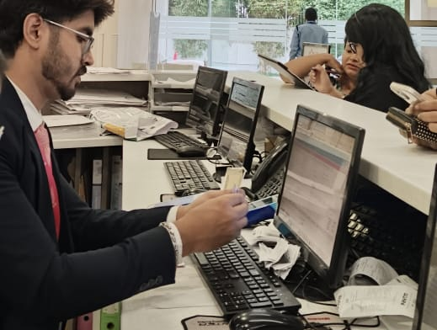
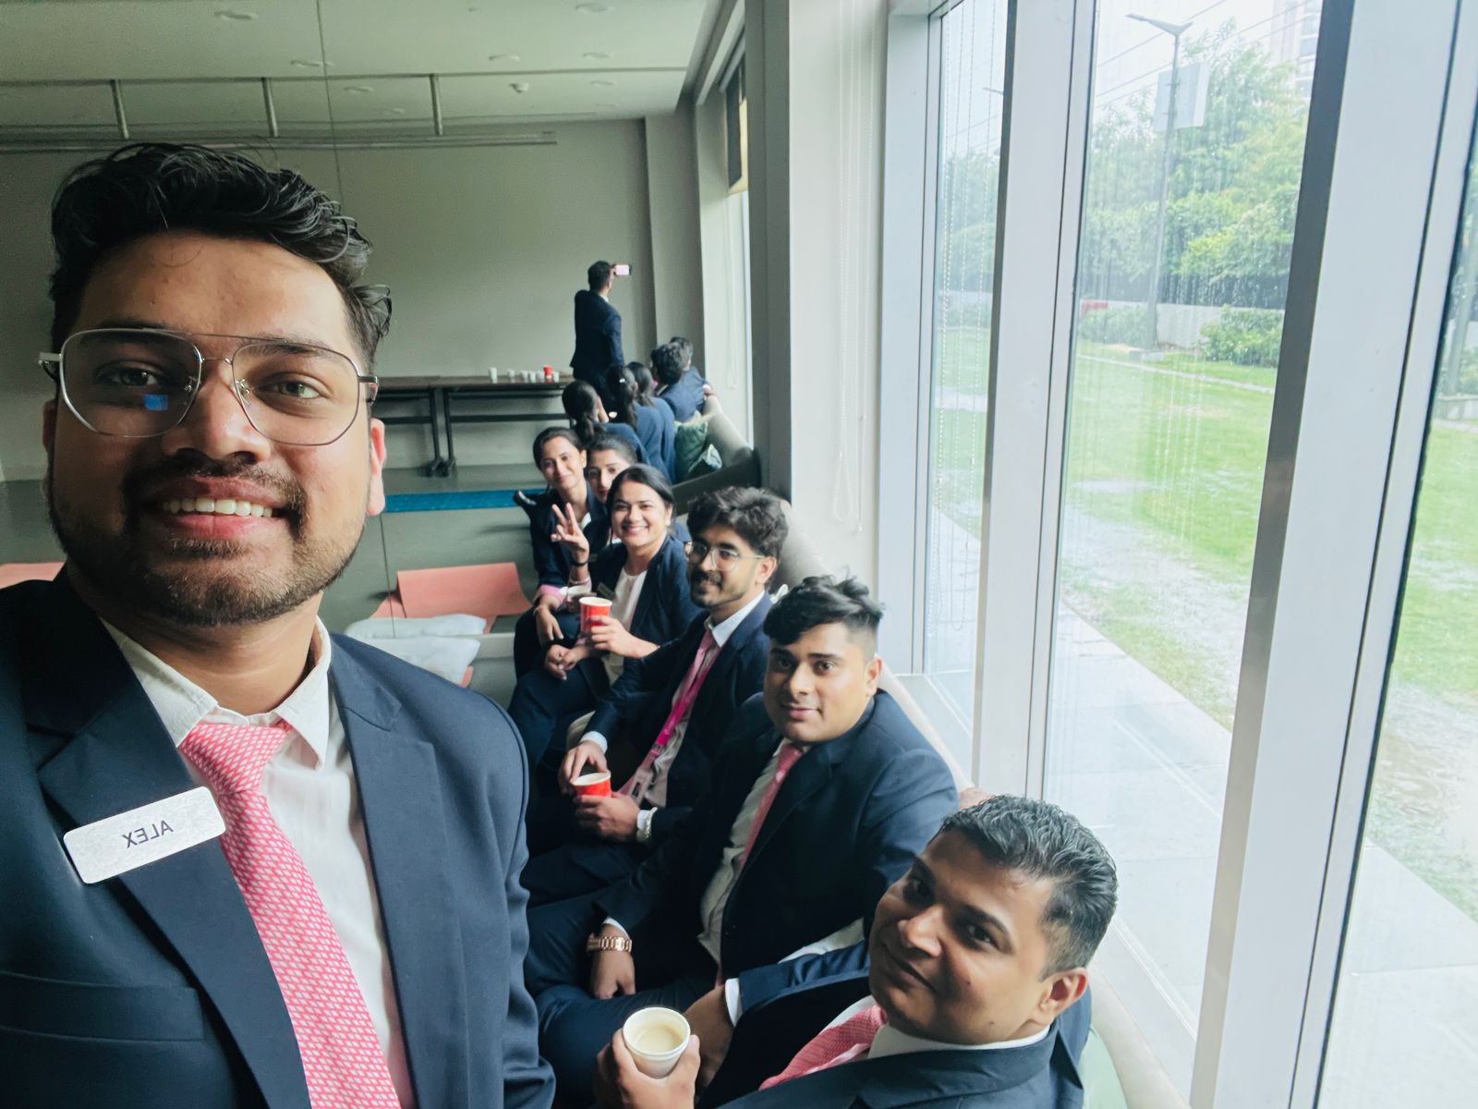
Pictorial Journey

