Slide 1

Title - Analysis of Tuberculosis Mass Screening Using Chest X-rays data of Madhya Pradesh
Organization - U4RAD Technologies Pvt LTD
Mentor - Dr Ekta Saroha
Submitted By - Rinku
(PG/23/091)

Slide 2


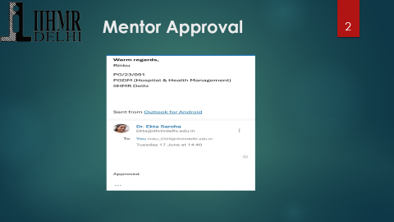
Mentor Approval

Slide 3
Introduction
Tuberculosis (TB) remains a significant public health concern in India. Early detection and effective screening strategies are vital to control its spread.
Despite extensive efforts under the National Tuberculosis Eradication Program (NTEP), early detection remains a critical factor in achieving control and eventual elimination.
Chest X-ray-based mass screening has been increasingly adopted in Madhya Pradesh to enhance early case detection.
The dataset used in this analysis consists of 1000 patient records of Kurai, a block in Seoni district, Madhya Pradesh collected through systematic sampling.
These records include age group data and TB status (positive/negative), allowing for identification of high-risk groups and assessment of screening efficiency.

Slide 4
Rationale of the Study:
This study aims to assess the outcomes of these screenings, identify high-risk age cohorts, and evaluate how effective the process is in detecting cases needing further clinical follow-up.
The findings will help improve targeted screening strategies and enhance early detection efforts in public health programs.

Slide 5
Objectives of Your Study
1. To analyze the outcomes of chest X-ray-based mass screening campaigns in Madhya Pradesh, with a focus on the prevalence of radiological abnormalities that may indicate respiratory issues or early TB.
2. To identify specific age cohorts within the screened population that exhibit a higher incidence of abnormalities, aiding in the formulation of targeted screening strategies.
3. To evaluate the overall yield of the screening process, assessing how effective it is in flagging cases requiring further clinical and diagnostic follow-up.

Slide 6
Research Question:
What is the prevalence of radiological abnormalities suggestive of respiratory diseases, including early tuberculosis, in chest X-ray-based mass screening campaigns conducted in Madhya Pradesh, and how does this vary across different age cohorts?

Slide 7
Methodology (1/2)
Study Design: This was a cross-sectional study using primary data obtained from a government-conducted mass TB screening program via mobile X-ray units.
Population & Sample: The dataset comprised records of 1,000 individuals with 11Y to 86Y of age screened during a specific phase of the program across districts of Madhya Pradesh.
Data Collection: Chest X-ray reports
Analysis: Microsoft Excel used for initial analysis and OTHM Software for extraction of data from chest x-ray reports.
Key Variables: Age (categorized into standard demographic cohorts), gender, and inferred radiological abnormality status based on text-based 'findings' field.

Slide 8
Methodology (2/2)
Inclusion Criteria: All patients with a valid age and interpretable chest X-ray findings were included.
Exclusion Criteria: Records with missing or erroneous age values, as well as those with uninterpretable or blank 'findings' fields, were excluded.
Data Preparation:
Chest X-ray findings were parsed using keyword-matching logic. Keywords such as 'Infective etiology,' 'Cardiomegaly,' 'Bronchovascular congestion,' and 'abnormality seen' were used to flag possible abnormalities.
Deduplication of records was carried out based on patient identifiers and date filters, resulting in the removal of 143 duplicate entries.
Post-exclusion, a total of 852 records were retained for analysis after filtering out 5 records with invalid findings.

Slide 9
Results (1/3)
General Screening Outcomes:
Out of 852 unique individuals, 158 (18.5%) exhibited chest X-ray findings suggestive of respiratory abnormalities requiring further evaluation.
The majority (690 individuals, 81%) showed no abnormality, while a very small fraction (4 individuals, 0.5%) had findings fields that were blank or uninterpretable.
Demographics:
The gender distribution was skewed toward females (60%), while males made up 40% of the screened population.
The average age of individuals screened was 49.5 years, with the youngest being 11 and the oldest 86 years old.

Slide 10
Results (2/3)
Prevalence of Abnormalities by Age Group:
The analysis revealed a clear upward trend in abnormality prevalence with increasing age.
The 55–64 year group showed the highest proportion of abnormal findings (22.0%), followed by the 65+ group (19.4%) and the 45–54 group (18.0%).
The lowest prevalence was observed in the under-25 cohort, suggesting age as a major risk factor for radiological abnormalities.
These results are crucial for resource optimization, indicating that screening yield is significantly higher in older populations.

Slide 11
Results (3/3)
Yield of Screening Process:
Of the 852 individuals screened, 158 showed radiological signs warranting further follow-up, translating to a yield of 18.5%.
This suggests that nearly 1 in 5 individuals screened via chest X-ray in the program exhibited signs meriting diagnostic attention.
Gender-Based Analysis:
While detailed breakdowns of abnormality by gender were not available, preliminary trends suggest similar prevalence across genders with slight female predominance.
Additional graph-based visualization can better depict comparative abnormality detection across male and female cohorts.

Slide 12
Discussion (1/2)
Key Interpretations:
The relatively high prevalence (18.5%) of radiological abnormalities justifies the inclusion of chest X-rays as a frontline screening tool in TB control strategies.
The strong correlation between increasing age and likelihood of abnormalities suggests a need to stratify populations by age when planning screening interventions.
The data aligns with global epidemiological evidence that older adults are more vulnerable to respiratory pathologies due to declining immune function and accumulated environmental exposure.

Slide 13
Discussion (2/2)
Public Health Implications:
The findings argue for a targeted screening model where higher-risk age groups (45 years and above) are prioritized, improving efficiency and optimizing resource use.
Screening tools such as mobile chest X-ray units should be more strategically deployed in areas with dense older populations.
Study Limitations:
The primary limitation is that the study only infers potential TB cases from suggestive radiological terms and not confirmed clinical diagnoses.
Absence of patient history, comorbidities, and symptomatology in the dataset restricts deeper correlation analysis.
Being a cross-sectional snapshot, the study cannot comment on disease progression or follow-up outcomes.

Slide 14
Conclusion
This analysis of 852 screened individuals under Madhya Pradesh's mass TB screening initiative shows a meaningful yield of 18.5% for radiological abnormalities.
It emphasizes the importance of incorporating targeted age-based strategies to enhance screening efficiency and public health impact.
Older age cohorts (45–64 and 65+ years) consistently showed higher prevalence, suggesting the need for focused interventions in these groups.
Improving data collection (e.g., symptom history, diagnostic follow-up) and integrating with care pathways will be crucial for enhancing future program effectiveness.

Slide 15
REFRENCES OF THE STUDY
World Health Organization. (2023). Global tuberculosis report 2023. World Health Organization. https://www.who.int/publications/i/item/9789240076729
Ministry of Health and Family Welfare. (2017). National strategic plan for tuberculosis elimination 2017–2025. Central TB Division, Government of India. https://tbcindia.gov.in
Central TB Division. (2021). Technical and operational guidelines for TB control in India. Ministry of Health and Family Welfare. https://tbcindia.gov.in/showfile.php?lid=3214
Bhargava, A., Jain, Y., & Chatterjee, M. (2013). Screening for pulmonary tuberculosis using chest radiography in India: Relevance to active case finding. Indian Journal of Tuberculosis, 60(2), 96–104.
Pai, M., Behr, M. A., Dowdy, D., Dheda, K., Divangahi, M., Boehme, C. C., Ginsberg, A., Swaminathan, S., Spigelman, M., Getahun, H., Menzies, D., & Raviglione, M. (2016). Tuberculosis. The Lancet, 387(10024), 2219–2232. https://doi.org/10.1016/S0140-6736(16)00576-6
Centers for Disease Control and Prevention. (2021). TB screening and testing of healthcare workers. https://www.cdc.gov/tb/topic/testing/healthcareworkers.htm

Slide 16
Involvement In Community Outreach Programme (Cop) Activities
Total no. of visits done by the Student: 10
Activities done by the student:
Mapping and listing of the area.
Interaction with the community and frontline healthcare workers.
Conducted IDI with the ASHA on High-risk pregnant women (Group project).

Slide 17
Key Learning From Cop Activities
1. Mapping and Listing of the Area
Understanding Community Layout: Developed a detailed understanding of the geographical distribution of households, health facilities, and key resources.
2. Interaction with Community & FLHWs
Observed field-level challenges (resource gaps, cultural barriers).
Gained clarity on roles of ASHA, ANM, and AWW.
Learned community engagement and trust-building skills.
3. IDI with ASHA on High-Risk Pregnancies
Understood criteria for identifying high-risk pregnancies.
Learned about referral and coordination systems.
Noted ASHA's challenges and coping mechanisms.

Slide 18
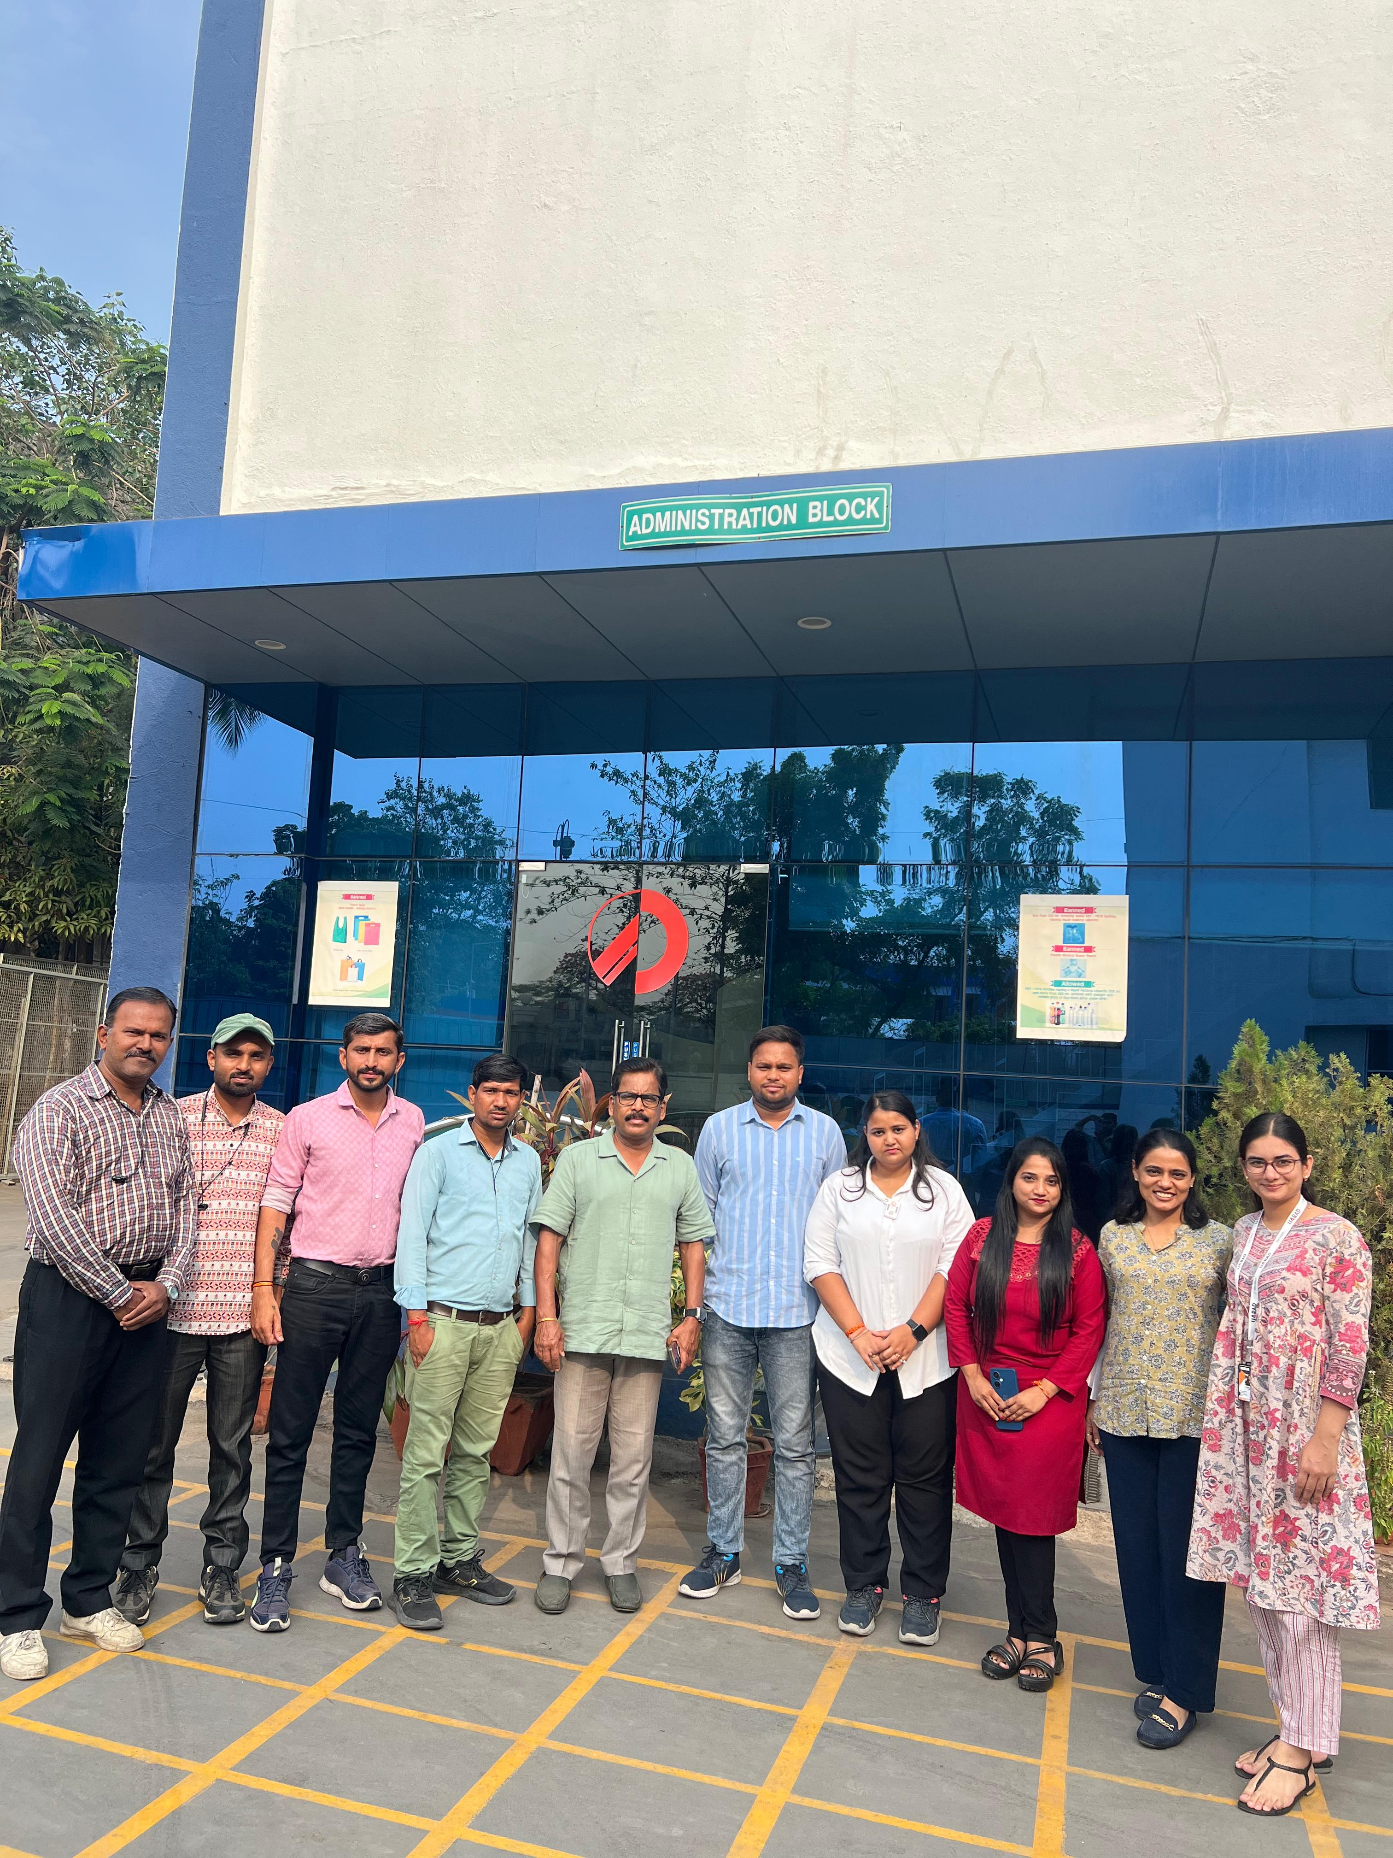

Pictorial Journey (1/2)

Slide 19
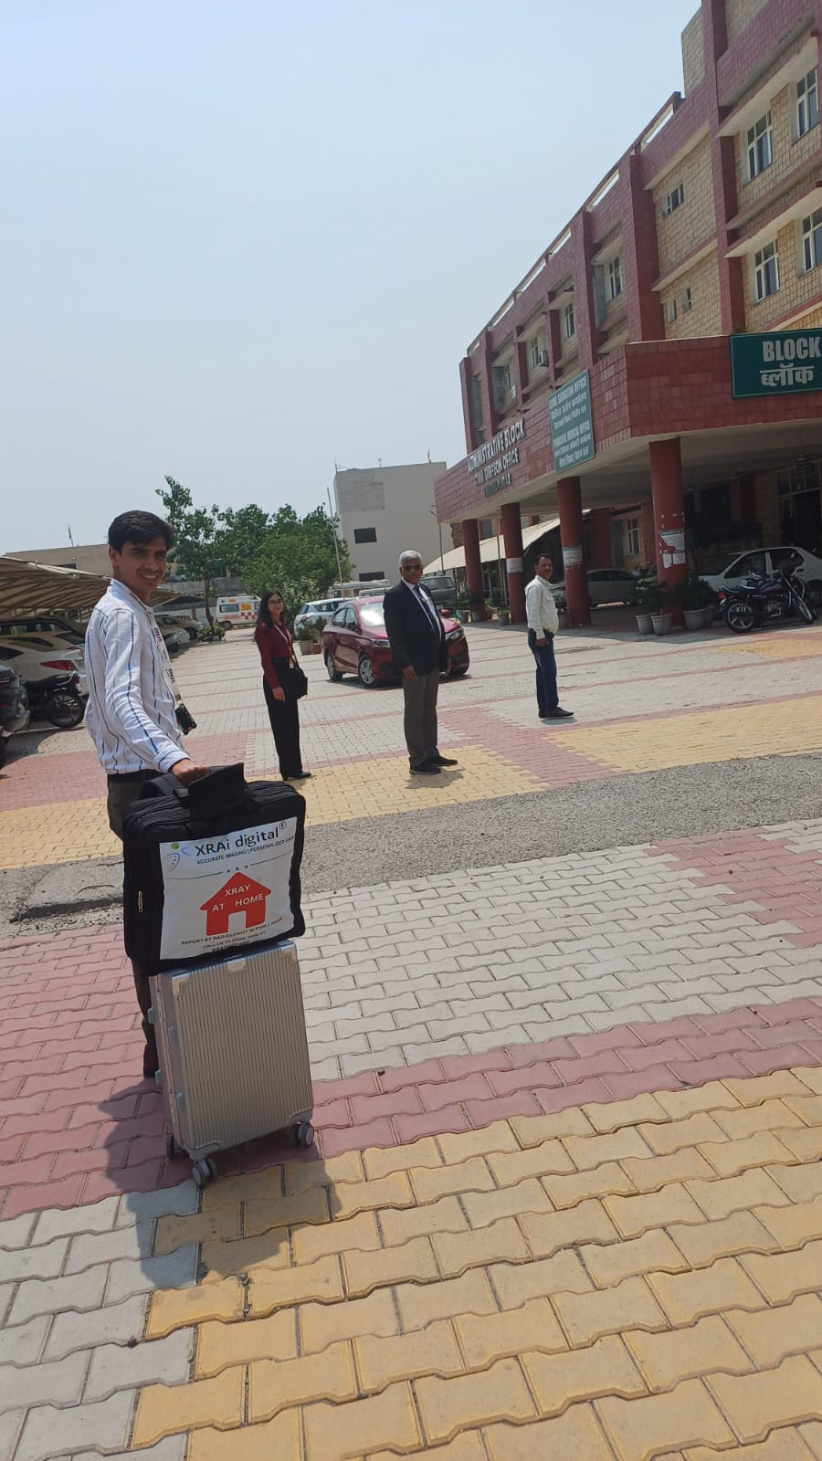
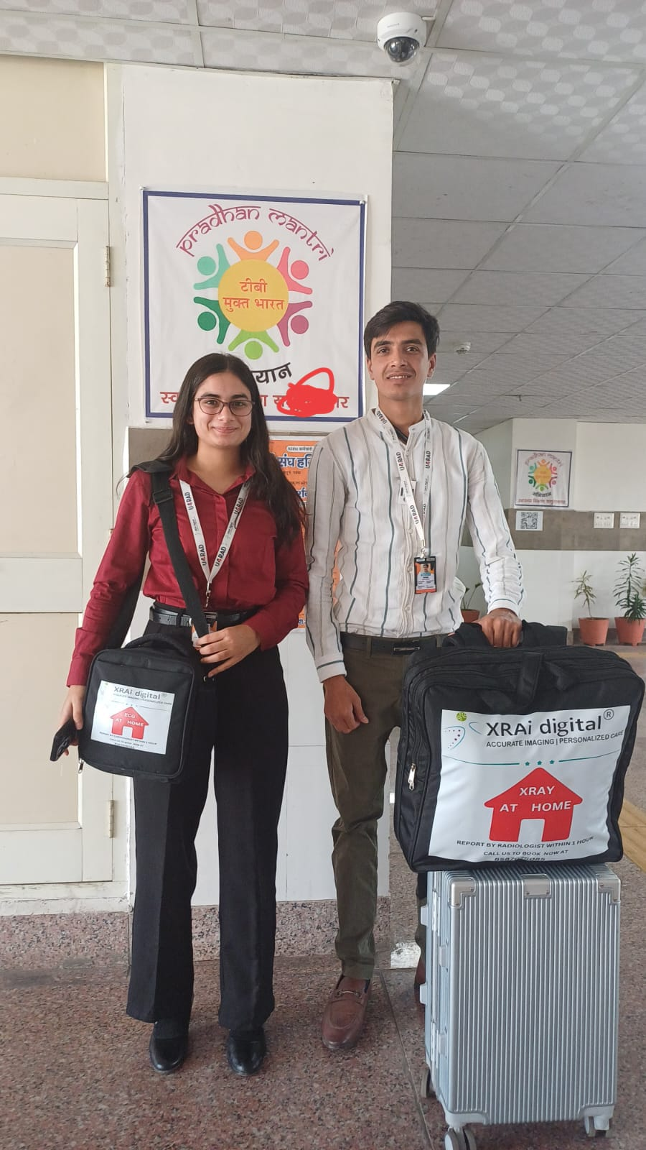
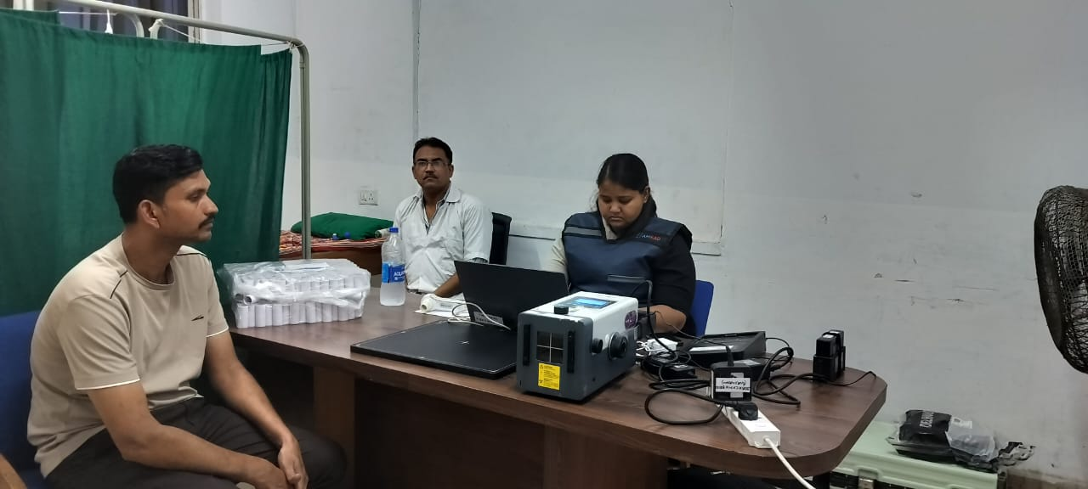
Pictorial Journey (2/2)

Slide 20
Thank You
Any Questions

