Slide 1

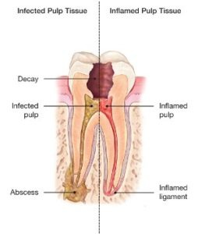
ESTIMATING STANDARD TIME FOR COMMON OPERATING PROCEDURE (ROOT CANAL TREATMENT)
AT
SMILE INDIA DENTAL CLINIC
PRESENTED BY:
Dr. Shalini Jha
ROLL NO: PG/23/104
Under the guidance of
Dr. Altaf Yousuf Mir, Associate Professor
IIHMR Delhi

Slide 2
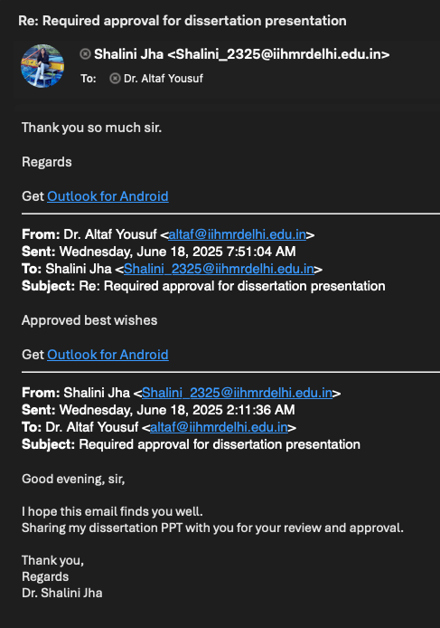
MENTOR APPROVAL

Slide 3
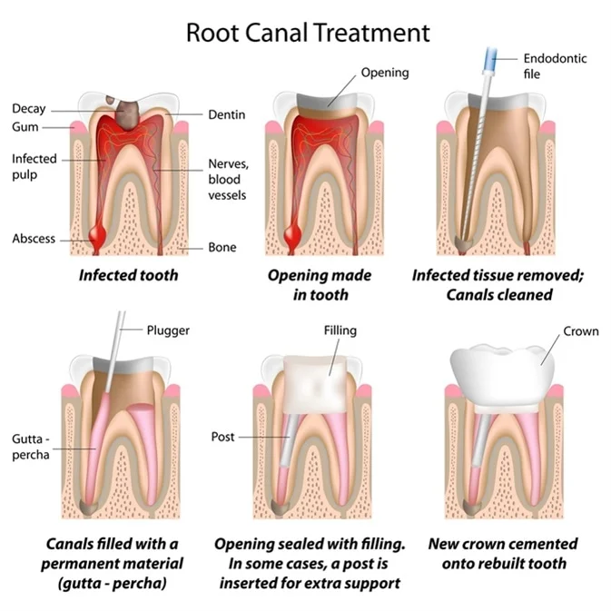
INTRODUCTION
ROOT CANAL TREATMENT
A root canal treatment is a dental procedure to remove inflamed or infected pulp on the inside of the tooth which is then carefully cleaned and disinfected, then filled and sealed. Root canal treatment is designed to eliminate bacteria from the infected root canal, prevent reinfection of the tooth and save the natural tooth.

Slide 4
Inside your tooth, beneath the white enamel and a hard layer called dentin, is a soft tissue called pulp. This tissue contains blood vessels, nerves and connective tissue, which help grow the root of your tooth during its development. A fully developed tooth can survive without the pulp because the tooth continues to be nourished by the tissues surrounding it.
Advantages of root canal treatment
Efficient chewing
Normal biting force and sensation
Natural appearance
Protects other teeth from excessive wear or strain
There are a few symptoms that mean you might need a root canal-
Severe pain while chewing or biting
Pimples on the gums
A chipped or cracked tooth
Lingering sensitivity to hot or cold, even after the sensation has been removed
Swollen or tender gums
Deep decay or darkening of the gums

Slide 5
INCLUSION & EXCLUSION CRITERIA
INCLUSION:
Age- 18 to 65 years.
Primary RCTs.
Includes Anterior, Premolars and 1st & 2nd molars.
Teeth diagnosed with Irreversible Pulpitis, Symptomatic/ Asymptomatic apical periodontitis, Pulp necrosis.
Cases that are manageable by general dental practitioners and do not require specialist referral.
Patients who provide their written consent to participate in the study and allow the recording of procedure duration.
EXCLUSION:
Re-RCTs.
Wisdom Tooth RCTs.
Non-cooperative patients.
Emergency visits, such as a Hot tooth.

Slide 6
OBJECTIVES OF THE STUDY
1.⁠ ⁠To analyse the time required for different stages of root canal treatment.
2.⁠ ⁠To provide suggestions for optimising procedure efficiency.

Slide 7
METHODOLOGY
STUDY DESIGN
A cross-sectional observational study in a dental clinic.
SAMPLE SELECTION:
Purposive Sampling
SAMPLE SIZE
A minimum of 30 RCT procedures.

Slide 8
METHODOLOGY
DATA COLLECTION
Breakdown of procedure stages:
1.⁠ ⁠Patient Preparation & Aesthesia
2.⁠ ⁠Access Cavity Preparation
3.⁠ ⁠Canal Cleaning & Shaping
4.⁠ ⁠Obturation & Sealing
5.⁠ ⁠Post-Operative Instructions
Time tracking through direct observation.
Consideration of influencing factors (e.g., tooth type, complexity, operator experience).

Slide 9
ANALYSIS TOOLS
MS Excel for calculating turnaround time..
EXPECTED RESULTS AND CONTRIBUTION
Identification of an average time for RCT procedures.
Recognition of significant factors affecting treatment duration
Practical suggestions for optimising treatment efficiency.

Slide 10
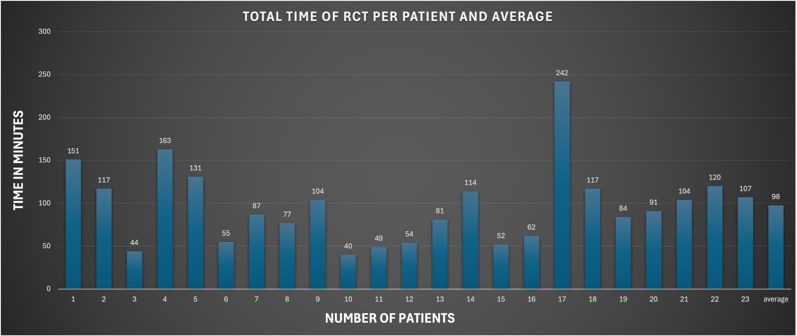
RESULTS

Slide 11
INTERPRETATION
The total number of patients observed was 23
The average time taken to complete one root canal treatment is 98 minutes.
The maximum time was 242 Minutes, that is 4 hours. Tooth No.27 (First molar)
The minimum time was 40 minutes. Tooth No. 43 (Canine)
A root canal can take anywhere from 90 minutes to 3 hours.

Slide 12
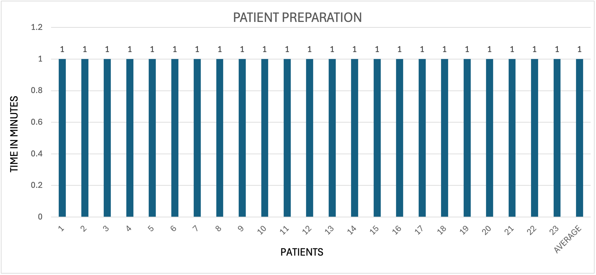
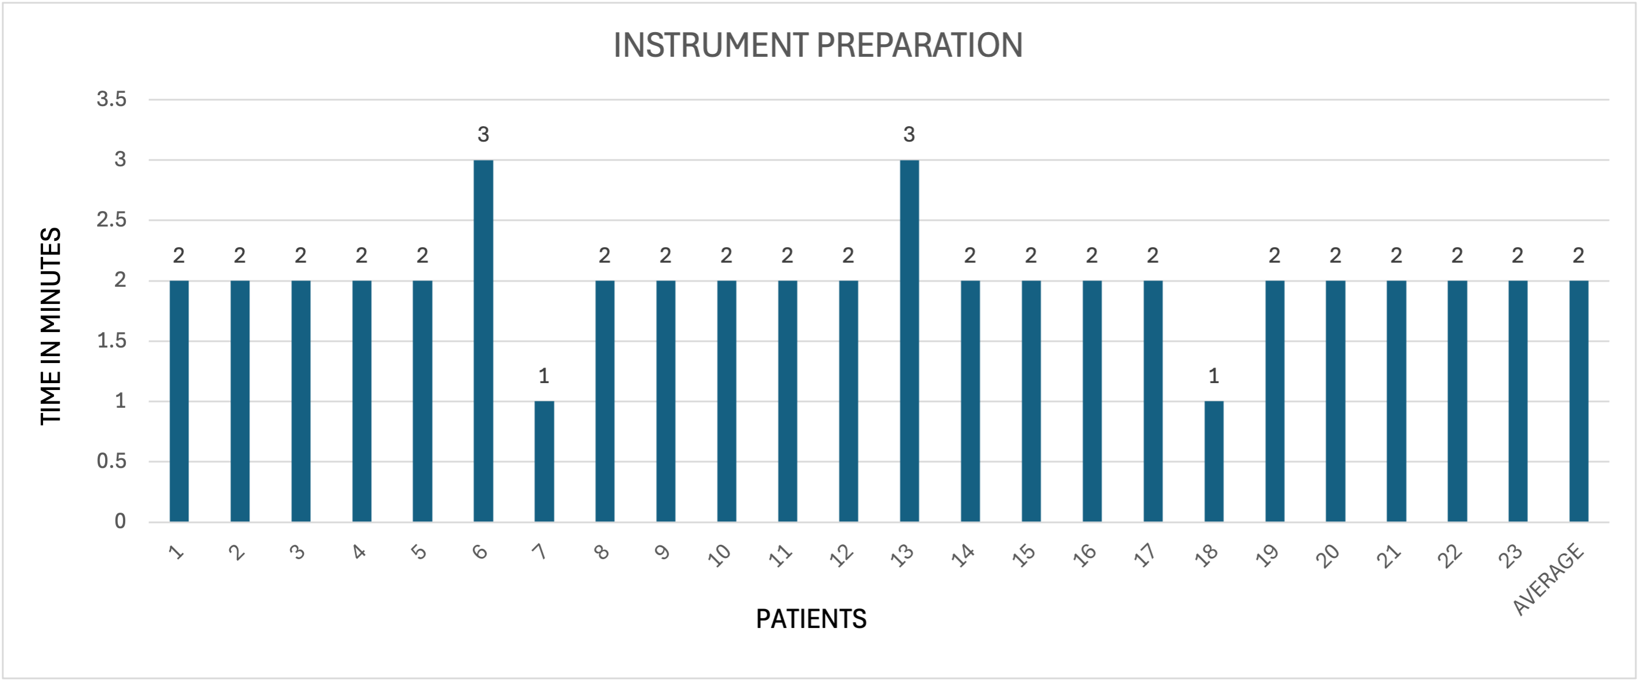
RESULTS & INTERPRETATION OF EACH PROCEDURE
Interpretation: Patient preparation mostly takes one minute—reasons: Trained attendants. Just patient draping is required.
Interpretation: The average time required to prepare the instruments was 2 minutes. Reasons: preparing the instruments beforehand in case of appointments.

Slide 13
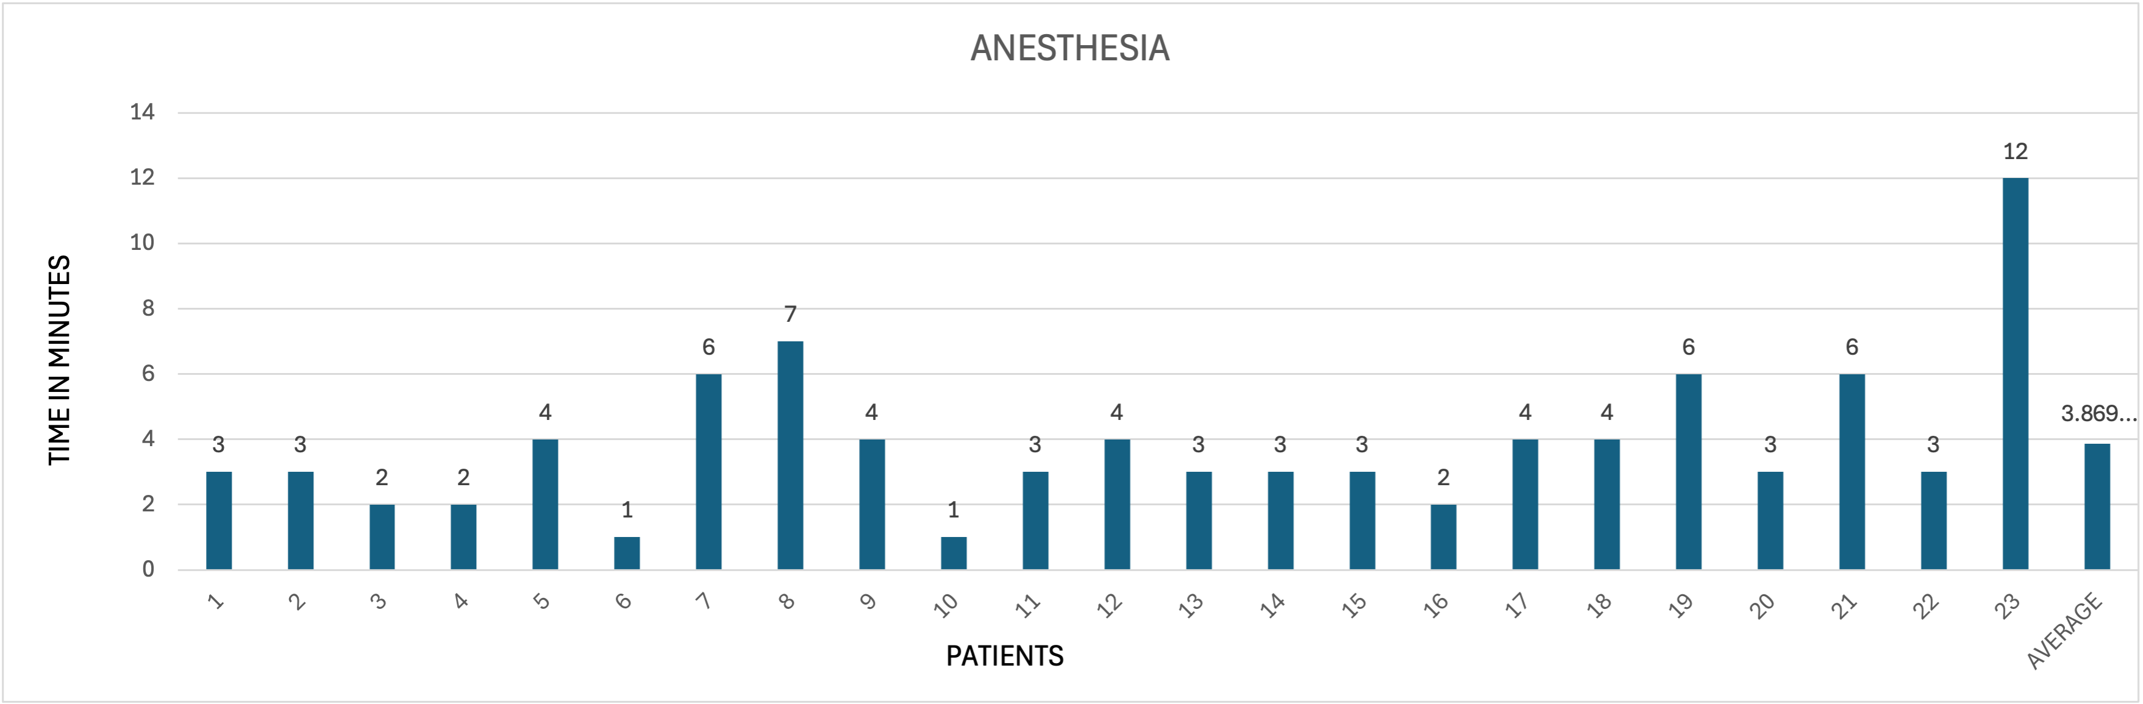
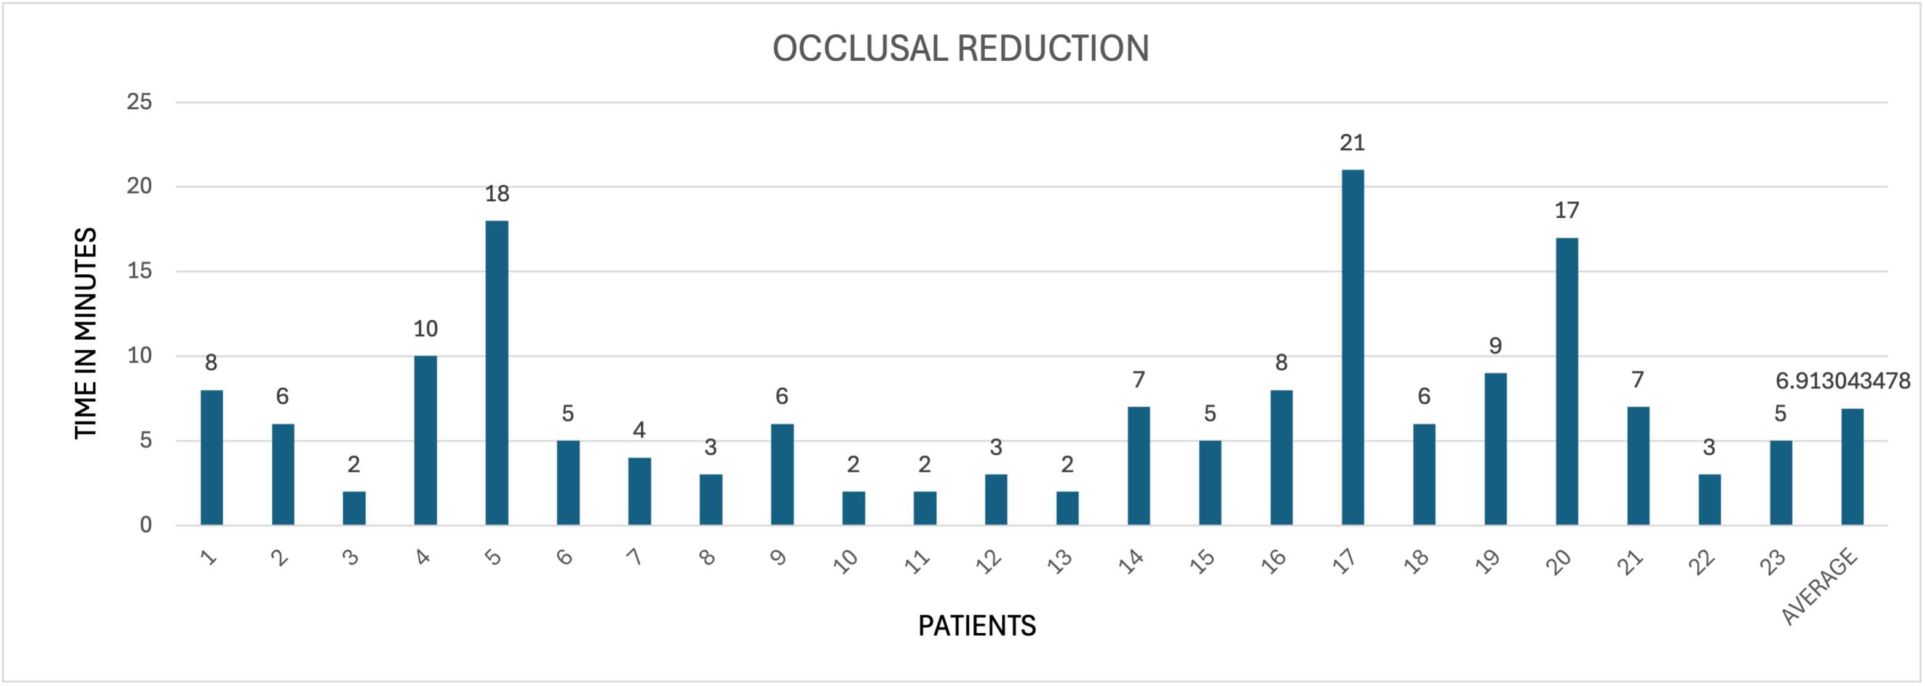
Interpretation: The average time taken to give anaesthesia was 4 minutes.- Reasons: it depends on the area to be anaesthetized.
Interpretation: The average time taken to reduce the occlusal or incisal contacts was 7 minutes.
Reasons: OR is affected by patients' cooperation, pain, and non-carious diseases such as attrition.

Slide 14
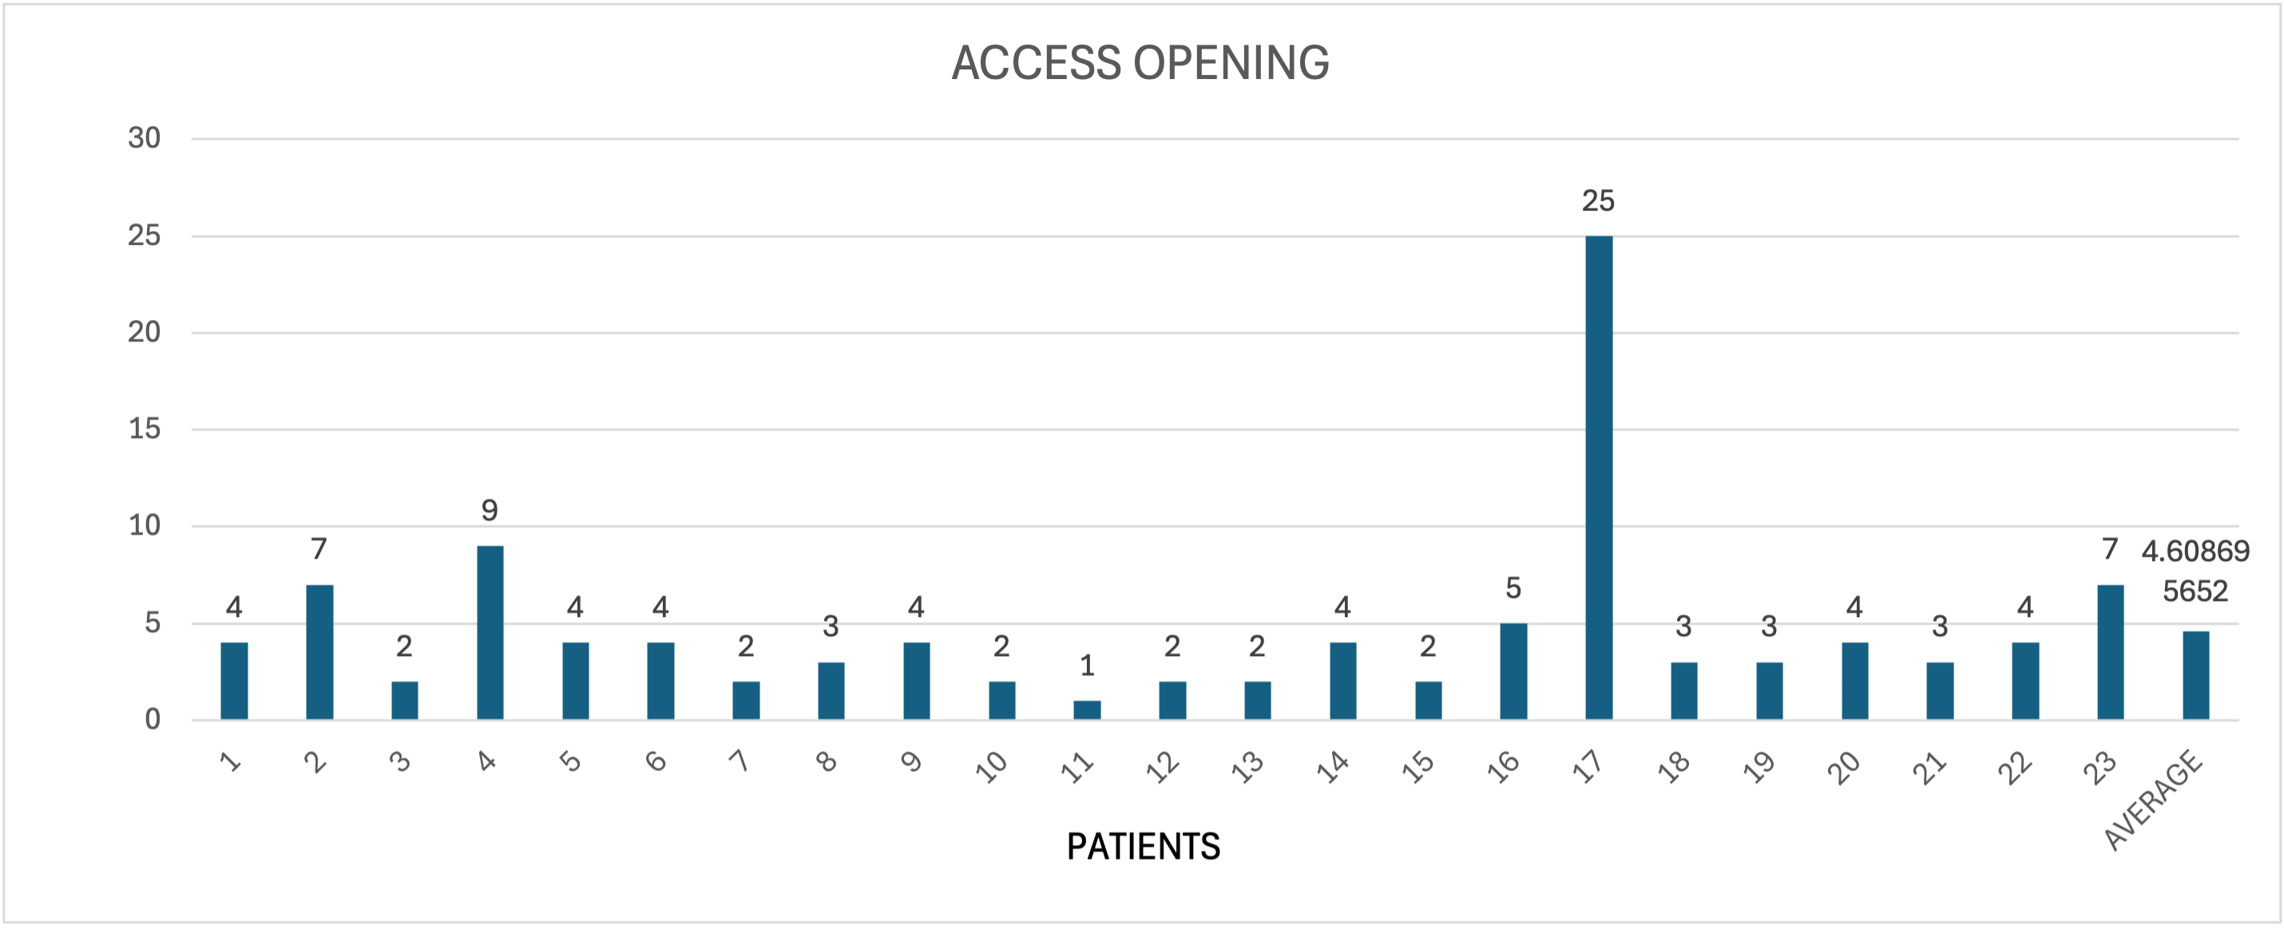
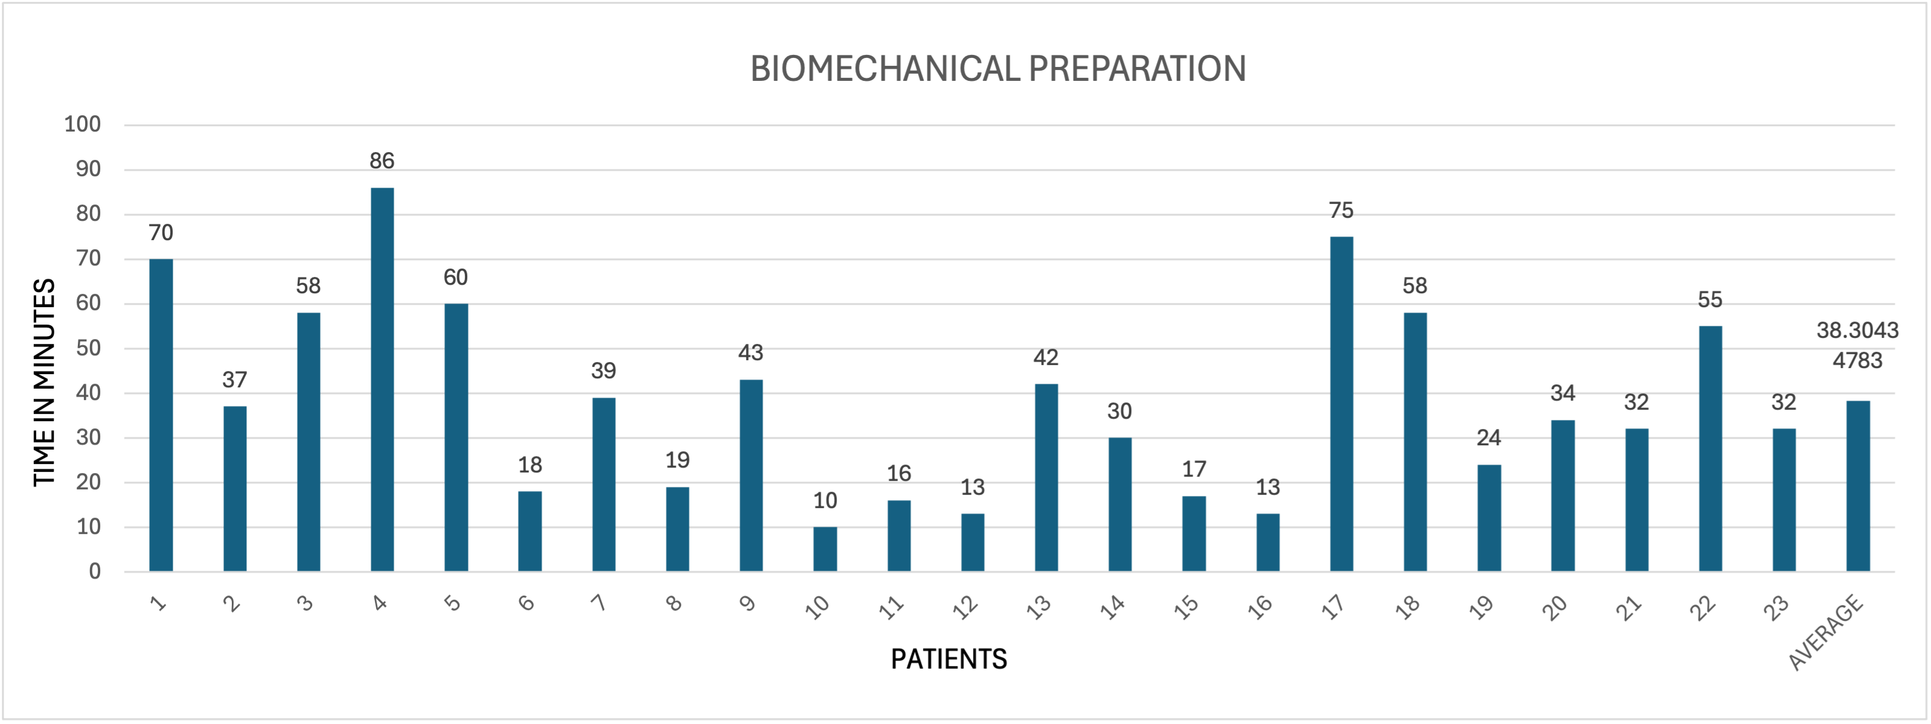
Interpretation: The average time taken to open the canals in the tooth was 5 minutes.
Reasons: The AO depends on the tooth being treated, pain and accessibility and number of canals.
TIME IN MINUTES
Interpretation: The average time taken for biomechanical preparation was 38 minutes.
Reasons: BMP is affected by the number of canals, accessibility, shape of canals, infection in the canals.

Slide 15
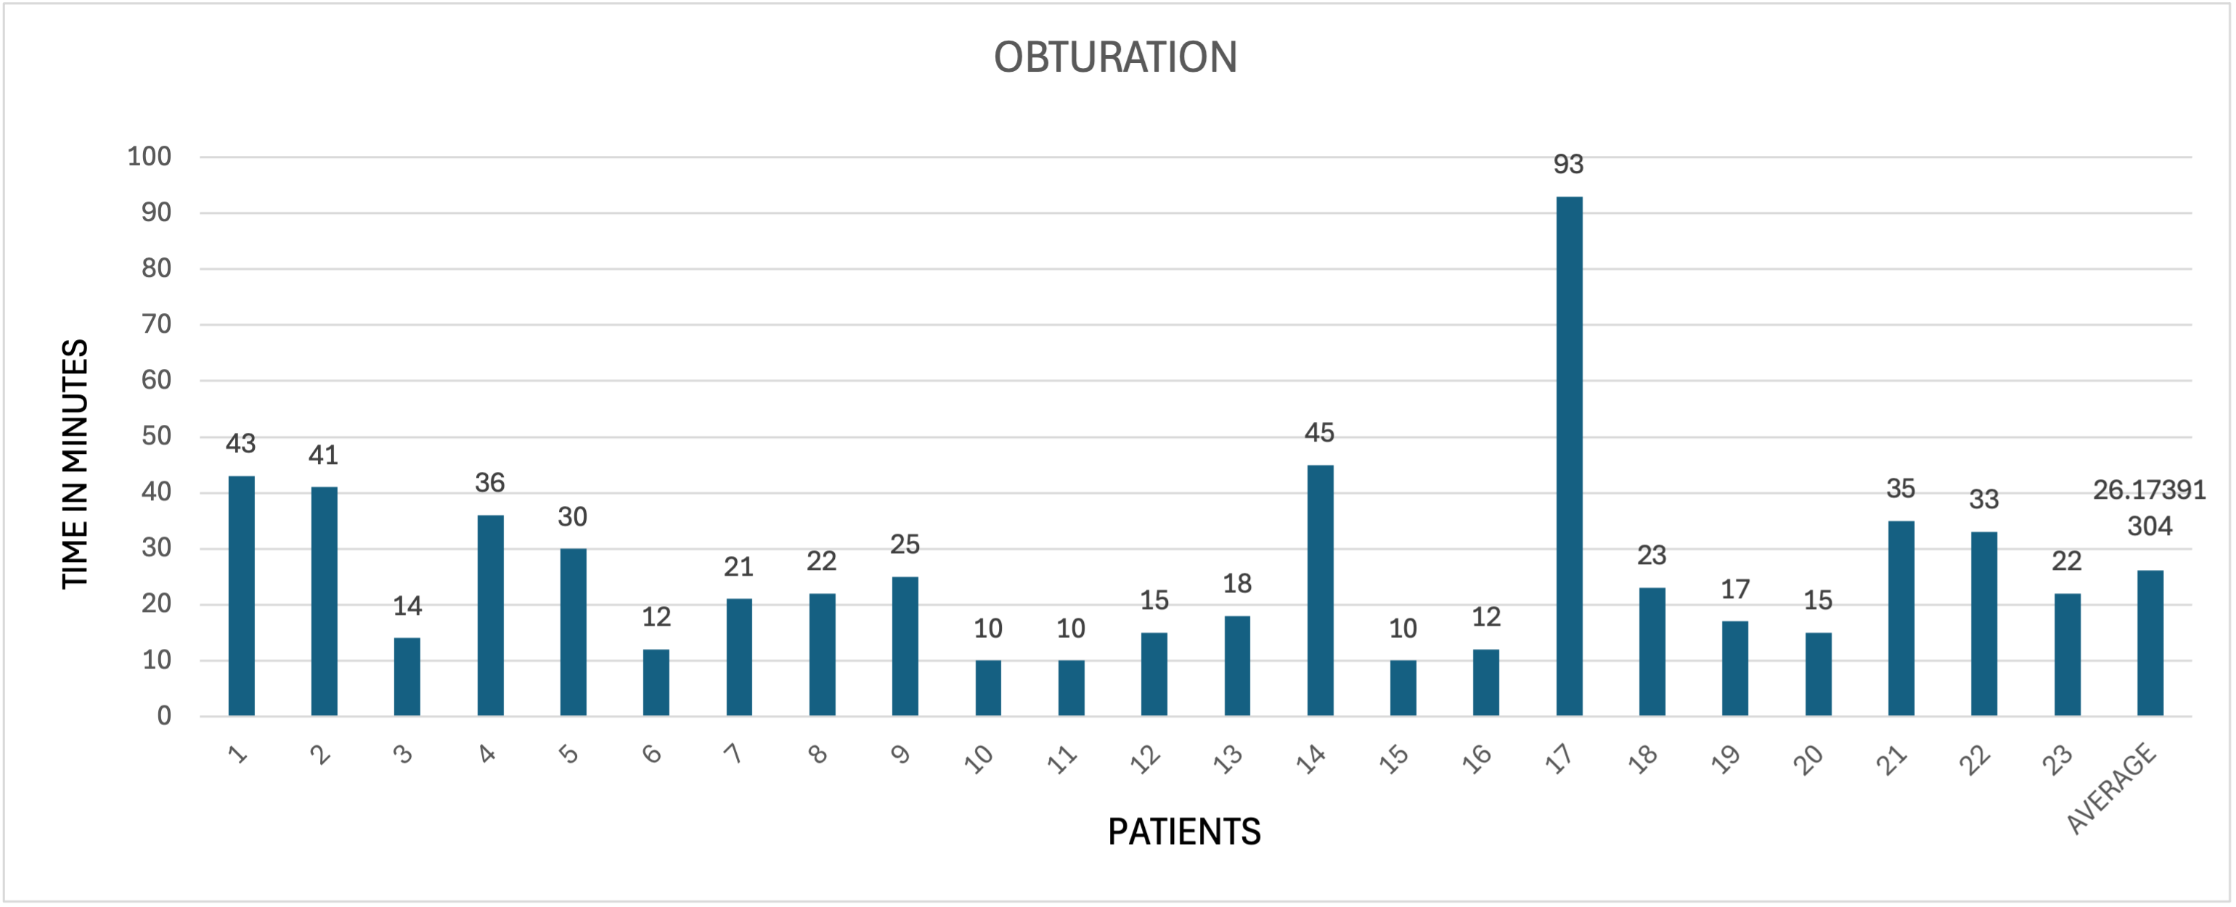
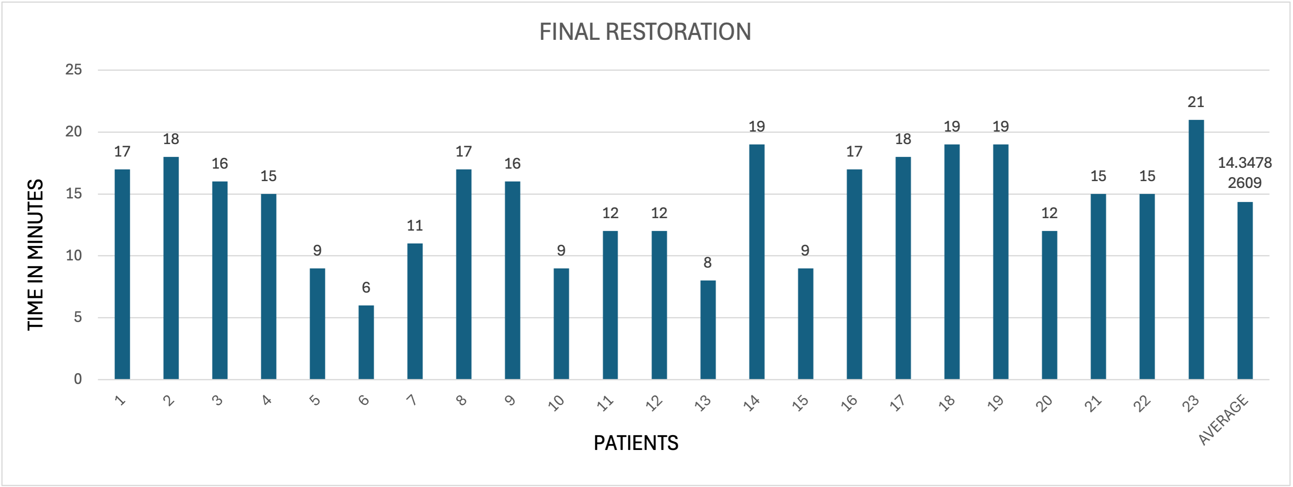
Interpretation: the average time for obturation was 26 minutes.
Reasons: the obturation is affected by the no. of canals, repetition of X- rays, and heating the instruments for sealing.
Interpretation: The average time taken for final restoration was 14 minutes.
Reasons: depends on the tooth size, the type of restorative material used, and isolation to prevent contact with the saliva.

Slide 16
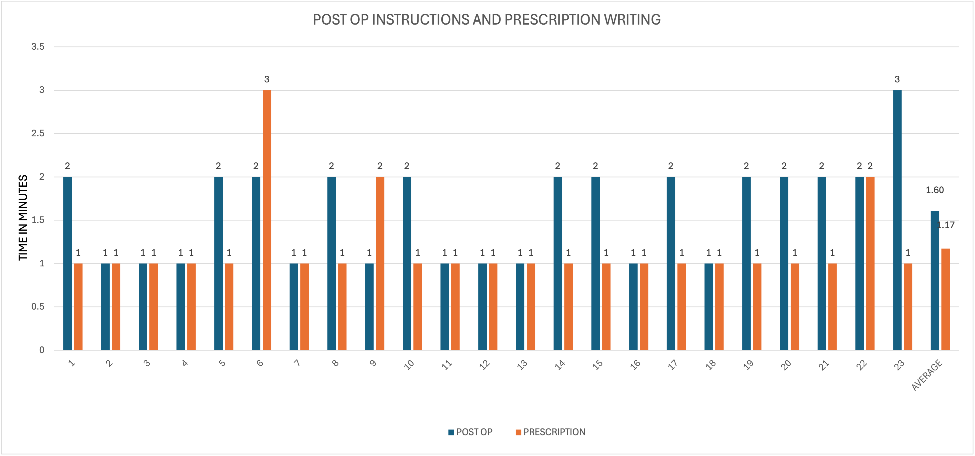
Interpretation: the average time taken to write the prescription and give post operative instructions to patients was 1 minute and 2 minutes, respectively.
Reasons: the prescriptions were prepared by the doctors who were not attending the patients at that time and the post op instructions were given at every step as soon as it was completed.

Slide 17
SUGGESTIONS FOR OPTIMISING PROCEDURE EFFICIENCY.
Streamline appointment scheduling according to the complexity of the case.
Employ digital scheduling systems to minimize patient waiting times and missed appointments.
Utilize dental microscopes or loupes for improved visibility and precision.
Implement four-handed dentistry. Train staff in four-handed dentistry to enhance efficiency and assistance.
Educate patients on the significance of follow-ups and timely appointments.
Ensure continuing professional development through regular training and workshops for staff and dentists on new materials, technologies, and techniques.
Changing the equipments on time to prevent equipment failure.
Prevention of instrument breakage in the canal by changing the files after a particular period of its use.

Slide 18
CONCLUSION
The time taken to complete one RCT is usually 90 minutes to 3 hours.
The posterior teeth take more time than the anterior ones due to a greater number of canals, the shape of canals, and accessibility.
The study shows the average time taken to complete the RCT is 98 minutes.
But one of the cases took 4 hours to complete.
The cause of delay includes the severity of infection, pain, patients' cooperation, effectiveness of anaesthesia, and patients not coming on appointed days, doctors on leave, leading to cancellation of the appointment of the patients.
Other potential causes of delay include medical conditions such as diabetes, hypertension, patients taking blood thinners, Periapical abscesses, perforations, challenging access to posterior teeth, and reduced mouth opening of the patients.
The time taken to complete the RCTs also depends on the doctors’ expertise and experience. The newly practising doctor would take more time than the experienced one as not only the treatment part but managing the patient on the dental chair is also crucial.

Slide 19
REFERENCES
https://www.aae.org/patients/root-canal-treatment/what-is-a-root-canal/

Slide 20


