Slide 1


Knowledge, perception and attitude towards Mental illness among patients and care givers.”- An explorative research.
Presented by: Riya Nandan
PG/21/086
Mentor: Dr Ratika Samtani

Slide 2
Introduction
•WHO launched the WHO Special Initiative for Mental Health (2019-2023): Universal Health Coverage for Mental Health to ensure access to quality and affordable care for mental health conditions in 12 priority countries to 100 million more people.
•Depression is one of the leading causes of disability. Suicide is the fourth leading cause of death among 15-29-year-olds.
•People with severe mental health conditions die prematurely – as much as two decades early – due to preventable physical conditions.
•Increased investment is required on all fronts: for mental health awareness to increase understanding and reduce stigma; for efforts to increase access to quality mental health care and effective treatments; and for research to identify new treatments and improve existing treatments for all mental disorders

Slide 3
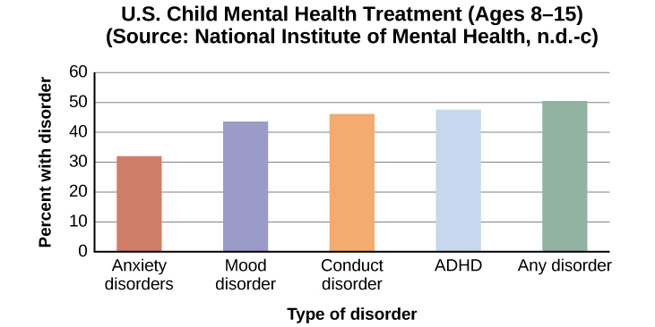
Background
•Mental illnesses are defined as “health conditions that are characterized by alterations in thinking, mood, or behavior (or some combination thereof) associated with distress and/or impaired functioning”
•Although there is a wide prevalence of mental illnesses, they are largely neglected and surrounded by misunderstanding and stigmatizing attitude.
•Families are the mainstay of caregiving for persons with mental illnesses. Yet, they often lack the knowledge and skills needed to assist their mentally ill relatives.

Slide 4
Key Terms
PWMI: People With Mental Illness
ISMI: Internalized Stigma of Mental Illness
CAMI: Community Attitude towards Mental Illness
KAPB: knowledge, attitude, perception, and belief

Slide 5
Study Instruments:
•The socio-demographic characteristics of the caregiver and the patient.
•A cross sectional study design was used. Data was collected from 455 study participants using structured and pre-tested self-administered questionnaire and analyzed using SPSS version 20 software respectively.
•The mental condition of the patient; diagnosis of mental illness (was obtained from the patient records), duration of mental illness, regular administration of prescribed medication, frequency of seeking outpatient psychiatric care and times of inpatient psychiatric hospital admission in the past 6 months

Slide 6
Rationales of the study:
Problem Statement: Around a lot of people have mental health issues every year. They range from prevalent issues like sadness and anxiety to uncommon issues.
Scope of the study: We must have a deeper understanding of the psychological processes that underlie societal shifts like self-harm, suicide, anxiety, and sadness. This knowledge will assist in the creation of novel, mechanistically based psychological therapies that can be applied in pandemic situations.

Slide 7
Methodology
Study design- Qualitative analysis in which I will be using primary data which has been collected while doing this research .
Study duration- 3 months
Study population- Mental health clients visiting DrSafeHands
Sampling method: Random sampling method will be used for the study.
Method of data collection: The Google form will be circulated among the eligible participants and the responses will be entered and stored in Microsoft Excel Spreadsheet.
Data Analysis: Data will be analysed using IBM SPSS. Chi square test will be used to test associations for statistical significance. To organize and summarize the data and need numbers to describe what happened, Histograms or Bar Graphs used to show the way data are distributed.

Slide 8

Caregivers who fulfilled the following criteria were included in the study after obtaining their written informed consent:
For caregivers:
Aged 21 years old or more,
Were the main care providers for the patients for ≥ 1 year (looking after their daily needs, supervising their medications, taking the patient to the hospital, staying with the patient during the inpatient stay and continuing contact with the hospital staff)
For patients:
Met the principal diagnosis of any mental disorder according to the diagnostic and statistical manual of mental disorders-fifth edition (DSM-5) criteria for ≥ 1 year.

Slide 9
Discussion
•Poor knowledge about mental illness and negative attitudes toward people with mental illness are widespread
•For the knowledge and attitude (social distance) towards people with mental illness, a computed knowledge score was derived and categorised into three groups ‘‘above average’’, ‘‘average’’ and ‘‘below-average’’ knowledge.
•The majority of them consulted traditional healers as first help for the care of their mentally ill relatives. The consulted traditional healers referred only a small percentage of patients to psychiatric care.

Slide 10

Impact of the study
•Mental health research saves lives, relieves significant distress and improves quality of life.
•It also benefits the whole of our society by generating social and economic benefits that contribute to thriving communities built upon resilience, reduced levels of mental ill-health and less stigma and discrimination.
•Research helps us understand how to best promote mental health in different populations.
•Data aids us in understanding whether the mental health services and resources that are available meet mental health needs.
•The findings from mental health research and evaluation studies provide crucial information about the specific needs within communities.

Slide 11
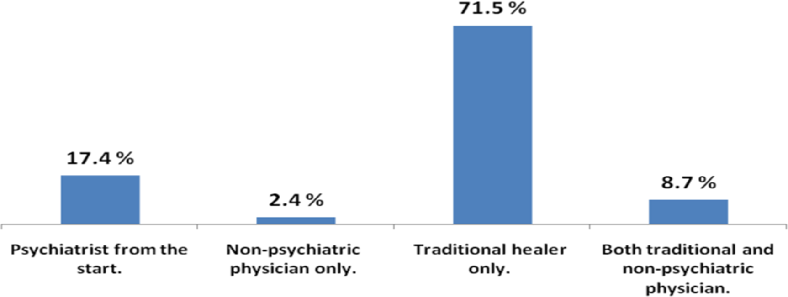
Type of the earliest sought care of the studied caregivers for their patients, DrSafeHands

Slide 12
Results
•Knowledge and attitude towards mental illness of the studied subjects were not predicted by the diagnosed type of mental illness of their relatives.
•This is consistent with a study of knowledge, attitude, perception, and belief (KAPB) of mentally ill patients’ relatives towards mental illness in India.
•The study found that KAPB of the relatives was not associated with the patient diagnosed illness .
•The mental health promotion and mental intervention system based on network adopts music, video, animation, electric journal and training, etc. which are suitable for people with healthy mentality, sub-healthy mentality, mild-and-moderate mental problems, as well as people with insufficient pressure, modest pressure and moderate pressure

Slide 13
Observations
•Mental intervention is the most common method in preventing mental problems and handling mental crisis
•Depression, anxiety, sensitive interpersonal relationship, job burnout, and other mental problems directly affect professionals’ normal work and life, but most professionals and employers only pay attention to solution to mental problems.
•Mental health status constantly changes, so the group with healthy mentality and sub-healthy mentality may have mental problems when meeting with irritant problems or crisis incidents
•At present, this method is mainly applied to patients with various severe mental problems, neuroses, and other abnormal mental problems, or groups with mental crisis

Slide 14

Conclusion
•Mental health promotion and positive mental intervention of people with healthy mentality, sub-healthy mentality, and mild-and-moderate mental problems to supplement traditional mental intervention with single layer and dimension for people with severe mental problems.
•In addition, the application of modern network may realize simultaneous mental intervention for several people without limitation of time and space.
•Family caregivers are a very important group because they have prolonged contact with the patients, and are involved in various aspects of care tasks with little assistance from limited public services.
•In the present study, education was a significant predictor of caregivers’ knowledge and attitude towards mental illness, where non-educated (illiterates/can read and write) caregivers had poor knowledge and negative attitude towards mental illness

Slide 15

References
1. Beidas rs, edmunds je, marcus sc, kendall pc. Training and consultation to promote implementation of an empirically supported treatment: a randomized trial. Psychiatric services. 2012;63(660-665)
2. Malhotra s, chakrabarti s, shah r. Telepsychiatry: promise, potential, and challenges. Indian j psychiatry. 2013
3. Telemed j e health.2022 jun;28(6):838-846. Doi: 10.1089/tmj.2021
4.Yuan q, liu s, tang s, zhang d. Happy@work: protocol for a web-based randomized controlled trial to improve mental well-being among an asian working population. Bmc public health. 2014;14:685. [Pmc free article] [pubmed] [google scholar]
5. Gold n. Using participatory research to help promote the physical and mental health of female social workers in child welfare. Child welfare. 1998;77:701–24. [Pubmed] [google scholar]

Slide 16
6.Schulze B, angermeyer M. Subjective experiences of stigma. A focus group study of schizophrenic patients, their relatives and mental health professionals. Soc sci med. 2003;56:299–312.
7.Bebbington P (2001) the world health report 2001. Soc psychiatry psychiatr epidemiol. 36(10):473–474
8. American psychiatric association: diagnostic and statistcal manual of mental disorders, fifth edition, arlington, VA, american psychiatric association. 2013.

Slide 17

Thank you

