Slide 1

Malnutrition among Under-5 children in district Panchkula- Haryana
Dr. Meenakshi Suman
Roll No : 49
PGDHM Batch- E (Health)

Slide 2
Organization and Work done
Organization- NRHM-Haryana
Designation- District Child Health Coordinator
Training of programmes of CHILD HEALTH under
NRHM-HARYANA – 5TH Feb -30th April
Key Learning's -
Programmes under Child Health
ENBCR
HBPNC
IMNCI
IMMUNIZATION
MALNUTRITION
SNCU
NBCC
NRCs
DATA QUALITY ASSESMENT

Slide 3
Overview
Introduction
Rationale
Scope of the Study
Findings
Recommendations
References

Slide 4
Introduction
Malnutrition continues to be a leading health concern in developing countries.
India is one of the countries where nearly half of infant deaths are related to Malnutrition.
According to NFHS III, 48 percent of the under-5 children are stunted, about 20 percent children have wasting and 42.5 percent children are Underweight in India.

Slide 5
IMR – where do we stand!

Slide 6
FACTS & FIGURES
Total under five population 25,00,000
Under Five Mortality = 48/1000 Live Birth
(SRS-2012)
Approximately 24000 children died every year

Slide 7
Causes Of Death In U5 Children
Source: Caulfield LE et al Am J Nutr 2004

Slide 8
Rationale
Haryana, has worst rates in terms of hunger and malnutrition.
NFHS III shows that among under-5 children, 41.9% are underweight, 52% are stunted and 18% have wasting in Haryana.
Recent Study on Malnutrition by PGI reveals that Panchkula , Ambala, Karnal, Yamunanager have maximum malnourished children. 37% underweight, 42.8% stunted , 17.5% wasted and 95% children were anaemic in Karnal.
The study intends to assess the nutritional status of the under-5 children and analyze the factors contributing to poor nutritional status among them.

Slide 9
Review of literature
A study done by Chiddarwar, Sonali S. in 2000 assessed the nutritional status of children below five years of age in Nagpur found that 60.6% of children were suffering from various grades of under nutrition. The prevalence of under nutrition was highest in 36-48 months group. The female children were found to be more affected (59.3%) than male (40.6%). The study revealed certain factors that affected the nutritional status of children, like, Education status of both mother & father, occupation of mother, birth order & birth weight of the child.
A situation analysis of acute malnutrition in Rajasthan and Madhya Pradesh by ACF in 2010 showed that Scheduled Castes and Tribal communities were the most vulnerable for under nutrition.

Slide 10
RQ and Objectives
Research Question
What is the nutritional status and which socio- economic factors that effect the nutritional status of under 5 children in the community?
Objectives
To assess the nutritional status of Under-5 Children in terms of Anthropometry.
To identify Socio economic factors and other related factors that contributing to the nutritional status of the Under-5 Children in the study area.

Slide 11
Methodology
Study Area : Kalka, Raipur and Urban Panchkula.
Study Design : Non-interventional descriptive Study
Target Population : Under-5 children (along with their mothers)
Sampling : 30x7 Cluster Sampling
Sample Size : 210
Covered clusters : 22
Collected Sample size : 154 Under 5 Children with mothers
Duration : Two and a half months (February 5 to April 30, 2014)
Data Collection Methods : Interviews with semi-structured questionnaire; Anthropometric measures children were taken using baby scale, SALTER machine, weighing machine, MUAC tape and measuring board.
Data Analysis : SPSS, MS Excel.

Slide 12
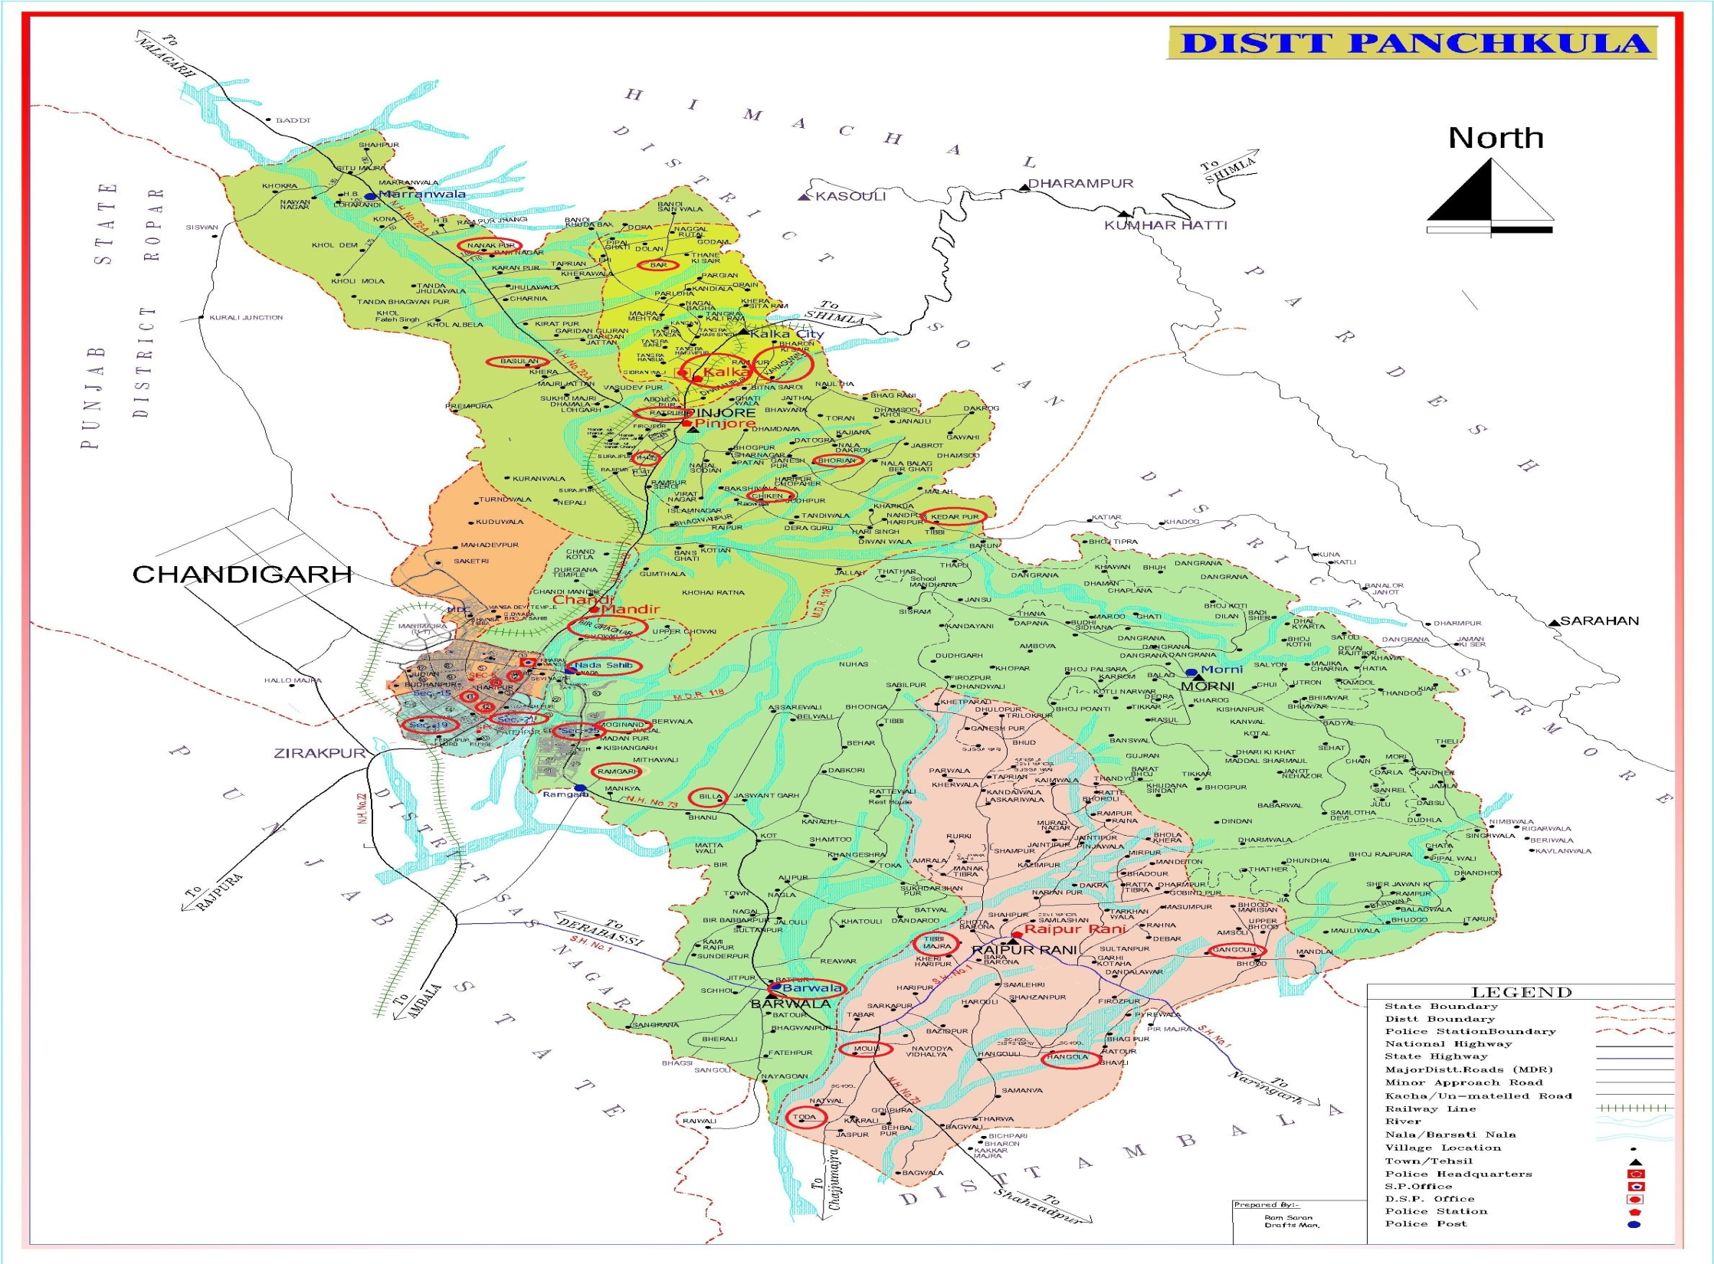

Slide 13
List of Areas visited
Kalka | Raipur | Urban PPK
Beerghaghar | Billa | Ashiana Pocket A
Kanguwala | Ramgarh | Ashiana Pocket B
Nanakpur | Barwala | Sec19
PPC Kalka (2) | Mouli | Sec 28
Ratpur | Toda (2) | Indra Colony , Rajiv Colony ( Sec 26)
Naida Sahib | Moginand | Sec 10 , Sec 6

Slide 14
Findings

Slide 15
A. Household Characteristics

Slide 16
n
Graph 1. Type of Family of the Household

Slide 17
Graph 2. Monthly income of the households

Slide 18
Graph 3. Monthly expenditure of the household

Slide 19
B. Maternal Characteristics
Graph 4. Occupation of Mothers

Slide 20
Chart 3. Education of mothers
Graph 5. Place of Delivery

Slide 21
Graph 6. Initiation of Breastfeeding

Slide 22
Graph 7. Whether Exclusive Breastfeeding was given for 6 months

Slide 23
C. Individual Characteristics
Chart 5. Age-wise distribution of Children

Slide 24
Chart 6: Gender wise distribution of children in the study

Slide 25
Graph 8. Immunization Status of the Children

Slide 26
Results

Slide 27
Graph 9. Nutritional status of the Children

Slide 28
Graph 10. Stunting

Slide 29
Graph 11. Wasting

Slide 30
Graph 12. Underweight

Slide 31
Graph 12. MUAC

Slide 32
Graph 13. Gender-wise Nutritional Status

Slide 33
Table 2. Age wise Nutritional Status of Children
Age | Underweight % | Total (N)
0-12 months | 26.08% | 46
13-24 months | 23.80% | 63
25-36 months | 36.84% | 19
37-48 months | 47.36% | 19
49-60 months | 33.33% | 6
Table 3. Mother’s Occupation & Nutritional Status of Children
Occupation of Mother | % of Malnourished Children | Total Children (N)
Employed (Agriculture/Labour/Private/Govt.) | 50% | 8
Housewife | 57% | 145

Slide 34
Graph 14. Mother's education & Nutritional status of children

Slide 35
Graph 15. Birth order and Nutritional Status

Slide 36
Graph 16 . HH income & Nutritional Status of Children
Percentage of Children

Slide 37
Graph 17. Family size & Nutritional Status of Children

Slide 38
Graph 18. Exclusive Breastfeed and Nutritional Status

Slide 39
Graph 19. Birth weight and Nutritional Status

Slide 40
Graph 20. Term at birth and Nutritional Status

Slide 41
Graph 21. Place of Delivery and Nutritional Status

Slide 42
Graph 22. Complimentary feeding and Nutritional Status

Slide 43
Graph 23. Caste and Nutritional Status

Slide 44
Graph 25. ANC Package Hold and Nutritional Status

Slide 45
Common Observations and Reasons during Survey
Anganwadi Workers - not skilled enough to take accurate measurements of the Children. They are not making growth charts.
Wheat - staple food of the people
Breastfeeding – exclusively for more than 6 months .
Handwashing - by soap used for washing clothes.
Reason for not giving breastfeed within 1st hr is due to cracks in nipples or delayed milk production.
Every mother told that they are using Tata Salt but they don’t know about the benefits of iodine.

Slide 46
Recommendations
Direct Interventions
Indirect Interventions
.
Promotion of Complimentary Feeding
Socio-economic protection by The Govt.
Effective Screening and Monitoring at Community Level
Zero Hunger Approach
Regular Follow-up
Making Malnutrition visible
Better Mapping & Planning at grass root level

Slide 47
References
Chiddarwar, Sonali S. (2000).Assessment of nutritional status of children below five years of age.Nagpur : Indira Gandhi Medical College, Department of Preventive and Social Medicine. ~150 p.
Jood, Sudesh et al (2000).Nutritional status of rural pre-school children of Haryana State. Indian Journal of Pediatrics,67(3): 189-96
Kango, Mangala (2001).Nutrition and malnutrition among children between 1 to 10 years.Ujjain.Govt.Girls Post Graduate College, Deptt. Of Home Science. ~3 p
Kanjilal,B, Guha Mazumdar, P.,Mukherjee, M. and M. Hafizur Rahman(2010). Nutritional Status of children in India: household socio-economic condition as the contextual determinant. International Journal for Equity in Health 2010,9:19

Slide 48
Sah, N. (2004) Determinants of Child Malnutrition in Nepal: A case analysis from Dhanusha, Central Terai of Nepal. Save the Children, Kathmadu, Nepal. Journal of Nepal Health Research Council, Volume 2 No.2, October-2004
Trivedi, G. (2011) KILLOL Project: A unique intervention to fight malnutrition among children. SRD-SPIPA, Gujarat.
Mendelson, S. (2007) Child malnutrition in India: why does it persists?
Castro Pellizzari, A. (2012) The Right to Food: Malnutirition Determinants in Rural Gujarat. MSc Thesis, International Development Studies, Utrecht: Utrecht University.
Government of Gujarat 2012, GR_of_Gujarat_State_Nutrition_Mission, Health and Family Welfare Department, Gandhinagar.

Slide 49
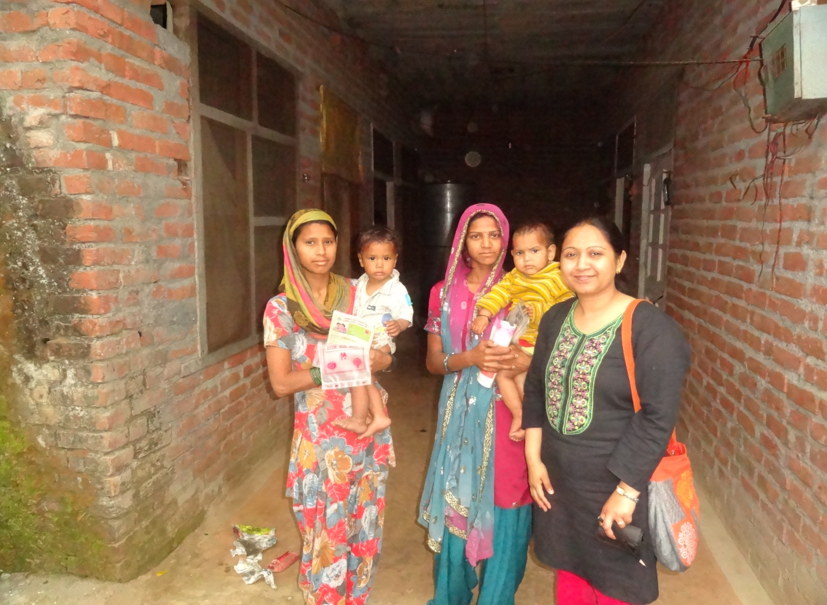

Slide 50
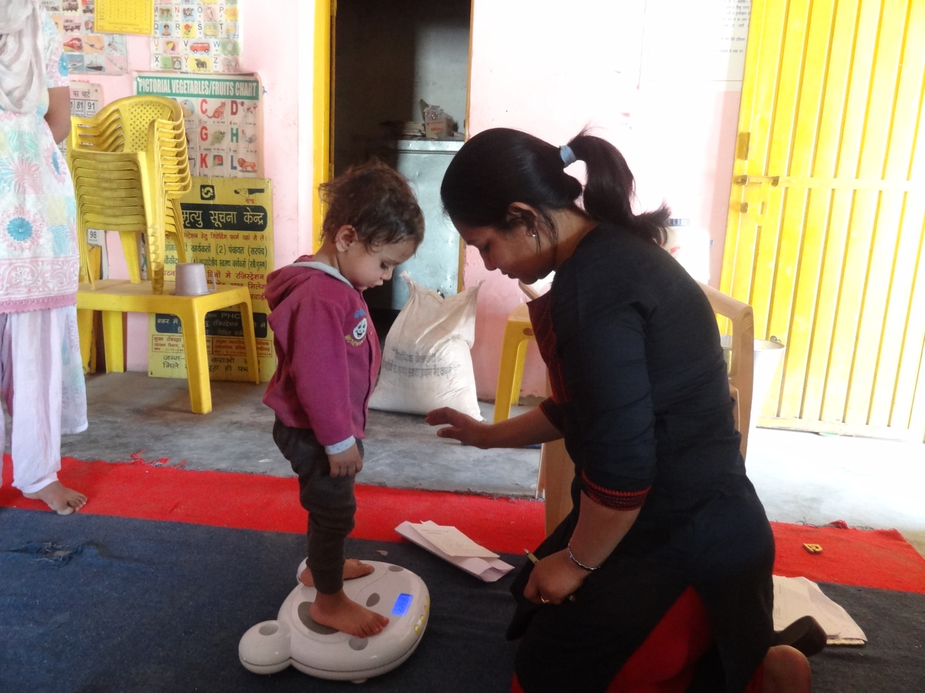

Slide 51
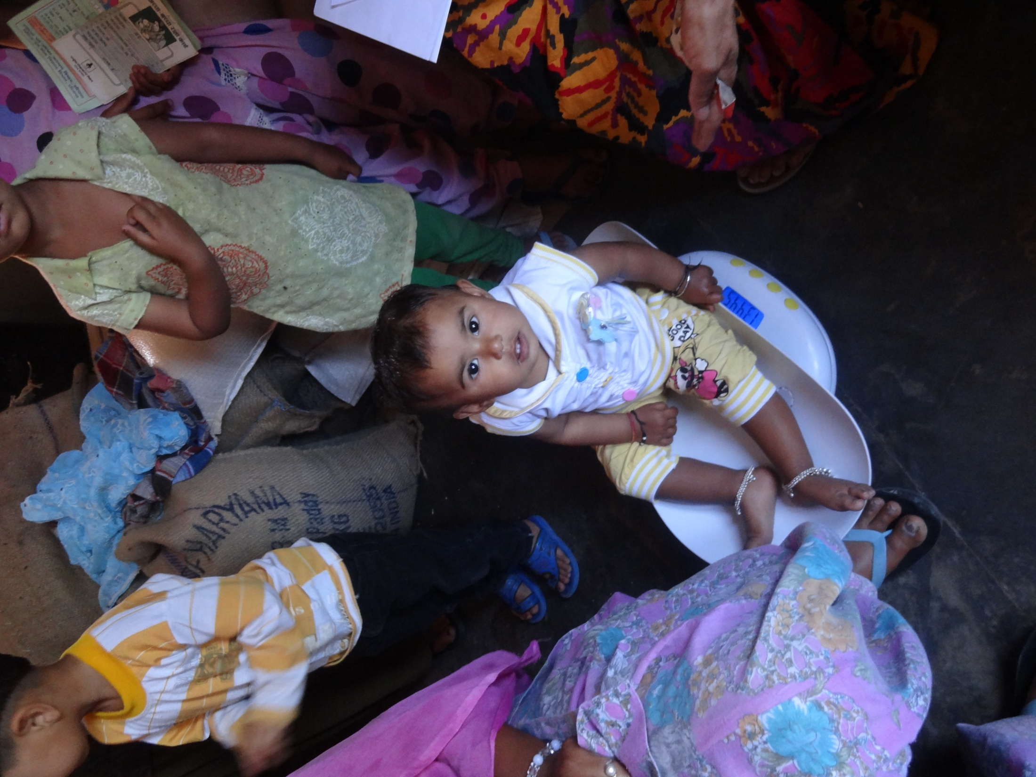

Slide 52
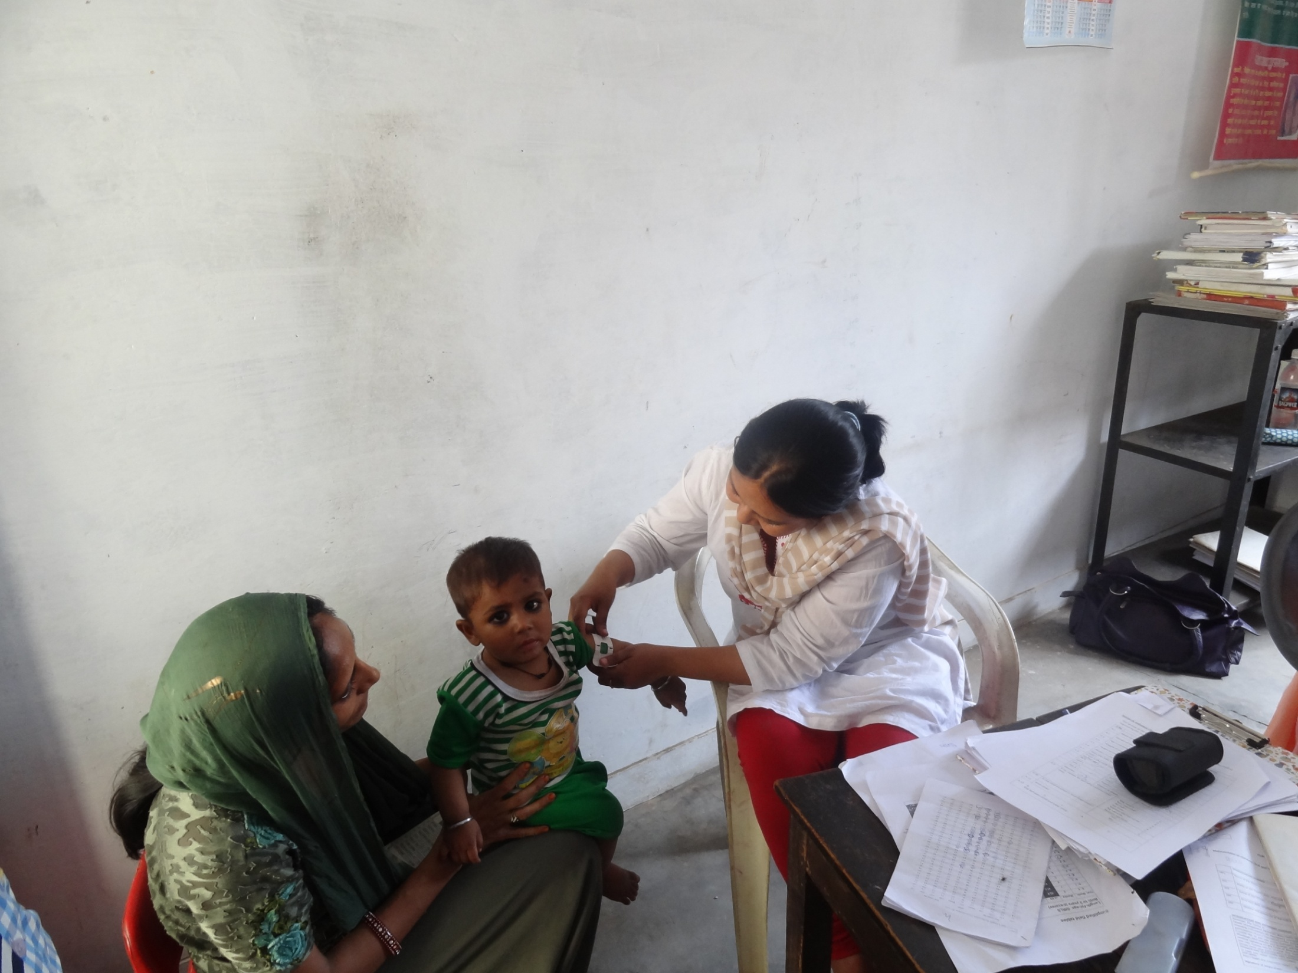

Slide 53
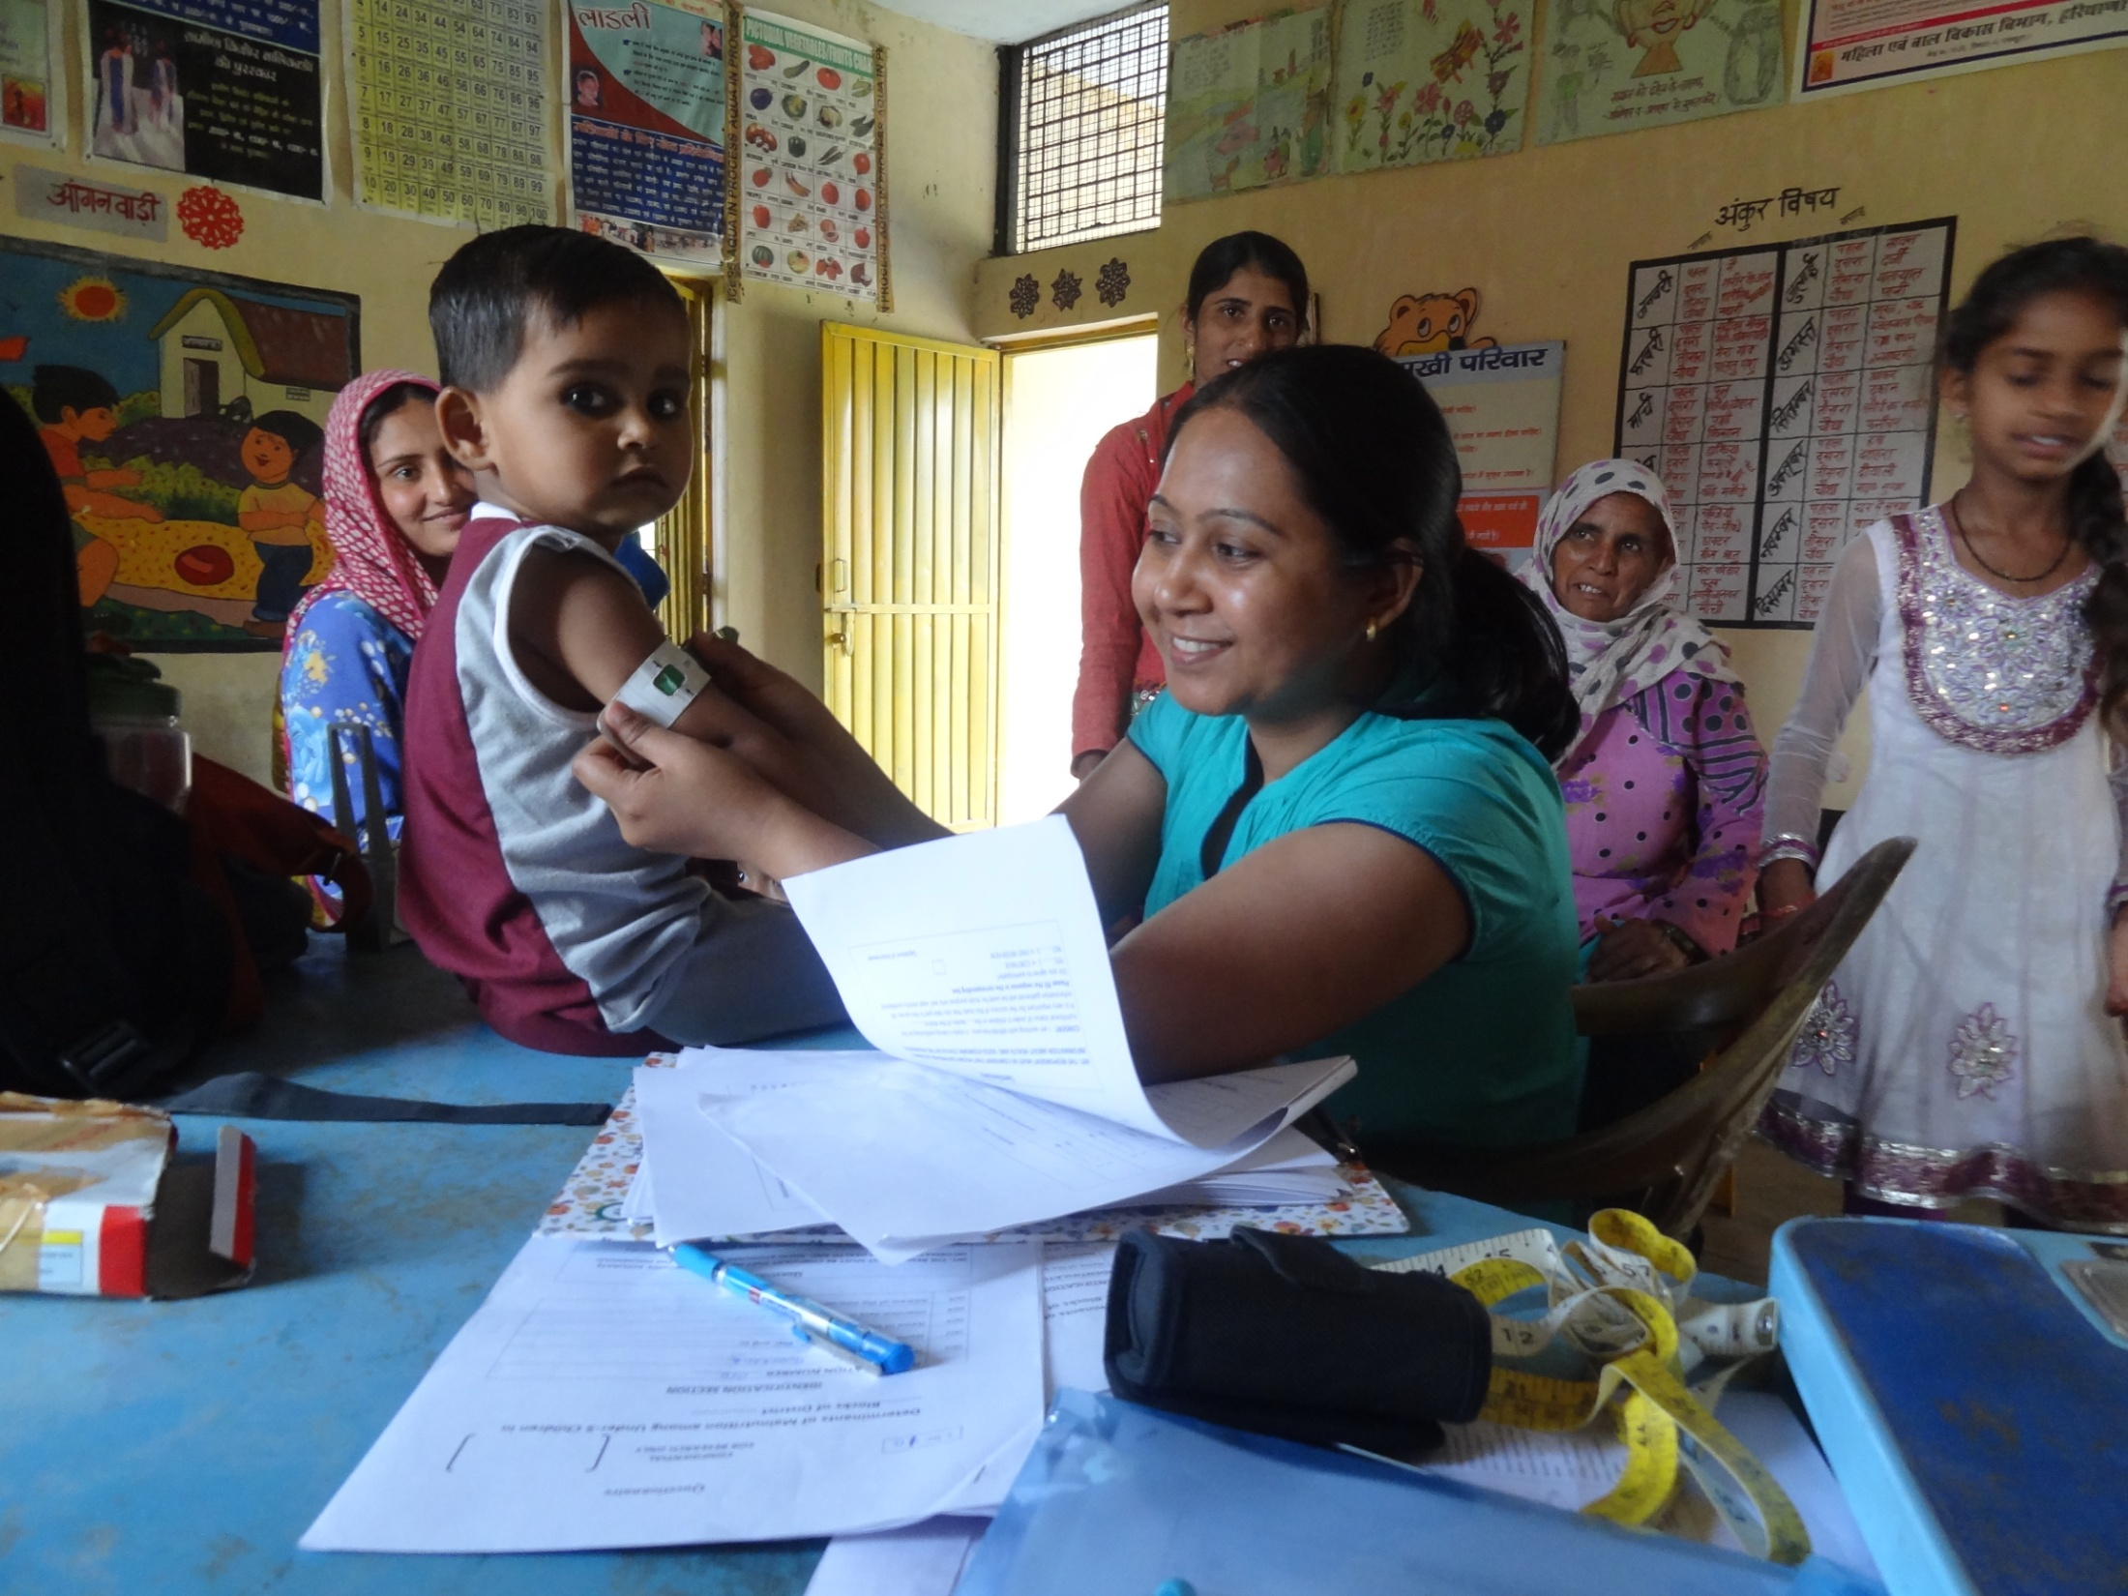

Slide 54
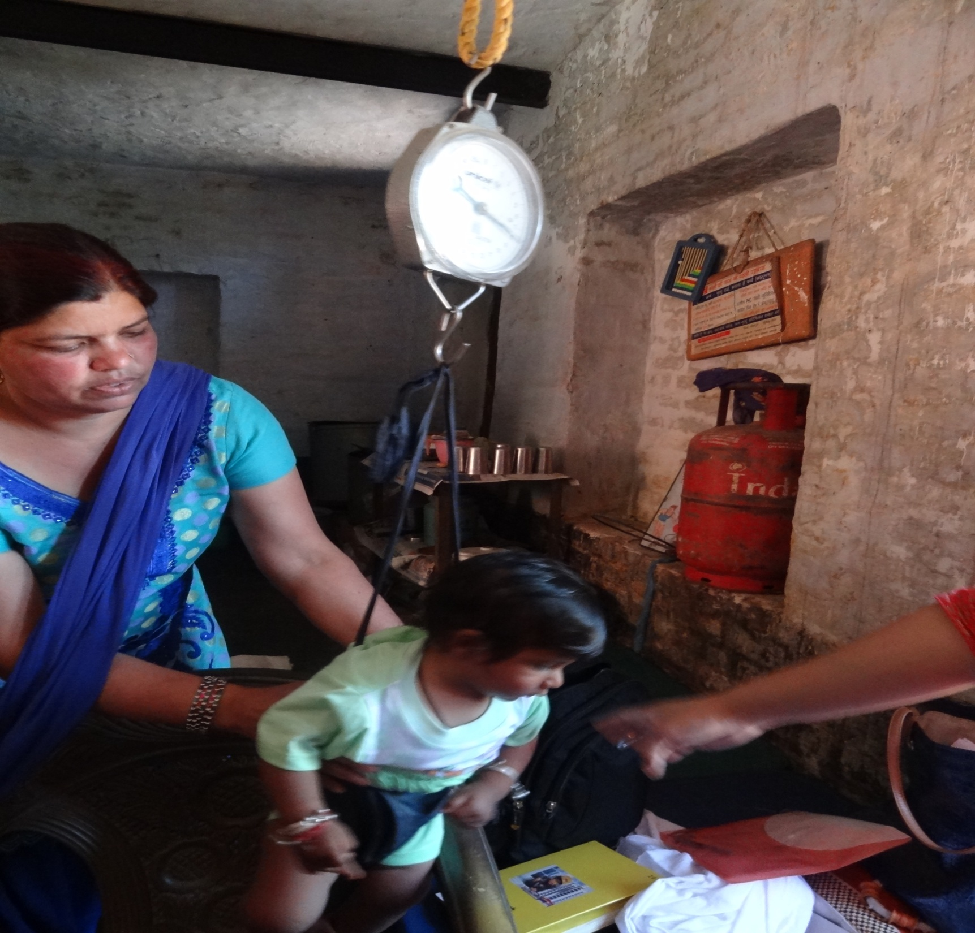

Slide 55
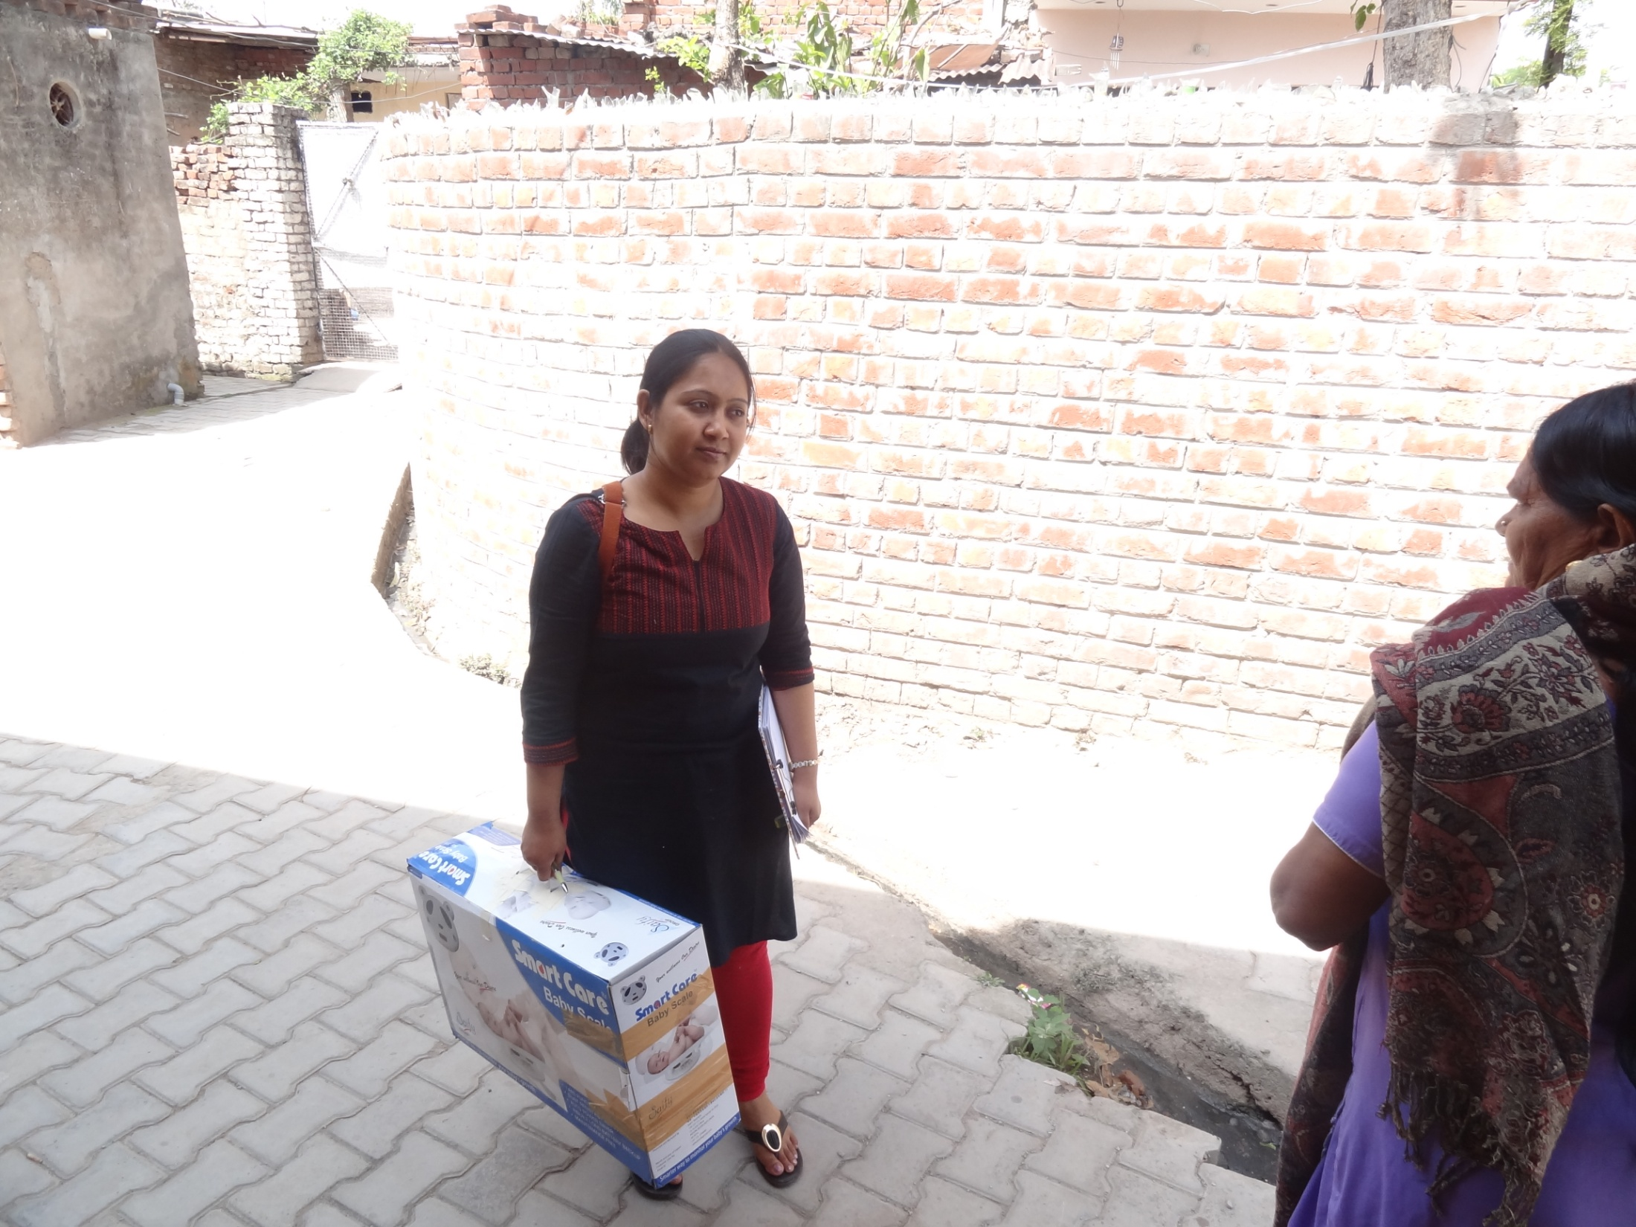

Slide 56
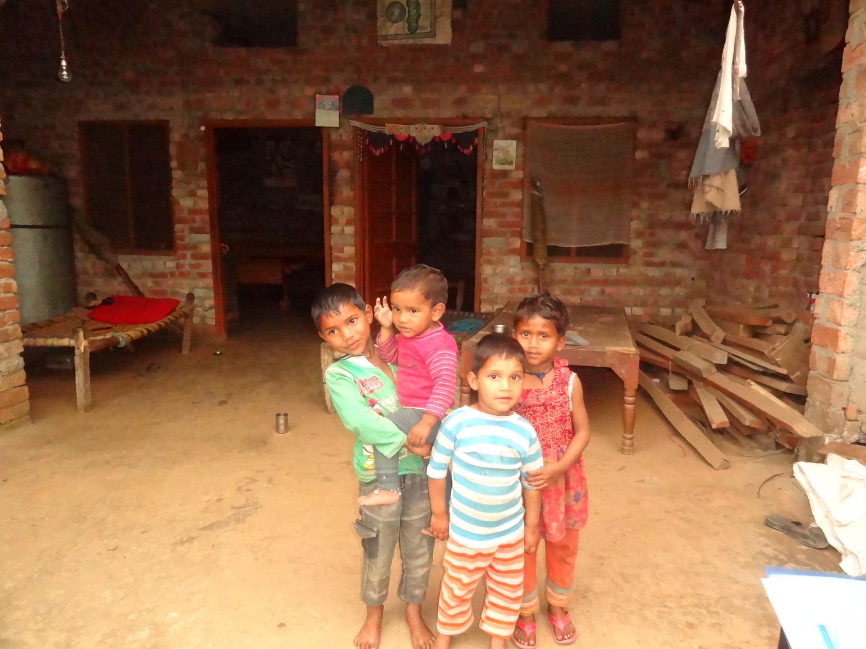

Slide 57


