Slide 1
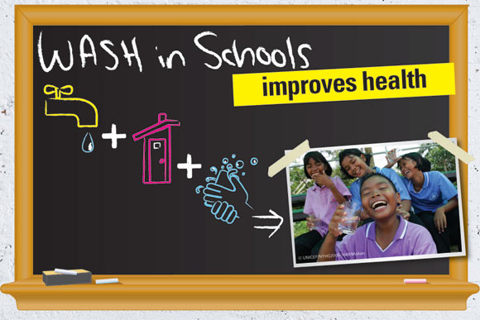
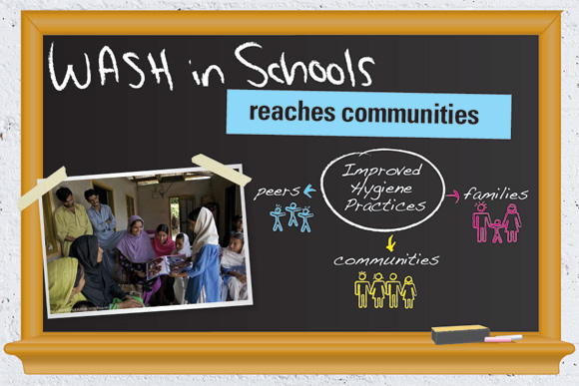
An intervention study on personal hygiene habits and sanitation practices among students of an urban primary government school of Delhi
DR. RAASHI GAUR
PG/16/039

Slide 2
OUTLINE
S.No | SLIDE CONTENT | SLIDE NUMBER
1 | INTRODUCTION | 3-6
2 | OBJECTIVES OF THE STUDY | 8
3 | METHODOLOGY | 9-11
4 | RESULTS | 14-29
5 | CONCLUSION | 31

Slide 3
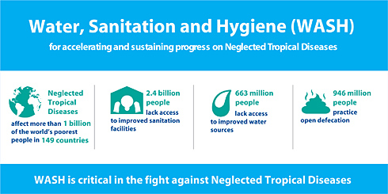
BACKGROUND
663 million people still lack access to improved drinking water facility.
Over 50% rural households defecate in the open.
Each year around 2,00,000 children die due to diarrhea.

Slide 4
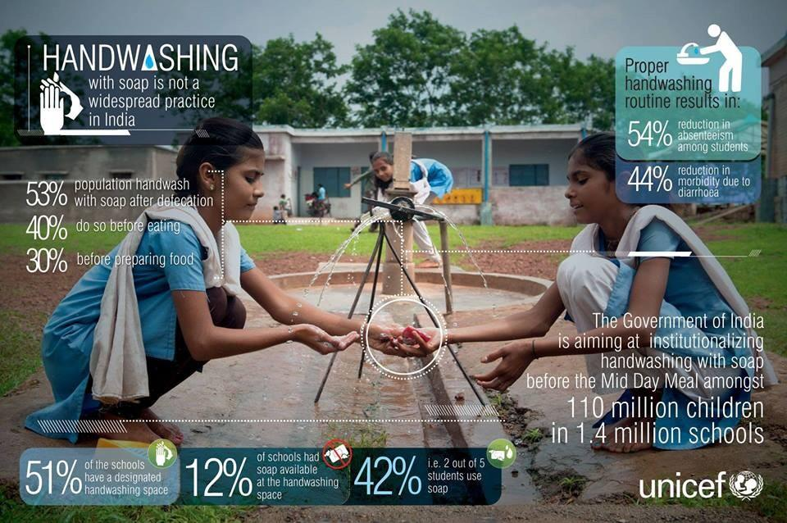
BACKGROUND
Only 42% students i.e. 2 out of 5 use soap for handwashing.
Only 12% of schools have soaps for washing hands after defecation.
60% use only water to wash their hands before eating.

Slide 5
BACKGROUND
Hygiene and sanitation are two important aspects of healthy living.
It includes bathing, brushing, washing hands, trimming nails and safe disposal of human waste.
Improving personal hygiene and sanitation is known to have a significant impact on health of both individual and community.
WASH is a collective term for water, sanitation and hygiene. These core neglected issues are interdependent on each other and affect the health of individual and community in a cumulative way.
WASH remains a leading cause of death worldwide, hitting children in a worst possible way.

Slide 6
BACKGROUND
In developing countries, 80% of the diseases are associated with poor domestic sanitation and improper hygiene.
According to WHO,
  1.7 billion cases of diarrhea occur every year.
  Around 7.6 lac under five die every year due to diarrheal episodes.
  Children loose around 272 million days per year.
  1 in every 3 child is infested with intestinal worms.
School is a place where children get a platform to learn and imbibe new things, knowledge and good practices.
GOI started a TSC (total sanitation campaign) in 2004 to ensure SSHE (school sanitation and hygiene education) for behavior change among school going children.
School children have been consistently implicated in spread of communicable disease. Bearing in mind that the school is a vital setting for health promotion, this study was planned.

Slide 7
OBJECTIVES OF THE STUDY
GENERAL OBJECTIVE: To assess the personal hygiene habits and sanitation practices of students of an urban primary Government school of Delhi and design and implement an intervention based on the above results to see an effect on the behaviour change among students.
SPECIFIC OBJECTIVES:
  To assess the personal hygiene habits and sanitation practices of students of an urban primary Government school of Delhi.
  To design an intervention based on the data obtained.
  To see the percentage increase in the responses before and after intervention.

Slide 8
METHODOLOGY
STUDY AREA: Urban Primary MC School, Rohini Zone, North-West district of Delhi.
STUDY PERIOD: The study was carried out in three phases during November 2017 to February 2018.
  Phase 1: Baseline assessment: December 2017
  Phase 2: Intervention (Designing and Implementation): January 2018
  Phase 3: End line assessment: February 2018
STUDY DESIGN: Intervention study: Pre-post
STUDY POPULATION: Students from class three to class five, present on the day of study.
SAMPLE SIZE: 190 students present on the day of intervention in pre intervention phase, whereas 200 students participated in the post intervention phase.

Slide 9
METHODOLOGY
INCLUSION CRITERIA: Students present on the day of data collection and willingly participated in the study.
EXCLUSION CRITERIA: Non-responsive, did not have parent’s consent, absent and not willing to participate in the study.
INSTRUMENT DESIGN: Questionnaire consisting three parts was designed. The three parts are as follows:
  Part 1: Demographic Information
  Part 2: Personal hygiene habits
  Part 3: Sanitation Practices
PRE-TESTING: Questionnaire was first drawn in English, translated to Hindi and then back translated to English to check the validity. One students per class and five students per grade were selected for pretesting of the questionnaire.

Slide 10
METHODOLOGY
PERMISSION: Written permission obtained form ADE, NDMC prior to start of the study. Written consent for conducting study and taking pictures obtained from school authorities.
ANALYSIS PLAN: Ideal answer marked as 1 and incorrect/unexpected response marked as 0. Based on this, simple frequencies and percentage were calculated.
ETHICAL CONSIDERATION: Participants adequately informed about purpose, benefits and risks of the study. Consent letter was designed to be signed by parents. Assent section was incorporated in the study to seek permission from the students.

Slide 11
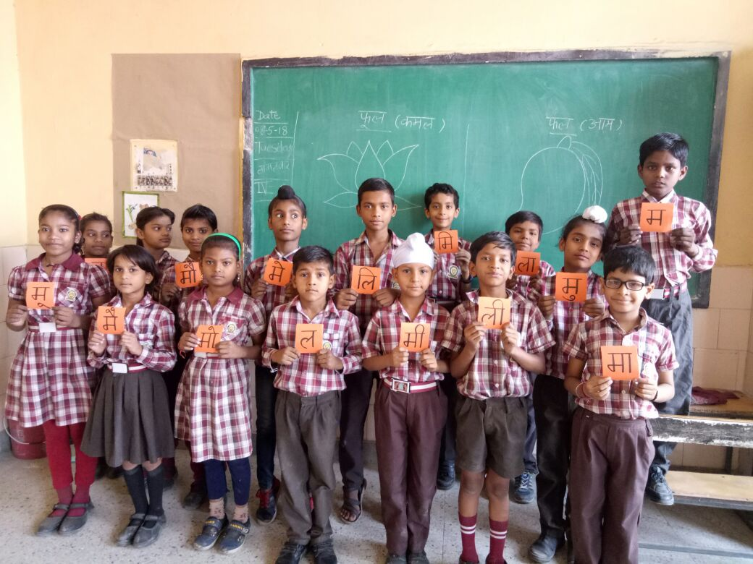
SCHOOL STUDENTS BEFORE THE STUDY

Slide 12
METHODOLOGY: DESIGNING INTERVENTION
Target audience: Age, background, SE status and current practices of students.
Sensitivity and sustainability: Creative and group learning, participatory approach, concept of change agents, reinforcement for sustainability.
Change in knowledge, skill and attitude for behavioral modification
Periodic assessment and innovations
Cost effective
Evidence informed
Piloting
Customization of available IEC material

Slide 13
METHODOLOGY: CONTENTS OF IEC MATERIAL
Posters (08): Handwashing steps, safe drinking water, good personal hygiene habits, handwashing with soap, cleanliness around the house, use of dustbin for throwing garbage, use of toilet for defecation and cleaning teeth.
Videos (04):
    “aakad-bakkad bambe bo” for handwashing before meals and using toilets.
    “Good manners” for maintaining healthy lifestyle.
    “Swacchta and Khushhaali” for handwashing habits.
    “Swachh poshtik khaana” for hygienic food.
Demonstrations (04): Demonstrations were given on brushing habits, placing of brush and movements during brushing.

Slide 14
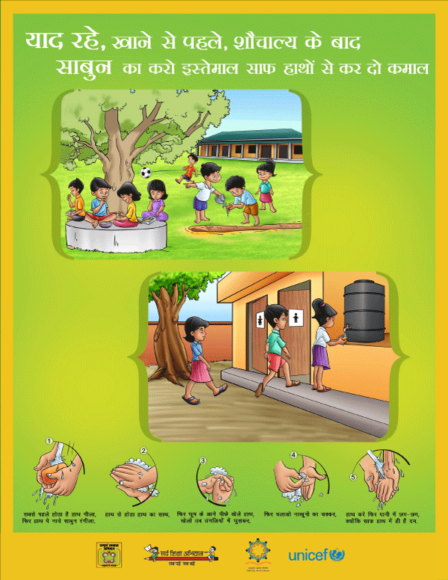
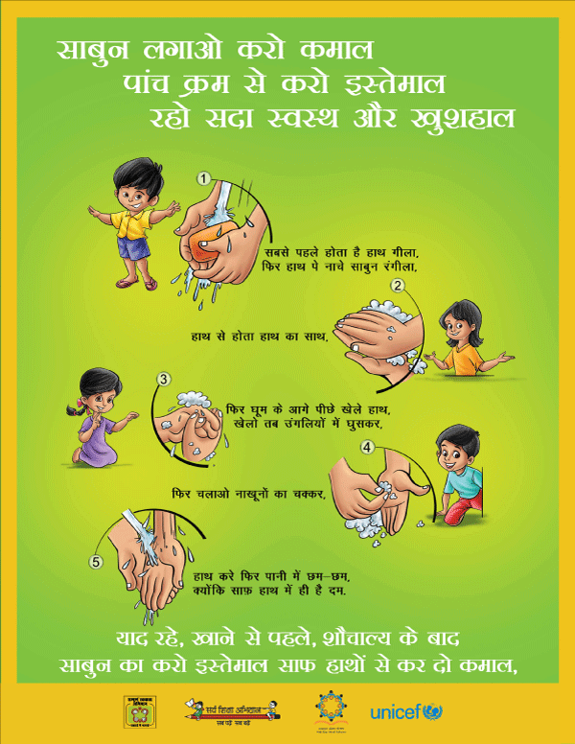
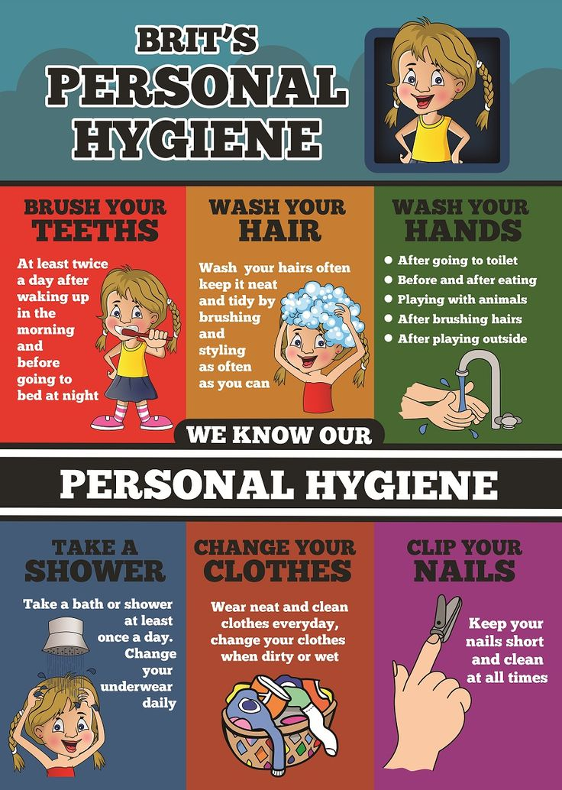
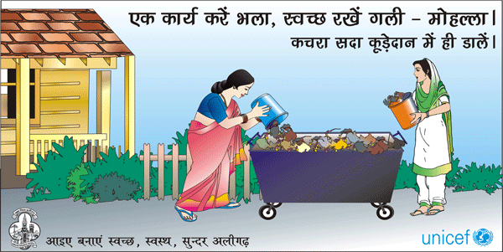
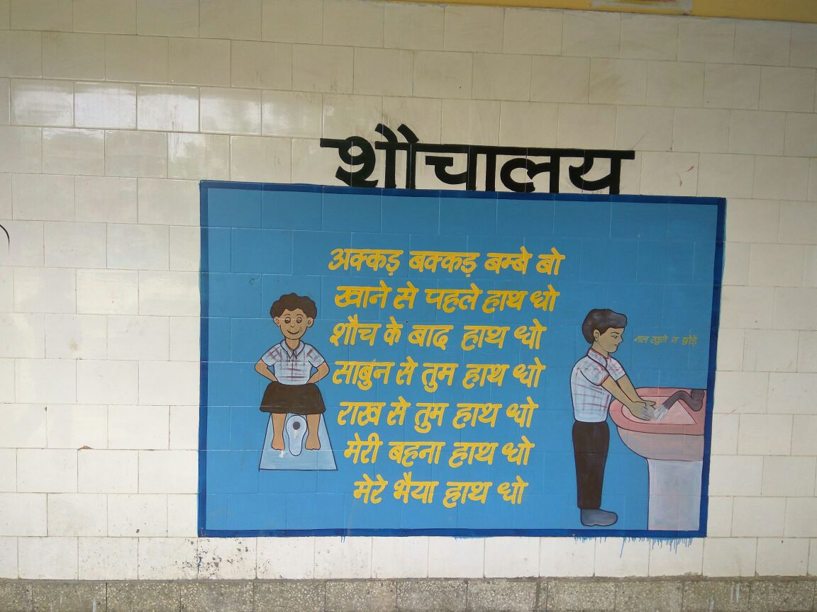
IEC MATERIAL

Slide 15
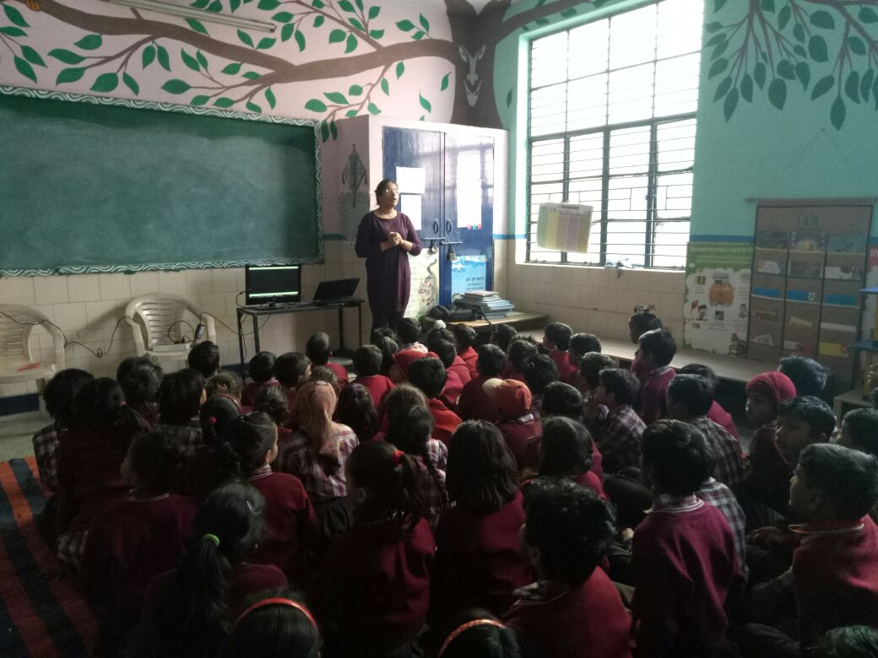
PILOTING INTERVENTION

Slide 16
RESULTS: SOCIO DEMOGRAPHIC PROFILE
Gender: 55.3% (105) Boys and 44.2% (84) Girls
Age Range: 8-10 years (101, 53.2%), Mean age 10 years (SD 1.295)
Grade wise participation:
  Third (44, 23.15%)
  Fourth (81, 42.63%)
  Fifth (65, 34.21%)
SE Status:
  Lower/Upper lower (143, 75.3%)
Family education: Uneducated: Mothers (52, 27.4%) and Fathers (24, 12.6%)
Family Income: 1866-5546 bracket: 143, 75.3%

Slide 17
RESULTS: COMPARISON OF THE FINDINGS
PERSONAL HYGIENE HABITS: For the assessment of current personal hygiene habits that the students follow, twenty questions were included in the questionnaire. The questions covered various aspects of personal hygiene habits like hand washing, eating with spoon, bathing daily, brushing regularly, changing into clean clothes after school and keeping finger/toe nails trimmed.
SANITATION PRACTICES: For the assessment of the sanitation practices that the students are aware of and see at home regularly, eleven questions were framed. These questions were based on the indicators of sanitation found during literature review i.e. presence of garbage near house, use of dustbin at home, type of toilet facility used, source, storage and handling of drinking water along with storing the cooked food at home.

Slide 18
RESULTS: PERSONAL HYGIENE HABITS
HAND WASHING HABITS
Students were asked about the handwashing practice that they follow during the two most crucial times i.e. before and after meals and after using toilet. Also, the medium of washing hands was assessed. Change in percentage obtained is shown in the graph above.

Slide 19
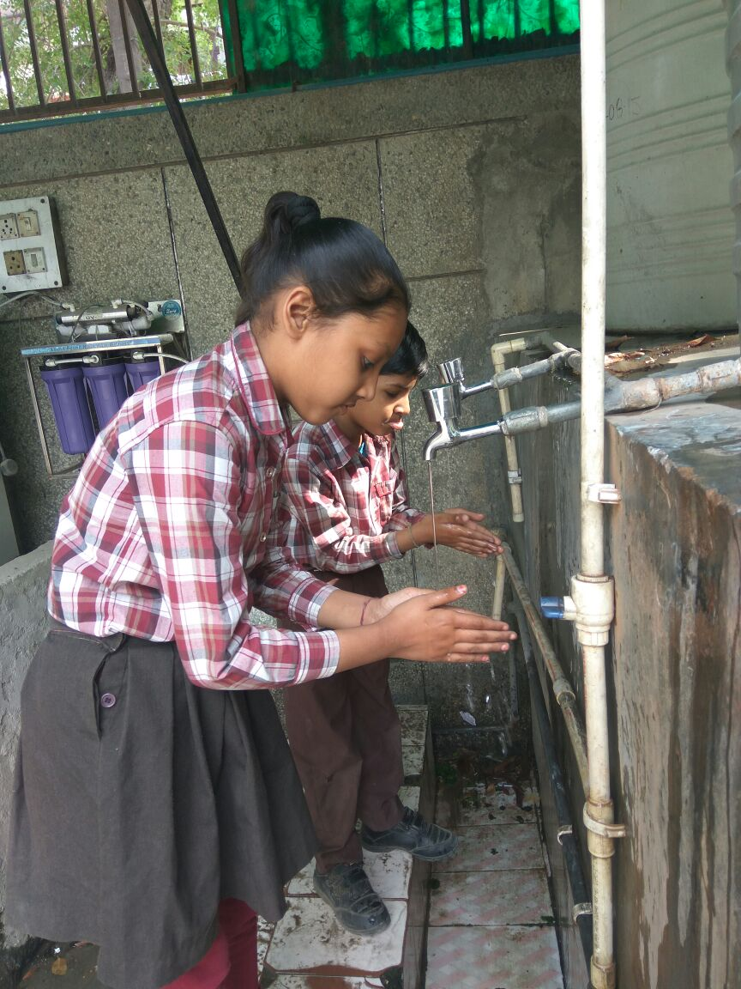
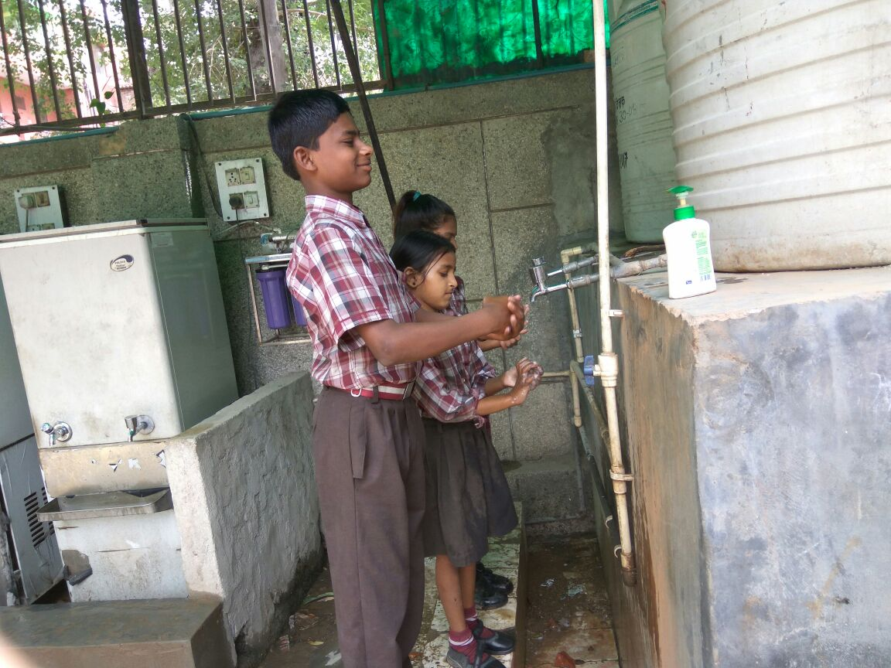
HAND WASHING BEFORE INTERVENTION
HAND WASHING AFTER INTERVENTION

Slide 20
RESULTS: PERSONAL HYGIENE HABITS
EATING HABITS
For eating habits, two important questions i.e. eating food with spoon and using tiffin to eat food were included in the questionnaire.
There was a 15% increase seen in the percentage of students using spoon after intervention.
Whereas a 8.9% rise was seen in students using tiffin to eat food rather than polybag or plastic.

Slide 21
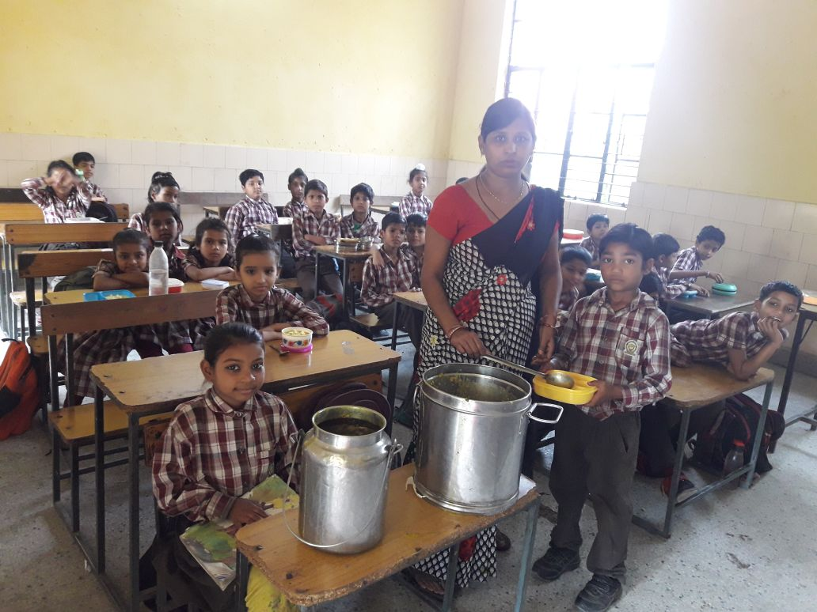
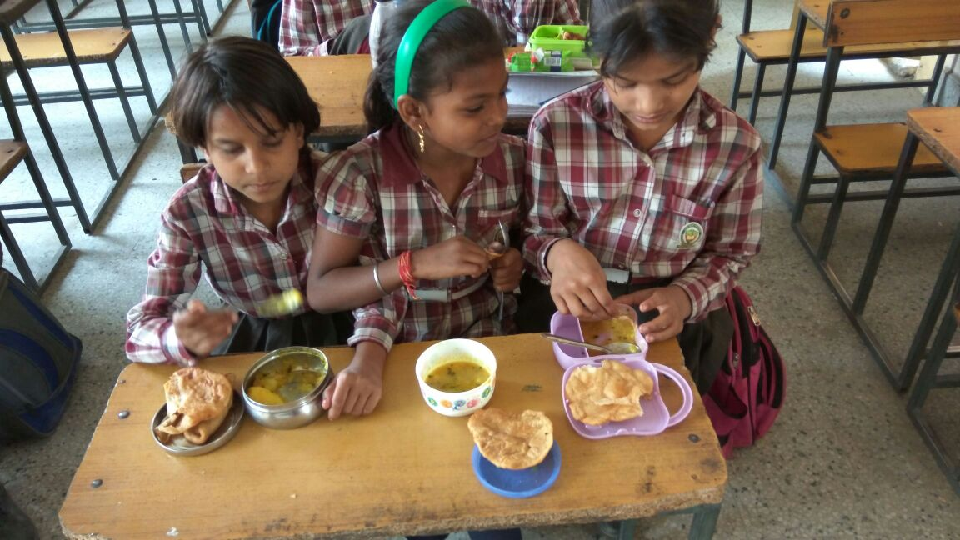
USING TIFFIN TO EAT MID-DAY MEALS
USING SPOON TO EAT MID-DAY MEAL AT SCHOOL

Slide 22
RESULTS: PERSONAL HYGIENE HABITS
BRUSHING HABITS
The frequency of brushing twice daily saw an increase of around 21% after intervention.
83% started cleaning their tongue after intervention in comparison to 80.6% before.
A 7.5% increase was seen in percentage of students using toothbrush and toothpaste for cleaning their teeth.

Slide 23
RESULTS: PERSONAL HYGIENE HABITS
BATHING HABITS
There was a positive trend seen in the increase in percentage in case of taking bath daily and washing hands and feet after going back home.
A negative trend was seen in case of using soap and water for washing hands. A decline of 0.5% was seen in reporting of this question in post intervention phase.

Slide 24
RESULTS: PERSONAL HYGIENE HABITS
DRESSING HABITS
The area of dressing habits i.e. changing uniform after going back home and changing into clean clothes saw an opposite trend in the percentage.
Changing uniform after going back home scored 98.6% during pre intervention phase while in post intervention, it saw a decrease to 97%.
Slightly positive trend was seen in changing into fresh clothes after going back home. It increased from 87.8% to 88%.

Slide 25
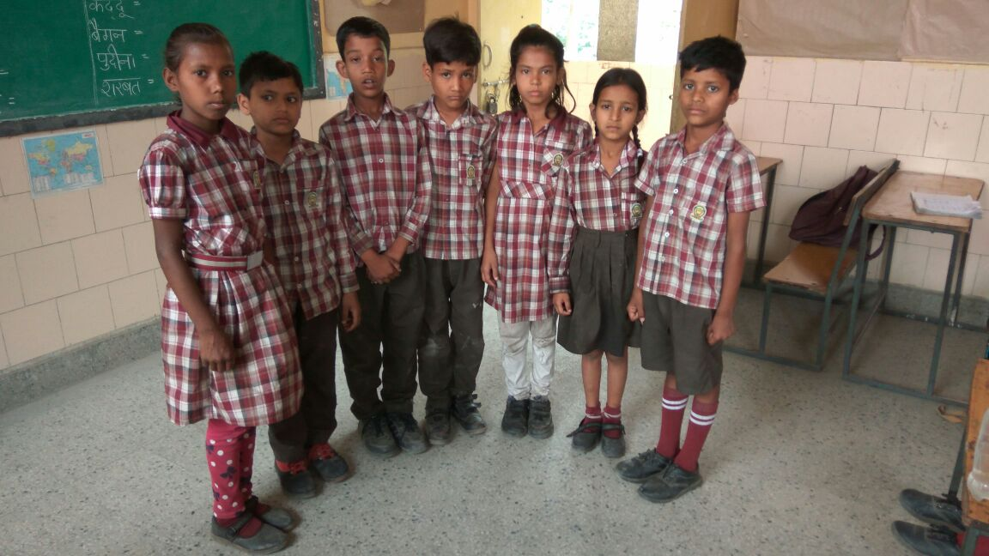
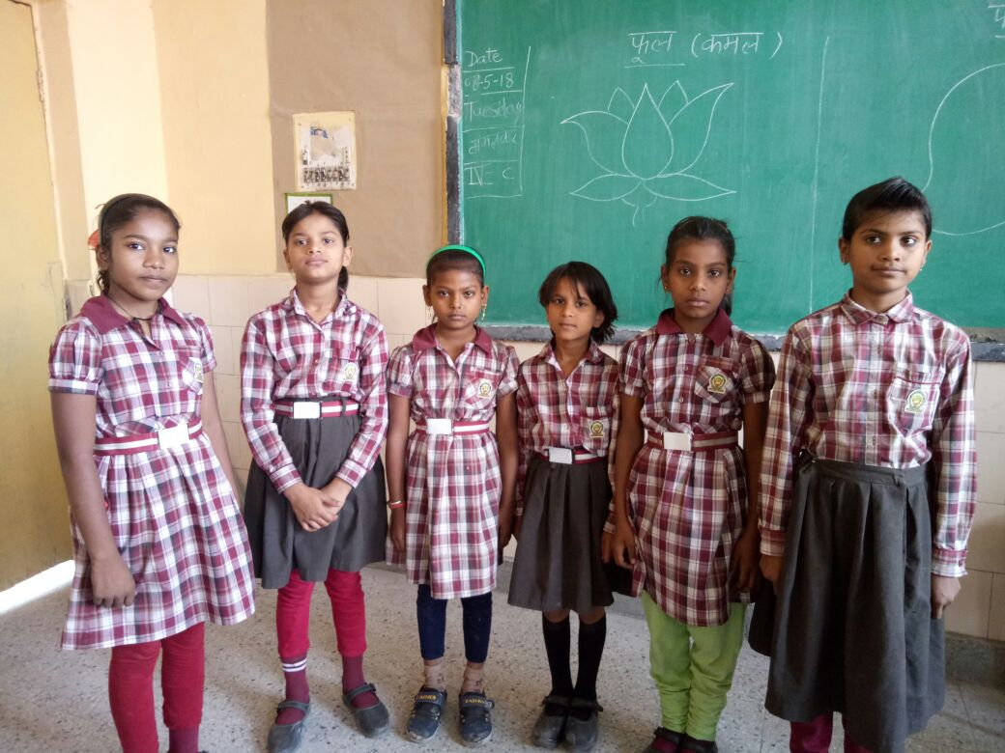
DIRTY UNIFORM BEFORE INTEREVNTION
CLEAN UNIFORM AFTER INTEREVNTION

Slide 26
RESULTS: PERSONAL HYGIENE HABITS
TRIMMING NAILS AND CLEANING EAR WAX
There was a slight increase from 72.7% to 74.5% seen in the percentage of students trimming their nails on weekly basis.
Cleaning of ear wax after having bath increased from 87.8% to 90.5%.

Slide 27
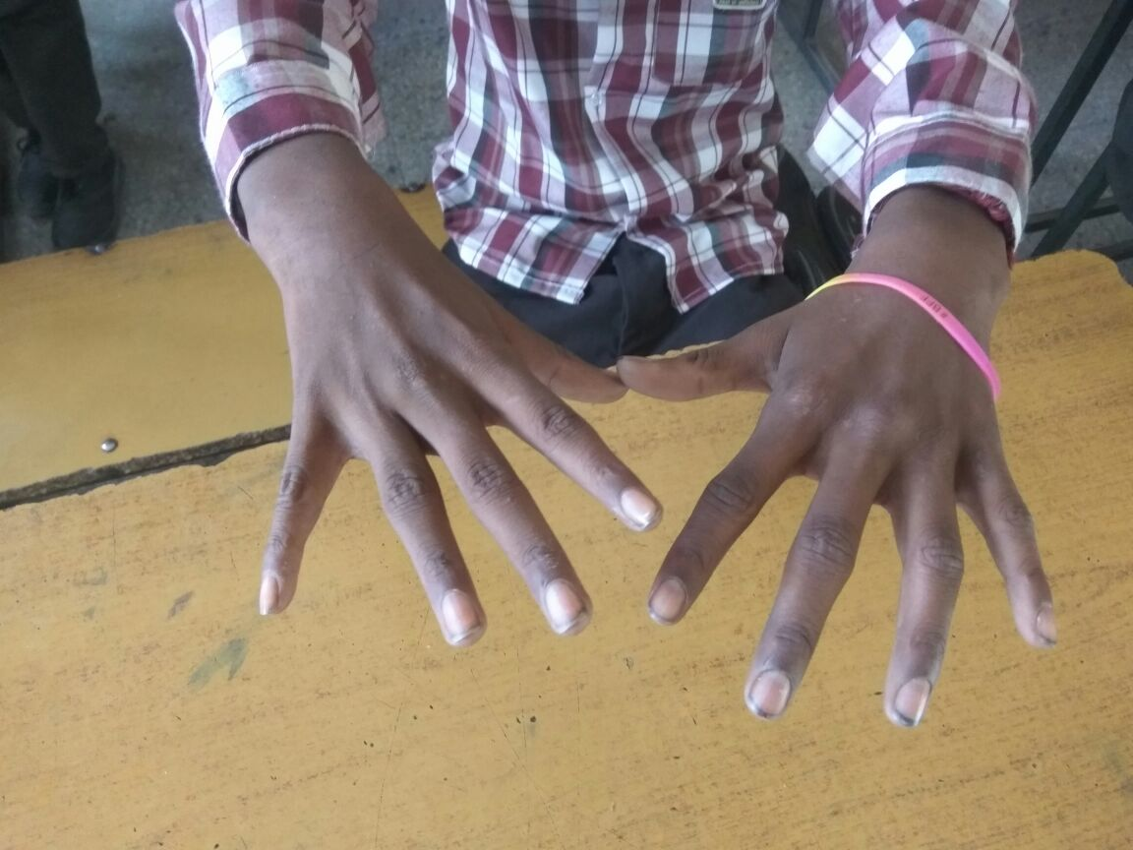
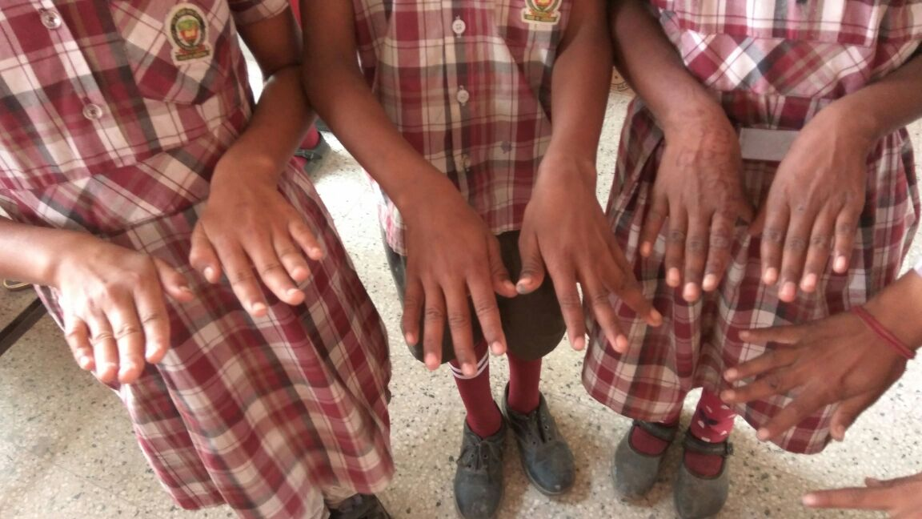
DIRTY NAILS BEFORE INTERVENTION
CLEAN NAILS AFTER INTERVENTION

Slide 28
RESULTS: PERSONAL HYGIENE HABITS
ABSENCE OF HEAD LICE
Very few students i.e. only 23% during pre intervention reported that they never had lice in their head.
This percentage increased by 5% in the post intervention phase.

Slide 29
RESULTS: SANITATION PRACTICES
CLEANLINESS
Presence of garbage was assessed using two questions i.e. presence of garbage around house and type of garbage present. The status of presence of garbage remained same in both the phases whereas for type of garbage present mixed reporting was seen.

Slide 30
RESULTS: SANITATION PRACTICES
USE OF DUSTBIN
Post intervention there was a rise seen in percentage use of dustbin at home from 86.3% to 91%.
Use of dustbin for disposing waste increased from 92% to 93%.
Daily cleaning of dustbin reduced from 60.4% to 61%.

Slide 31
RESULTS: SANITATION PRACTICES
TYPE OF TOILET FACILITY USED AT HOME
There was a declining trend seen in reporting of toilet use at home.
During the pre intervention phase 89.9% students responded in having toilet at home but post intervention only 84.5% responded having toilets at home.

Slide 32
RESULTS: SANITATION PRACTICES
SOURCE STORAGE AND HANDLING OF DRINKING WATER
Students reporting Government water supply as the main source of drinking water decreased by 5.5% from 51.5% to 46%.
Decline in covering of water container with lid was seen from 91.4% to 90.5%.
Use of long handled utensil for taking out drinking water was seen in 44% students in comparison to 31% in pre intervention phase.

Slide 33
DISCUSSION
The aim of the study was to design targeted interventions and assess its effectiveness.
Heterogeneous media approach for sustainability and effectiveness.
Study results in sympathy with previous intervention studies conducted in Mumbai and Chennai. However variations noticed when compared with Ethiopia and Ghana studies.
Audio-Visual media was found to be most effective in terms of influencing behavior and inculcating good habits.
Limitations

Slide 34
CONCLUSION
The targeted interventions led to inculcating good personal hygiene habits among students (10%-20% increase in the values was seen).
Improvement of around 5% was seen in sanitation practices.
For intervention to be effective and innovative, larger study involving mix of schools and backgrounds is recommended.
Synergy between stakeholders is of paramount importance to achieve desired change.

Slide 35
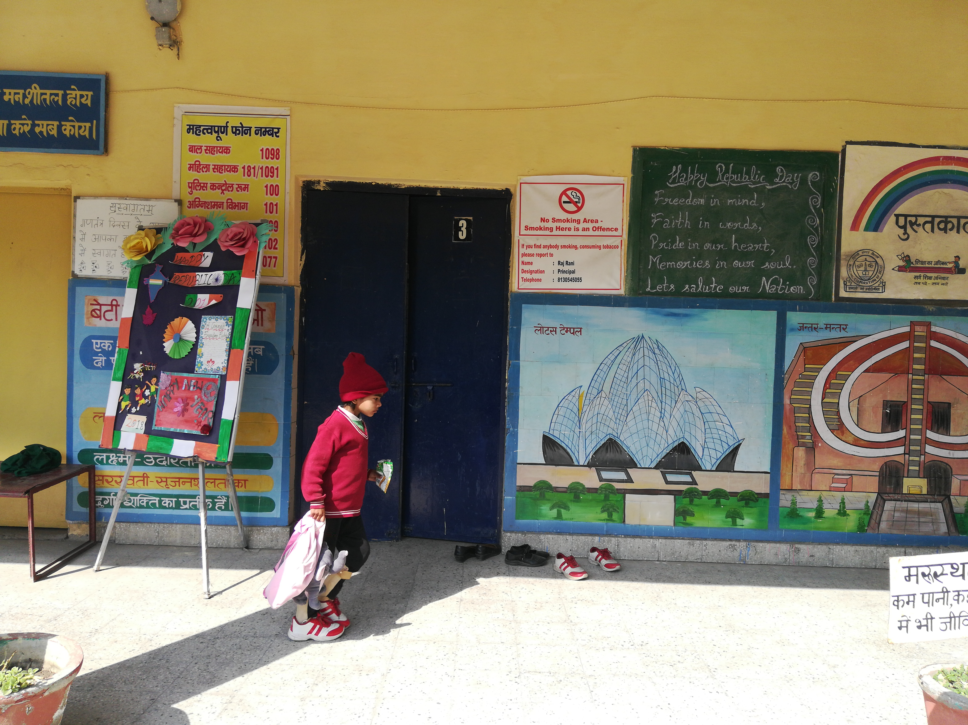
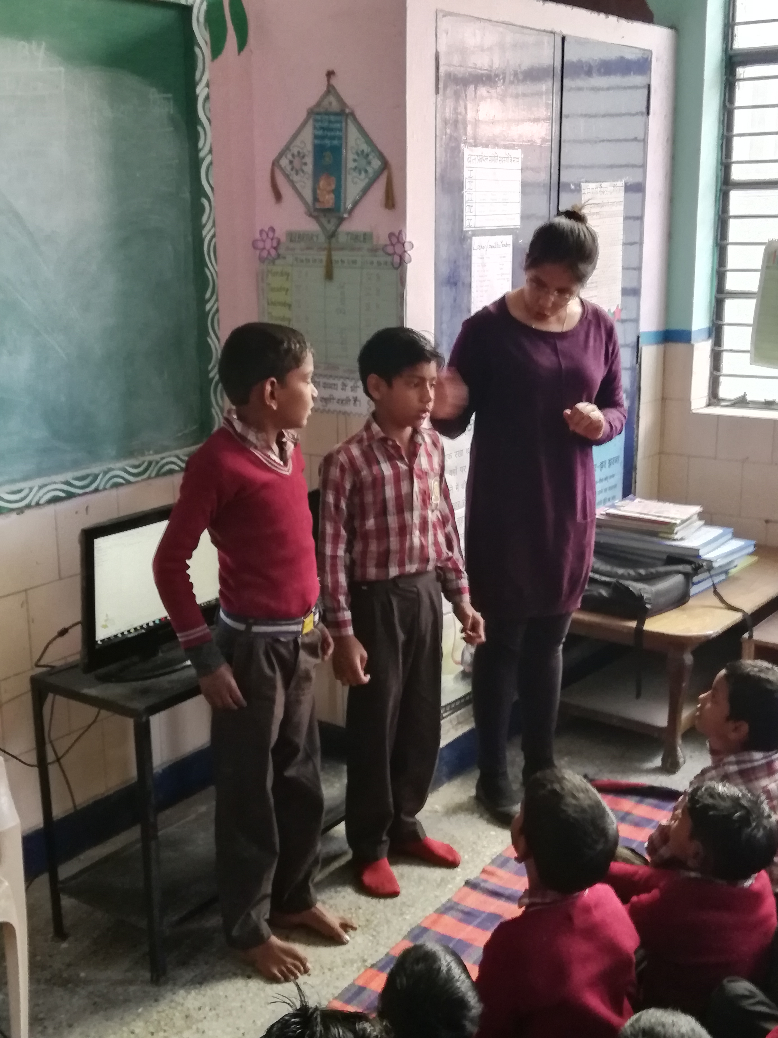
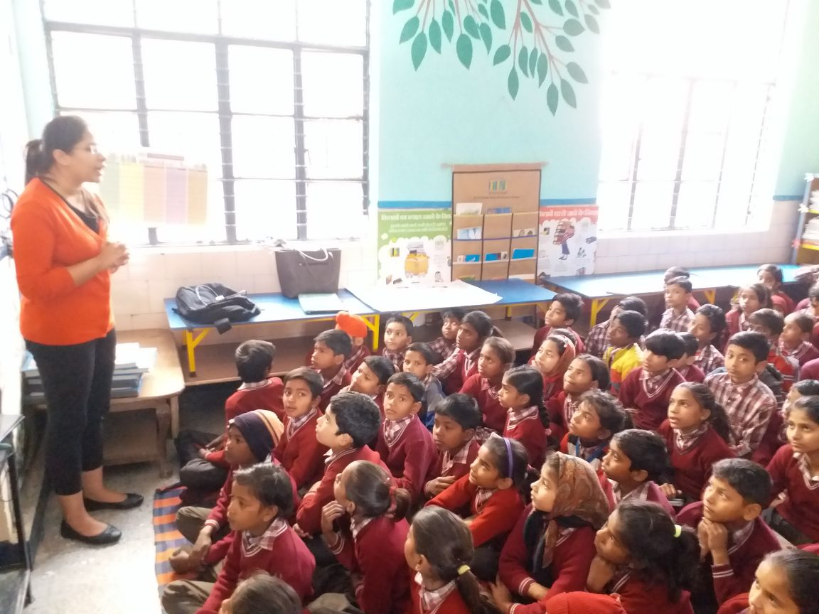
STUDY HIGHLIGHTS

Slide 36





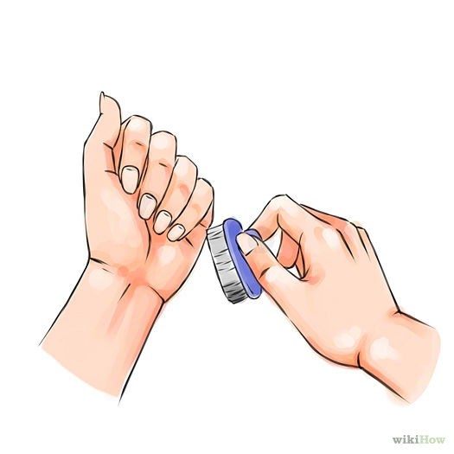
THANK YOU!!!

