Slide 1

A QUALITATIVE RESEARCH ON WOMEN EXPERIENCE WITH ANEMIA PRE AND POST PARTUM
Under the guidance of Dr Pijush Kanti Khan
IIHMR Delhi

Slide 2
Mentor Approval

Slide 3
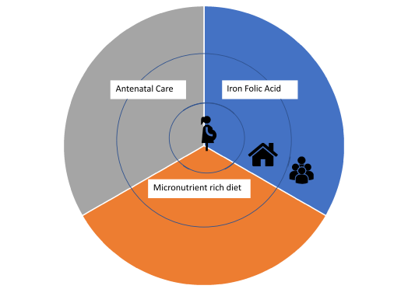
Introduction
Anaemia is defined as a condition where the level of haemoglobin in the blood is less than 11g/dl.
Studies have shown the main cause of anaemia in pregnancy in India is Iron deficiency.
Anaemia during pregnancy can have significant health implications for both the mother and the developing foetus.
Anaemia post-pregnancy can also have long-term health implications.
The experiences of anaemic women during and after pregnancy are not well understood, which can impact a woman's ability to care for herself and her newborn.

Slide 4
Objectives
To explore the experiences of anaemic women during and after pregnancy, including their physical, emotional, and social needs, and the challenges they faced.
To identify the factors that influence the adherence to iron supplementation among anaemic women during and after pregnancy.

Slide 5
Data & Methodology
Sampling: The study will use purposive sampling for anaemic women who are currently pregnant or have recently given birth.
Qualitative data: Semi-structured interviews will be conducted to collect in-depth data on the experiences of anemic women during and after pregnancy.
Data analysis: The quantitative data will be analyzed using descriptive statistics, and the qualitative data will be analyzed using thematic analysis.

Slide 6
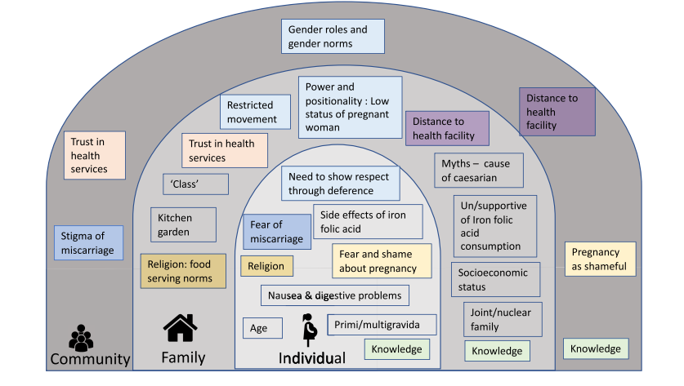
Result

Slide 7
Results
ACCESS TO ANTENATAL CARE -
Individual: Fear and shame- ‘if it’s their first pregnancy they needed a guardian, they were afraid to go out alone’
Community: Shame and stigma- fathers were less understanding of the women shyness, they do not talk about it with their in-laws during pregnancy.
Family: Power and positionality- ‘ I didn’t go outside of my home alone as I am daughter in-law and it is my first pregnancy.
Community: Quality of antenatal care and trust
CONSUMPTION OF MICRONUTRIENT RICH DIET
Individual: Nausea and digestive problems-’ I did not like to eat, my stomach felt heavy’
Individual and family: Knowledge- beetroot and pomegranate were specifically mentioned.
Family and community: Knowledge-should not eat dry food was considered low in energy.
Family: power and positionality- mother in-law took the decision of what should I eat.

Slide 8
Results
CONSUMPTION OF IFA
Individuals: Knowledge- ‘it gives energy, you won’t have weakness.’ ‘Amount of blood increases’
Individuals: Side-effects- commonly percieved side effects(digestive problems, black stool, vomiting)
Family: Power and positionality- ‘mother in-law brought IFA tablet for her daughter in-law and few keep check also.

Slide 9
Discussion
Complex interventions are necessaryto address the multiple causes of anemia in this context.
Pregnant women and other family members lacked awareness.
Harmful gender norms restricted women's mobility, access to iron rich food and antenatal care.

Slide 10
Conclusion
Anemia in pregnancy is a persistent problem in India and a contextual understanding of the causes of anemia is necessary to develop responsive interventions.
Gender norms thatplace maternal health in the female domain ,where men are not expectedto participate beyond their provider role are harmful and limit the agency of men and women to address anemia during pregnancy.

Slide 11
References
Williams MD, Wheby MS. Anemia in pregnancy. Medical Clinics of North America. 1992 May 1;76(3):631-47.
Horowitz KM, Ingardia CJ, Borgida AF. Anemia in pregnancy. Clinics in laboratory medicine. 2013 Jun 1;33(2):281-91.
Lee AI, Okam MM. Anemia in pregnancy. Hematology/Oncology Clinics. 2011 Apr 1;25(2):241-59.
Sifakis S, Pharmakides G. Anemia in pregnancy. Annals of the New York Academy of Sciences. 2000 Apr;900(1):125-36.

Slide 12
Thank You
Any Questions

Slide 13
Pictorial Journey (1/2)
Put 2 of your best photographs here

Slide 14
Pictorial Journey (2/2)
Put 2 of your best photographs here

