Slide 1
Studying the present status of Medical Tourism in context of various corporate hospitals in Delhi/NCR
Dissertation Organization:
Delhi Heart & Lung Institute
Submitted By:
SONI
Student – PGDHHM
IIHMR, New Delhi

Slide 2
Reflection of Internship
Hospital marketing
Marketing & corporate relations department
Key initiatives undertaken
Tasks performed during the period of internship
A sound client relationship management (CRM) forms the basis for soliciting corporate tie-ups today
Events, both indoor and out-reach programmes, play a significant role in marketing of healthcare institutions.
Hospitals need to conduct research so as to segmentize the market and tap that area from which patients are not turning up

Slide 3
Introduction
Medical tourism refers specifically to the increasing tendency among people from developed countries to undertake medical travel in combination with visiting tourist attractions.
Drivers for medical tourism
Category of medical travelers
Risks
Legal & Ethical Issues
Need of the Study –
  The hospital required a primary study
  To develop an effective marketing strategy
  Focus on the major regions of medical tourists
  Service attributes related with International patients requirements

Slide 4
Objectives of the Study
General Objective:
To study the medical tourism industry in various corporate hospitals of Delhi/ NCR.
Specific Objectives:
To understand the concept of medical tourism
To identify the major regions and specialty-wise distribution of international patients.
To identify attributes which influence number of international foot-falls. (Through questionnaire – what will attract patient to the hospital again – easy travel, convenience, language, etc.)
To develop the process for international patients’ visit to Delhi Heart & Lung Institute.

Slide 5
Methodology of the Study
Study Design: Cross-sectional study
Study Type: Convenience sampling study
Study Setting: All the corporate/private hospitals in Delhi/NCR receiving International patients and participating in the project.
Sample Size: 100 patients
Data Collection:
A questionnaire was developed for feedback and other information required from International patients.
Secondary data from internet about the profiles of various hospitals.
Data Analysis: Using excel software.

Slide 6
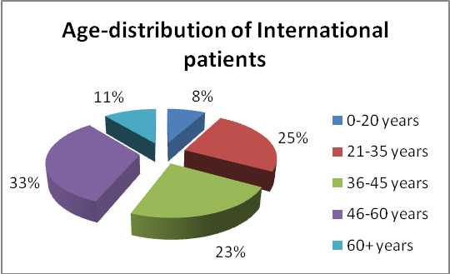
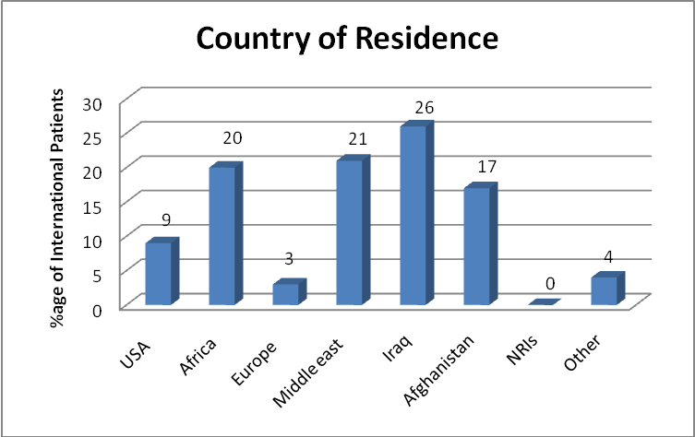
Study Findings

Slide 7
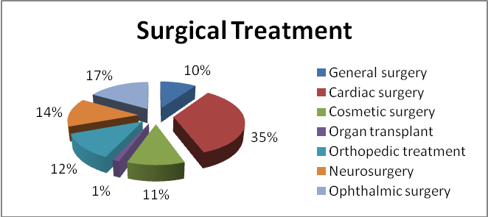
Contd..

Slide 8
Contd..
REASON FOR MEDICAL TRAVEL OUTSIDE HOME COUNTRY | %AGE OF INTERNATIONAL PATIENTS
(A)Inadequate health insurance coverage | 4%
(B)Long waiting list | 8%
(C) High cost of medical treatment in home country | 10%
(D)Unavailable quality services | 28%
(E) Poor medical infrastructural facilities | 45%
(F) Rare/Complex medical disease | 4%
REASON FOR CHOOSING AS MEDICAL DESTINATION | %AGE OF INTERNATIONAL PATIENTS
(A) Low cost treatment | 25%
(B) Availability of latest medical technologies | 29%
(C) Excellent quality services | 26%
(D) No language barrier in | 1%
(E) No waiting time/Immediate treatment | 11%
(F) Convenient to travel | 5%
(G) Coinciding with business trip to | 2%

Slide 9
Contd..

Slide 10
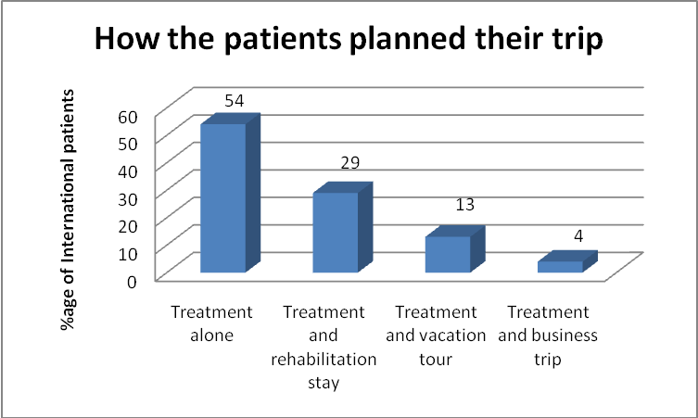
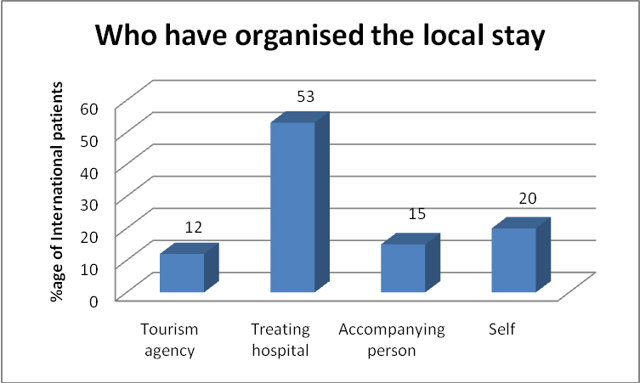
Contd..

Slide 11
Contd..
Attributes of services of hospital | AVERAGED RANKING | rELATIVE ranking
Good medical / surgical treatment | 2.06 | 1
Comfortable facility | 3.69 | 3
Low cost procedures | 3.16 | 2
Transparent billing | 5.38 | 5
Responsive nursing | 5.56 | 6
Easy communication | 6.08 | 7
High technology equipment | 3.93 | 4
Organized and planned trip | 6.12 | 8

Slide 12
Recommendations
Tie-up with medical tourism companies.
Tie-up with doctors and/or hospitals at countries with prospective patients.
Campaigns / CMEs to be conducted at the countries with prospective patients.
Articles, advertisements to be printed in some financially feasible international journals/ magazines on medical tourism.
Tie-up with health insurance companies for assisting international patients in health insurance facilitation for their treatment.
Tie-up with hospitals within the country to facilitate international patients transfer to self and other specialized care facility as and when required.

Slide 13
Contd..
Preferences for various attributes of services given describes that for better flow of international patients to the hospital, it needs to take the following steps:
Focus on advancement of medical technologies and doctors expertise needs to be undertaken.
Billing for particular procedure should be predefined & pre-informed to the international patients.
Strict Communication training for the nursing staff should be undertaken as they represent the medical services of the hospital.
Correct, accurate & relevant information should be provided by every employee of the hospital to the patients.
Response time should be well defined & fast.
Appointment scheduling, air-ticket booking and accommodation arrangement for patient and attendant should be done on time to make their trip well organized & planned.

Slide 14
THANK YOU

