Slide 1


Assessing knowledge, awareness and attitude towards climate change
Presented by Supriya Sarkar
Faculty Mentor- Dr. Vinay Tripathi
IIHMR Delhi

Slide 2
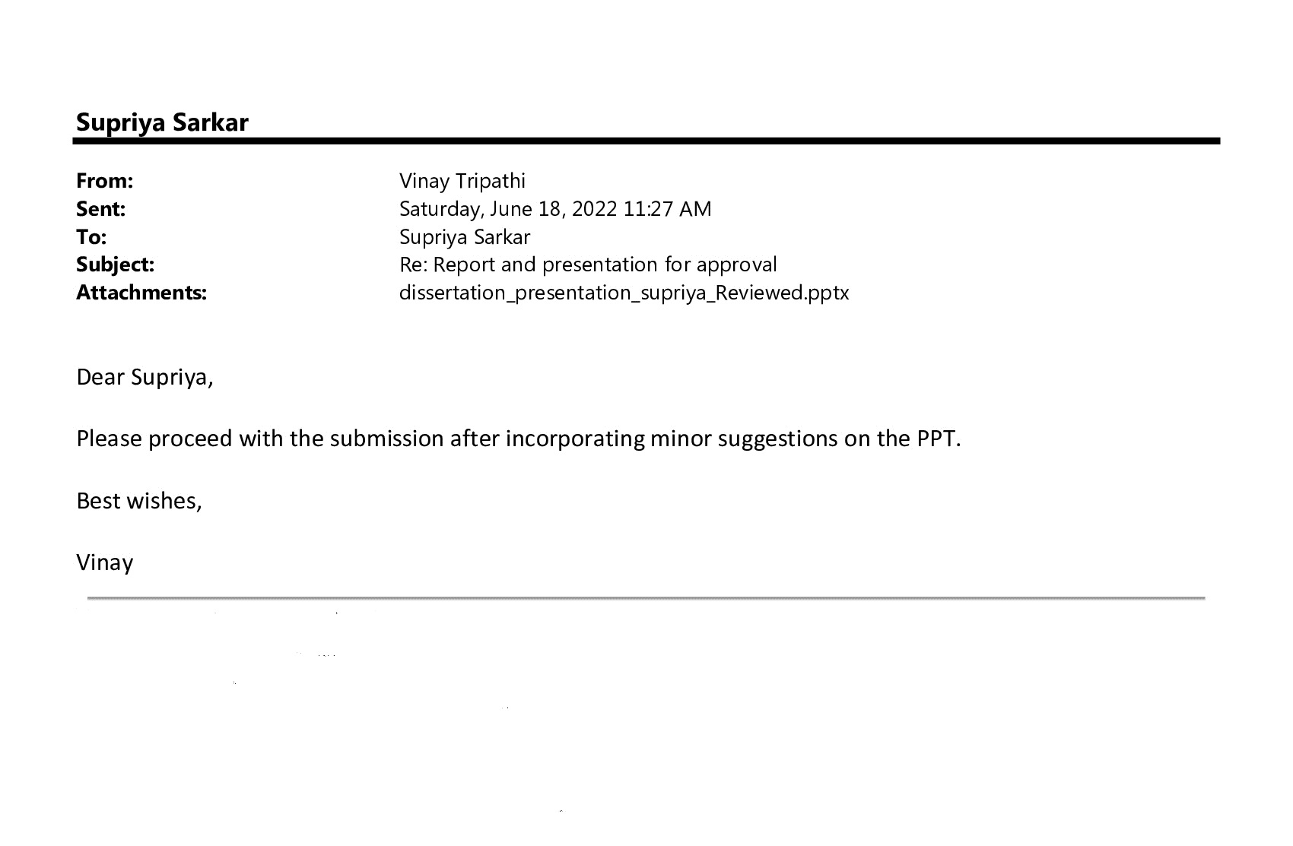
Screenshot of approval

Slide 3
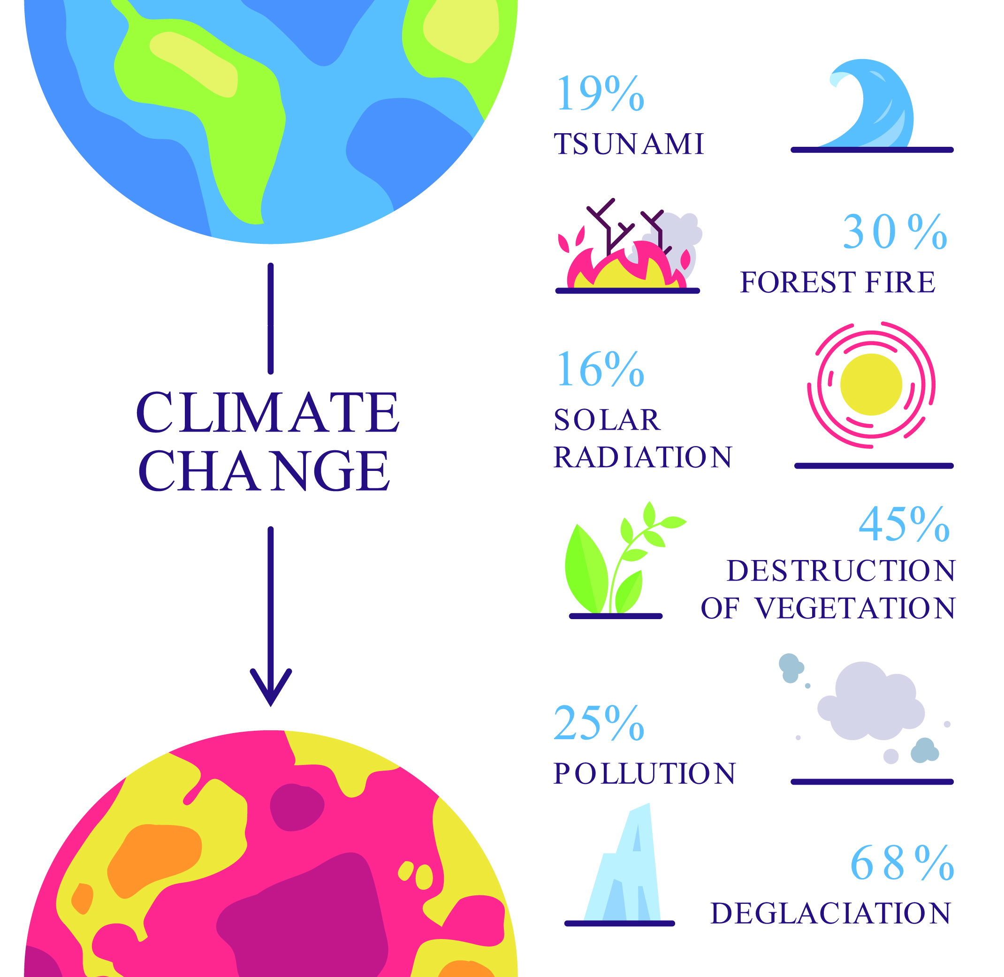
Introduction
It is the single largest environment threat facing the planet and humankind today
Vulnerable nations are affected 15 times greater from droughts, storms & floods in 2010-2020
Climatic change is the change in the temperature and weather patterns
The Climate crisis threatens to undo the last fifty years of progress in development, global health, and poverty reduction & widen existing health inequalities
Human behaviors, through activities has increased to the emission of GHGs such as carbon dioxide and methane

Slide 4
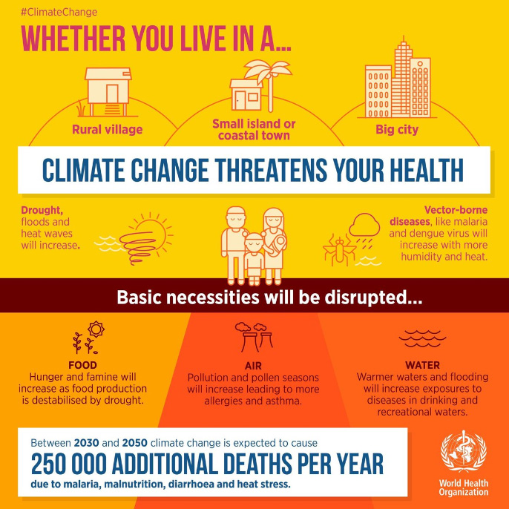
Climate change and health
Water-borne diseases
Food-borne diseases
Vector-borne diseases
Respiratory diseases
Malnutrition
Extreme weather related and heat waves

Slide 5

Objective of the study
To understand their attitude towards making adaptive changes to mitigate climate change.
To assess the knowledge and awareness of people towards climate change

Slide 6

Methodology
Study design-cross-sectional descriptive study
Sampling techniques- purposive sampling technique
Sample size- 150 people.
Medium of questionnaire - English language.
Questionnaire composed of 24 question
It comprises socio-demographic information like age, gender, education, and profession.
Also, Knowledge, awareness of climate change, and adaptation measures

Slide 7
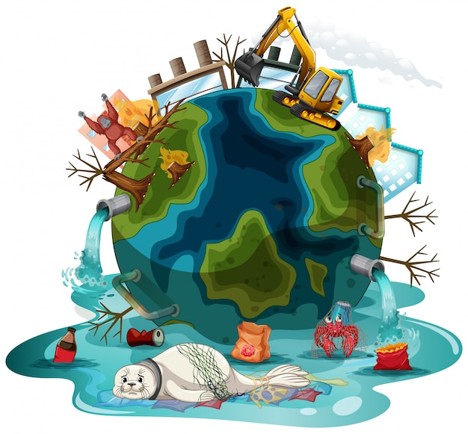
Methodology
Questions were of a multi-response type
Last questions were open-ended for suggestions and comments.
The data was collected using a semi-structured questionnaire which was administered using an online platform
The participants who gave their consent before participating in the study and who did not provide consent were excluded.
Data analysis was done using SPSS and google forms.

Slide 8
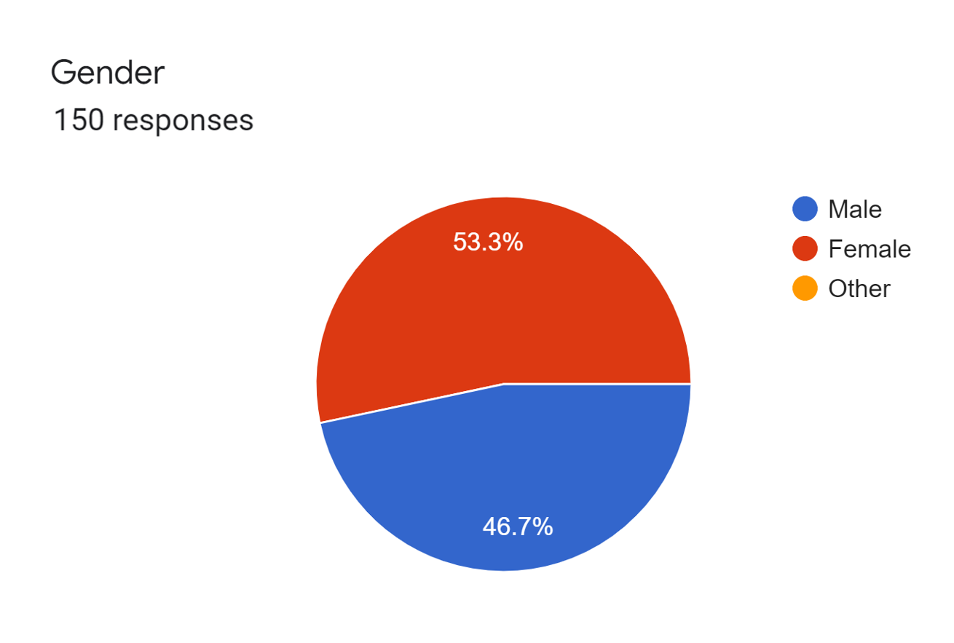
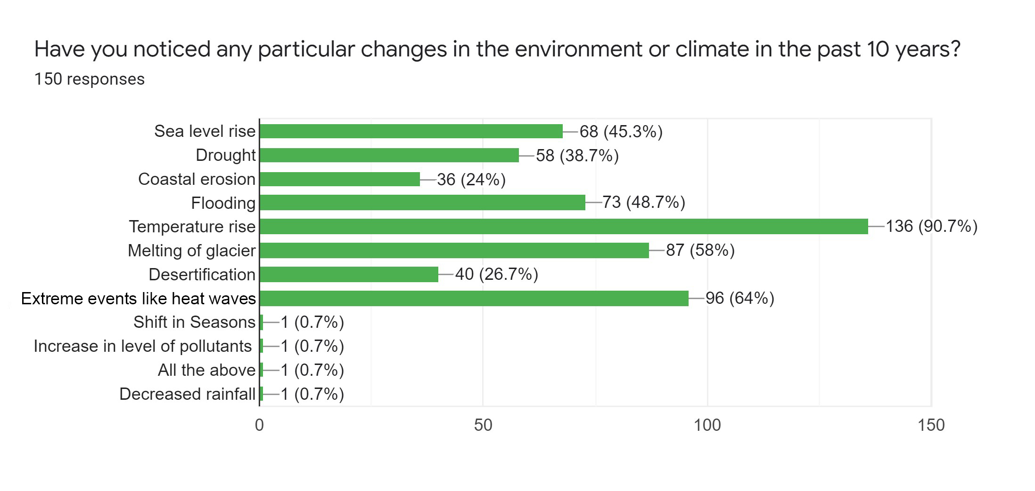
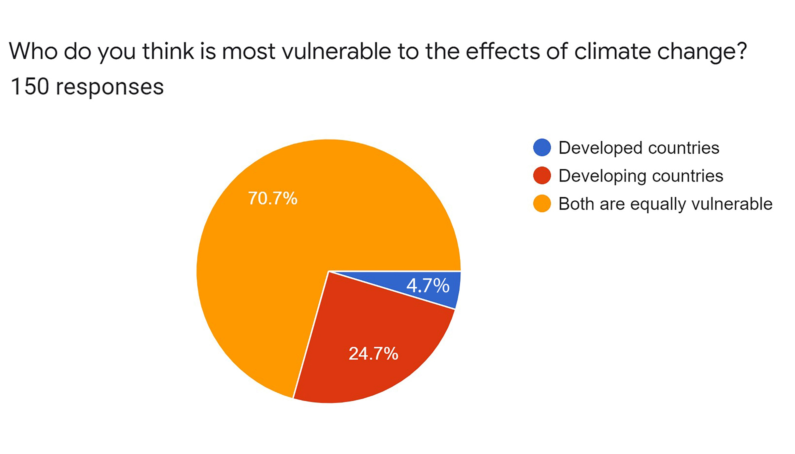
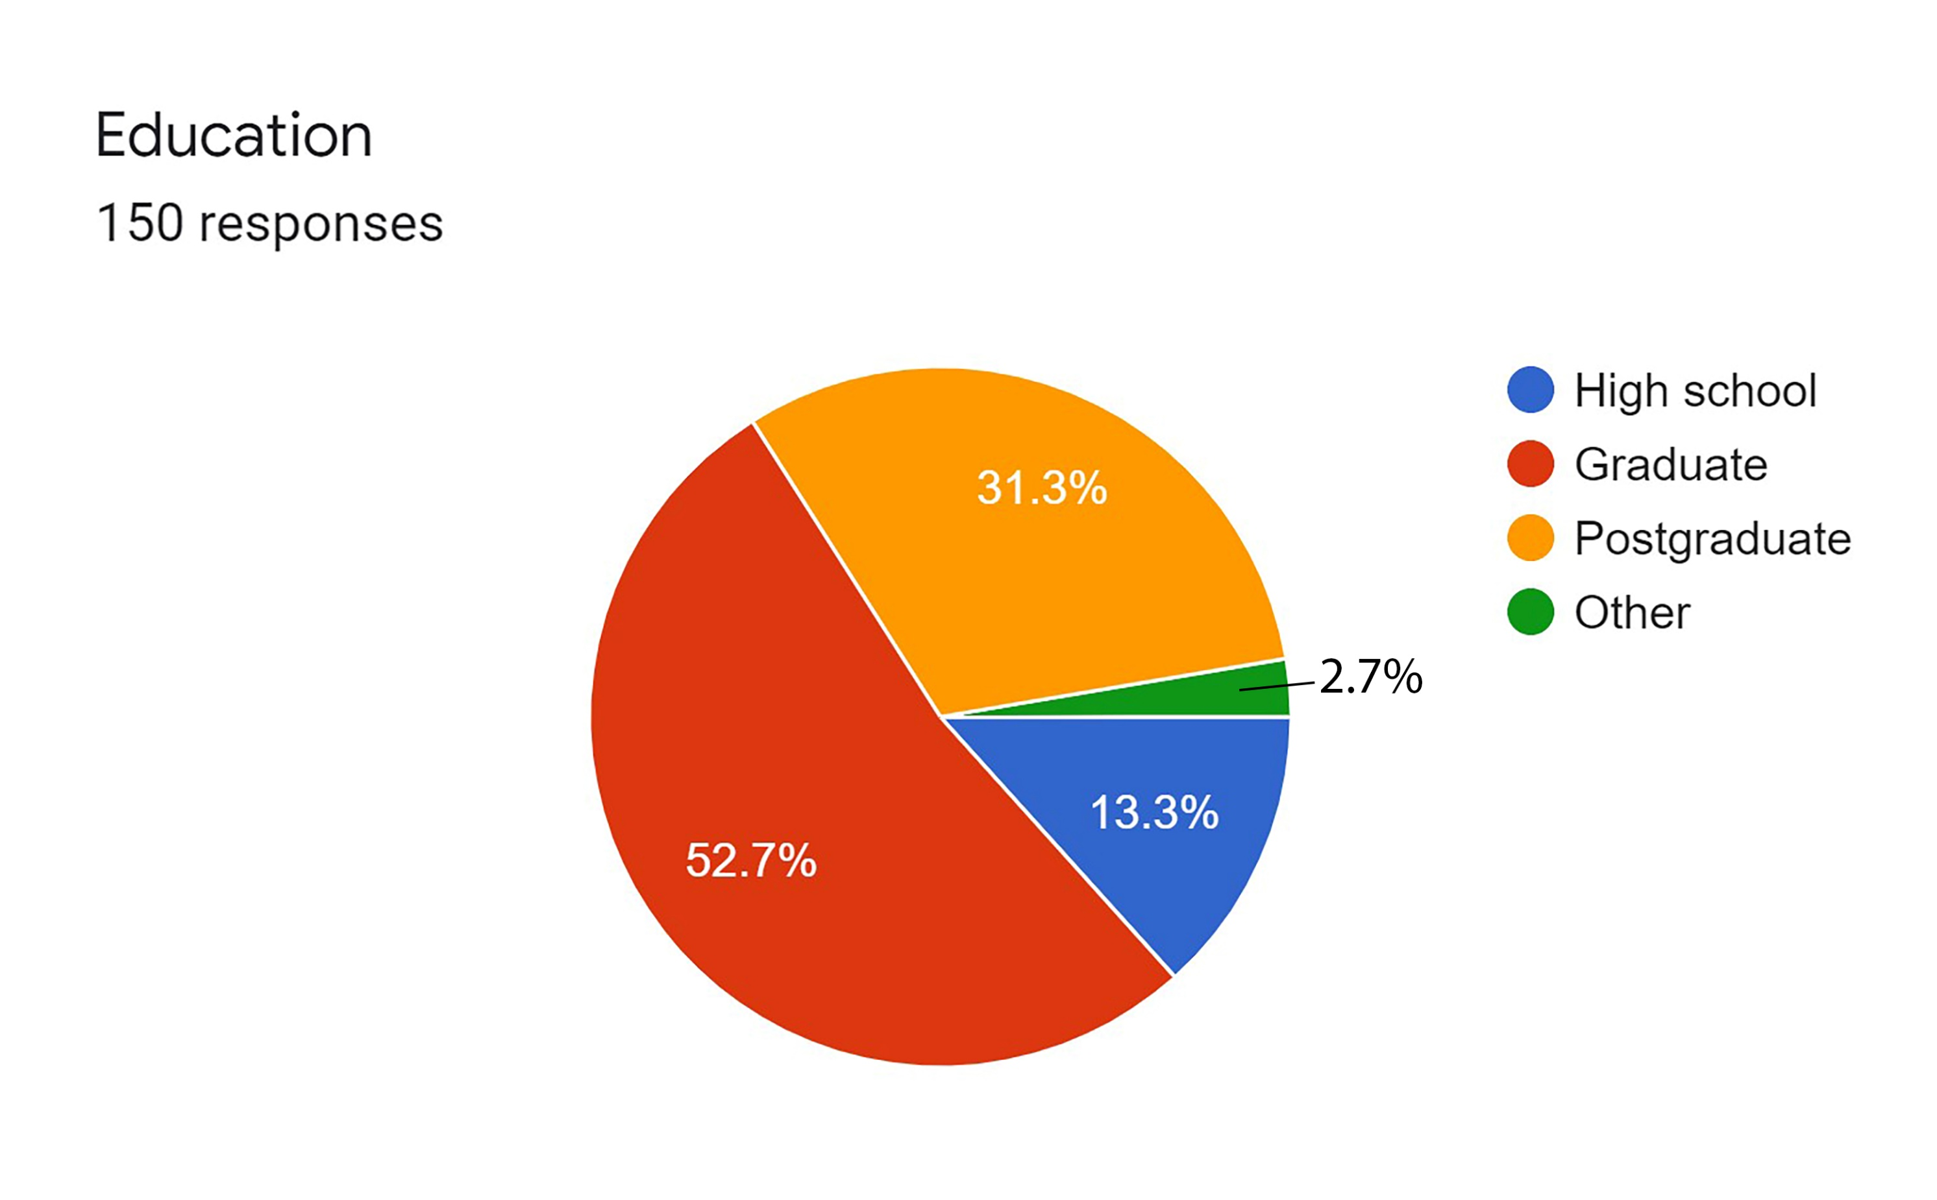
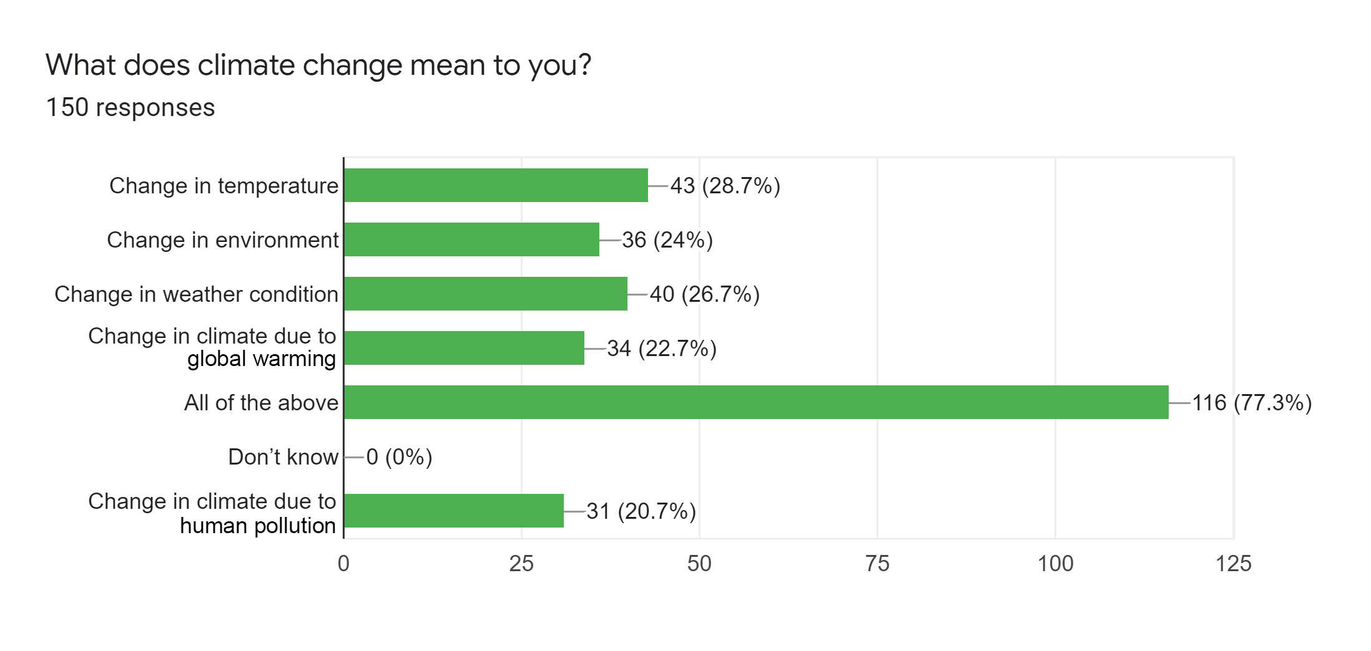
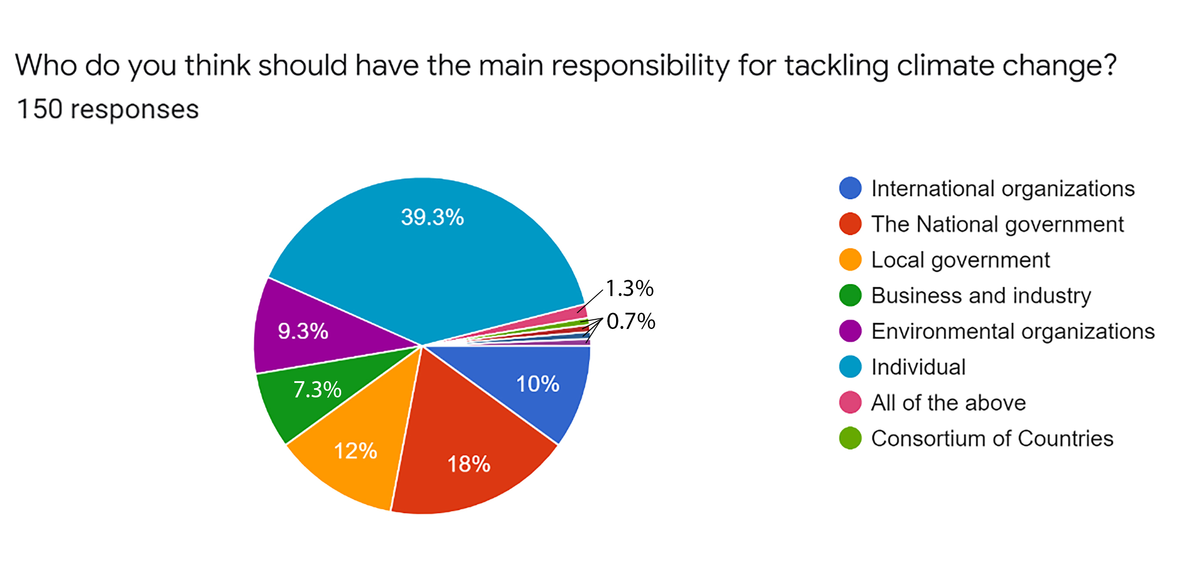
Result
Knowledge about climate change
Demographic details
Figure 1- gender-wise percentage
Figure 3- Changes observed by respondents
Figure 5- vulnerable countries
Figure 2- Education wise percentage
Figure 4- Climate change definition
Figure 6- Responsible of climate change

Slide 9
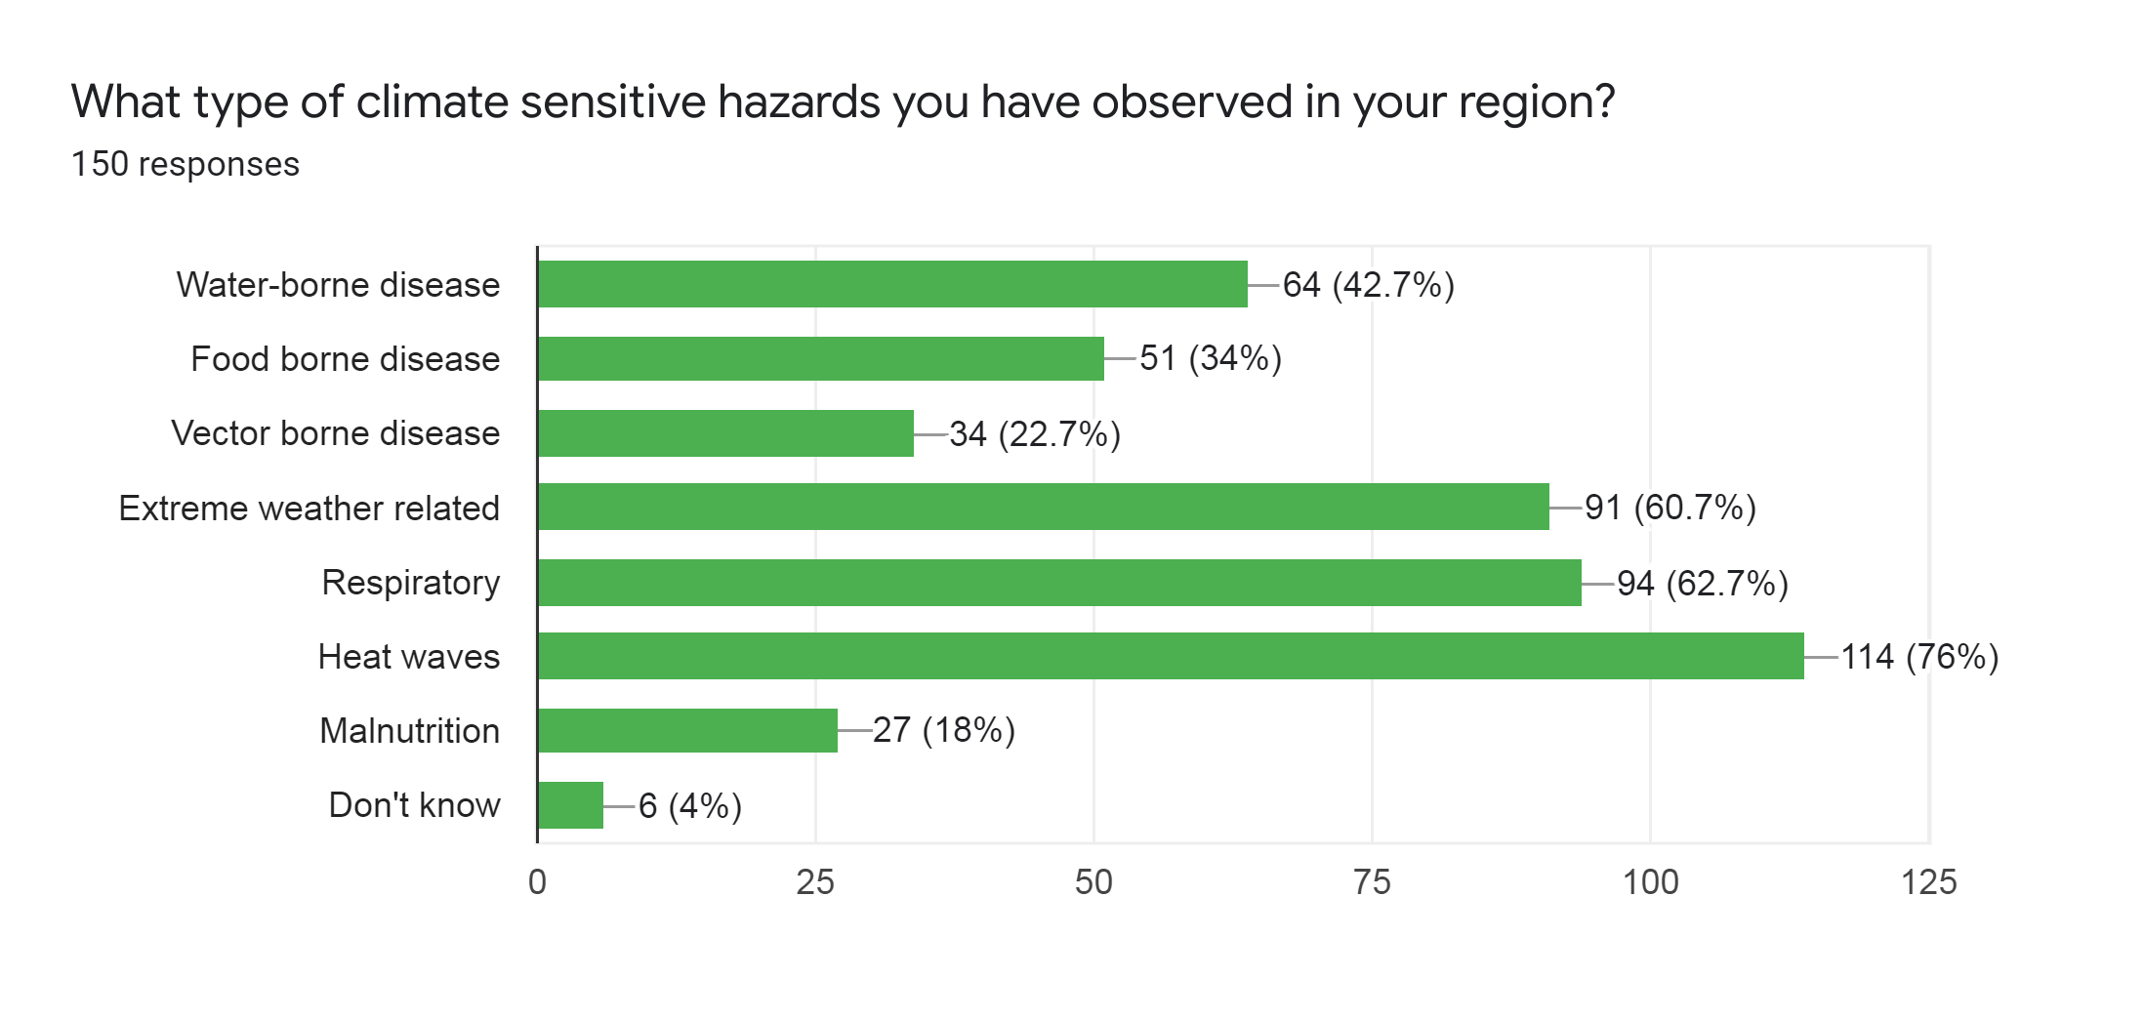
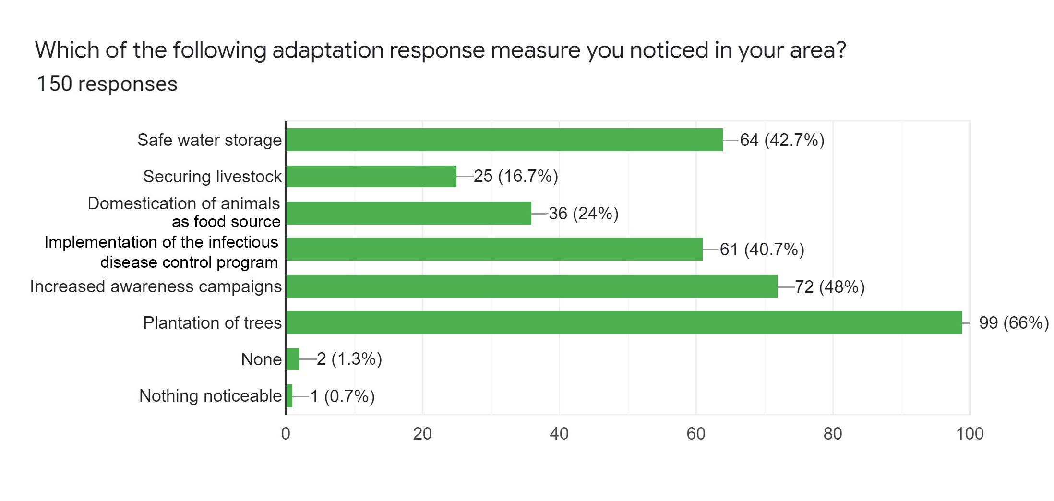
Result
Knowledge and Awareness
Questions | Yes/Agree | No/disagree | Maybe/Don’t know
Do you feel the pattern of weather is generally changing? | 91.30% | 3.30% | 5.30%
Do you think human activity is responsible for climate change? | 96% | 1.30% | 2.70%
In your view, has climate change ever affected your health? | 76% | 6.70% | 17.30%
To the best of your knowledge, are climate change awareness campaigns carried out in your region? | 34% | 27.30% | 38.70%
Do you follow climate change related activities or policy? | 66% | 44%
Do you think enough is being done for climate change? | 18.70% | 67.30% | 14%
Have you ever taken, or do you regularly take, any action out of concern for climate change? | 54% | 18% | 28%
Figure 7- Climate sensitive hazard percentage-wise
Table 1- Analysis on knowledge & awareness of climate change
Figure 8- Adaptive measure percentage

Slide 10
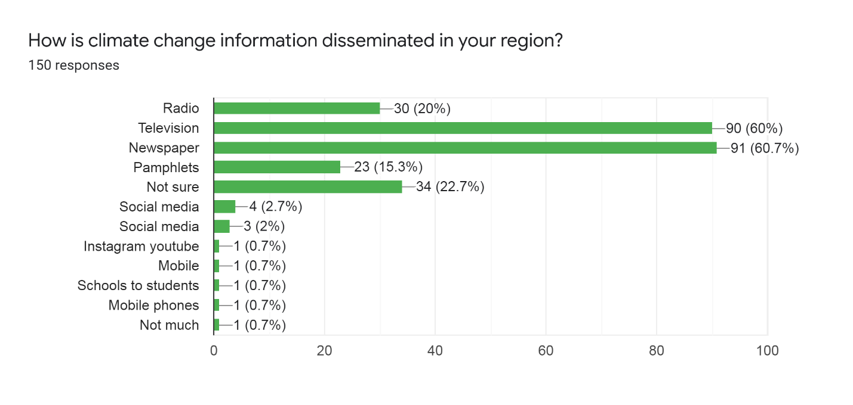
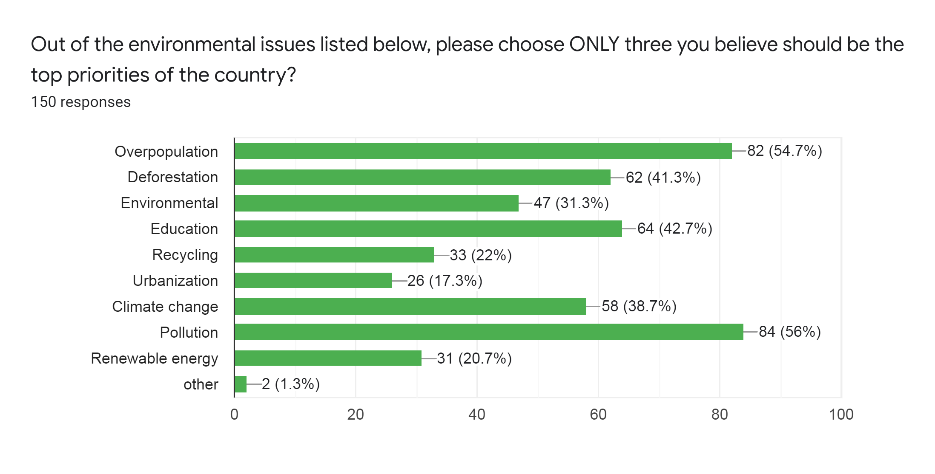
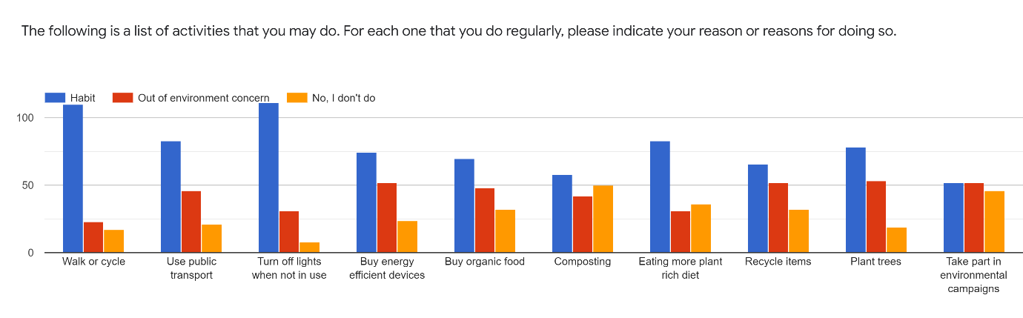
Result
Figure 9- Information dissemination mode
Figure 10- Important environment issues
Education * Who do you think is most vulnerable to the effects of climate change? Crosstabulation
Count
 |  | Who do you think is most vulnerable to the effects of climate change? |  |  | Total
 |  | Both are equally vulnerable | Developed countries | Developing countries
Education | Graduate | 55 | 4 | 20 | 79
 | High school | 14 | 1 | 5 | 20
 | Other | 4 | 0 | 0 | 4
 | Postgraduate | 33 | 2 | 12 | 47
Total |  | 106 | 7 | 37 | 150
Figure 11- Adaptive measures
Table 2- Cross-tabulation of education & vulnerable countries

Slide 11

Discussion
Respondents come from different professions like banking, architecture, health professionals, engineers, teachers, and much more.
Majority of respondents hold good knowledge about climate change and events related to it.
They had noticed changes in temperature, and extreme weather-related events like heat waves other than season shifts.
Awareness of the climate-sensitive hazards and adaptation measures in the region could be seen.
Most of the respondents answered that both developing and developed countries are equally vulnerable.
Respondents were not sure of climate awareness campaigns in their region.

Slide 12

Discussion
Majority of the respondents agreed of not enough is being done for climate change.
Respondents are most willing to educate themselves regarding climate change (80%)by promoting(74%) & advocating for climate change adaptation measures(50.7%).
This finding demonstrates that more effort should be invested in information dissemination and sharing climate-sensitive awareness.
Charity starts from home, this every individual should look out for everything and anything he can in his potential to protect the environment.
More physical actions within smaller communities/societies should take place regularly which will directly help people to motivate and to educate about climate fixation
Above are comments by respondents

Slide 13

Limitations of the study
1.
This study has few limitations as it was an online survey, and no face-to-face interaction was possible.
2.
There could be bias in response, particularly about the practice of adaptative and mitigative measures which are mentioned by the respondents in the survey.

Slide 14

Conclusion
Climate crisis cannot be overstated. Impacts are already being felt around the world from longer heat waves, reductions in crop yields, and depleted freshwater reserves.
The world needs to reduce emissions over the next several decades, to minimize the intensity of climate change.
It is suggested that awareness campaigns/programs regarding global warming and measures should be taken to improve the condition.
People’s awareness and attitude play an important role in reducing emissions, asking questions about policies, and being part of environmental programs.
Also, the community’s perception can help in designing interventions according to them.

Slide 15
References
Sandra Venghaus, Meike Henseleit and Maria Belka, The impact of climate change awareness on behavioral changes in Germany: changing minds or changing behavior?, February 2022
Narcisa Maria Oliveira Carvalho Dias, Diogo Guedes Vidal, Hélder Fernando Pedrosa e Sousa et. al, Exploring Associations between Attitudes towards Climate Change and Motivational Human Values, November 2020
Tai-Yi Yu and Tai-Kuei Yu, The Moderating Effects of Students’ Personality Traits on Pro-Environmental Behavioral Intentions in Response to Climate Change, November, 2017
Md Iqbal Kabir, Md Bayzidur Rahman, Wayne Smith et. al Knowledge and perception about climate change and human health: findings from a baseline survey among vulnerable communities in Bangladesh, March 2016
Folajogun V. Falaye & Eugenia A. Okwilagwe Assessing the senior school students’ Knowledge, attitude and practices related to climate change, 2016
Jitendra Kumar Sah, Asha Anil Bellad, Mubashir Angolkar, Assessment of Knowledge and Attitude Regarding Global Warming among High School Students of Ramnagar Belagavi city: A cross sectional study, 2015
Dr Dragana Bojovic, Ars Locus DOOEL, Climate change perception and awareness level: An online survey of the citizens of The Republic of Macedonia, December 2014

Slide 16
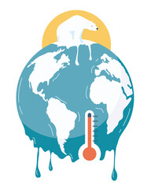
THANK YOU!
ANY QUESTIONS ?

Slide 17

Suggestions to the Organization where the Study was Conducted
The Energy and Research Institute (TERI) has its permanent base in Darbari Seth Block, in the Indian Habitat Center complex located at Lodhi Road, New Delhi.
Indian habitat center itself is a sustainable building.
And TERI is a multi-dimensional organization that brings out innovators and agents of change in the energy, environment, climate change, and sustainability space, having pioneered conversations and action in these areas for over four decades.
The institute believes in resource efficiency and waste management for smart, sustainable, and inclusive development. So, no suggestion

Slide 18
Dissertation Experiences
What did you learn (skill/ topic)?
Overall self comments on Dissertation
Developing of intervention tool for the study and for other research works
Data analysis
Important prospects of climate change related issues and its impact on health.
Climate change and its impact is real challenge for the whole world.
More interventions and measures should be taken to mitigate it.
Peoples’ attitude and perception plays a major role.

Slide 19
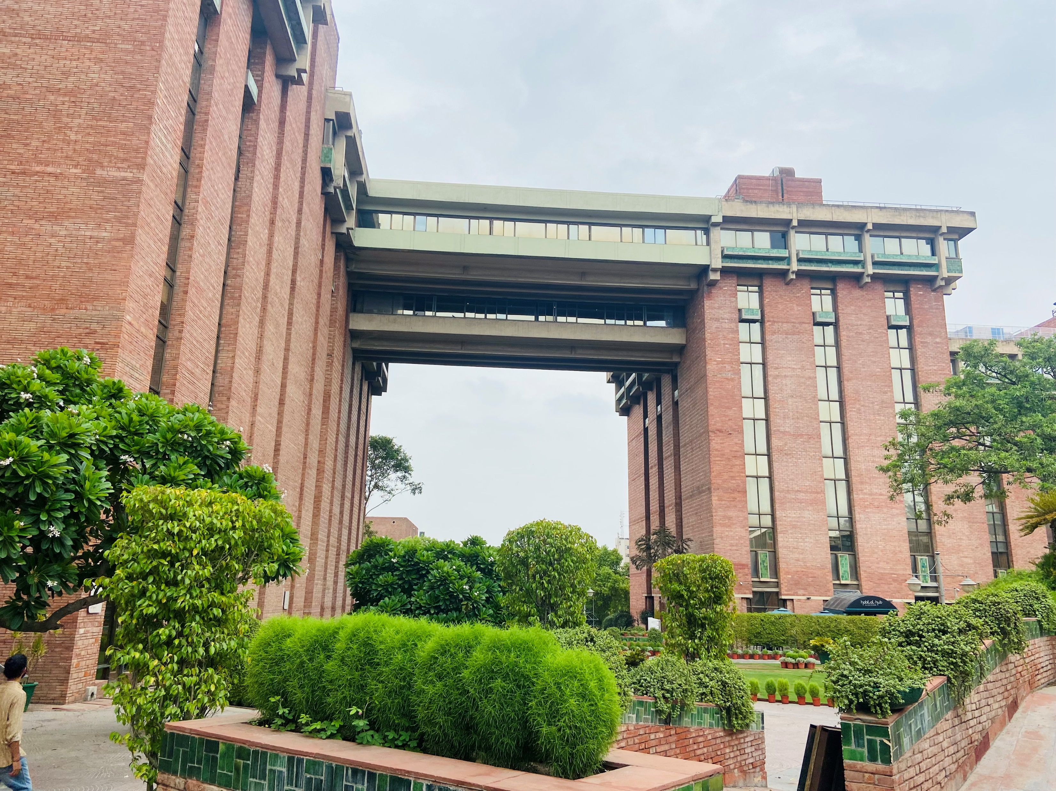

Pictorial Journey

Slide 20
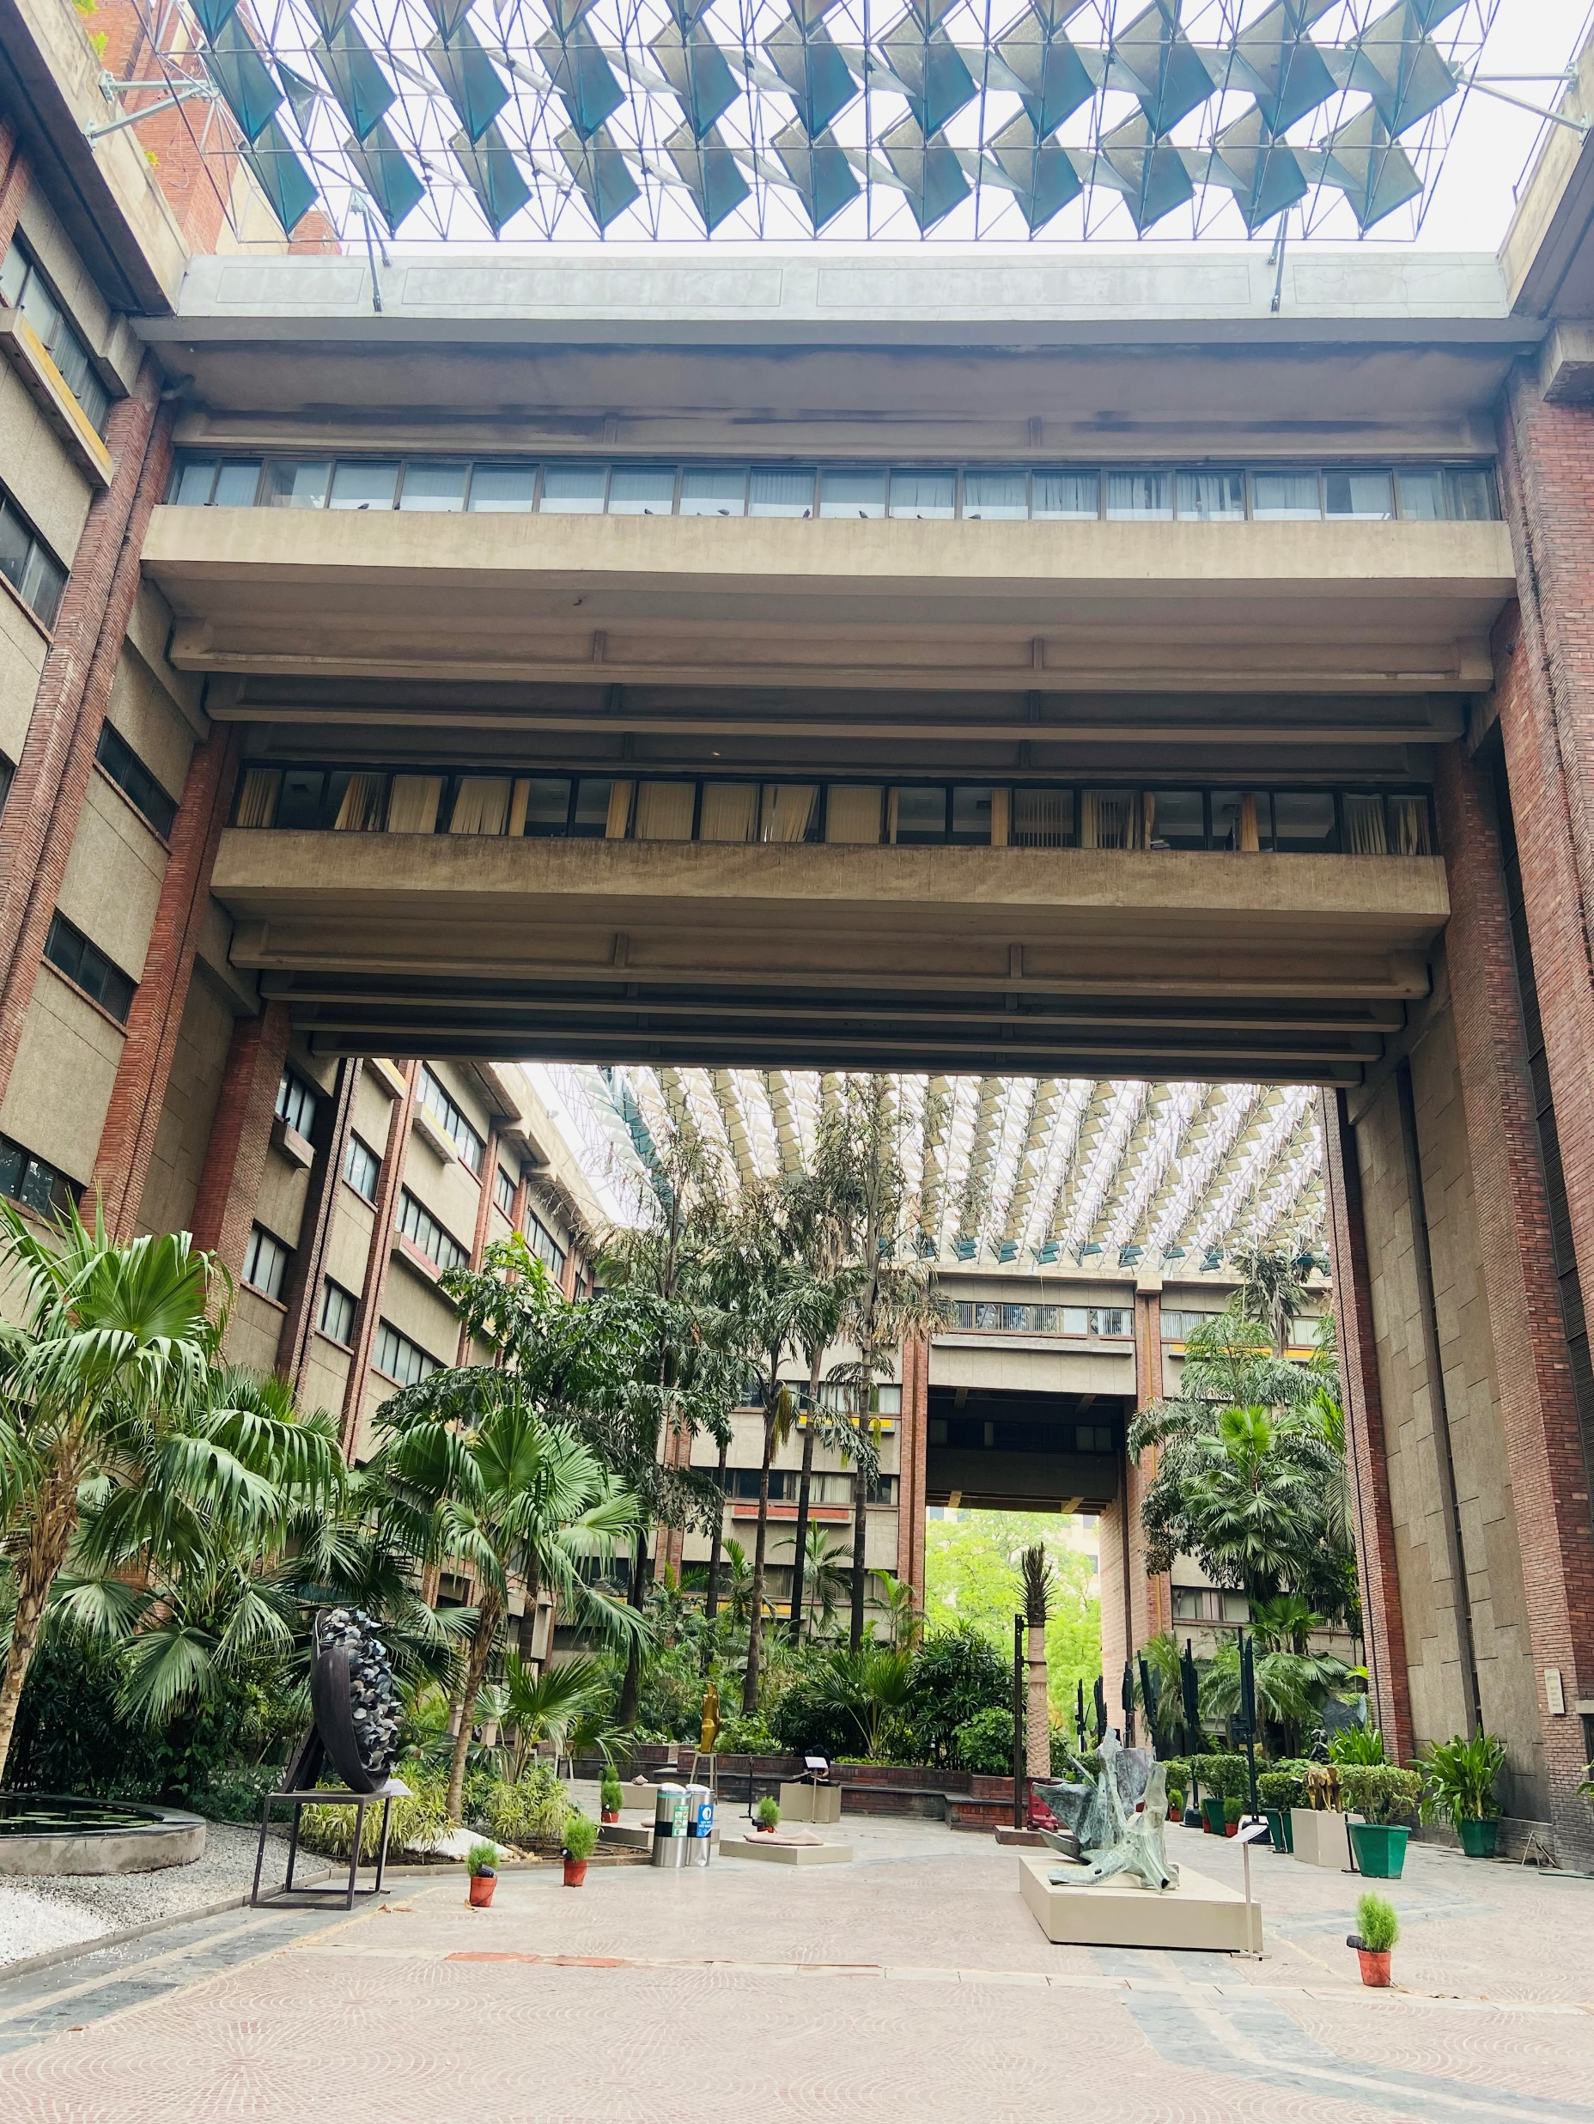
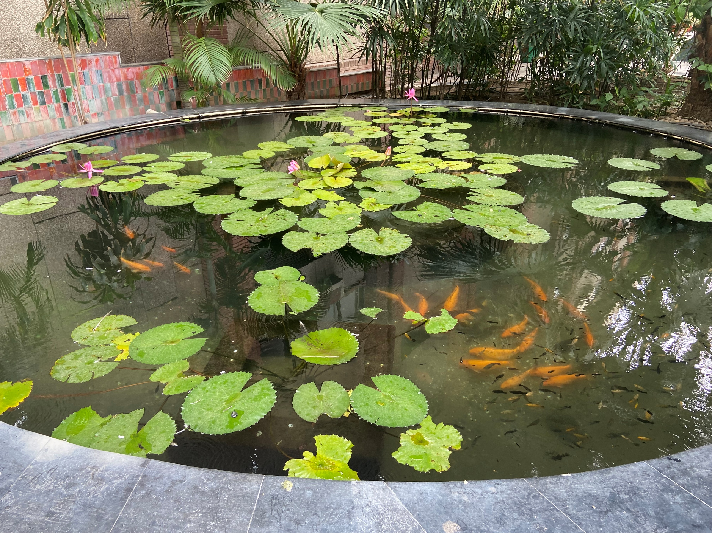
Pictorial Journey

