Slide 1


Impact and Acceptance of Annual Health and Pre-Employment Health Checkups on Company Employees
AT
PROJECT UNDER - MediBuddy
Presented By- Dr. Samridhi Kaur
PG/23/118
Health Management
Mentor – Nishikant Bele

Slide 2

T
A
B
L
E
O
F
C
O
N
T
E
N
T
S
INTRODUCTION
KEY RESEARCH QUESTION
METHODOLOGY
ETHICAL CONSIDERATION
LIMITATIONS & TOOLS
RESULT & DISCUSSIONS
REFERENCE QUESTIONNAIRE

Slide 3
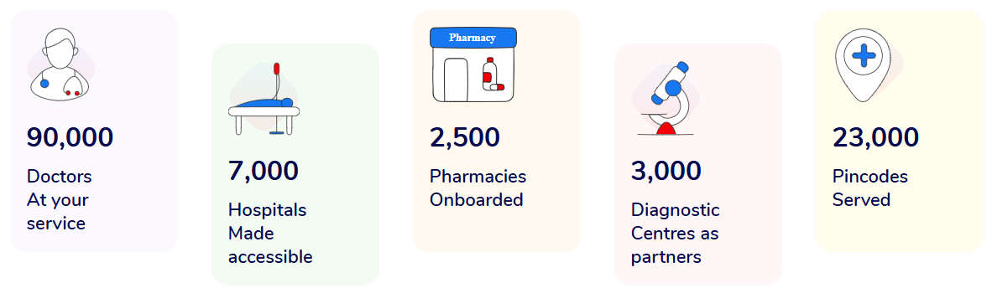
INTRODUCTION (1/2)
ABOUT ORGANISATION
MediBuddy is India’s leading digital healthcare platform, offering seamless access to a wide range of health services anytime, anywhere.
From online doctor consultations and lab test bookings to medicine delivery and hospitalization support, MediBuddy empowers users with convenient, reliable, and affordable healthcare at their fingertips.
MediBuddy bridges the gap between patients and quality healthcare through cutting-edge technology and a user-friendly interface having a strong network of:

Slide 4
INTRODUCTION (2/2)
Rationale of the Study
The increasing focus on employee well-being has led organizations to adopt regular health checkups as a key component of workplace wellness programs. Annual health and pre-employment health checkups aim to prevent health risks, improve productivity, and ensure a healthier workforce. However, the acceptance and perceived impact of such initiatives vary across industries and employee demographics. This study seeks to explore the effectiveness, challenges, and overall perception of these health checkups in corporate environments.
Project Location: MediBuddy, Gurgaon

Slide 5
Review of Literature
Author & Year | Study Focus | Key Findings
Sivagami & Samuel, 2024 | Utilization, motivators, and barriers to preventive health checkups in Perambalur | Only 29.82% of adults underwent checkups; motivators included doctor’s advice and insurance; barriers were lack of awareness and discomfort.
Deepa & Mohan, 2013 | Review of worksite health and wellness programs in India | Identified cardiovascular risk as a key concern; emphasized need for structured and evidence-based wellness programs.
Rao & Nayak, 2021 | Diagnostic value of health checkups for employees aged ≥40 years in a tertiary hospital | Regular screenings led to early detection and better health outcomes among employees.
Bhatnagar & Dey, 2022 (NBEMS) | Significance of preventive health checkups in enhancing well-being | Checkups associated with 45% reduction in all-cause mortality; recommended institutionalizing workplace physicals.

Slide 6
Key Research Question
Research Question: How do annual physical checkups given in corporates influence healthcare awareness and disease risk prevention among employees
OBJECTIVE OF STUDY
To evaluate employee experiences with annual and pre-employment health checkups provided by their organization.
To assess the perceived benefits of these health checkups such as early detection of health issues and lifestyle changes.
To examine the impact of health checkups on employee well-being, absents

Slide 7
METHODOLOGY (1/2)
A mixed-methods approach, incorporating both qualitative research.
Study
Design
Sampling
Method
Purposive Sampling
Study
Duration
Sample
Size
Project
Methodology
3 Months (Mar-May)
70
Study
Area
Sample
Selection
Employees from different industries, with a mix of those who have undergone health checkups and those who have not.
MediBuddy, Gurgaon

Slide 8
METHODOLOGY (2/2)
SELECTION CRITERIA
DATA & ANALYSIS PLAN
1.Inclusion criteria - Employees from different industries, with a mix of those who have undergone health checkups and those who have not.
2.Exclusion criteria - Employees at higher official positions that include Strategy Planning, policy, Non Functional areas like Finance, HR, and Sales.
1
2
STUDY TOOL -
Semi structured questionnaire containing closed and open questions.
The tool includes questions for individuals who have undergone health checkups.
METHOD OF DATA
COLLECTION
The Google form was circulated among the eligible participants and their responses were recorded and stored in MS Excel Spreadsheet
3
ANALYSIS PLAN
The Data Analysis would be done on MS Excel

Slide 9
Ethical Consideration & Limitations
Informed consent taken from all participants
Confidentiality of data ensured.
Non-probability sampling may reduce the external validity of the study findings
Expected Outcome & Tool Used
Insights into employee satisfaction with health checkups
Recommendations to improve participation and outcomes
Evidence for organizational policy enhancement
Google Form (https://forms.gle/x3hGdz3g2ub76JCK7)

Slide 10
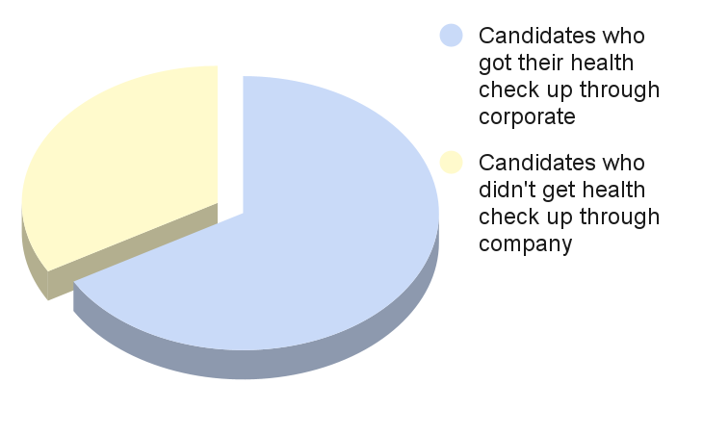
Result (1/4)
Total candidates who participated in the survey :- 156
Candidates who does not got their health check up through corporate :- 52
Total candidates remaining in the survey :-104
Finding:
Out of the 156 employees in the sample, 66% have taken a health checkup through the company, while 34% have not got their Health check up through company

Slide 11
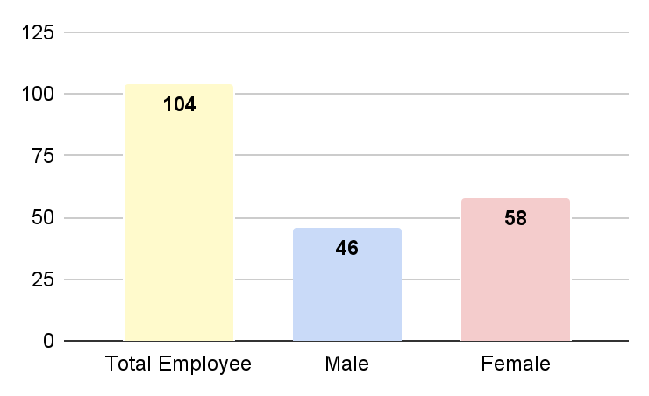
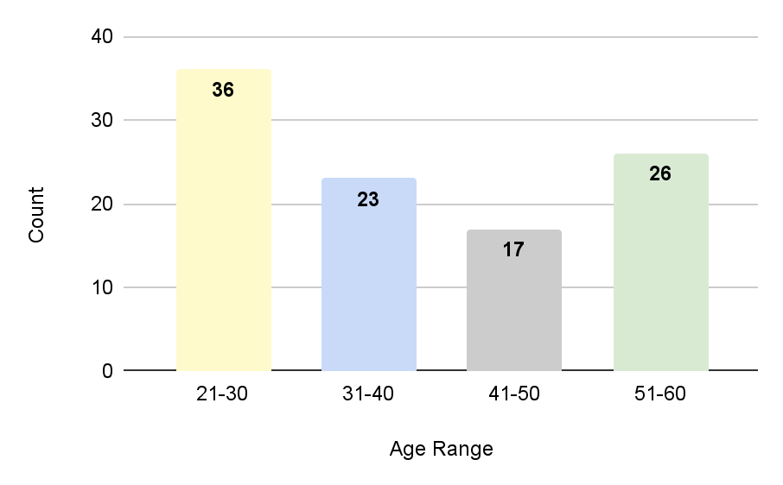
Result (2/4)
Gender distribution
Age distribution

Slide 12
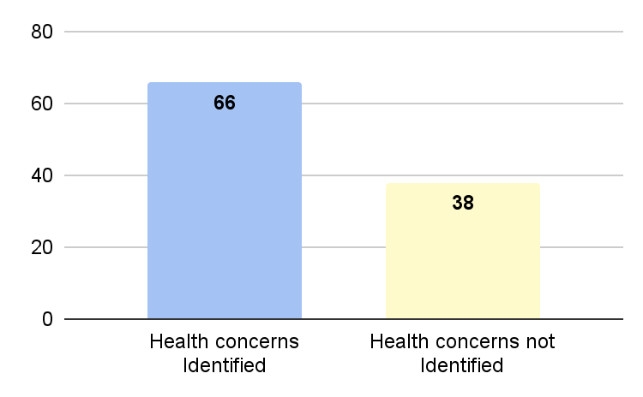
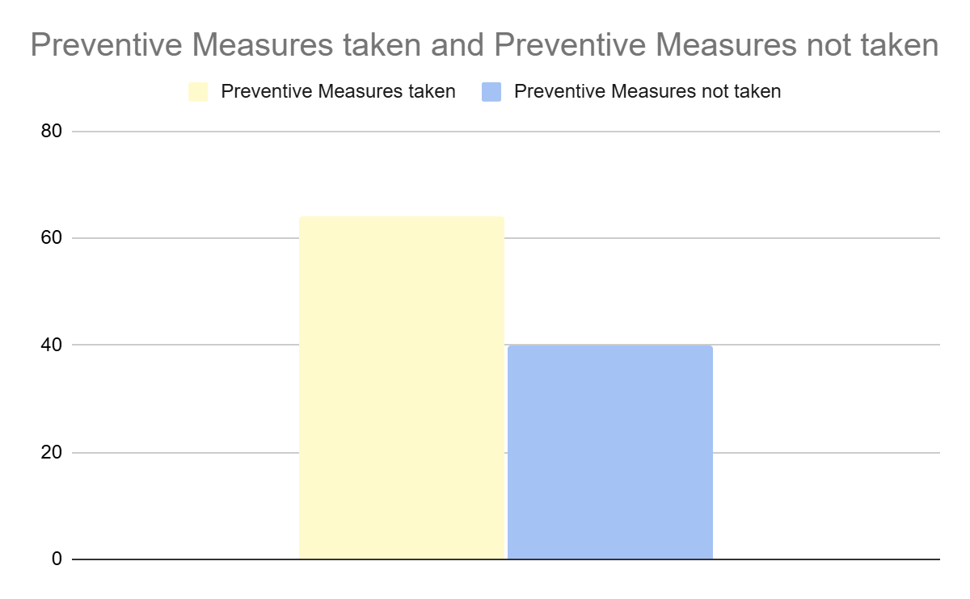
Result (3/4)
Identification of Health concerns
People who took preventive measures after the Health Check up
64
40

Slide 13
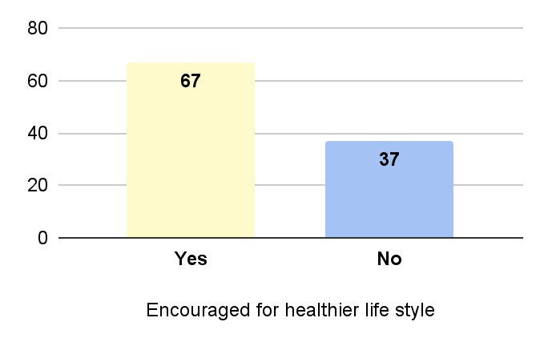
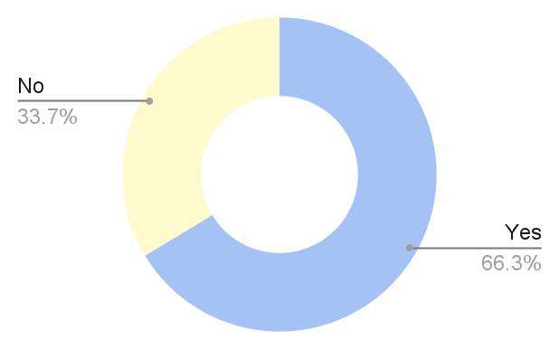
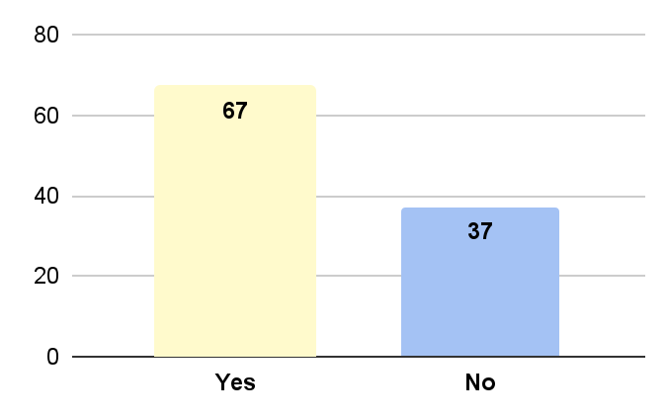
Result (4/4)
Encouraged for healthier lifestyle
Health Awareness
Did it effect overall wellbeing at work

Slide 14
Discussions
Health Checkup Participation:
66% of employees have utilized company-sponsored health checkups, indicating good engagement, while 34% have not.
Gender & Age Insights:
Out of 104 respondents, 56% are female and 44% male. Majority fall in the 21–30 and 51–60 age brackets, suggesting targeted health awareness may be needed for mid-age groups.
Preventive Health Awareness:
64 employees take preventive health measures, showing moderate awareness. 40 do not, signaling scope for better health education.
Impact of Health Checkups:
67 employees felt encouraged to lead a healthier lifestyle post-checkup, and the same number linked it to improved workplace wellbeing.
Opportunities for Improvement:
A significant number (37) remain unconvinced about the value of health checkups, indicating a need for increased awareness and communication.

Slide 15
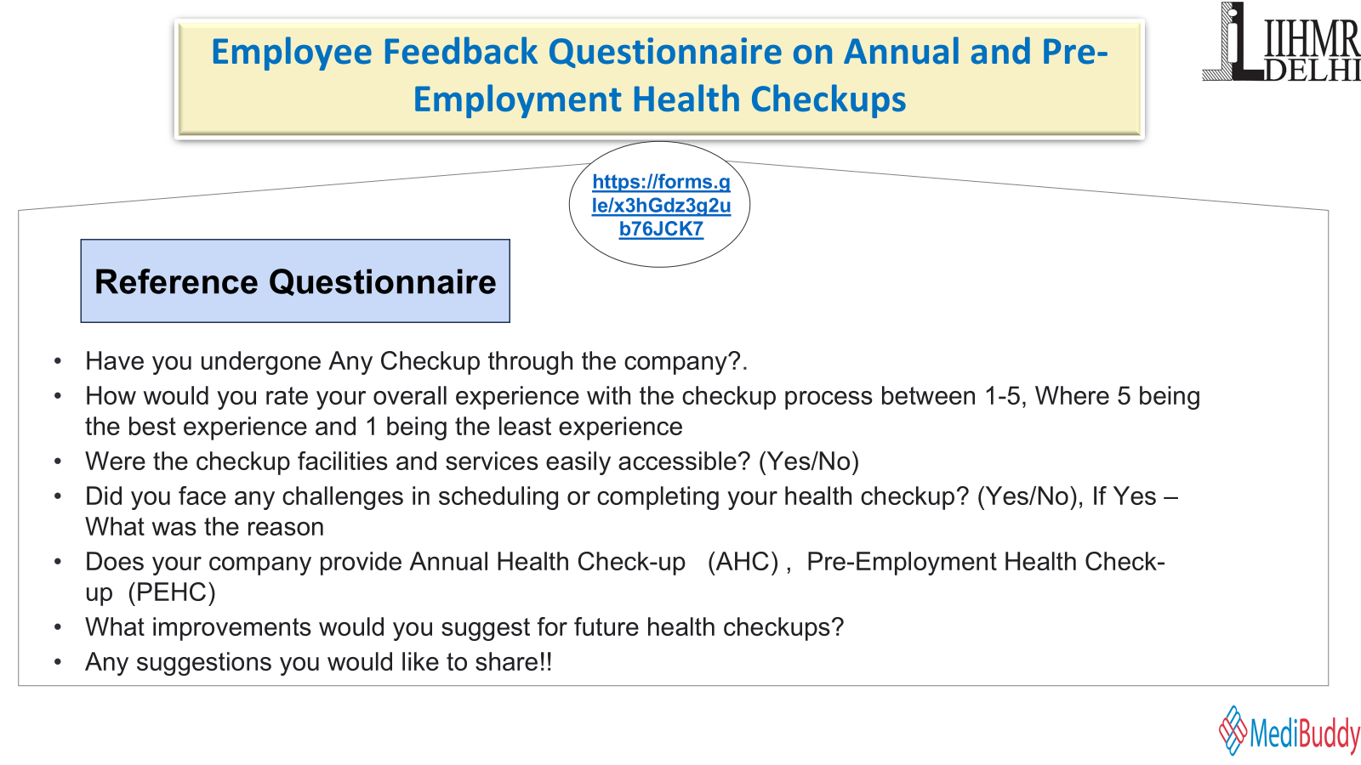

Slide 16
REFERENCES
https://pmc.ncbi.nlm.nih.gov/articles/PMC6598800/?utm_
https://pmc.ncbi.nlm.nih.gov/articles/PMC10874466/
https://www.researchgate.net/publication/259093786_Worksite_Health_and_Wellness_Programs_in_India
https://pmc.ncbi.nlm.nih.gov/articles/PMC6598800/?utm_
https://pmc.ncbi.nlm.nih.gov/articles/PMC10874466/
(PDF) Worksite Health and Wellness ProgramsResearchhttps://journals.lww.com/jcsr/fulltext/2021/10010/general_health_check_up_of_employees_aged__40.5.aspx
Microsoft Word - Article_5-Original
(PDF) "A Study on Perception of Corporate Employees working in Bangalore City towards Corporate Wellness Programs offered by their Company"https://www.researchgate.net/publication/353260498_A_Study_on_Perception_of_Corporate_Employees_working_in_Bangalore_City_towards_Corporate_Wellness_Programs_offered_by_their_Company
https://www.ijnrd.org/papers/IJNRD2404792.pdf
A Study on Wokplace Wellness Programs and Their Effectiveness in https://www.irejournals.com/formatedpaper/1700714.pdf
https://sist.sathyabama.ac.in/sist_naac/documents/1.3.4/2022-mba-mba-batchno-40.pdf
https://www.peoplematters.digital/Campaign-Wellness360-A-research-study-on-corporate-wellness-programs

Slide 17

Thank You
Notes:
Add RFP reference number

