Slide 1

Data Governance and Cybersecurity in Digital Healthcare: A Comparative Literature Review of Global Frameworks and India’s Regulatory Ecosystem
Presented by: Dr. Pearl Jaggi
Mentor: Dr. Mukesh Ravi Raushan
IIHMR Delhi

Slide 2
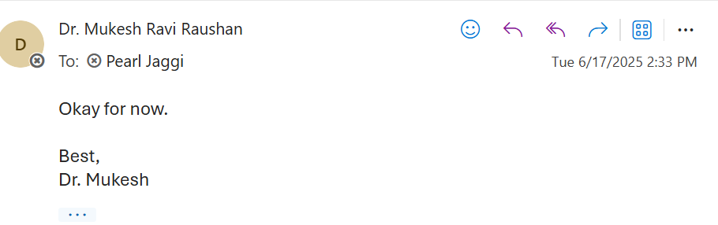
Mentor Approval

Slide 3
INTRODUCTION
The increasing digitalization of healthcare systems has raised urgent concerns around the protection of sensitive patient data. Cybersecurity in healthcare focuses on protecting health data and systems from threats like ransomware and data breaches.
Data governance in healthcare ensures that data is managed ethically, securely, and in compliance with regulations, ultimately improving patient care and driving better outcomes. It's about establishing clear policies and procedures for collecting, using, and sharing patient information, while also safeguarding privacy and confidentiality.

Slide 4
In India, incidents such as the AIIMS Delhi ransomware attack highlight vulnerabilities. Globally, frameworks like GDPR and HIPAA have set strong precedents for digital health data governance.
This study examines global standards of data governance and cybersecurity in healthcare, including frameworks from the US (HIPAA, HITECH), UK (NHS DSP Toolkit), and EU (GDPR), comparing them with India’s DPDP Act and ABDM.
Despite India’s strides in digital health infrastructure, gaps in policy enforcement, readiness, and awareness remain. Most existing literature addresses cybersecurity or data governance in isolation. This study bridges both domains.

Slide 5
OBJECTIVES OF STUDY
To understand the global frameworks related to data governance and cybersecurity in healthcare
To study current digital health regulations, including the DPDP Act and ABDM in context of India.
To understand the comparative approaches identifying the gaps and challenges in context of India and global

Slide 6
METHODOLOGY
This study adopts a secondary research approach based on a narrative literature review. It will help analyze existing research and regulatory documents to identify key challenges, strategies, and gaps in data governance and cybersecurity within the digital healthcare ecosystem when compared with the global standards of the USA, UK, Europe, and other international benchmarks.
Few Keywords like - healthcare cybersecurity India, GDPR in healthcare, data governance in digital health, HIPAA healthcare compliance, GDPR in healthcare, healthcare cybersecurity global

Slide 7
Search Engine:
Data is gathered from secondary resources such as Google Scholar, PubMed, Scopus, and ResearchGate, as well as open-access sources. Official websites of organizations and initiatives (e.g., WHO, NITI Aayog, NHS) will also be reviewed for relevant policies and frameworks.

Slide 8
Inclusion Criteria:
-Publications focusing on healthcare-related data governance and cybersecurity.
-Relevant research papers published post-2015.
-Coverage of global (e.g., GDPR, HIPAA) and Indian (e.g., DPDP, ABDM) frameworks.
-Written in the English language.
-Sourced from trusted platforms like Google Scholar, PubMed, Scopus, ResearchGate.
Exclusion Criteria:
- Studies unrelated to healthcare (e.g., finance, legal, education sectors).
- Articles published before 2015, unless historically significant.
- Blogs, news articles, and other non-peer-reviewed content.
- Non-English publications.

Slide 9
RESULTS
United States: HIPAA (Health Insurance Portability and Accountability Act, 1996) and HITECH (Health Information Technology for Economic and Clinical Health Act, 2009) emphasize individual privacy, breach notification, and electronic records security.
UK & EU: GDPR (General Data Protection Regulation) provides the most comprehensive data protection. The NHS Toolkit enforces cybersecurity compliance. Emphasis on accountability, consent, and right to erasure.
India: ABDM and DPDP are still evolving. Implementation challenges include digital literacy, infrastructure, and policy ambiguity. Significant gaps in enforcement, consent standards, and interoperability.
Notes:
U.S. Department of Health and Human Services (HHS) Office for Civil Rights (OCR
Data Security and Protection Toolkit (DSPT), an online self-assessment tool used by organizations accessing NHS patient data

Slide 10
COMPARATIVE GAPS AND CHALLENGES IDENTIFIED IN INDIA’S HEALTH DATA GOVERNANCE
Health Data Needs Extra Care
Global laws like GDPR and HIPAA treat health data as highly sensitive. India’s DPDP Act doesn’t give it that special status yet.
When Breaches Happen, Who Knows?
Globally, patients are informed if their data is leaked. In India, there’s no clear rule—meaning people may never know if their health data was compromised.
What About IT Vendors?
In today’s digital healthcare, third-party tech providers manage a lot of data. But under India’s law, they aren’t directly held accountable like in the EU.
Rules Exist, But Who’s Implementing?
Many Indian hospitals don’t have trained privacy officers or regular audits. Even the best policies fall short without the right people and systems in place.
Rights on Paper, But Not in Practice
The DPDP Act gives patients rights over their data, but few hospitals offer easy ways to use them. There’s no clear path for asking to delete records or withdraw consent.
Notes:
missing stronger consent and protection measures.

Slide 11
DISCUSSION
The comparative results illustrate that India is at an early but promising stage in establishing a robust data governance framework for digital health. The passage of the DPDP Act 2023 and launch of ABDM mark a paradigm shift from a previously fragmented approach to a more unified vision of protecting personal data, including health data.
India must invest in policy enforcement, public-private partnerships, and capacity building to bridge gaps. The comparison highlights urgency in standardizing digital health practices and aligning with global norms.

Slide 12
India’s regulatory framework is currently more generalized and less prescriptive for healthcare, which could result in both under-protection of patient data and uncertainty among healthcare providers.
Global frameworks by contrast either tailor the rules to healthcare (as HIPAA does) or explicitly recognize the heightened sensitivity of health data (as GDPR does).
India’s choice not to have a special category for health data in the DPDP Act signals a reliance on one size-fits-all data protection. This might simplify compliance on paper, but in practice, it does not account for the unique ethical and practical considerations of healthcare data handling.

Slide 13
Enforcement and accountability mechanisms in India are still largely untested and potentially weak in the health context.
Enforcement historically has been reactive rather than proactive the AIIMS breach outcome, for instance, involved post-incident scrambling rather than preventive oversight.

Slide 14
LIMITATION OF THE STUDY
This study is limited to a literature review and does not include primary or real-time data. It relies on the availability and quality of published information. Changes in policy or new regulations introduced after the research period may not be reflected in the findings. Since no primary data have been collected, any new developments or unpublished findings are not included.

Slide 15
CONCLUSION
Digital healthcare in India is at a pivotal juncture. The nation is embracing technologies that promise accessible, efficient, and personalized care for over a billion people.
However, as this study has explored, the backbone of a successful digital health ecosystem is robust data governance and cybersecurity. Without these, the digital promise could be undermined by data breaches, loss of public trust, and harm to patients.

Slide 16
CONCLUSION
India's progress is promising but needs robust infrastructure, clarity in consent mechanisms, and enforcement policies. Learning from GDPR and HIPAA will guide India toward secure and inclusive digital health governance.
A central interpretation is that India’s regulatory framework is currently more generalized and less prescriptive for healthcare, which could result in both under-protection of patient data and uncertainty among healthcare providers.

Slide 17
References
Yang, Y., et al. Towards big data governance in cybersecurity. Journal of Cybersecurity and Information Systems, 2019;12(1), 33–47.
Threat landscape for healthcare: Sectoral threat assessment. European Union Agency for Cybersecurity (ENISA). 2020;
Public reports on ransomware attack. Universal Health Services [Internet]. 2020; Available from: https://www.uhs.com/news/uhs-ransomware-attack-2020CERT-In. (2022). AIIMS Delhi cyberattack incident: Government of India response documentation. Ministry of Electronics & Information Technology.
Rao K, Babatope O. The role of data governance in enhancing cybersecurity resilience globally. International Journal of Cybersecurity Policy. 2024;15(1):45–58.
Churi, P., et al. A comprehensive survey on data utility and privacy: Policy gaps in India’s healthcare ecosystem. Journal of Health Informatics Research, 2021;5(2), 112–130.
Abbas, R., et al. Impact of cybersecurity measures on digital healthcare performance in Asia. Journal of e-Government and Digital Transformation, 2022;9(4), 78–91.

Slide 18
Sood A, Mishra S, Chavan NA, et al. Challenges and recommendations for enhancing digital data protection in Indian Medical Research and Healthcare Sector. NPJ Digital Medicine. 2025; 8(1):Article 123.
Burde H. THE HITECH ACT: An Overview. AMA Journal of Ethics. 2011; 13(3):172-175. European Union. Regulation (EU) 2016/679 (General Data Protection Regulation). 2016. Articles 5, 9, 32, 33.
NHS Digital (UK). Data Security and Protection Toolkit (DSP Toolkit) Guidelines. 2021.
Health Insurance Portability and Accountability Act (HIPAA), Pub.L. 104–191. Privacy Rule (45 CFR 164.502) and Security Rule (45 CFR §§164.306-316).
Office for Civil Rights, HHS (USA). Summary of the HIPAA Privacy Rule and Summary of the HIPAA Security Rule. 2013.
Ministry of Electronics & IT (India). The Digital Personal Data Protection Act, 2023. Gazette of India, Aug 2023. Sections 4, 7, 8, 33.
National Health Authority (India). Ayushman Bharat Digital Mission: Health Data Management Policy (version 2022).

Slide 19
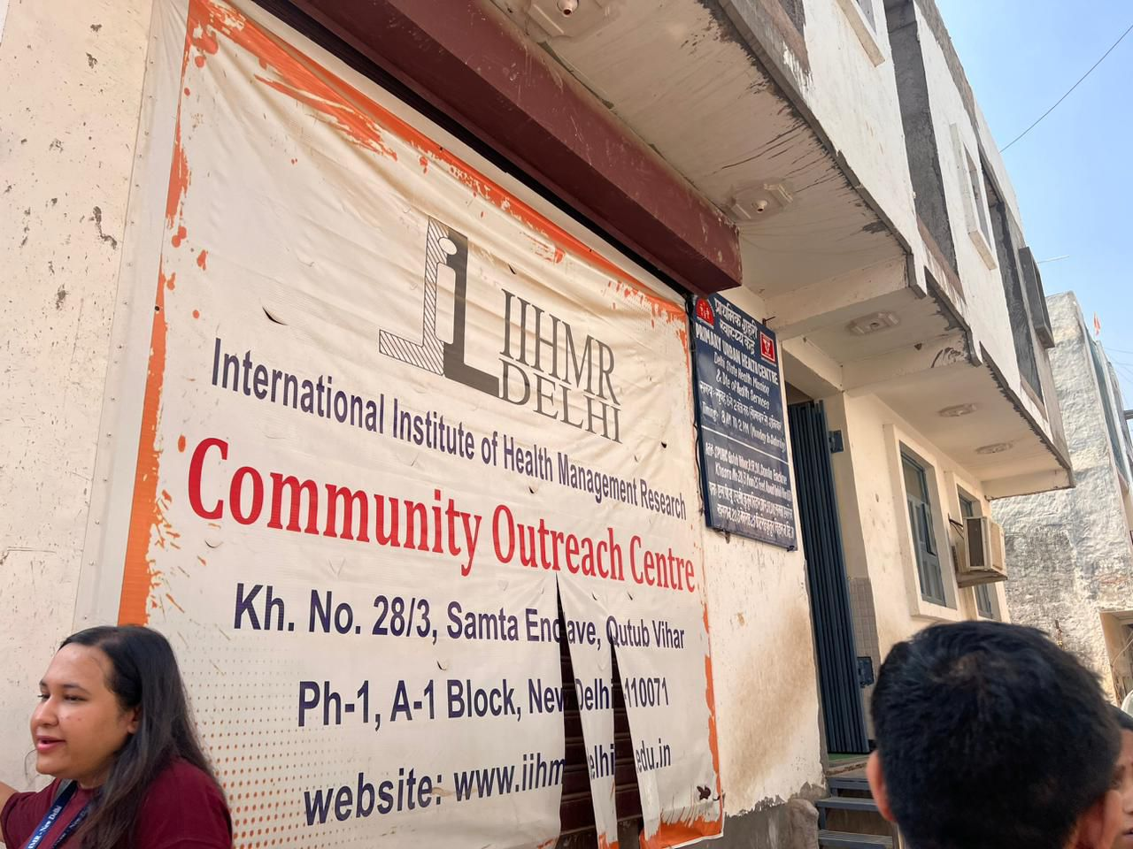

Community Outreach Program- Visit To Goyla Dairy

Slide 20
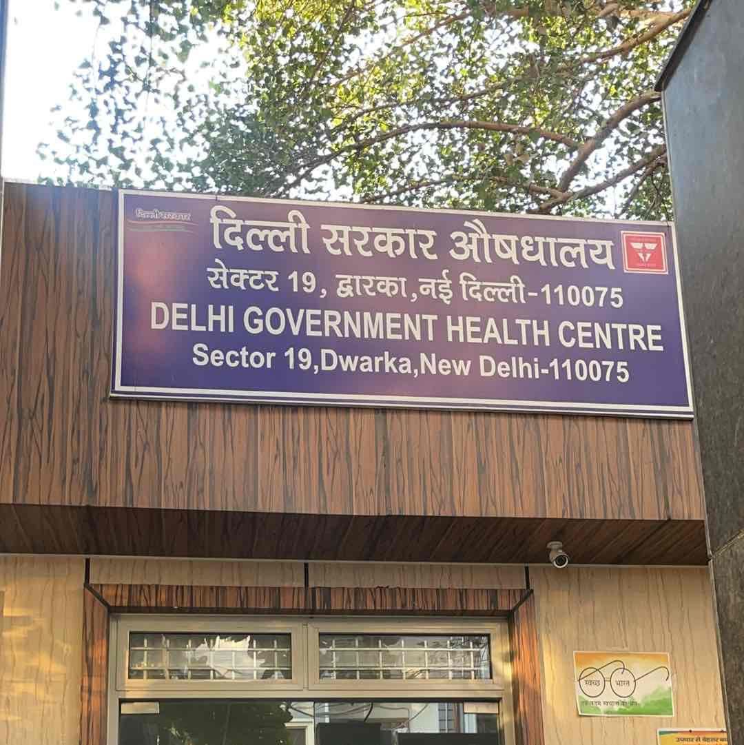
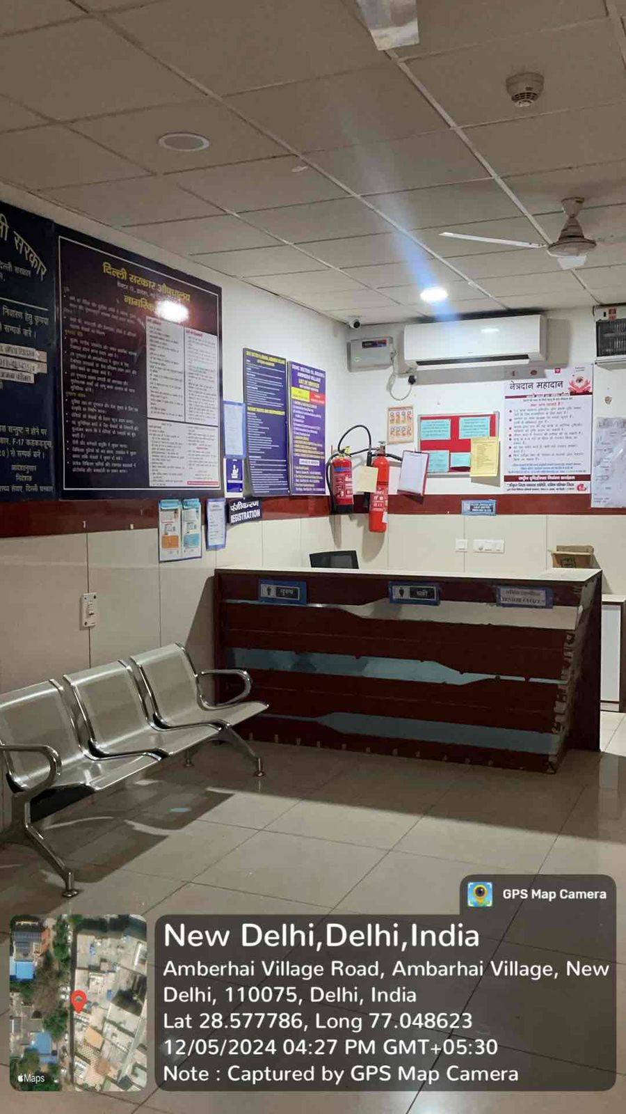
HEALTH & WELLNESS CENTRE

Slide 21
Thank You

