Slide 1



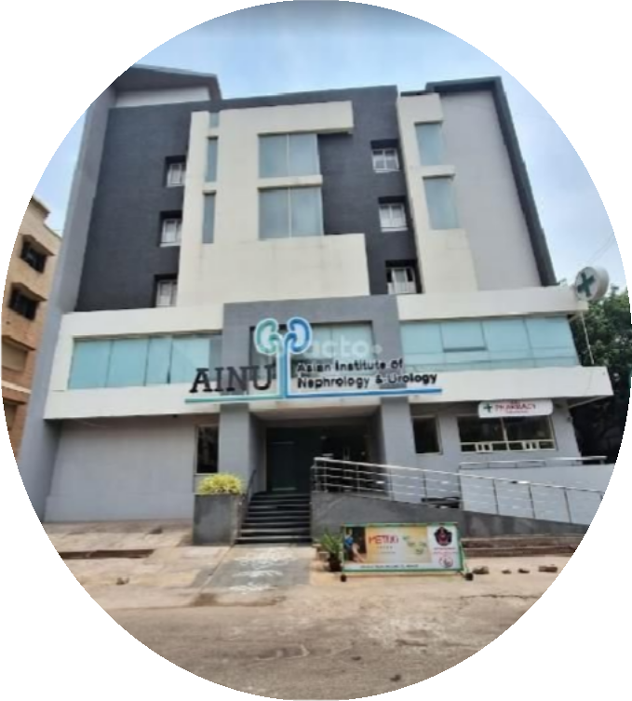
EVALUATING THE EFFECTIVENESS OF HOSPITAL INFORMATION SYSTEM TRAINING:
A CASE STUDY ON DOCTOR AND NURSE TRAINING FOR OPD REGISTRATION, EMR UTILIZATION, AND INDENTATION MANAGEMENT
HOSPITAL: AINU HOSPITAL, VISHAKHAPATNAM, ANDHRA PRADESH
Presented By: Dr. Manvi Chadha PG/23/057
Faculty Mentor- Dr. Sukesh Bharadwaj
Organization –
PGDM (Hospital and Health Management)
My Healthcare Technologies Pvt. Ltd.
Health IT Batch 2023-25
Mentor –
International Institute of Health Management
Research, New Delhi.
Dr. Ashiya Maharan

Slide 2

Screenshot of Approval from Mentor
2

Slide 3




Introduction
Research Objective
To evaluate the effectiveness of Hospital Information System (HIS) training provided to doctors and nurses at AINU Hospital, Vizag, with a focus on system usage, adoption, and impact on day-to-day clinical operations.
Public Health Context
Efficient use of HIS is essential for improving healthcare delivery, reducing medical errors, and ensuring continuity of care—key components in strengthening the public health infrastructure and patient safety initiatives.
Project Summary
Methodology
The study will use a mixed-methods approach, including surveys and observational assessments, to gauge the proficiency of healthcare professionals in using HIS modules such as OPD registration, EMR documentation, and indentation management.
Expected Outcomes
The research aims to identify training gaps, highlight best practices, and recommend improvements in HIS training programs to boost user adoption, enhance workflow efficiency, and ultimately improve the quality of patient care.
Key words: Hospital Information System(HIS), Electronic Medical Record(EMR), Workflow Efficiency, Patient Care Improvement
3

Slide 4

Objectives
Research Question
How effective is the HIS training in improving performance and reducing errors in OPD registration, EMR use, and indentation?
Primary objective
Secondary objective
Evaluate the effectiveness of HIS training for doctors and nurses at AINU Hospital, Vizag Unit.
To identify the challenges faced by doctors and nurses in implementing HIS functions post-training & post-live.

Slide 5
Methodology
Research design
Type of Research
A cross-sectional design is used, where data is collected at a single point in time to assess the impact of HIS training on doctors and nurses.
Inclusion Criteria: All the in-house doctors and full- time working nurses.
Exclusion Criteria: Part-time/ On-call doctors and any new joinee post training.
1
Primary Research
The study employs a mixed methods approach, integrating both quantitative and qualitative data to evaluate the immediate outcomes of HIS training.
2
Duration of Study
3
The study includes 22 healthcare professionals (full- time doctors and nursing staff), specifically those involved in HIS-based daily tasks.
Data analyzed one month after training to measure short-term impact.
Research Objective
To evaluate the effectiveness of HIS training among healthcare professionals at AINU Hospital, Vizag, and identify improvements in HIS usage, system usability, and workflow efficiency.
4
Mode of Data Collection
Data is collected using:
Pre- and Post-Training Surveys
Training Feedback Survey
This includes both structured quantitative questions and open-ended qualitative feedback.
5

Slide 6
Results (1/5)
Data Analysis
Demographic Characteristics:
a) Experience - 9% Less than a year, 18% 1-3 years of experience, 31%
Data was collected using Google Forms and analyzed using Microsoft Excel for both quantitative interpretation and visual representation.
3-5 years of More than 5 years of
experience, 42% experience
b) Specialization - Nephrologists.
The study analyzed responses from a sample professionals, including both in- house doctors underwent HIS training.
of 22 healthcare and nurses who
67% Urologists, 33%
Survey questions were designed to evaluate the participants’ knowledge, system usability experience, and practical application of HIS functionalities post-training.
Knowledge about Hospital Information System (HIS):
Usability with HIS- 82% respondents have had an exposure to using a Hospital Information System, before the training
Familiarity with features of an HIS- 27% Prescription making, 33% Diagnosis and entering order sets, 18% Managing patient history, 9% viewing test results and previous records, 21% Navigating the HIS dashboard for patient consultations
The analysis aimed to determine the effectiveness of the HIS training in improving platform understanding, adoption, and workflow efficiency among clinical staff.
Exclusion Criteria: Part-time/ On-call doctors and any new joinee (doctor &/or nurse) post training.

Slide 7
Results (2/5)
How many years of experience do you have?
6 responses
0
Specialty
6 responses
Have you used a Hospital Information System (HIS) before this training?
22 responses
1
1
0
4
4
Less than a year 3-5 years
1-3 years
More than 5 years
2
Nephrology Urology Other
How many years of experience do you
have?
16 responses
Less than a year
1-3 years
4
3
2
3-5 years
18
4
More than 5 years
Yes No
7

Slide 8
Results (3/5)
Perceptions Toward HIS Usage:
Perceived Training Impact: 72% of respondents reported that the training was very effective in helping them understand and use the HIS platform for clinical functions such as prescription entry and order placement.
Confidence in Using HIS: A majority of trained staff expressed increased confidence in handling patient prescriptions and raising indent requests post-training.
Practices Related to HIS Functionality:
Prescription & Order Efficiency: Over 60% of respondents observed improved accuracy and reduced time in prescription writing and order management after undergoing the training.
Usage Frequency: More than half of the doctors and nurses reported regular use of the HIS for these tasks post-training, indicating increased adoption.
Statistical Analysis:
Correlation Observation: A positive association was noted between prior digital literacy and ease of adapting to HIS modules, particularly among younger staff.
How do you enter patient's diagnosis in HIS?
6 responses
How easy was it to learn and use HIS for daily tasks? (Post- Implementation)
16 responses
1
2
Very difficult
1
Somewhat difficult
2
3
Neutral
0
Manually writing each time
Somewhat Easy
Using order sets/ templates
5
Copying previous enteries and modifying them
Very Easy
8

Slide 9
Results (4/5)
(Doctor’s Pain points)
Can you view and modify patient demographic details within HIS?
6 responses
1 1
What challenges do you
still face after HIS tr i^{S}n^{lo}i^{w}ng^{sy}?^{stem}
How easily can you add medications to a
a
patient’s prescription? (Before & After
6 responses
response
Training)
6 responses
Manually enter every time
4
Yes, easily
Somewhat, with difficulty No
0
Navigation between screen is not intuitive
1
Use saved favorites
2
How many years of experience do you have?
2
2
Difficulty in entering data quickly
Use a combination of manual entry and saved favorites
6 responses
0
1
1
2
3
4
5
2
0
Lack of customizatio n for personal prefernces
3
2
3

Slide 10
Results (5/5)
(Nurses' Pain points)
How easy was it to learn and use HIS for daily tasks? (Post-Implementation)
0
16 responses
Very Easy
Nursing Clearance Before Discharge ( Pre-HIS Implementation (Manual Process))- Handwritten in patient files : PRE & POST IMPLEMENTATION
3
2
Somewhat Easy
Neutral
Which feature of HIS improved your work efficiency the most?
16 responses
4
Somewhat Difficult
Very Difficult
16 responses
1
2
3
4
5
0
4
7
2
2
11
What were the biggest challenges faced before HIS implementation?
16 responses
7
1
1
Paper-Based records were difficult to manage
Medication errors due to Manual indenting
3
2
Did HIS reduce your overall documentation workload?
16 responses
0
5
4
Slow patient record retrieval
Quick Vital Entry
Medication Indent and tracking Easy acess to past patient records
Digital documentation and progress notes Nursing clearance automation
Yes No
Somewhat
2
Time -Consuming nursing clearance process
4
5
9

Slide 11
Discussion (1/2)
Baseline HIS Experience
All participants had prior exposure to the Hospital Information System (HIS), providing a foundational familiarity that enabled a focused assessment of training impact.
Diagnosis Entry Pattern
Before training, 100% of users entered diagnoses manually for every case, indicating underutilization of tools like order sets or saved templates
Pre – Training
(Doctors & Nurses)
Workflow Challenges
Many respondents faced difficulties with critical workflows such as raising admission/surgery requests and ordering medications, reflecting gaps in system navigation skills.
System Usage Barriers
Manual dependency and lack of awareness about available HIS features limited efficiency and consistency in prescription and order management.

Slide 12
Discussion (2/2)
Diversified Diagnosis Entry
After training, users adopted varied strategies: 34% began copying and modifying past entries, 33% continued manual input, and 33% started using order sets, indicating improved system utilization.
Perceived Workflow Efficiency
A strong 74% of respondents rated the training as a 4 or 5-star improvement in workflow efficiency, confirming the training’s positive impact on daily clinical operations.
Post – Training
(Doctors & Nurses)
Ongoing Challenges
Despite gains, 33% reported issues with non-intuitive system navigation, while 28% faced customization limitations, suggesting room for UI/UX and functional enhancements.
Improved System Confidence
Post-training, doctors and nurses demonstrated increased confidence and consistency in using HIS for documentation, prescribing, and order placement— addressing earlier functional bottlenecks.

Slide 13

Limitations of Research Study
Resource Constraints
Sampling Bias
The study only includes in- house doctors and full-time appointed nurses, excluding the usage efficiency of on call doctors and new Joines post-training.
Participants may overestimate or underestimate their knowledge due to social desirability or recall bias.
Findings may not be applicable to healthcare professionals with different socio-cultural contexts.
The study captures data at a single point in time, not reflecting changes over time.
Question framing may influence responses, and the survey may not cover all relevant factors comprehensively.
Non-participants might have different knowledge and awareness levels not captured in the study.
Differences in language proficiency or understanding of medical terms might affect response accuracy.
10
1
Data Collection
Method
Self-Reporting Bias
9
2
Cultural Sensitivity
8
Limitations
3
Limited Generalizability
7
Language and Communication
Barriers
4
6
5
Cross-Sectional Design
Non-Response
Bias
Survey Design

Slide 14
Conclusion
The study highlights the successful implementation of the MyHealthcare HIS platform, with users expressing overall satisfaction with its performance and features.
Users appreciated the system’s ability to simplify key operations such as patient registration, billing, and document storage, indicating improved workflow efficiency.
The training sessions were well-received for their clarity, interactivity, and the expertise of the trainers, all of which contributed to effective learning.
The combination of a user-friendly system and well-structured training significantly enhanced users’ confidence and readiness in utilizing the HIS in daily clinical practice.

Slide 15
References
Trikha S, Arora B, Sharma M, Thakur P. Implementing e–Upchaar: Hospital Management Information System for public health facilities in Haryana. Electron physician [Internet]. 2020 Jun 25 [cited 2025 Jun 23];12(2):7694–702. Available from: http://www.ephysician.ir/index.php/browse-issues/12/2/1169-7694
Alharaibi MA, Alhifany AA, Asiri YA, Alwhaibi MM, Ali S, Jaganathan PP, Alhawassi TM. Prescribing errors among adult patients in a large tertiary care system in Saudi Arabia. Ann Saudi Med. 2021;41(3):147–156. doi:10.5144/0256- 4947.2021.147.
Kumari N, Suresh Kumar PK. A case study on acceptance of hospital information systems (HIS) among nurses in a tertiary care hospital. Int J Case Stud Bus IT Educ (IJCSBE). 2023;7(3):149-161. doi:10.5281/zenodo.8187284.
Pai MMM, Ganiga R, Pai RM, Sinha RK. Standard electronic health record (EHR) framework for Indian healthcare system. Health Serv Outcomes Res Method [Internet]. 2021 Sep [cited 2025 Jun 23];21(3):339–62. Available from: https://link.springer.com/10.1007/s10742-020-00238-0

Slide 16

Involvement in Community Outreach Programme (COP) Activities
Total no. of visits done by the Student: 1
Total number of days spent on client site: 20 days
Day-wise activities done by the student:
Day 1 to Day 10 – Pre live training to the doctors and nurses
Days 11 to Day 20 – Post live support to doctors and nurses

Slide 17
INVOLVEMENT IN COMMUNITY OUTREACH PROGRAMME (COP) ACTIVITIES
Identified System Utilization Gaps:
Initial interactions within the Community of Practice (CoP) revealed critical inefficiencies in HIS utilization, including a reliance on manual data entry, underuse of order sets, and frequent disruptions in clinical workflows.
Enhanced Adoption Through Peer Learning:
Collaborative peer discussions facilitated knowledge exchange, enabling users to uncover advanced system functionalities such as favorites and templates, thereby promoting smoother adoption and minimizing resistance to digital workflows.
Need for Tailored Training and Support:
Participants highlighted the importance of customized training interventions, emphasizing the need for role-specific modules, improved system navigation, and a more responsive user interface to support clinical efficiency.

Slide 18

COP FIELD ACTIVITIES PHOTOGRAPHS

Slide 19

PICTORIAL JOURNEY

Slide 20












