Slide 1


‘Seeds of Sustainability: Positioning Millets at the Core of Planetary Health Agenda’ at
National University of Singapore
Presented by Dr. Angelica Singh, PG/23/017
Mentors: Dr. Anandhi Ramachandran, Dr. Ratika Samtani, Dr. Ramon Lorenzo Luis Rosa Guinto
IIHMR, Delhi

Slide 2

Mentor Approval

Slide 3
Introduction
Millets, a group of ancient drought-resistant cereals, have been cultivated for over 5,000 years across Asia and Africa. In India, they were traditionally staple grains until the Green Revolution's focus on high-yielding rice and wheat varieties led to a significant decline in millet cultivation. However, global and national conversations around climate change, food security, and sustainable agriculture have reawakened interest in millets due to their extraordinary agronomic and nutritional profiles.
They’re grown in arid and semi-arid regions of India. Nutritionally, they are rich in protein, fiber, iron, calcium, zinc, and antioxidants making them highly suitable to address India’s dual burden of malnutrition and rising non-communicable diseases. Their low glycemic index also supports diabetes management and cardiovascular health. Millets were rebranded as “nutri-cereals” in 2018 under NFSM, enabling targeted support through central and state schemes.
To create domestic and global demand and to provide nutritional food to the people, Government of India had proposed to the United Nations for declaring 2023 as ‘International Year of Millets’ to increase the production and promotion of millets. The proposal of India was supported by 72 countries and United Nation's General Assembly (UNGA) declared 2023 as International Year of Millets on 5th March, 2021 (MoA&FW, 2023).

Slide 4
Introduction
Nutritional advantage- Nutritionally, millets provide a rich source of macronutrients and micronutrients. ICRISAT (2022) reports that millets contain 7-12% protein, 2-5% fat, 65-75% carbohydrates, and 8–15% dietary fiber, making them effective in combating malnutrition, especially among vulnerable populations like children and pregnant women. Finger millet, for instance, is rich in calcium and has been linked with reduced risks of osteoporosis, anaemia. Theyre gluten- free: ideal for patients with celiac disease.
Environmental advantage- They are highly adaptive to heat and drought, owing to their C4 photosynthetic pathway, deep root systems, and short cropping cycles. According to FAO (2022), their water requirement is only 300-500 litres per kilogram compared to rice’s 3,000-5,000 litres. They require fewer fertilizers and pesticides, reducing both input costs and environmental damage
Economic importance- Economically, millets can enhance farmer incomes due to their lower cultivation costs and increasing demand in health-conscious urban markets. Studies have shown that replacing rice with millets in the Public Distribution System (PDS) could reduce economic costs by over ₹900 crore for the government while improving nutritional outcomes (ICRISAT, 2021). Government support through MSP, subsidies, and millet inclusion in public schemes enhances their market viability. Overall, millets contribute to rural livelihoods, value addition, and economic resilience in climate-vulnerable regions.

Slide 5

Criticisms of Millets
Antinutrients in Millets- they contain compounds like phytates, tannins, saponins, and enzyme inhibitors that can reduce the absorption of key minerals such as iron, calcium, and zinc.
These substances may also interfere with digestive enzymes and thyroid function, especially in individuals with hypothyroidism, as certain polyphenols like apigenin and luteolin disrupt iodine uptake. Moreover, these compounds are heat-resistant, remaining active even after cooking. Hence, excessive millet consumption may not be suitable for individuals with hypothyroidism.
However, processing techniques such as milling (grinding grains into flour), decortication (Removing outer seed coat), soaking, germination, fermentation, boiling, and roasting significantly reduce these antinutrients and enhance bioavailability of essential minerals.
Seasonal Suitability:. ‘Bajra and jowar are often recommended for winter diets because they provide warmth and sustained energy release, which is especially beneficial in colder climates.’ - (ICMR-NIN, 2022). Millets such as ragi (finger millet) and foxtail millet are traditionally consumed during the summer months as they are considered cooling and easy to digest, especially when prepared as porridge or upma.
Processing Challenges: Processing millets is complex and labor-intensive due to their grain structure and limited mechanization. These challenges raise costs, reduce product variety, and constrain millet consumption, particularly in urban and low-income settings. Poor infrastructure, inconsistent quality, and limited market presence make them less accessible and underutilized.

Slide 6

Challenges and Barriers in Millet Adoption and Consumption
Sensory Acceptance and Culinary Adaptability- Millets possess a naturally coarse texture and an earthy flavor, which differ significantly from the more refined taste of polished rice and wheat. Encouraging the development of millet-based ready-to-eat products such as cookies, noodles, pasta, and porridge is a strategic approach to enhance millet consumption.
Limited Shelf Life: One such challenge is the limited shelf life of varieties like jowar and bajra, which have high lipid content and are prone to rancidity during storage (ICRISAT, 2021). This makes it difficult to store, transport, and integrate millets into the Public Distribution System (PDS). To address this, it is crucial to invest in cold chain logistics and develop airtight, moisture-resistant packaging.
Low Agricultural Yields: Yields are lower than rice/wheat, discouraging farmers. Promote R&D for high-yielding millet varieties and support farmers through MSP, subsidies.
Inadequate Processing Infrastructure in Rural Areas: Lack of rural processing units leads to manual labor and inefficiency. Setting up decentralized units, train SHGs/FPOs for value addition, and boost rural processing capacity.
Policy Legacy and Procurement Bias: Green Revolution-era policies favor rice and wheat, marginalizing millets in procurement. Reforming public procurement policies to include millets under the PDS and ensuring consistent MSP coverage would be essential. Reframing policies around nutrition-sensitive agriculture.
Lack of awareness- on the benefits of millet consumption.

Slide 7

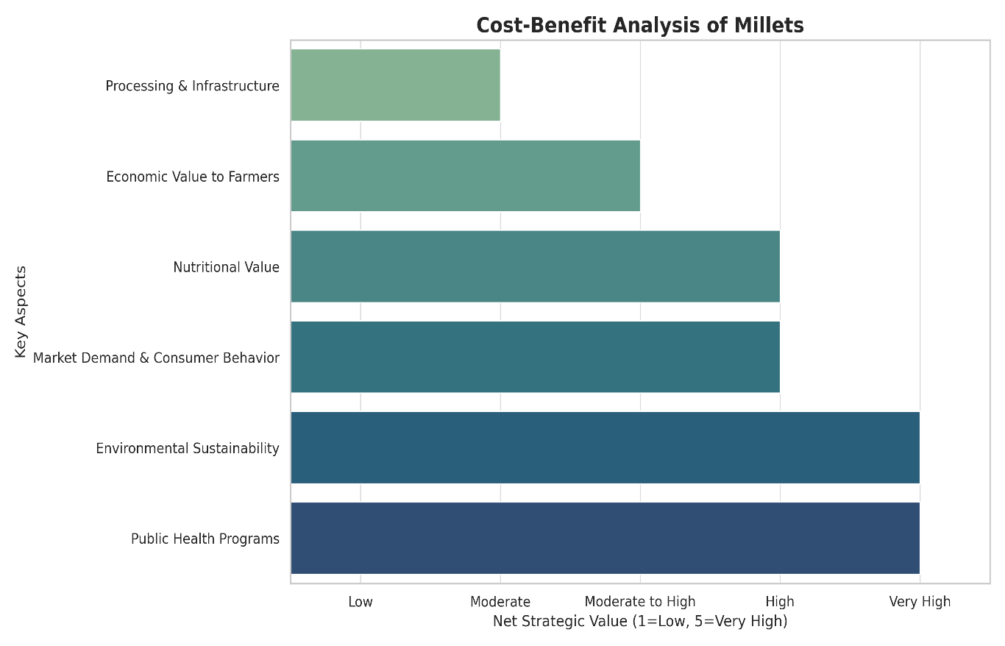
Cost-Benefit Analysis of Millets

Slide 8
Rationale
Climate and Health Nexus: Millets, being climate-resilient crops, present a sustainable solution to dual global challenges- climate change and malnutrition making them a critical area of study within the planetary health paradigm.
Underutilized Potential: India is the largest producer of Millets in the world and accounts for 38.4% of the world’s millet production, but is underutlilized due to Policy bias, Lack of processing and storage infrastructure, lower government procurement & incentives and lack of consumer awareness.
Leveraging Policy for Systemic Transformation This study is rooted in the recognition that policy- not just production or promotion is the most powerful lever for mainstreaming millets. Existing literature tends to focus on agronomic or nutritional aspects in isolation, without unpacking the "how," "why," and "who" of millet policymaking and implementation. The study focuses on the policy analysis of Millet related polices in India using structured frameworks and to identify critical policy gaps.

Slide 9
Research Objectives
To analyse the contextual factors (environmental, economic, and nutritional crises) that have influenced the policy prioritization of millets in India.
To examine the content and components of India’s millet policies and assess their alignment with sustainability, nutrition security, and biodiversity conservation.
To trace the evolution and implementation mechanisms of millet-related policies at national and state levels from 2017 to 2025.
To identify and understand the roles and interests of key actors involved in shaping, promoting, and implementing millet policies in India.

Slide 10
Research Methodology
1. Research Design
A qualitative policy analysis approach was adopted using the Policy Triangle Framework to examine millet-related policies in India.
The framework analyzes four dimensions- Context, Content, Process, and Actors through corresponding research questions to ensure a structured and comprehensive analysis.
2. Data Collection Method
A structured literature survey was conducted across official government portals and databases such as PubMed, Scopus, and Google Scholar using MeSH (Medical Subject Headings).

Slide 11
Research Methodology
Keywords and search terms used includes: ‘Millet policies in India,” “National/International Year of Millets,” “POSHAN Abhiyaan,” “Public Distribution System and Millets,” “Production Linked Incentive Scheme,” etc.
The literature was then synthesized using the Policy Triangle Framework, offering a multi-dimensional view of millet policymaking in India.
3. Sources of data
A secondary data collection method is used, focusing on academic and policy literature.
Sources include- Scholarly publications accessed through platforms such as PubMed and Google Scholar.
Government reports and official documents issued by institutions such as the Ministry of Agriculture and Farmers' Welfare ( MoAFW), NITI Aayog, National Food Security Mission (NFSM), Ministry of Health and Family Welfare (MoHFW), and Indian Council of Agricultural Research (ICAR).

Slide 12
Research Methodology
Publications and reports from international organizations, including the Food and Agriculture Organization (FAO), National Bank for Agriculture and Rural Development (NABARD) United Nations Development Programme (UNDP), International Fund for Agricultural Development (IFAD).
Grey literature such as working papers, research briefs, and case studies.
Media reports and feature articles from reputed national publications such as The Hindu, The Indian Express, and Down To Earth.
Statistical databases including AgriStat, FAOSTAT, IndiaStat, and datasets from the Ministry of Statistics and Programme Implementation (MoSPI).

Slide 13
Research Methodology
Inclusion Criteria:
Timeframe: 2017–2025 (National & International Year of Millets)
Geography: India (focus on Karnataka, Odisha, Chhattisgarh, Tamil Nadu, Andhra Pradesh, Telangana)
Policy Types: Agriculture, nutrition, and climate-linked millet policies (MSP, PDS, POSHAN Abhiyaan, PMFBY, ICDS)
Exclusion Criteria:
Policies outside India or prior to 2017 (unless still active)
Non-policy academic or agri-tech innovations
Consumer surveys unrelated to formal policy mechanisms

Slide 14
Data Analysis
Analytical Approach:
  Thematic Analysis: Coding of policy content based on the four domains of the Policy Triangle Framework (Walt & Gilson, 1994) to guide its policy analysis. The four domains- Context, Content, Process, and Actors- are mapped to the following research questions, as shown-
  Narrative Synthesis: Comparison of policy intentions versus outcomes.
  Mapping Tools: Creation of a stakeholder map and SDG-Millet Diagram and Venn diagram to visualize policy alignment with sustainability goals.
  Gap Analysis and Recommendations: Identifying disconnects between policy ambition and implementation and suggest recommendations for the same.

Slide 15
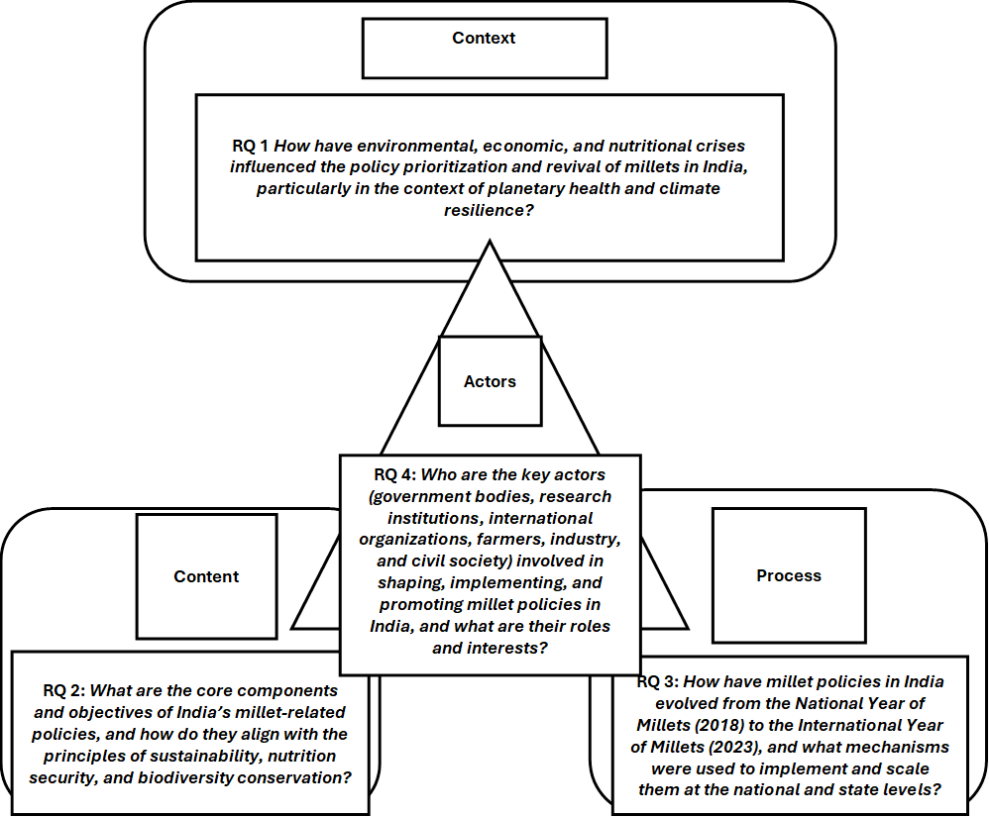
Policy Triangle Framework

Slide 16
Results
National Policy Milestones
- National Year of Millets, 2018: Declared by Government of India to revive millet discourse.
- International Year of Millets, 2023: Global advocacy led by India at FAO; milestone year for inter-ministerial mobilization.
Millets included in key schemes:
  Public Distribution System (PDS) - Jowar, bajra, and ragi have been progressively integrated into the Public Distribution System (PDS) since 2018 in selected states, as part of millet mainstreaming initiatives. Before 2018, PDS primarily focused on Rice and Wheat.
  POSHAN Abhiyaan- Promotes millets in child nutrition and anemia control.
  Mid-Day Meal (MDM) and ICDS - Pilot millet-based meals in schools and anganwadis.
  Pradhan Mantri Fasal Bima Yojana (PMFBY) - Insurance extended to select millet crops.
  Minimum Support Price (MSP) - Declared for 7 millets; highest for ragi and bajra.

Slide 17
Results
State-Level Innovation Models
Odisha Millets Mission (OMM): Decentralized procurement, tribal empowerment, recipe revival.
Karnataka Millet Strategy: Urban millet cafés, organic-millet policy convergence.
Chhattisgarh Millet Mission: Tribal-focused, FPO-led aggregation, school-level nutrition.
Andhra Pradesh Millets Board Act (2023): First legislative body dedicated to millets.
Telangana & Tamil Nadu: Mini-missions promoting Millet R&D and distribution.

Slide 18
Results
Unpacking Millet Policy Through the Policy Triangle Framework-
RQ1: Context – Crises Converging on a Solution
India’s millet revival is driven by triple crises: environmental degradation, nutritional deficiencies, and smallholder distress.
Green Revolution led to groundwater depletion and soil degradation; millets offer a climate-resilient, low-input alternative.
Rising NCDs and under-nutrition prompted the 2018 reclassification of millets as ‘nutri-cereals’.
India's leadership in International Year of Millets (2023) signifies global recognition.
However, deep-rooted bias toward rice-wheat monocultures still hampers millet mainstreaming.

Slide 19
RQ2: Content – Evolving Millet Policy Framework
India's millet policies cover five core areas:
  Reviving cultivation (seeds, training, NFSM inclusion)
  Nutritional integration (PDS, MDM, POSHAN Abhiyaan)
  Value chain development (PLISMBP, FPO support)
  Biodiversity conservation (diverse millet varieties)
  Research & innovation (ICAR, IIMR, state universities)
Implementation gaps remain in urban demand, R&D funding, and procurement mechanisms.
RQ3: Process – Policy Formulation and Implementation
The National (2018) and International (2023) Years of Millets catalyzed systemic momentum.
Policy rollout combines top-down (PDS, ICDS) and bottom-up (state missions) approaches.
Innovative pilots in Odisha, Karnataka, Chhattisgarh demonstrate decentralized, tribal-led models.
Behavioural campaigns, millet expos, and recipe contests support urban consumer engagement.
Cross-sector partnerships with NGOs, startups, and processors strengthen innovation and adoption.

Slide 20
RQ4: Actors – Multi-Stakeholder Ecosystem
Government ministries:
  MoA&FW (production, procurement),
  MoWCD ( Ministry of Women and Child Development) & MoHFW (nutrition schemes),
  MoFPI ( Ministry of Food Processing Industries) & APEDA (processing, exports),
  FSSAI (standards, awareness)
ICAR & IIMR: R&D, varietal development, biofortification, post-harvest tech
Nutrihub: Incubated 350+ startups, launched 120 millet-based products
State Governments: Context-sensitive missions (Odisha, Karnataka, AP)
Farmer Producer Organizations (FPOs): Aggregation, processing, and marketing
NGOs & Civil Society (e.g., WASSAN): Community mobilization, grassroots revival
Private Sector: Startups like ‘Slurrp Farm’ and ‘Nourish You’ shift millets to aspirational health spaces.

Slide 21
Identified Policy Gaps and Recommendations:
:
Policy Gap Identified | Recommendation | Target Stakeholders
Limited procurement of millets under PDS despite inclusion in NFSA | Expand and enforce procurement mandates for millets at both central and state levels; incentivize states through fiscal support for decentralized procurement. | MoCAFPD( Ministry of Consumer Affairs, Food and Public Distribution), State Civil Supplies Departments.
Inadequate processing infrastructure, especially in rural/tribal areas | Establish decentralized millet processing units and common facility centers with SHG/FPO ownership | MoRD, State Rural Livelihood Missions, NABARD, MSME Ministry.
Low consumer awareness and cultural stigma toward millets | Launch national behaviour change campaigns and millet recipe contests; promote millet-based meals in schools, hospitals, and corporate canteens | MoWCD, MoHFW, MoE
Insufficient R&D investment in high-yielding and climate-resilient millet varieties | Strengthen funding for varietal development and bio fortification through ICAR and State Agricultural Universities | ICAR, IIMR, State Agriculture Departments
Poor market linkages and lack of value chain integration | Support millet FPOs with credit, capacity-building, and direct market access; promote contract farming and private sector linkages. Mandate millet products in e-commerce, school canteens, and supermarkets. | SFAC(Small Farmers’ Agribusiness Consortium), APEDA, MoA&FW, State Agriculture Marketing Boards

Slide 22
Limited urban market access and shelf-stable millet products | Incentivize start-ups under PLISMBP; develop millet-based RTE/RTC products using modern packaging technologies. | MoFPI, Nutrihub, Startup India, State Innovation Councils
Fragmented inter-ministerial coordination | Create a National Millet Coordination Taskforce to ensure convergence across agriculture, nutrition, commerce, and education sectors Create a National Millet Coordination Taskforce to ensure convergence across agriculture, nutrition, commerce, and education sectors. | NITI Aayog, MoA&FW, MoHFW, MoFPI, MoWCD
Weak institutionalization of millet policies at the state level | Encourage states to adopt millet-specific legislation or long-term missions like AP Millets Board Act or Odisha Millets Mission. | State Governments, Legislative Assemblies
Lack of data on millet consumption, production, and nutrition outcomes | Integrate millet tracking into NFHS, NSSO, and ICDS-MIS databases to generate evidence for policy advocacy. | MoHFW, MoSPI, NITI Aayog
Millets not adequately mainstreamed in climate-resilient agriculture frameworks | Embed millets within national climate action plans, agrobiodiversity conservation schemes, and regenerative agriculture policies. | MoEFCC, MoA&FW, ICAR
(Source- Developed by author based on analysis of secondary sources including MoA&FW (2023), NITI Aayog (2023), ICAR-IIMR (2022), FAO (2023), FSSAI (2023), and relevant policy reports)

Slide 23
To drive a structured and holistic millet transformation in India, this thesis proposes a dual roadmap, combining strategic policy phases with targeted actions addressing key implementation gaps.
Strategic Policy Roadmap for Advancing Millet Integration into Sustainable Food Systems in India:
Stage | Action Required | Stakeholders | Expected Outcome
Short- Term | Expand decentralized millet procurement | State government, FPOs | More Tribal Millet farmers integrated into PDS
Mid- Term | Invest in Processing & Cold infrastructure | MoFPI, SHGs | Lower post- harvest losses and better product quality
Long- Term | Integrate Millets into dietary guidelines & food labelling laws | FSSAI, MoHFW | Shift in public dietary behaviour and urban adoption
Source: Developed by author based on gaps identified in literature and policy reports from MoA&FW, FAO, and ICAR (2023).

Slide 24
Gap-Based Implementation Roadmap for Millet Mainstreaming in India
Gap Addressed (Linked to table) | Strategic Action Steps | Timeline | Lead Stakeholders
Limited procurement under PDS | Expand decentralized procurement in millet-rich states; update PDS guidelines | Short-term | MoCAFPD, State Civil Supplies Depts
Inadequate processing infrastructure | Set up millet processing clusters with SHG/FPO ownership in blocks | Medium-term | MoRD, NABARD, State Agri. Dept.
Low consumer awareness and stigma | Nationwide behaviour change campaigns (media + school curriculums) | Short-term | FSSAI, MoHFW, MoWCD
Low investment in millet R&D | Allocate dedicated millet research funding; incentivize biofortified & climate-resilient varieties | Long-term | ICAR, IIMR, SAUs
Poor market linkages | Support FPOs with aggregation support and millet-specific marketing platforms | Medium-term | SFAC, APEDA, State Agri. Boards
Lack of shelf-stable millet products | PLISMBP expansion; promote innovation for RTE/RTC millet-based food | Short to Medium | MoFPI, Nutrihub, Startups
Weak inter-ministerial coordination | Form a National Millet Taskforce; create shared monitoring indicators | Immediate | NITI Aayog, MoA&FW, MoFPI
Lack of millet-focused state policies | Encourage state millet missions or legislative boards (e.g. AP model) | Medium-term | State Govts, Legislative Assemblies
Inadequate data on millet consumption and impact | Integrate millet tracking into NFHS, NSS, ICDS-MIS, and PDS dashboards | Medium to Long | MoSPI, MoHFW, NITI Aayog
Poor alignment with climate action frameworks | Incorporate millets in NAPCC, PMKSY, and agroecological policy instruments | Long-term | MoEFCC, MoA&FW, ICAR

Slide 25
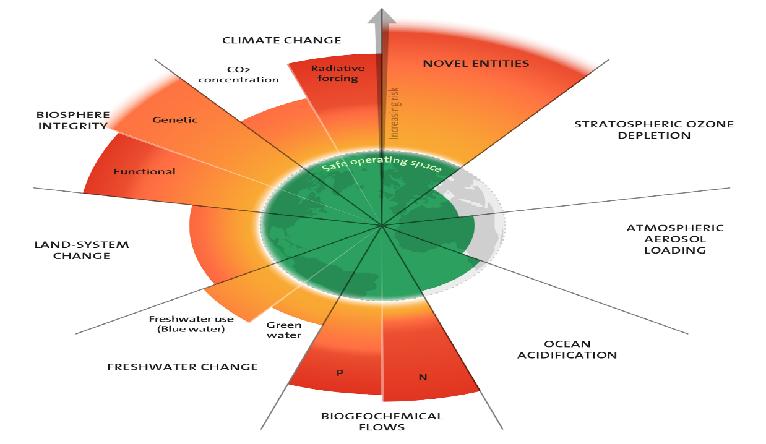
Discussion
To deepen the understanding of how millet integration aligns with global sustainability limits, this study mapped their potential impacts across the Nine Planetary Boundaries proposed by Johan Rockström and 28 other leading scientists in 2009. It defines nine critical Earth system processes that regulate the stability and resilience of our planet, and it sets “safe operating limits” for each to ensure a stable environment for humanity.
The 2023 update to the Planetary boundaries (9 Boundaries assessed and 6 transgressed)-

Slide 26
Discussion
Applying the Planetary Boundaries Framework to Millets
Millets align positively with 8 out of 9 Planetary Boundaries.
Climate Change (+) Lower carbon footprint than rice/wheat; rainfed & carbon-sequestering.
Biosphere Integrity (+): Boosts biodiversity; minimal pesticide use; supports crop diversity.
Land-System Change (+): Grows on marginal lands; prevents deforestation.
Freshwater Use (+): Needs much less water; ideal for rainfed regions.
Biogeochemical Flows (+): Low fertilizer need; reduces nitrogen runoff.
Ocean Acidification (+) : (Less Direct impact) Sustainable millet farming can reduce carbon emissions, indirectly mitigating ocean acidification.
Atmospheric Aerosol loading (+): (Less Direct impact )Indirect benefits via low emissions and sustainable practices.
Novel Entities (Chemical pollution and plastics) (+): Naturally pest- resistant, less pesticide dependence, less use of chemicals.
Ozone Depletion (±): (Minimal direct impact) Millet cultivation has negligible influence on ozone depletion. Avoid the use of ozone-depleting substances in pest control.
Human progress can’t go beyond these ecological limits of Earth's systems without risking irreversible environmental damage. Millets operate within Earth’s safe operating space. This analysis positions millets not merely as nutritional interventions, but as ecological safeguards. Their policy integration is thus both a national priority and a planetary necessity.

Slide 27
Discussion
Voices from the Ground- Empowerment through millets-
Rekha Devi, a Self-Help Group (SHG) member from Kandhamal, reflects on this shift: ‘Before the mission, we barely made enough. Now, I run a millet café with my SHG sisters. We serve health, and we serve dignity.’ (OMM, 2023). Her story is emblematic of how millet policies have created avenues for grassroots women’s empowerment, linking health, dignity, and economic security. As a member of a women's Self-Help Group (SHG) in Kandhamal, Odisha- a tribal-majority district, Rekha was part of an initiative that empowered rural women to take charge of local value chains through millet-based enterprises.
The OMM not only focused on promoting climate-resilient farming of indigenous millets but also prioritized gender-inclusive livelihood development. Through targeted capacity-building, access to revolving funds, community kitchens, and procurement linkages, women like Rekha were able to co-create dignified employment in a sector traditionally marked by marginalization.
Dual Lens Approach: Policy Meets Planetary Health
By weaving together the Policy Triangle and Planetary Boundaries frameworks, this thesis adopts a dual-lens approach to understand what policies exist, how they function, and why they matter. This integration also allows a critical evaluation of whether these policies align with broader planetary health goals and where environmental, social, and economic objectives converge or conflict.
The intersection of policy and planetary health reveals a crucial insight: millets are not merely underutilized- they are under-recognized systems solutions. Their potential lies in creating convergence across ministries, breaking silos between agriculture and health, and anchoring food security in ecological limits.

Slide 28
Mainstreaming Millets: Turning Vision into Action-
1. Scale with Intent
Move beyond pilot projects.
✅ Institutionalize millet programs as long-term, federally supported missions with substantial public investment.
2. Empower the Backbone
Center people, not just products.
✅ Recognize and strengthen the role of SHGs, tribal farmers, and women-led enterprises across the value chain.
3. Close the Accessibility Gap
Bridge awareness with availability.
✅ Integrate millets into retail markets, e-commerce, and public institutions like schools and hospitals to normalize consumption.
4. Redefine Success in Agriculture
Go beyond yields.
✅ Adopt a systems-thinking approach that values resilience, biodiversity, and ecological health over monocultural efficiency.
5. Millets as Catalysts for the Future
These are not relics of the past- they are resilient crops for a climate-challenged world.
Unlocking their full potential requires a bold mindset shift and unwavering policy commitment.

Slide 29
Limitations of the Study and Future Directions
While this thesis draws from rich secondary data, primary fieldwork could further contextualize millet policy implementation. Future studies could explore:
Household-level adoption patterns in millet-promoting states
Longitudinal impact of millet inclusion in PDS and MDM schemes
Comparative frameworks assessing millets in Africa, Southeast Asia.
The Final Word: A Future Rooted in Resilience
India’s millet renaissance has begun, but its future depends on a transformation in how we value resilience, diversity, and equity in food systems. Millets offer a quiet revolution. Whether they stay on the periphery or rise to prominence will depend on policy ambition, planetary awareness, and public will.

Slide 30
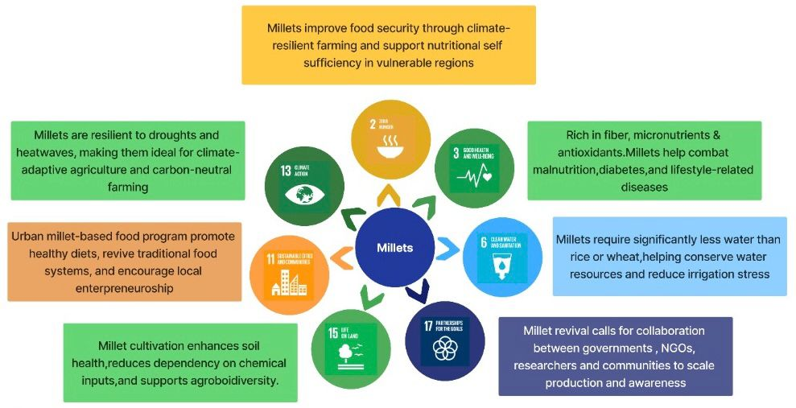
Conclusion
Millets and the Road to Achieving the Sustainable Development Goals: Adopted in 2015, the UN’s 17 Sustainable Development Goals (SDGs) offer a global blueprint for a just, equitable, and sustainable future. Millets have an impact on 7 SDGs out of the 17.
Millets: A Catalyst for Achieving Seven Sustainable Development Goals

Slide 31
With just five years left until the 2030 deadline for achieving the Sustainable Development Goals, time is of the essence. The world stands at a crucial crossroads- our food choices must serve both people and the planet. Millets, with their potential to regenerate soils, nourish communities, and lower our ecological footprint, represent more than just a grain: they are a climate-resilient solution embedded in tradition yet vital for our future.
Millets at the Nexus of Health, Economy, and Environment- As we transition to the next slide, observe how millets form a powerful confluence of nutritional benefits, economic opportunities, and ecological harmony- positioning them as a ‘true supercrop for sustainable development.’ The upcoming Venn diagram(as depicted in the next page) highlights how millets serve as a convergence point for three critical pillars of sustainable development- Health, Economic well-being, and Environmental resilience. Their multidimensional benefits underscore why millets must move from the margins to the mainstream of policy and practice.

Slide 32
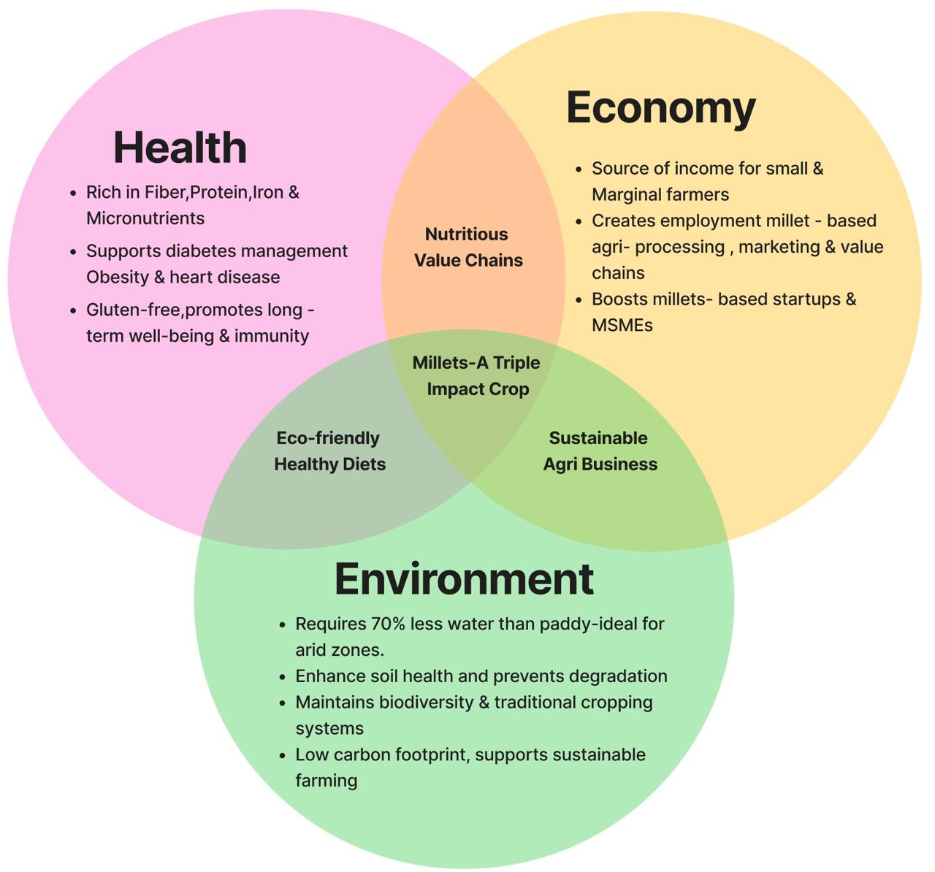
Conclusion
Millets- A Triple Win for Health, Economy and Environment

Slide 33
Conclusion
As we approach 2030, the case for millets has never been stronger or more urgent. This thesis has illuminated how these resilient grains intersect the axes of nutrition, sustainability, and policy reform.
The food system today is a paradox- starved and overfed, fertile and failing. Millets offer more than nourishment; they offer renewal.
They can replenish groundwater, revive soil, and restore dignity to marginalized farmers. This thesis reveals how millets sit at the intersection of health, equity, and ecology.
From the deserts of Rajasthan to the hills of Odisha, they are not just crops- they are cultural resistance and ecological revival. The question is no longer about millets' promise - but our political will to embrace them.
This thesis proves that millets are not just grains, they are policy levers, climate solutions, and justice interventions.
They can heal land, nourish bodies, and empower rural communities -but only if we go beyond pilot projects and fragmented schemes.

Slide 34
The Policy Triangle Framework reveals that while momentum exists, fragmentation persists. A unified National millet mission, backed by integrated supply chains, consumer awareness, and continuous R&D, can turn this tide. The future of food must be climate-resilient, culturally rooted, and nutritionally rich. In this vision, millets are not a relic of the past, they are seeds of our sustainable future.
Millets are not just food, they are systems interventions. They represent an opportunity to create a future where climate resilience, biodiversity, food equity, and economic justice intersect. The real question is not whether millets can solve our problems- but whether our policies and societies are ready to let them.
In this context, the title ‘Seeds of Sustainability’ is not poetic flourish- it is policy truth. Millets represent the very seeds from which ecological renewal, nutritional equity, and rural empowerment can sprout. By positioning them at the ‘core of planetary health agenda’, this thesis offers not an idealistic vision, but an evidence-based imperative. Millets are no longer marginal, they are mission-critical. This framing reclaims their rightful place in the global food discourse- as agents of change in a world hungry for sustainable solutions.

Slide 35
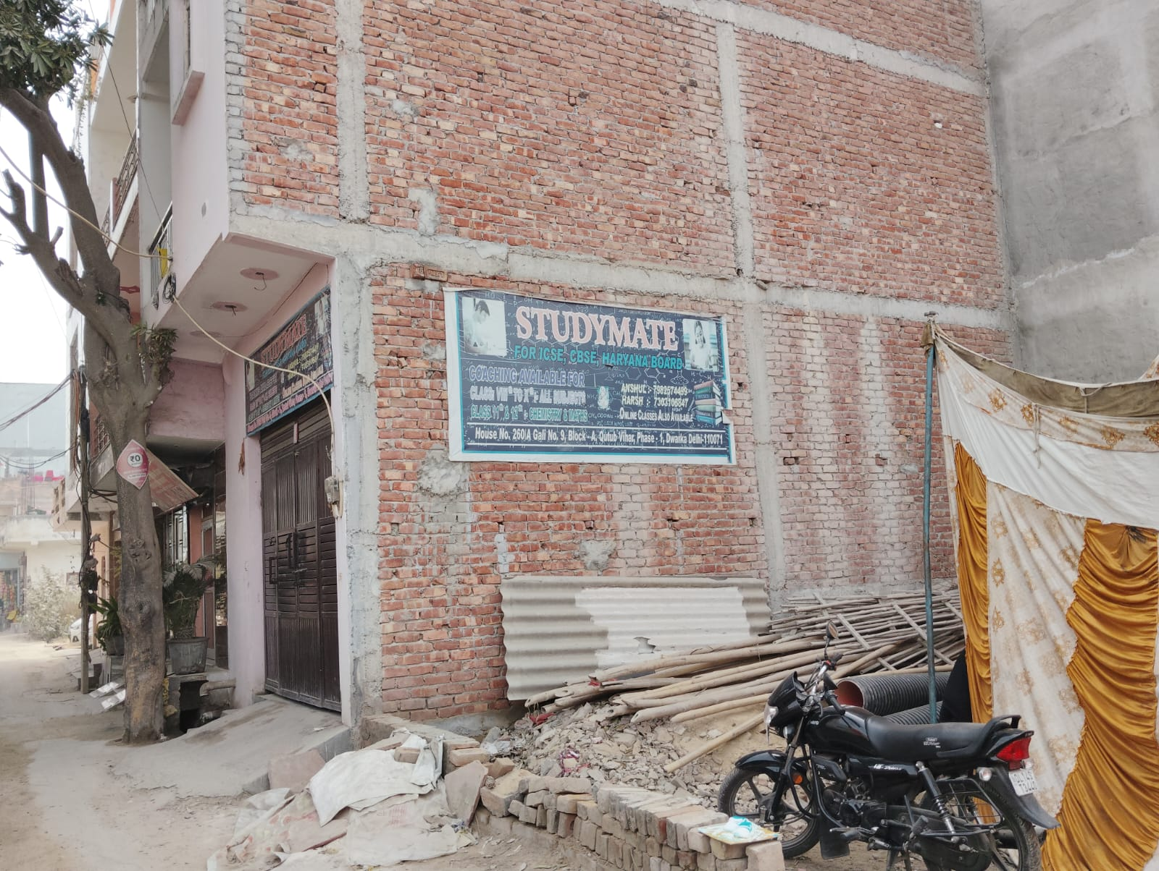
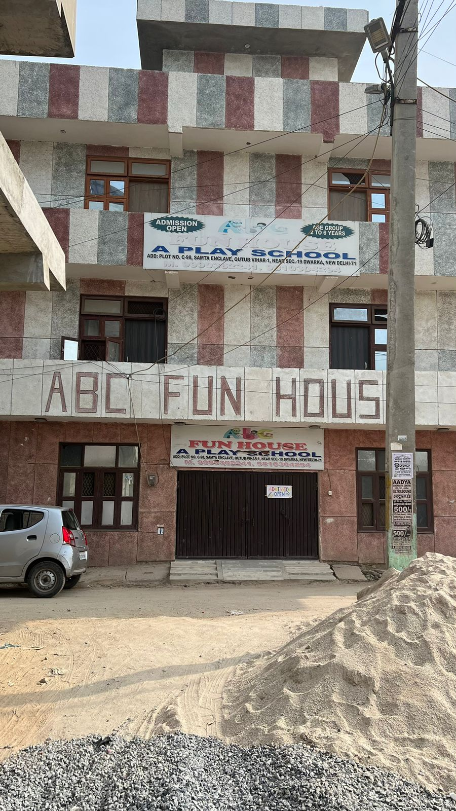
Community Outreach Program Activities

Slide 36
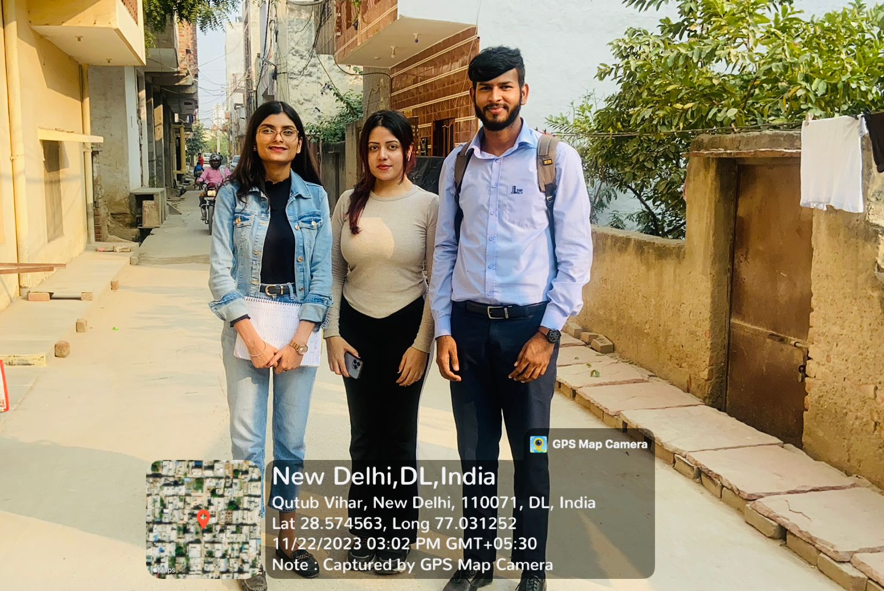
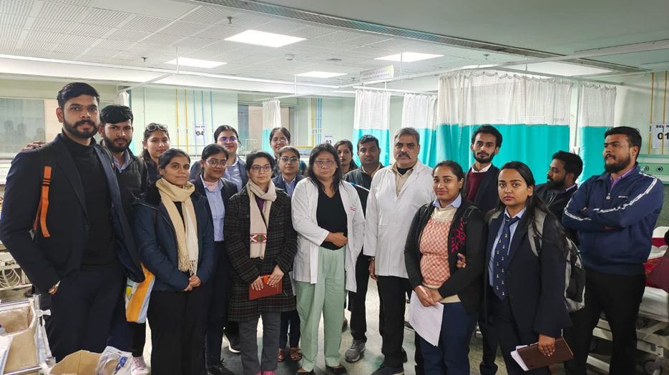
Community Outreach Program Activities

Slide 37
References
Walt, G., & Gilson, L. (1994).
Reforming the health sector in developing countries: the central role of policy analysis.
Health Policy and Planning, 9(4), 353–370.
https://doi.org/10.1093/heapol/9.4.353
Rockström, J., Steffen, W., et al. (2009).
Planetary boundaries: Exploring the safe operating space for humanity.
Ecology and Society, 14(2).
https://www.ecologyandsociety.org/vol14/iss2/art32/
FAO (2023).
International Year of Millets 2023.
Food and Agriculture Organization of the United Nations.
https://www.fao.org/millets-2023/en/
ICRISAT (2022).
Millets: Smart Foods for Nutrition and Climate Resilience.
International Crops Research Institute for the Semi-Arid Tropics.
https://www.icrisat.org/millets-smart-foods/

Slide 38
Ministry of Agriculture & Farmers’ Welfare (2023).
Policy initiatives to promote millet cultivation and consumption in India.
Government of India.
https://agricoop.gov.in/
Strategy Paper on Mainstreaming Millets.
https://www.niti.gov.in/
FSSAI (2023).
Eat Right India Movement – Millet Promotion Guidelines.
Food Safety and Standards Authority of India.
https://www.fssai.gov.in/
ICAR-IIMR (2021).
Indian Institute of Millets Research – Millet Varieties and R&D.
https://www.millets.res.in/
Global Panel on Agriculture and Food Systems for Nutrition (2021).
Future Food Systems: For people, our planet, and prosperity.
https://www.glopan.org/reports/future-food-systems/
Harvard T.H. Chan School of Public Health (2022).
Whole Grains – Millet Nutrition and Health Effects.
https://www.hsph.harvard.edu/nutritionsource/food-features/millet/

Slide 39
Thank You

