Slide 1


Analyzing the gap in follow-up patients at BetterWay Clinic and developing strategies to increase uptake
Presented By: Dr. Muskan Gupta (PG/23/068)
Faculty Mentor- Dr. Nidhi Yadav
IIHMR Delhi

Slide 2
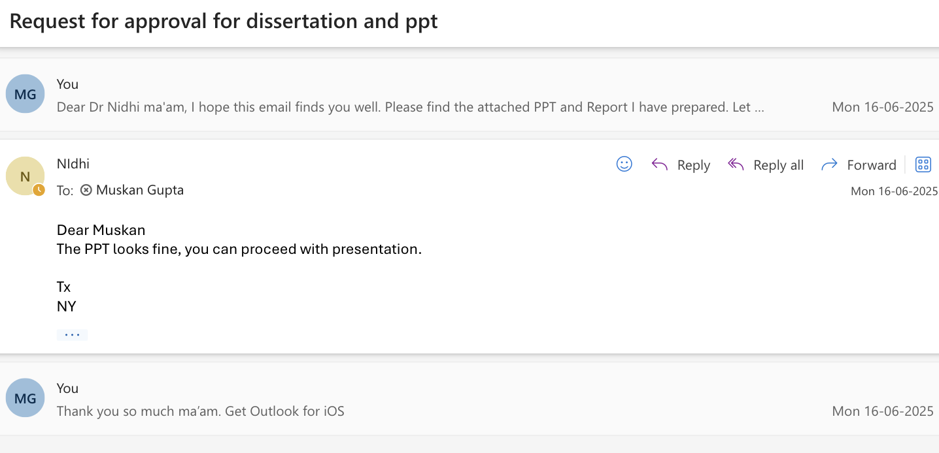
Mentor Approval

Slide 3
Introduction
Continuity of care and consistent patient-doctor interaction are essential components of effective healthcare delivery, particularly in the management of chronic conditions. Regular follow-up visits not only enable timely monitoring and treatment adjustments but also enhance patient trust and engagement in their care journey.
At BetterWay clinic, a significant challenge has emerged in ensuring that patients return for their scheduled follow-up consultations. Internal observations and early data analysis reveal that approximately 50–55% of patients do not adhere to their follow-up timelines. This lapse in continuity can result in disease progression, poor treatment outcomes, and reduced patient satisfaction.
Given the critical role of follow-up care in managing health outcomes, this dissertation aims to investigate the root causes behind missed follow-up appointments and develop evidence-based, patient-centered strategies to increase adherence. Addressing this gap is vital for strengthening care quality and optimizing resource utilization at Betterway.

Slide 4
Introduction
Theoretical Framework: Health Belief Model (HBM) – Rosenstock et al., 1950s
Application: This model helps to explore factors that drive or hinder patient compliance with Ayurvedic interventions.
HBM Component | Ayurvedic Context
Perceived Susceptibility | Belief in body imbalances causing disease (e.g., Pitta aggravation causing acidity)
Perceived Severity | Awareness of chronic disease progression if left untreated
Perceived Benefits | Belief that Ayurveda restores balance and reduces reliance on allopathy
Perceived Barriers | Cost, accessibility of Ayurvedic treatment, or time commitment
Cues to Action | Recommendations by practitioners, family traditions, alternate curative approaches to disease management vs current addictive medication
Self-Efficacy | Confidence in one’s ability to follow Ayurvedic regimens and dietary restrictions

Slide 5
Objectives of the Study
To quantify the percentage of missed follow-up appointments among BetterWay patients over the past 3 months (October- December’24).
To identify key factors contributing to missed follow-ups
To develop data-driven and practical strategies to increase follow-up visit uptake.

Slide 6
Research Questions
What are the primary reasons patients do not return for follow-up visits?
How can BetterWay clinic implement cost-effective strategies to enhance follow-up visit rates?

Slide 7
Methodology
Study Design: A mixed-methods approach using both qualitative and quantitative data collection.
Sample size- 150 patients who have chronic diseases and discontinued post first time consultation and fail to come for next follow up. In duration from Oct’24 to Dec’24.
Sampling Technique- Stratifying sampling was used to include only those chronic care patients at BetterWay clinic who missed follow-up visits, ensuring relevant and focused data for understanding the reasons behind non-adherence.
Stratifying Sample- Patients who have chronic disease and-
Taken first time consultation
Taken first time consultation + Diet and lifestyle
Taken first time consultation + Diet and lifestyle + Post care connect

Slide 8
Methodology
Inclusion Criteria
Patients (18+ years) registered with BetterWay
Chronic disease patients
Have missed all follow-up within the past 3 months.
Exclusion Criteria
Patients with cognitive impairments that hinder communication
Patients currently undergoing hospitalization.
Data Collection:
Interviews with patients to understand barriers to follow-up.
Analysis of BetterWay records to determine trends in missed follow-ups.
Data Analysis: Statistical analysis of quantitative data and thematic analysis of qualitative insights using Microsoft excel.
Ethical Considerations
Informed consent will be obtained from all participants.
Anonymity and confidentiality will be maintained.

Slide 9
Results
Metric | Count | Percentage
Unique Call Attempts | 216 | 100%
Unique Connects | 150 | 69.4% of attempts
Positive Responses | 50 | 33.3% of connects / 23.1% of attempts
Negative Responses | 50 | 33.3% of connects / 23.1% of attempts
DNP (Did Not Pick) | 50 | 33.3% of connects / 23.1% of attempts

Slide 10
Results
72% (36 out of 50) patients had fulfillment issues, meaning they did not return for their follow-up.
28% (14 out of 50) patients followed through as per plan and reported no issues.
This high drop-off rate (72%) is a signal that despite the best clinical protocols, patient retention requires more than just a prescription—it requires a relationship.

Slide 11
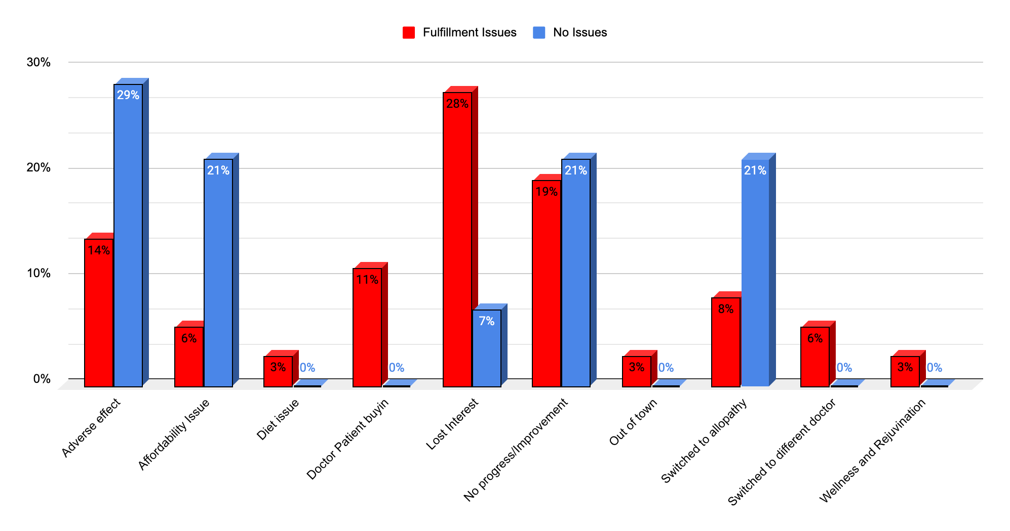
Results

Slide 12
Discussion
The data tells a story—but the deeper narrative lies in the patient interviews and experiences. Patients spoke about feeling unheard, unsure, or simply disillusioned. Many came with the hope of a rapid transformation, only to realize that Ayurvedic care often demands patience, persistence, and inner commitment. Some felt that the benefits were not clearly explained, while others found the treatment too demanding in terms of lifestyle changes. There were logistical challenges too—scheduling issues, lack of reminders, or not enough support between visit. Interestingly, a small percentage of patients who left cited affordability or external factors. This shows that the primary problem is not cost or access—it is engagement and trust.

Slide 13
Discussion
Strategy | Cost | Impact
SMS/WhatsApp Reminders | Low | High
Progress Cards/Patient Milestone | Minimal (printing) | Moderate to High
Pre-booking Next Follow-up | Free | High
Personal Video Tips | Free | Moderate
Feedback Collection & Action | Free | High
Follow-up Bundled Offers | Low (Discounted) | High
Intern Calls for DNP patients | Free (HR cost) | Moderate

Slide 14
Limitations
Sample Size Constraints: The fulfillment data analyzed was based on a subset of 50 patients out of a total of 150 surveyed, which may not fully capture the diversity of the patient base.
Temporal Limitation: The data was gathered over a specific 3-month window (Oct–Dec 2024). Seasonality, clinic campaigns, or public health fluctuations could have impacted results.
Subjectivity in Patient Feedback: Some interview responses might have been influenced by social desirability bias or limited recall, especially among patients disengaged for over a month.
No Longitudinal Follow-Up: The study did not track patients who eventually returned after a prolonged gap, potentially overlooking late-comeback cases.
No Comparative Benchmark: There was no parallel analysis of patients who successfully completed all follow-ups, which could have offered useful contrast.

Slide 15
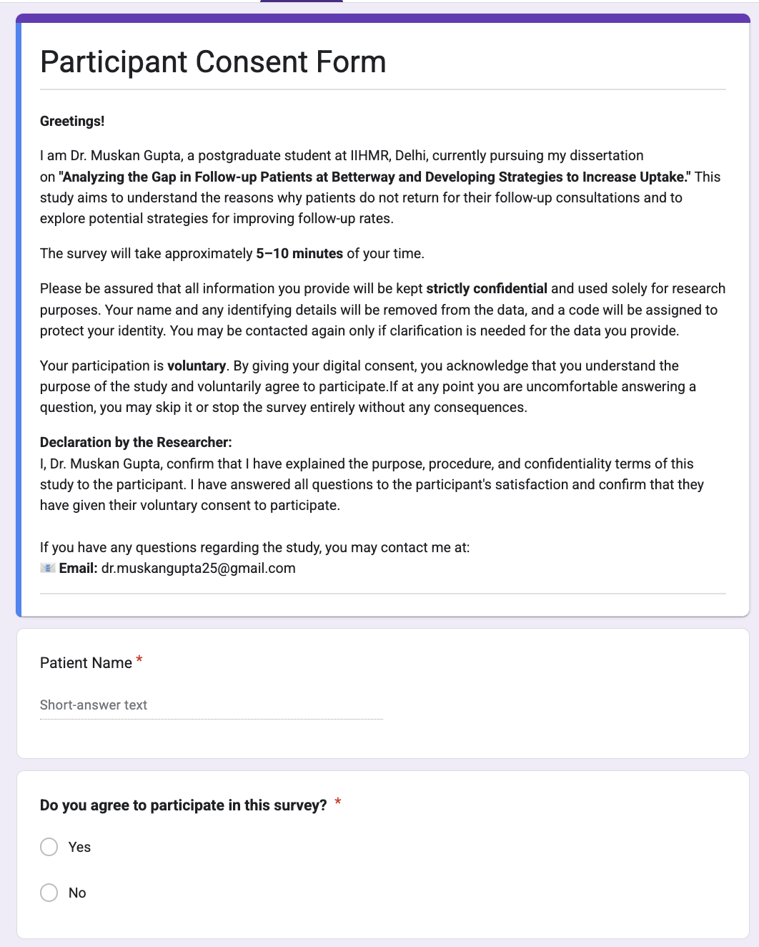
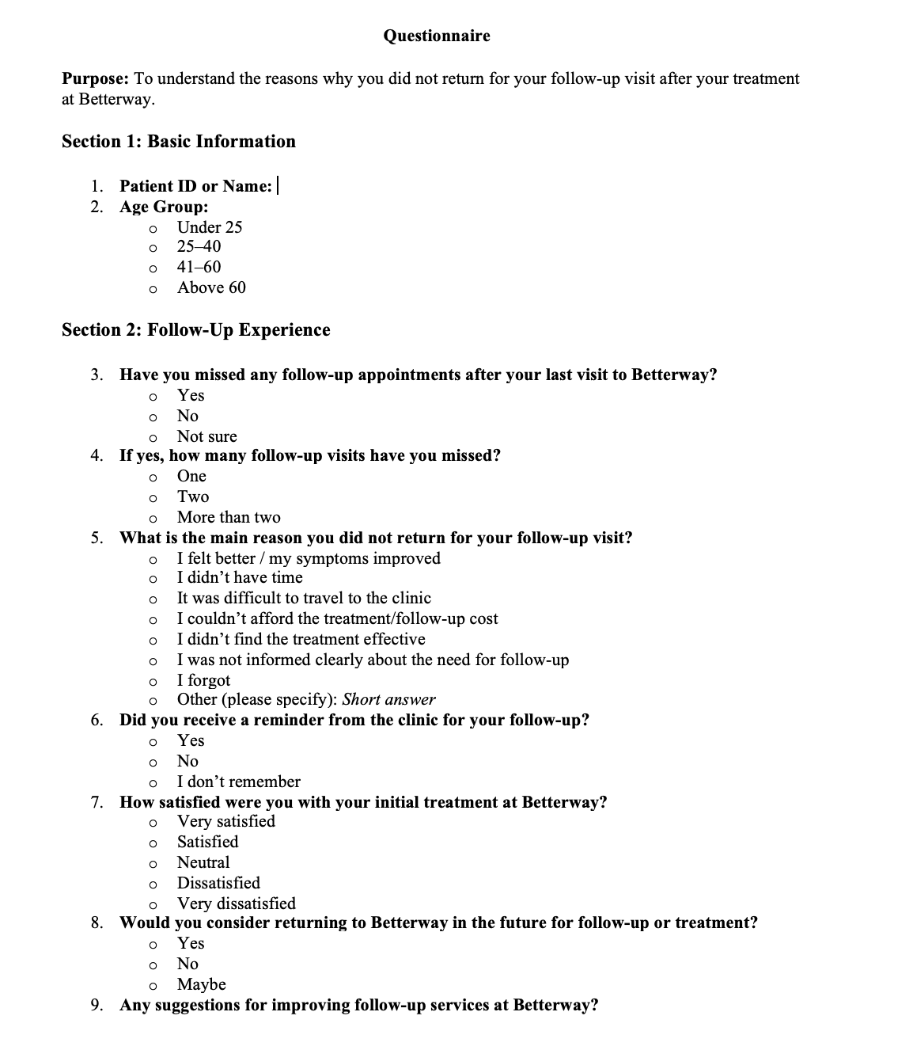
TOOLS

Slide 16



Pictorial Journey

Slide 17
References
Cabana MD, Jee SH. Does continuity of care improve patient outcomes? J Fam Pract. 2004;53(12):974–980.
https://www.mdedge.com/familymedicine/article/60162/does-continuity-care-improve-patient-outcomes
Haynes RB, Ackloo E, Sahota N, McDonald HP, Yao X. Interventions for enhancing medication adherence. Cochrane Database Syst Rev. 2008;(2):CD000011.
https://doi.org/10.1002/14651858.CD000011.pub3
Kripalani S, Yao X, Haynes RB. Interventions to enhance medication adherence in chronic medical conditions: a systematic review. Arch Intern Med. 2007;167(6):540–550.
https://jamanetwork.com/journals/jamainternalmedicine/fullarticle/411361

Slide 18
Thank You

