Slide 1
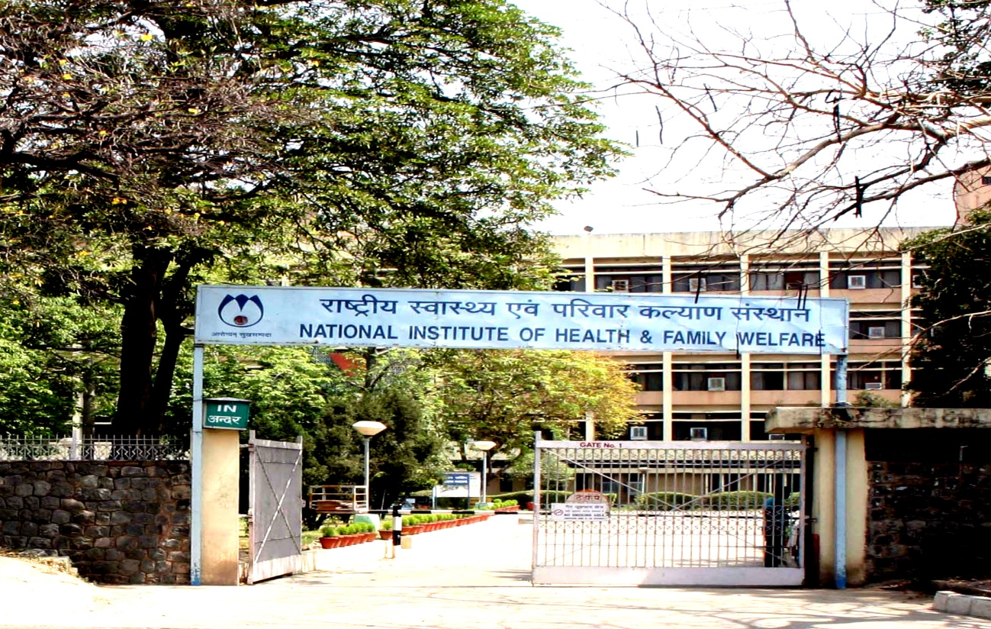
INTERNSHIP REPORT BY COL SUMESH SETH

Slide 2
NIHFW PROFILE
Established on 9th Mar, 1977 by merger of two national level institutions, viz. NIHAE and NIFP.
Vision – ‘NIHFW to be seen as an Institute of global repute in public health & family welfare management’.
Mission – ‘To act as think tank, catalyst & innovator for management of public health and related health & family welfare programmes by pursuing multiple functions of Education & Training, Research & Evaluation, Consultancy & Advisory services as well as provision of specialized services through inter-disciplinary teams’.

Slide 3
NIHFW ORGANISATION

Slide 4
NIHFW : COURSES AND PROJECTS
MD (Community Health Administration) for 3 years, Delhi University.
Diploma in Health Administration for 2 years, Delhi University.
PG Diploma in Public Health Management, one year.
Professional Development Courses and In-service Trainings/Pgmes.
Reproductive and Child Health Training and Administrative Unit
National Nodal Agency for coordinating training since Dec 1997.
Development of prototype modules, training curricula & other training materials, conducting training of Master Trainers and coordinating/monitoring training/performance, assisted by 18 CTIs.
National Nodal Agency for coordinating training under NRHM and RCH lI wef April 2006.
HIV Surveillance Unit
To coordinate, supervise and monitor implementation of Annual Sentinel Survey for HIV, with regional teams.
To collate, analyse, interpret and prepare a national epidemiological report on the status of HIV infection since 1998.

Slide 5
NIHFW : COURSES AND PROJECTS
MCTS Cell
Established 1st Oct 2012, nodal agency for providing coordination & technical guidance, working under Statistics & Demography Dept.
A name-based tracking system for pregnant women and children for their ANCs, PNCs and immunization along with a feedback system for ANM, ASHA etc.
Health Policy Unit
An apex body leading health policy research and analysis guiding govts, health based civil society organisations, advocacy networks and coalitions, academic institutions and other stakeholders.
National Health Portal
Setup under CHI to provide a single platform for authenticated healthcare related information to all citizens of India.
Also provides links to useful healthcare related websites and selected m-health apps, in both English and Hindi.

Slide 6
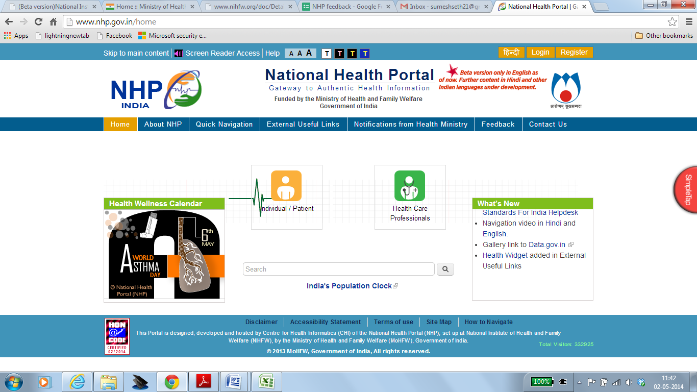
DISSERTATION EVALUATION OF USABILITY AND EFFECTIVENESS OF NHP BY COL SUMESH SETH

Slide 8
OBJECTIVES
General Objective. To evaluate the usability and effectiveness of NHP.
Specific Objectives.
To obtain perceived benefits of NHP from the environment vs laid down development objectives.
To determine satisfaction level regarding design, information, innovation, links and listed m-health apps.
Research Question. What is the usability and effectiveness of NHP amongst urban healthcare professionals?

Slide 9
LIMITATIONS
Time. Limited time was available.
Resources. Restricted manpower, dedicated working space and non-availability of reliable high speed internet connection.
Sample Size. 33 responses received against the desired sample size of 96, due to lack of time and resources.
Study Population. Mainly urban population with email accounts.

Slide 10
REVIEW OF LITERATURE
Health 2.0 in Practice: A Review of German Health Care Web Portals by Roland Görlitz, Benjamin Seip et al, 2010.
Health 2.0, a development that leads patients and doctors to actively participate and contribute on health portals.
An extensive analysis of 246 German web portals that provide health-related content from a user perspective.
General design options for health care portals are drawn to aid in the development of new health care portals.
European Citizens' use of E-health Services: A Study of Seven Countries by H K Andreassen, Iveta Pudule et al, 2007.
Investigated patterns of health-related internet use, its consequences, and citizens' expectations about their doctors' provision of e-health services.
Total 7934 respondents. 71 % of internet users used it for health purposes (read information, decision to meet doctor)
Factors positively affecting were youth, higher education, white-collar or no paid job, visits to GP in past year, long-term illness or disabilities, and subjective assessment of own health as good.

Slide 11
METHODOLOGY
Semi-qualitative, semi-quantitative, descriptive, cross-sectional study.
About 800 healthcare professionals including providers, researchers, consultants, students, NGOs, govt entities and healthcare IT managers restricted to urban areas approached (33 responses).
Email with Google docs link sent to obtain feedback based on questionnaire.
Evaluation by collating and analysing key study variables such as perceived benefits, design, information, links, innovativeness and listed m-health apps of NHP.
https://docs.google.com/forms/d/1f3_c67VS_Dl0zG1jsaj-_lNhNSTbdjqZ53LcFkc4UNQ/

Slide 12
RESULTS & DISCUSSION
Respondents asked to give up to three perceived benefits of the NHP.
Most respondents assimilated the concept and development objectives of the NHP.
Perceived benefits divided into 15 different categories.
Health literacy and reliable health information considered most important with 55% responses each in their favour.
Interoperability, open/easy access and availability of policies/plans/programmes receive 24% votes each.

Slide 13
PERCEIVED BENEFITS

Slide 14
RESULTS & DISCUSSION
Question set as five point scale to obtain satisfaction level of users about NHP aspects.
About 82% respondents were moderately and very satisfied with design of the NHP.
About 73% respondents were moderately and very satisfied with information given on the portal.
About 85% respondents were moderately and very satisfied with links offered at the NHP.
About 76% respondents were moderately and very satisfied with innovativeness of the portal.
About 54% respondents were moderately and very satisfied with m-health apps listed at the NHP.

Slide 15
SATISFACTION LEVEL : NHP

Slide 16
CONCLUSION
Health portal refers to delivery of information and health services via internet or related technologies.
E-health applications can be useful in providing better quality of life in a cost effective way.
Many local and regional e-health projects/programs and health portals in India, but with usability problems.
Search for information about health care news, maps and directions, state health organization and activities, how to manage health, treatments and diseases, rights and obligations of the patient, etc.
Merits of the NHP.
Effortless accessing health related information and health services.
Easily visible search feature.
Very simple to use, with relevant information.
Information about different clinics, opening hours and addresses.
E-services making citizens more capable of taking decisions.
Information on symptoms of diseases, treatments and self care.
Updated information about health problems.

Slide 17
CONCLUSION
Demerits of the NHP.
Not completely satisfied with contents and health related information for diagnosing health problems and how to cure.
Number of diseases for which information not placed/updated.
Layout of page providing information about symptoms of different diseases, its treatments and advice on self care not satisfactory.
Long text instead of graphical representation of health information.
Procedure of advice on self care not pleasing and attractive.
Help page complex. Lengthy descriptions to be avoided. More elaborated screen tips for performing different activities.
Icons used on different pages not very attractive and meaningful.
No support for audio and video multimedia contents making it less interactive and effective.
Only some parts of the portal are available in languages other than English.

Slide 18
CASE STUDY EVALUATION OF USABILITY AND EFFECTIVENESS OF M-HEALTH APPS BY COL SUMESH SETH

Slide 19
OBJECTIVES
General Objective. To evaluate the usability and effectiveness of m-health apps.
Specific Objectives.
To recognize key potential benefits, drivers, cost drivers and barriers to m-health apps in next five years.
To identify key m-health apps categories and devices.
To find out importance of vernacular languages in m-health apps.
Research Question. What is the usability and effectiveness of m-health apps amongst urban healthcare professionals?

Slide 20
METHODOLOGY
Semi-qualitative, semi-quantitative, descriptive, cross-sectional study.
About 800 healthcare professionals including providers, researchers, consultants, students, NGOs, govt entities and healthcare IT managers restricted to urban areas approached (33 responses).
Email with Google docs link sent to obtain feedback based on questionnaire.
Evaluation by collating and analysing key study variables such as potential benefits, barriers, drivers, cost drivers, categories, devices and importance of vernacular languages.

Slide 21
RESULTS & DISCUSSION
Key potential benefits of m-health apps were listed for respondents to rank them from 1 to 8.
51.5% (Rank 1) consider m-health apps to increase health consciousness of the society.
About 40% ranked ‘improve interaction between patients and doctors’ at 2nd place.
57.6% respondents ranked ‘reduce/slowdown increase of healthcare costs’ at 7th or 8th position.
42.4% consider ‘improve data quality to develop improved medications/treatment plans’ at 7th or 8th position.

Slide 22
POTENTIAL BENEFITS OF M-HEALTH APPS

Slide 23
RESULTS & DISCUSSION
Impact of key drivers on growth of m-health market in next five years obtained from respondents (3 out of 10).
Smartphone and tablet penetration considered by almost 67% as the main driver.
User/patient demand for m-health apps chosen by about 48% respondents.
Price development of m-health apps and corporate involvement in m-health received only 12% and 15% votes respectively.

Slide 24
IMPACT OF DRIVERS ON M-HEALTH MARKET

Slide 25
RESULTS & DISCUSSION
13 popular categories offered to respondents for choosing up to three with highest market potential.
‘Reminders and alerts apps’ and ‘remote monitoring apps’ received about 48% and 42% responses respectively.
Remote consultation apps, diagnostic apps, fitness apps and nutrition apps received about 30% votes each.
Continuing medical education tools and wellness apps received only 6% responses each in their favour.

Slide 26
MARKET POTENTIAL OF M-HEALTH APPS CATEGORY

Slide 27
RESULTS & DISCUSSION
NHP plans to offer information in 13 vernacular languages, now available in Hindi and English including 49 m-health apps/websites in English and 19 m-health apps in Hindi.
Respondents asked for their opinion regarding improvement of health indices in India by vernacular (Hindi) m-health apps, in the form of a five-point scale.
30% of respondents strongly agreed with the view and 55% agreed with the view, 9% neutral and 3% each disagree and strongly disagree.

Slide 28
IMPORTANCE OF VERNACULAR LANGUAGES IN M-HEALTH APPS

Slide 29
CONCLUSION
About 45% believe ‘reduce prevention cost by apps that support patient education’ and 42% each believe ‘reduce costs of patients non-adherence to a medical treatment by increasing patient engagement with compliance apps’ and ‘reduce labour costs by increased outsourcing via apps that provide access to remote consultation & diagnostics in low labour cost countries’ as key healthcare cost drivers impacted by m-health apps.
Lack of standardisation, lack of data security and resistance from traditional healthcare providers selected as three main barriers to m-health apps with about 42%, 33% and 33% responses respectively.
Smart phones considered main target device for m-health apps in next five years with about 76% responses; Tablets ranked at second position with about 48.5% responses.
M-health can embrace modern technology to widen healthcare accessibility in rural India and be solution for India’s healthcare woes.
Opportunity for m-Health also stimulated by number of factors, viz. technological innovations relating to systems integration, improvements in wireless networks, mobile handset innovations, and continued growth of mobile phone subscribers.

Slide 30
Thank You
Dear Col. Seth,
Congratulations for conducting an excellent study on NHP!
I must compliment you for your dedication and sincerity in carrying out the research study which has reflected in brilliant pointers to the portal. This would go a long way in improving and strategising our portal.
I wish you all success in your career and life !
Best wishes
Prof. Indrajit Bhattacharya,
B.Tech, MBA (IT), FIETE, (PhD)
Additional Director,
Centre for Health Informatics (CHI) of NHP

