Slide 1

Assess the national validity of sample indicators on Climate-related emergency preparedness and management in the latest WHO climate resilient health system guidelines: A Review
Presented by
Mr. Harshit bhardwaj
PG/22/036
BATCH 2022-2024
Under the guidance of : Dr. sumant swain

Slide 2
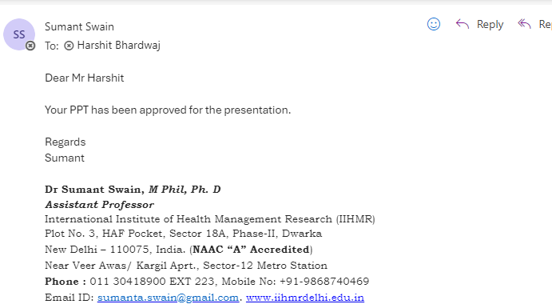
MENTOR APPROVAL

Slide 3
INTRODUCTION
Health System
The health system comprises all the organizations, institutions, people, resources, and actions whose primary purpose is to improve, restore or maintain health
The goals of a health system are improving health and health equity in ways that are responsive, financially fair and make the best or most efficient use of available resources.
Six health system building blocks together constitute a complete health system – health service delivery; health workforce; health information; medical technologies; health financing; leadership and governance
Climate resilient health systems
Climate resilient health systems are those capable of anticipating, responding to, coping with, recovering from, and adapting to climate-related shocks and stress, to bring about sustained improvements in population health, despite an unstable climate.

Slide 4
WHO CRHS INDICATORS
Objectives | Sample measurable outputs and indicators
Policies and protocols | Policies, protocols, plans, and strategies for Health Emergency and Disaster Risk Management (H-EDRM) reviewed and improved through the integration of climate-sensitive health risks and weather and climate information (e.g. El Niño/La Niña conditions)
 | Health sector contingency plans for extreme weather events developed and implemented
 | Gender sensitivity and equity approaches included in H-EDRM, considering vulnerable populations and regions at risk from climate related hazards
 | Health sector contingency plans for extreme weather events, including risk reduction, preparedness, and response, are aligned with the WHO H-EDRM or a local health emergency and disaster risk management framework
 | Protocols for H-EDRM integrate low carbon and environmentally sustainable practices including for logistics, supply change, procurement and storage of medicines and equipment, and transport
Risk management | Risk assessments for current and projected future exposure to extreme weather events routinely used to inform health sector strategic development plans
 | Climate change related emergency and disaster response plans for individual health facilities developed and implemented
 | Geographical and seasonal distribution of climate health risks and outcomes used to inform emergency and disaster response plans
 | EWS for extreme weather events and climate-sensitive diseases used to inform roles and responsibilities of different actors for H-EDRM planning
Community empowerment | Capacity development programmes implemented to support the roles of local communities to identify risks, prevent exposure to hazards, and take action to save lives in extreme weather events
 | Stakeholder mechanism to support participation, dialogue and information exchange, to empower civil society and community groups as primary actors in emergency preparedness and response established
 | Mechanisms in place to ensure information related to health risks from extreme weather events reaches communities in a way that preventive action by them is triggered

Slide 5
Rationale
Heightened risk of climate induced disasters
High cost of Health infrastructure
High operational cost of running the health care
Safe and resilient hospitals need prioritization
Government emphasis on funding for healthcare resilience
Delivery of national health programmes
Institutional frameworks for climate resilience health care to be implemented

Slide 6
OBJECTIVES
To understand the implementation of WHO Indicators through NAPCCHH.

Slide 7
METHODOLOGY
Study Type
Search Strategy
Selection Criteria
Selection Process
Information Sources
Data Management

Slide 8
METHODOLOGY
Study type- Secondary data analysis using PRISMA guidlines
Time Frames- 2015-2024
Information Sources- The following databases & grey literature, using the identified search terms, were used. PubMed, Research Gate, Google Scholar. etc.
Inclusion Criteria- Relevant literature, guidelines, policies, and frameworks related to climate resilience and emergency management in health systems.
-Studies published in English language.
Exclusion Criteria- Articles is not focused on India and, irrelevant to Component 9 indicators.

Slide 9
METHODOLOGY
Search Strategy- The appropriate MESH terms which were applied are as follows: "Climate Change," "Emergency Preparedness," "Health Systems," "Disaster Planning," and "Public Health." Keywords will encompass phrases like "climate-related emergency preparedness," "WHO health system guidelines," "national validity," "climate-resilient health systems," and "disaster management. "These are various terms that were searched using appropriate Boolean connectors (AND/OR) for example- Vulnerability AND H-ERDM.
Selection Process- We first screened all the selected literatures title & abstract according to the inclusion criteria. We then conducted a full text report screening & cross-checked references.
Data Management- To conduct this review, we extract relevant data from the studies into a Microsoft Excel spreadsheet and then drew result from the same.
Data Analysis – Thematic content analysis

Slide 10
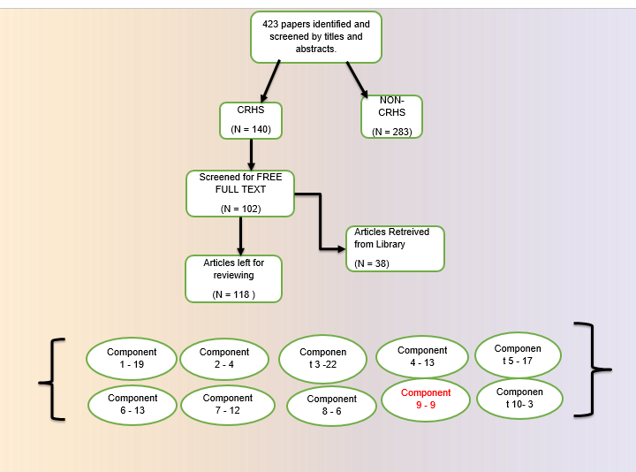

Slide 11
RESULT
The Study Profiles:
423 articles extracted (Research Gate = 60, PubMed= 100, Google Scholar= 223) and 40 from other resource
The 9 publications that met the inclusion criteria were further subjected to full-text scrutiny to answer the scoping review question.
The reasons for the exclusion of most of the studies were as follows:
Studies did not align with the research’s objective
Papers without the full text available.
14 & 87 articles were removed for being duplicate & after being screened for abstracts & titles respectively
102 articles left for full text availability
Different articles separate out among other components
9 articles left for analysis

Slide 12
Evidence Table
Articles | Type of Study | Location | Population/Setting | Exposure | Outcome | Findings
Policy development in disaster preparedness and management: lessons learned from the January 2001 earthquake in Gujarat, India (1) | Case study | Gujarat, India | General population affected by the January 2001 earthquake | Earthquake and its aftermath | Policy development in disaster preparedness and management | The study highlighted the importance of policy development and lessons learned from the disaster response to improve future disaster preparedness and management.
Occupational heat stress profiles in selected workplaces in India(2) | Cross-sectional study | Selected workplaces in India | Workers in various occupational settings | Occupational heat stress | Profiles of heat stress and its impacts on workers | The study identified high levels of heat stress in several workplaces and recommended interventions to mitigate health risks for workers.
Estimating population heat exposure and impacts on working people in conjunction with climate change(3) | Quantitative analysis | Global, with implications for India | Working population | Heat exposure due to climate change | Impacts on working people, including productivity loss and health risks | The study projected increased heat exposure for working populations, leading to significant health and economic impacts if no adaptation measures are taken.
Future projection of climate extremes across contiguous northeast India and Bangladesh(4) | Projection study | Northeast India and Bangladesh | General population | Climate extremes | Future projections of climate extremes | The study predicted an increase in climate extremes in the region, emphasizing the need for enhanced adaptive measures and policy interventions
Climate disasters challenge health infrastructures in India(5) | Review Study | India | Health infrastructure and general population | Climate disasters | Challenges to health infrastructures | The Review highlighted the significant challenges that climate disasters pose to India's health infrastructure, calling for urgent improvements in preparedness and response.

Slide 13
Articles | Type of Study | Location | Population/Setting | Exposure | Outcome | Findings
Exploring the vulnerability of the coastal wetlands of India to the changing climate and their adaptation strategies(6) | Review study | Coastal wetlands in India | Coastal ecosystems | Climate change | Vulnerability and adaptation strategies | The review explored the vulnerability of coastal wetlands to climate change and discussed various adaptation strategies to mitigate these impacts.
Climate change and seasonal floods: potential long-term nutritional consequences for children in Kerala, India(7) | Cross-sectional study | Kerala, India | Children affected by seasonal floods | Seasonal floods | Long-term nutritional consequences | The study found that seasonal floods have potential long-term nutritional consequences for children, highlighting the need for targeted interventions.
Characteristics of Households’ Vulnerability to Extreme Heat: An Analytical Cross-Sectional Study from India(8) | Review Study | Coastal and transitional ecosystems in India | Coastal and transitional ecosystems | Climate change | Current status, future projections, solutions, and policies | The review provided an overview of the impacts of climate change on coastal and transitional ecosystems, including current status, future projections, and recommended solutions and policies.
Long-term impacts of climate change on coastal and transitional eco-systems in India: an overview of its current status, future projections, solutions, and policies (9) | Review study | Coastal and transitional ecosystems in India | Coastal and transitional ecosystems in India | Climate change | Current status, future projections, solutions, and policies | Current Status: The review highlights the current state of coastal and transitional ecosystems in India, noting significant degradation due to anthropogenic pressures and climate change. Future Projections: The study projects that climate change will exacerbate existing issues, such as sea-level rise, increased frequency of extreme weather events, and changes in biodiversity. Solutions: Suggested solutions include the implementation of nature-based solutions (NbS), such as mangrove restoration, and the adoption of sustainable coastal management practices. Policies: The article emphasizes the need for comprehensive policy frameworks that integrate climate change adaptation and mitigation strategies to protect and preserve coastal ecosystems. Policies should focus on enhancing the resilience of these ecosystems and the communities dependent on them through proactive planning and management.

Slide 14
WHO Indicator with NAPCCHH status
INDICATOR | Description from NAPCCHH | STATUS
Policies, protocols, plans, and strategies for H-EDRM integrated with climate-sensitive health risks | Integration of climate-sensitive health risks (2)(4) | GREEN
Health sector contingency plans for extreme weather events developed and implemented | Health sector contingency plans for extreme weather events developed and implemented(5)(6)(8) | GREEN
Gender sensitivity and equity approaches included in H-EDRM | Approaches included in H-EDRM(9) | RED
Health sector contingency plans aligned with WHO H-EDRM framework | Plans aligned with WHO H-EDRM(4)(1) | YELLOW
Protocols for H-EDRM integrate low carbon and environmentally sustainable practices | Protocols for H-EDRM integrate low carbon and environmentally sustainable practices(7)(3) | GREEN
INDICATOR | Description from NAPCCHH | STATUS
Risk assessments for exposure to extreme weather events inform health sector strategic plans | Risk assessments inform strategic plans (6)(9) | GREEN
Climate change-related emergency and disaster response plans for individual health facilities developed and implemented | Emergency response plans developed (2)(7) | GREEN
Geographical and seasonal distribution of climate health risks used to inform plans | Distribution of risks used to inform plans(1) | GREEN
Early warning systems (EWS) for extreme weather events and climate-sensitive diseases used | EWS used for H-EDRM planning(9) | GREEN
INDICATOR | Description from NAPCCHH | STATUS
Capacity development programs implemented for local communities | Integration of climate-sensitive health risks(2)(8)(6) | GREEN
Stakeholder mechanism to support participation and information exchange established | Health sector contingency plans for extreme weather events developed and implemented(3)(5)()7 | GREEN
Mechanisms in place to ensure information reaches communities and triggers preventive action | Approaches included in H-EDRM(1) | RED

Slide 15
RESULT
All WHO indicators should be implemented for a fully climate-resilient health system (CRHS). However, certain indicators still require implementation, particularly those related to health sensitivity, health equity, and community-level engagement
Fully Implemented (9 Indicators):
- Integration of climate-sensitive health risks into policies and protocols.
- Development and implementation of health sector contingency plans for extreme weather events.
- Integration of low carbon and environmentally sustainable practices in health sector protocols.
- Risk assessments for exposure to extreme weather events informing strategic plans.
- Climate change-related emergency and disaster response plans developed for individual health facilities.
- Geographical and seasonal distribution of climate health risks used to inform plans.
- Early warning systems (EWS) for extreme weather events and climate-sensitive diseases used in H-EDRM planning.
- Capacity development programs for local communities.
- In Progress (1 Indicator):
- Alignment of health sector contingency plans with the WHO H-EDRM framework.
- Not Implemented (2 Indicators):
- Inclusion of gender sensitivity and equity approaches in H-EDRM.
- Development and implementation of health sector contingency plans for extreme weather events at the community level.

Slide 16
Discussion
WHO’s 10 indicators serve as standard guidelines for establishing a climate-resilient health system (CRHS). These indicators provide a comprehensive framework for assessing and enhancing the resilience of health systems to climate change.
Most countries in Europe, America, the USA, and Latin America have adopted these WHO indicators, demonstrating their commitment to building climate-resilient health systems. Their experiences provide valuable insights and benchmarks for other countries, including India.
India is actively working towards the implementation of these indicators. The country’s efforts reflect its recognition of the importance of climate resilience in the health sector and its commitment to improving health outcomes in the face of climate change.
Out of the 12 WHO indicators, 9 have been fully implemented, showcasing significant progress. These include critical areas such as risk assessments, emergency response plans, and community capacity development.
However, 3 indicators are at different stages of implementation. While one is in progress, focusing on aligning health sector contingency plans with the WHO framework, the remaining two, concerning gender sensitivity, health equity, and community-level contingency planning, have yet to be implemented.

Slide 17
RECOMMENDATIONS
Strengthen Community Engagement: Enhance mechanisms for community-level engagement, information dissemination, and preventive actions.
Focus on Equity: Develop and integrate gender-sensitive and equitable health emergency policies
Accelerate Implementation: Expedite the alignment of health sector contingency plans with the WHO H-EDRM framework.

Slide 18
LIMITATIONS
Regional variability in healthcare systems may affect the generalizability of findings.
Inconsistencies in study methodologies could impact the comparability of results.
Limited access to full-text articles might restrict the depth of analysis.

Slide 19
CONCLUSION
This scoping review highlights the national validity of WHO's climate resilience and low-carbon sustainability indicators in emergency and disaster management. While significant progress has been made in policy development, risk management, and community empowerment, there are notable gaps in uniform implementation and practical application across regions due to hereto Genuity and inclusiveness.
Addressing these gaps through targeted policy improvements, enhanced risk management practices, and strengthened community empowerment initiatives is crucial for building a climate-resilient health system.

Slide 20
REFERENCES
Bremer R. Policy development in disaster preparedness and management: lessons learned from the January 2001 earthquake in Gujarat, India. Prehospital and disaster medicine. 2003 Dec;18(4):372-84.
Venugopal V, Chinnadurai JS, Lucas RA, Kjellstrom T. Occupational heat stress profiles in selected workplaces in India. International journal of environmental research and public health. 2016 Jan;13(1):89.
Kjellstrom T, Freyberg C, Lemke B, Otto M, Briggs D. Estimating population heat exposure and impacts on working people in conjunction with climate change. International journal of biometeorology. 2018 Mar;62(3):291-306.
Paul AR, Maity R. Future projection of climate extremes across contiguous northeast India and Bangladesh. Scientific Reports. 2023 Sep 20;13(1):15616.
Sharma DC. Climate disasters challenge health infrastructures in India. The Lancet. 2023 Jul 22;402(10398):279-80.

Slide 21
REFERENCES
Debnath S, Sarkar UK, Kumari S, Karnatak G, Puthiyottil M, Das BK, Das A, Ghosh BD, Roy A. Exploring the vulnerability of the coastal wetlands of India to the changing climate and their adaptation strategies. International Journal of Biometeorology. 2024 Jan 20:1-2.
Muttarak R, Dimitrova A. Climate change and seasonal floods: potential long-term nutritional consequences for children in Kerala, India. BMJ Global Health. 2019 Apr 1;4(2):e001215.
Subramanian A, Nagarajan AM, Vinod S, Chakraborty S, Sivagami K, Theodore T, Sathyanarayanan SS, Tamizhdurai P, Mangesh VL. Long-term impacts of climate change on coastal and transitional eco-systems in India: an overview of its current status, future projections, solutions, and policies. RSC advances. 2023;13(18):12204-28.
WHO CRHS DOCUMENT
NAPCCHH

Slide 22


