Slide 1


TOPIC- TO ANALYZE AND REDUCE THE WAITING TIME OF OPD
ORGANIZATION- EYE-Q HOSPITAL SWAROOP NAGAR, KANPUR
NAME- RENU GUPTA
FACULTY NAME – DR.SUMESH KUMAR IIHMR DELHI

Slide 2
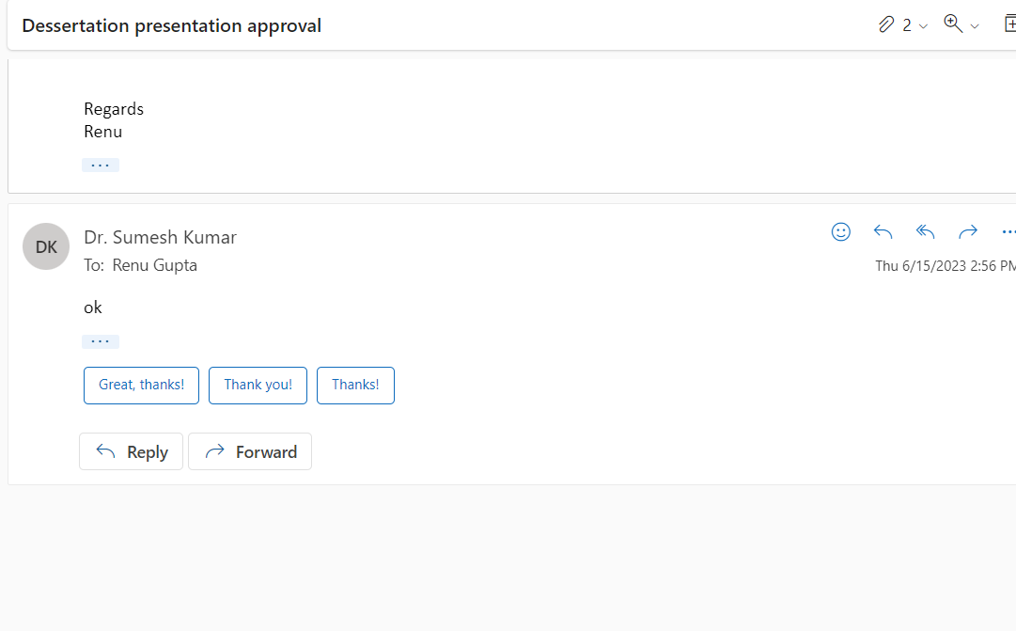
MENTORS APPROVAL

Slide 3
INTRODUCTION
We have observed how quickly the healthcare market is expanding. The correct information about the operations and the anticipated time to complete such treatments must be given in order to satisfy a patient.
These processes consist of a preliminary evaluation, consultation, and diagnosis. Instead of lengthy waiting times, this information typically makes the patients happy.
Turnaround time (TAT) is the total time the patient enters the hospital till the discharge of the patient.
To get patient satisfaction and optimum output, long waiting hours should not be long.

Slide 4
OUT PATIENT DEPARTMENT
The Out Patient Department (OPD) is the hospital's main point of contact. The care given in the OPD reflects the caliber of treatment given, which will then be reflected in the level of patient satisfaction.
The hospital's OPD must be high-quality and time-efficient in order for the hospital output to be effective. Due to the patient spending 50–60% of his time in the OPD.
This 3 months study will find out the patient journey analysis

Slide 5
OBJECTIVES
To analyze and reduce the waiting timing of the OPD.
To identify the factors that are responsible for high waiting time in the OPD.

Slide 6
METHODOLOGY
STUDY DESIGN- The study is an observational study with the objective of understanding of reducing turnaround time in outpatient departments
STUDY AREA- The study has been done in the Outpatient Department of EYE-Q Hospital, Kanpur.
STUDY POPULATION- The study population includes all the appointment patients. Both categories of Patients, dilated and not-dilated includes in the study.

Slide 7
STUDY PERIOD- The study has been conducted for two months from February 2022 to April 2022.
SAMPLE SIZE- The study is conducted among 250 patients. Daily 8 to 10 samples are collected for study for 1 month (April).
DATA SOURCE- Collects the primary data with the help of EMR.
DATA ANALYSIS- MS- EXCEL

Slide 8
RESULTS
1. Pie chart showing the percentage of dilated and Non-dilated patients.
2. Showing the percentage of new, follow-up patients

Slide 9
Patient Journey TAT: Dilated Patients
(A) Patient check-in
(B) Initial examination
(C) Patient gets dilated
Drop-1
Drop-2
Drop-3
(D) Doctor’s Consultation
(E)Patient check-out

Slide 10
Patient Journey TAT: Non-dilated patient
(A) Patient check-in
(C) Doctor’s Consultation
(D)Patient check-out
Patient not dilated
(B) Initial examination

Slide 11
Ideal timing of Dilated and Non-dilated patients

Slide 12
TAT OF NON-DILATED PATIENTS
Showing average time among new & follow-up non-dilated Patients.

Slide 13
TAT OF DILATED PATIENTS
Showing average time among new patient & follow-up patient dilated patients.

Slide 14
Discussion
The benchmark for non-dilated patients is 45 min and the benchmark for dilated patients are 90 mins.
Findings that lead to time gap of the patients
Staff shortage leads to slow procedure.
Doctors consultation time – 1-1.5 hours
Poor coordination among the staff
HMIS issues

Slide 15
LIMITATIONS
Only dilated and non-dilated patients were considered
The study time period was only three months.
The study focuses only on the Out Patient Department (OPD) patients.

Slide 16
Conclusion
The Turnaround Time (TAT) of an Outpatient Department (OPD) plays a crucial role in the overall patient experience and the efficiency of healthcare services.
A well-managed OPD with an optimized TAT can significantly enhance patient satisfaction, minimize waiting times, and improve the overall quality of healthcare services.
A well-organized OPD with efficient TAT allows healthcare professionals to utilize their time effectively, resulting in improved productivity. Streamlined workflows, reduced waiting times, and optimized scheduling enable staff members to focus on providing high-quality care rather than being overwhelmed by administrative tasks.

Slide 17
Reference
Khan, K. (2014). Root Cause Analysis (RCA) of Prolonged Laboratory Turnaround Time in a Tertiary Care Set up. Journal of Clinical and Diagnostic Research: JCDR, 8(4), FC05-08. https://doi.org/10.7860/JCDR/2014/7269.4255
2- Olokoba, L. B., Durowade, K. A., Adepoju, F. G., & Olokoba, A. B. (2020). Assessment of patients waiting and service times in the ophthalmology clinic of a public tertiary hospital in Nigeria. Ghana Medical Journal, 54(4), 231–237. https://doi.org/10.4314/gmj.v54i4.5
Journal, “Study on around the time of outpatients billing services at super specialty hospital” -Chennai

Slide 18
Thank you

