Slide 1

A CROSS SECTIONAL STUDY ON KNOWLEDGE, ATTITUDE AND PRACTICES OF BRIDGE POPULATION (TRUCKERS AND MIGRANTS) AND HIGH-RISK POPULATIONS (FEMALE SEX WORKERS) ON HIV/AIDS IN 5 STATES OF INDIA
Presented by dr Jaganjeet Kaur Randhawa
Under the guidance of dr rupsa Banerjee

Slide 2
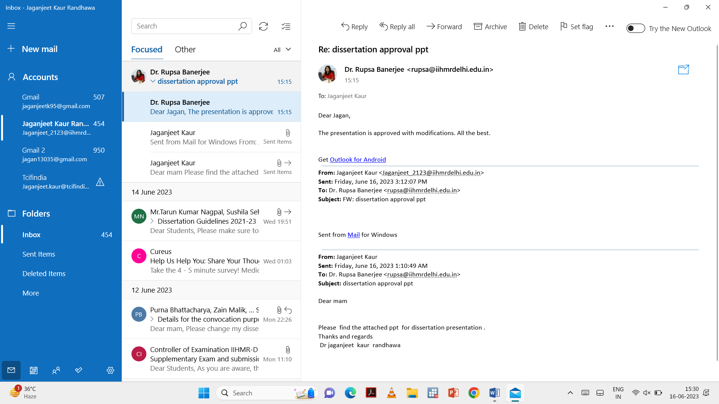
Mentor Approval

Slide 3
Introduction
Human immunodeficiency virus (HIV) and acquired immune deficiency syndrome (AIDS) are major global public health issues, with millions becoming infected each year.
Human immunodeficiency virus (HIV) is an infection that attacks the body’s immune system, specifically the white blood cells called CD4 cells. HIV destroys these CD4 cells, weakening a person’s immunity against opportunistic infections, such as tuberculosis and fungal infections & severe bacterial infections (WHO).
Acquired immunodeficiency syndrome (AIDS) is a term that applies to the most advanced stages of HIV infection. It is defined by the occurrence of any of the more than 20 life-threatening cancers or “opportunistic infections”, so named because they take advantage of a weakened immune system (WHO)
As per the latest epidemiological data, India is estimated to have around 24.0 lakh (19.92- 29.07 lakh) people living with HIV/ADIS (PLHIV) with overall adult prevalence of 0.21% (0.17-0.25%) in 2021.

Slide 4
The overall adult prevalence remains low (0.21%), HIV prevalence among high risks groups and the bridge population remains very high. HIV prevalence among migrants is 4 times , among truckers is 5 times, female sex works is 9 times ,among men who have sex with men (MSM) is 16 times , among transgender people is 18 times and among injecting drug users is 43 times of the overall adult prevalence.
Long-distance truck drivers, are frequently away from home for extended periods of time, operate in hazardous settings, and may participate in risky behaviour that can lead to infection. Their mobility makes it difficult to obtain health information and treatment, as well as to stick to a medicine regimen. Furthermore, as new roads connect low and high prevalence areas, the sector acts as a vector for HIV transmission
Female Sex Workers (FSWs) belong to an important high-risk group (HRG) in the transmission of HIV/AIDS.
Migrant population especially labors – when the travelled from one place to another in search of work- they are potential carriers of spreading infection.

Slide 5
Objectives
Purpose of this study
Knowledge, attitudes and practices (KAPs) regarding HIV/AIDS is one of the corner stones in the fight against the disease. Bridge population and high-risk group population are most vulnerable to infection because they engage in risky practices. Thus, evaluating their KAPs will help in designing appropriate prevention strategies.
Objectives
1.1 To assess the level of knowledge of bridge population and high-risk group population regarding HIV/AIDS transmission, prevention, and treatment.
1.2 To determine the attitudes of bridge population and high-risk group population towards HIV/AIDS.
1.3 To identify the risky behaviors and practices of bridge population and high-risk group population that may contribute to the spread of HIV/AIDS.

Slide 6
Methodology
Study design – cross- sectional study
Sampling method -Convenient Sampling Was Used To Collect Data after calculating sample size from 1 march – 30 April 2023
Targeted population (study population )
Truckers (long distance: more than 800 km)
Migrant workers (industrial and daily wagers)
Female sex workers
Study settings
The present study will be aimed to evaluate truck driver’s, female sexual workers, and migrant population knowledge, attitudes, and practices about HIV/ AIDS in Khushi clinics of Ludhiana, Chandigarh, haldia, Mainpuri, Rae – Bareli, Haridwar, Rudarpur, Jalgaon. This study should help to better target campaigns against HIV by enabling these population to refine, considering their concerns.

Slide 7
Sampling frame ( based on operational and logistic feasibility )
TRUCKERS POPULATION (TRUCK DRIVER AND HELPER
KHUSHI CLINICS
PUNJAB
UTTAR PRADESH
UTTARAKHAND
WEST BENGAL
MAHARASHTRA
LUDHIANA TR
CHANDIGARH TR
RUDARPUR
HARIDWAR
PATA GAIL ( CORPORATE )
HALDIA
JALGOAN

Slide 8
MIGRANTS
MIGRANT POPULATION
CHANDIGARH MIGRANT CLINIC
FEMALE SEX WORKERS
UTTAR PRADESH
RAE - BARELI
MAINPURI

Slide 9
Sample Size
Truckers | Migrants | Female Sex Workers
Using following study as baseline https://pubmed.ncbi.nlm.nih.gov/19098482/ consistent condom use Using formula = Z*Z*P*Q/D*D Z= 95 % confidence interval (1.96) P= 70% Q= P-Q D= 10 % = 1.96*1.96*.7*.3/0.1*0.1=.806/0.01=80.6 Taking 20% attrition rate = 80.6+16.12= 96.72 | Using following study as baseline https://pubmed.ncbi.nlm.nih.gov/25861172/ Using formula = Z*Z*P*Q/D*D Z= 95% confidence interval P=46% Q= P-Q D=10% 1.96*1.96*.46*.54/0.1*.1=.95425/0.01=95.42 Taking 20% as attrition rate = 95.42+19.08=114.54 | Using following study as baseline https://pubmed.ncbi.nlm.nih.gov/32509679/ Using formula = Z*Z*P*Q/D*D Z= 95% confidence interval P=97.8 Q=P-Q= 0.02 D= 5% = 1.96*1.96*.97*.03/.05*.05=.1117 = .1117/.0025=44.68 Taking 20% as attrition rate 44.68+8.936=53.616

Slide 10
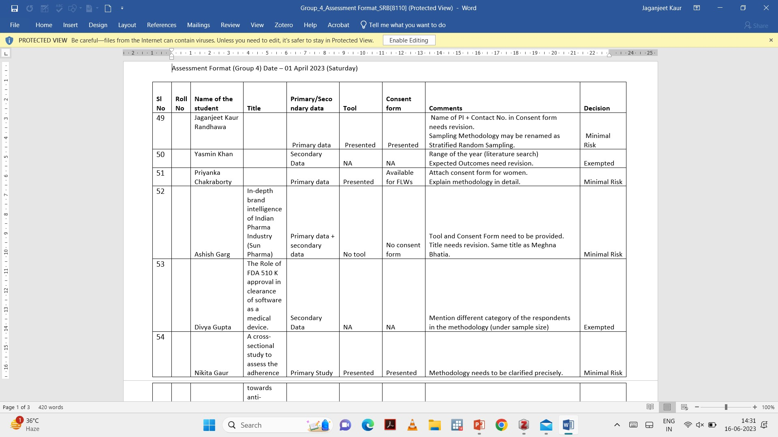
Ethical approval
This study was a component of a dissertation and ethical clearance was taken form IIHMR

Slide 11
Data collection and analysis
Data for this study was gathered through interviews using an interviewer schedule. Informed consent was signed from these participants and full confidentiality of the participants was maintained through coding of data for example (001,002). Informed consent of the patients were obtained on hard copies duly signed by participants.
The truck drivers, migrants and female sex workers were briefed about the purpose of the study, importance of their participation, its consequential benefit to other truck drivers and assured confidentiality.
Data was received in Excel version 2021 and then exported to the Statistical Package for Social Scientist (SPSS) version 18 for cleaning and analysing. The data analysis included: a descriptive statistic that was used to establish the frequency, range, mean, and standard deviation of demographic factors and clinical characteristics. Frequency, range, mean, and standard deviation used for continuous variables. Percentage and frequency were used for categorical variables..

Slide 12
SOCIODEMOGRAPHIC PROFILE OF THE STUDY PARTICIPANTS
VARIABLES | FEMALE SEX WORKERS | TRUCKERS | MIGRANTS
 | (N= 98% | N= 146(%) | N=122(%)
Gender
Female | 98(98%) | - | -
Male | - | 146 | 122
Age of the participant
15-19 | 1(1) | 2(1.013) | 1(0.81)
20-24 | 15(15.3) | 11(7.53) | 12(9.83)
25-29 | 47(47) | 33(22.60) | 27(22.13)
30-34 | 16 (16) | 36(24.65) | 28(22.95)
35-39 | 13 (13.3) | 27(18.49) | 31(25.40)
40-44 | 5 (5.1) | 23(15.75) | 15(0.10)
45-49 | 1(1) | 12(8.21) | 8(6.55)
50-54 | 0 | 2(1.013) | 0
Residence (permanent Place)
Rural | 11.2(11.2) | 56(38.35) | 65(53.27)
Urban | 80(81.7) | 6(4.10) | 43(35.24)
Semi- urban | 7(7.1) | 84(57.53) | 14(11.47)
Level of education
No education | 23(23) | 20(13.69) | 26(21.31)
Primary | 46(47) | 90(61.64) | 53(43.44)
Secondary or more | 29(30) | 36(24.65) | 43(35.24)
House hold income
Below 10,000 | 35(35.7) | 88(60.27) | 67(54.91)
10,000-50,000 | 55(56.1) | 57(39.04) | 55(45.08)
50,000-1 lakh | 8(8.1) | 1(0.68) | 0
Religion
Sikh | 0 | 9(6.16) | 9(7.377)
Muslim | 27(27.5) | 14(9.58) | 14(11.47)
Hindu | 71(72.4) | 122(83.56) | 99(81.14)
Christianity | 0 | 1(0.06) | 0

Slide 14
KNOWLEDGE ABOUT TRANSMISSION AND PREVENTION
Variables | FEMALE SEX WORKERS | TRUCKERS | MIGRANTS
 | N=98(%) | N=146(%) | N=122(%)
Knowledge about transmission through sexual mode
YES | 75(76.5) | 56(38.4) | 95(77.9)
NO | 20(20.4) | 73(50) | 22(18)
DON’T KNOW | 3(3.1) | 17(11.6) | 5(4.1)
Knowledge about transmission through needle sharing
YES | 56(57.1) | 98(67.1) | 85(69.7)
NO | 31(31.6) | 42(28.8) | 32)26.2)
DON’T KNOW | 11(11.2) | 6(4.1) | 5(4.1)
Knowledge about transmission through blood transfusion
YES | 78(79.6) | 64(43.8) | 97(79.5)
NO | 13(13.3) | 62(42.5) | 19(15.6)
DON’T KNOW | 7(7.1) | 20(13.7) | 6(4.9)
Knowledge about prevention by having one faithful partner
YES | 89(90.8) | 88(60.3) | 91(74.6)
NO | 7(7.1) | 38(26) | 15(12.3)
DON’T KNOW | 2(2) | 20(13.7) | 16(13.1)
Knowledge about prevention through consistent condom use
YES | 78(79.6) | 64(43.8) | 97(79.5)
NO | 13(13.3) | 62(42.5) | 19(15.6)
DON’T KNOW | 7(7.1) | 20(13.7) | 6(4.9)

Slide 15
STATISTICAL ANALYSIS BETWEEN GROUPS
VARIABLES | FEMALE SEX WORKERS AND MIGRANT | FEMALE SEX WORKERS AND TRUCKERS | MIGRANT AND TRUCKERS
Knowledge about transmission through sexual mode
P value | .814 | .000 | .000
Chi-square | .055 | 34.369 | 42.185
Degree of freedom | 1 | 1 | 1
Knowledge about transmission through needle sharing
P value | .054 | .113 | .000
Chi-square | 3.707 | 2.509 | 42.185
Degree of freedom | 1 | 1 | 2
Knowledge about transmission through blood transfusion
P value | .988 | .000 | .000
Chi-square | .000 | 30.817 | 35.262
Degree of freedom | 1 | 1 | 1
Knowledge about prevention by having one faithful partner
P value | .002 | .000 | .013
Chi-square | 9.619 | 27.462 | 6.141
Degree of freedom | 1 | 1 | 1
Knowledge about prevention through consistent condom use
P value | .988 | .000 | .000
Chi-square | .000 | 30.817 | 35.262
Degree of freedom | 1 | 1 | 1

Slide 16
MISCONCEPTIONS REGARDING SPREAD OF HIV
Variables | Female sex workers | Truckers | Migrants
Misconception about HIV transmission | N=98(%) | N=146(%) | N=122(%)
Through sharing the same meal
YES | 16(16.32) | 49(33.56) | 35(28.68)
NO | 50(51.02) | 69(47.26) | 63(51.63)
DON’T KNOW | 32(32.65) | 28(19.17) | 24(19.67)
Mosquito bite
YES | 8(8.16) | 50(34.24) | 17(13.93)
NO | 60(61.22) | 73(50) | 71(58.19)
DON’T KNOW | 30(30.61) | 23(15.75) | 34(27.86)
By sharing the same tool (utensils) of infected person
YES | 32(32.65) | 41(28.08) | 23(18.85)
NO | 54(55.10) | 71(48.63) | 75(61.47)
DON’T KNOW | 12(12.24) | 34(23.28) | 24(19.67)
By Living in the same room with infected person
YES | 32(32.65) | 57(39.04) | 23(18.85)
NO | 57(58.16) | 60(41.09) | 75(61.47)
DON’T KNOW | 9(9.18) | 29(19.86) | 24(19.67)

Slide 17
MISCONCEPTIONS CONTINUED
MISCONCEPTION ABOUT HIV TRANSMISSION | FEMALE SEX WORKERS N=98(%) | TRUCKERS N=146(%) | MIGRANTS N=122(%)
By sharing the same clothes with infected person
YES | 18(18.36) | 34(23.28) | 30(24.59)
NO | 65(66.32) | 85(58.21) | 66(54.09)
DON’T KNOW | 15(15.30) | 27(18.49) | 26(21.31)
By shaking hands with infected person
YES | 22(22.44) | 42(28.76) | 29(23.77)
NO | 69(70.40) | 77(52.73) | 76(62.29)
DON’T KNOW | 7(7.14) | 27(18.49) | 17(13.93)
By using the same toilet facilities with infected person
YES | 22(22.44) | 45(30.82) | 29(23.77)
NO | 66(67.340 | 78(53.42) | 76(62.29)
DON’T KNOW | 10(10.20) | 23(15.75) | 17(13.93)
Is there any cure for HIV
YES | 27(27) | 60(41.09) | 28(22.95)
NO | 45(45.91) | 64(43.83) | 75(61.47)
DON’T KNOW | 26(26.53) | 22(15.06) | 19(15.57)
Is it possible for someone to have HIV and not know about it
YES | 66(67.34) | 87(59.58) | 84(68.85)
NO | 32(32.65) | 59(40.41) | 38(31.14)

Slide 18
ATTITUDE OF THE PARTICIPANTS

Slide 19
PRACTICES OF THE FEMALE SEX WORKERS

Slide 20
PRACTICES ( TRUCKERS AND MIGRANTS )

Slide 21
OPEN ENDED QUESTIONS
Question -Do you have any concerns or fears about accessing HIV testing or treatment services due to stigma or discrimination related to you sex work?
Female sex worker
“We get exposed in front of everyone , people come to know that we have come for HIV testing since there is lot of phobia regarding HIV and it’s a deadly disease , its become difficult for us to avail services from hospitals and clinics although we know that it’s a disease similar to others”
“Our identity get disclosed which will be a big problem for my family
If anyone see me going for HIV testing”
INFERENCES
Most of the female sex workers are afraid that there identity will get disclosed if they go for HIV testing. Even the medical staff have indefinite behaviors towards which is a barrier for them to receive care and avail services
“Staff in the hospitals do not treat us good when we go to avail services because they think its our mistake that we are involved in sex work”
‘I will not get in any work if people come to know that I am HIV positive so because of that fear I do not go for HIV testing”

Slide 22
Have you ever experienced violence or abuse from clients related to HIV or condom use, and how do you handle the situation (open ended)?
“When we go to the client , people accompanying them forcefully try to die sex with ous without using condoms , if we inform our broker she might find a solution but most of the times it really becomes difficult for us to control the situation”
Our broker provide us the condoms but clients do not wear them because they say we do not get pleasure
Inferences
Female sex workers have knowledge about the importance of wearing condoms since clients do not agree they involve in risky behavior which is area of concern since female sex workers are bridge population
“Generally clients are drunk and abuse us and do not wear condom despite telling them”
Clients generally do not agree for condom use and offer us to pay more money in case we resist

Slide 23
DISCUSSION
Participants had adequate knowledge about modes of transmission but they had lot of misconceptions regarding spread of disease especially among truckers population
Despite of having knowledge attitude of the participants regarding people living with HIV(PLHIV) was not good
Female sex workers engaged in risky behavior and have sex without condoms just because clients made more money
Both truckers and migrants engage in sex with multiple sex partners which is area of concern regarding elimination of HIV due to chain of spread of HIV from one person to another
Despite of various modes of media exposure ,injectable drug users share needles with other users .
The government should take the initiative that the female sex workers do not face any harassment in hospitals as well as from clients

Slide 24
Strengths
This study was done in 5 states across India with robust sample size
Limitations
This study was a component of dissertation and had time limitations .This study has its limitations due to convenient sampling and possibility of interviewer bias. The questionnaires were in English initially and translated into Hindi. This translation may have had shortcomings and that is the other constraint in this study. The language barrier restricts the type of questions that could have been asked.

Slide 25
Conclusion
A more concentrated focus is needed on changes in sexual behavior and safer sex.
More focus should be laid down to spread awareness regarding misconceptions
Strict regulations should be laid down so that female sex workers do not face any harassment and there is no breach of privacy of any individual while receiving medical care

Slide 26
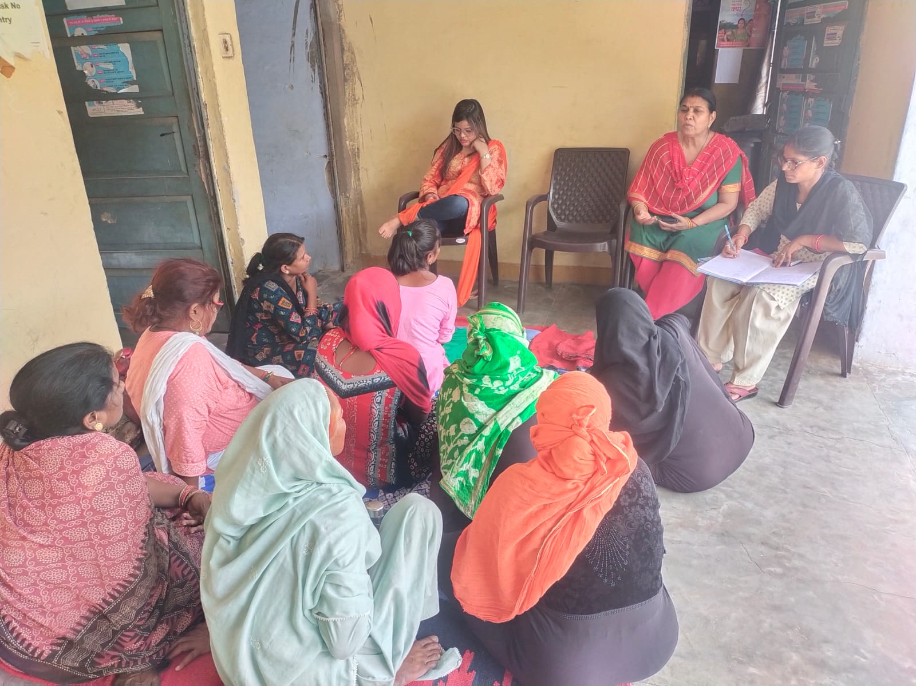
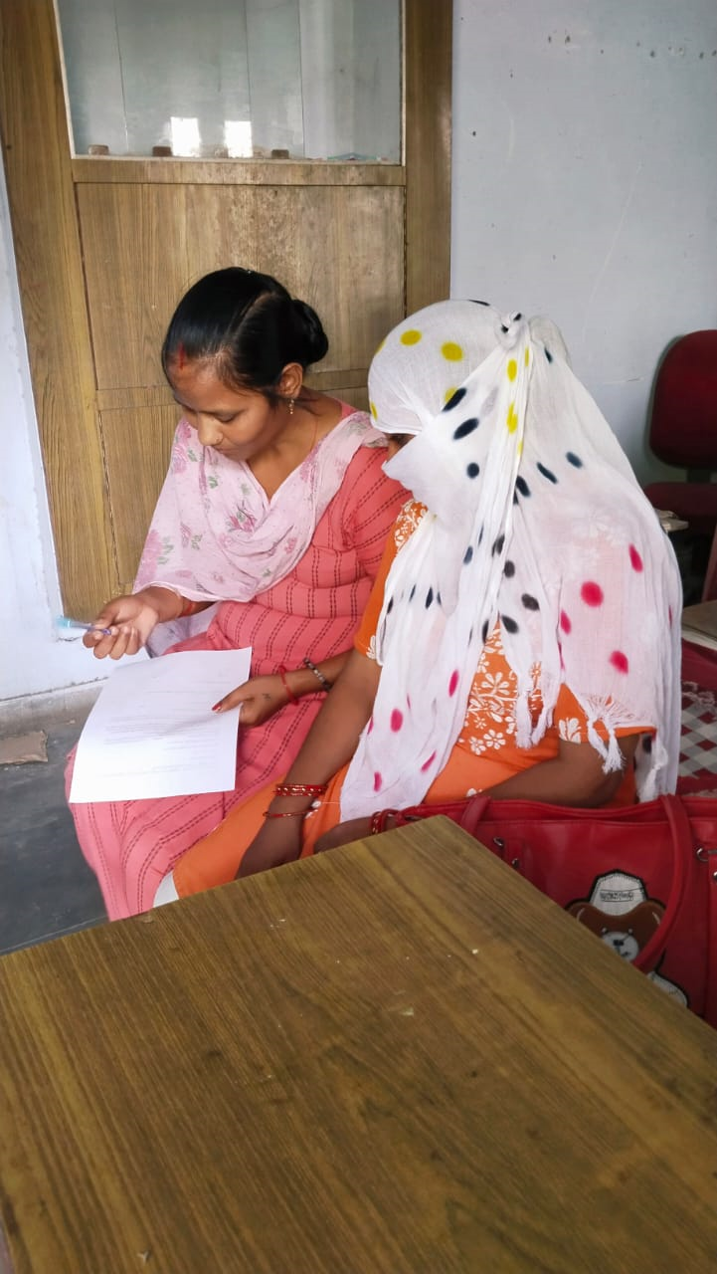
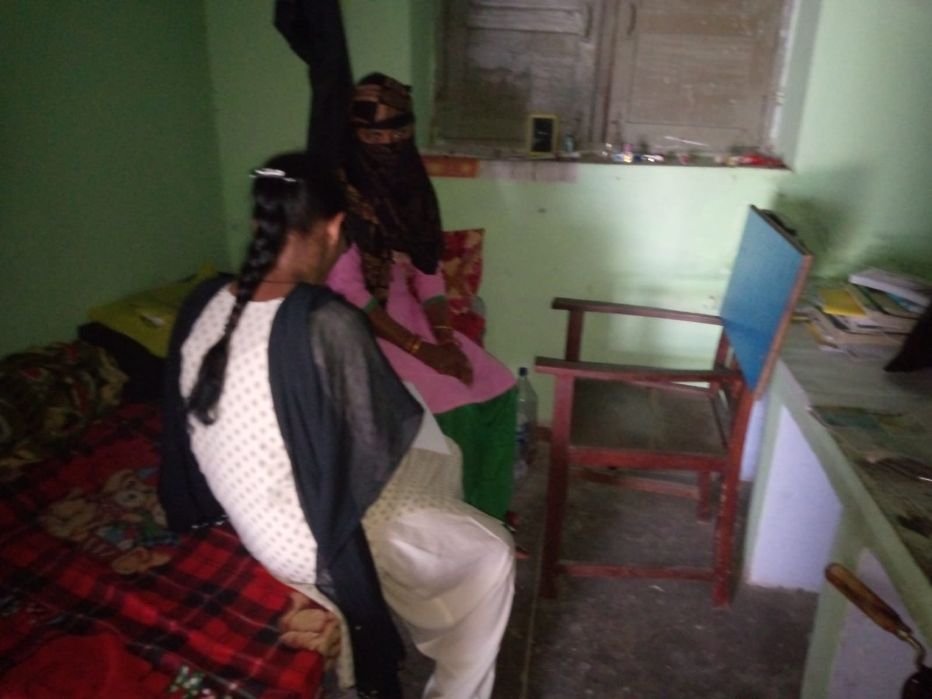
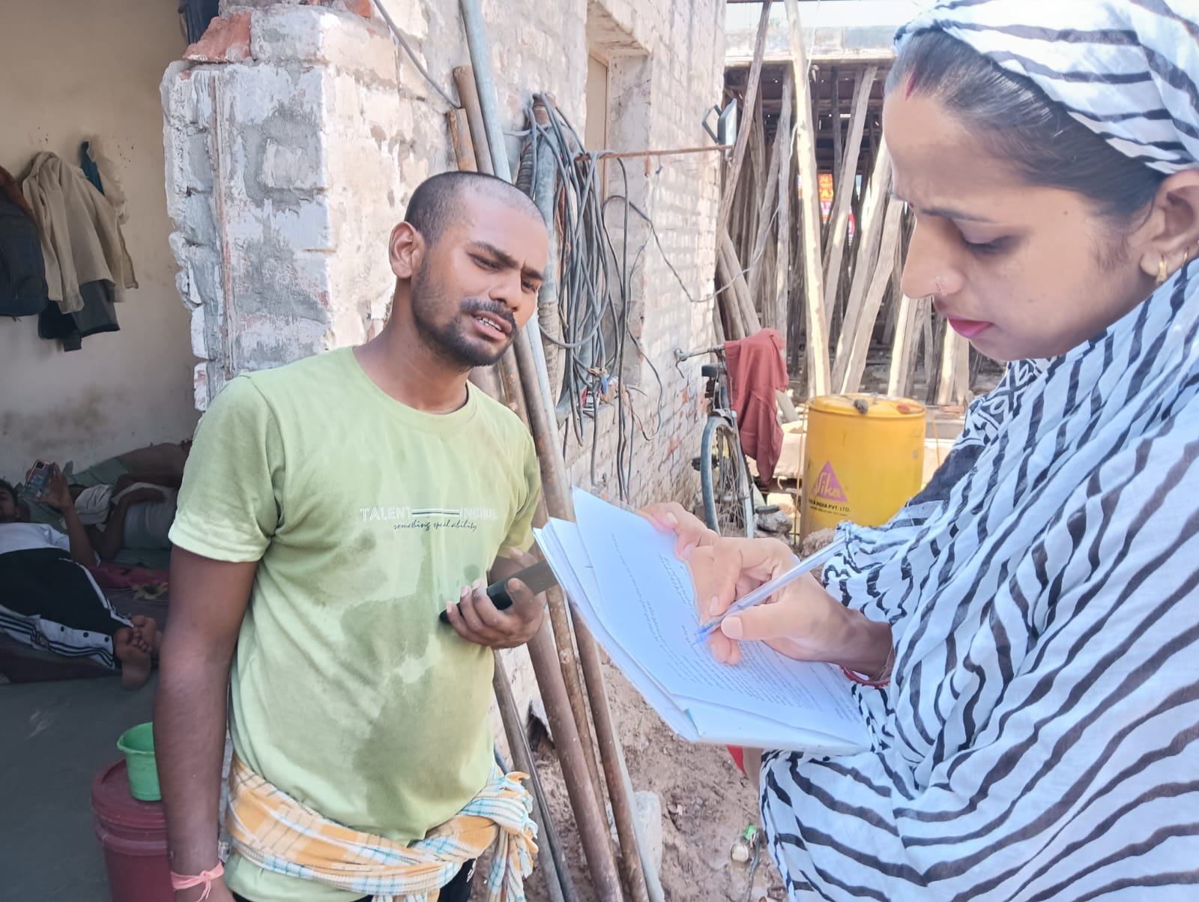

Slide 27
REFERENCES
1.Tee Y, Huang M. Knowledge of HIV/AIDS and attitudes towards people living with HIV among the general staff of a public university in Malaysia. SAHARA J J Soc Asp HIVAIDS Res Alliance. 2009 Dec;6(4):179–87.
2.Adebajo SB, Bamgbala AO, Oyediran MA. Attitudes of health care providers to persons living with HIV/AIDS in Lagos State, Nigeria. Afr J Reprod Health. 2003 Apr;7(1):103–12.
3.HIV / AIDS | National Health Portal Of India [Internet]. [cited 2023 Feb 26]. Available from: https://www.nhp.gov.in/hiv-aids_pg
4.Sankalak_Booklet_2021_Third_Edition.pdf [Internet]. [cited 2023 Mar 22]. Available from: http://naco.gov.in/sites/default/files/Sankalak_Booklet_2021_Third_Edition.pdf
5.HIV [Internet]. [cited 2023 Feb 24]. Available from: https://www.who.int/data/gho/data/themes/hiv-aids

Slide 28
6.Transport Against HIV/AIDS : Synthesis of Experience and Best Practice Guidelines [Internet]. [cited 2023 Feb 24]. Available from: https://openknowledge.worldbank.org/handle/10986/17461
7.Pandey A, Benara SK, Roy N, Sahu D, Thomas M, Joshi DK, et al. Risk behaviour, sexually transmitted infections and HIV among long-distance truck drivers: a cross-sectional survey along national highways in India. AIDS. 2008 Dec;22:S81.
8.National AIDS Control Programme III | National AIDS Control Organization | MoHFW | GoI [Internet]. [cited 2023 Feb 24]. Available from: http://naco.gov.in/nacp
9.Rameza F. Knowledge, attitudes and practices concerning HIV/AIDS among Iranian at-risk sub-populations. East Mediterr Health J. 2008;14(1).

Slide 29
THANK YOU

