Slide 1


Topic- Reporting Errors in Teleradiology: A descriptive study to analyse the leading causes of reporting errors in Teleradiology.
Technologies LLP
Submitted by: Bhawana, PG/20/015
Mentor: Dr. Anandhi Ramachandran
IIHMR Delhi

Slide 2
Introduction
One billion radiologic examinations are performed worldwide annually.
Most of the resulting images are interpreted by radiologists. If these interpretations carried an average error rate of only 4% (the lowest estimate for the rate of radiologic error) this would be approximately 40 million radiologist errors per year.
Around 250,000 people die each year in the US because of medical errors, according to a study by researchers at John Hopkins University School of Medicine.
This number is bigger than those who die from car accidents, breast cancers, or work accidents.
Medical error constitutes the third leading cause of death in the United States.
Teleradiology- electronic transformation of radiological images from one location to another for consultation and reporting.
Reporting errors in teleradiology

Slide 3
Objectives of the study
To analyse different types of reporting errors in teleradiology.
To determine main causes for reporting errors in teleradiology.
To suggest measures for minimizing radiological errors during reporting.

Slide 4
LOR
Under-reading | Abnormality visible, but not reported. | 42%
Satisfaction of search | After having identified a first abnormality, radiologist fails to continue to look for additional abnormalities. | 22%
Faulty reasoning | Abnormalities identified, but attributed to wrong cause. | 9%
Abnormalities outside area of interest (but visible) | Many on first or last image of CT or MR series, suggesting radiologist’s attention not fully engaged at beginning or end of reviewing series. | 7%
Satisfaction of report (alliterative reasoning) | Uncritical reliance on previous report in reaching diagnosis, leading to perpetuation of error through consecutive studies. | 6%
Failure to consult prior imaging studies |  | 5%
Inaccurate or incomplete clinical history |  | 2%
Correct report failing to reach referring clinician |  | 0.08%
In 2014, Kim and Mansfield published a classification system for radiological errors, adding some useful categories to the Renfrew classification ^{[9,10]}.
Their data were derived from 1269 errors (all made by faculty radiologists) reviewed at problem case conferences in a US Army medical centre over an 8-year period.
Most errors occurred in plain radiography cases (54%), followed by large-data volume cross-sectional studies: CT 30.5% and MRI 11.4%. ^{[9,10]}

Slide 5
LOR
In 2013, Adrian Brady, Risteárd Ó Laoide, Peter McCarthy and Ronan McDermott published a study on causes of error in radiology. They explained ‘availability of trained and certified Radiographers, Physicists and other staff members within radiology departments’, ‘staff shortage’, ‘excess workload’ and ‘unavailability of previous studies and inadequacy of clinical information as major causes of error in radiology’.
In 1995, Berlin L and Berlin JW published a study that showed inadequacy of clinical information available to the reporting radiologist is one of the many strong arguments against the use of remote teleradiology reporting for radiologic studies. Knowledge of pertinent clinical history has been shown to increase the accuracy of CXR interpretations from 16 to 72% for trainees, and from 38 to 84% for consultant-grade radiologists. ^{[12]}

Slide 6
Methodology
Study location: U4RAD
Study population: Patients who had undergone CT, XRAY and MRI scans.
Study design: This is a descriptive study.
Data collection method: Quantitative Secondary data provided by the organization.
Sample Selection: The data is being used to analyse the different types of reporting errors in teleradiology. Non- probability Purposive Sampling method is used to choose sample. The duration of the collected and analysed data is from 01st August 2021 – 30th May 2022.
Data Analysis Tool: Excel is being used for data analysis.

Slide 7
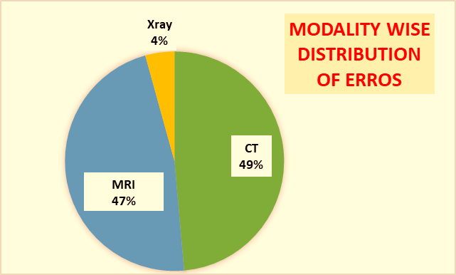
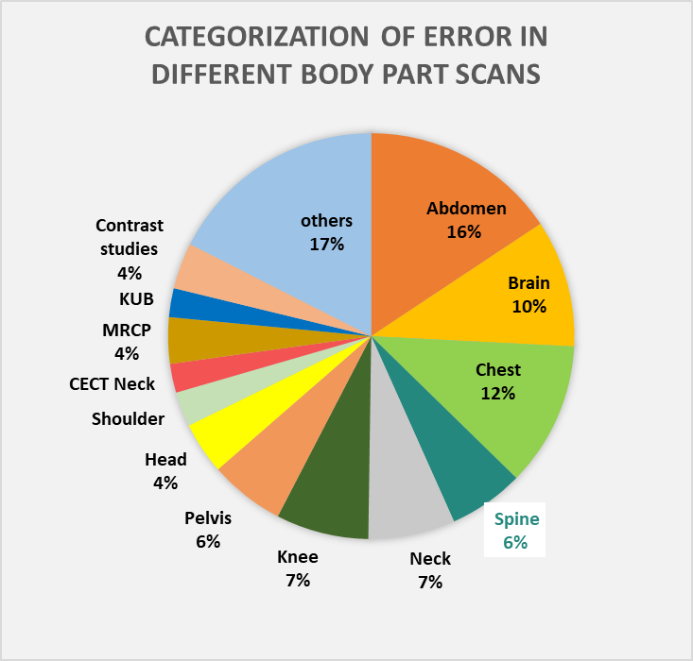
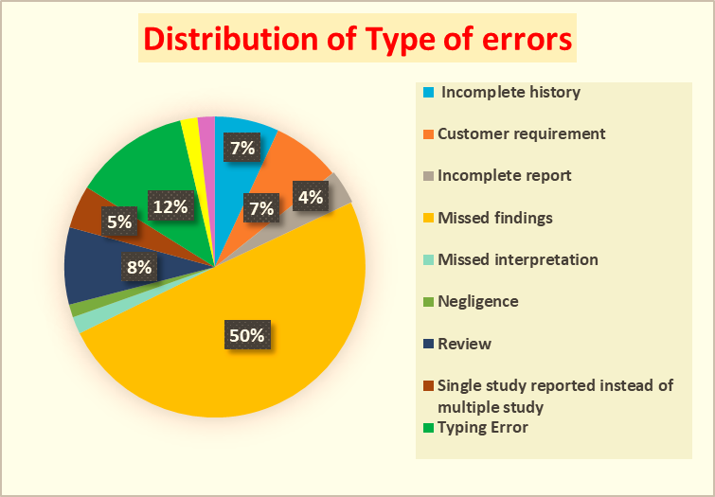
Results
Types of errors-Missed findings, incomplete history, etc.
Modality wise distribution of errors-XRAY, MRI and CT
Errors distribution based on different body part scans
N=217
N=217
N=217

Slide 8
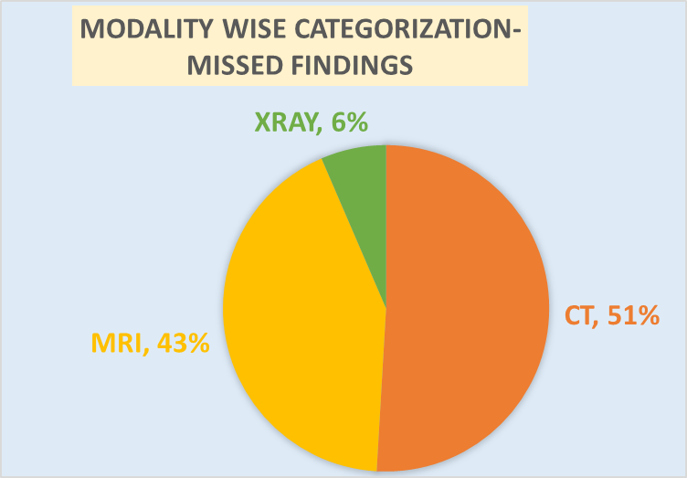
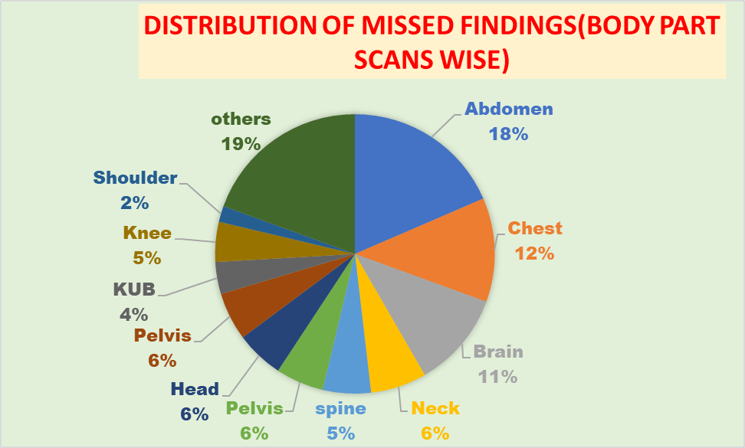
Results
N=108
N=108
Missed findings-categorization based on modality
Missed findings distribution based on different body scans

Slide 9
Discussion
Missed findings (under reading) contributed 50% to the errors, which is similar in Kim’s study. ^{[9]}
In 2014, Kim’s study described that incomplete history constitutes 2% of the total errors while this study shows 7% errors are due to the incomplete history.
Typing error was also one of the cause of errors in radiology reports which constitutes 12% of the total errors in this study.
Modality wise distribution shows CT and MRI reports have more errors than XRAY’s reports, both constituted 95% of the errors.(kim’s-42%-MRI and CT)
Abdomen scan reports has highest rate of errors compared to other body part scans.

Slide 10
Discussion
Missed findings- categorized based on the modality
94% missed findings were seen in CT and MRI only.
Body parts scans such as abdomen, chest and brain has more missed findings than other body part scans.
18% of the missed findings were seen in abdomen studies while 12% seen in chest studies and 10% seen in brain studies.
Incomplete history causes error in 7% of the reports which Berlin also showed in his study published in 1995 that incomplete history was one of the causes of error, Berlin’s study explained that knowledge of clinical history decreases the errors. ^{[12]}
The main causes of error that are identified in this study is missed findings (50%), typing error (12%) and incomplete history (7%).

Slide 11
Limitations of the Study
The data set is small to determine significant causes of errors in radiology.
The data was not adequate to do the root cause analysis of the errors. The data was only limited to the description of modality, what type of body part scan and the type of error.

Slide 12
Recommendation
Structure reporting- Using a define structure for writing reports
Use of AI in radiology- Image analytics help radiologist to highlight the abnormal findings that radiologist will miss.
Automation of reports- . Instead of typing the whole report or using templates, findings can be selected by the radiologists just like a computer based Multiple choice questions (MCQs). These questions will be provided by the system in which the radiologist is reporting cases. This method of reporting will highly reduce the errors.
Root cause analysis- Targeting on determining what error has occurred, why it has occurred & what has to be done to prevent it from occurring again: this is what "root cause analysis" is all about.

Slide 13
Conclusion
Errors will often occur, but some can be avoided by paying close attention to the thought processes.
Being mindful of possible prejudices and system flaws that can lead to errors, and employing all necessary available techniques to mitigate these negative factors.(can limit these errors)
However, if we believe that any technique will completely eradicate radiology error, we are deceiving both ourselves and the patients who depend on our advice.

Slide 14
References
Goddard P, Leslie A, Jones A, Wakeley C, Kabala J. Error in radiology. Br J Radiol. 2001;74:949–951. doi: 10.1259/bjr.74.886.740949. [PubMed]
Robinson PJA. Radiology’s Achilles’ heel: error and variation in the interpretation of the Röntgen image. BJR. 1997;70:1085–1098. doi: 10.1259/bjr.70.839.9536897. [PubMed] [CrossRef] [Google Scholar] [Ref list]
Muhm JR, Miller WE, Fontana RS, Sanderson DR, Uhlenhopp MA. Lung cancer detected during a screening program using four-month chest radiographs. Radiology. 1983;148:609–615. doi: 10.1148/radiology.148.3.6308709. [PubMed]
Quekel LGBA, Kessels AGH, Goei R, van Engelshoven JMA. Miss rate of lung cancer on the chest radiograph in clinical practice. Chest. 1999;115:720–724. doi: 10.1378/chest.115.3.720. [PubMed]
Berlin L. Radiologic errors and malpractice: a blurry distinction. AJR. 2007;189:517–522. doi: 10.2214/AJR.07.2209. [PubMed] [Google Scholar]
Bruno MA, Walker EA, Abujudeh HH. Understanding and confronting our mistakes: the epidemiology of error in radiology and strategies for error reduction. Radiographics. 2015;35:1668–1676. doi: 10.1148/rg.2015150023. [PubMed]

Slide 15
References
Robinson PJ, Wilson D, Coral A, Murphy A, Verow P. Variation between experienced observers in the interpretation of accident and emergency radiographs. Br J Radiol. 1999;72:323–330. doi: 10.1259/bjr.72.856.10474490. [PubMed] [Google Scholar]
Renfrew DL, Franken EA, Berbaum KS, Weigelt FH, Abu-Yousef MM. Error in radiology: classification and lessons in 182 cases presented at a problem case conference. Radiology. 1992;183:145–150. doi: 10.1148/radiology.183.1.1549661. [PubMed]
Kim YW, Mansfield LT. Fool me twice: delayed diagnoses in radiology with emphasis on perceptuated errors. AJR. 2014;202:465–470. doi: 10.2214/AJR.13.11493. [PubMed]
Smith M. Error and variation in diagnostic radiography. Springfield: Charles C. Thomas; 1967. [Google Scholar]
Adrian Brady, Risteárd Ó Laoide, Peter McCarthy , Ronan McDermott. Discrepancy and Error in Radiology: Concepts, Causes and Consequences. 2011 Oct 3. [NCBI]
Berlin L, Berlin JW. Malpractice and radiologists in Cook County, IL: trends in 20 years of litigation. AJR Am J Roentgenol. 1995;165(4):781–8. [PubMed] [Google Scholar] [Ref list]

Slide 16
Thank You

Slide 17
Suggestions to the Organization where the Study was Conducted
Take corrective actions to reduce the radiology errors-as recommended
After the actions- again study to be done on radiology error to know if there is any significant change comes after implementing the actions.

Slide 18
Dissertation Experiences
What did you learn (skill/ topic)?
Overall self comments on Dissertation
Radiology errors are prominent- ways to reduce reporting errors.
Explored different field in Healthcare IT
Learned the importance of Requirement in IT Projects
Explore the field of health analytics.
The study is helpful in highlighting the major errors in teleradiology reporting.

