Slide 1
Employee Readiness towards acceptance of Eye Quick ticketing system for raising Grievances to HR Department at Eye Q
BY -MUSKAN SETIYA
PG/19/048
Under the guidance of Mentors – Dr Preetha (IIHMR Delhi ) and Mr Sumit Bhasin (Eye Q)

Slide 2
INTRODUCTION
Grievance is any kind of dissatisfaction or discontent of employee with job or its nature.
Grievances not handled properly lead to employee dissatisfaction, high attrition, and absenteeism.
Features of a good grievance redressal system:
Timely action must be taken on grievance.
All the grievance must be acknowledged.
Problem Identification
Collecting the facts
Analyzing the cause
Taking decision based on facts.
Implementation of a decision

Slide 3
CONT.
Employee Readiness is the extent to which an employee is ready to accept change.
Factors Influencing Employee Readiness:
Practical Intelligence
Trust in top Management
Quality of Communication
Participation in Decision Making
Emotional Attachment to the Organization.
Eye Quick Ticketing System:
Launched in Eye Q in December 2020 in IT department to effectively handle queries of employees.
Employees raise a ticket to the concerned department with a query.
Better than E- Mails as it maintains confidentiality.
Each type of query has a definite time period to be solved.
Better record maintenance.
Better Analysis of type of queries, which help in improving the system.

Slide 4
OBJECTIVE
Aim of the study is to assess employee acceptance towards Eye Quick ticketing system implementation in HR Department.
SPECIFIC OBJECTIVES
To Assess Employee Acceptance towards Eye Quick for raising grievances to HR Department.
To Assess which mode of communication is preferred by employees.
To assess the employee expectation towards the Turn Around Time for handling grievances.
To Assess Employee Satisfaction towards Eye Quick, already implemented in IT Department.

Slide 5
LITERATURE REVIEW
AUTHOR NAME | YEAR | TYPE OF STUDY | FINDINGS
Kirubasankar N. et al | 2020 | Cross Sectional Survey | Employees were satisfied with the Grievance handling mechanism but improvement was required in mode of communication.
Dissanayake et al | 2019 | Cross Sectional Survey | Employees were not satisfied with grievance handling mechanism as they wanted organization to pay attention towards addressing the grievances timely.
Eromafuru Edward Godbles et al | 2020 | Cross Sectional Survey | Employees believed that Grievance handling mechanism should revolve around justice and must abridge the length of time for grievance resolution.
Sharma DD et al | 2018 | Cross Sectional Survey | Study reveals that 77% of the employees timely resolution of their grievances.
Naimatullah Shah | 2011 | Cross Sectional Survey | Interpersonal relations among employees have significant positive relation with Employee readiness and also, the findings reveal that younger employees have more readiness towards change.
Soumyaja1 et al (2011): | 2011 | Cross Sectional Survey | employee readiness can be encouraged through organizational justice. The study concluded that demographic variables such as gender and age do not have significant relationship with employee readiness

Slide 6
METHODOLOGY
Research Methodology: Cross- Sectional Descriptive Study
Source of Data: Primary and Secondary Data
Study Duration: 1 May 2021- 31 May 2021
Population Size: 480 Employees
Sample Size: 214 Employees
Sampling Method: Simple Random Sampling
Data Collection: Google forms were sent for data collection to the employees.
A questionnaire of 20 questions out of which 12 questions were based on Likert’s scale for assessing employee acceptance was prepared for collecting the data from the employees.
Scoring of 1-5 was done on questions with Likert’s scale and score of more than 60% was considered as score of acceptance towards Eye Quick

Slide 7
Cont..
Data Analysis Procedure:
Data was collected using questionnaire and then was represented in the form of pie charts as well as analyzed through excel.
Inclusion Criteria:
All the full-time active employees with Date of Joining before 15th May 2021.
Exclusion Criteria:
Employees not having access to Eye Quick were not included in the study.
Management Trainees, Housekeeping staff was excluded because of not having access to Eye Quick.
Employees of Nigeria centers were not included.
3.1 Ethical Considerations:
Informed consent was taken from the employees. Participation in the study was voluntary.
Approval was taken from the authorized signatory to use the name of the tool in the study.
Personal data such as Name and Contact Number were not collected from any of the participants. Identity of the participants remained anonymous.

Slide 8
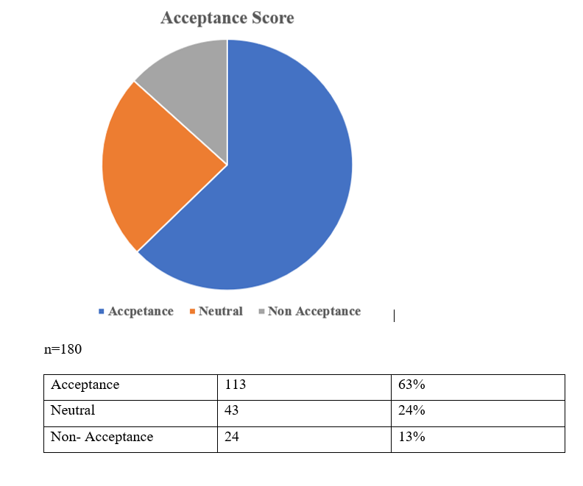
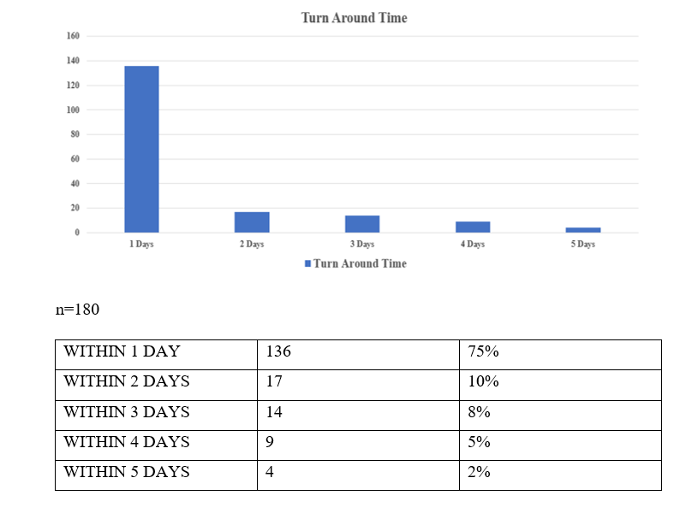
RESULTS AND ANALYSIS

Slide 9
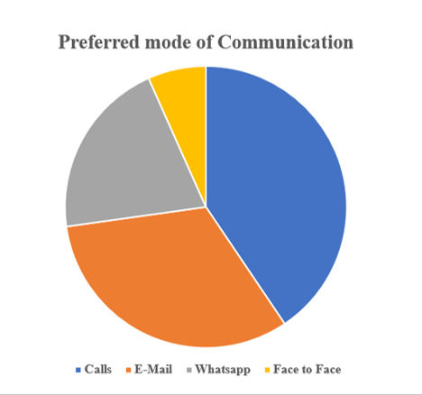
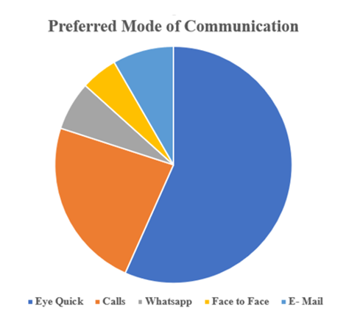
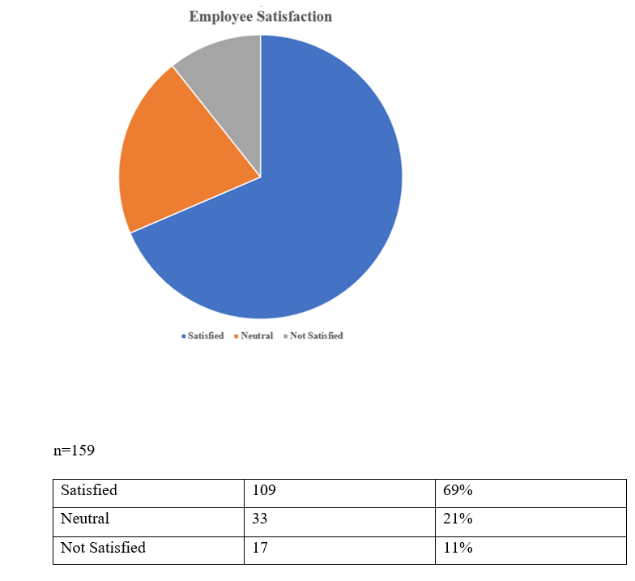
RESULTS AND ANALYSIS
RESPONSE RATE : 84.11 % n= 180
The graph 1 depicts that calls are preferred mode of communication if Eye Quick is not an option.
Graph 2 depicts that employees would prefer using Eye Quick , if it is implemented.

Slide 10
DISCUSSION
Females had more acceptance towards usage of Eye Quick at Eye Q
This result is different from the study by Naimatullah Shah (2011) which states that Gender has no impact on employee readiness.
This result is in accordance to the study of Ruth Alas (2012) which reveals that female have better knowledge about organizational changes which has a positive relation towards readiness to accept change.
There was a huge decrease in preference of using WhatsApp, Calls and E-mails if Eye Quick was introduced.
This result is in relevance to the study findings of Kirubasankar N. et al (2020) which revealed that employees need a better mode of communication for communicating their grievances so that their grievances can reach to top management
Few employees preferred face to face as a mode of communication
HR department is a centralized department at Eye Q and only corporate office employees can interact face to face.
Employees preferred their grievances to be resolved within one day
This is in accordance with the findings of Dissanayake et al (2019) that employees want their grievance to be resolved timely.

Slide 11
CONCLUSION & RECOMMENDATIONS
CONCLUSION:
The study concluded that 63% Employees were ready to accept the implementation of Eye Quick at HR Department also.
Employees who were in the organization from a long time had a resistance to change.
Employees accept Eye Quick as a better mode of communicating grievances.
RECOMMENDATIONS:
There is a need to conduct trainings and knowledge sessions for Employees who have neutral attitude towards acceptance of Eye Quick.
Employees must participate in decision making for implementation of Eye Quick as this can increase Employee satisfaction towards Eye Quick.
A proper change management system must be in place for employees who are resistant to change.

Slide 12
LIMITATIONS & REFERENCES
LIMITATION:
Sample size of 214 could not be reached due to unavailability of employees because of business demands.
REFERENCES:
. Shah N. A study of the relationship between organisational justice and employee readiness for change. J Enterp Inf Manag. 2011;24(3):224–36.
5. Shah N, Ghulam Sarwar Shah S. Relationships between employee readiness for organisational change, supervisor and peer relations and demography. J Enterp Inf Manag. 2010;23(5):640–52.
7. Kirubasankar N, Imayavendan V, Gowtham E. Descriptive study on grievance handling procedure in steering and suspension manufacturing and distribution company. NJOBM. 2020;32–40.
8. D.W.R.A.A.B Dissanayake, Anjala A. Conflict handling through grievance handling: An evidence from apparel industry in Sri Lanka. 2019 [cited 2021 Jun 9]; Available from: https://www.semanticscholar.org/paper/ade89c4abdfefb7b9b24f2244333ee9a0bf1afbc

