Slide 1


Biomedical Waste Management knowledge & practices among Tertiary care Hospitals in Delhi.
UNDER GUIDANCE OF: by: Tanushri Dutta
DR. Sutapa Bandyopadhyay roll no: pg/19/094
Director hospital management iihmr, delhi batch- 2019-21

Slide 2

Introduction
'Bio-medical waste' (BMW) implies any solid and liquid fluid waste including its container and any intermediate product, which is created during the diagnosis, treatment or vaccination of people or animals or in research relating .
India approximately creates 2kg/bed/day and this biomedical waste incorporates wastes like anatomical waste, cytotoxic waste, sharps, which when inadequately segregated could cause various kinds of deadly infectious disease.
Acceptable administration of biomedical waste management starts from the underlying phase of generation of waste, segregation at the source, storage at the vicinity, sterilization, and move to the terminal disposal site plays a basic part within the removal of waste.

Slide 3
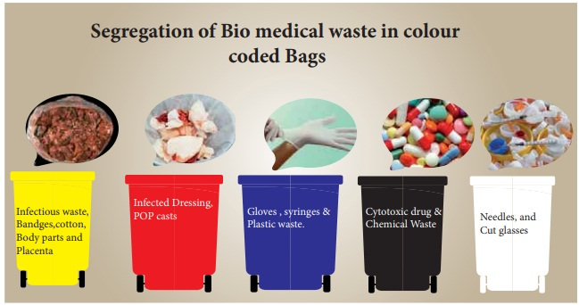
Studies recorded from various parts of the nation; actually pass on that there are gaps within the Knowledge, lacunae within the attitudinal part and inconsistency within the practice aspects which are matters of concern among the health care services experts.
Many hospitals don't go with biomedical waste management act (1998) and revised guidelines for common biomedical waste treatment facilities (2016).

Slide 4
OBJECTIVE
The aim of this study is to assess and analyze the prevailing biomedical waste management practices in recognized hospitals of Delhi.
SPECIFIC OBJECTIVES
• To analyze if wastes generated in each category are segregated properly in line with the color coding of bags.
• To analyze if proper weight of biomedical waste generated in each bag is recorded on daily/monthly/yearly basis.
• To explore if there are basic waste disposal facilities available like Incinerators, plasma pyrolysis, Autoclave, shredder, Needle tip cutter, deep burial pits and concrete pits, Chemical disinfection etc.
• To explore if trainings regarding biomedical waste management is conducted for healthcare personnel at regular intervals.
• To explore if biomedical waste management procedures are recorded on site.

Slide 5
Methods and materials
TYPE OF STUDY – DESCRIPTIVE STUDY
Sources of data collection
The study involved Google search engine and data was collected from annual biomedical waste management reports of varied hospitals of Delhi (both government and private) including SOPs of hospitals.
Statistical data and knowledge gathered are used as secondary database and a descriptive study base has been constructed.
Inclusion Criteria:
Annual biomedical waste management report of both government and private hospitals located in several regions of Delhi and those starting from 70 bedded to 2500 bedded are included. Reports by hospitals of financial year 2017-18 onwards and report by NDMC and ministries of environment and climatic change are studied.
Exclusion Criteria:
This had to be considered in case of hospital chains which has branches outside of India. Reports of financial year before 2016 were excluded.

Slide 6
result
The biomedical waste is segregated according to color coding and generated waste is transported to central collection point of hospital. Proper onsite records are maintained. Treated or untreated waste is handed to CBMWTF provider may be public or private. Trainings have been held at regular intervals of time. Different facilities for waste disposal are present in every hospital.
Total of 5 hospitals have been taken and compared i.e.
AIIMS, Delhi
Sitaram Bhartia Institute of Medical Sciences
Aakash Healthcare, Delhi
Max, Shalimar Bagh
Lady Hardinge Medical College

Slide 7
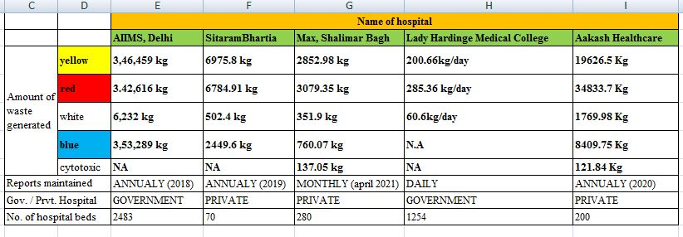
COMPARISION TABLE

Slide 8
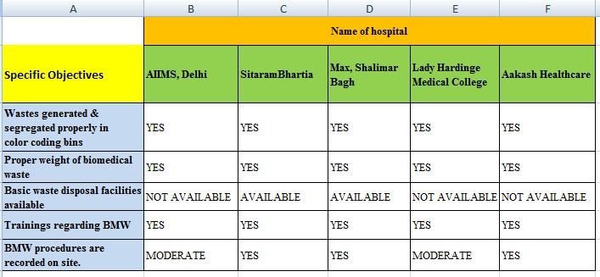
On basis of objectives

Slide 9
Discussion
General waste is separated from medical waste at the waste production sites.
Waste is segregated into different colour coded containers/bins and disposed off accordingly.
Hospitals should have basic infrastructure available for waste disposal. But, in most of the hospitals of India, Proper guidelines for BMW management are not followed because of lack of facilities available.
In a study done at tertiary care teaching hospital, deficiency in supply of needle cutters in 40% of wards was found. Hospitals should maintain records at time of onsite transportation also.

Slide 10
conclusion
By the study, Segregation of waste is most important step of BMW management.
It has been found that the both government and private hospitals have some gaps for biomedical waste handling. Government hospitals whereas outsourced the CBWTF for treatment of Biomedical .
Some private hospitals don’t have all treatment facilities available in their vicinity.
Maintaining of records require more efficiency under the supervision.
Regular trainings of housekeep personals should be done.
Surveillance of HAI should be done in high risk areas.

Slide 11
Recommendations
Details of injury during BMW management mostly needle stick injury should be recorded.
ETP should be constructed in each and every hospital
Details of ETP sludge generated during treatment of waste should be recorded.
Hospital staff should be vaccinated against hepatitis B and Tetanus
BMW management committee should be made in each hospital so that they can monitor the disposal of waste closely
Training on BMW at regular intervals should be made mandatory for all healthcare staff.
Hoardings on segregation of waste in different containers should be placed in every department.

Slide 12
Limitations
The data used in this study is secondary and giving little or no knowledge about the process of data collection and accuracy of the report of hospitals.

Slide 13
Program outcome
Program Outcomes
1. Internalize the concepts of management such as healthcare delivery system, strategic planning, HR, marketing, finance and operations 3 | 2. Apply knowledge of research and management techniques and functions in an integrated manner in healthcare set up 3 | 3. Use appropriate skills to support healthcare organizations to take informed decision in planning, building and managing healthcare organizations 3 | 4. Utilize learning acquired from trainings and practical exposures in real time situations. 3
Thank you!

