Slide 1
ASSESSMENT OF CASE MANAGEMENT PROCESS OF MAXBUPA HEALTH
INSURANCE CORPORATION,
BANGALORE
Presented by-
Dr. Nabila Khan
Roll No.- 34
Hospital Stream

Slide 2

Introduction
Health insurance companies are subjected to healthcare fraud and abuse.
Common healthcare abuse practices that lead increased claim expenditure include:
Inappropriate billing for the medicines and services that are not provided
Substantial tariff variations between actual bill & tariff (up-coding)
Unwarranted procedures and consultations
Expensive medications
Excessive diagnostic tests
Extended length of stay

Slide 3
INTRODUCTION CONTD.
Clinical Quality & Governance (CQG) Department of MaxBupa came up with this new initiative i.e. Case Management, through which they are able to control fraud and minimise abuse by the provider.
The ultimate purpose of Case Management to achieve cost effective quality care

Slide 4
AIM AND OBJECTIVE
The aim of this study is to understand and analyse the effectiveness of case management by measuring outcomes
Specific Objectives:
To calculate savings by comparing the requested amount with the final bill amount.
To identify the factors that are adding unnecessary cost to claim.

Slide 5
Methodology
Type of study- Cross-sectional study
Study Duration- Study was carried out for 1 month from 15-April 2019 to 20-May-2019
Study Area - Maxbupa Health Insurance Corporation, Bangalore
Sample Size- the total sample size of 50 patients was collected
Sampling Technique - Convenient sampling technique
Data was recorded in a tracker sheet, formulated and entered in an excel spreadsheet and then analysed to measure the outcomes.
Study Criteria:
Inclusion Criteria:
Study population included all the patients with cashless scheme.
Exclusion Criteria:
Patients whose preauthorisation requests were rejected or cancelled
Source of Data- Primary

Slide 6
RESULT AND DISCUSSION
Fig.1 depicts Case Management Outcome. Savings were achieved only in 42% of cases, because case management was successful, where as in 18% cases case management failed to contain cost as the final bill crossed the estimated amount requested by the hospital.

Slide 7
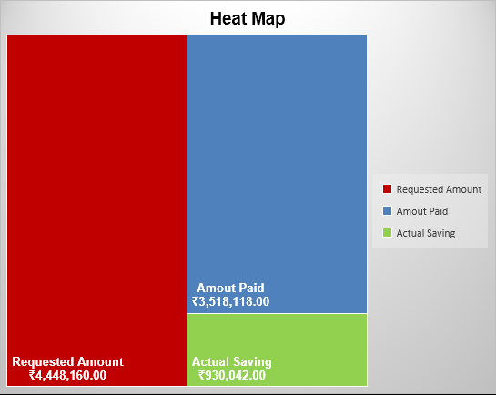
This heat map provides immediate visual summary of requested amount by hospital, amount paid by insurance company i.e. the final bill and actual savings achieved through case management process.

Slide 8
This bar chart shows patient wise requested amount, amount paid and actual saving.

Slide 9
Outcome was successful in cases wherein there was over billing or the estimated LOS shared by hospital was high, since only in these two pointers hospital tries to make maximum profit.

Slide 10
CONCLUSION
It was clearly evident that Case Management plays a vital role in saving cost without compromising on quality of care. Effective case management not only saved cost, but also significantly reduced hospital days i.e. Length of Stay (LOS).

Slide 11
THANK YOU

