Slide 1
INTERNSHIP AND DISSERTATION
AT
YADAV HOSPITAL GURugram
By – Col Satish Yadav

Slide 2
PREVIEW
Introduction
Rationale for the Study
Methodology
- General and Specific Objectives
- Sampling
- Data Collection
Results
Discussions
Suggestions

Slide 3
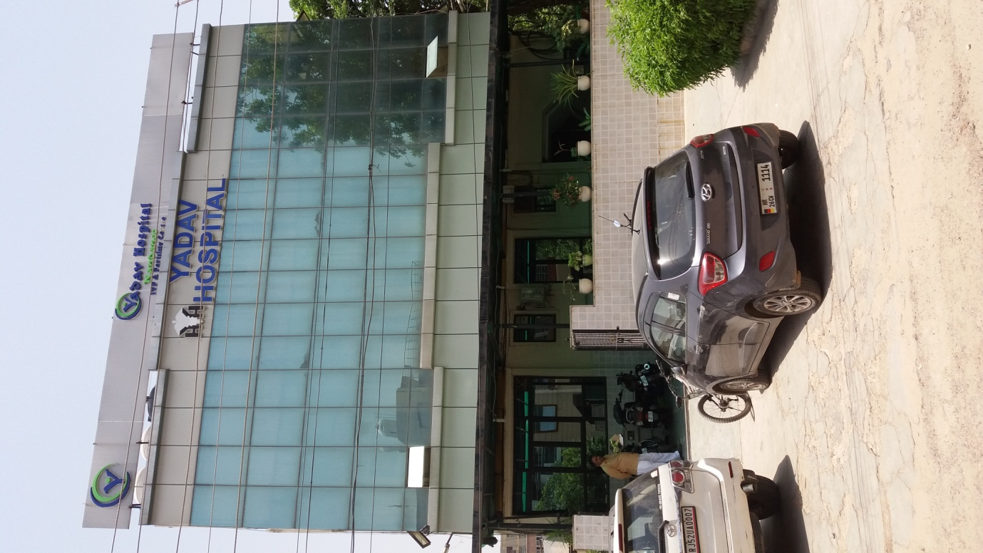

Slide 4
Introduction
The “Yadav Hospital”, Gurugram is a 30 bedded multispecialty hospital.
The hospital was established in the year 2005 in Sector 10 A, Gurugram.
The location of the hospital is about one kilometre from Hero Honda chowk, Gurugram on NH-8.
Presently, Dr Gaurav Rao is the director of the hospital.

Slide 5
OPD Time Slots
Dr. Gaurav Rao 11AM - 2 PM 6 – 8 PM
Dr. Shalini Yadav 11AM - 2 PM 6 – 8 PM
Dr Ramakant 11 AM - 2 PM 6 – 8 PM
Dr. B S Yadav - 6 – 8 PM
Dr. Nidhi Rao 11 AM – 2 PM 6 – 8 PM
Dr Anita 11 AM – 2 PM 6 – 8 PM

Slide 6
Rationale For The Study
On an average approx 4600 – 4800 patients visit the OPD of Yadav Hospital every month.
It was observed that OPDs of six departments were having huge rush at times and patients were seen waiting to meet the doctors.
It was felt that a study is required to assess the average waiting time and the reasons for the same and to suggest remedial measures to reduce the waiting time, thereby enhancing the satisfaction level of patients.

Slide 7
Methodology
General Objective : To determine the average waiting time in the OPDs of six departments of Yadav Hospital, Gurugram and assess the causes for the same.
Specific Objectives :
To assess the average waiting time for registration of patients in OPDs of six departments of Yadav Hospital, namely, General physician, Internal medicine, Gynaecology, Paediatric, Dermatology and Physiotherapy.

Slide 8
To assess the average waiting time spent by patients after registration before they are able to meet the doctors in ibid OPDs.
To determine the reasons for the waiting periods in ibid OPDs.
To suggest measures to reduce the waiting periods in the above mentioned OPDs

Slide 9
Sampling
Duration of sample collection : 35 Days from 12 Feb to 21 Apr 2018
Type of Study : Observational Study
Sample size : 480
Sampling Technique : Convenience Sampling

Slide 10
Data Collection
The OPD timings promulgated by the hospital for the six OPDs under study were noted down and the variables were identified as follows:
The time of arrival of the patients to the registration desk /queue.
The time of completion of the registration.
The time of arrival of the doctor to his / her chamber.

Slide 11
The time of the patient’s entry to the doctor’s chamber.
The time duration for which doctors were engaged in administrative activities or other such activities as were not part of their OPD duties.
The time for which the registration computer was not functioning.

Slide 12
Observation procedure :
The time of arrival of the patient to the registration desk /queue was noted down by observation, by asking each patient as to which OPD he/she had come to.
The time of completion of registration was noted down by observation as well as from the register.
The time of arrival of the doctor to his/her chamber was noted down by observation.

Slide 13
The time of entry of the patient to the doctor’s chamber as per his registered waiting number was noted down by observation and his/her registration time was later reconciled from the register.The time for which a patient was not available at his turn was also noted down.
The time for which doctors were engaged in non OPD activities was noted down.
The time for which the registration computer was malfunctioning was noted down.

Slide 14
Results
The overall average waiting time was found to be as follows:
< 15 minutes – 32.08 % (154 patients)
15 to 30 minutes – 30.41 % (146 patients)
> 30 minutes to 1 hour – 31.04 % (149 patients)
> 1 hour – 6.45 % (31 patients)

Slide 16
Department – Wise Results

Slide 23
Discussions
The average waiting time for 180 patients (37.5 % of the sample size) was found to be more than 30 minutes.
In many cases (75 patients out of 180 patients,or,15.6% of the sample size) the primary reason for the large waiting time of more than 30 minutes, was late arrival of the doctors.
In some cases (36 patients, which is 7.5 % of the sample size of 480), the non availability of the patient at his turn was the reason for increased waiting time.

Slide 24
The small window of two hours for paediatric patients was the primary reason for the long waiting period as patients preferred to come early so that they do not miss meeting the doctor.
Doctors were seen doing administrative work during OPDs. This also resulted in an increase in the waiting time in about 16% of the sample cases ( 77 patients ).
Malfunctioning of the registration computer caused an increase in waiting period in about 6% of the cases ( 29 patients ).

Slide 25
Suggestions
The doctors be encouraged to adhere to the laid down timings for their respective OPDs. This will greatly reduce the waiting time.
The timings of paediatric OPD be increased from two hours to reduce the rush of people and thereby reduce the waiting period.
The hospital may also consider increased appointment on telephone to reduce the waiting period during registration. This will have to be followed up by regular monitoring and tracking of the patients.

Slide 26
The doctors be encouraged not to spend time on activities which are not related to patients, during OPD timings.
An effort be made to educate the patients regarding benefits to all concerned if they adhere to the appointed timings.
The serviceability of the registration computer be increased by timely maintenance.

Slide 27
THANK YOU

